Slide 1
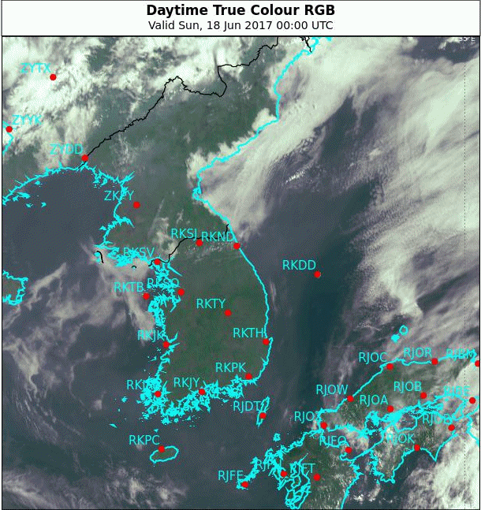
East Korea Convective Development, 18 June 2017 True Colour RGB (00 to 10UTC) 2FPS vs 10FPS
satellite images courtesy JMA/BOM
Please start the Power Point Slide Show to activate the animation

Slide 2
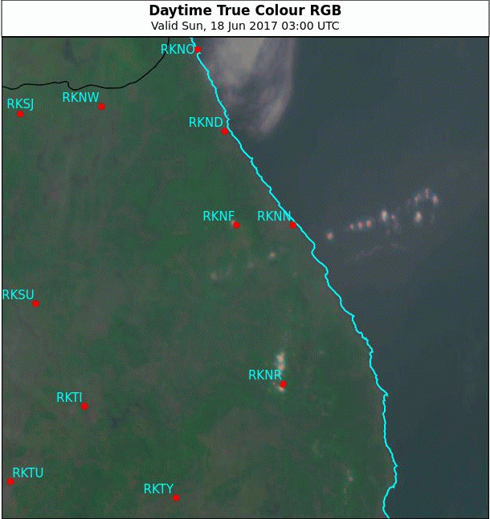
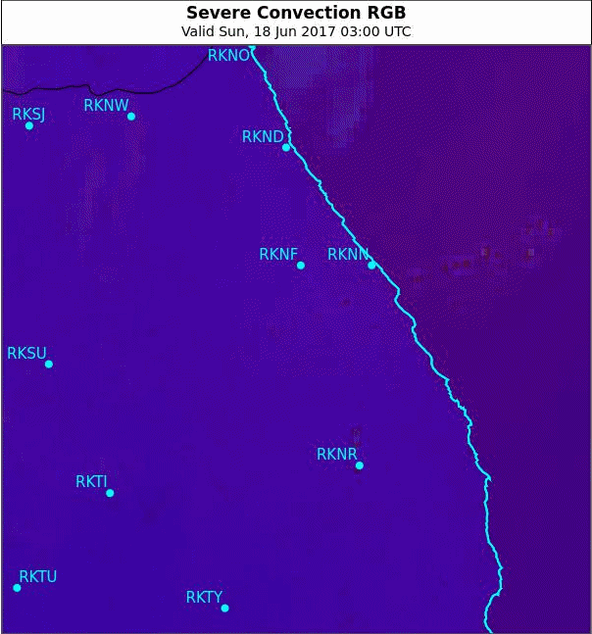
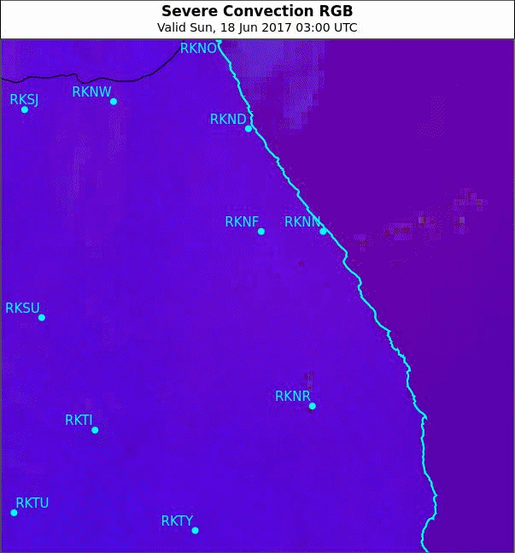
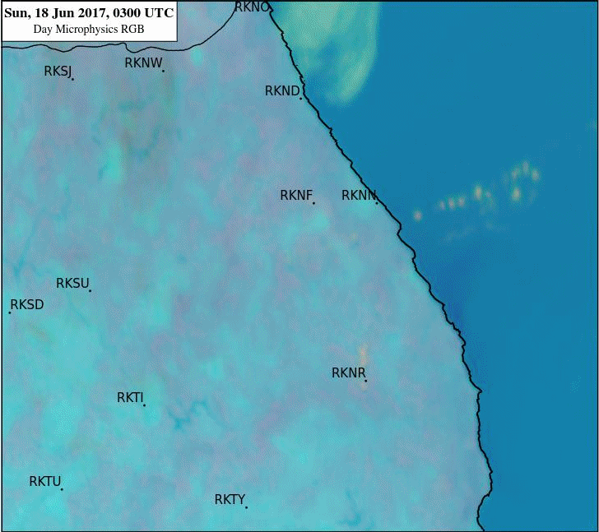
Additional RGB and Sandwich Products
Day Convection RGB Sandwich Product
True Colour RGB Product
Day Microphysics RGB Product
Day Convection RGB Product
Please start the Power Point Slide Show to activate the animation
satellite images courtesy JMA/BOM

Slide 3
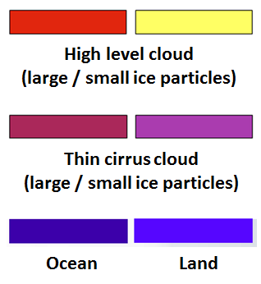
Day Microphysics RGB (BOM*) | Range | Gamma
VIS0.8 | 0 to 100% | 1.2
NIR3.9 | 0 to 60% | 1.8
IR10.8 | +203 to +323 K | 0.8
Day Convection RGB | Range | Gamma
6.2 – 7.3 micron | -35 to 5 | 1.0
3.9-10.4 micron | -5 to 60 | 0.5
1.6-0.6 micron | -75 to +20% | 1.0
Deep precip cloud
Deep precip cloud
(Cb cloud with strong
updrafts)
Thin Cirrus cloud
(large ice particles)
Thin Cirrus cloud
(small ice particles)
Super
cooled, thick
water cloud – large droplets
Supercooled, thick
water cloud – small droplets
Super cooled thin water
cloud with large droplets
Super cooled, thin water
cloud with small droplets
Thick water cloud
(warm rain cloud) – large droplets
Thick water cloud
- small droplets, no pptn
Thin water cloud with large droplets
Thin water cloud
with small droplets
* NOTE: this is the version used by the Australian Bureau of Meteorology Victoria Regional Forecasting Centre Forecasters

Slide 4
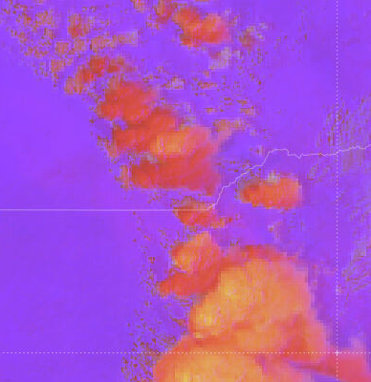
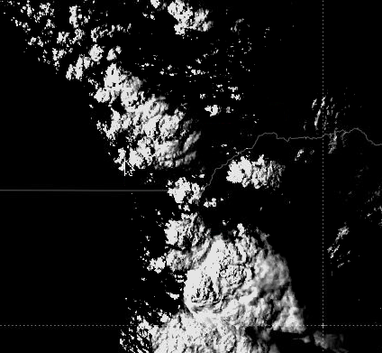
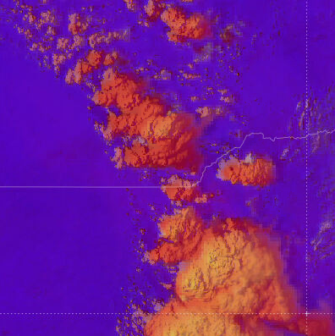
The Day Convection RGB / Visible Sandwich Product"
Upper layer: Day Convection RGB image
Day Convection RGB (Mid-latitude) | Range | Gamma
WV6.2 - WV7.3 BTD | -35 to 5 | 1.0
IR3.9 - IR10.8 BTD | -5 to 60 | 0.5
NIR1.6 - VIS0.6 REFL | -75 to 25% | 1.0
Bottom layer (“background”): HRV image
Upper layer opacity set to 75% for the Day Convection RGB Sandwich Product
The contrast of the HRV layer has been increased to 300 and the brightness reduced to -110
Blending options – applied to the upper layer

