Slide 1
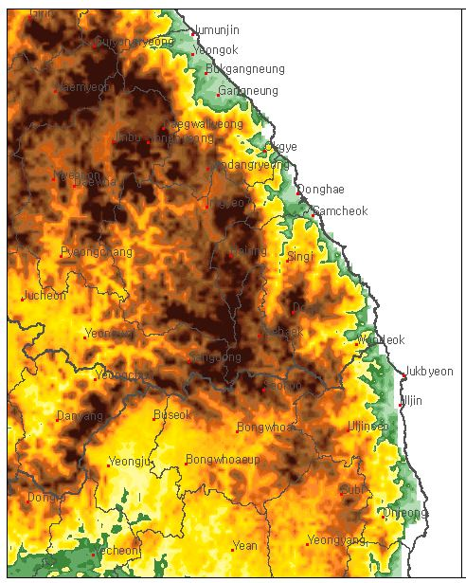
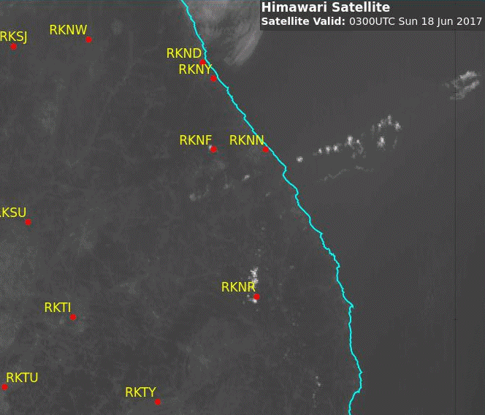
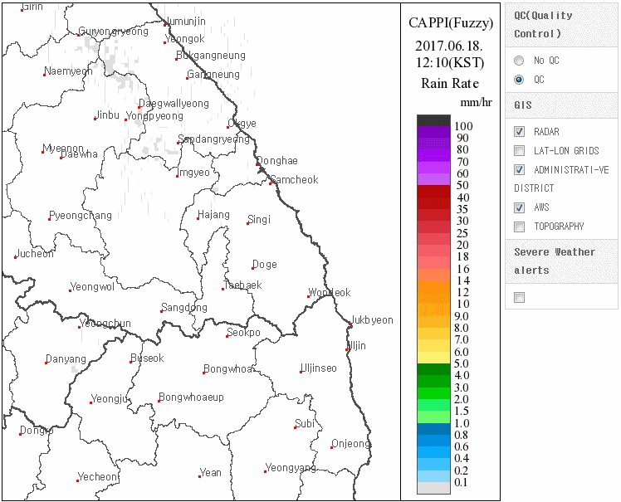
East Korea Convective Development, 18 June 2017 Sandwich Product with lightning data, RADAR (QC) and Topography (03-10UTC)
Please start the Power Point Slide Show to activate the animation
RADAR animation / topography image courtesy Korea Meteorological Administration (KMA)
animation courtesy JMA/BOM, lightning data courtesy WeatherZone
Notes:
http://radar.kma.go.kr/eng/index.do

Slide 2
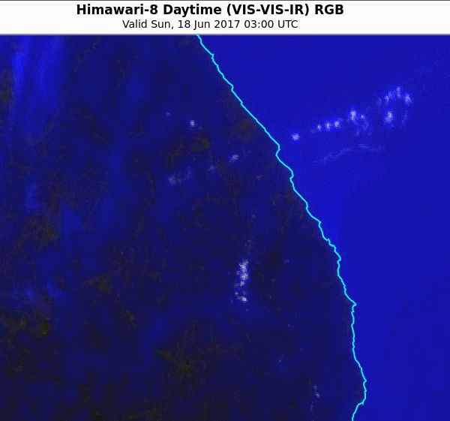
East Korea Convective Development, 18 June 2017 VIS-VIS-IR RGB product RADAR (QC) and Topography (03-10UTC)
Please start the Power Point Slide Show to activate the animation
RADAR animation / topography image courtesy Korea Meteorological Administration (KMA)
animation courtesy JMA/BOM
Notes:
http://radar.kma.go.kr/eng/index.do

Slide 3
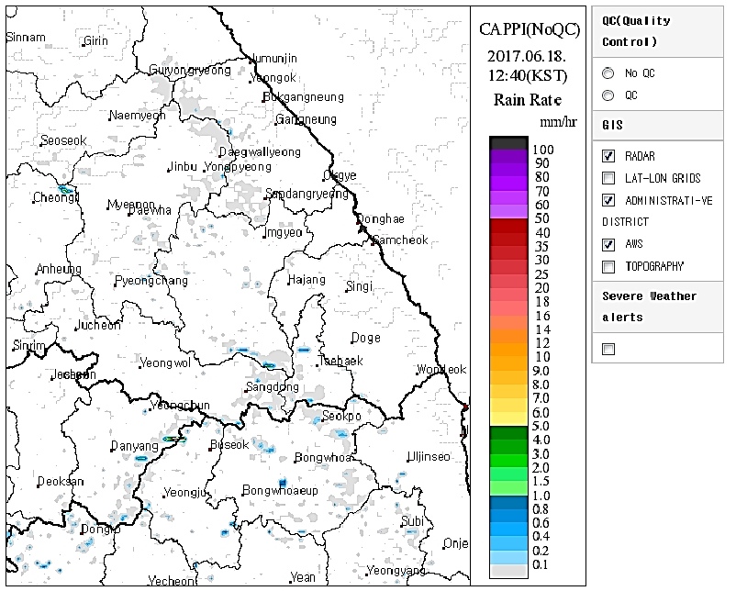
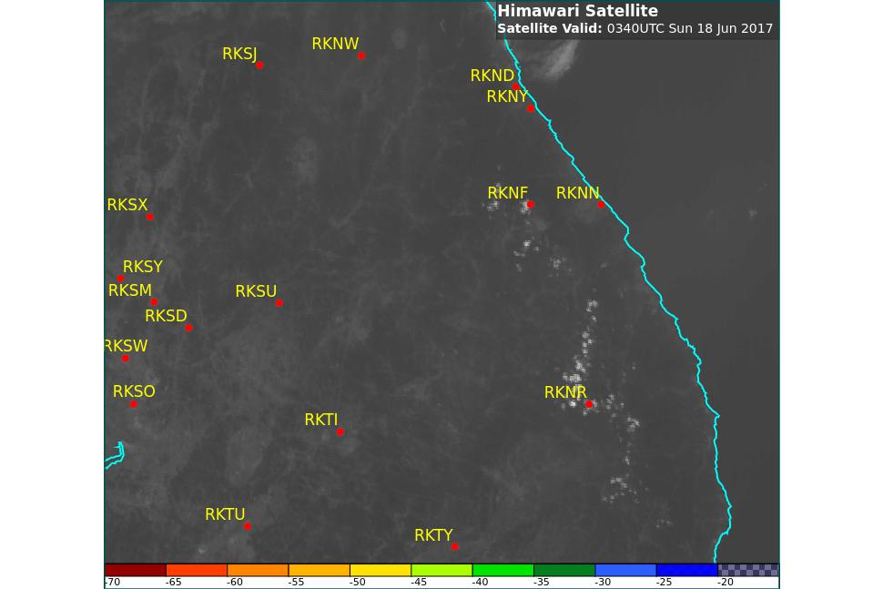
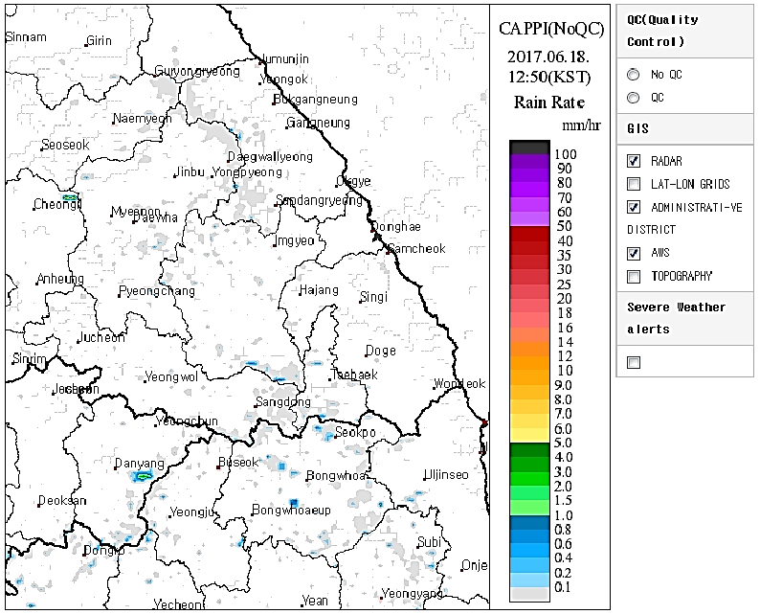
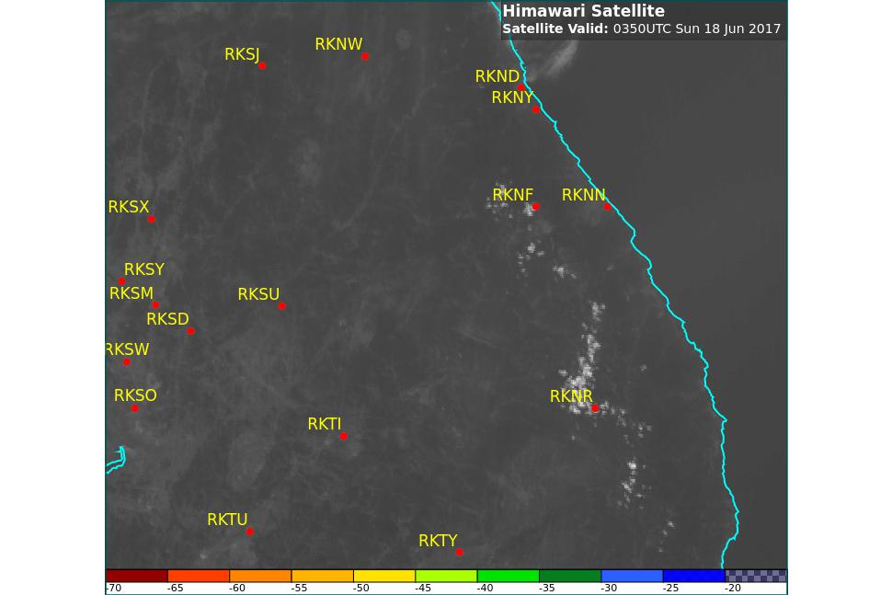
First cumulus field develops in satellite imagery: 0540-0550UTC (1440-1450KST)
RADAR images courtesy Korea Meteorological Administration (KMA)
satellite images courtesy JMA/BOM

Slide 4
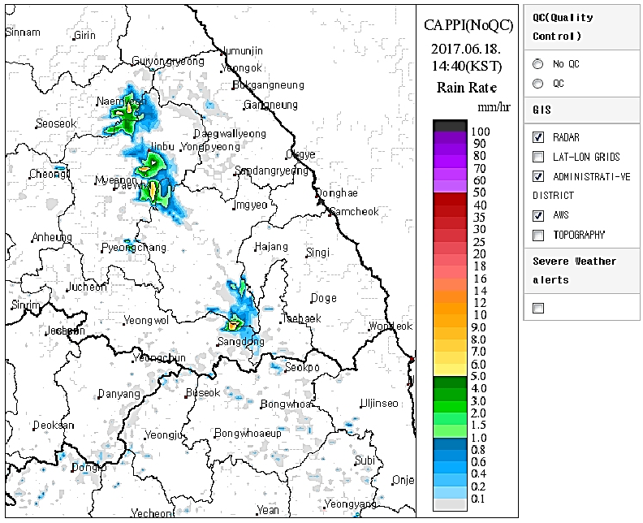
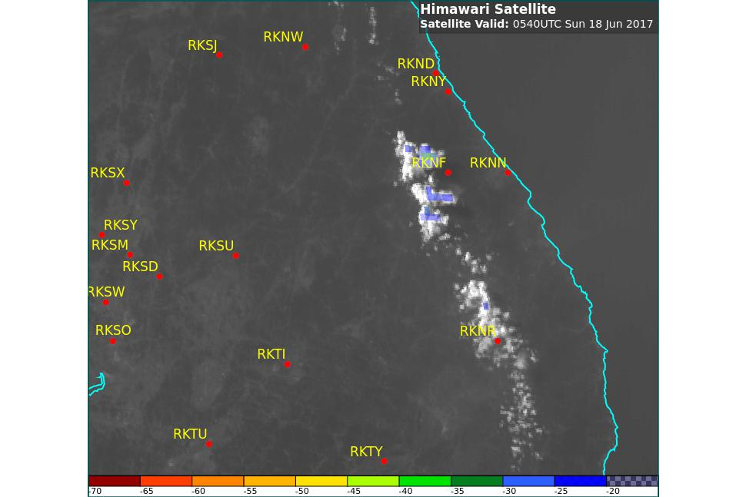
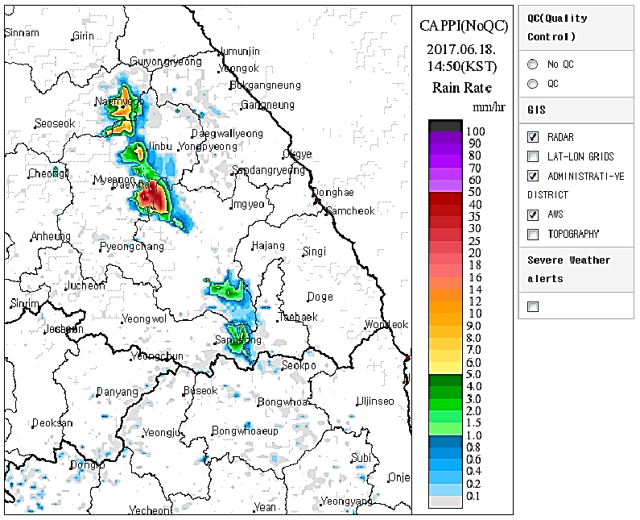
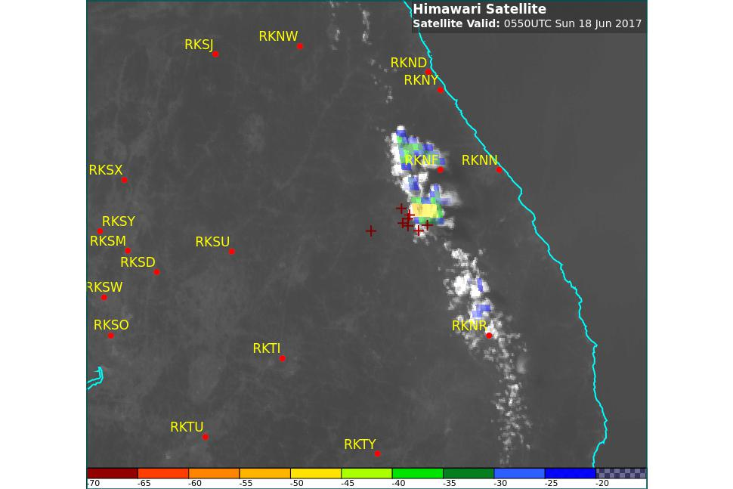
First lightning strikes recorded: 0540-0550UTC (1440-1450KST)
RADAR images courtesy Korea Meteorological Administration (KMA)
satellite images courtesy JMA/BOM

