Slide 1
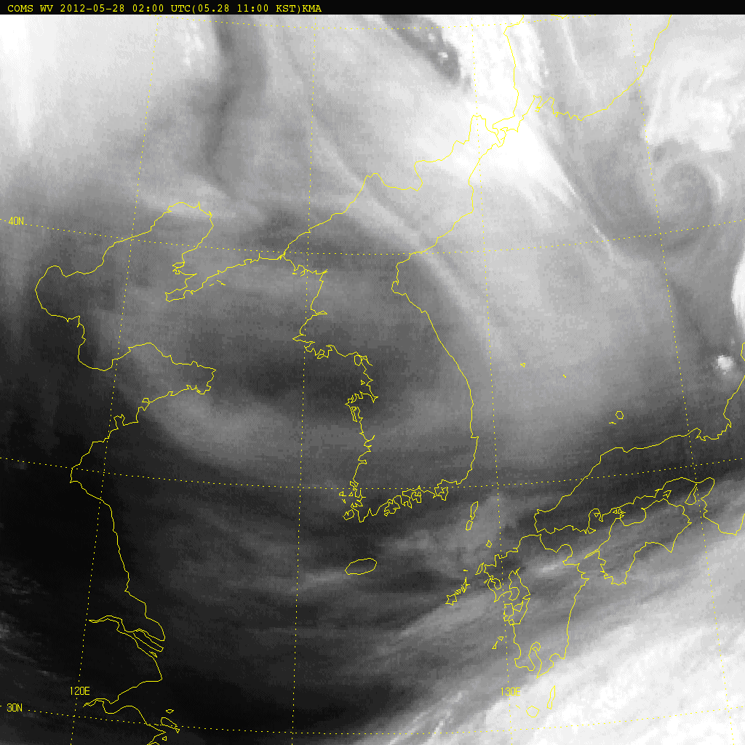

Rapidly Developing Thunderstorm (RDT)
( 02:00~10:00 UTC 28th May 2012 )

