Slide 1
Applying existing and new RGB products to Himawari-8 data. Collaborative meeting between BOM, JMA and NOAA, November 2016
Bodo Zeschke
Teacher, Bureau of Meteorology Training Centre
Australian Vlab Centre of Excellence Point of Contact
Should you use these resources please acknowledge the Australian Bureau of Meteorology Training Centre. In addition, you need to retain acknowledgement in the PowerPoint slides of EUMETSAT, the Japan Meteorological Agency, the Bureau of Meteorology and any other sources of information.
Slide 1

Slide 2
Contents of this session
Modifications to the Night Microphysics RGB product
Mid-latitude and Tropical versions
Modifications to the Day Convection RGB product and its use in combination with the Sandwich Product
Limitations in applying the Day Convection RGB product for winter storms
Application and potential modifications to the Dust RGB product
Monitoring large and small dust plumes
Interpretation of the product using histogram analysis (example from the Korea Meteorological Administration)
Forecaster / stakeholder feedback regarding the effective use of these RGB products, including the optimal display of this data with other information for Operational Forecasters.
Australian Vlab Centre of Excellence Regional Focus Group meeting resources
Slide 2

Slide 3
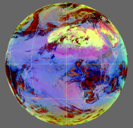
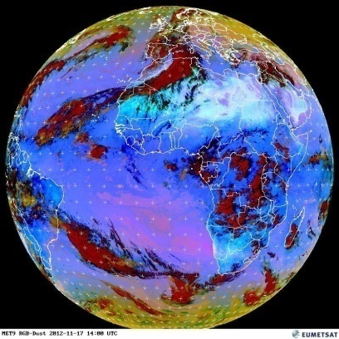
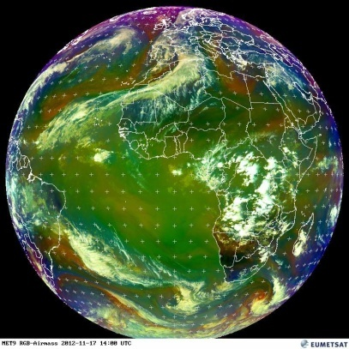
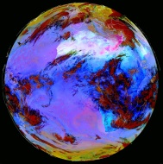
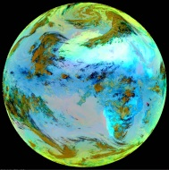
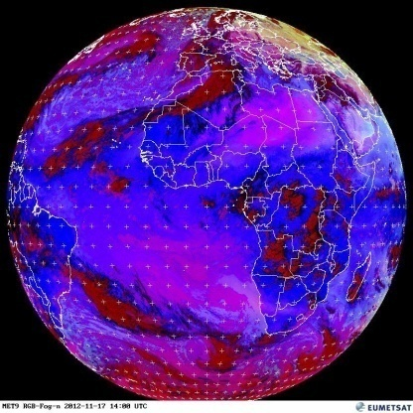
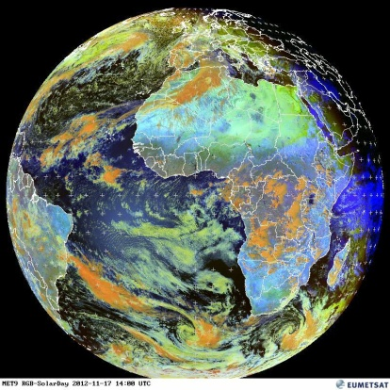
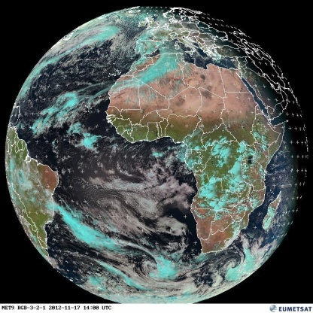
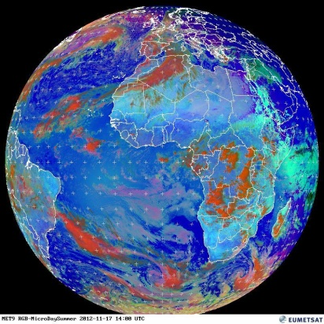
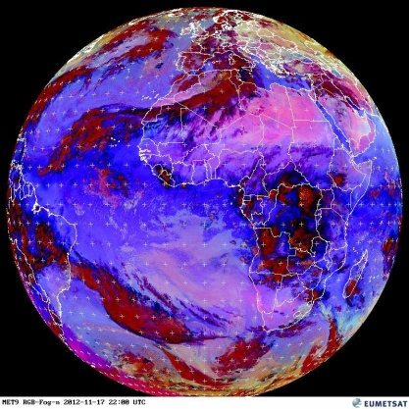
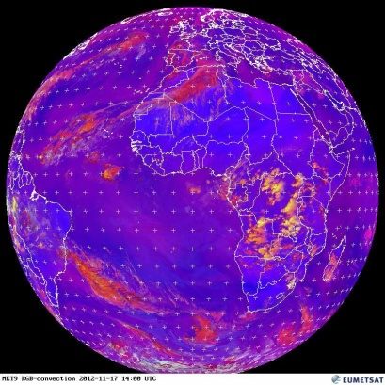
RGB products for Operational Forecasting – WMO/EUMETSAT recommendation
Two RGB composites which complement each other
Cloud
dust
Ash
24 hour Microphysical RGB
Airmass RGB
from RGB Products Overview (RGB Tutorial)
J. Kerkmann EumetSAT
Five application specific RGBs
Day Microphysical RGB
Night Microphysical RGB
Day Convection RGB
Snow / fog RGB
Natural Colours RGB
Slide 3

Slide 4
RGB products for Operational Forecasting – WMO/EUMETSAT recommendation
Two RGB composites which complement each other
Cloud
dust
Ash
24 hour Microphysical RGB
Airmass RGB
from RGB Products Overview (RGB Tutorial)
J. Kerkmann EumetSAT
Five application specific RGBs
Night Microphysical RGB
Day Convection RGB
Day Microphysical RGB
Night Microphysical RGB
Snow / fog RGB
Natural Colours RGB
Slide 4

Slide 5
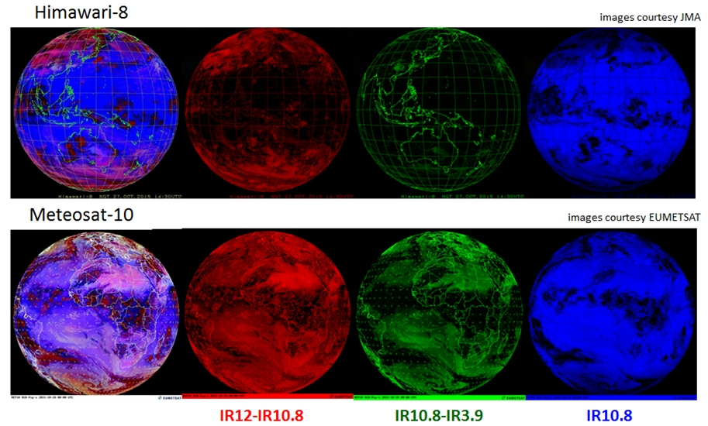
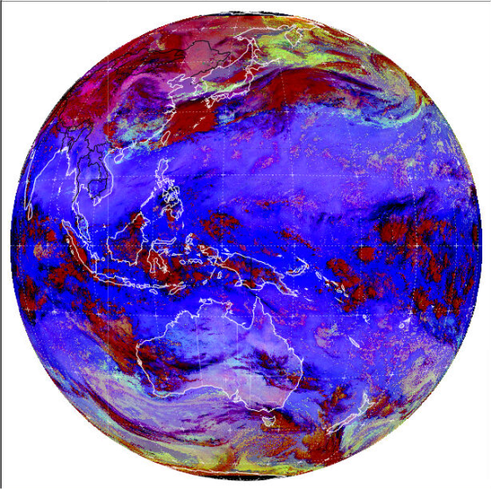
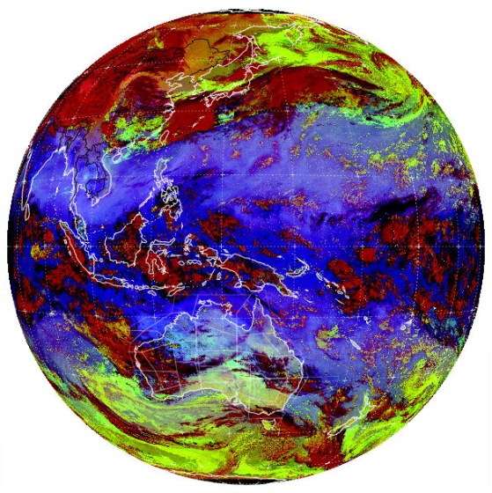
Tuning the Night Microphysics RGB products by Forecasters and stakeholders to suit local conditions
METEOSAT images courtesy EUMETSAT, Himawari-8 images courtesy Japan Meteorological Agency (JMA)
Most tuning required in the Red and Green beams
A
C
D
 | RED (IR12.0 – IR10.4) | GREEN (IR10.4-NIR3.9) | BLUE (C) (IR10.4)
A: SEVIRI RECIPE | -4 to 2 | 0 to 10 | -30 to 20
B: NCMP-TROP | -4 to 2 | 0 to 5 | 0 to 27
C: JMA version 2 | -6.7 to 2.6 | -3.1 to 5.2 | -29.4 to 19.4
D: TROP Hybrid (scaled) | -6.7 to 2.6 | -3.1 to 2.6 | 0.6 to 26.4
Slide 5

Slide 6
Tuning the Night Microphysics RGB products by Forecasters and stakeholders to suit local conditions
From correspondence with Jochen Kerkmann, EUMETSAT, there are two versions of the Night Microphysics as used for the SEVIRI instrument data of the METEOSAT Second Generation satellite: one for Europe (or extra tropics) and one for tropical moist regions, the Night Cloud Microphysics Tropical (NCMP-TROP). The recipes are given in examples A and B in the preceding slide 5.
The recipe for the Night Microphysics RGB product as tuned for Himawari-8 by the Japan Meteorological Agency is given in example C.
Knowing the above recipes we can derive a "first order" approximation of the tropical tuned Night Microphysics RGB product suitable for the Himawari-8 AHI data and this is given in example D.
NOTE SLIDE

Slide 7
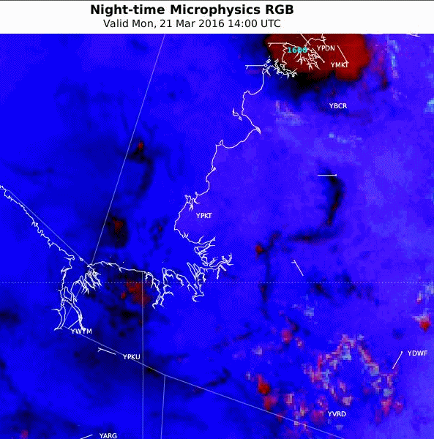
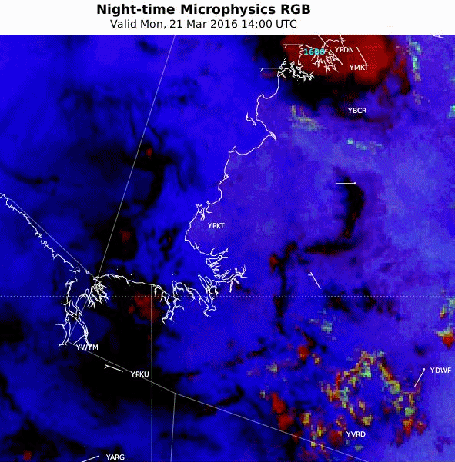
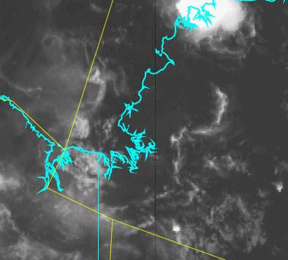
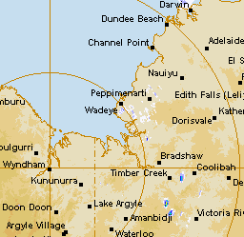
Northern Territory, 21st March 2016, 14 – 22UTC
satellite animation courtesy BOM/JMA
A: JMA version 2
B: TROP Hybrid (scaled)
10.4 micron IR
Darwin
Wyndham RADAR
Question: What RGB product do you prefer?
What are the advantages in using the RGB product?
Port Keats
radar animation courtesy BOM
NOTE THESE ARE EMBEDDED ANIMATIONS
Slide 6
Notes:
http://www.theweatherchaser.com/radar-loop/IDR072-wyndham/2016-03-21-12/2016-03-21-23
http://flurry-dm.bom.gov.au:8008/radar/request_radar.php

Slide 8
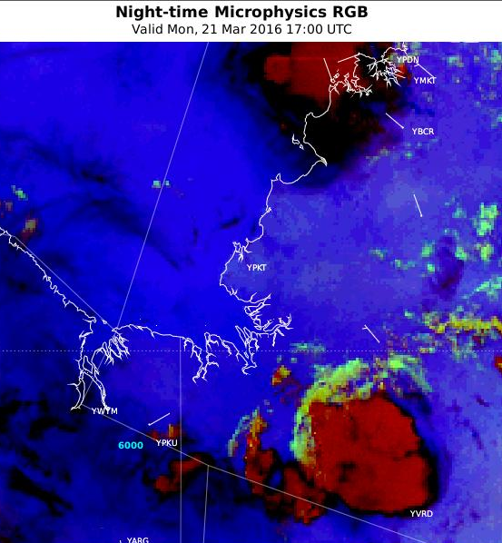
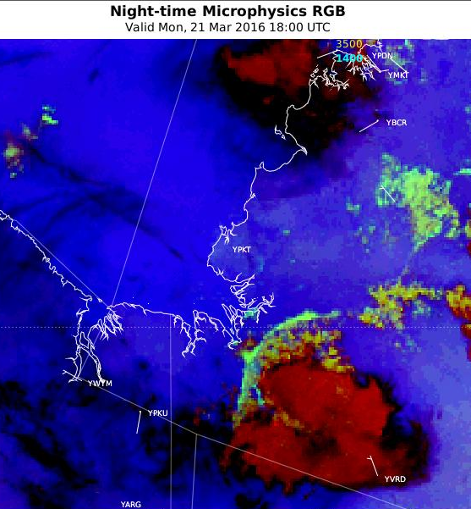
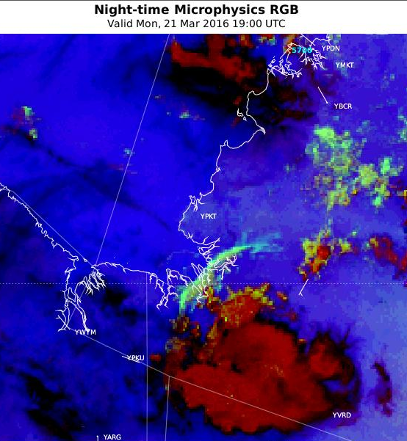
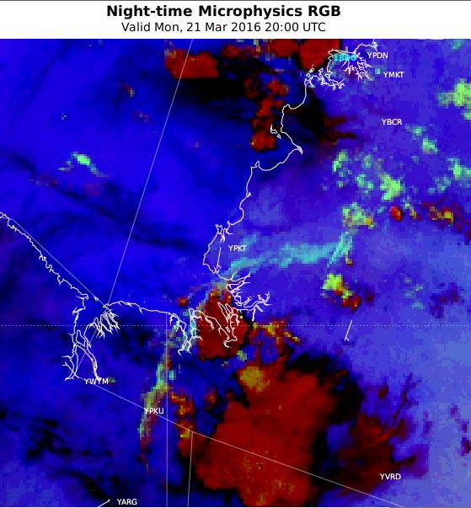
Northern Territory, 21st March 2016, 17 – 20UTC
17UTC
18UTC
satellite animation courtesy BOM/JMA
19UTC
20UTC
Monitoring of the storm outflow / gust front and the development of secondary convection using the Night Microphysics RGB product
Slide 7

Slide 9
Interpreting the Tropical tuned Night Microphysics RGB product – Central Indonesian region 13UTC 9th April 2016
Night Microphysics RGB
10.4 micron IR
Jakarta
Jakarta
Question: Any unexpected colours in the RGB product that do not match the EUMETSAT RGB palette?
images courtesy BOM/JMA
Slide 8

Slide 10
Interpreting the Tropical tuned Night Microphysics RGB product – Central Indonesian region 13UTC 9th April 2016
Night Microphysics RGB
10.4 micron IR
Tb = 19C
Tb = 12C
Tb = 2.8C
Tb = - 3.3C
Tb = -21C
Jakarta
Jakarta
Tb = -76C
Question: What clouds have these "unexpected" colours:
A: high level cloud tops B: mid level cloud tops C: low level cloud tops
images courtesy BOM/JMA
Slide 9

Slide 11
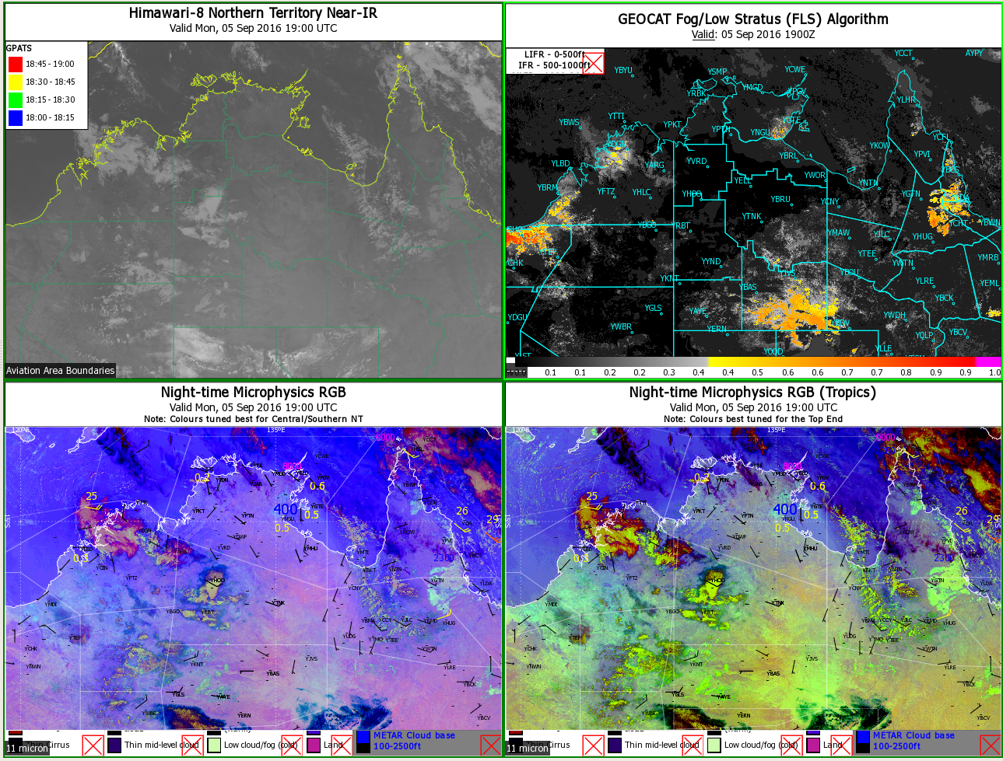
Forecaster Display - Adapting the Night Microphysics RGB product to the tropics Courtesy Rebecca Patrick NTRO
image courtesy BOM/JMA
Slide 10

Slide 12
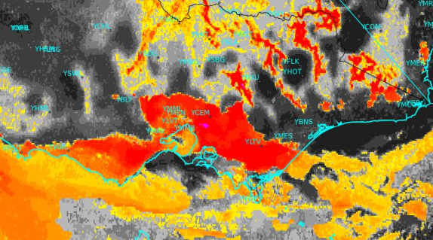
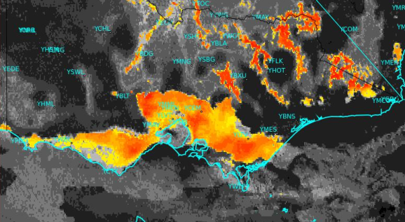
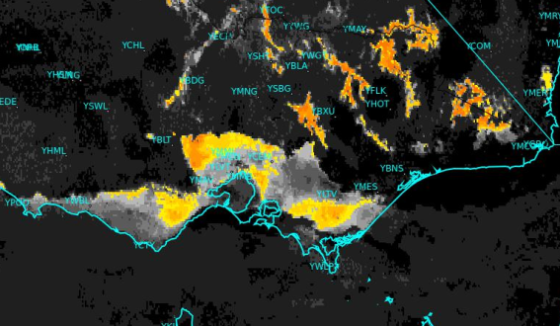
Explaining the GEOCAT GOES-R fog/low cloud algorithm (Calvert and Pavolonis NOAA NESDIS STAR)
MVFR fog/low cloud Probability (below 3000ft)
IFR fog/low cloud Probability (below 1000ft)
Uses Himawari-8 data
0.65, 3.9, 11 micron daytime
3.9, 11 micron at night
B
Algorithm also uses:
Modelled relative humidity (NWP profile to find highest RH in the lowest 1000/3000 ft layer)
Textural & spectral information
Difference between cloud radiative temperature and surface temperature
Cloud object based filtering technique
C
Victoria 15th July 2016 20UTC
LIFR Fog/low cloud Probability (below 500ft)
LIFR, IFR, MVFR FLC probability
A
Melbourne
Key output in Visual Weather:
MVFR conditions
IFR conditions
LIFR conditions
A: Valley fog/low cloud
B: Stratus
C: Marine Stratocumulus
A
From the Regional Focus Group Weather and Forecast Discussion, 7th July 2016 as presented by B.Zeschke.
NOTE SLIDE
Images from BOM

Slide 13
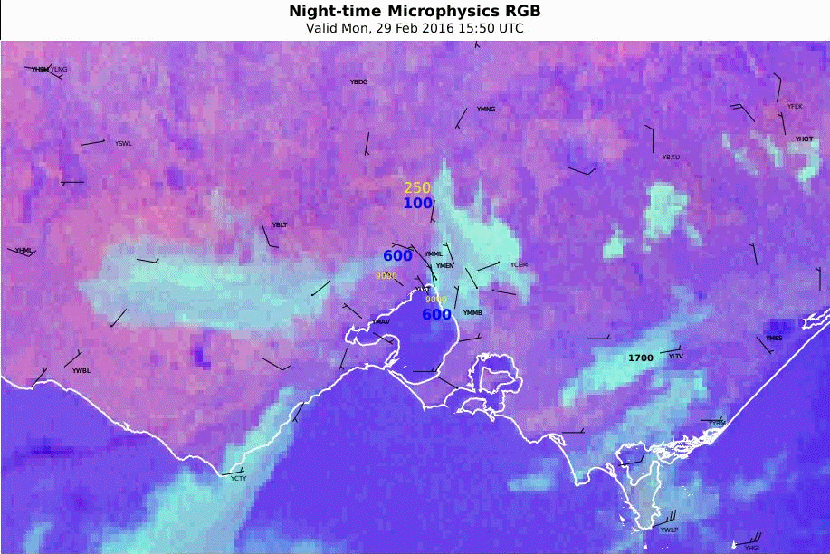
Forecaster Display - Himawari-8 Night-Microphysics RGB product, Melbourne region (19UTC 29th Feb 2016)
animation courtesy JMA/BOM
NOTE: THIS IS AN EMBEDDED ANIMATION
Slide 11

Slide 14
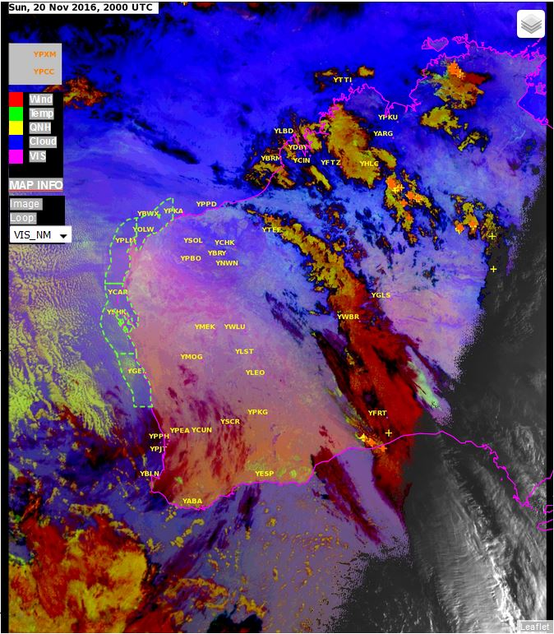
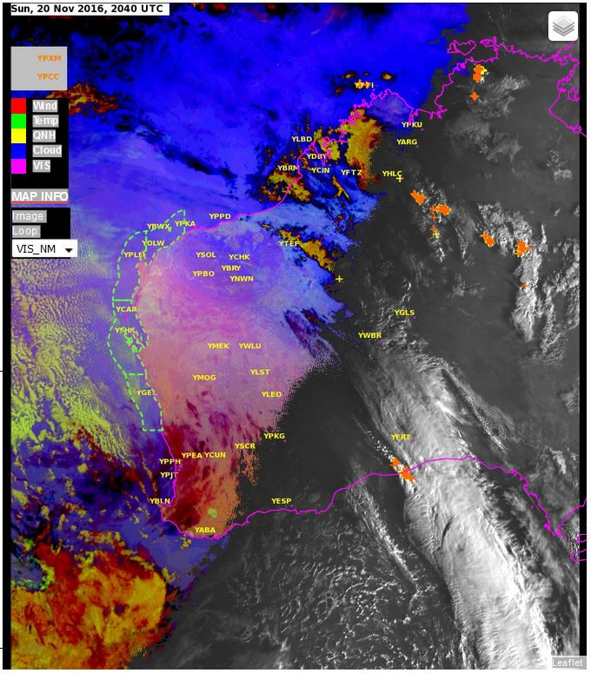
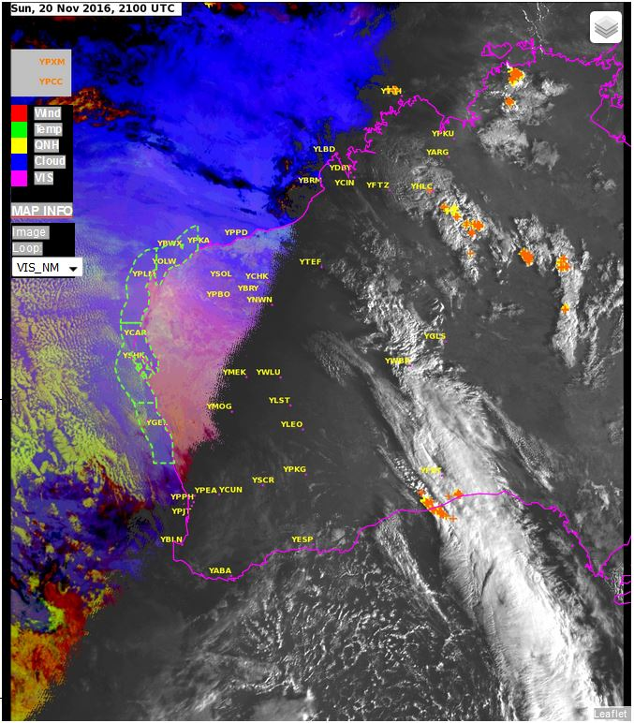
Forecaster Display – the transition of the Night Microphysics RGB into visible imagery (Bureau of Meteorology West Australian Regional Office development led by C.Stuart)
The algorithm displays the Night Microphysics RGB product whenever there is no signal in the visible image
Slide 12

Slide 15
Summary - Bureau Forecaster feedback regarding the use of the Night Microphysics RGB product (1)
This product has been developed recently for a number of reasons:
Forecasters are familiar with this RGB product as a similar product was constructed using MTSAT data previously.
The Southern Hemisphere winter season has recently concluded. During this season the fog/low cloud events are most frequent over Australia.
The imagery loads relatively quickly on the computer as the emissive infrared and short wave infrared channels composing the RGB product are smaller in size than the visible channel.
The fog/low cloud signal is quite clear and unambiguous most of the time. In many instances fog/low cloud can be monitored in the presence of higher cloud.
Land surfaces can be seen more clearly in the Himawari-8 data, compared to MTSAT-2 and that can help in discriminating between true fog/low cloud and false signals.
NOTE SLIDE

Slide 16
Summary - Bureau Forecaster feedback regarding the use of the Night Microphysics RGB product (2)
There are some limitations in the use of this product: :
There are still some cases of false fog/low cloud signal over desert areas.
When using the night microphysical RGB images it is important to be aware of how temperature effects the images. The blue channel is sensitive to temperature, this means that fog and stratus events may look different depending on the surface temperature. We have seen the RGB colour of the fog/low cloud change between seasons. Even during the overnight period when there are large temperature changes in one night the colours can change dramatically (N.Benger South Australian Regional Office). One way around this is to use multipanel displays showing, for example, the midlatitude and tropical tuned RGB products together with the short wave infrared and the GEOCAT Fog/Low Stratus product
People who have vision colour deficiency have problems in viewing this imagery. The use of Derived Products (GEOCAT Fog/Low Stratus cloud algorithm) can help overcome this.
NOTE SLIDE

Slide 17
RGB products for Operational Forecasting – WMO/EUMETSAT recommendation
Two RGB composites which complement each other
Cloud
dust
Ash
24 hour Microphysical RGB
Airmass RGB
from RGB Products Overview (RGB Tutorial)
J. Kerkmann EumetSAT
Five application specific RGBs
Night Microphysical RGB
Day Convection RGB
Day Microphysical RGB
Day Convection RGB
Snow / fog RGB
Natural Colours RGB
Slide 13

Slide 18
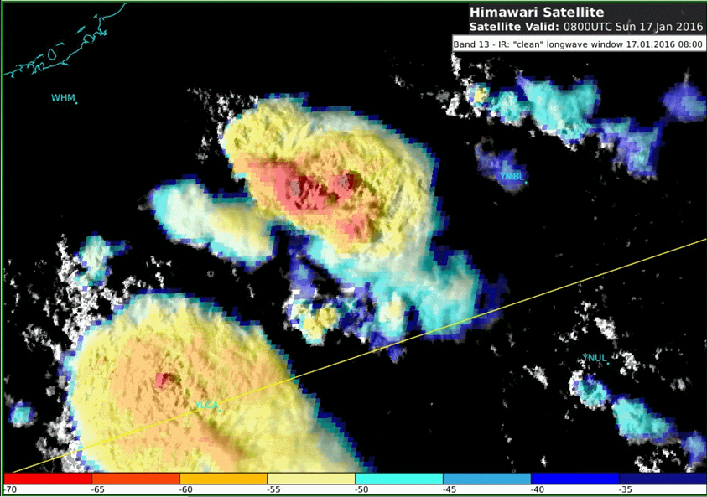
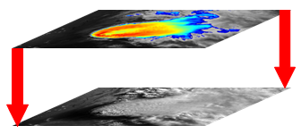
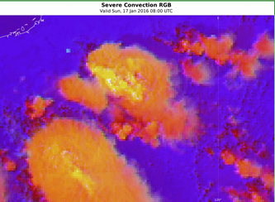
The Sandwich Product and the Day Convection RGB product
images courtesy JMA/BOM
Upper layer: IR10.4 BT image
Bottom layer (“background”): HRV image
The Sandwich Product (M.Setvak)
sandwich HRV & IR10.8-BT
Day Convection RGB product
Day Convection RGB
Slide 14

Slide 19
The Sandwich Product (M.Setvak CHI) http://oiswww.eumetsat.org/WEBOPS/iotm/iotm/20090923_convection/20090923_convection.html
The product consists of two layers: the base one, which is the High Resolution Visible (HRV) image, and the upper layer, containing the color-enhanced IR10.8 image, showing the details of the brightness temperature field. Next, there are several options how to blend these two layers together. The simplest way is to use just the partial transparency of the upper layer, setting the layer opacity somewhere between 40 to 75%
The primary advantage of sandwich products is that they merge the features of the two input images into one single image, thus enabling one to observe the characteristics of both images simultaneously in one single product. In the case of the visible – IR-window sandwich combination (VIS/IR-BT), the visible band brings to the final image the cloud-top “morphology” (shadows and textures), while the color-enhanced IR-window band adds the BT information. Such images often gain almost a 3D appearance, which is absent if the source input images are compared side-by-side. It is much easier to follow the evolution of convective storms (or any other weather phenomenon) in one single sandwich product, rather than in two windows, showing the input bands separately. Finally, the main advantage of the sandwich product is in its animation possibilities, showing the evolution of studied phenomena in one single loop. This makes the sandwich products very attractive for operational applications. As the sandwich products are based on solar bands (visible or near IR), they can’t be used at night.
NOTE SLIDE

Slide 20
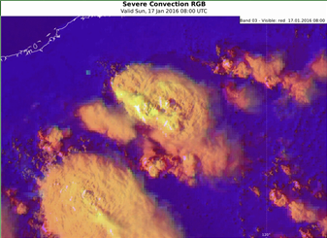
The Sandwich Product / Day Convection RGB product
images courtesy JMA/BOM
Upper layer: IR10.4 BT image
Bottom layer (“background”): HRV image
The Sandwich Product (M.Setvak)
sandwich HRV & IR10.8-BT
Slide 15
Day Convection RGB product
sandwich HRV & Day Convection RGB

Slide 21
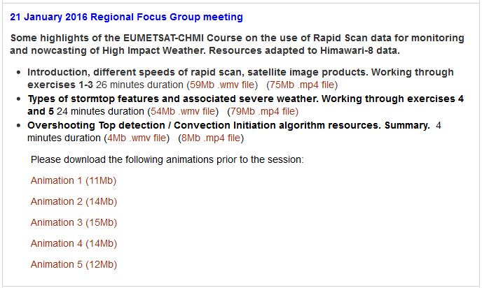
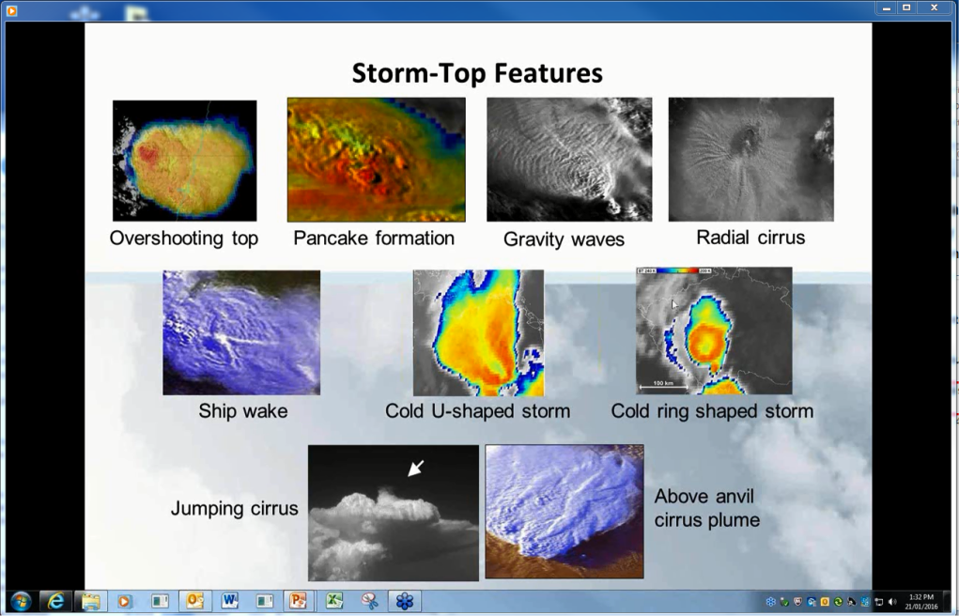
Storm-Top Features identified in high resolution satellite data Australian Vlab CoE Regional Focus Group meeting of January 2016 http://www.virtuallab.bom.gov.au/archive/regional-focus-group-recordings/
Slide 16

Slide 22
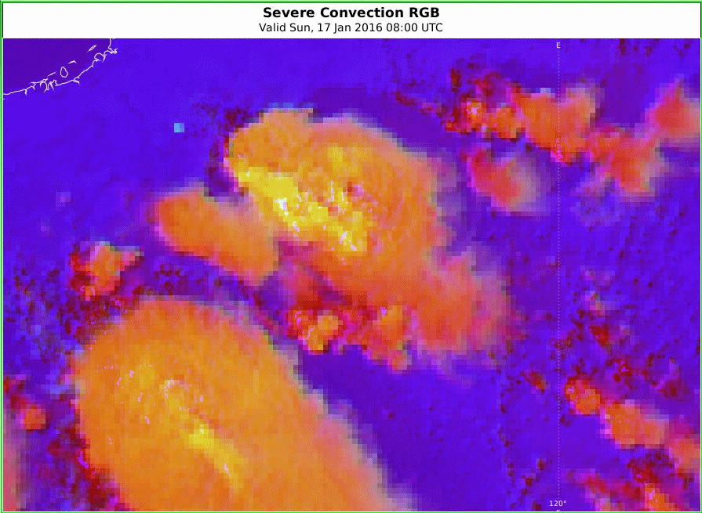
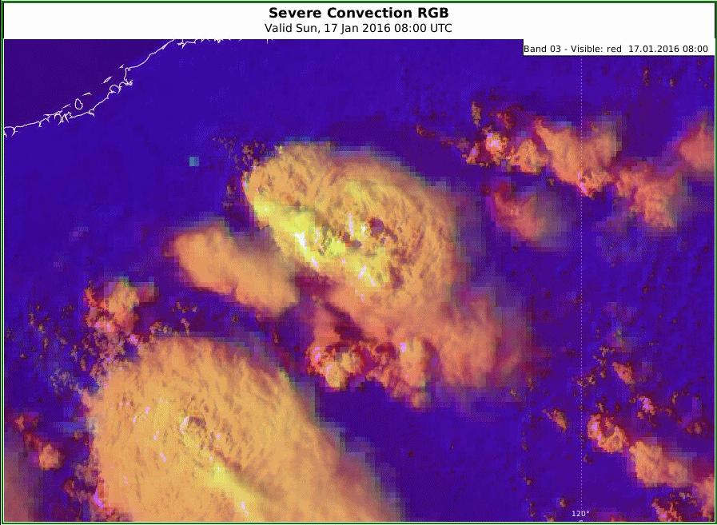
Storms, northwest Australia, 17th January 2016 (Himawari-8 10 minute data)
lightning data courtesy Global Position and Tracking Systems Pty Ltd (GPATS)
satellite animations courtesy BOM/JMA
A: Sandwich product and lightning
B: Sandwich product
C: Day Convection RGB product
D: HRV/Convection RGB Sandwich Product
NOTE THESE ARE EMBEDDED ANIMATIONS
Slide 17

Slide 23
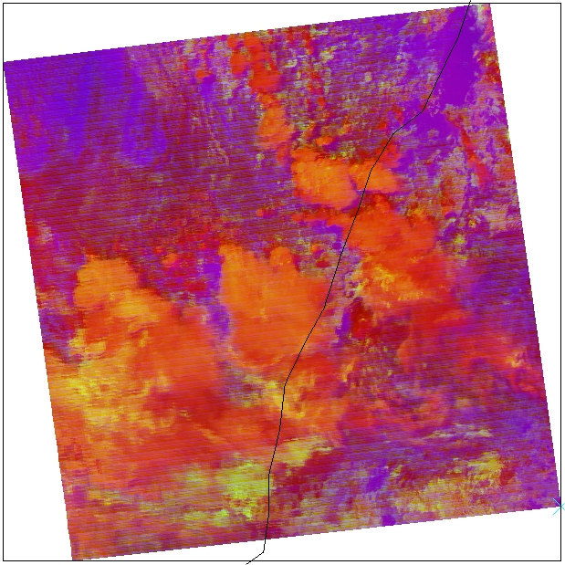
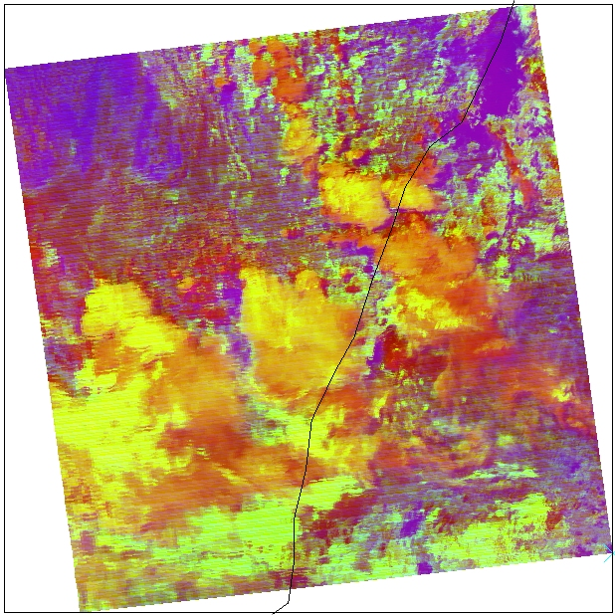
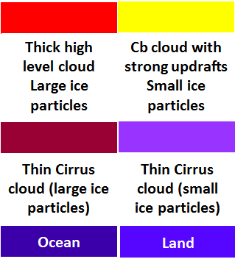
Tuning the Day Convective RGB product for a lower tropopause, Severe Storms New South Wales, 24th August 2015
images courtesy NASA FIRMS
LHS, Green beam thresholds
-5 to +60
RHS, Green beam thresholds
-5 to +40. Note that the active stormtops are well captured (black circles), but the mid level water clouds contaminates this signal
Sydney
Sydney
Enhanced IR image
-47C
-31C
-23C
-15C
-7C
cloudtop brightness temperature
Sydney
image courtesy BOM/JMA
Slide 18

Slide 24
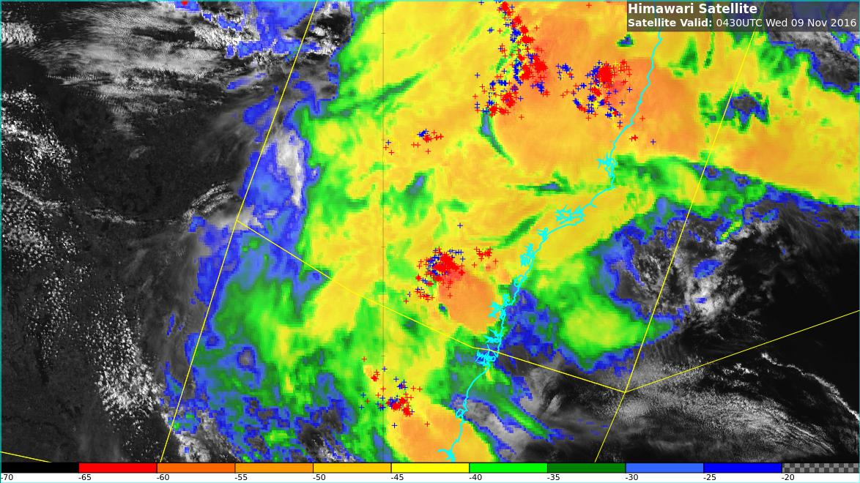
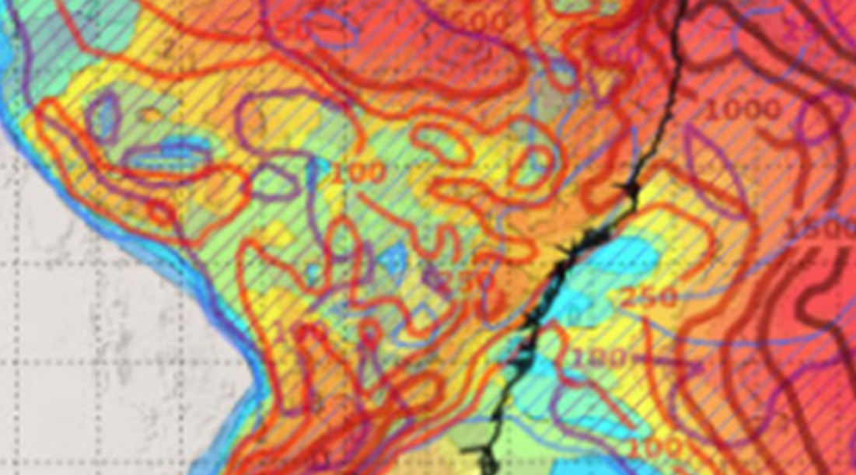
Forecaster Display – combining a number of products (feedback from AOMSUC-7 and BOM/JMA/NOAA 29Nov meeting)
images courtesy JMA/BOM
BT
Sydney
Sydney
Sandwich Product and Lightning
HRV/Convection RGB Sandwich Product
Sydney
Sydney
Ingredients based NWP output
(layered to permit interrogation of components)
RADAR
Slide 19

Slide 25
Summary - feedback regarding the use of the Day Convection RGB product and the Sandwich Product (1)
South Australian Forecasters do not use the Day Convection RGB very much as it is slow to load due to the large size of the reflective channels. Using storm-top enhancements on single channel imagery works similarly and takes far less time to load.
Queensland Forecasters have found it useful to define particular temperature thresholds in the enhanced infrared channels as important for thunderstorm monitoring. Forecasters look for temperatures colder than -10C to show increased potential. Temperatures colder than -20C usually corresponds to thunderstorms formation.
Northern Territory (tropical) Forecasters have found that the Day Convection RGB shows the yellow stormtop enhancement for many storms. There is a perception that this product has too many "false alarms" and requires tuning. Comment from Jochen Kerkmann, EUMETSAT is that the green range of the convection RGB should be increased to -5 to +75 K, for the cold cloud tops corresponding to tropical conditions.
NOTE SLIDE

Slide 26
Summary - feedback regarding the use of the Day Convection RGB product and the Sandwich Product (2)
Further comments from Jochen Kerkmann (EUMETSAT):
The Day Convection RGB product is most useful in detecting the initial stages of the development of severe thunderstorms with small ice crystals spewing out of their tops. The later stages, when the anvil grows and small and large ice particles mix, are less interesting. Certainly new convective towers can shoot up through the anvil, which then have to be monitored.
The Day Convection RGB only sees high level clouds, so it is not useful for monitoring low level features like outflow boundaries. Therefore it is useful to combine the Day Convection RGB product with the high resolution visible (HRV) product to capture all phases of storm formation and development (see slides 15 and 17) .
For wintertime convection (not deep), the Day Convection RGB product is not suited well. It is possible to change the range of the Green Beam to -5 to +40 K in order to detect the most active storms, but at the cost of enhancing also other cloud types, in particular mid-level supercooled clouds (for cold water cloud, the signal IR3.9 – IR10.8 gets quite large), see slide 18.
NOTE SLIDE

Slide 27
RGB products for Operational Forecasting – WMO/EUMETSAT recommendation
Two RGB composites which complement each other
Cloud
dust
dust
Ash
24 hour Microphysical RGB
Airmass RGB
24 hour Microphysical RGB
from RGB Products Overview (RGB Tutorial)
J. Kerkmann EumetSAT
Five application specific RGBs
Day Microphysical RGB
Night Microphysical RGB
Day Convection RGB
Snow / fog RGB
Natural Colours RGB
Slide 20

Slide 28
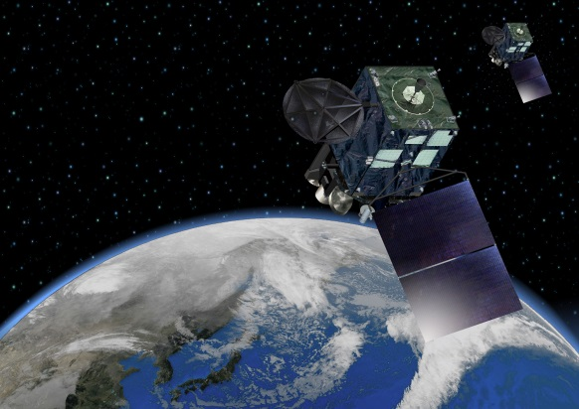
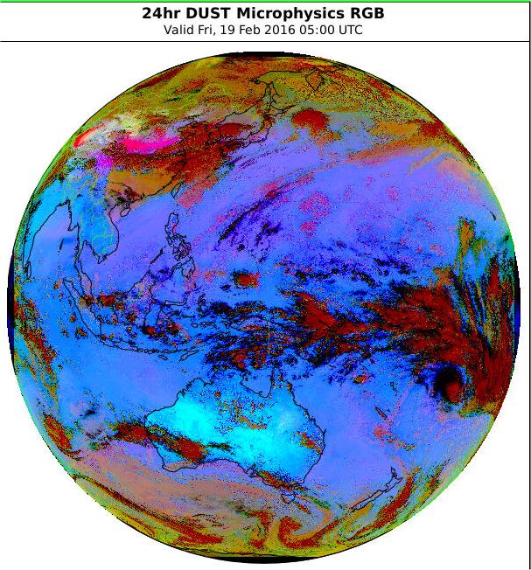
Processing of the Himawari-8 data – the Dust RGB
images courtesy JMA / Eumetsat
Dust RGB | Range | Gamma
12.0 – 10.4 micron | -6.7 to 2.6 | 1.0
11.2 – 8.7 micron | -0.5 to 20.0 | 2.5
10.4 micron | 261.2 to 288.7 | 1.0
CHANNEL COMBINATION (JMA recipe)
Himawari-8 channels
Himawari-8 RGB Composite
Colour interpretation palette
Slide 21

Slide 29
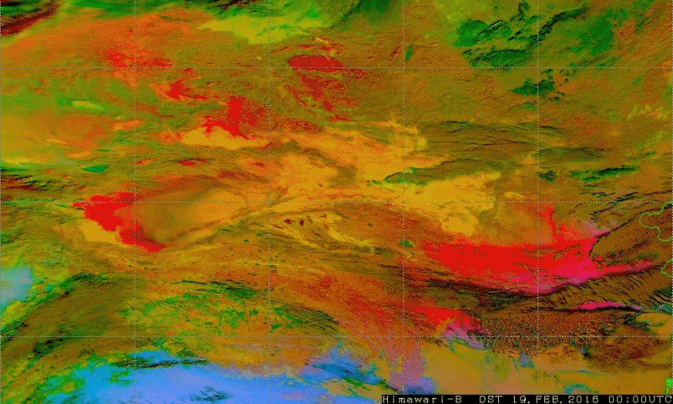
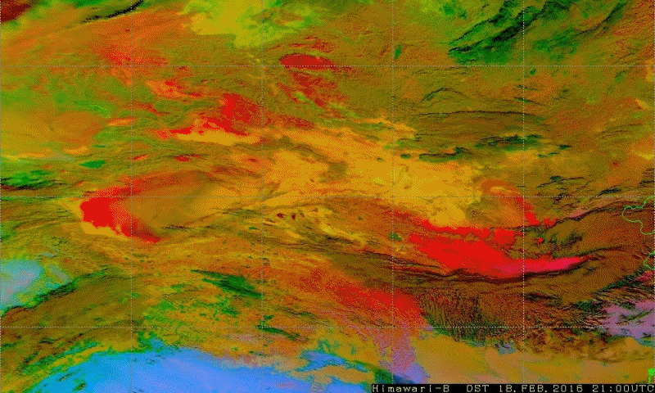
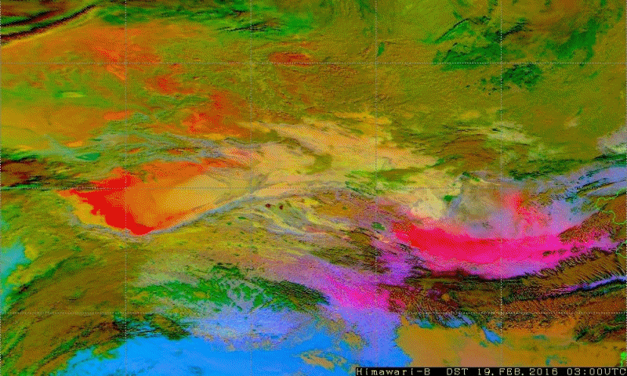
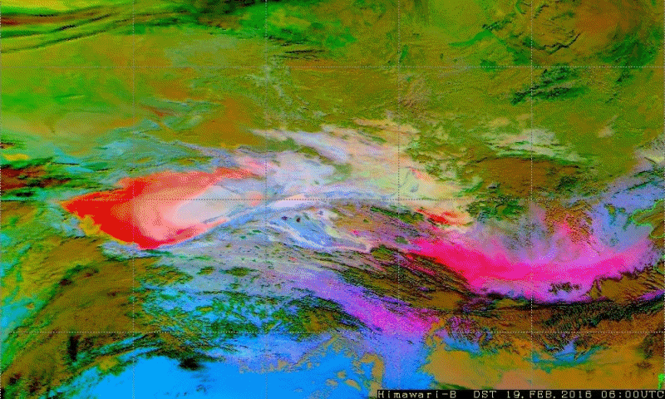
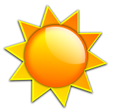
China dust storm, Dust RGB, 18-19 Feb 2016
18 Feb 21UTC
19 Feb 00UTC
Gobi Desert
Gobi Desert
Beijing
Takla Makan
Deset
Beijing
Takla Makan
Deset
19 Feb 03UTC
19 Feb 06UTC
Gobi Desert
Gobi Desert
Takla Makan
Deset
Beijing
Takla Makan
Deset
Beijing
Slide 22
Images forwarded by Jochen Kerkmann, EUMETSAT, 19th February

Slide 30
Comparing various products for a weak dust plume (northwestern Australia, 4 March 2016)
Himawari-8 images courtesy BOM/JMA
Natural Colour RGB (0300UTC)
Dust Microphysics RGB (0300UTC)
Learmonth
Soumi NPP VIIRS True Colour image (~0450UTC)
MODIS True Colour image (0305UTC)
Slide 23
Soumi NPP and MODIS images from NASA Worldview Earthdata at https://worldview.earthdata.nasa.gov/index.html

Slide 31
Comparing various products for a weak dust plume (northwestern Australia, 4 March 2016)
Himawari-8 images courtesy BOM/JMA
Himawari-8 Band 3 (0300UTC)
Dust Microphysics RGB (0300UTC)
Soumi NPP VIIRS True Colour image (~0450UTC)
MODIS True Colour image (0305UTC)
Slide 24
Soumi NPP and MODIS images from NASA Worldview Earthdata at https://worldview.earthdata.nasa.gov/index.html

Slide 32
Some work conducted by the Korea Meteorological Administration
0
255
Dust
Cloud
Takla Makan
Clear Ocean
0
255
RED : IR12.3-IR10.4
Range: -4 ~ 2K
GREEN : IR10.4-IR8.6
Range : 0 ~ 15K
BLUE : IR10.4
Range: 261 ~ 289K
0
255
Dust =RED+BLUE
From "Dust Detection Method using Various Satellite Products" Australian Vlab Centre of Excellence presentation of August 2016 by Dr Hyesook Park
Slide 25

Slide 33
Summary - feedback regarding the use of the Dust RGB product (1)
Tropical Forecasters in the Bureau do not use the Dust RGB much, as they have had limited success in using this product. For example, a West Australian Forecaster sent me an example of a dust plume near Learmonth which did not show up in the Dust RGB product but did shows up well in the Natural Colour RGB product (see slides 23 and 24).
Mid latitude, South Australian Forecasters have noted that a number of dust reports at stations do not show up in the Dust RGB product. They have found the visible imagery more useful for detecting and monitoring this dust, particularly very small dust plumes. On the other hand, the thick dust observed near Adelaide on the 3 December 2015 could be seen in the RGB product.
Jochen Kerkmann (EUMETSAT) has noted that the range of the Green Beam is best from 1.0 to 10.9. (email of 4th November 2016).
It is also noted that very cold, snow covered surfaces (eg Siberia in winter) will have a similar signal to dust at night (see slide 22).
NOTE SLIDE

Slide 34
Summary - feedback regarding the use of the Dust RGB product (2)
During the Australian VLab Centre of Excellence Regional Focus Group meeting of August 2016, Dr Hyesook Park of the Korea Meteorological Administration showed an example of statistical analysis conducted on the beams of the Dust RGB product for a dust outbreak over China (see slide 25). Further analysis of this type is also possible using the HYDRA software as demonstrated by Kathy Strabala (CIMSS University of Wisconsin, Madison) and Graham Martin (SSEC University of Wisconsin, Madison) during the AOMSUC-7 Training Event conducted in South Korea during October 2016.
NOTE SLIDE

Slide 35
Summary
Mid-latitude and Tropical versions of the Night Microphysics RGB product have been presented
Have introduced modifications to the Day Convection RGB product and its use in combination with the Sandwich Product, including limitations in applying the RGB product for winter storms.
Have introduced the application of the Dust RGB product and potential modifications to this product, including the monitoring of large and small dust plumes, also the interpretation of the product using histogram analysis.
Forecaster / stakeholder feedback regarding the effective use of the Day Convection, Night Microphysics and Dust RGB products has been presented, including the optimal display of this data with other information for Operational Forecasters.
Australian VLab Centre of Excellence Regional Focus Group meeting recordings have a lot of information pertaining to the application of Himawari-8 RGB products to case studies in the Australasian-Pacific region.
Slide 26

