Slide 1
Clear air Turbulence (CAT)
South Africa

Slide 2
Purpose of this presentation
Reinforce the theoretical concept of CAT – wind shear criteria and hazard to aviation.
Identify the hazard in real time with the use of satellite and Aerological diagrams.
Forecast the hazard with the use of NWP.
2013- Advanced Forecaster Course 18 July 2013

Slide 3
Introduction
Clear Air Turbulence (CAT) is defined as turbulence encountered by an aircraft when flying through airspace devoid of clouds (AMS, 1989)
Turbulence, (whether lower or upper level) is a major forecasting concern for the Aviation Industry due to its hazardous impact on aircraft.
As such it is required by ICAO/WMO that all AMF can demonstrate competency in their ability to detect and forecast this hazard to its customer
2013- Advanced Forecaster Course 18 July 2013
Notes:
However it is very often the presence of clouds adjacent to these cloud free areas that can signify the presence of turbulence

Slide 4
DEFINED WIND SHEAR CRITERIA
 | Moderate CAT | Moderate to Severe CAT | Severe CAT
Vertical wind shear | ≥ 6kt/1000 ft |  | ≥ 9kt/1000 ft
Horizontal wind shear | ≥ 20kt/1º latitude |  | ≥ 30kt/1º latitude
Wind speed deceleration | >40kt /10 º latitude | >60kt /10 º latitude | >125kt /10 º latitude
Wind direction shear |  | 75º wind shift near to a temperature gradient
2013- Advanced Forecaster Course 18 July 2013

Slide 5
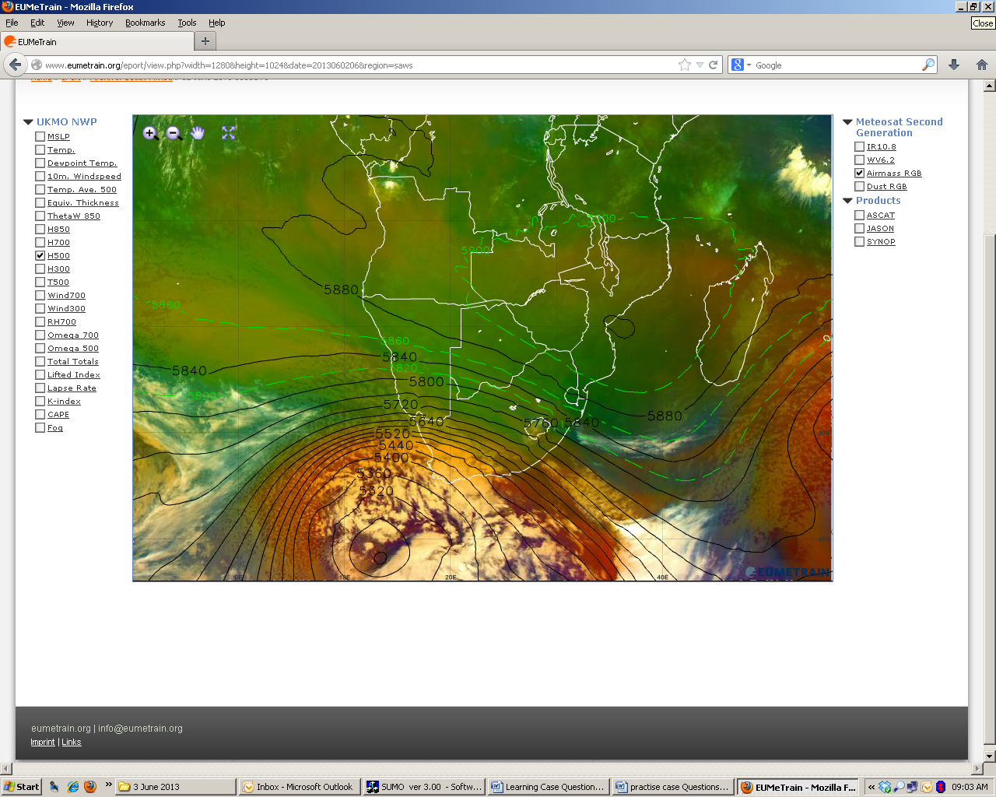
Diagnosing the hazard using satellite imagery
© Eumetsat
Airmass RGB
C
B
A
2013- Advanced Forecaster Course 18 July 2013
Notes:
Identify the possible location of a cold front?

Slide 6
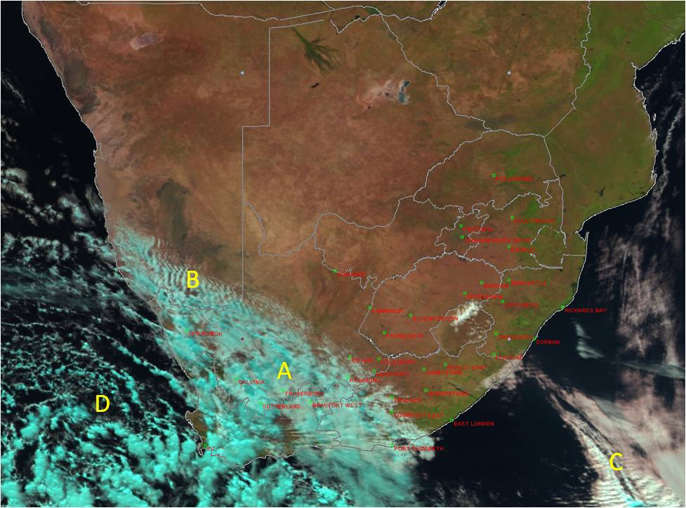
Day Natural Colours RGB
© Eumetsat
2013- Advanced Forecaster Course 18 July 2013
Notes:
When using satellite imagery alone, turbulent signatures can be identified as wave-like features oriented perpendicular (at right angles) to the dominant wind direction. At which points can turbulence be noted
A and B
A and C
B and C
A and D

Slide 7
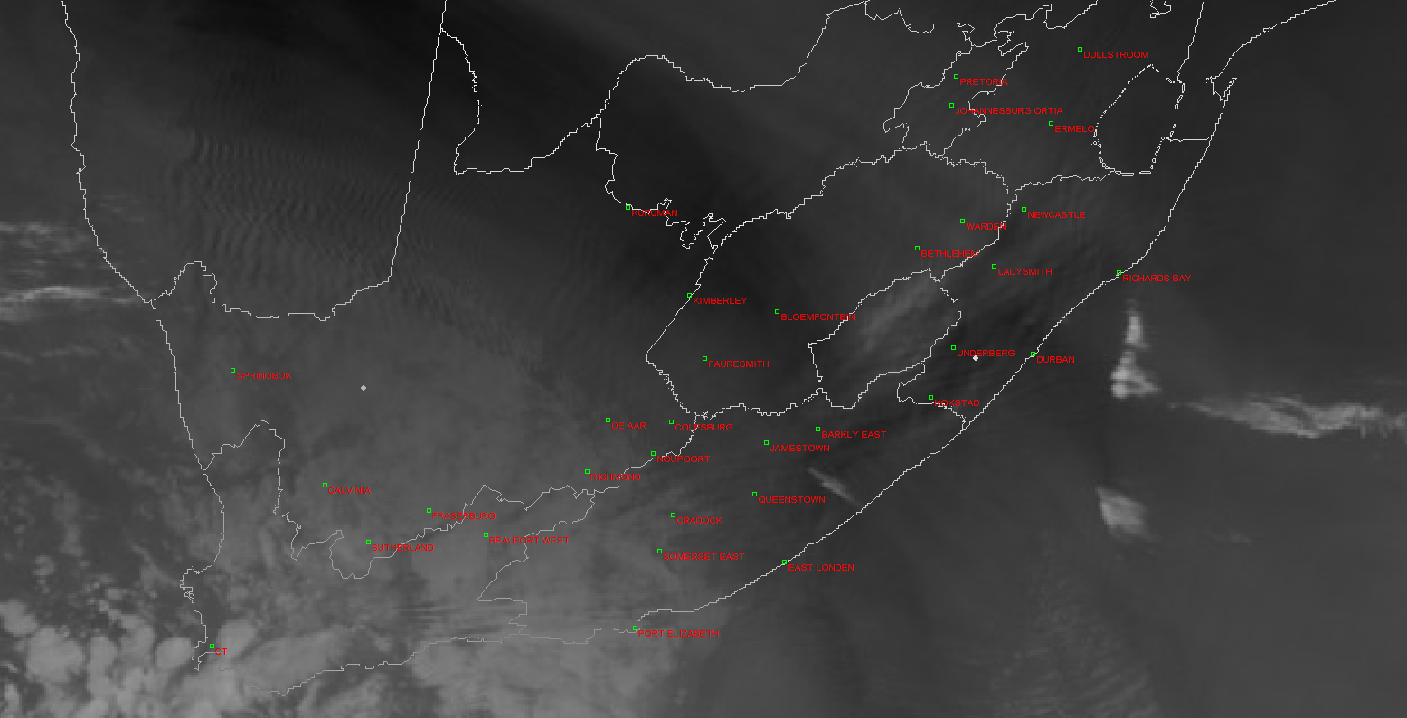
© Eumetsat
Water Vapour 6.2
Cloud free area
2013- Advanced Forecaster Course 18 July 2013
Notes:
However at the same time, areas devoid of cloud were indicating mid to upper level turbulence (Eastern cape). Indicate where possible turbulent signatures can be identified within the cloud free area.

Slide 8
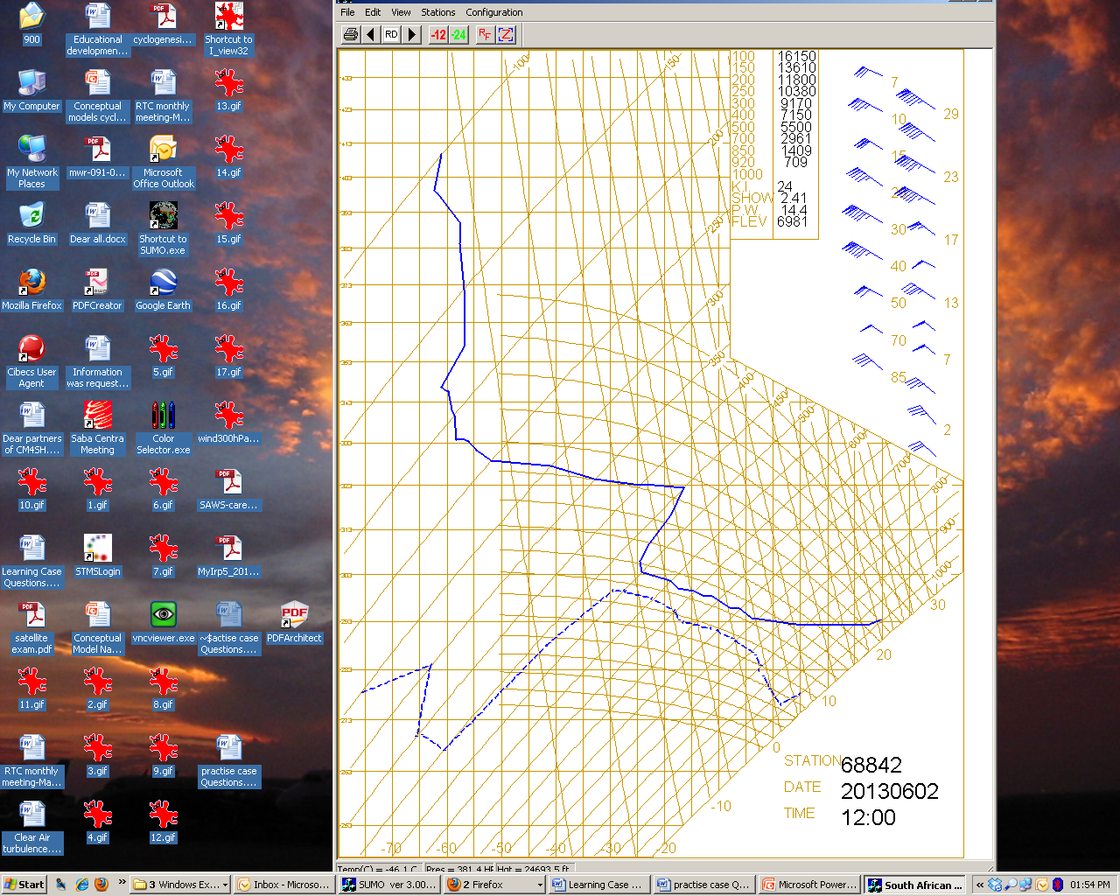
Diagnosing the hazard using vertical sounding
© SAWS
2013- Advanced Forecaster Course 18 July 2013
Notes:
What feature on this tephi gram could support mid to upper level turbulence?

Slide 9
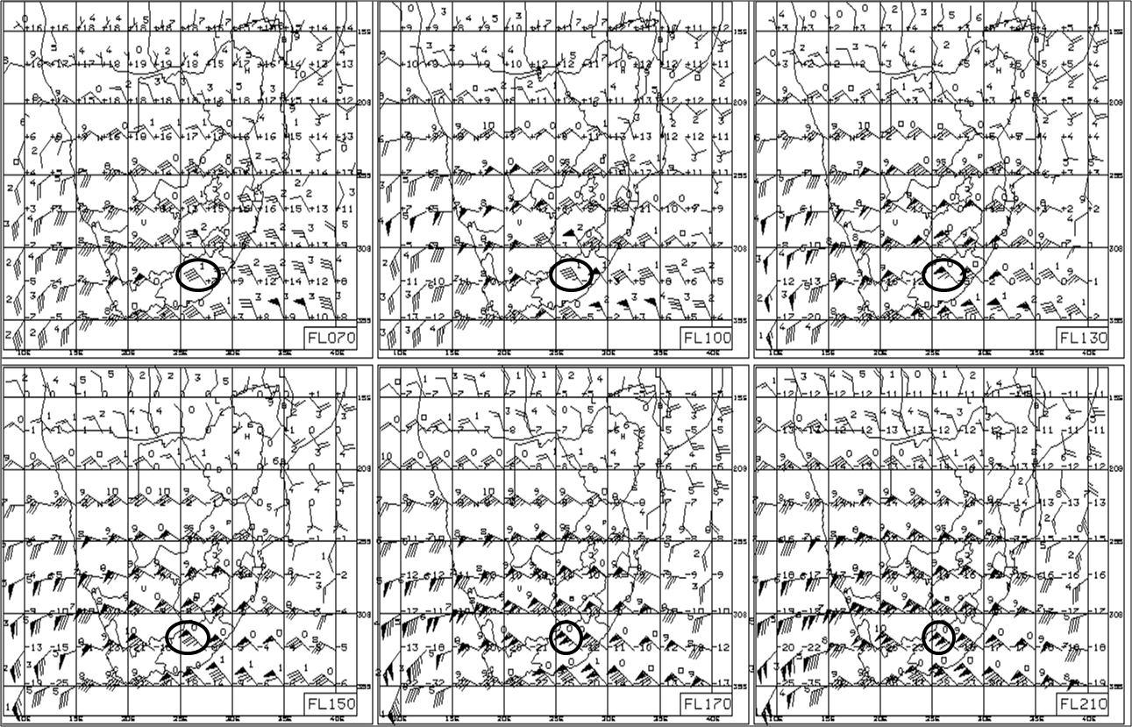
Diagnosing the hazard using NWP
5 kts per 1000 ft
7 kts per 1000 ft
10 kts per 1000 ft
2013- Advanced Forecaster Course 18 July 2013
Notes:
How many knots per 1000 ft is the wind shear in this example – correct answer is c)

Slide 10
Conclusion
WV imagery is very use full in identifying turbulent signatures in real time.
These can be further correlated with upper air soundings and NWP.
This provides a forecasting method for this hazard.

