Slide 1
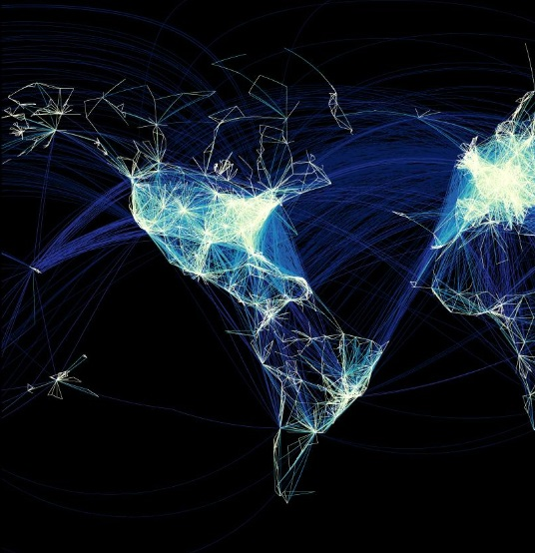
SIGMETS without PIREPs
Forecasting aviation weather hazards in a quiet airspace
Tom Adams and Chris Webster July 2015
Image by Michael Markieta based on 2011 data
Notes:
Few planes over NZZO, west of Aus, Pacific in general

Slide 2
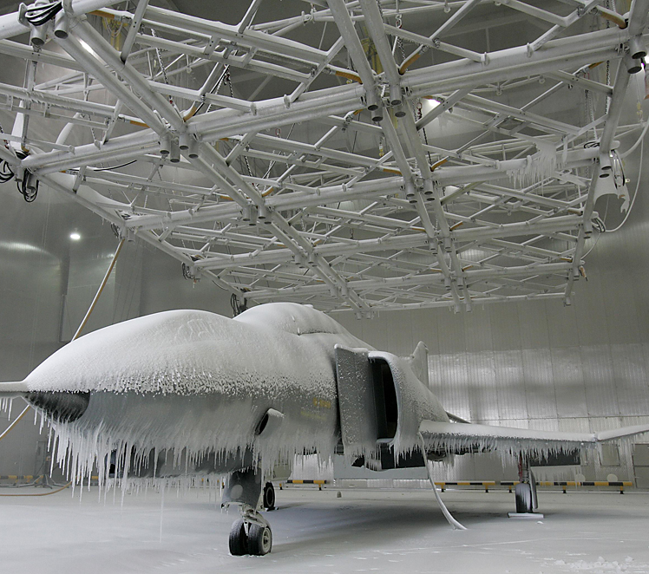
Introduction
What is significant aviation weather?
What forecasts are provided?
Types of observations
Forecasting methods over oceanic areas
Clear Air Turbulence
Icing

Slide 3
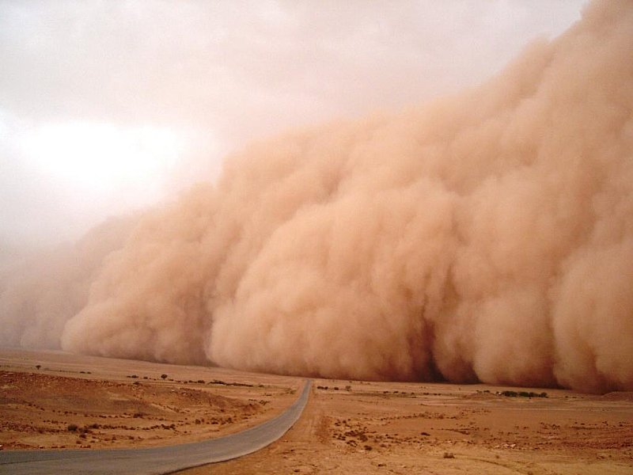
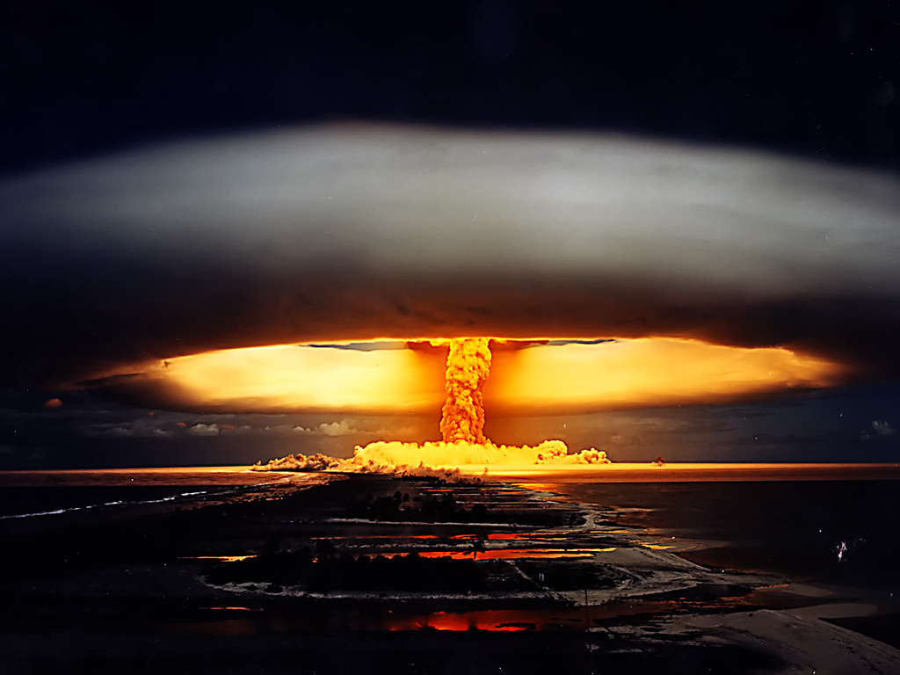
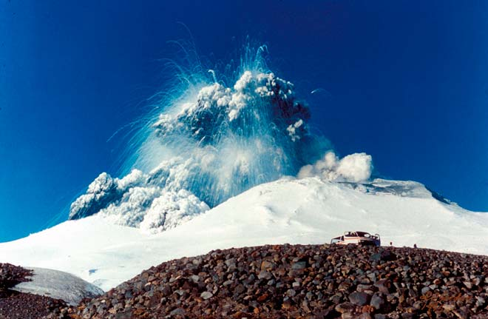
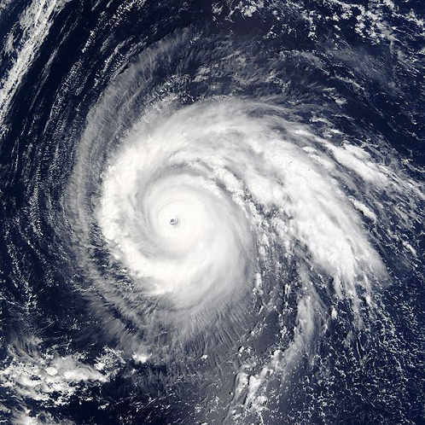
Notes:
What is sig wx? Dust and sand storms, radioactive clouds, volcanic ash clouds and tropical cyclones. These are not covered as have quite specialised procedures, except duststorms which haven’t got a clue about in NZ!

Slide 4
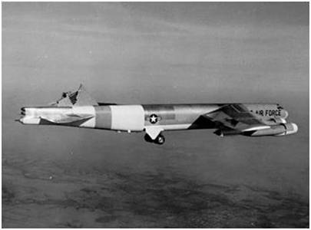
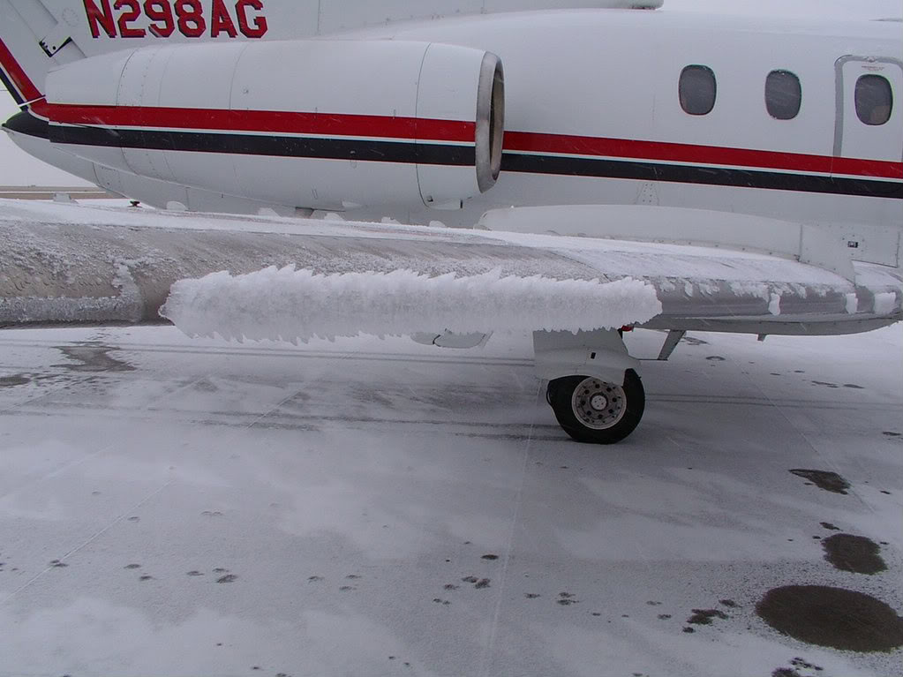
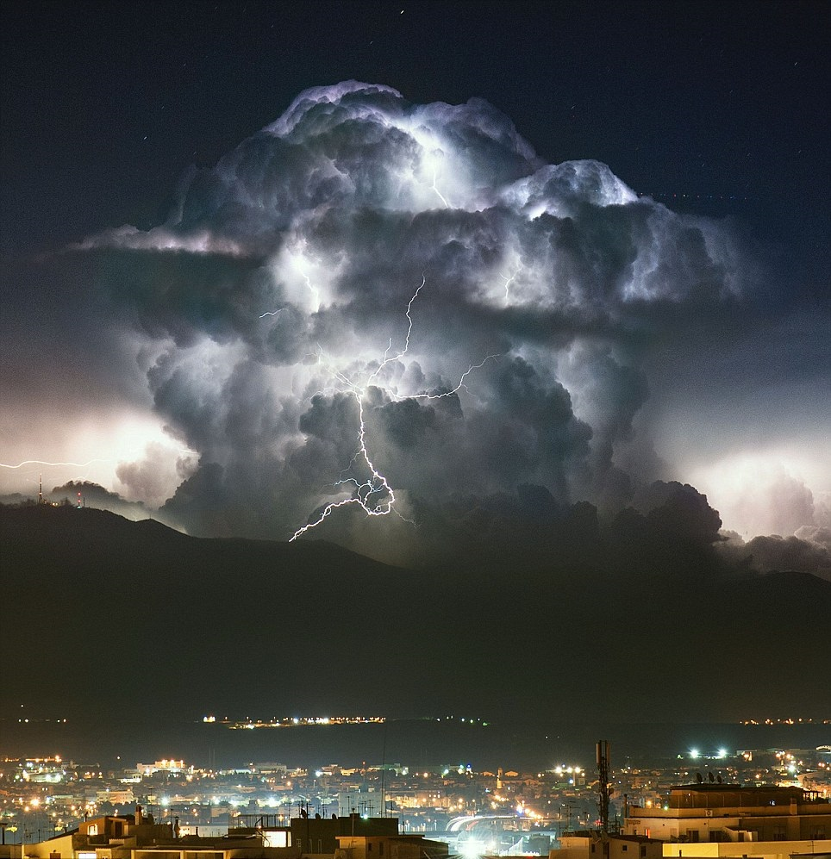
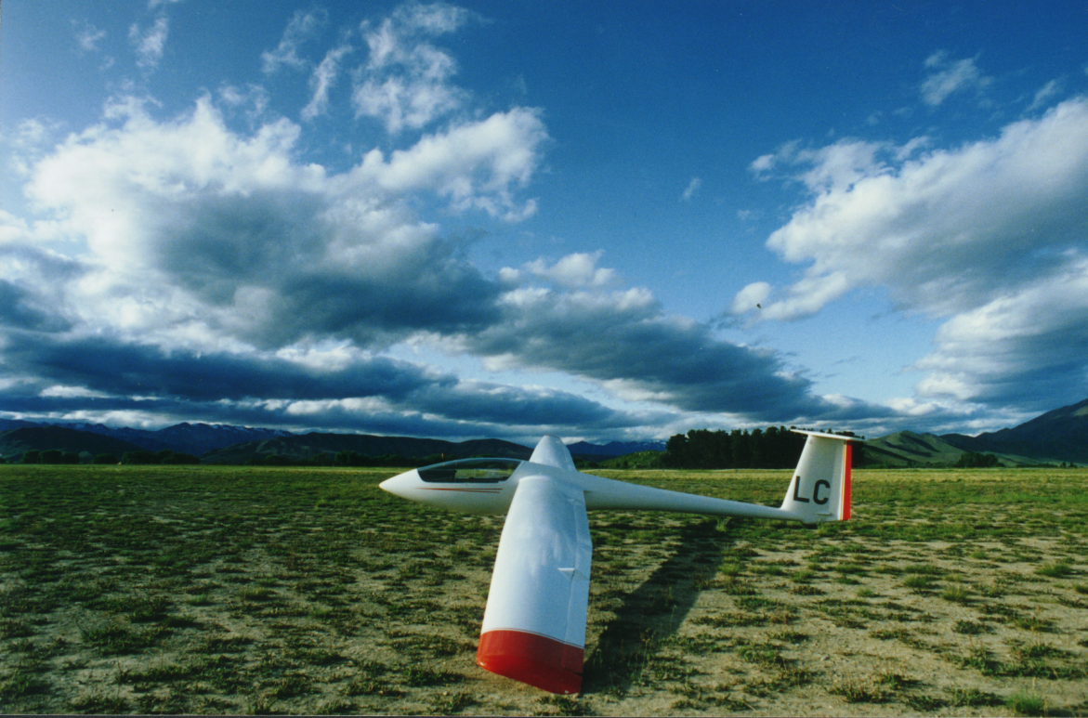
Notes:
Also turbulence (CAT + MTW), icing and thunderstorms. These are fairly common occurrences in the south pacific region.

Slide 5
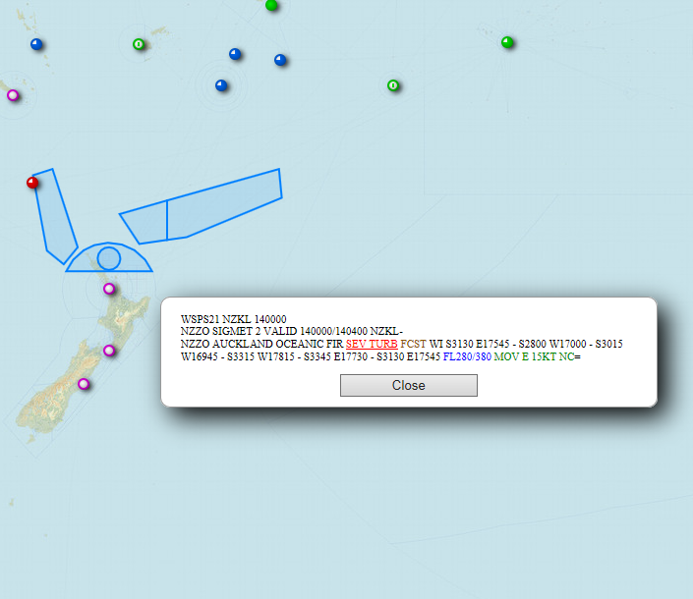
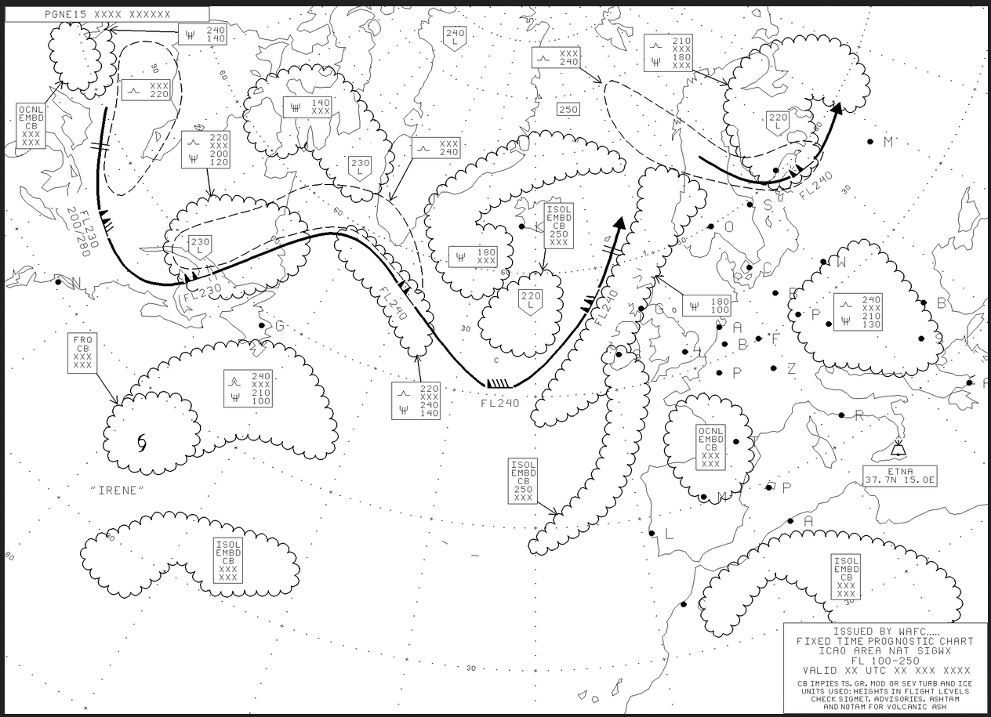
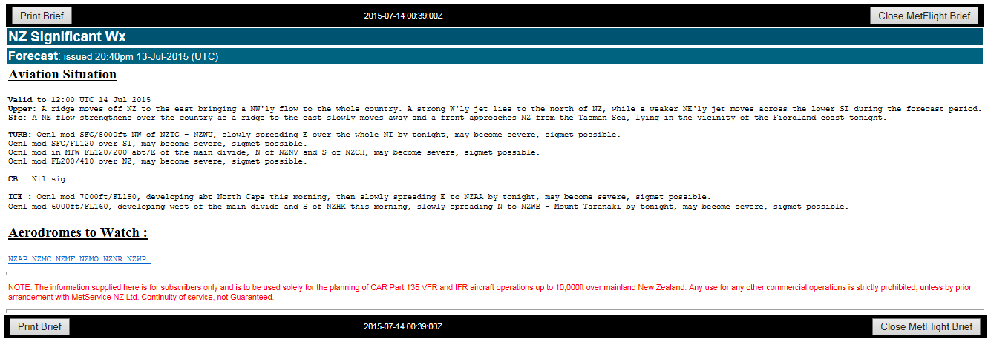
Notes:
How do we communicate this with pilots? Sigmets – validity 4 hours. Oceanic sig weather charts for +18hours, and domestic sig wx forecasts for +18ish. Elements of these also feed into other forecasts, e.g. TAFs and ARFORs.

Slide 6
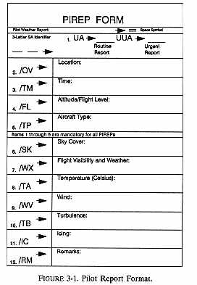
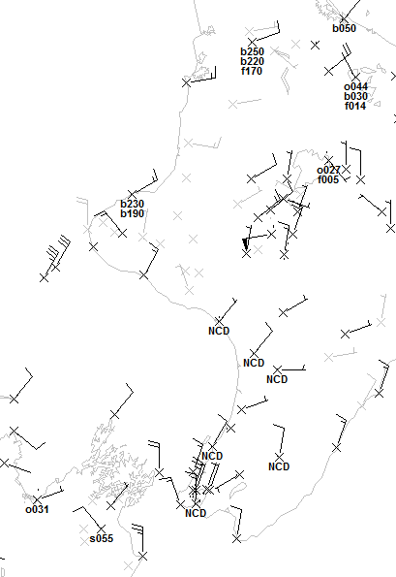
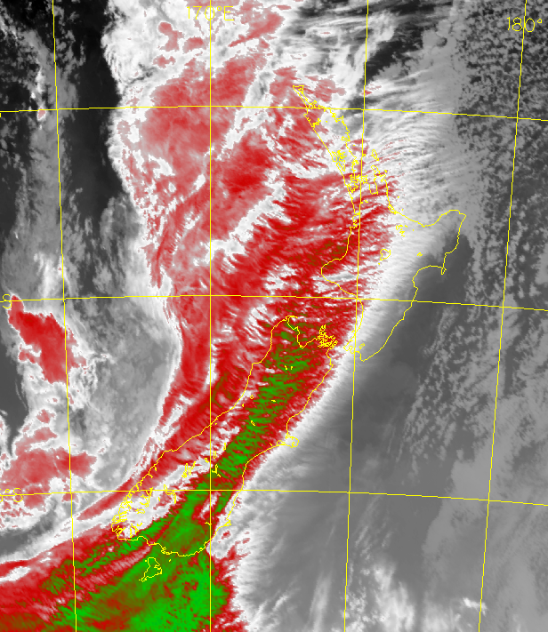
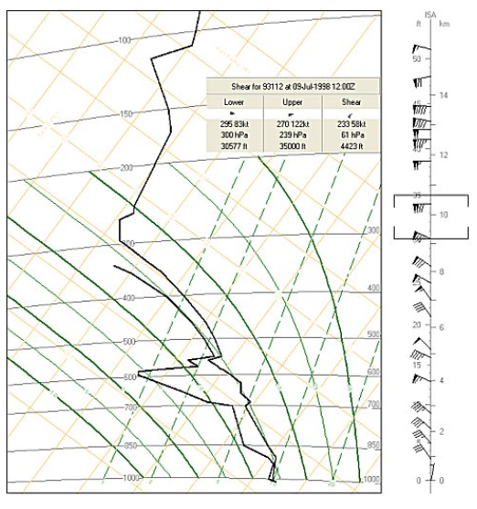
Surface observations
IR satellite imagery
Water vapour imagery
Tephigram
RaDAR cross section
Notes:
Forecast based on real observations. Pireps, radar, soundings, surface obs and satellite data (IR and WV). Best of these are direct obs – Pireps, CBs in sat data, high reflectivities above FZL in radar. Other indirect measures – signatures such as channel differencing in IR for SLW, transverse banding in IR for CAT, large vertical shears in soundings all give strong signals of sig wx. However, over oceanic areas only have satellite data. Much less to go on. Lack of verification can lead to systematic bias

Slide 7
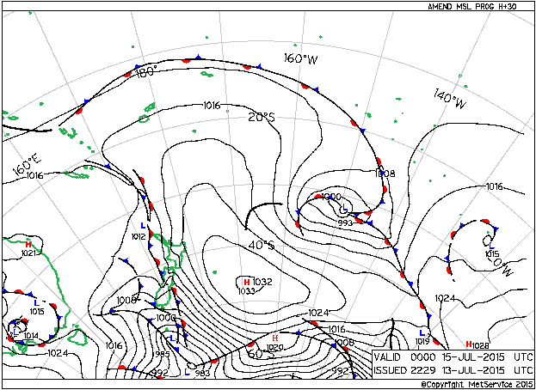
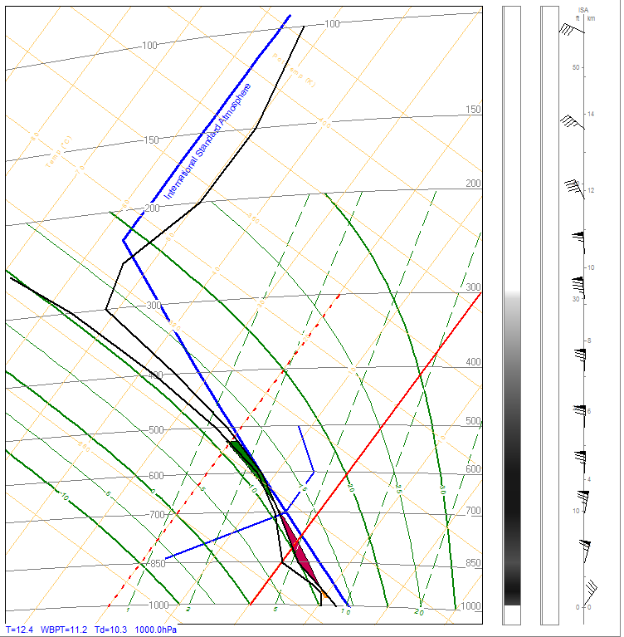
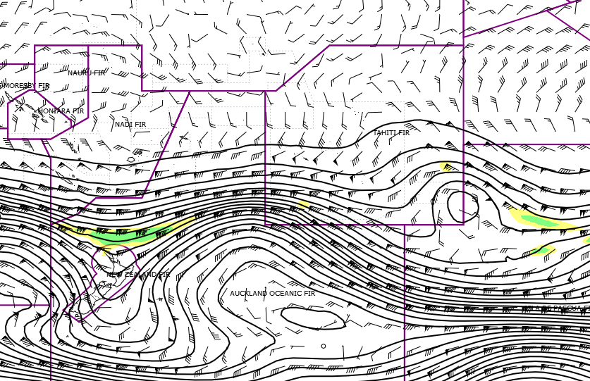
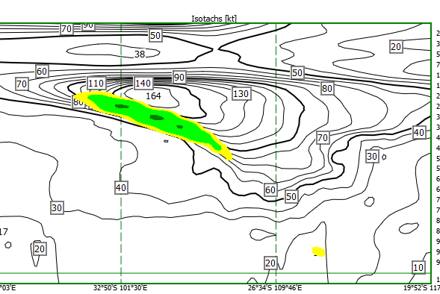
Surface synoptic situation
Tephigram
Geopotential height and Ellrod index
Cross section of isotachs and Ellrod index
Notes:
NWP. Synoptic situation. CAT on cold side of jet in X section (going S – N)

Slide 8
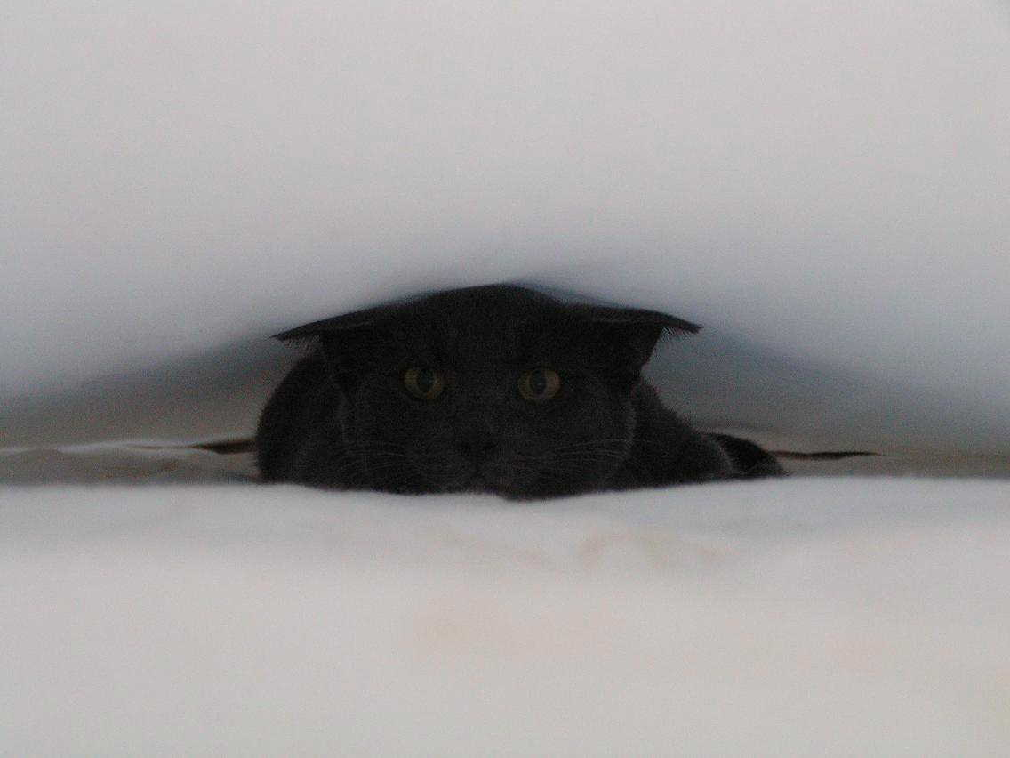
Clear Air Turbulence (CAT)
Courtesy of Matt Ford, cat expert

Slide 9
Clear Air Turbulence (CAT) Basic theory: Reynolds and Richardson
$$Reynolds number \left(Re\right)≈ \frac{inertial forces}{viscous forces}$$
Large momentum, small viscosity → Turbulence
Small Re leads to laminar flow, large Re turbulent flow.
$$Bulk Richardson Number (BRN)≈ \frac{Stability}{Vertical shear}$$
Large BRN good for convection but dissipates turbulence.
Small BRN good for CAT (good restoring force for eddies)
Notes:
Causes of turbulence
Turbulent vertical motions use gravity as restoring force so dissipate quickly in unstable conditions. Using variations of Richardson number for local gradients can accurately predict the onset of turbulence, but across large (bulk) scales harder as don’t know exact local gradients.

Slide 10
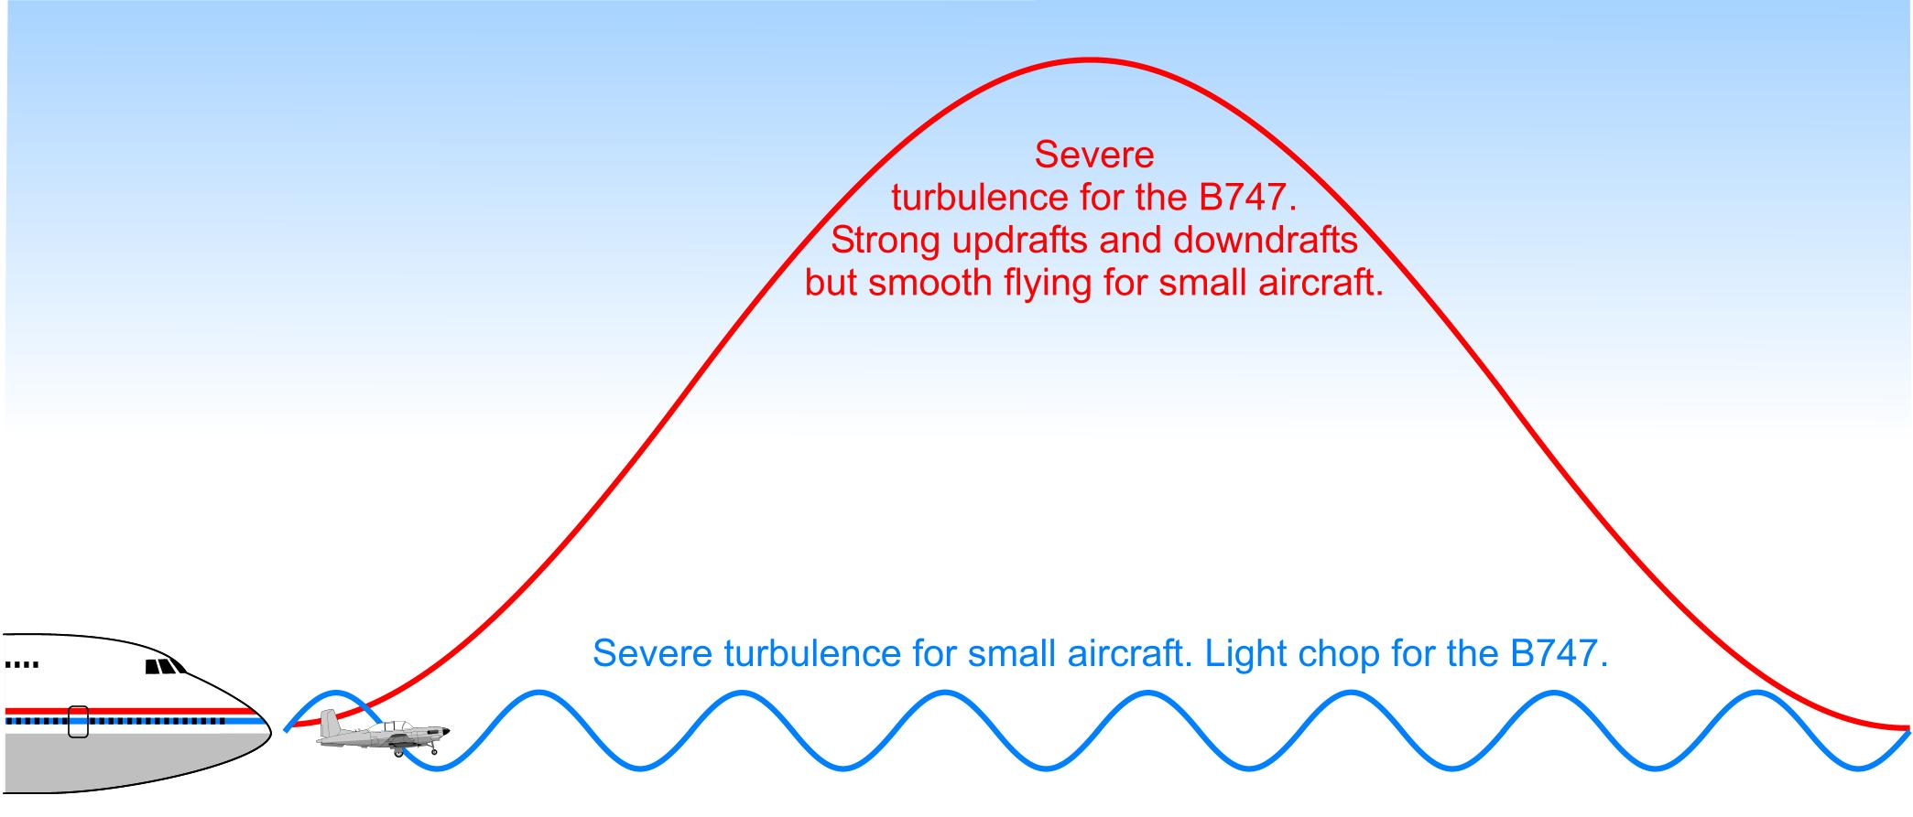
Clear Air Turbulence (CAT) Basic theory
Notes:
Turbulence occurs at many size scales simultaneously. If stable and shear enough, turbulence can build to size where effects aircraft. Can also contain components bigger than aircraft and not turb inducing

Slide 11
CAT Basic theory
Cat is dependant on local gradients at scales not explicitly modelled.
NWP does not explictly forecast CAT, just areas where CAT is likely.
Dutton, M. J. O. (1980). PROBABILITY FORECASTS OF CLEAR-AIR TURBULENCE BASED ON NUMERICAL-MODEL OUTPUT. Meteorological Magazine, 109(1299), 293-306.
In a large-scale turbulence survey in 1976, it was found that if one aeroplane reported moderate or severe CAT in a 100km x 100km region, another aeroplane flying through the same region within an hour would only have a 23% chance of also experiencing mod-severe CAT. This probability reduced to only 4% by three hours.
Dutton 1980

Slide 12
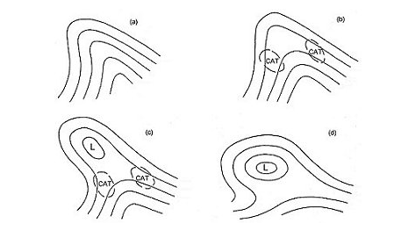
CAT Forecasting
Upper flows with typical CAT locations (S.H.)
IR satellite imagery
Water vapour imagery
Notes:
Use satellite imagery and synoptic situation (good info on web more detail), essentially looking where fluid stressed, check with WV.

Slide 13
CAT Forecasting
CAT is a function of:
Vertical wind shear
Stability
Divergence
Stretching deformation
Shearing deformation
Rate of change of divergence
Rate of change of stability Horizontal wind shear
Wind speed
Richardson number
1883 – Reynolds Number
1920s – Richardson number
1973 – Brown number
1976 – Sparks number
1980 – Dutton number
1992 – Ellrod TI1
1992 – Ellrod TI2
2006 – GTG2
2010 – Ellrod-Knox DTI
2011 - TBindex
Notes:
None of these parameters directly observable right through the atmosphere (cloud motion vectors only few areas and heights). Going to use NWP if going to be effective. Forecaster can’t look at all these fields individually (physical parameters), each implies a probability when looked at in conjunction with others. Use combined index which are always empirically based (in thresholds if not in formulation). Commercial aircraft really kicked off in the 50s+60s hence interest in 70s.

Slide 14
CAT Forecasting
CAT is a function of:
Vertical wind shear
Stability
Divergence
Stretching deformation
Shearing deformation
Rate of change of divergence
Rate of change of stability Horizontal wind shear
Wind speed
Richardson number
1883 – Reynolds Number
1920s – Richardson number
1973 – Brown number
1976 – Sparks number
1980 – Dutton number
1992 – Ellrod TI1
1992 – Ellrod TI2
2006 – GTG2
2010 – Ellrod-Knox DTI
2011 - TBindex
Physics
Notes:
None of these parameters directly observable right through the atmosphere (cloud motion vectors only few areas and heights). Going to use NWP if going to be effective. Forecaster can’t look at all these fields individually (physical parameters), each implies a probability when looked at in conjunction with others. Use combined index which are always empirically based (in thresholds if not in formulation). Commercial aircraft really kicked off in the 50s+60s hence interest in 70s.

Slide 15
CAT Forecasting
Regression
CAT is a function of:
Vertical wind shear
Stability
Divergence
Stretching deformation
Shearing deformation
Rate of change of divergence
Rate of change of stability Horizontal wind shear
Wind speed
Richardson number
1883 – Reynolds Number
1920s – Richardson number
1973 – Brown number
1976 – Sparks number
1980 – Dutton number
1992 – Ellrod TI1
1992 – Ellrod TI2
2006 – GTG2
2010 – Ellrod-Knox DTI
2011 - TBindex
Notes:
None of these parameters directly observable right through the atmosphere (cloud motion vectors only few areas and heights). Going to use NWP if going to be effective. Forecaster can’t look at all these fields individually (physical parameters), each implies a probability when looked at in conjunction with others. Use combined index which are always empirically based (in thresholds if not in formulation). Commercial aircraft really kicked off in the 50s+60s hence interest in 70s.

Slide 16
CAT Forecasting
CAT is a function of:
Vertical wind shear
Stability
Divergence
Stretching deformation
Shearing deformation
Rate of change of divergence
Rate of change of stability Horizontal wind shear
Wind speed
Richardson number
1883 – Reynolds Number
1920s – Richardson number
1973 – Brown number
1976 – Sparks number
1980 – Dutton number
1992 – Ellrod TI1
1992 – Ellrod TI2
2006 – GTG2
2010 – Ellrod-Knox DTI
2011 - TBindex
Index regression
Notes:
None of these parameters directly observable right through the atmosphere (cloud motion vectors only few areas and heights). Going to use NWP if going to be effective. Forecaster can’t look at all these fields individually (physical parameters), each implies a probability when looked at in conjunction with others. Use combined index which are always empirically based (in thresholds if not in formulation). Commercial aircraft really kicked off in the 50s+60s hence interest in 70s.

Slide 17
CAT Forecasting
Environmental wind profile
Altitude
Modelled pressure level
Modelled wind profile
Wind speed

Slide 18
CAT Forecasting
Environmental wind profile
Altitude
Modelled pressure level
Modelled wind profile
Wind speed

Slide 19
CAT Forecasting
Environmental wind profile
Altitude
Modelled pressure level
Modelled wind profile
Wind speed

Slide 20
CAT Forecasting Summary
CAT is rare. 1973 study found severe CAT in 0.013% of air kms (507km out of 3.9 million km of flight) Sparks (1976)
Are there continuous areas across multiple pressure levels?
Know where your indices came from.
Are they still applicable?
Are the thresholds up to date?
Sparks, W. R., Cornford, S. G., & Gibson, J. K. (1976). Bumpiness in clear air and its relation to some synoptic-scale indices. HM Stationery Office.
Turbulence thresholds for the Ellrod Index
 | AWC/NOAA | Visual Weather / Wikipedia
Light-Mod | 24 | 4
Mod | 32 | 12
Mod-Severe | 48-64 | 16
Notes:
0.013% fact – like travelling round the world 100 times and only encountering sev turb once as you crossed over NSW. Less bias as back then forecasted CAT over about 20% of airspace so less flying around it!

Slide 21
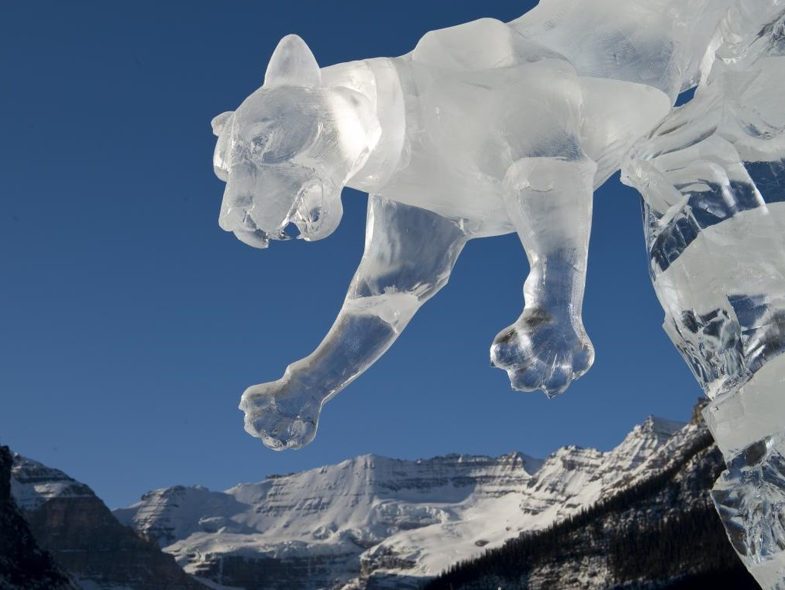
Aircraft Icing

Slide 22
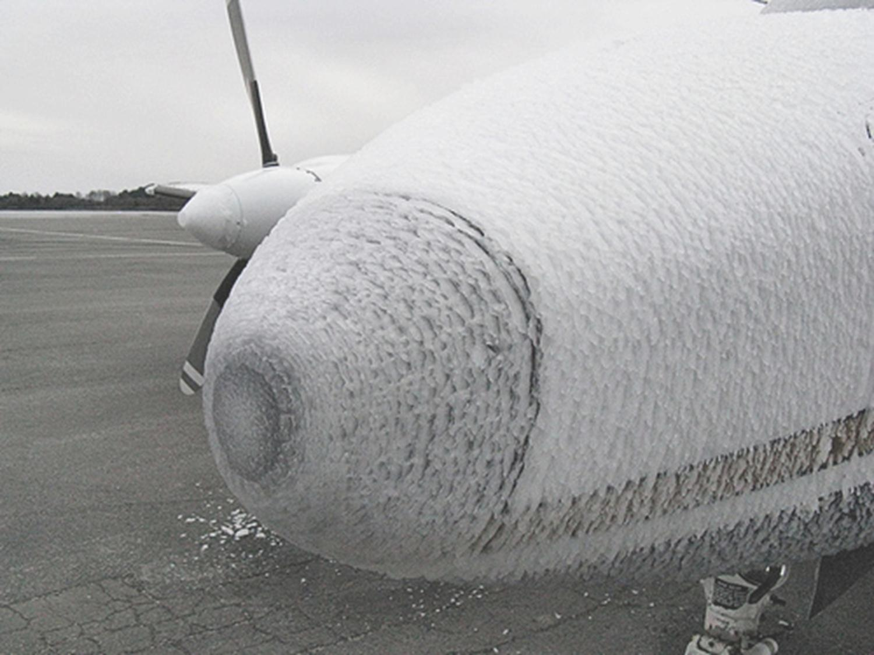
Aircraft Icing – basic theory
Without freezing nuclei, water can remain liquid when cooled to -40C. It is common to find supercooled liquid water (SLW) at -20C in the atmosphere.
Aircraft are such a nucleus. SLW in the atmosphere freezes on the aircraft.

Slide 23
Aircraft Icing – basic theory
Aircraft icing is a function of :
Moisture content
Temperature
Droplet phase
Collection efficiency
Collection rate
Droplet size
Upwards motion
Notes:
Can measure RH + temp by satellite with soundings (with error), and to a lesser degree droplet phase + size which can be used as a proxy for collection efficiency. Upwards motion is hard to derive, but much needed parameter, and used as proxy for collection rate. In short, need high concentrations of SLW, or moderate concentrations and decent upwards motion.

Slide 24
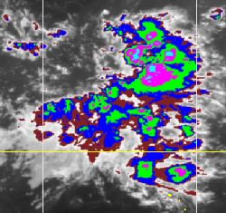
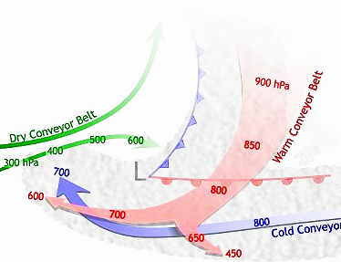
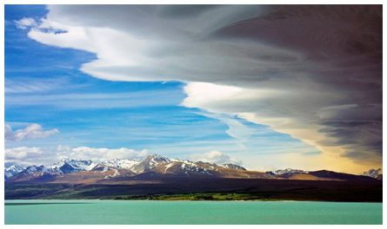
Aircraft Icing – Basic theory
Icing set-ups:
Strong vertical motion: CBs, TCUs, orographic lifting
High moisture content: Warm conveyors
Untrapped mountain wave cloud
IR satellite imagery
Notes:
As dealing with oceanic icing, not covering MTWs.

Slide 25
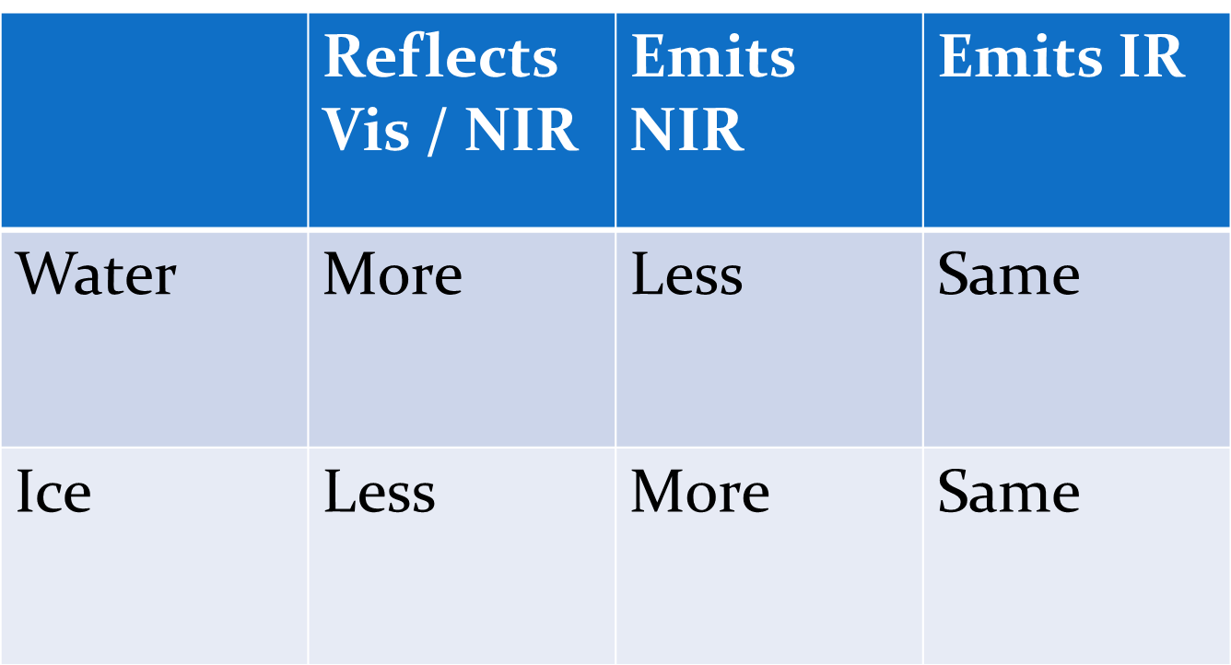
Icing – satellite indicators
Channel differencing (BTD) methods:
Commonly used 3.7µm - 11µm (Ch2 – Ch4) < 0 for fog actually showing liquid water clouds.
If a cloud is liquid, colder than -3C, and deep then it is an icing risk.
Notes:
BTD better for smaller droplet sizes (e.g. fog). Droplet size increases with height within a cloud.
New channels for Himawari 8 may show this better? No idea?
Study over NZZC this stratiform case nearly always obscured by ice cloud due to strong upwards motion.

Slide 26
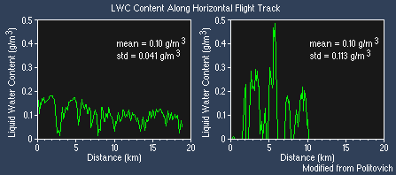
Icing - NWP
Two examples of actual LWC variations along a horizontal flight path in stratiform clouds from Comet Module "Icing Type and Severity"
Just like CAT, icing not explicitly resolved in NWP.
All we can forecast is areas of high icing probability from NWP fields.
Deeper moisture more likely to contain icing.
Notes:
Moisture content very variable within a cloud (icing very patchy). IR soundings with footprints of several kms won’t resolve the pockets of high LWC necessary for icing. Also know convection scale smaller than most NWP models, so won’t be explicitly resolved either

Slide 27
Icing - NWP
Indicators:
Depth of moisture between 0 and -20C
Strong upwards motion
Some combined NWP indices exist
1951 – -8D index (Moisture and temperature, T < -8(T-T_{d}))
1990 – Swedish Index A (moisture content)
1999 – Swedish Index B (moisture and upwards motion)
But RH, temperature and upwards motion work OK individually as long as you think in 3 dimensions.
Notes:
Think three dimensionally – explore as many pressure levels as possible.

Slide 28
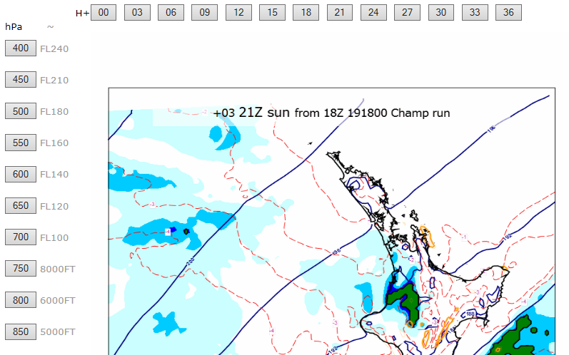
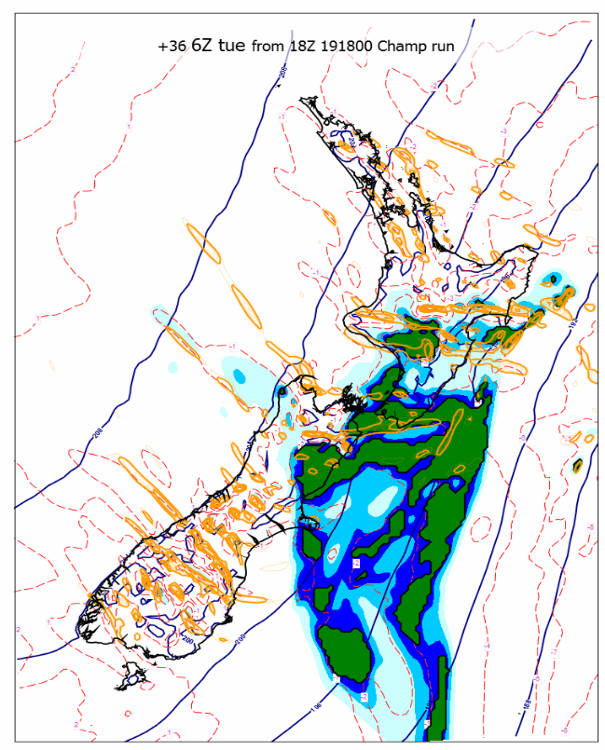
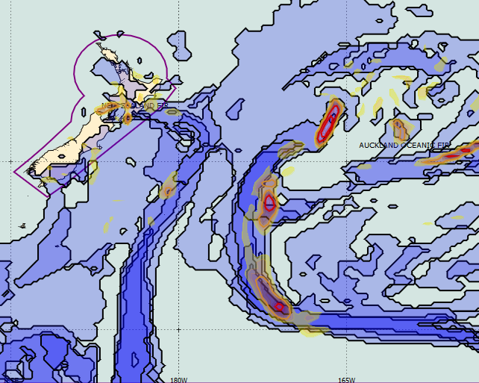
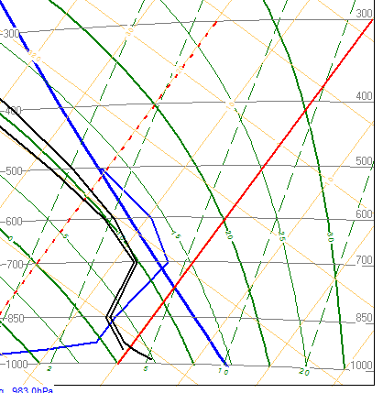
Icing - NWP
International -8D guidance
at multiple levels
Tephigram
with -8D line
Domestic -8D guidance
Notes:
Examples of guidance used at Metservice – High res -8D from local WRF models and global 8D with 8D overlay on tephigram.

Slide 29
Icing Forecasting Summary
Satellite imagery useful for:
Cloud top phase
Cloud top temperature
Be careful that liquid water isn’t hidden by ice
NWP information:
Temperature
Moisture content (RH)
Upwards motion
NWP useful, but think in three dimensions.

Slide 30
Forecasting examples…..

Slide 31
Equations:
CAT:
Dutton = 1.25.HWS + 0.25.VWS² + 10.5
Ellrod: TI1 = VWS x DEF
TI2 = VWS x (DEF + α x CVG).
EKI = (VWS x DEF) + Cx(ΔDIV / ΔT).
Icing:
8D = T < -8(T-T_{d})
Notes:
Note on 8D. T-Td always negative, but will be closer to zero when very saturated. So if very saturated for low T, conditions will be met.

