Slide 1
Weather Briefing South Africa
July 2015

Slide 2
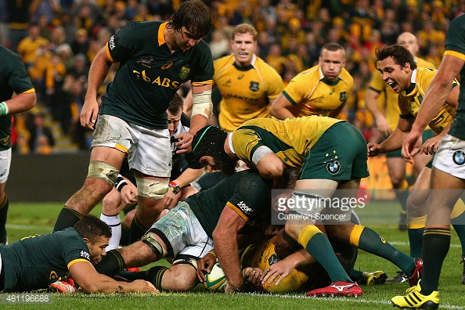

Slide 3
Agenda
Looking back at the previous months weather
Looking ahead

Slide 4
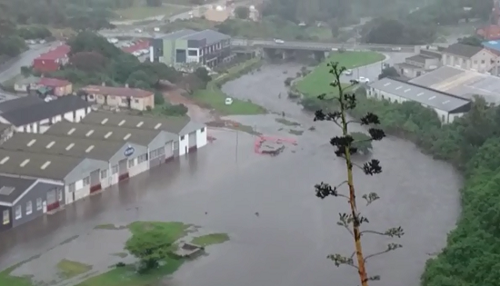

Slide 5
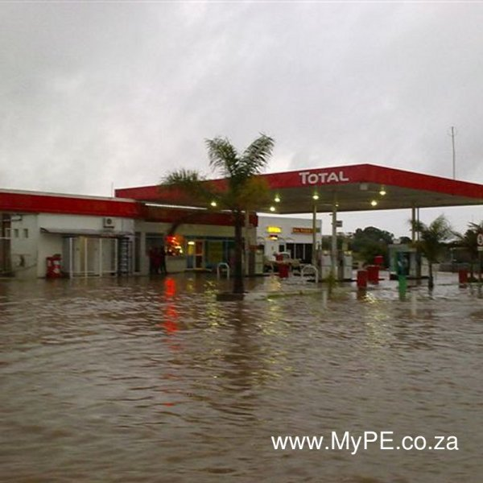
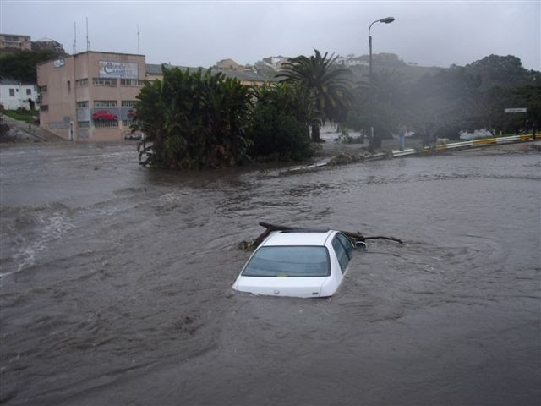

Slide 6
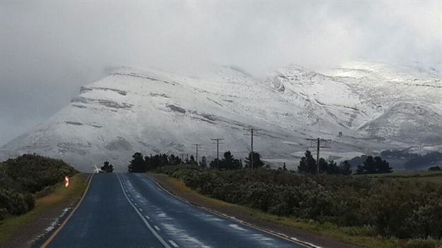
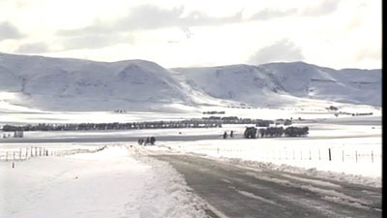

Slide 7
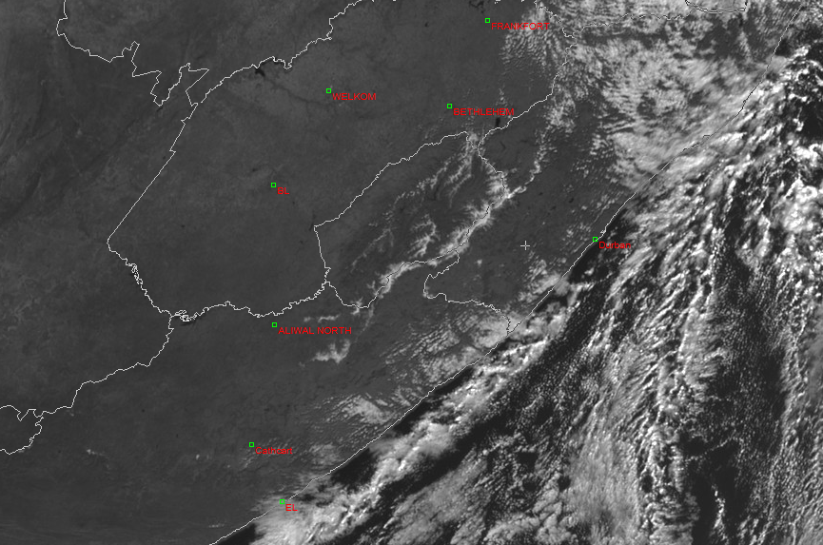

Slide 8
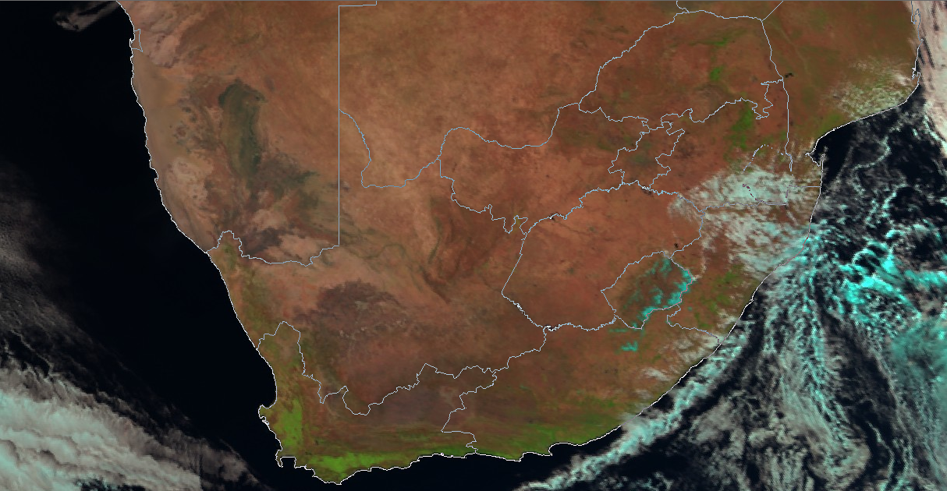
Day natural colours 26 July

Slide 9
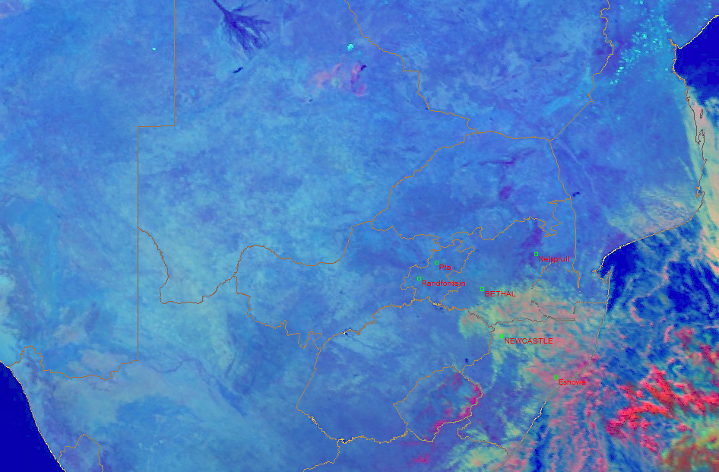
Day microphysical (2;4r;9)

Slide 10
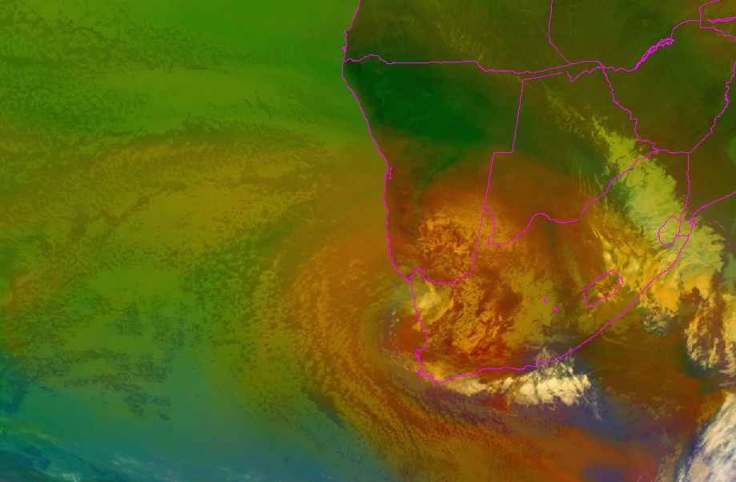
Airmass RGB 24 July (5-6;8-9;5i)

Slide 11
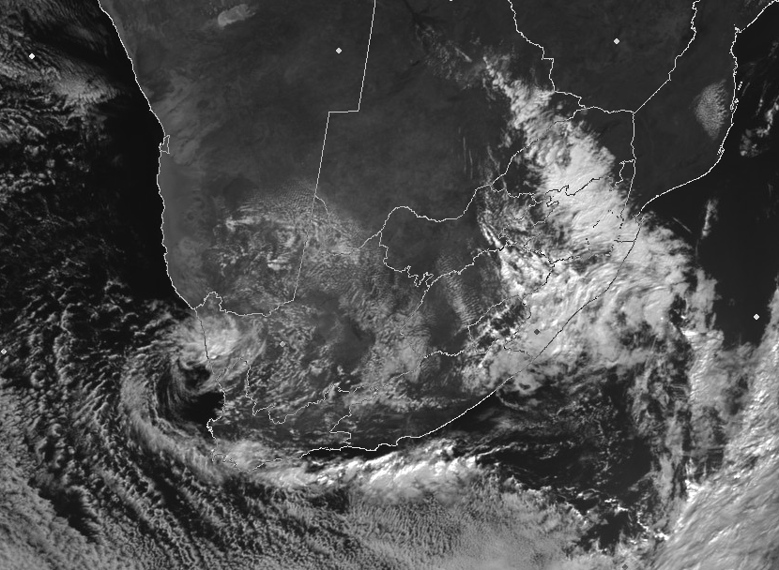
VIS 0.6 24 July

Slide 12
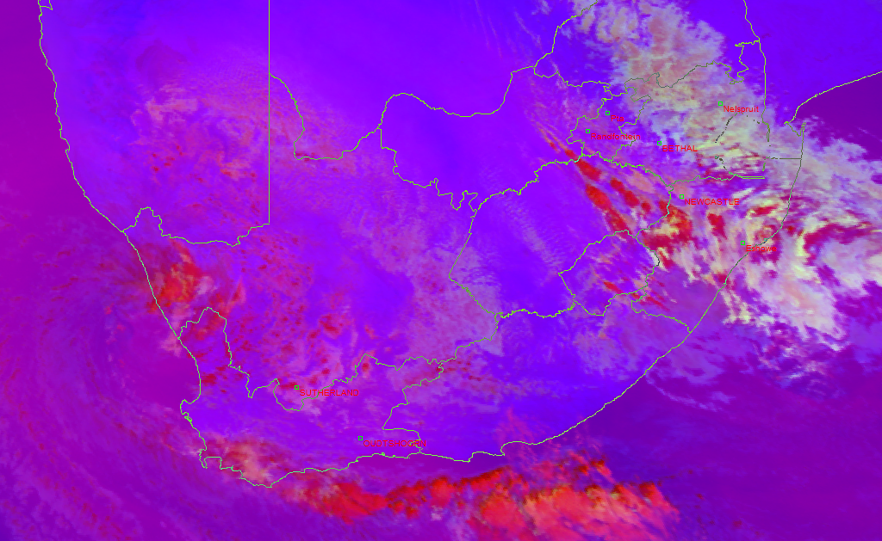
Convective storms 24 July (5-6;4-9;3-1)

Slide 13
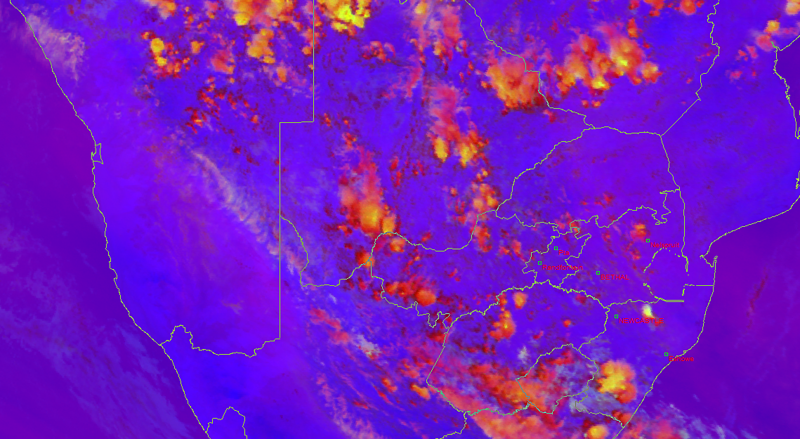
Convective storms 3 January 2011

Slide 14
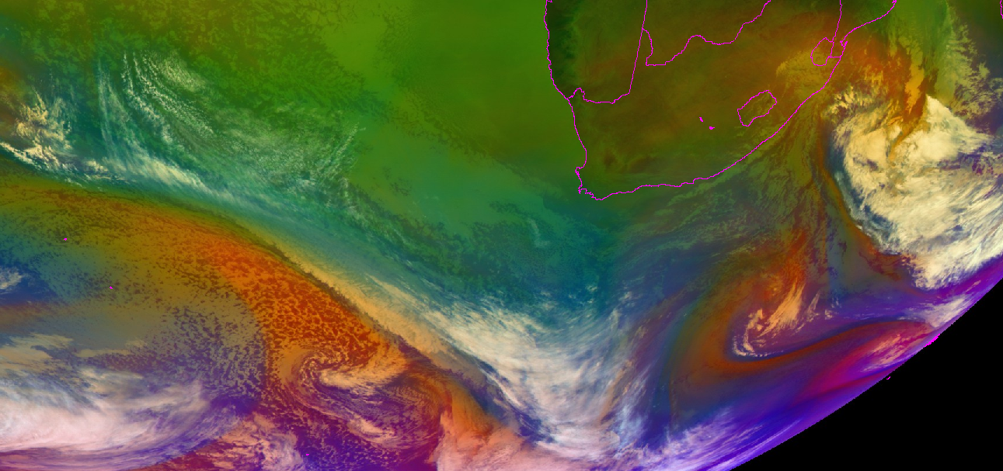
25 July Airmass RGB

Slide 15
What are these systems?

Slide 16
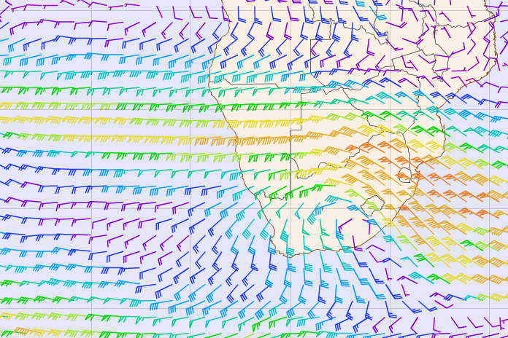
300hPa winds

Slide 17
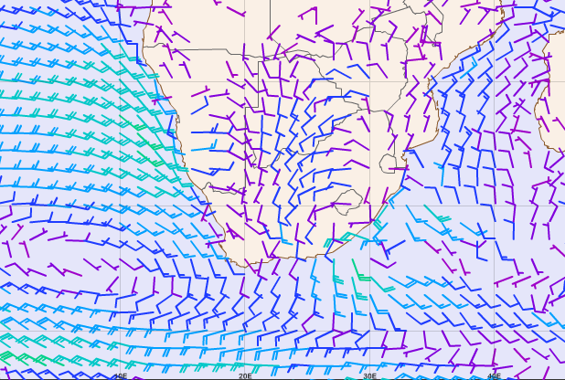
10m Wind

Slide 18
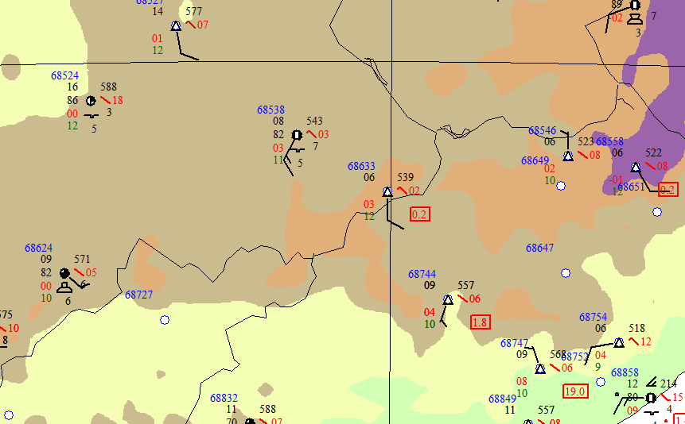
25 July 12UTC

Slide 19
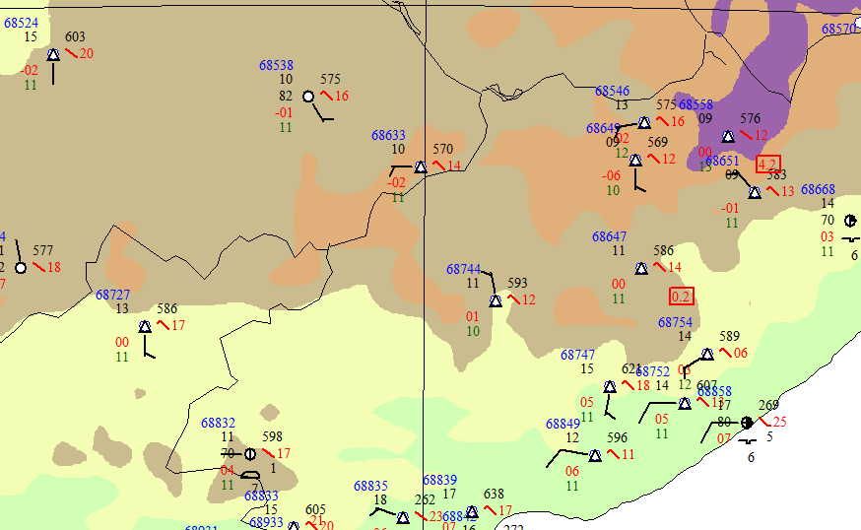
26 July 12UTC

Slide 20
27 July 12UTC

Slide 21
Looking ahead

Slide 22
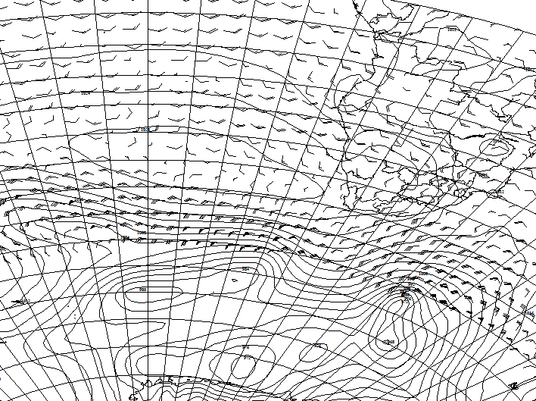
Friday

Slide 24
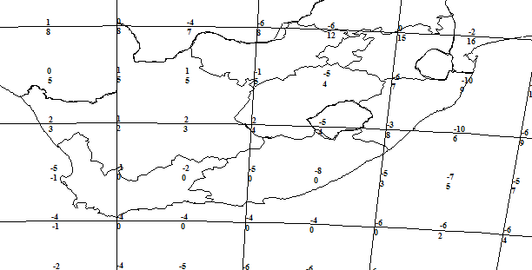

Slide 25
Next Session
21 August 1000UTC

