Slide 1
Implementation of Himawari-8
into Bureau Operations
27th July 2015
Denis Margetic
Satellite Operations Manager
Himawari-8 Project Director

Slide 2
Project Overview

Slide 3
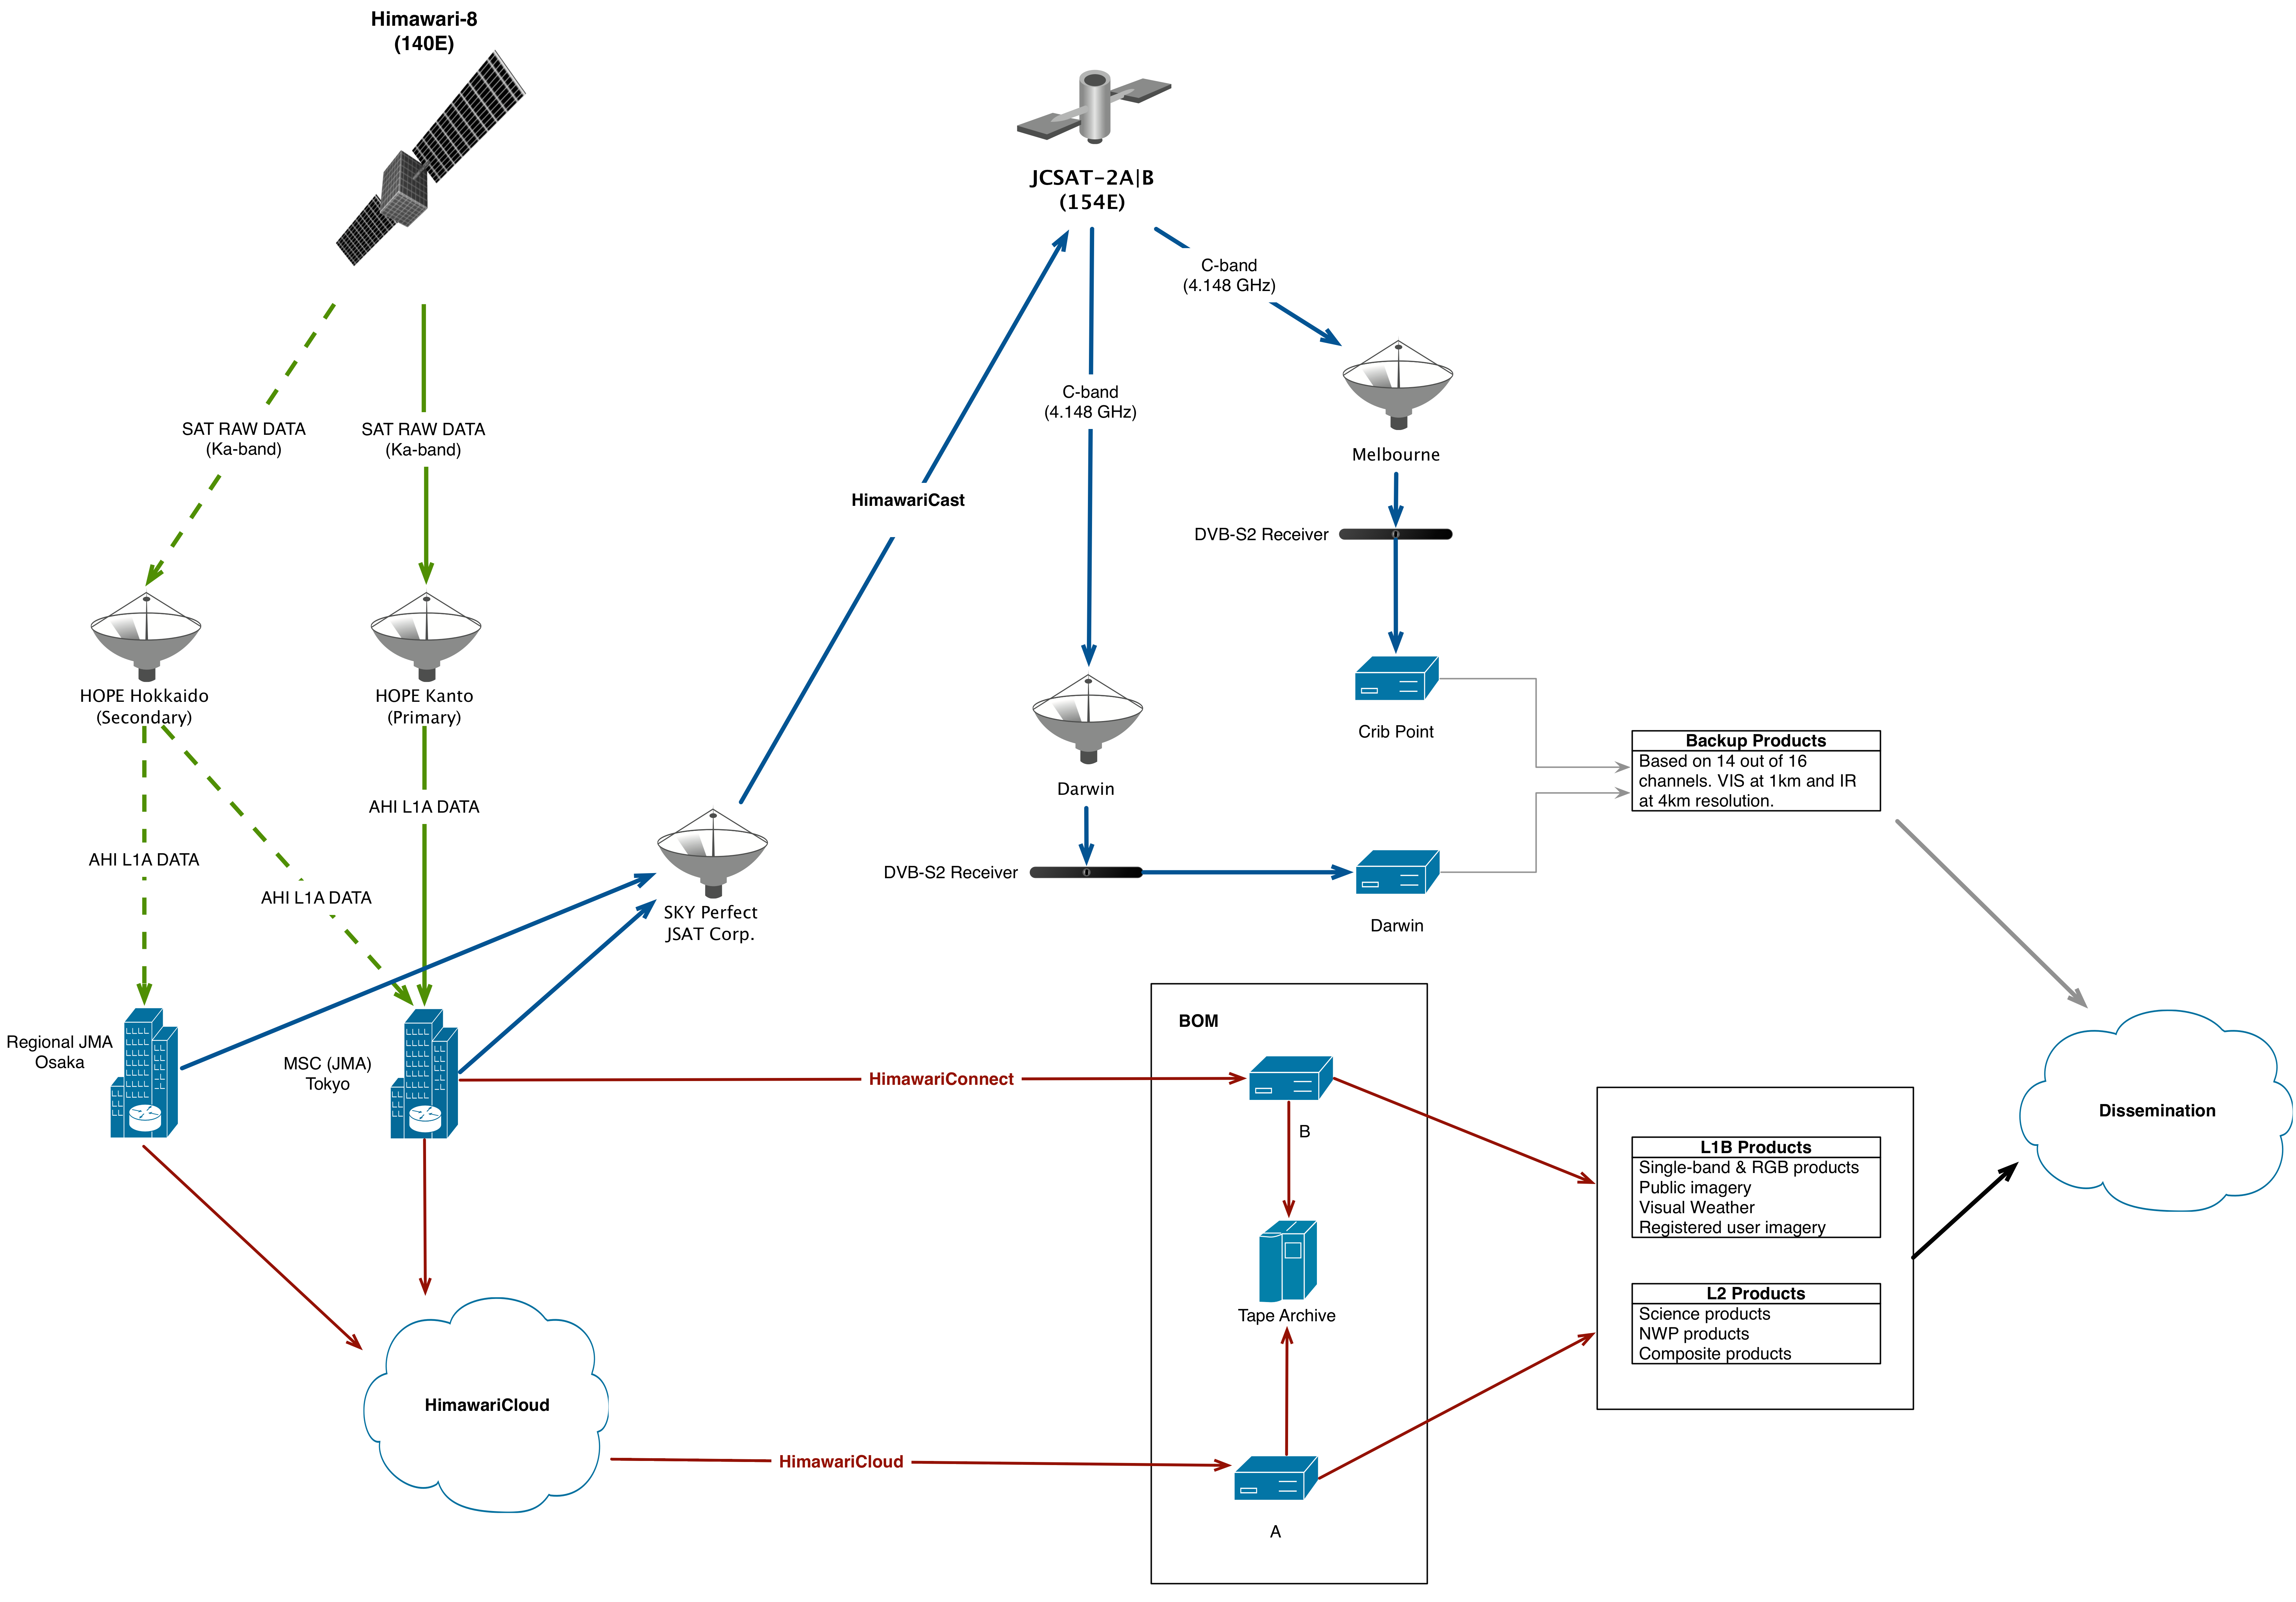

Slide 4
Project Update
Data Communications
HimawariCloud operational - optimisations ongoing
HimawariConnect (direct connection) expected mid August
HimawariCast expected in September
Application Development
Basic imagery/RGB products – application development completed
Quantitative products – application development well underway
Computer Processing Infrastructure
Initial Product Generation System operational
Expansion of the Product Generation System continuing throughout August

Slide 5
Products for Forecasters
Basic Imagery

Slide 6
Products for Forecasters
False Colour RGB Products
WMO endorsed false-colour RGB products derived from individual AHI bands:
24-hour microphysical
airmass
day microphysical
night microphysical
day convection
snow/fog natural colours

Slide 7
Products for Forecasters
L2 (quantitative) Products
Transitional:
Cloud characteristics
Fog and low cloud
Volcanic ash detection
SST
Atmospheric Motion Vectors
Innovative:
Advanced Dvorak analysis
Overshooting tops
Convective initiation
Aircraft icing potential
Early storm warning (research)

Slide 8
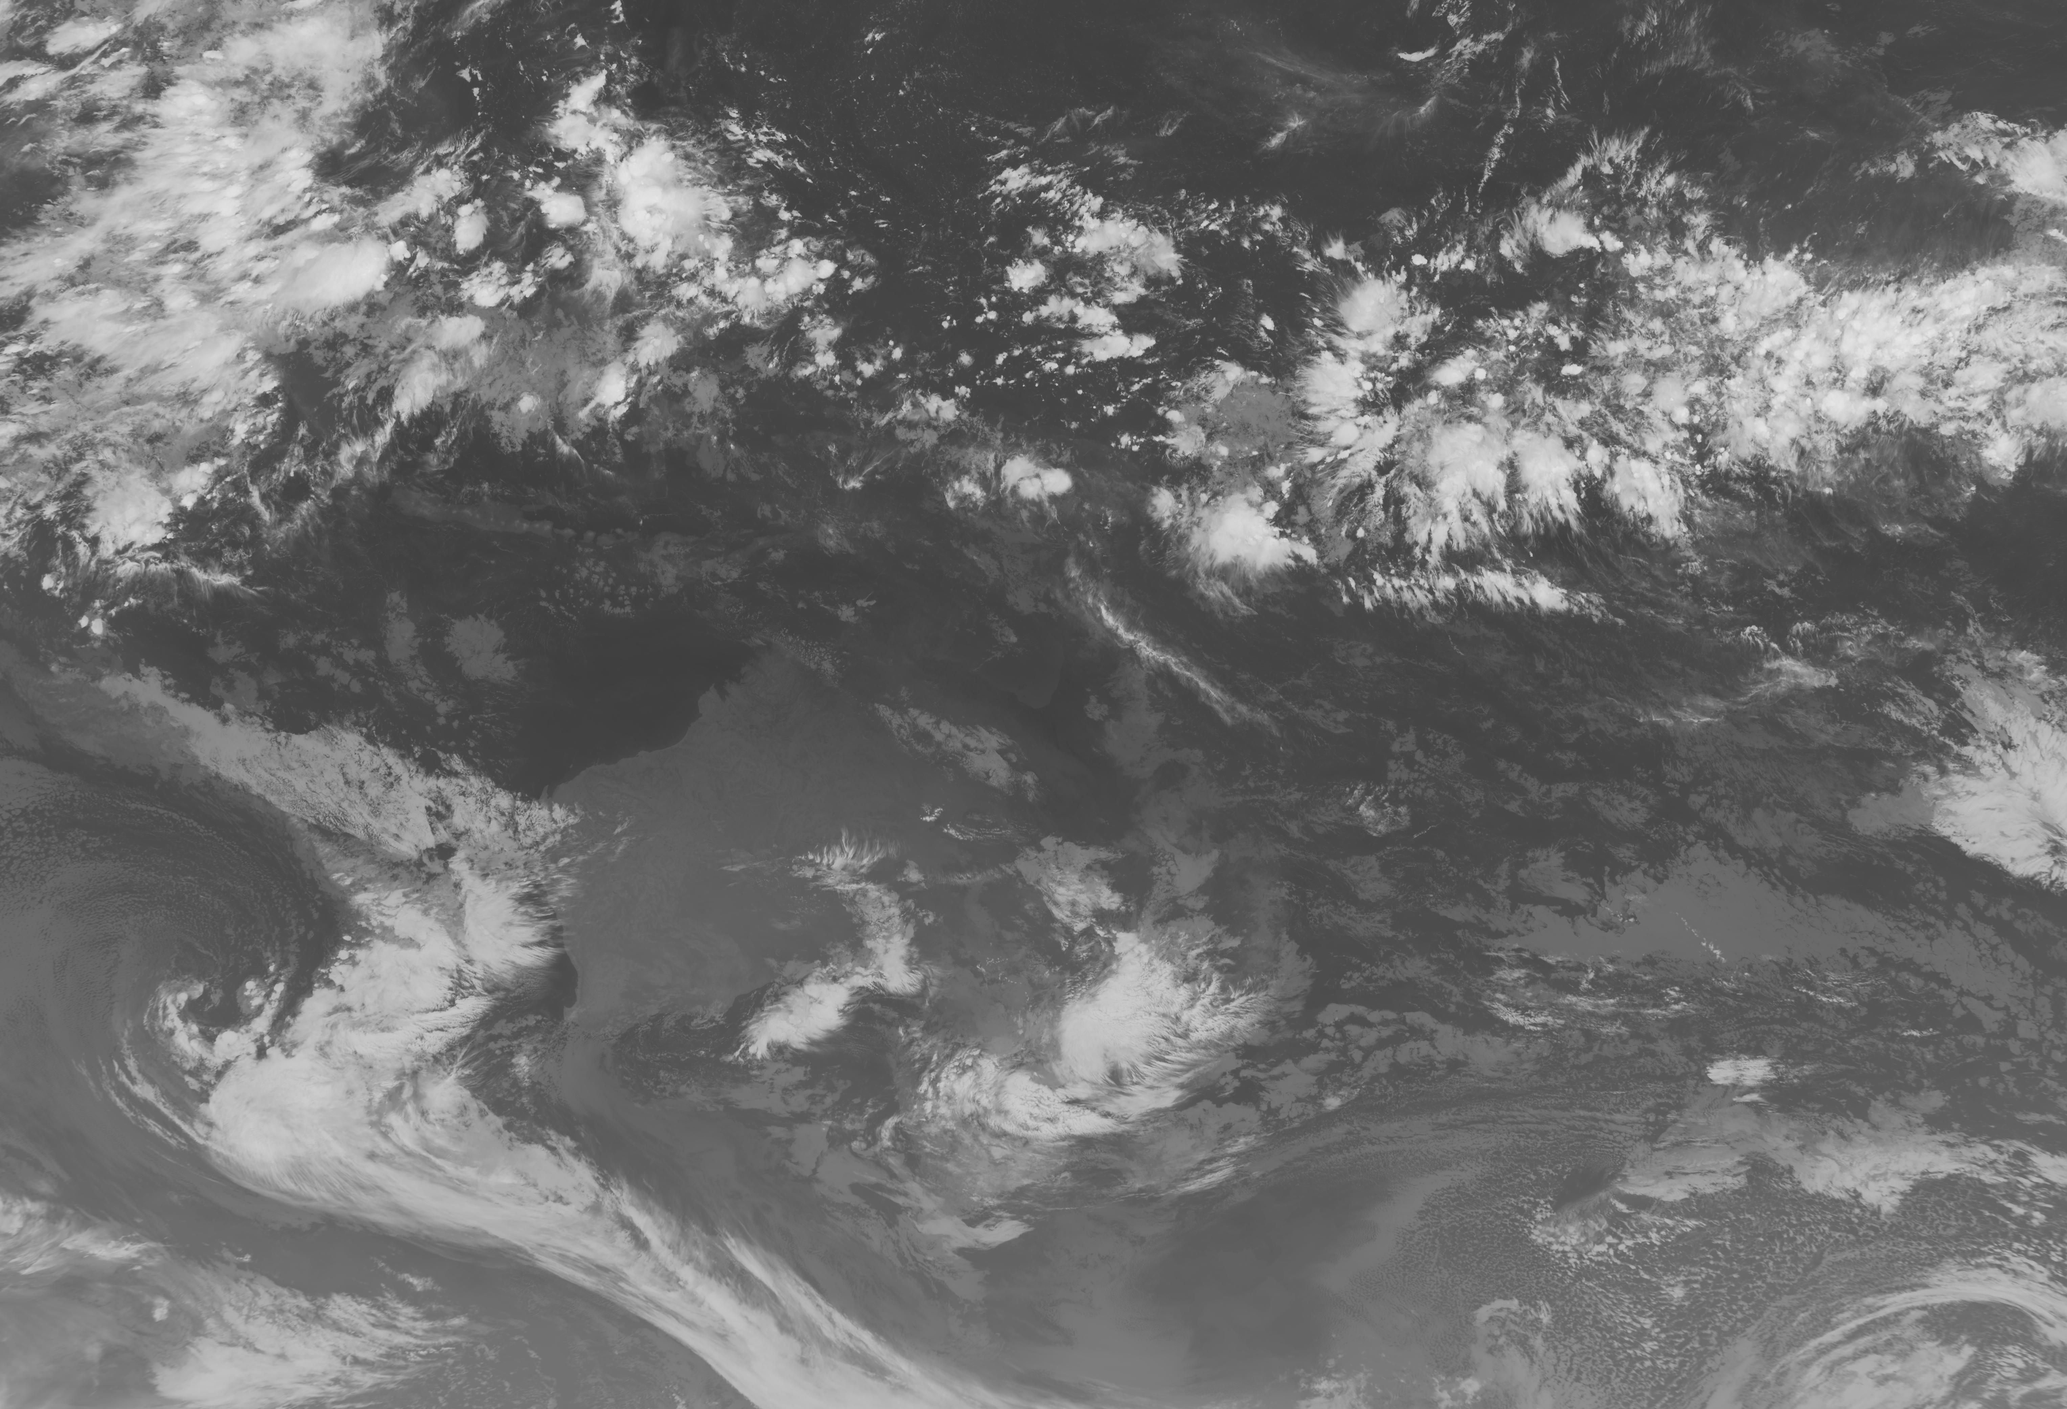
Products for Australian Public

Slide 9
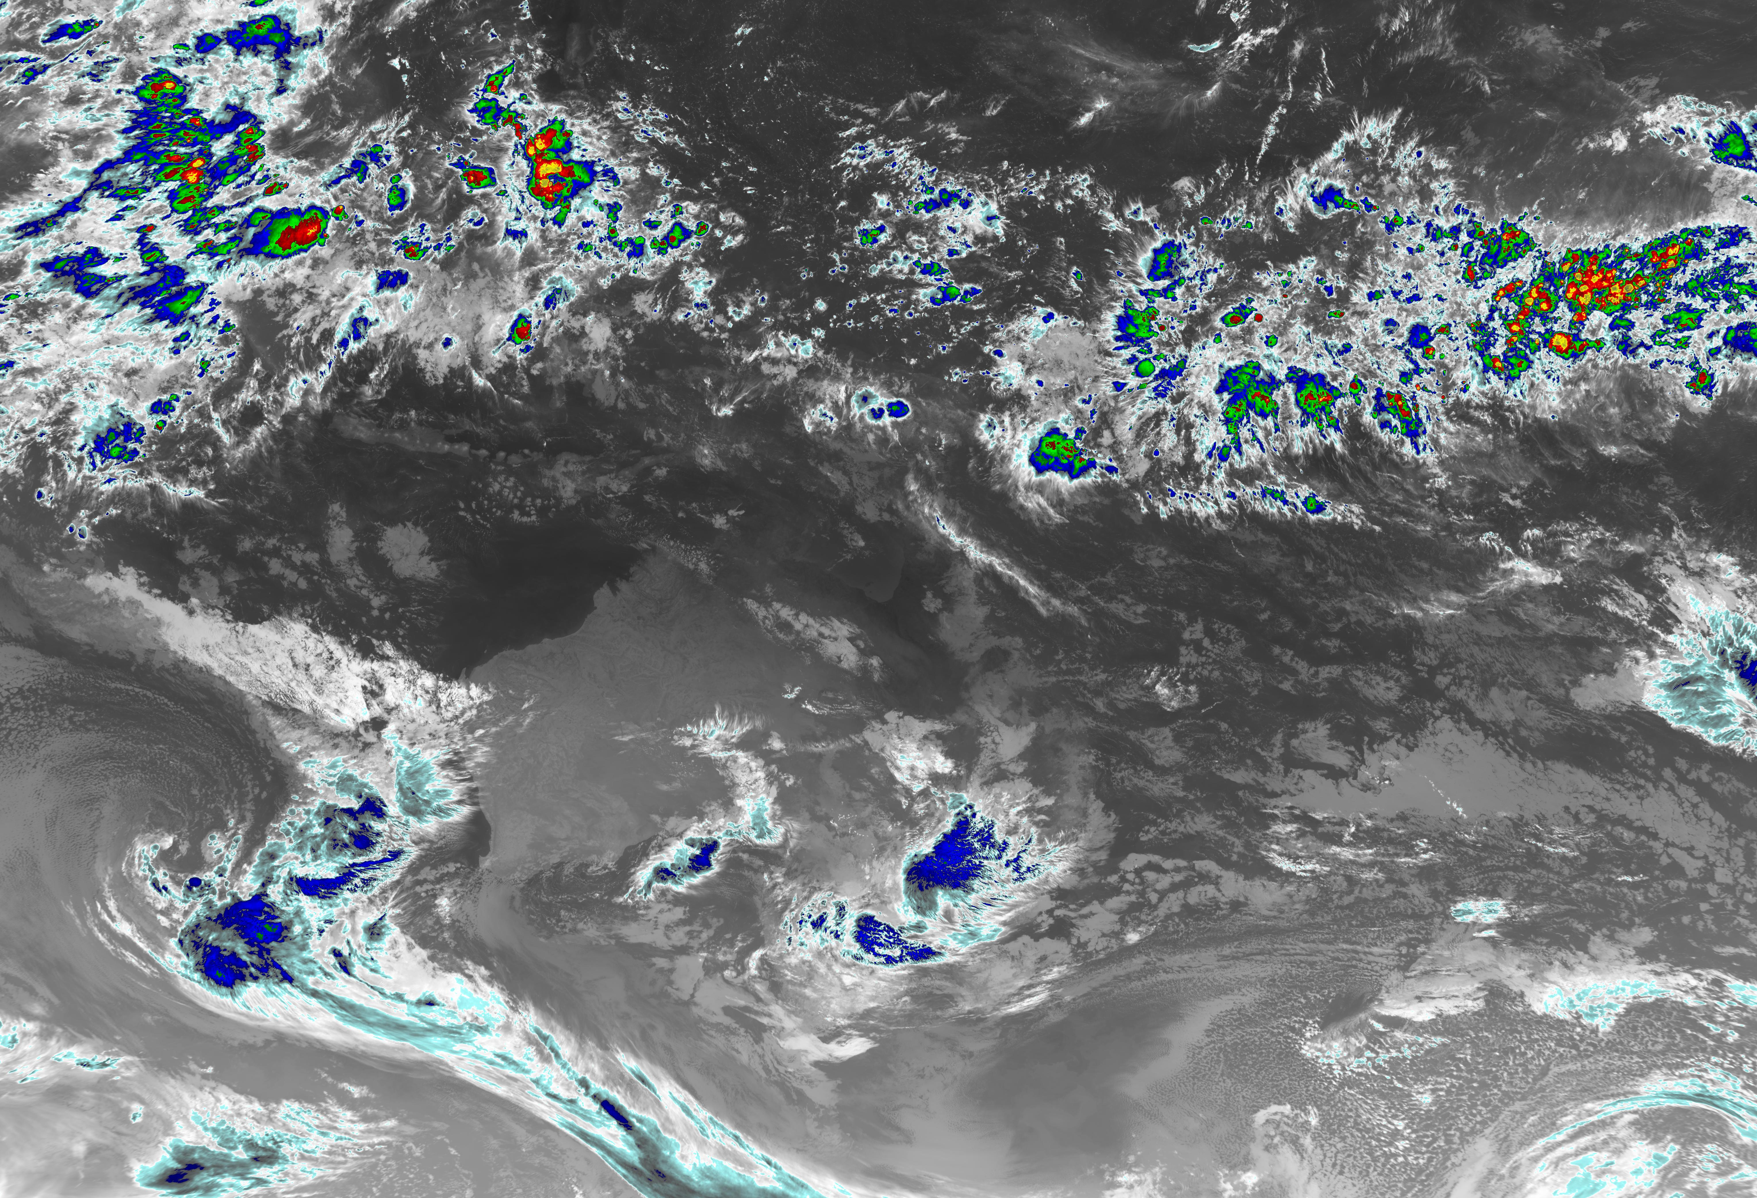
Products for Australian Public

Slide 10
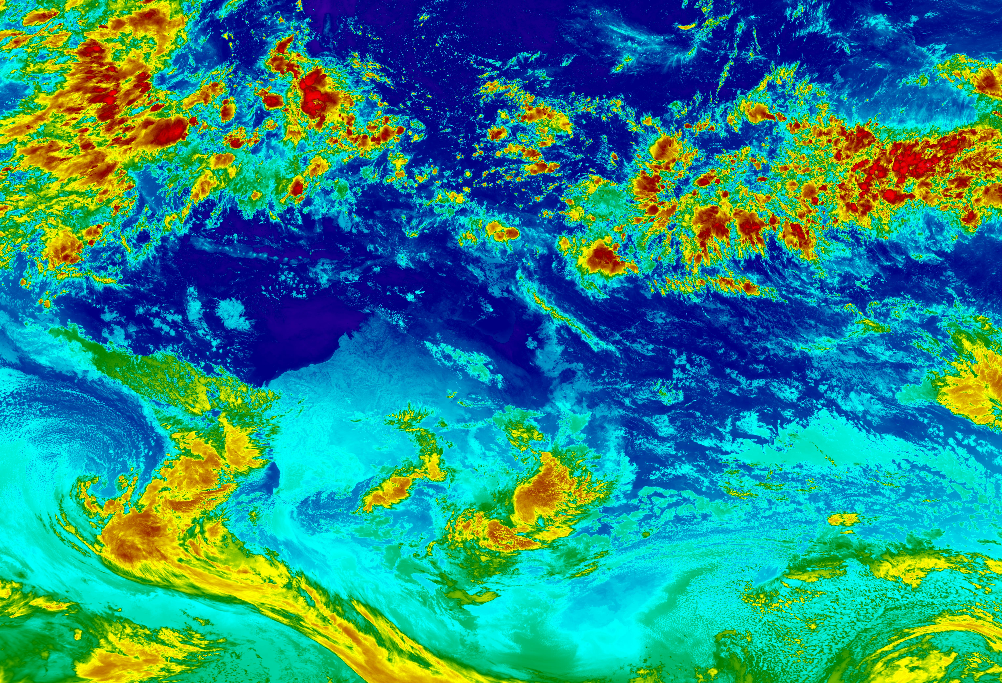
Products for Australian Public

Slide 11
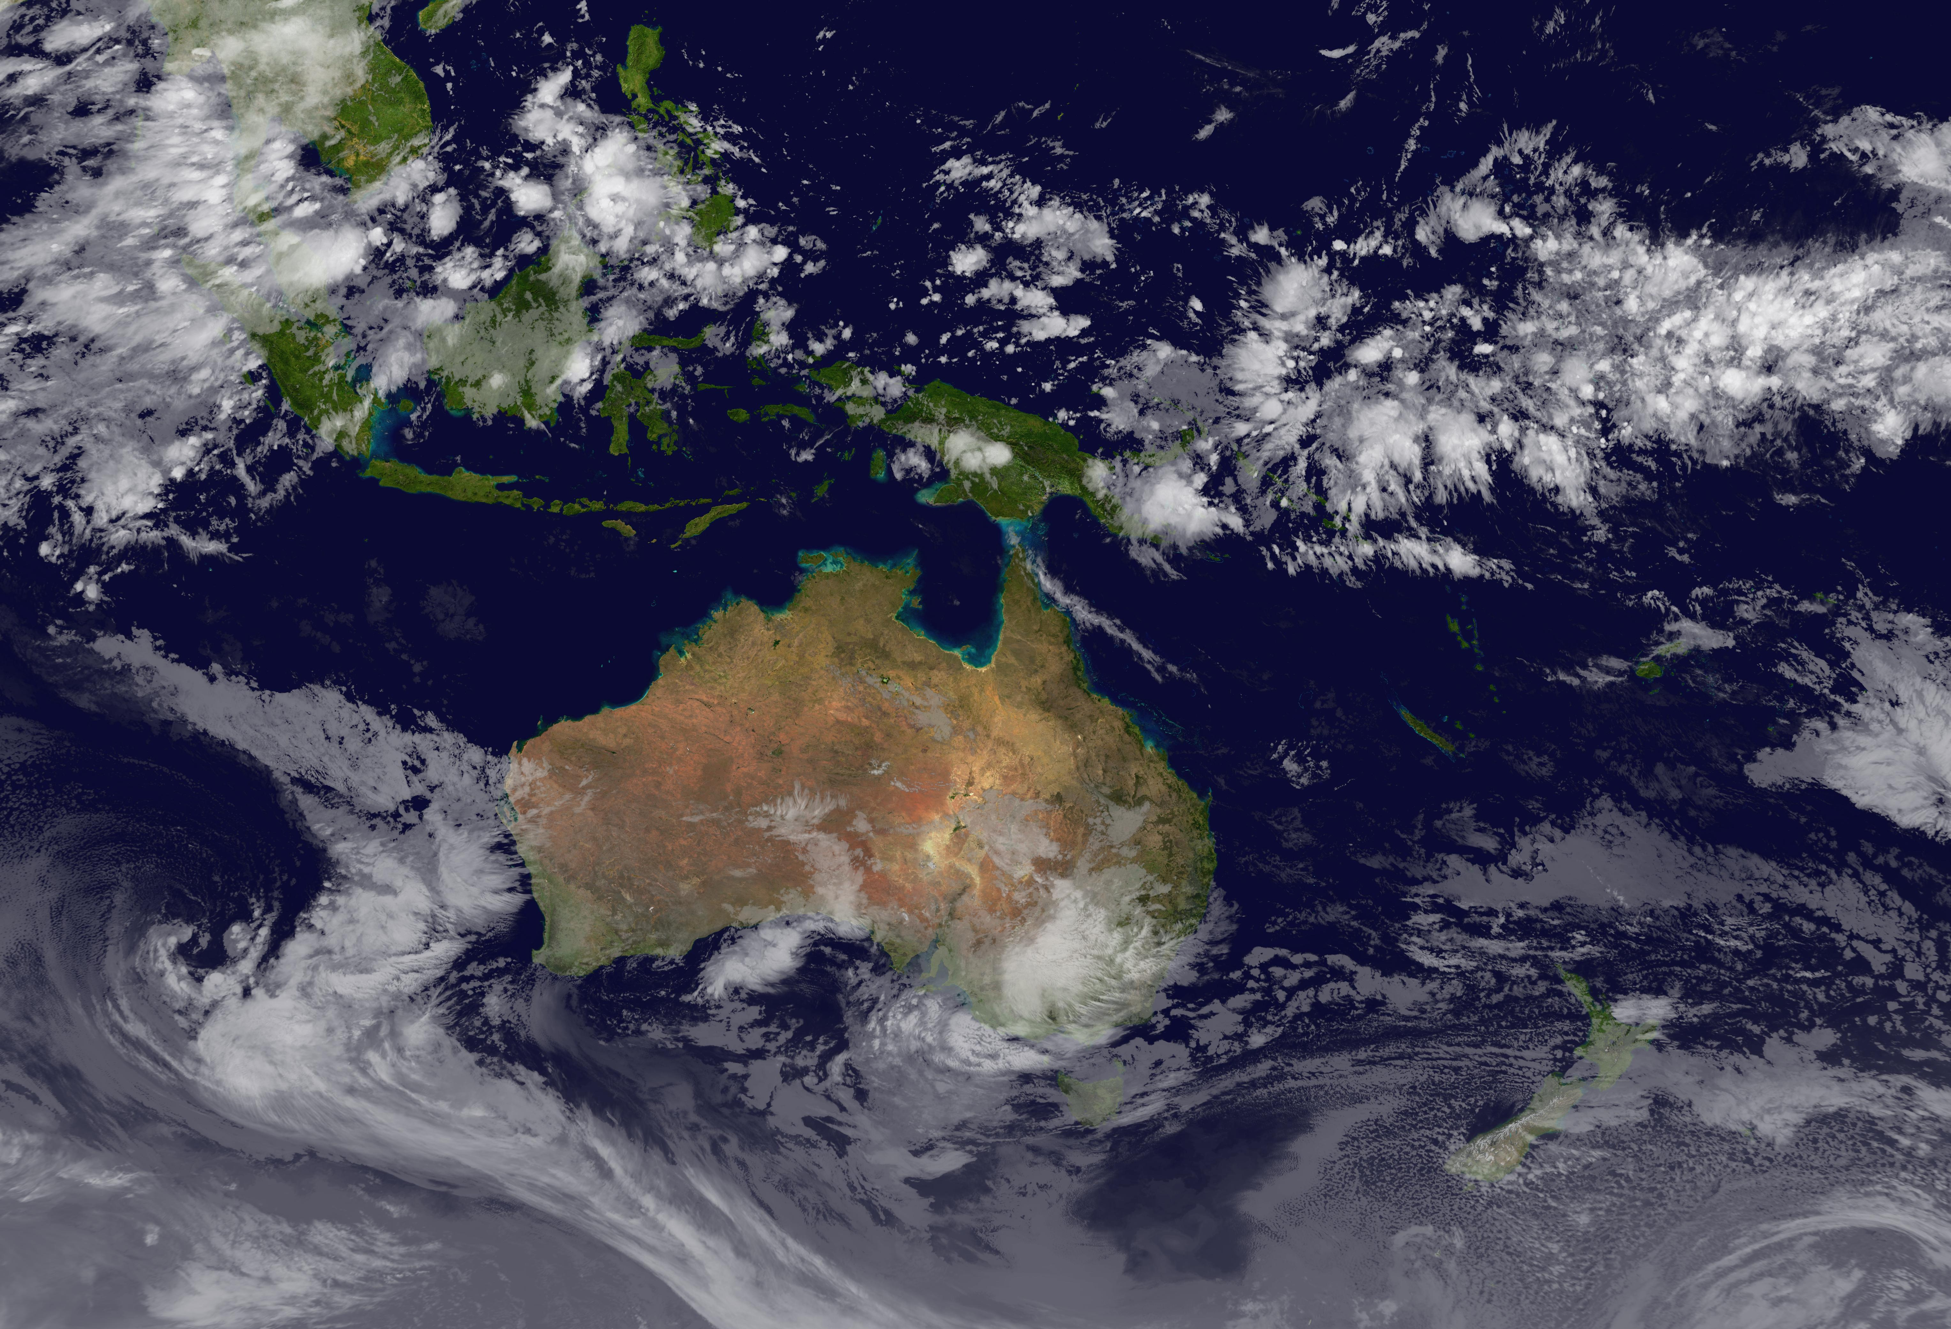
Products for Australian Public

Slide 12
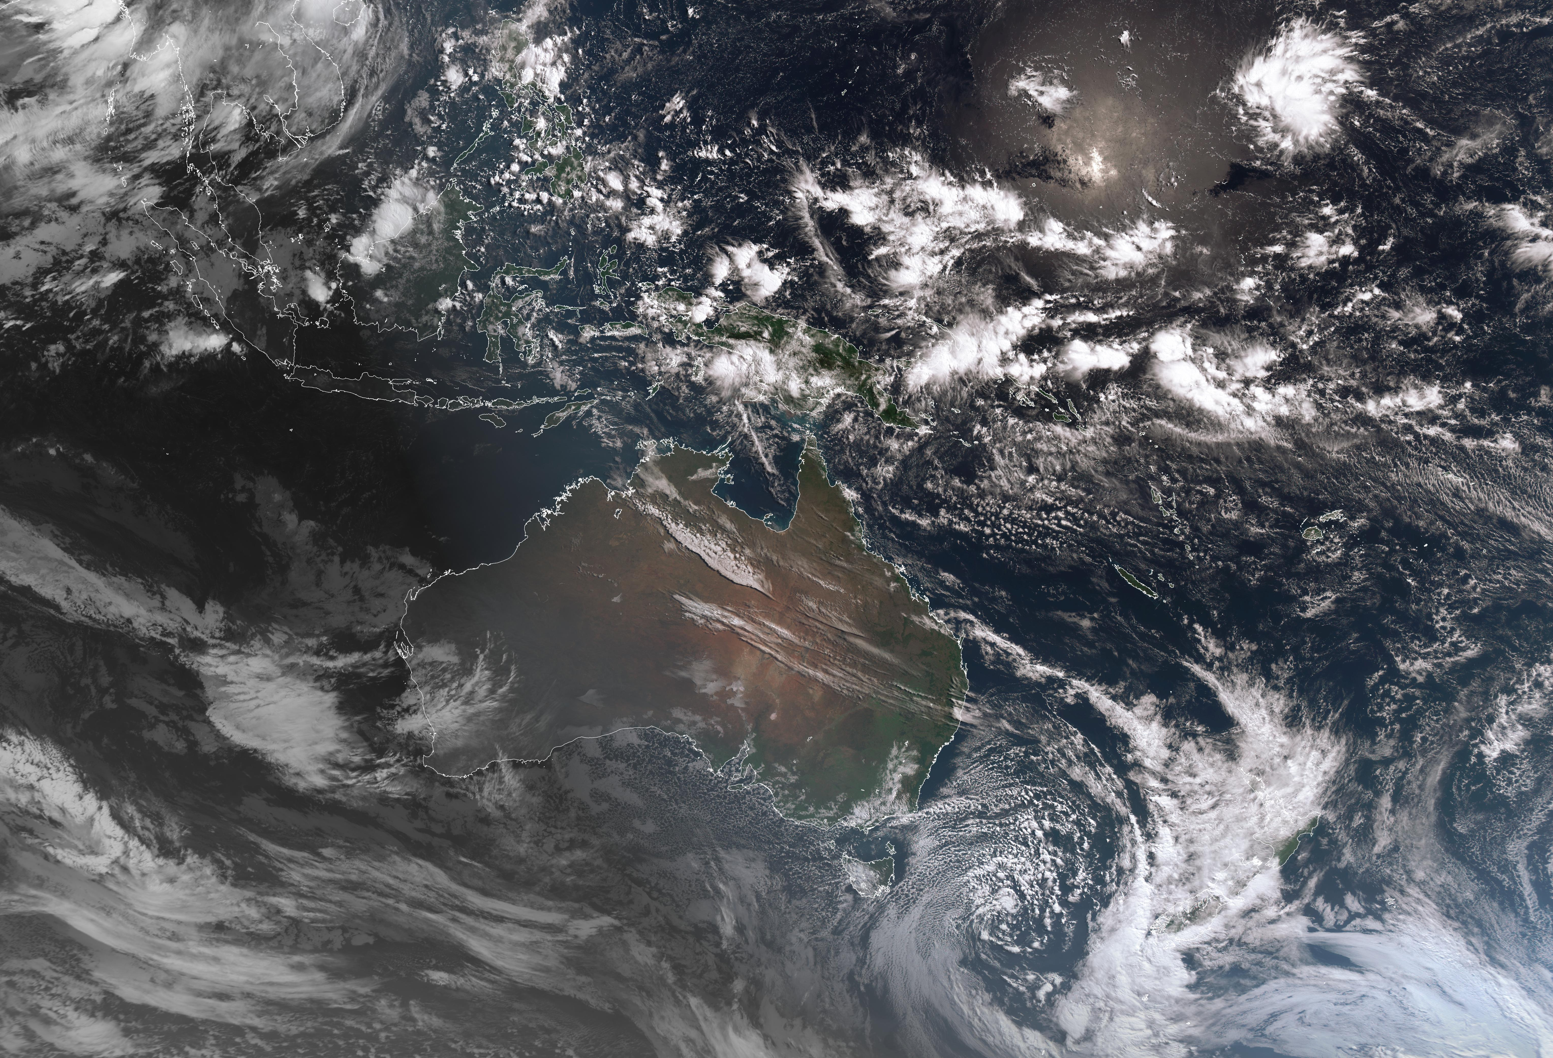
Products for Australian Public

Slide 13
Data Distribution
Format Continuity
Imagery as JPGs
2km resolution for Australian region
Includes new true colour/IR blend
New Capabilities
Products made available as geoTIFF to offer better support for GIS users
Products made available in netCDF format to offer better support for computational users

Slide 14
THANK YOU
QUESTIONS?

