Slide 1

Developments in the High Resolution ACCESS Models
Peter Steinle on behalf of
Earth System Modelling and the SREP Teams

Slide 2
What's happening with ACCESS NWP?
What is driving the change?
High resolution NWP
Modelling
Assimilation
Assessment
FDP over Sydney & Eastern NSW
The good news
What needs some attention

Slide 3
Service Drivers
Ensembles
Forecasts to include uncertainty & possible scenarios
Essential for data assimilation (Hybrid VAR and then EnVAR)
Resolution
Useful forecast information on the scale users need: 6km information at least.
Decreased latency between obs & forecasts for rapidly changing weather
Rapid Update (hourly)

Slide 4
Modelling
Resolution ~ 1.5km
Topography & coastlines
land surface (urban vs rural vs forest)
Convection permitting
No convection parametrization
cloud scheme & dynamics creates clouds & storms
better timing & evolution
Ensembles
essential for these scales

Slide 5
Data Assimilation
Assimilation – filling in the gaps between observations
4dVAR
Use 4d relationships between obs, includes tendencies
time derivatives → spatial derivatives
Flow dependent spreading of information
Dynamic covariances
Ensemble information (Hybrid or Ens VAR)

Slide 6
Assessment
Uncertainty in forecasts & observations
Neighbourhood Methods
Scale of useful information / Pattern similarity
Forecast Demonstration Project
Objective verification “under development”
Make sure asking the right questions for verification
Involving forecasters in the development

Slide 7
DRAFT NWP Configurations
 | APS-2 (Op: 2015) | APS-3 (Op: Mid-2018) | APS-4 (Op: End-2020)
ACCESS-G | 25km {4dV} | 12km {Hy-4dV} | 12km {Hy/En-4dV}
ACCESS-R | 12km {4dV} | 8km {Hy-4dV} | 4.5km {Hy/En-4dV}
ACCESS-TC | 12km {4dV} | 4.5km {Hy-4dV} | 4.5km {Hy-4dV}
ACCESS-GE | 60km (lim) | 30km | 30km
ACCESS-C | 1.5km {FC} | 1.5km {Hy-4dV} | 1.5km {Hy/En-4dV}
ACCESS-CE | - | 2.2km (lim) | 1.5km
ACCESS-X | - | 1.5km {Hy-4dV} | 1.5km {Hy/En-4dV}
ACCESS-XE | - | - | 1.5km
Operational date = full system
- Start rolling out operational systems about 12 months earlier

Slide 8
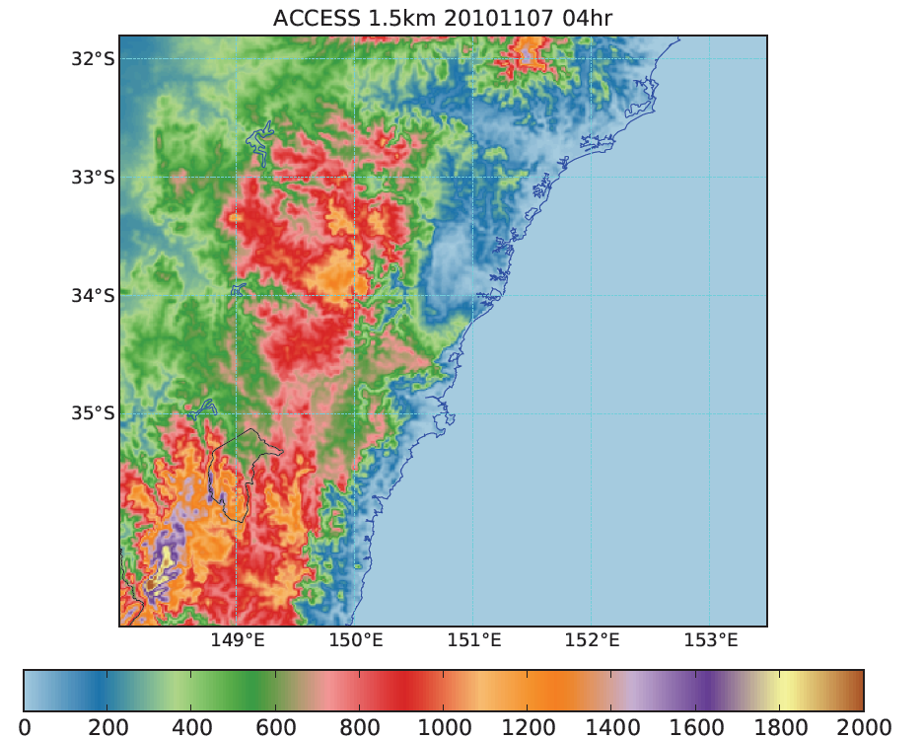
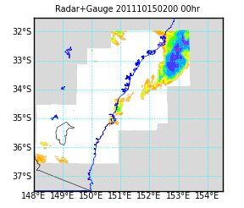
Target area
High population (Greater Sydney ~5M)
Best observing system (Radar & surface)
Susceptible to severe weather
Heavy rain, storms etc.
→ Sydney & Eastern NSW
Notes:
For socio-economic impact Estern NSW is obvious – biggest population and most small scale but damaging weather. Also has the most obs. So if a high res NWP system is going to be useful anywhere it should be here.

Slide 9
Configuration
3dVAR (Ran out of time to finish testing of 4dVAR,
Also used old covariances)
1.5km stretched grid
Nested in N512 (LBCs updated at 04, 10, 16, 22UTC)
Latent Heat Nudging (turned down a bit)
& Doppler Winds
Hourly updates, 55min data cut off
…Generally similar to UKV from a year or two ago
Notes:
Basically UKV from PS32, with Doppler winds and hourly updates

Slide 10
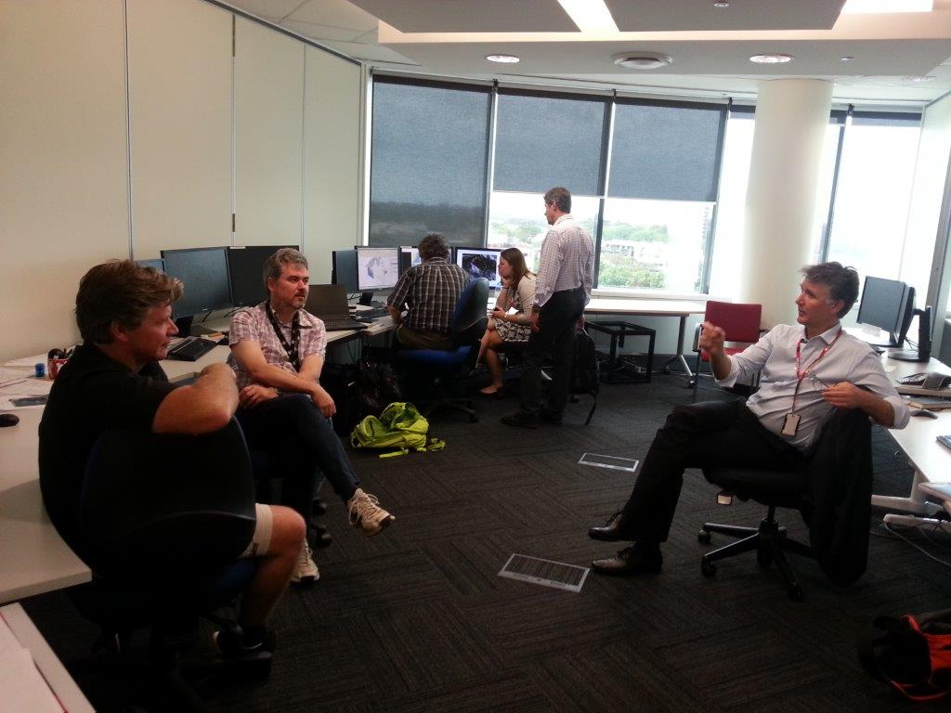
Forecast Demonstration Project
Set up second forecast office for ~10 weeks
- Forecasters stayed for 2 weeks, staggered starts
Decide on "issue of the day" after operational briefing (7am)
- Prepare forecasts etc. as per operational schedule
Discuss previous days results at lunch time
- A "win" if everyone agreed the RUC added value to the forecasts
Forecast blog with comments, annotated charts/forecast etc.
Notes:
Mimicking operational centre, but also with time to discuss and analyse….and continue discussions in nearby coffee shops to help get the “REAL” story from forecasters

Slide 11
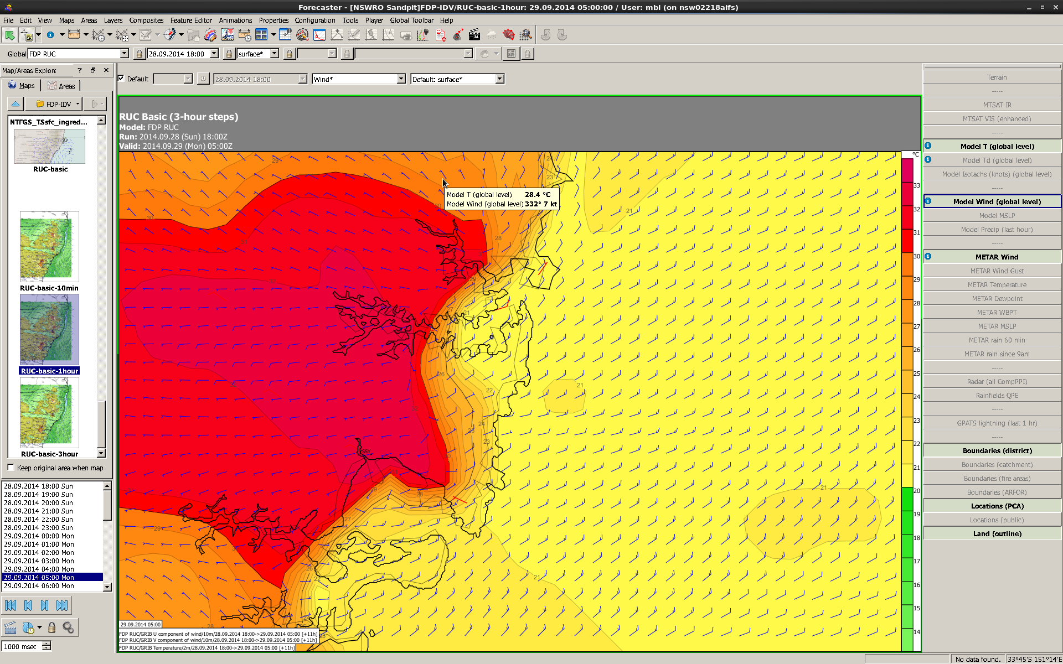
The Good News Subjective: 14 wins, 3 losses, 47 contests
33
32
31
30
29
28
27
26
25
24
23
22
21
20
19
18
17
16
15
14
Physical phenomena start to look realistic
Topographic features
Lake effects, cloud decks & ranges
Rain patterns look like rain
Vortices & gusts on wind changes
Sea breeze-like changes
Timing & triggering of convection
Organization of convection
… and associated outflows
Despite position errors still provides info on strength & behaviour of features
Notes:
5M people in Sydney. Image shows every gridpoint.
Get the sea breeze front wrong by 10km or so and 1M people experience a 10-15 degree temperature error. Not only are they annoyed, but also makes it harder to sell the message when damaging weather is coming.
Also improved the reverse land breeze – had cases of lines of reasonable showers of the coast under strong highs due to convergence with early morning land breeze. No other models captured them. Important to capture for coastal waters forecasts.

Slide 12
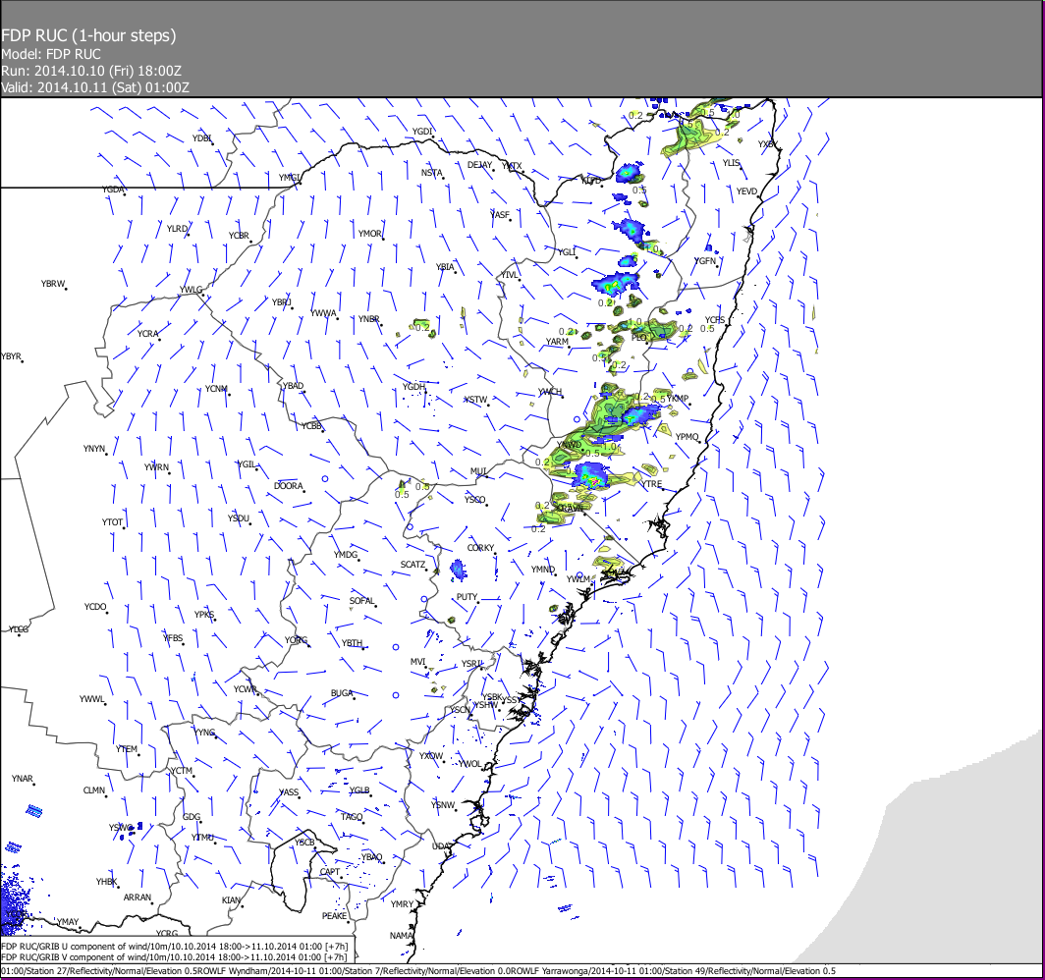
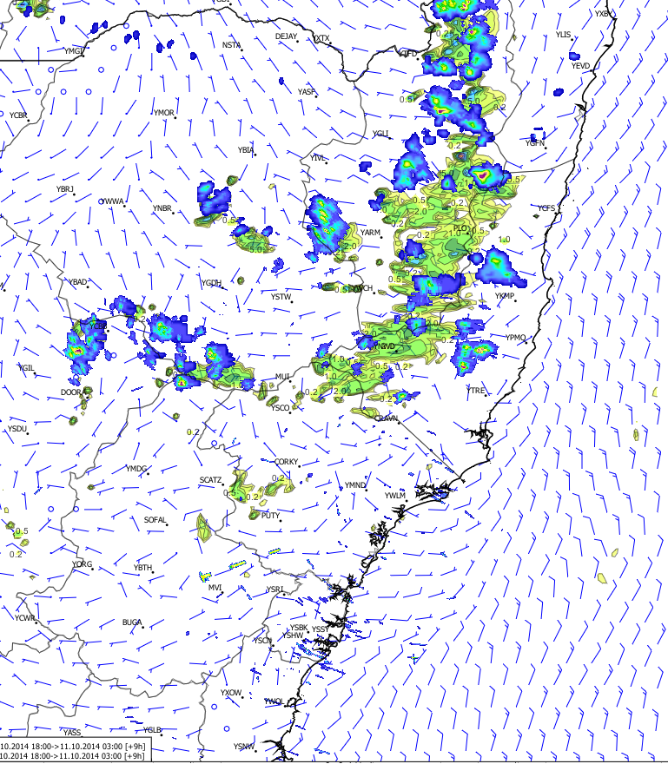
Timing & movement of convection

Slide 13
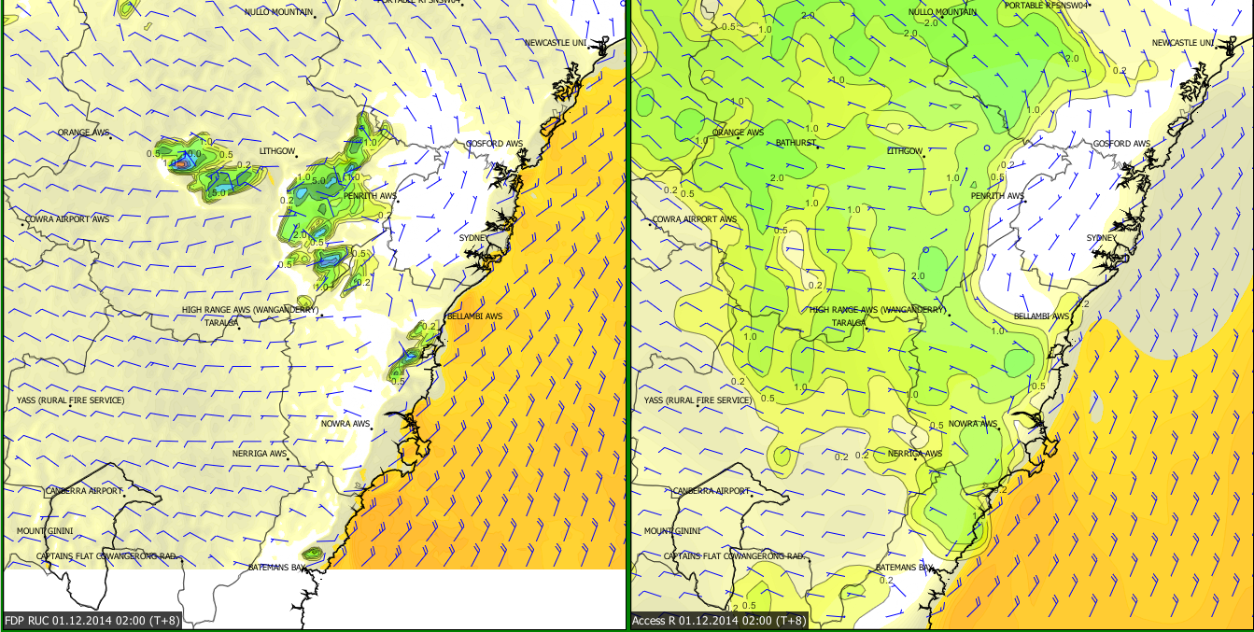
Example: Secondary development RUC starts with small cluster of storms
1.5km +8
R12 +8
Notes:
1.5km vs 12km from SAME base time. Should favour 12km. On this domain 12km effective up to date LBC but 1.5km has 6 hour older LBC.
1.5km at 8 hours shows a small cluster of storms (green & blue) rather than large rain band
Yellow colouring reflects wind speed

Slide 14
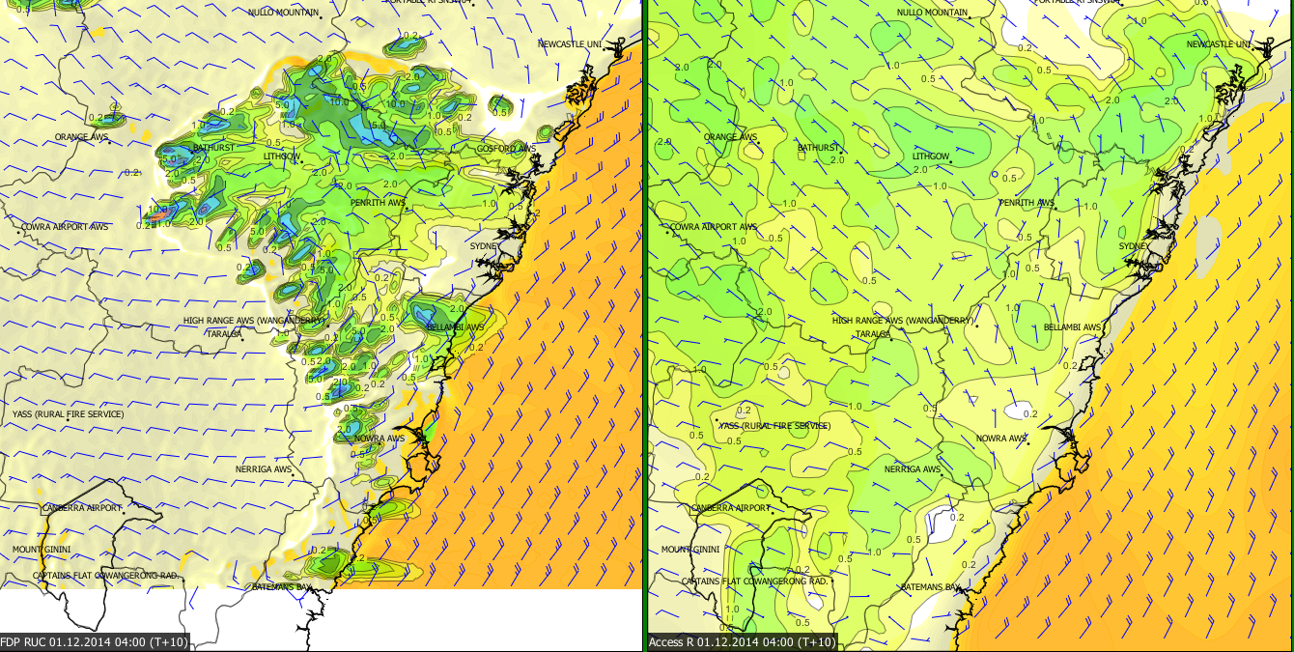
Area of storms increases and propagates towards West Unexpected - Prevailing winds FROM the West
1.5km +10
R12 +10
Notes:
1.5km shows cluster grows and propagates UPWIND. 12km just has expansion of rain area.
4km was more like 12km

Slide 15
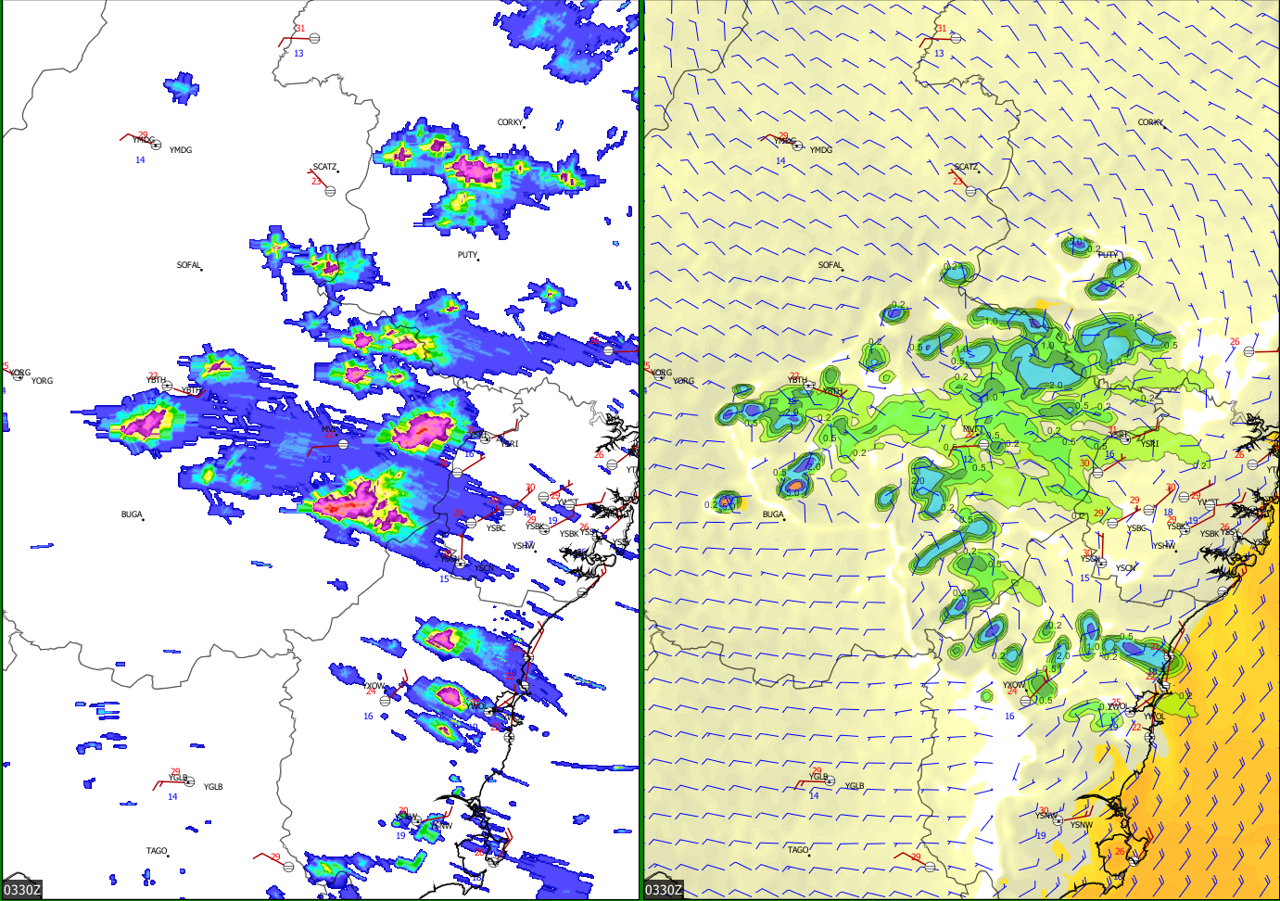
Scale, location, timing and motion of cluster compared well to radar
Radar derived rain
1.5km +9.5
Notes:
Radar shows general location, size of cells and arrangement of 1.5km is OK.

Slide 16
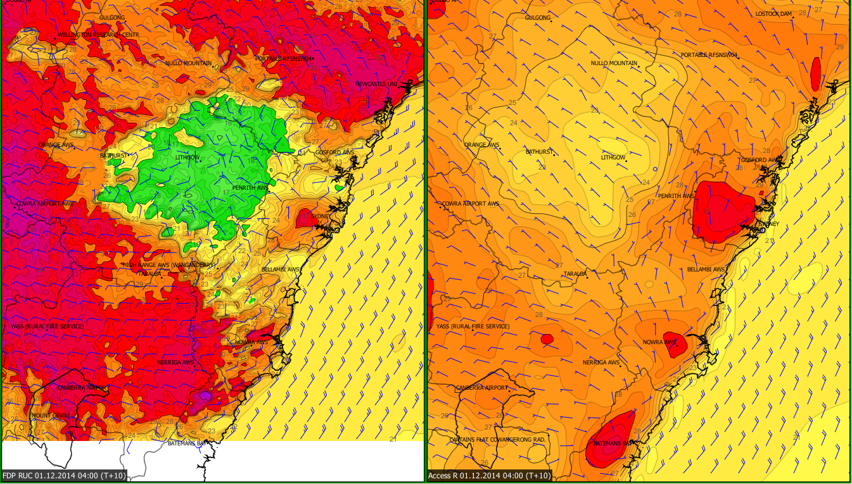
Cold pools from convection
1.5km +10
R12 +10
33
32
31
30
29
28
27
26
25
24
23
22
21
20
19
18
17
16
15
14
Notes:
Reason for 1.5km doing so well – picks up cold pool. Colours reflect T2m
Note high temps – so IF there was a fire extra info would have been fantastically important.

Slide 17
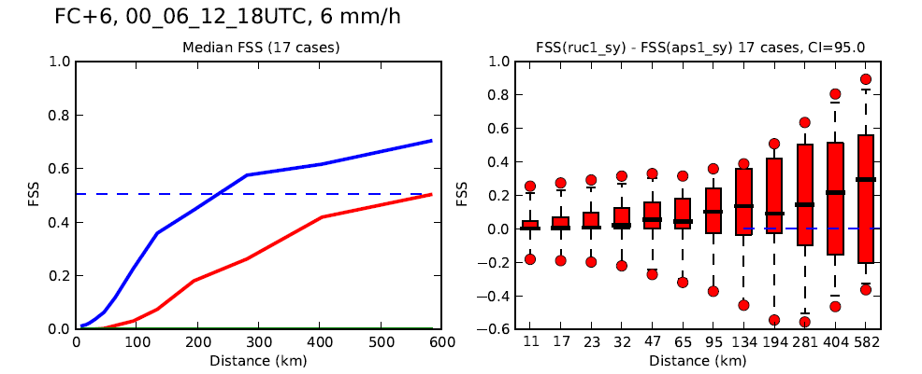
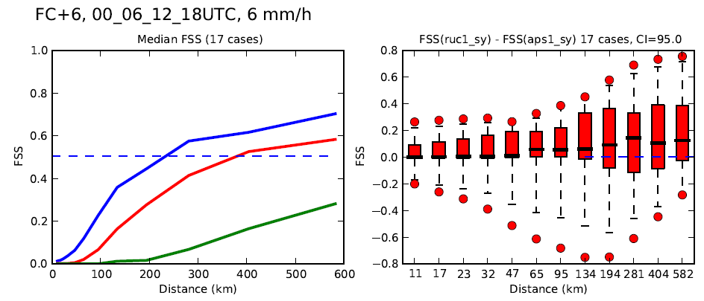
Rainfall Verifcation Fractions Skill Score (T+6)
IQR, median and 95%
FSS(RUC) – FSS(SY1)
RUC
APS1-4km (+6)
APS1-12km (+6)
RUC
APS1-4km (+0)
APS1-12km (+0)
Require > 0.15% of pts above threshold
Notes:
Objective verification (have many additional months) median FSS and inter quartile distribution etc.
Compare against 0hour and 6 hour offsets with other models.. In general somewhere in between.

Slide 18
Surface elements
SY: 4km downscaler
R: 12km+ 4dVAR
6 hour forecasts - % improvement
Element | RUC RMS | % impr. (SY+0) | % impr. (R+0) | % impr. (SY+6) | % impr. (R+6)
T_2m (K) | 2.0 | 0 | 11 | 8 | 17
Td_2m (K) | 3.0 | 0 | 2 | 6 | 9
10m wspeed (m/s) | 2.4 | 6 | -1 | 7 | 3
Downscaling handles temp & dewpt OK,
NOT winds
12 hour forecasts - % improvement
Element | RUC RMS | % impr. (SY+0) | % impr. (R+0) | % impr. (SY+6) | % impr. (R+6)
T_2m (K) | 2.0 | 7 | 15 | 5 | 9
Td_2m (K) | 3.0 | 5 | 7 | 7 | 8
10m wspeed (m/s) | 2.4 | 7 | 3 | 9 | 2
Notes:
Again comparisons against 0hour and 6 hour offsets
Temp and Dewpoint seems to downscale OK

Slide 19
Surface elements
SY: 4km downscaler
R: 12km+ 4dVAR
6 hour forecasts - % improvement
Element | RUC RMS | % impr. (SY+0) | % impr. (R+0) | % impr. (SY+6) | % impr. (R+6)
T_2m (K) | 2.0 | 0 | 11 | 8 | 17
Td_2m (K) | 3.0 | 0 | 2 | 6 | 9
10m wspeed (m/s) | 2.4 | 6 | -1 | 7 | 3
Not much difference in accuracy between 6 & 12 hour RUC forecasts
→ RELATIVE gain in accuracy
12 hour forecasts - % improvement
Element | RUC RMS | % impr. (SY+0) | % impr. (R+0) | % impr. (SY+6) | % impr. (R+6)
T_2m | 2.0 | 7 | 15 | 5 | 9
Td_2m | 3.0 | 5 | 7 | 7 | 8
10m wspeed | 2.4 | 7 | 3 | 9 | 2
Notes:
Note that relative gain at 12 hours beats 6 hours
These are for forecasts that verify in the afternoon – very important time of day (max meso-scale action)
- relative perforamce very complicated relationship with start time and length of forecast
Most of 1.5km error is static (land surface mis-specification etc.) – very little growing error

Slide 20
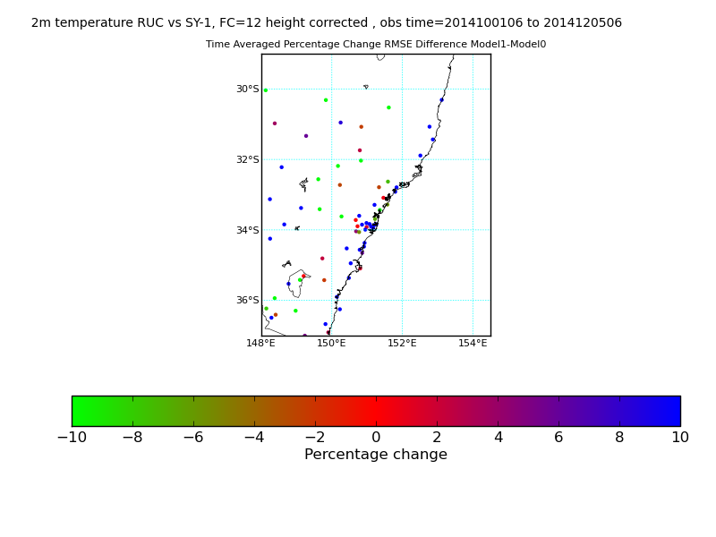
Gain mostly on coastal plain & ranges (inland ~ random)
RMS(RUC+12) – RMS(SY_4km+12)
+ → RUC better
6 hour forecasts - % improvement
Element | RUC RMS | % impr. (SY+6) | % impr. (R+0) | % impr. (SY+6) | % impr. (R+6)
T_2m | 2.0 | 0 | 11 | 8 | 17
Td_2m | 3.0 | 0 | 2 | 6 | 9
10m wspeed | 2.4 | 6 | -1 | 7 | 3
12 hour forecasts - % improvement
Element | RUC RMS | % impr. (SY+0) | % impr. (R+0) | % impr. (SY+6) | % impr. (R+6)
T_2m | 2.0 | 7 | 15 | 5 | 9
Td_2m | 3.0 | 5 | 7 | 7 | 8
10m wspeed | 2.4 | 7 | 3 | 9 | 2
Best when strong mesoscale forcing
- coast, ranges, sea breeze, …
Notes:
Showing most of the gain on coast & ranges.
Inland little mesoscale forcing – flat & no observations!

Slide 21
Future Improvements
Ensembles ← small scale predictability
4D-Var ← More localized adjustment
Hybrid VAR ← Flow & topographically aware adjustments
Obs ← H-8 cloud & AMV, more satellite channels
Doppler Wind QC (dual pol)
Land Surface DA ← analysis & model consistent, Aus land surfaces.
Model Physics ← Rain & cloud processes
Resolution < 1km? ← Fog, Airports, Fires, (Storms??)
probably only experimental
Notes:
Not unexpected weaknesses. Working through getting approval to attack these problems.
Hydbrid &/or 4dVAR & covariances requires – as system seemed slow to respond to new data.

Slide 22
Full system operational in 2018 … with ensembles
- will need to change the way data delivered
FDP certainly worth it
- and 1.5km system generally well received by forecasters
… Thank you
Peter Steinle
+61 3 9669 4848
p.steinle@bom.gov.au
Notes:
‘Twas GREAT time!

