Slide 1







Science Week 2015 (July 28, 2015)
Development of Geo-KOMPSAT-2A and its meteorological products
Sung-Rae Chung
National Meteorological Satellite Center
Korea Meteorological Administration
csr@korea.kr

Slide 2
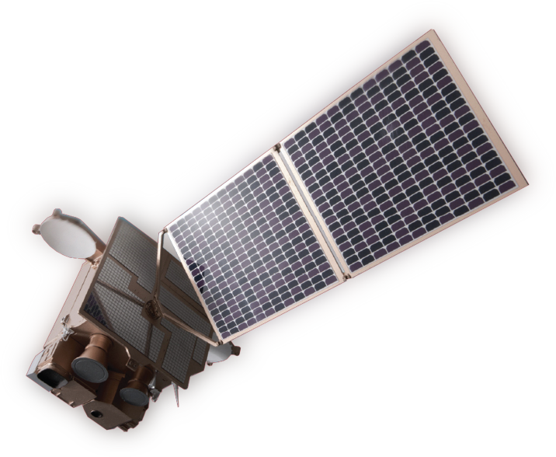
Contents
Development of Geo-KOMPSAT-2A
Development of GK-2A Ground Segment and Meteorological Products
Notes:
The contents of this presentation are
current status of COMS,
utilization of COMS data
And plan for GEO-KOMPSAT-2A.

Slide 3
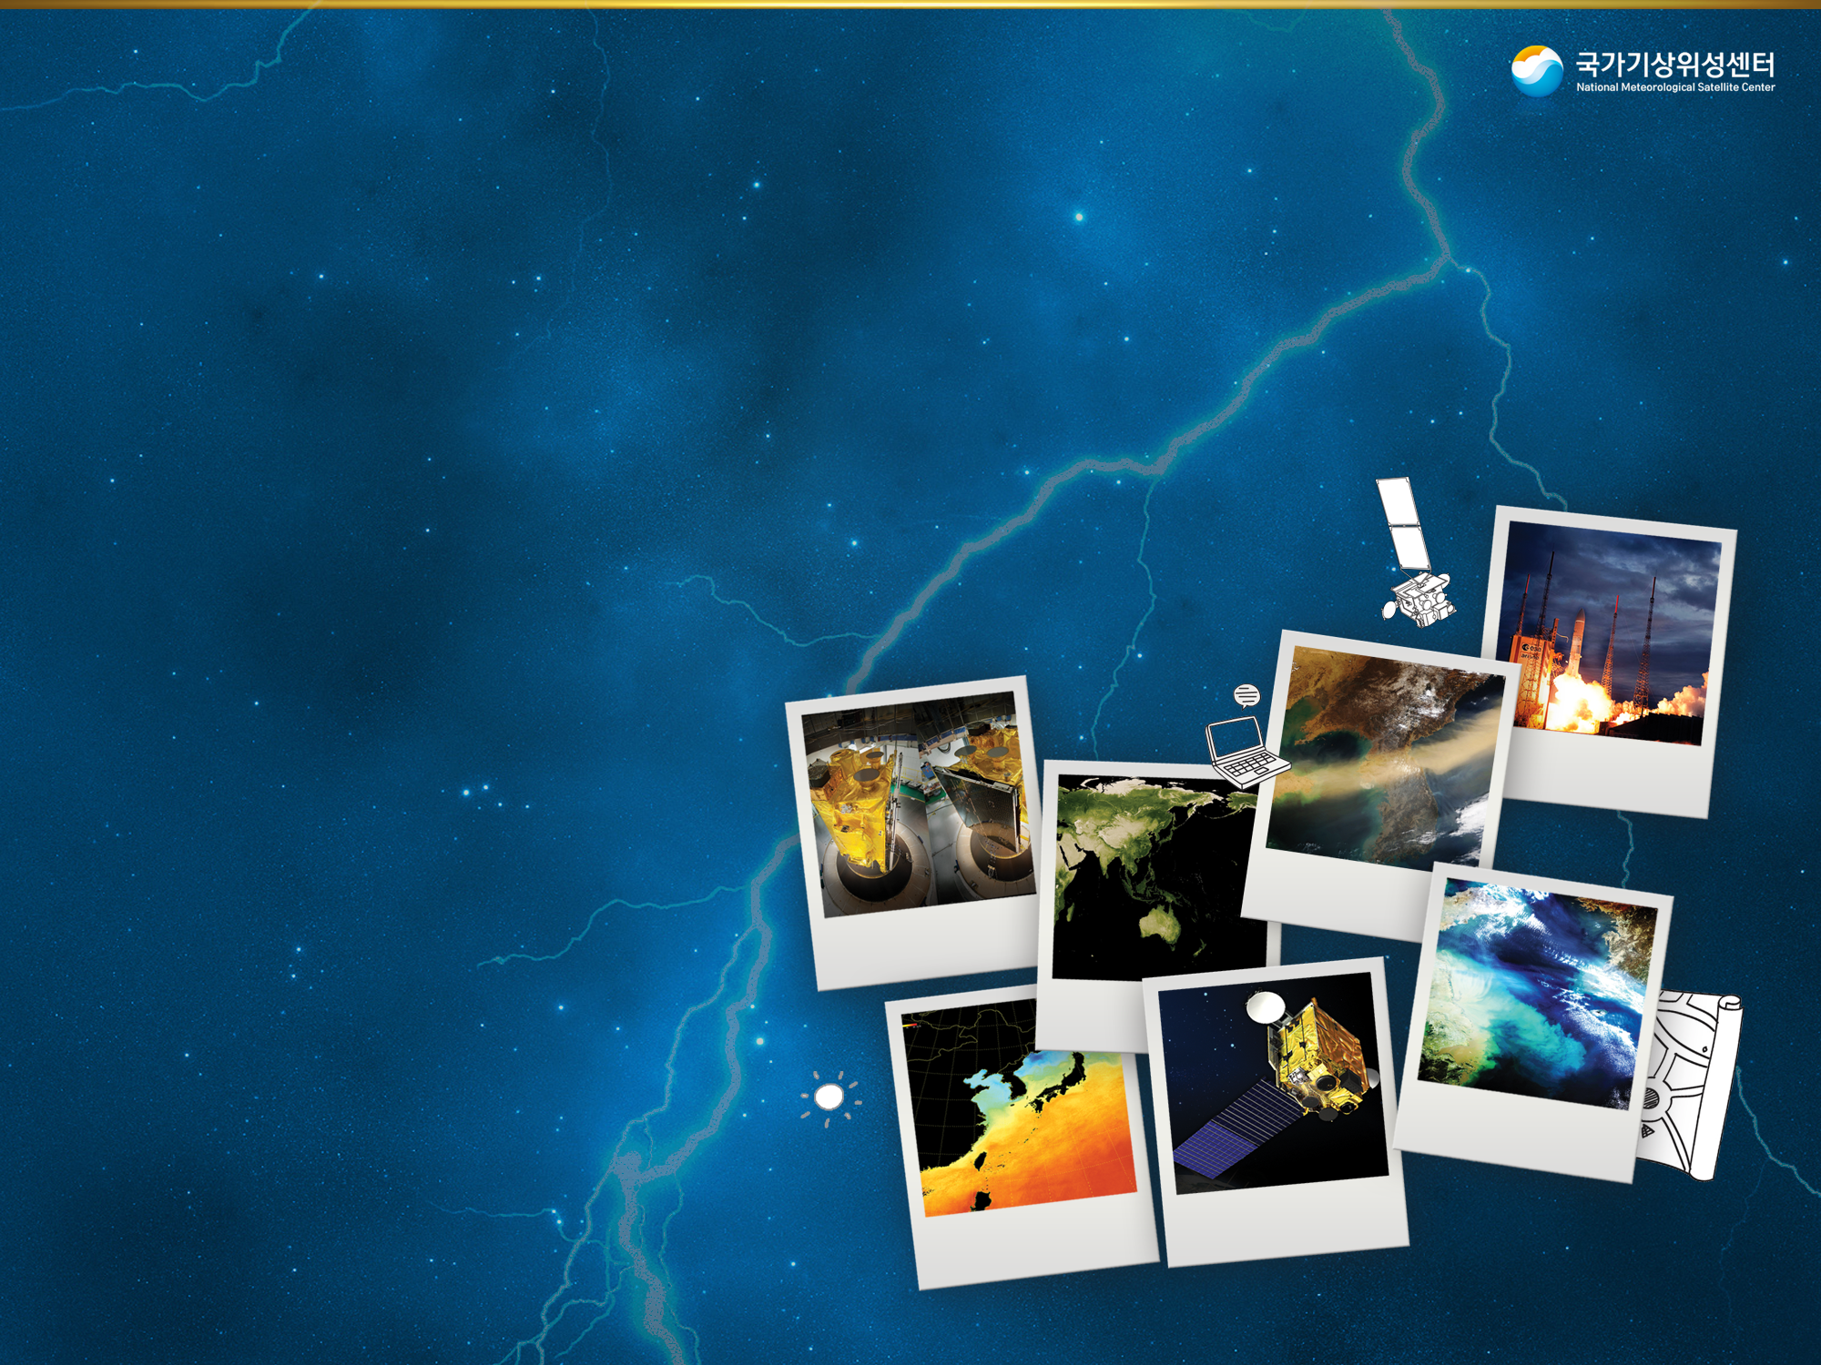
Development of
Geo-KOMPSAT-2A

Slide 4
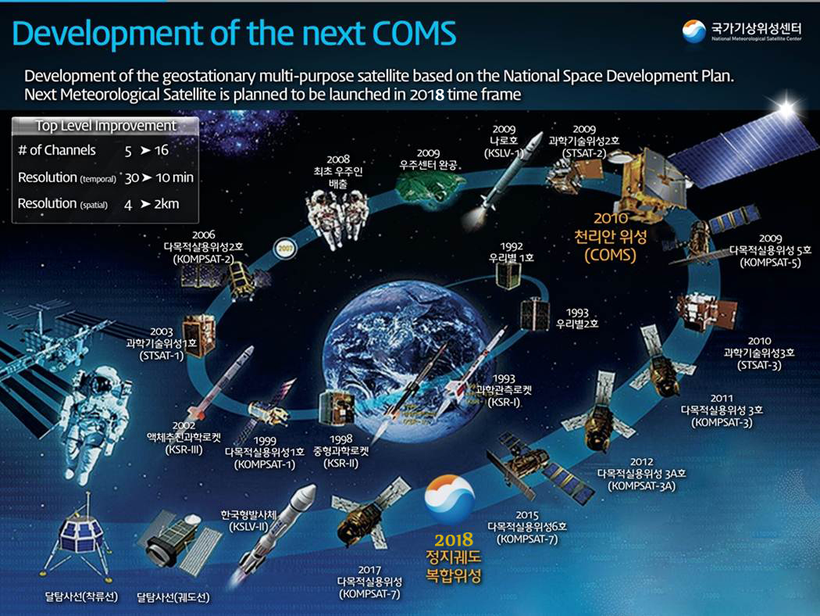
(GK-2A)
4
4
Notes:
KMA’s development of geostationary multi-purposed satellite is based on the “national space development plan”
As you know COMS was successfully launched in June 2010. As for “National Space Development Plan”, COMS follow-on, named, GEO-KOPMSAT-2A is scheduled to be launched in 2018 to succeed the meteorological mission.

Slide 5
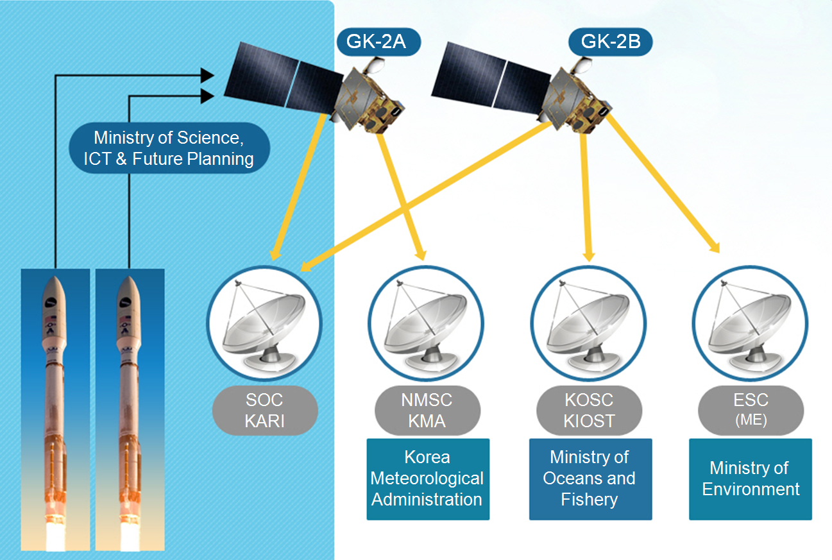
Geo-KOMPSAT-2 (GK-2) Program
GK-2 program has two mission
GK-2A for the weather, climate and space weather monitoring
GK-2B for the ocean color and atmospheric trace gas monitoring
5
Notes:
The schematic diagram is brief introduction of development of GEO-KOMPSAT-2 program in Korea.
Differently from COMS, two separated satellites are developing. One is for meteorological mission only named GEO-KOMPSAT-2A, and the other is for ocean and environmental mission named GEOKOMPSAT-2B.
As for sub-payload of GEO-KOMPSAT-2A, KMA is developing the space weather sensor for developing the space weather monitoring system by observing the solar activities.
The program of the development of ground segment and data processing system will be kicked off in 2014. And the preliminary study has been started in 2011 and is extended to the end of this year.

Slide 6
Geo-KOMPSAT-2 (GK-2) Program
GK-2A
Launch scheduled: May 2018
Payloads: Advanced Meteorological Imager (AMI)
Korea Space Environmental Monitor (KSEM)
- Particle Detector
- Magnetic Field Sensor
- Charging Monitor
GK-2B
Launch scheduled: March 2019
Payloads: Geostationary Ocean Color Imager-II (GOCI-II)
Geostationary Environmental Monitoring Spectrometer (GEMS)
6

Slide 7
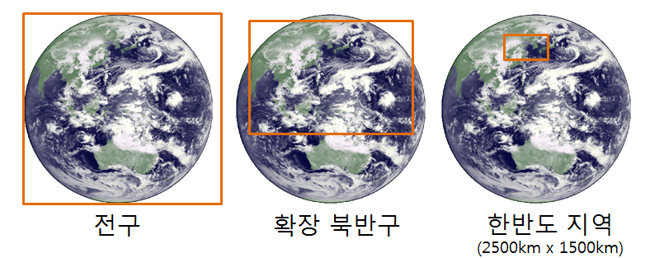
Scan Mode of GK-2A/AMI
Full Disc (FD)
Extended Northern Hemisphere (ENH)
Local Area (LA)
Scan time: FD < 10 min, ENH < 5 min, LA < 2 min
LA : moving scan area
7

Slide 8
Advance Meteorological Imager (AMI)
Spectral Bands: 16 channels
 |  | Geo-KOMPSAT-2A AMI |  |  |  |  | COMS MI
Channel | Band name | wavelength (µm) | resolution (km) | SNR | NEdT(K) (240/300K) | Radiometric Accuracy | Wavelength (µm) | Resolution (km)
1 | VIS0.4 | 0.47 | 1 | 250 |  | 5%
2 | VIS0.5 | 0.51 | 1 | 250 |  | 5%
3 | VIS0.6 | 0.64 | 0.5 | 120 |  | 5% | 0.675 | 1
4 | VIS0.8 | 0.856 | 1 | 210 |  | 5%
5 | NIR1.3 | 1.378 | 2 | 300 |  | 5%
6 | NIR1.6 | 1.61 | 2 | 300 |  | 5%
7 | IR3.8 | 3.9 | 2 |  | 3/0.2 | 1K | 3.75 | 4
8 | IR6.3 | 6.185 | 2 |  | 0.4/0.1 | 1K
9 | IR6.9 | 6.95 | 2 |  | 0.37/0.1 | 1K | 6.75 | 4
10 | IR7.3 | 7.34 | 2 |  | 0.35/0.12 | 1K
11 | IR8.7 | 8.5 | 2 |  | 0.27/0.1 | 1K
12 | IR9.6 | 9.61 | 2 |  | 0.35/0.15 | 1K
13 | IR10.5 | 10.35 | 2 |  | 0.4/0.2 | 1K | 10.8 | 4
14 | IR11.2 | 11.2 | 2 |  | 0.19/0.1 | 1K
15 | IR12.3 | 12.3 | 2 |  | 0.35/0.2 | 1.1K | 12.0 | 4
16 | IR13.3 | 13.3 | 2 |  | 0.48/0.3 | 1.1K
8

Slide 9
AMI vs ABI vs AHI
Spectral Bands
Data Service
Center wavelength (μm)
AMI |  | ABI | AHI
1 | 0.47 | 0.47 | 0.46
2 | 0.511 |  | 0.51
3 | 0.64 | 0.64 | 0.64
4 | 0.856 | 0.865 | 0.86
5 | 1.38 | 1.378
6 | 1.61 | 1.61 | 1.6
 |  | 2.25 | 2.3
7 | 3.830 | 3.90 | 3.9
8 | 6.241 | 6.185 | 6.2
9 | 6.952 | 6.95 | 7.0
10 | 7.344 | 7.34 | 7.3
11 | 8.592 | 8.50 | 8.6
12 | 9.625 | 9.61 | 9.6
13 | 10.403 | 10.35 | 10.4
14 | 11.212 | 11.2 | 11.2
15 | 12.364 | 12.3 | 12.3
16 | 13.31 | 13.3 | 13.3
GK-2A/AMI
- Ultra High Rate Information Transmission (UHRIT): 16 channel Level 1B
- HRIT/LRIT
GOES-R/ABI
- GOES ReBroadcast (GRB)
: Direct Broadcast of L1B
Himawari-8/AHI
- HimawariCloud
- HimawariCast
9

Slide 10
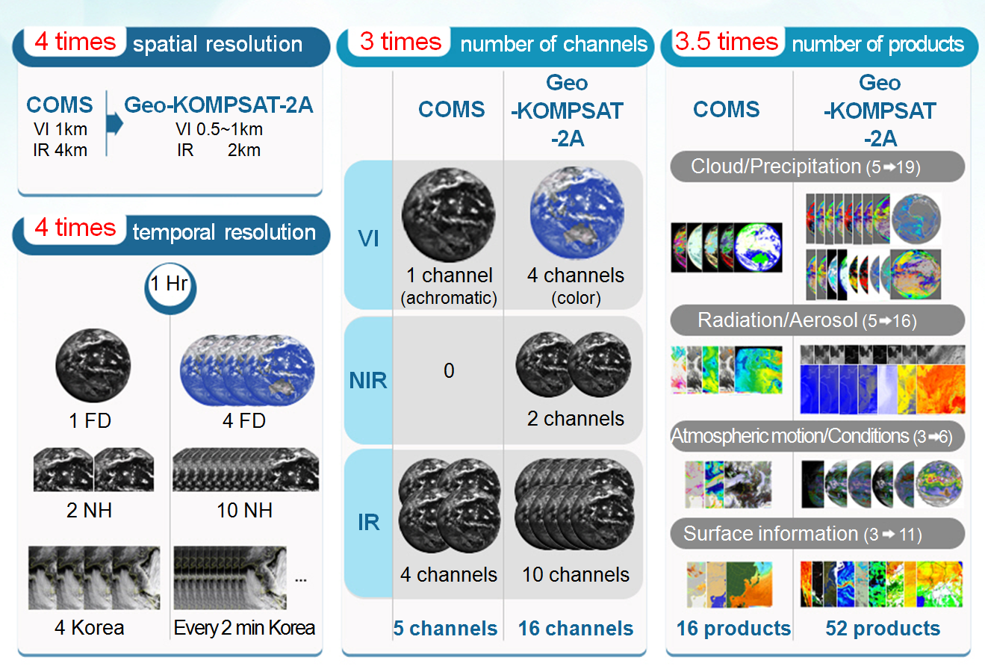
COMS MI vs. GEO-KOMPSAT-2A AMI
10
Notes:
Here is the summary of the comparison between COMS and GEO-KOMPSAT-2A.
The performance of GEO-KOMPSAT-2A is about 4 times in spatial resolution, 3 times in temporal resolution, 3 time in the number of channels and 3.5 time in the number of products.
By these improved performance, KMA can detect the Asian dust with true color image, vegetation, fire, etc, and diversify products like T/Q profile, stability indices, cloud information compared with existing COMS products.

Slide 11



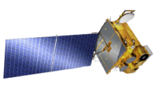
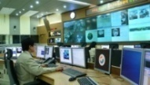

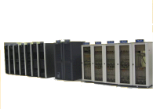
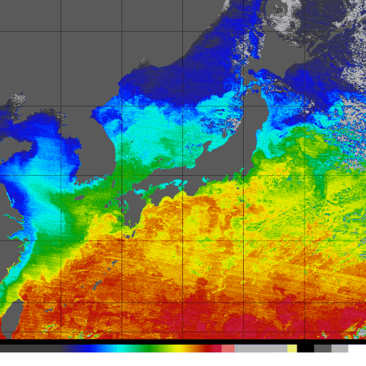


Milestone for the Geo-KOMPSAT-2A
Satellite bus design
and Review
Integrate
Module
Satellite system
integration
Launch/IOT/Operation
PAYLOAD
And
Satellite
Satellite
operation
Analysis of system
requirements
Preliminary
design
Critical design
Instrument
Integration
and test
System
Integration
and test
Prepare
To
launch
launch / IOT
Start
SRR
PDR
EQSR/CDR
Environmental Test
Launch
TRR
Delivery
2013
2014
2015
2016
2017
2018
Operation/utilization /service
GROUND SYSTEM
Preliminary
design
Critical
design
Implementation
/verification
Integration test
/idealization
IOT
/Supporting operation
data receiving and processing system
System requirements /Standards creation
Preliminary design
Critical
design
System implementation
Install
/Testing
Training operator
Launch
Supporting operation
satellite control system
Review and analysis of requirements/standards/design
Selection of TTC and RF production companies
Integration and install TTC system
Install control S/W and interface testing
Training operator
Test operation and verification
data processing system
2014
2015
2016
2017
2018
-Algorithm development I
-Algorithm development II
-Algorithm development complete
-System construction
- SW idealization
- Test operation and verification
data management and service system
2014
2015 ~ 2016
2017 ~ 2018
-analysis of user requirements
-set up system requirements
-Preliminary/critical design
-Create system
-Verify system
-test operation and complement
11
Notes:
KMA wants to launch GEO-KOMPSAT-2A in 2017 before the retirement of COMS mission. Thus the master schedule is scheduled by considering the succession of meteorological mission.
The contract for meteorological payload will be scheduled in second half of 2012
And Critical Design Review in 2014, and Test Readiness Review in 2015
After system integration in 2017 and launch in 2018, operation will be started in early 2019.

Slide 12
Development of
GK-2A Ground Segment & Meteorological
Products
12

Slide 13
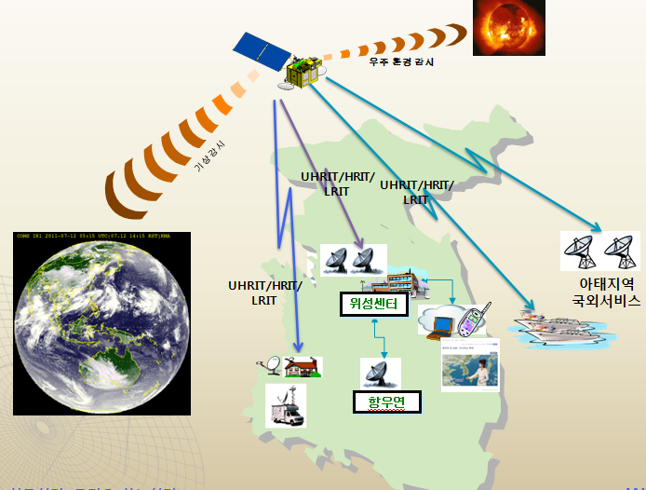
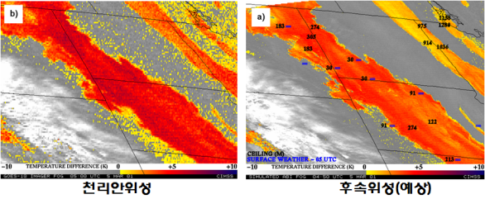
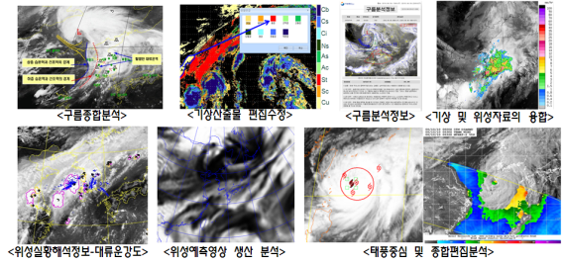
Development of GK-2A Ground Segment
Outline
Development of GeoKOMPSAT-2A ground segment
- Develop Level 2 products algorithms
- Develop integrated analysis and application facilities
- Develop meteorological/space weather data processing system
- Establish satellite control system
- Develop data management and service system
- Integration test & normal operation preparation
Period : 2014 ~ 2019 (6yrs)
Mission
Enhancing forecast/climate monitoring based on high resolution measurements
Generation of the baseline meteorological products, and application to hydrology, agriculture, disaster mitigation etc.
Dissemination of GK-2A data via satellite broadcast system, LRIT/HRIT/UHRIT
Supporting satellite operation with space weather monitoring
13
Notes:
KMA is scheduled to develop the GEO-KOMPSAT-2A Ground segment before the GEO-KOMPSAT-2A launch and scheduled to finish in 2017 one year before the launch.
The development of ground segment will include:
- development of L2 products algorithm and data processing system
- development of data management and service system
The segment will enhance forecast and climate monitoring based on high resolution measurements, and will support satellite operation as well.

Slide 14
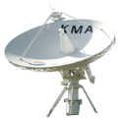






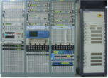


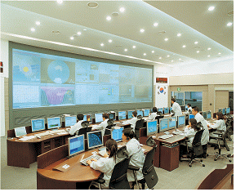




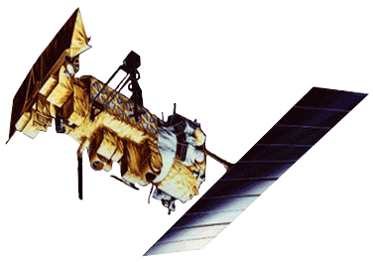










Structure of GK-2A Ground Segment
Outline
Ground Segment
Data Utilization Station
RF
RF
RF
RF
RF
RF
Command/
Telemetry
RF
RF
LRIT/HRIT/UHRIT
BB
BB
BB
BB
LRIT/HRIT/UHRIT
BB
BB
BB
BB
Testbed
Reception & Processing
Tracking, Telemetry & Command
Reception & Processing
Raw Data
Raw Data
Algorithm development
Preprocessing
RF/BB
Preprocessing
Level 1A/1B
DB
DB
Level 1A/1B
Reprocessing Simulator
Level 2/3
Level 2/3
Processing/Analysis
Processing/Analysis
Algorithm optimization
Level 0/1A/1B/2/3
Data Management
& Service
Foreign Satellite Data
Data Management & Service
Level 0/1A/1B/2/3, Foreign Satellite
Level 1B
Users
14

Slide 15
Development of GK-2A Meteorological Products(1/3)
KMA/NMSC has started to develop algorithms of fifty-two meteorological products for applying nowcasting, numerical weather prediction, climate and so on.
Development Schedule
2014-2016 : Algorithm Development
2017-2018 : Validation and Integration of Algorithm for Operation
4 Algorithm Groups
Cloud and Precipitation, Radiation and Aerosol, Atmosphere and Aviation, Scene analysis and Surface information
Radiative Transfer Model and Calibration/Validation
New Technique and Uniqueness of GK-2A Data Processing
Development “algorithm test-bed” to optimize scientific algorithm to operation system
Introduction of “optimal estimation” for consistency within products of cloud
“Discriminate clouds optical properties” to increase of products accuracy
Utilize “machine learning” to improve some product data accuracy
15

Slide 16
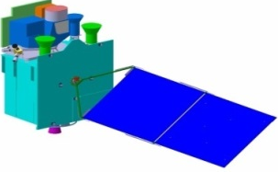
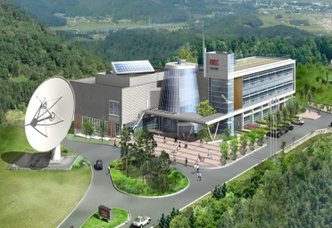
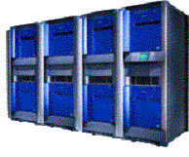


Development of GK-2A Meteorological Products(2/3)
Geo-KOMPSAT-2A
Ancillary data
NMSC/KMA
Image Processing
Level 1B
Archive and Service
Quality Monitoring
Pro-processing System
Data Processing System
Processing Flow
Scene Analysis
Cloud Mask | Snow Cover | Sea Ice
Cloud
Clear
Scene / Surface | Cloud / Precipitation |  |  | Radiation / Aerosol | Atmosphere /Aviation
FOG | CTT | CTP | CTH | RAD(CLD) | CI | TOZ (CLD)
 | CP | CT | CA
 |  |  |  |  | AMV | AII
 | COT | CER
 |  |  |  | VIS
 | LWP | IWP | CLH
 |  |  |  |  | VTP | VHP
 | RR | PoR | RP
 |  |  |  |  | Icing | OT
Scene / Surface |  |  | Radiation / Aerosol |  |  | Atmosphere /Aviation
SST | LST | OC | ADP | DADP | VAP | TOZ (CLR) | VTP | VHP
 |  |  | AOD | DAOD | RAD(CLR)
 |  |  |  |  |  | AII | SO2D | TPW
FF | VI | FVC
 |  |  | AER | VIS | RSR
 |  |  | DSR | ASR | DLR
 |  |  |  |  |  | TFTD
LSE | SAL | SD
 |  |  | ULR | OLR
* All Sky
16

Slide 17
Development of GK-2A Meteorological Products(3/3)
Scene & Surface Analysis (13) | Cloud & Precipitation (14) | Aerosol & Radiation (14) | Atmospheric condition & Aviation (11)
Cloud detection | Cloud Top Temperature | Aerosol Detection | Atmospheric Motion Vector
Snow Cover | Cloud Top Pressure | Aerosol Optical Depth | Vertical Temperature Profile
Sea Ice Cover | Cloud Top Height | Asian Dust Detection | Vertical Moisture Profile
Fog | Cloud Type | Asian Dust Optical Depth | Stability Index
Sea Surface Temperature | Cloud Phase | Aerosol Particle Size | Total Precipitable Water
Land Surface Temperature | Cloud Amount | Volcanic Ash Detection and Height | Tropopause Folding Turbulence
Surface Emissivity | Cloud Optical Depth | Visibility | Total Ozone
Surface Albedo | Cloud Effective Radius | Radiances | SO₂ Detection
Fire Detection | Cloud Liquid Water Path | Downward SW Radiation (SFC) | Convective Initiation
Vegetation Index | Cloud Ice Water Path | Reflected SW Radiation (TOA) | Overshooting Top Detection
Vegetation Green Fraction | Cloud Layer/Height | Absorbed SW Radiation (SFC) | Aircraft Icing
Snow Depth | Rainfall Rate | Upward LW Radiation (TOA)
Current | Rainfall Potential | Downward LW Radiation (SFC)
 | Probability of Rainfall | Upward LW Radiation (SFC)
17
Notes:
I want to explain the meteorological products a little more detail since the meteorological products will be also provided to end users. The algorithm will be completed within 2016 as mentioned in previous slide and will continue to test for operation.
As mentioned by previous slides, the number of products are 52 with the four categories such as cloud/rainfall, radiation/aerosol, atmospheric motion/conditions, and surface. And 52 specific names of the products are in this chart.

Slide 18
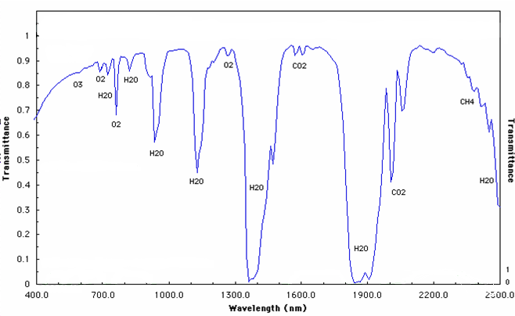
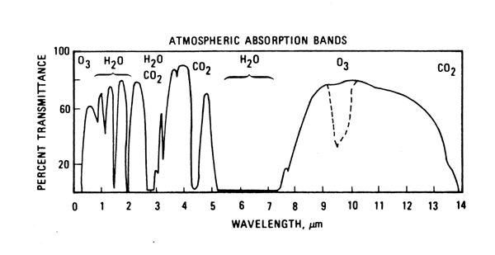
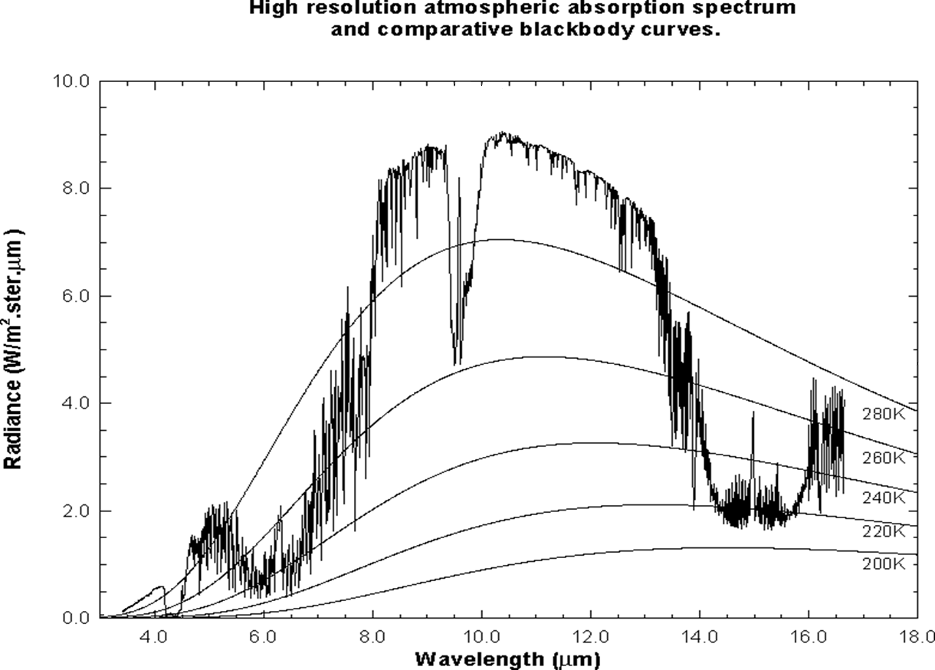
Scene Analysis
Tests for Cloud Detection
Single channel tests
Test on T11.2
REF 0.6(0.8)
REF 1.3 : Cirrus detection
BTD tests
BTD11.2-3.8 : nighttime low cloud
BTD11.2-8.7 : high semi-transparent cloud
BTD11.2-12.3 : Cirrus, cloud edge
Spatial texture tests
REF0.6 3x3, REF1.3 3x3
Tb3.8 3x3, Tb11.2 3x3, Tb12.3 3x3
Clear and cloudy pixel “restoring” test
Removing some false alarms passing through the previous test
Temporal test
Stationary, rapidly moving or developing clouds in twilight condition
1.38
1.61
0.47
0.51
0.86
0.64
7.34
11.2
6.95
8.5
10.4
12.3
9.61
13.3
3.9
6.19
18

Slide 19
Aerosol Products
Cloud-Screened TOA Spectral Reflectance over Land
Rayleigh and Gas Corrections
Precipitable Water, Total Ozone
Land Cover
Aerosol Detection (Dust, Smoke)
Surface Reflectance Data Base
Surface Reflectance Estimation Algor.
NDVI, MNDVI
Main Inversion Module for Aerosol Retrieval
Aerosol Mask, AOD, Size Parameter(AE)
Volcanic Ash
19

Slide 20
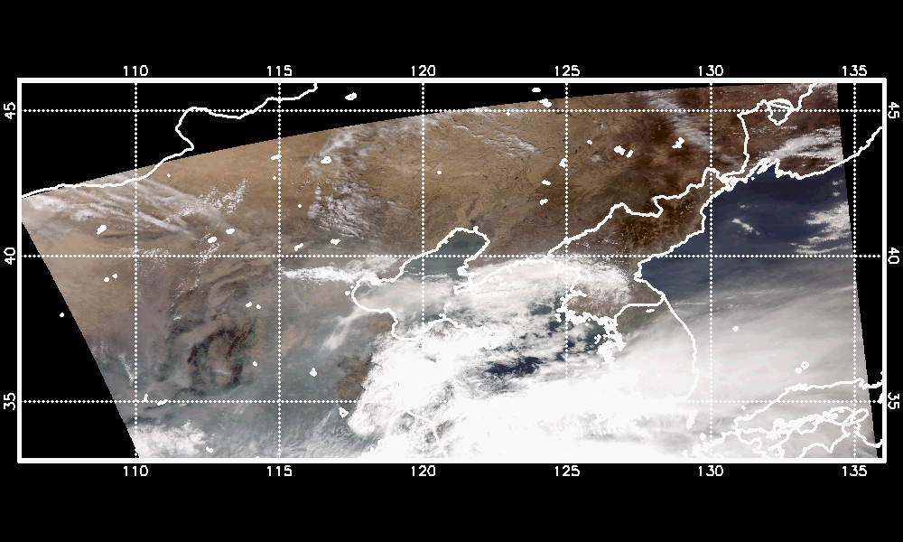
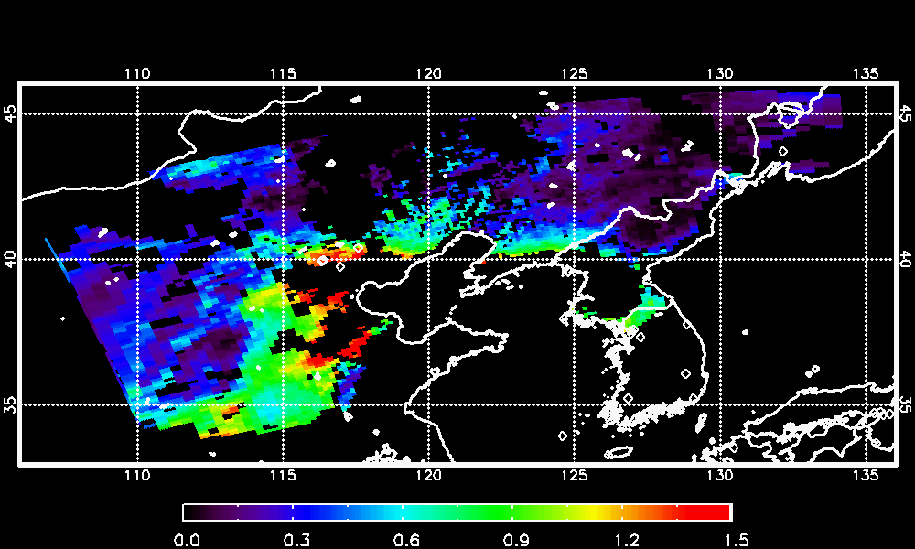
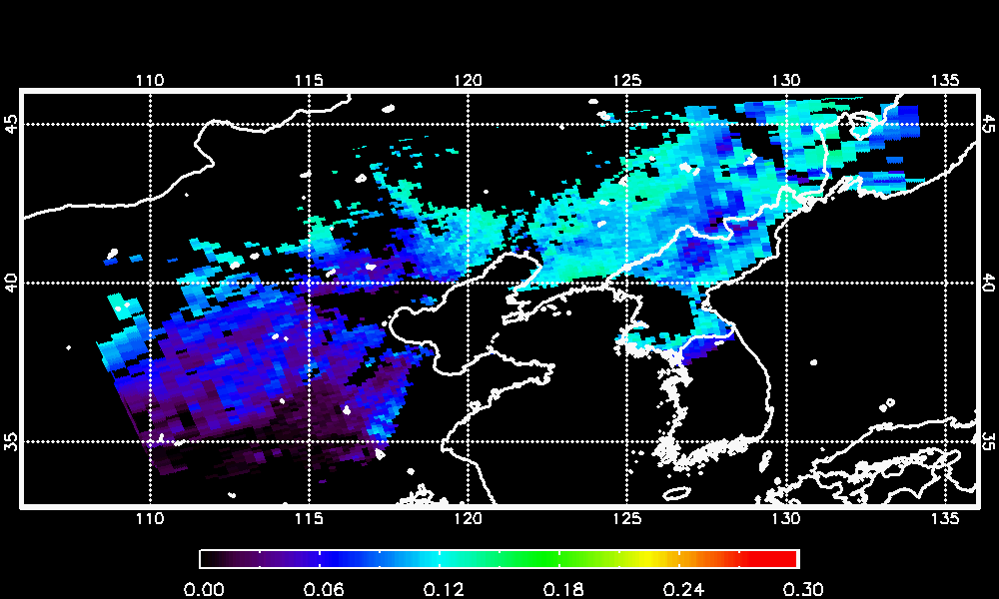
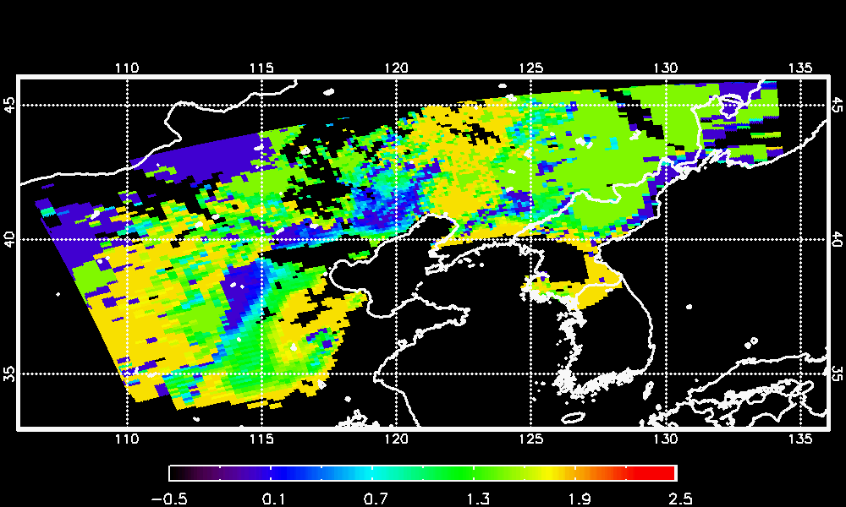
Aerosol Optical Depth and Size Parameter
RGB Image
Aerosol Optical Depth (AOD)
Surface Reflectance
Aerosol Size Parameter (Angstrom Exp.)
20

Slide 21
Process of Cloud Products
L2B radiance, brightness temperature, cloud mask
Cloud emissivity (8.5, 11.2, 12,3 μm)
Cloud phase
Radiance fitting
Multi-layer clouds
Cloud top temperature/pressure/height
Nighttime cloud optical thickness/cloud effective radius
Cloud type
Clustering
Cloud amount
Cloud fraction
21

Slide 22
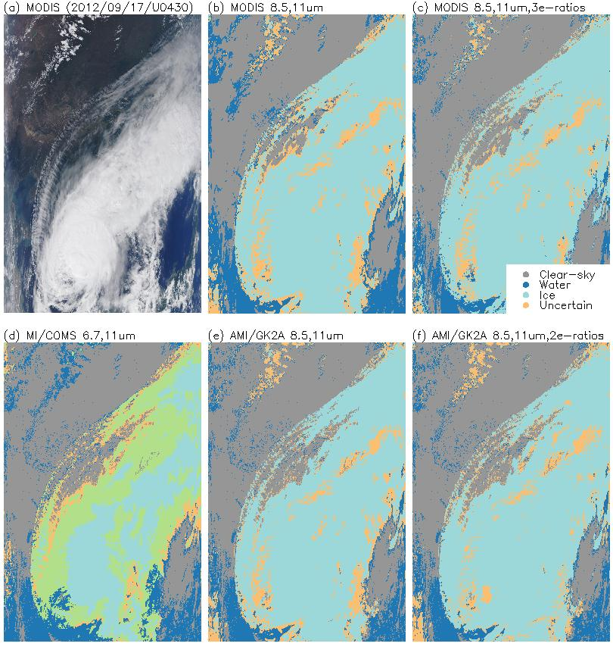
Cloud Phase (CP)
RGB
MODIS C5
MODIS C6
MODIS RGB
MODIS Collection 5 CP
MODIS Collection 6 CP
COMS MI CP
Tb6.7, Tb11
* ice, water, mixed, uncertain
(e) GK-2A AMI CP (interim)
Tb8.5, Tb11.2
(f) GK-2A AMI CP (final)
Tb8.5, Tb11.2
Emissivity ratios over land and ocean
* ice, water, uncertain
MI
AMI (interim)
AMI (final)
22

Slide 23
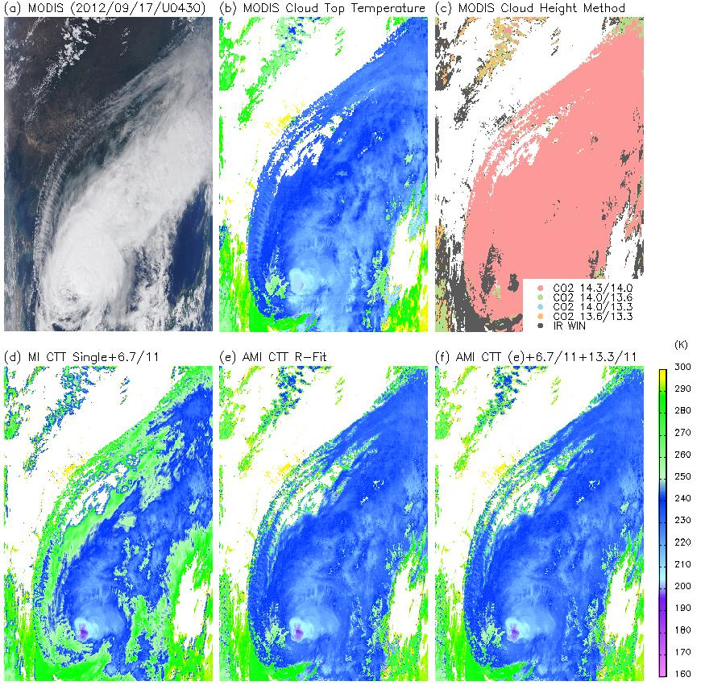
Cloud Top Temperature (CTT)
RGB
MODIS C5
MODIS C6
MODIS RGB
MODIS Collection 5 CTT
MODIS Collection 6 CTT
COMS MI CTT
Tb11 fitting
Ratioing method (Tb6.7/11)
(e) GK-2A AMI CTT (interim)
Radiance fitting method
(f) GK-2A AMI CTT (final)
Radiance fitting
Ratioing method
(Tb6.7/11 & Tb13.3/11)
MI
AMI (interim)
AMI (final)
23

Slide 24
Vertical temperature/humidity profile & Instability index
Clear Sky
Run RTTOV
(inputs: ε, x₀ get: T_{B,0})
yes
yes
T_{B}(obs) - T_{B,n+1}(cal) < threshold?
Final profile: x₀
Input data
no
Clear
sky?
Iteration start
Satellite data
NWP data
Surface emissivity
Background error covariance
Calculate RTTOV Jacobian(K_{n})
Instability Index
Solve equation (x_{n+1} )
Lifted Index
K Index
Showalter Index
Total Totals
CAPE
no
Run RTTOV forward model (T_{B,n+1})
T_{B} (obs) - T_{B,n+1}(cal) < threshold?
no
Exit
yes
No profile found
24
Final profile: x_{n+1}
24

Slide 25
Atmospheric Motion Vector (AMV)
Regular interval
Optimal selection
AMV: vector describing the displacement of clouds or water vapor features over three consecutive images, together with a vector height
Height
Assignment
QI, QC, EE
Tracking
CCC + Gaussian model (low level)
Gaussian model + Coldest cluster (high level)
Target
Selection
AMV Process
25

Slide 26
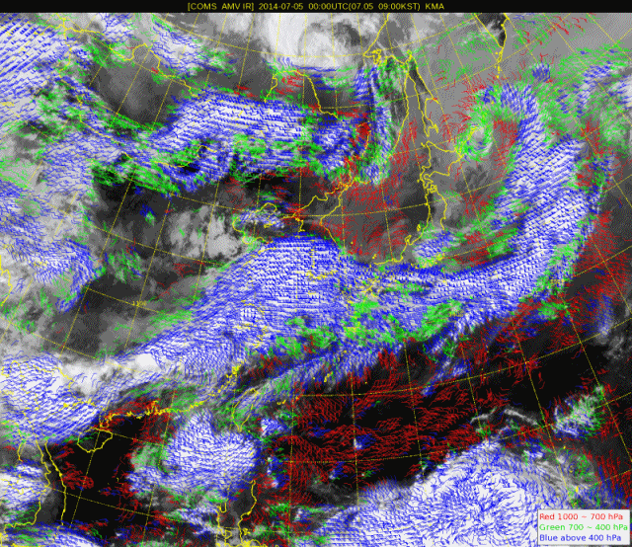
AMV using COMS data
Usage
Input data of NWP model
Monitoring of convective system movement

Slide 27
Development of Integrated Analysis & Application Facilities
Based on GK-2A 52 meteorological products and auxiliary data
Main applications are as follows:
Nowcasting
Typhoon and Marine meteorology
Numerical weather prediction
Environment and Hydrology
27

Slide 28
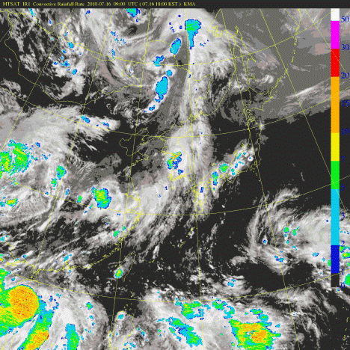
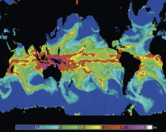
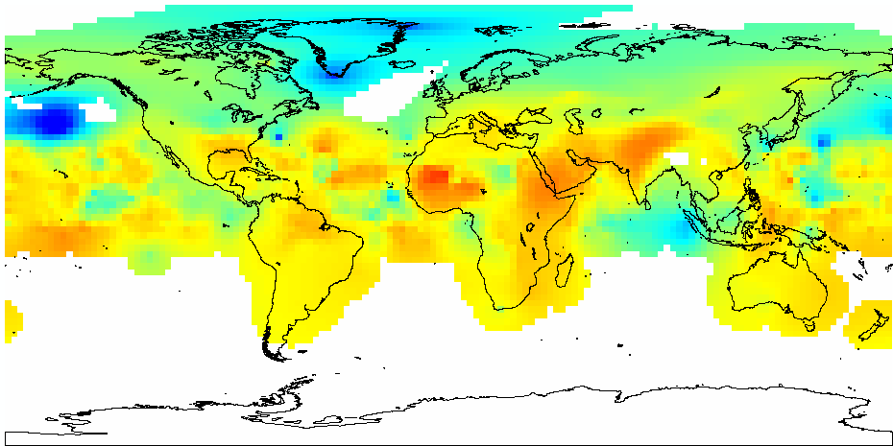
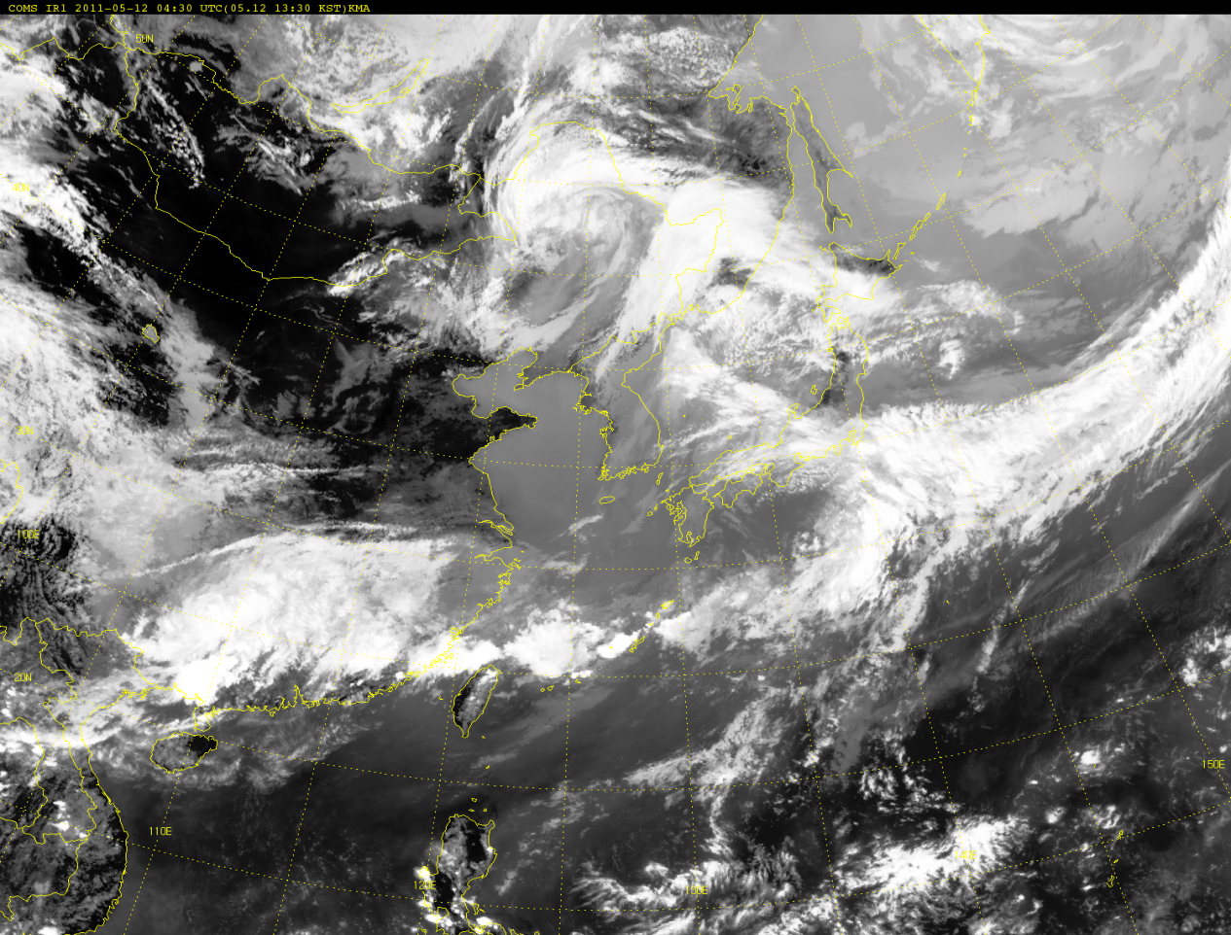
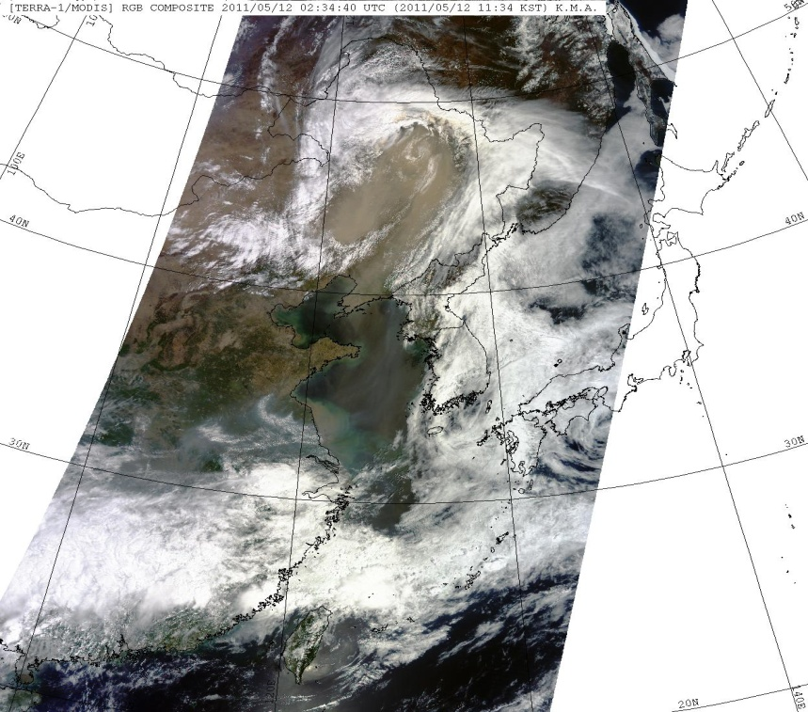

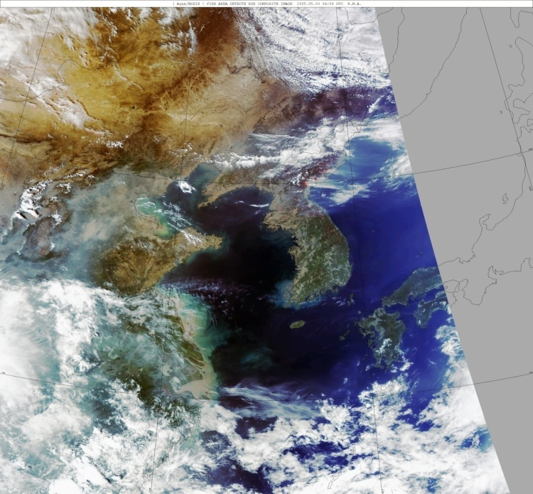
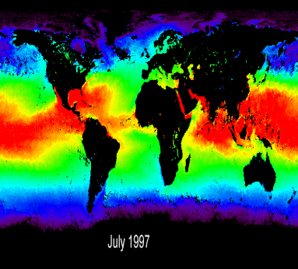
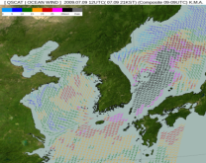
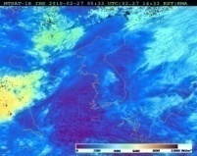
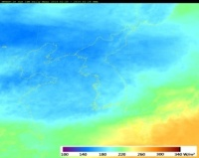
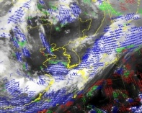
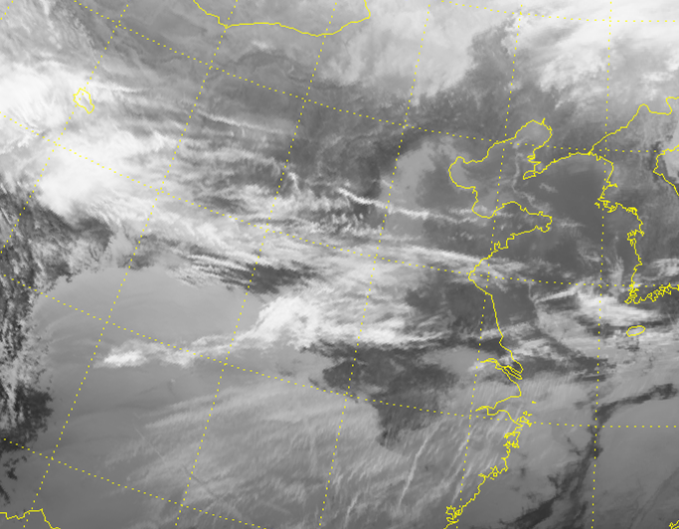
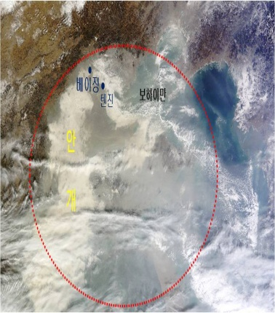
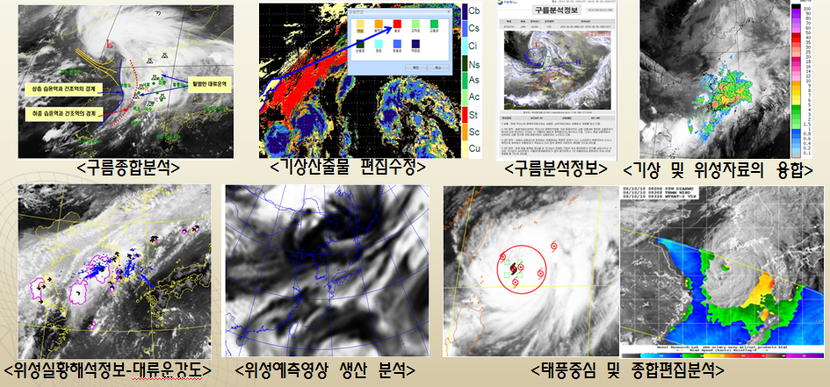
Development of data processing and application technique
Production of various products
- Support for quantitative data extraction
Black and White image → Detection of yellow dust/fog by using RGB composite image
Yellow dust
Rainfall
TPW
Greenhouse gases
Color
composition
Wildfire
SST
Sea surface wind
COMS
GEO-KOMPSAT-2A
Insolation
Upward radiation
AMV
Support for integrated forecast analysis by using various application technique
Color
composition
Fog
COMS
GEO-KOMPSAT-2A
Black and White image
Color image
28
Notes:
Here shows summary and some of example of production and application of the products.
The developed products will be used for supporting forecast, NWP, and various application area.
One of improvement in image analysis is the true color image as demonstrated in right panels such as Asian dust, Yellow dust in Korea due to its color, and Fog.

Slide 29
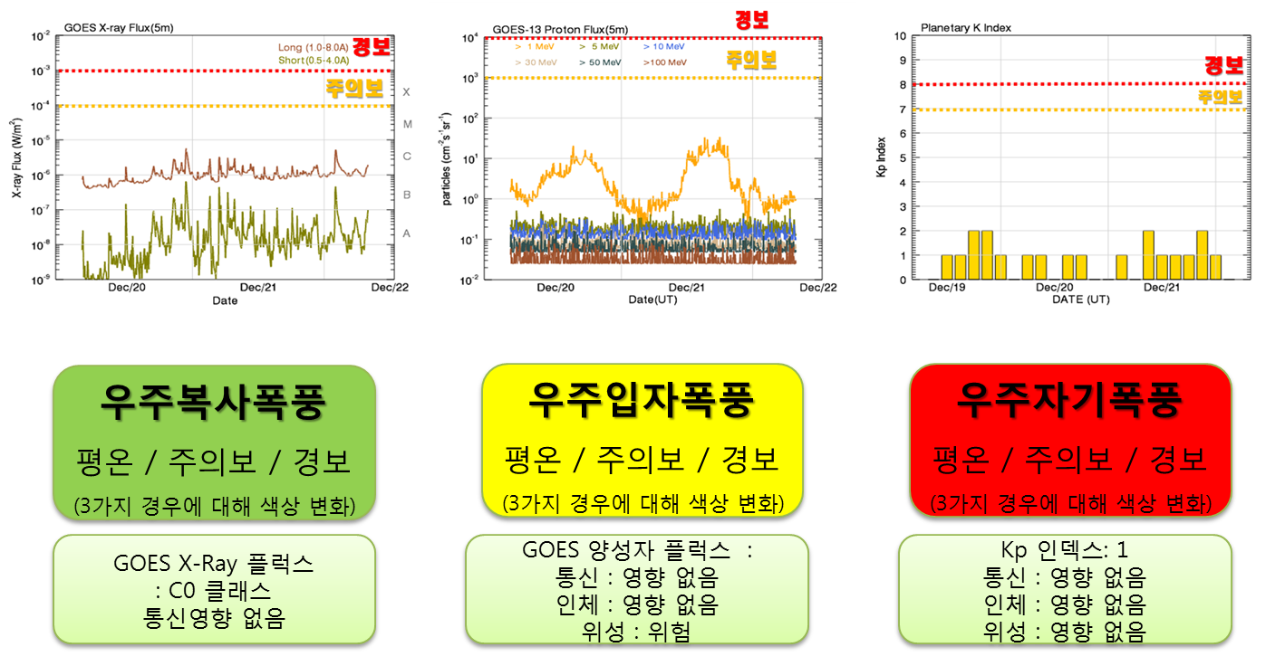
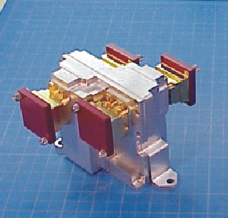
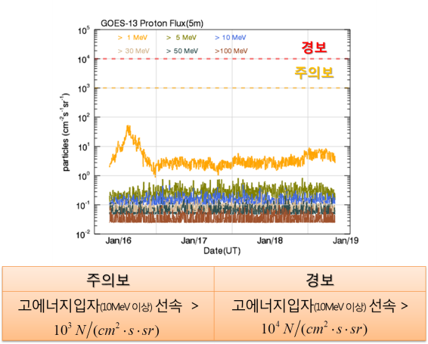
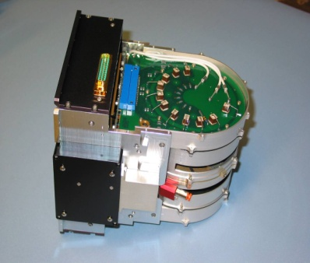
Development of techniques in space weather
Korea Space Environment Monitor(KSEM)
Measurement of electron on mid energy range and magnetic field
Sensor Unit | Measurement Range | Accuracy | Time Resolution | Remark
Particle Detector | 100KeV ~ 2MeV | <30%(ΔE/E) | 0.33s | 6 measurement direction
Magnetic Field Sensor | -350nT ~ +350nT | <1nT | <0.1s | Boom type
Charging Monitor | -3pA/cm² ~+3pA/cm² | <0.01 pA/cm² | < 1s | -
Support for stable operation of GEO-KOMPSAT-2A
Data
Products(5)
Time(satellite position)
Energy channel
(electron)
Particle flux
(each direction)
Magnetic field flux(3axis)
Background flux
Noise
Payload monitoring data
(Voltage, darkcurrent, etc.)
real-time high energy particle distribution over the radiation belt
3D particle distribution /prediction
deep dielectric charging prediction index
geomagnetic storm index(2)
29
Notes:
Korea Space Environment Monitor(KSEM) loaded in GEO-KOMPSAT-2A
measures the electron flux on mid-level energy range, magnetic field
and the charging current due to high energy particles for space weather
and to support for stable operation of GEO-KOMPSAT-2A.
KMA will develop the 5 more products in the area of space weather in addition to 52 meteorological products.

Slide 30


