Slide 1
Data Distribution/dissemination Method

Slide 2
Data distribution/dissemination methods
Two Ways of Himawari-8/9 Imagery
Dissemination/Distribution
HimawariCast via Communication Satellite
Service for Everyone
No Pass Code for Receiving
JMA’s Baseline for Imagery Dissemination
14 bands (1 VIS and 13 IR) every 10 minutes for Full Disk
Spatial Resolution is same as that of MTSAT HRIT compatible
HimawariCloud via Internet Cloud
Service for NMHSs with high-speed Internet access
All 16 bands (3 VIS and 13 IR)
Full Specification (temporal and spatial) of Imagery

Slide 3
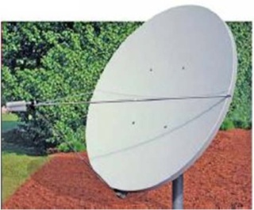
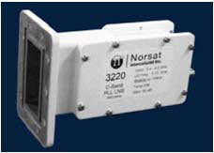
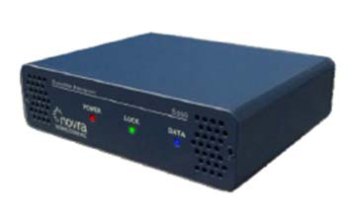
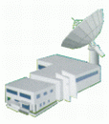
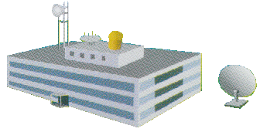
Data distribution/dissemination methods
Communication Satellite (CS)
Himawari-8/9
HimawariCast
service
C-band antenna
raw data
HRIT files,
LRIT files,
SATAID files
LNB
CS Operator
DVB-S2 receiver
All imagery
(full data)
PC & software
JMA
HimawariCloud service
NMHSs
Users

Slide 4
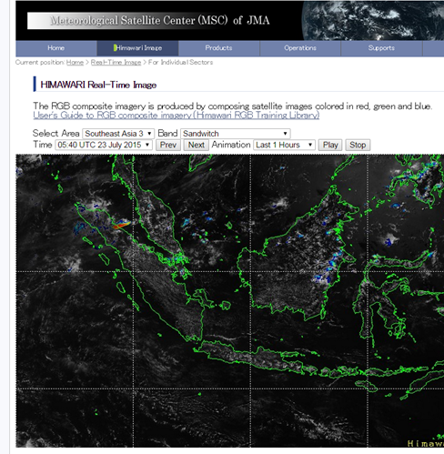
Imagery service through MSC website
Real-time JPEG imagery service through MSC website for Asia-Oceania region
Providing imagery on MSC website
Easy access to Himawari imagery
- Processed into sectored images in JPEG format for
Australia
Central Asia
Pacific Islands
Southeast Asia
and more....
on real-time basis with animation in the last 24 hours
http://www.data.jma.go.jp/mscweb/data/himawari/index.html

Slide 5
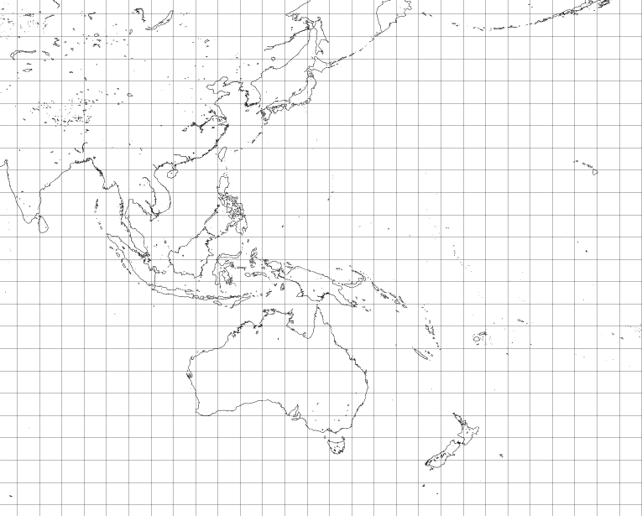
Real-time JPEG Imagery Service through JMA/MSC Website for Asia-Oceania Region
Central Asia
Hi-res. Asia 2
South-east Asia 1
South-east Asia 2
Hi-res. Asia 3
Pacific Islands 1
Hi-res. Asia 1
Pacific Islands 2
Hi-res. Asia 4
Pacific Islands 3
South-east Asia 3
Pacific Islands 6
Pacific Islands 5
Pacific Islands 4
Australia
New Zealand

Slide 6
Enhancement in Himawari-8 Geophysical Products

Slide 7
Level-2 DAY-1 Products from Himawari-8/9 AHI
Increased Observation Spectral Bands
VIS: 1 --> 3
NIR/IR : 4 --> 13
with Higher Resolution
Spatial: 1km --> 0.5km for a VIS band 4km --> 2 km for IR bands Temporal: 1 hr --> 10 min for “full disk” 2.5min for limited areas
….. will Enhance Baseline DAY-1 Products, especially
- Cloud Products (incl. Rapidly Developed Convective Clouds)
- Atmospheric Motion Vectors (AMVs)/Clear Sky Radiances (CSRs)
- Aerosol (incl. Asian Dust) / Volcanic Ash
Numerical Weather Prediction
Severe Weather Monitoring
Environmental Monitoring

Slide 8
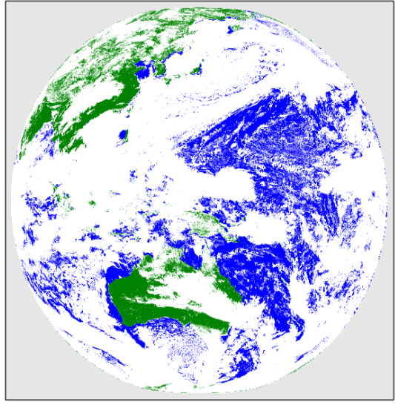
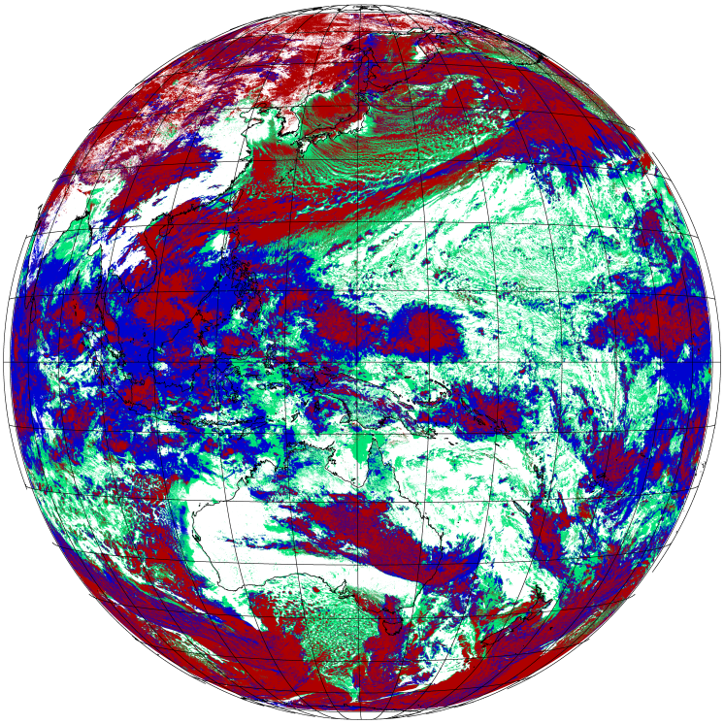
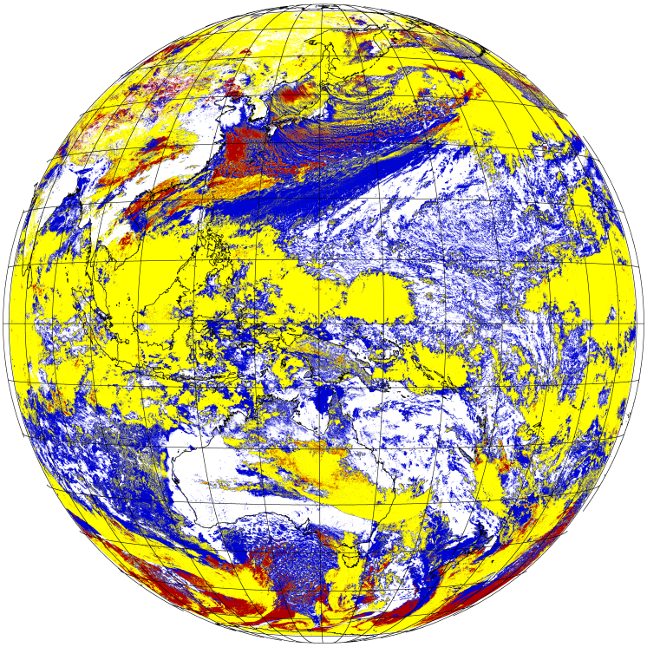
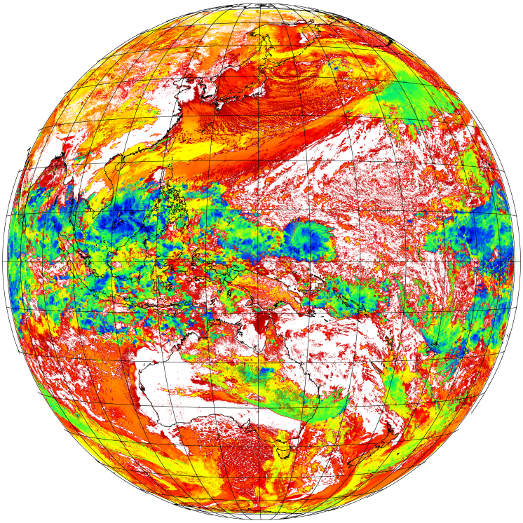
Cloud Products from Himawari-8/9 AHI
Extracted Parameters: Cloud Mask, Type, Phase, and Top Height
Algorithm is based on NWC-SAF^{*1} and NOAA/NESDIS^{*2}
(*1) Meteo-France 2012: Algorithm Theoretical Basis Document for “Cloud Products” (CMa-PGE01v3.2, CT-PGE02 v2.2 & CTTH-PGE03 v2.2) http://www.nwcsaf.org/HD/MainNS.jsp
(*2) Andrew Heidinger, 2011: ABI Cloud Mask, NOAA NESDIS CENTER for SATELLITE APPLICATIONS and RESEARCH ATBD
http://www.goes-r.gov/products/baseline.html
Cloud Mask
Type
Phase
Cloud Top Height
[m]
Cloud
Mixed Phase
18,000
Fractional
Clear
Ocean
Semi-transparent
Liquid
9,000
Clear
Land
Ice
Opaque
0

Slide 9
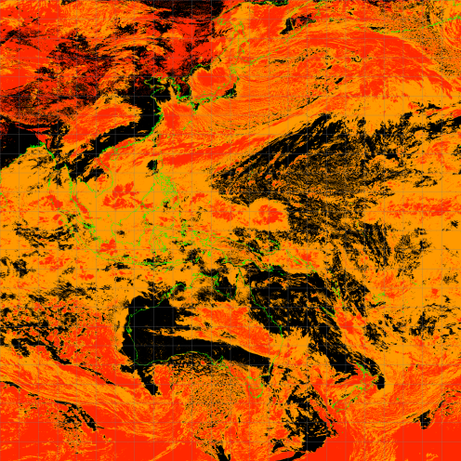
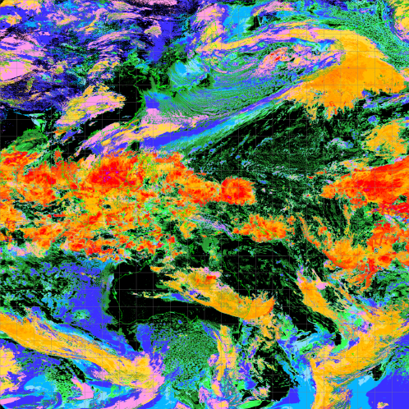
Objective Cloud Analysis Information (OCAI)
Basic cloud product with latitude-longitude grid in 0.05 degree.
cloud mask, cloud type and cloud top height
Be produced hourly
Started to provide to NMHSs, e.g. Indonesia and Myanmar, in response to requests.
Cloud Mask
Cloud Top Height
Clear
Mixed
Cloud

Slide 10
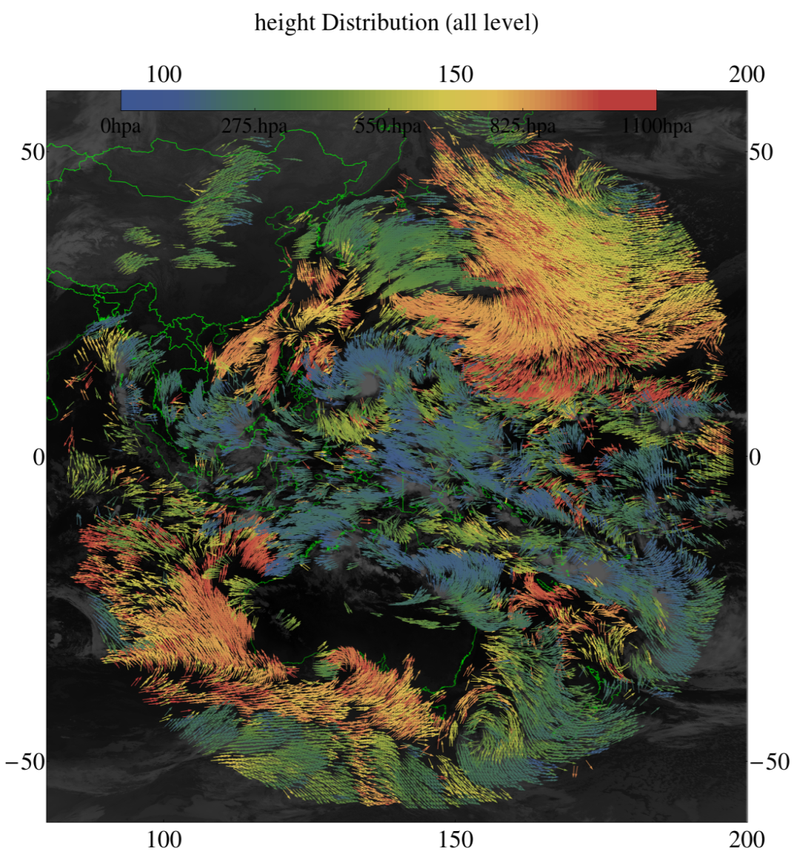
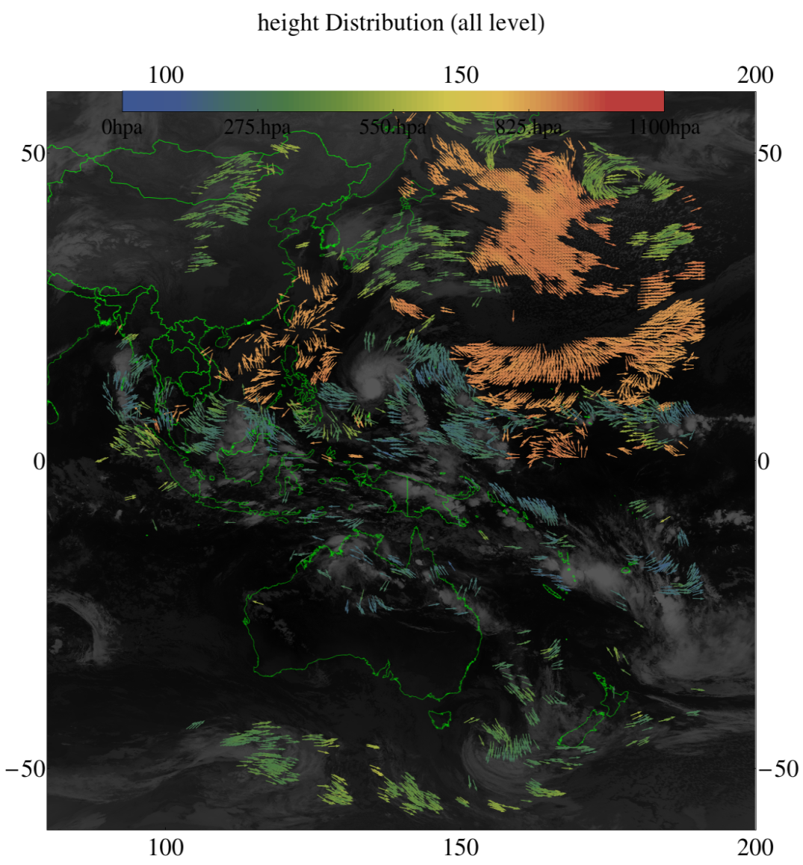
Improvement in Atmospheric Motion Vectors (AMVs) Retrieval
Himawari-8 AMVs derived from Himawari-8 imagery with new algorithm
MTSAT-2 AMVs derived from MTSAT-2 imagery and heritage algorithm
Resolution 2km/10min.
Resolution 4km/30min.
Resolution 4km/60min.
Colder color : upper level wind warmer color : low level wind
Himawari-8 and MTSAT-2 IR AMV (QI>60, 2015 01 14 1700UTC)

Slide 11
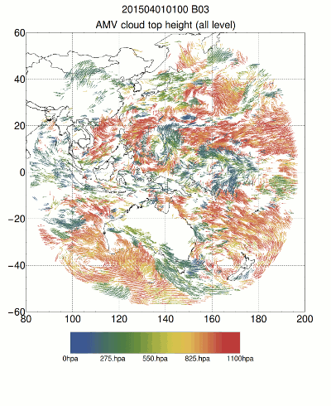
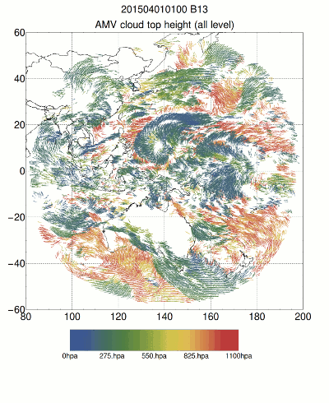
Atmospheric Motion Vectors (AMVs)
JMA/MSC has developed a new algorithm for Himawari-8 AMVs based on an optimal estimation method for full exploitation of satellite data (Shimoji 2014).
Validation results are informed to NWP users (IWW mailing list)
Band #3 (VIS)
Band #13 (IR)

Slide 12
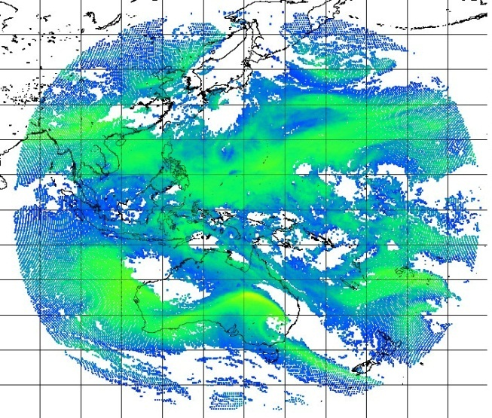
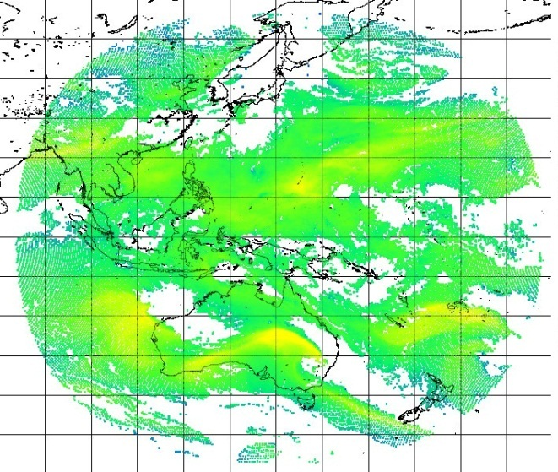
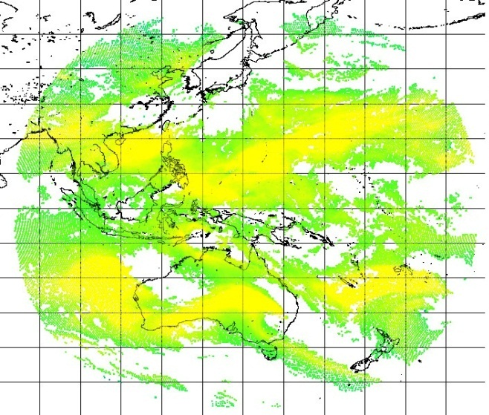
Clear Sky Radiances (CSRs)
Area averaged clear sky radiance and brightness temperature.
Specifications:
All IR bands (3.9, 6.2, 6.9, 7.3, 8.6, 9.6, 10.4, 11.2, 12.4, 13.3 um)
Full disk, Hourly produced
Spatial resolution (size of area for averaging): 16 x 16 pixel (IR) (32 x 32 km @SSP)
Band #8 (6.2 um)
Band #9 (6.9 um)
Band #10 (7.3 um)
03 UTC 20 April 2015

Slide 13
Overview of Himawari-8
Himawari-8 began operation on 7th July 2015.
Himawari-8 has remarkable advantage in spatial resolution, observation frequency and the number of observation spectral bands over MTSAT-2.
Those advantage enhanced Geophysical Products.
Himawari-8 data are distributed and disseminated via HimawariCast and HimawariCloud.

Slide 14
Thank you for
your kind attention
JMA mascot “Harerun”

