Slide 1
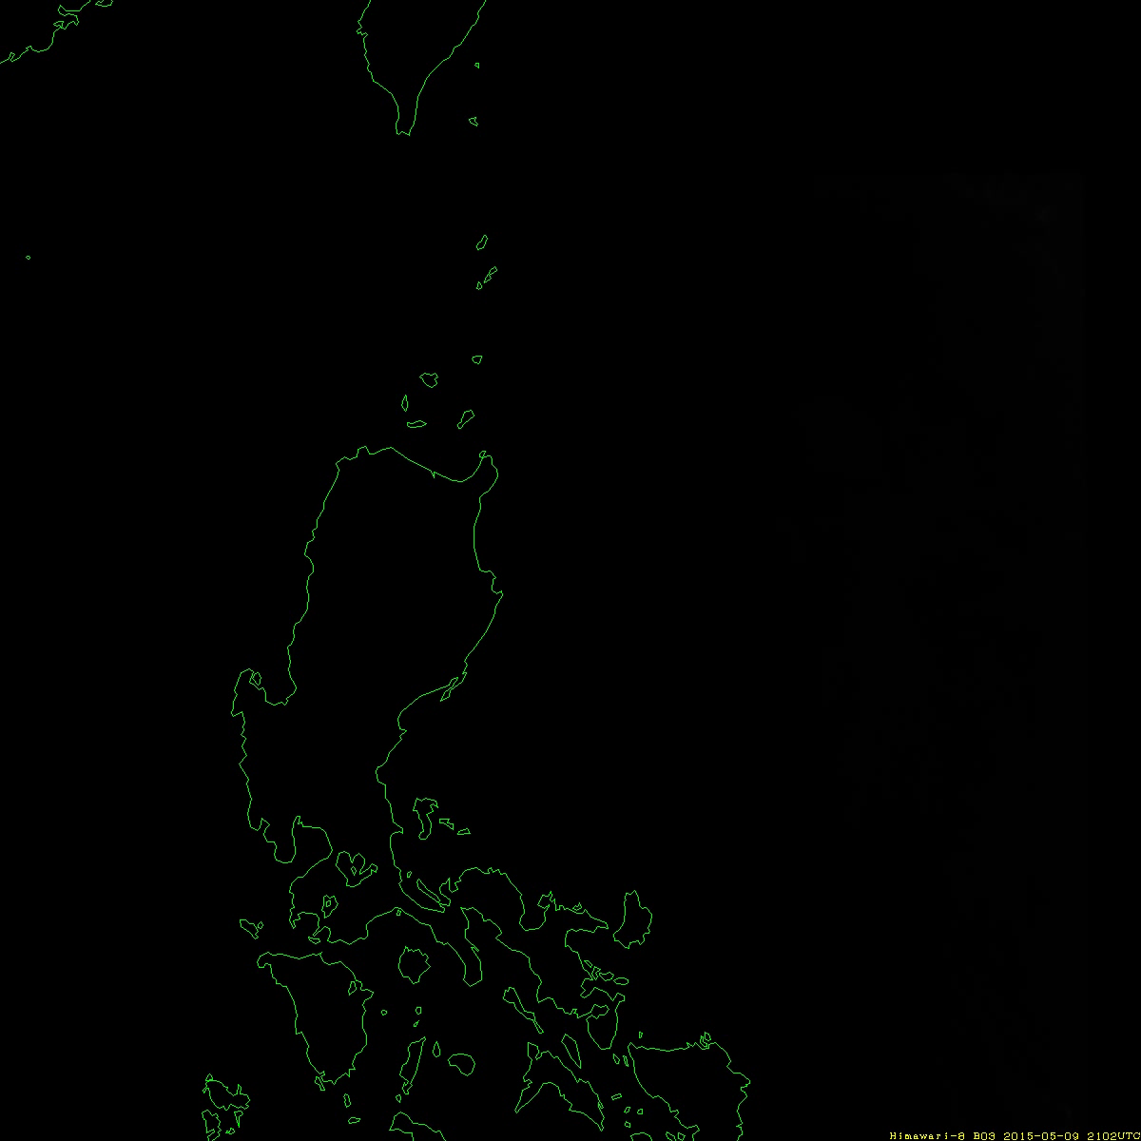
Target Area Observation (Typhoon)
Estimated position by interpolation between two forecast(current) positions
Typhoon center position
(Forecast FT=FT₂)
Typhoon center position
(Forecast FT=FT₁)
Typhoon position (current)
21 UTC on 9th – 10 UTC on 10rh, May 2015
Typhoon Noul (2015) Band 03

