Slide 1
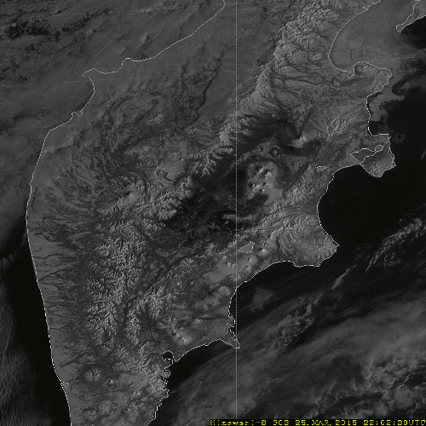
Target Area Observation (Volcano)
Target Area Observation
Frequency of observation
every 2.5 min.
Range of observation
1000km x 1000km
Target of observation
Volcano, Typhoon, etc…
(Optional Area)
Mt. Shiveluch in Kamchatka
Band-03 (0.64 µm, visible)
Every 2.5 minutes

