Slide 1
An introduction of Japanese new geostationary meteorological satellite, Himawari-8
Meteorological Satellite Center of JMA
Tasuku TABATA

Slide 2
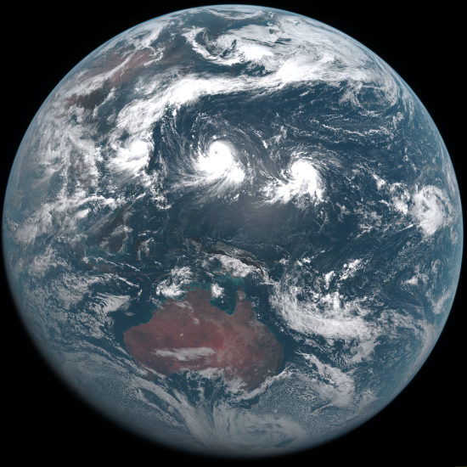
Himawari-8 began operation
at 02:00 UTC on 7th July 2015.

Slide 3
Contents
Outline of Himawari-8
Data Distribution/dissemination Method
Enhancement in Himawari-8 Geophysical Products

Slide 4
Outline of Himawari-8

Slide 5
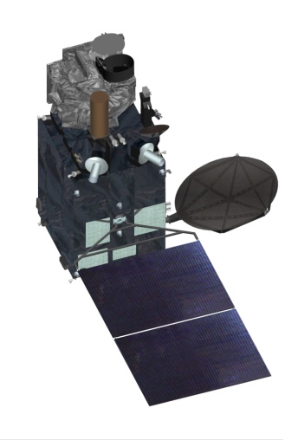
Outline of Himawari-8
Advanced Himawari Imager (AHI)
Geostationary position | Around 140.7° E
Attitude control | 3-axis attitude-controlled geostationary satellite
Communication | 1) Raw observation data transmission Ka-band, 18.1 - 18.4 GHz (downlink)
 | 2) DCS International channel 402.0 - 402.1 MHz (uplink) Domestic channel 402.1 - 402.4 MHz (uplink) Transmission to ground segments Ka-band, 18.1 - 18.4 GHz (downlink)
 | 3) Telemetry and command Ku-band, 12.2 - 12.75 GHz (downlink) 13.75 - 14.5 GHz (uplink)
communications antennas
solar panel
Himawari-8 began operation on 7 July 2015, replacing the previous MTSAT-2 operational satellite
 | 2005 | 2006 | 2007 | 2008 | 2009 | 2010 | 2011 | 2012 | 2013 | 2014 | 2015 | 2016 | 2017 | 2018 | 2019 | 2020 | 2021 | 2022 | 2023 | 2024 | 2025 | 2026 | 2027 | 2028 | 2029
MTSAT-1R MTSAT-2
Himawari-8 Himawari-9
operation
standby
standby
operation
standby
a package purchase
manufacture
launch
operation
standby
manufacture
launch
standby
operation
standby

Slide 6
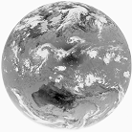
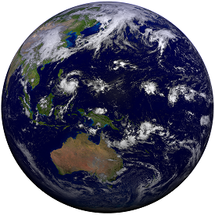
Advantage of AHI
Improved spatial resolution
More spectral bands
MTSAT-1R/2
Himawari-8/9
VIS
VIS
1 band
3 bands
VIS 1 km
IR 4 km
VIS 0.5/1 km
IR 2 km
More frequent observation
R
G
B
１０min.
NIR
３０min.
3 bands
１０min.
１０min.
IR
IR
More flexible regional observation
4 bands
10 bands
Special
observation
Target area obs. every 2.5 minutes
5 bands
16 bands

Slide 7
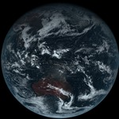
Characteristics of AHI 16 Spectral bands
as of MTSAT-1R/2
Similar to ABI for GOES-R
Band | Wavelength [µm] | Quantization [bit] | Spatial Resolution (km)
1 | 0.46 | 11 | 1km
2 | 0.51 | 11 | 1km
3 | 0.64 | 11 | 0.5km
4 | 0.86 | 11 | 1km
5 | 1.6 | 11 | 2km
6 | 2.3 | 11 | 2Km
7 | 3.9 | 14 | 2Km
8 | 6.2 | 11 | 2Km
9 | 7.0 | 11 | 2Km
10 | 7.3 | 12 | 2Km
11 | 8.6 | 12 | 2Km
12 | 9.6 | 12 | 2Km
13 | 10.4 | 12 | 2Km
14 | 11.2 | 12 | 2Km
15 | 12.3 | 12 | 2Km
16 | 13.3 | 11 | 2Km
True Color Image
RGB band
Composited
VIS
0.51 µm (Band 2)
instead of ABI’s 1.38 µm
IR4
IR3
Water vapor
SO2
O₃
IR1
Atmospheric
Windows
IR2
CO2

Slide 8
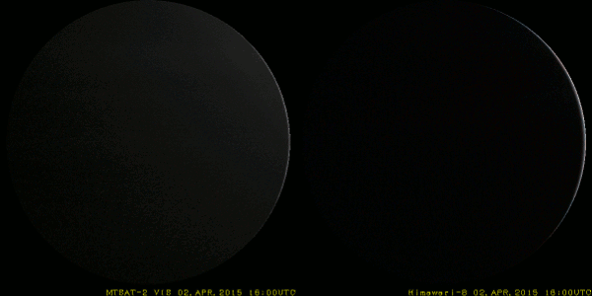
Dawn of a “New Era”
02:40 UTC on 18 December 2014
April 2, 16UTC - April 3, 13UTC
MTSAT-2
Hourly in Monochrome
Himawari-8
every 10 minutes in Full-Color

Slide 9
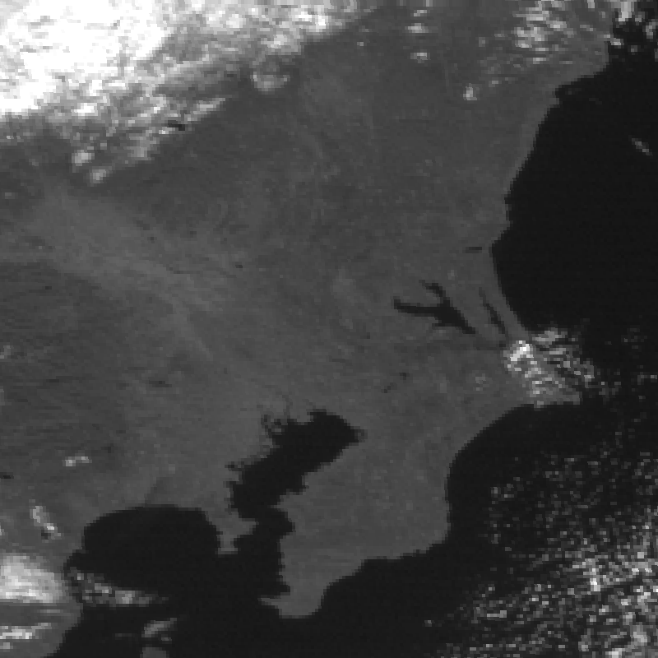
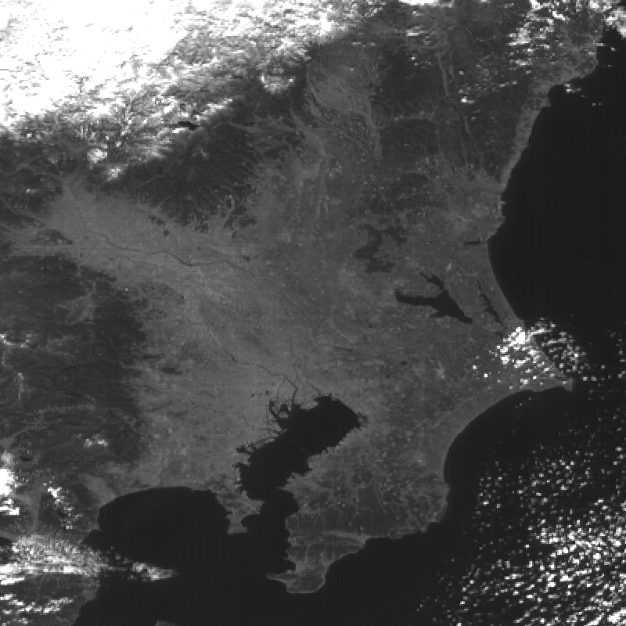
Advantage of Resolution
Visible Band
Himawari-8 (0.5km)
MTSAT-2 (1km)
Tokyo
Tokyo
03:00 UTC on 29 January 2015

Slide 10
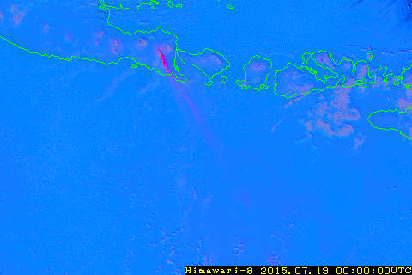
Advantage of many spectral bands
Combination of B11, B13 and B15
Mt. Raung volcano, in Indonesia
Shimizu-san will lecture particularly about RGB in next term.

