Slide 1



Introduction of JMA VLab Support Site on RGB Composite Imagery
The Science Week 2015
Collaboration with Australian BoM-JMA
A
M
J
Akihiro SHIMIZU
Analysis Division, Data Processing Department
Meteorological Satellite Center (MSC), JMA

Slide 2
Table of Contents
Introduction of JMA VLab support site on RGB composite imagery
Short lecture of RGB composite imagery by VLab support site material

Slide 3
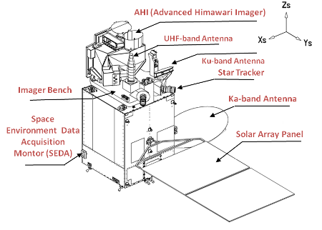
Introduction of JMA VLab support site on RGB composite imagery
http://www.data.jma.go.jp/mscweb/en/himawari89/space_segment/spsg_spacecraft.html

Slide 4
Background of Opening of VLab Support Site on RGB composite imagery
RGB composite technique is in the “spotlight” as an effective use of the AHI/Himawari-8 imagery data.
The Himawari user community is not familiar with RGB composite imagery.
→ The basic RGB materials are necessary.

Slide 5
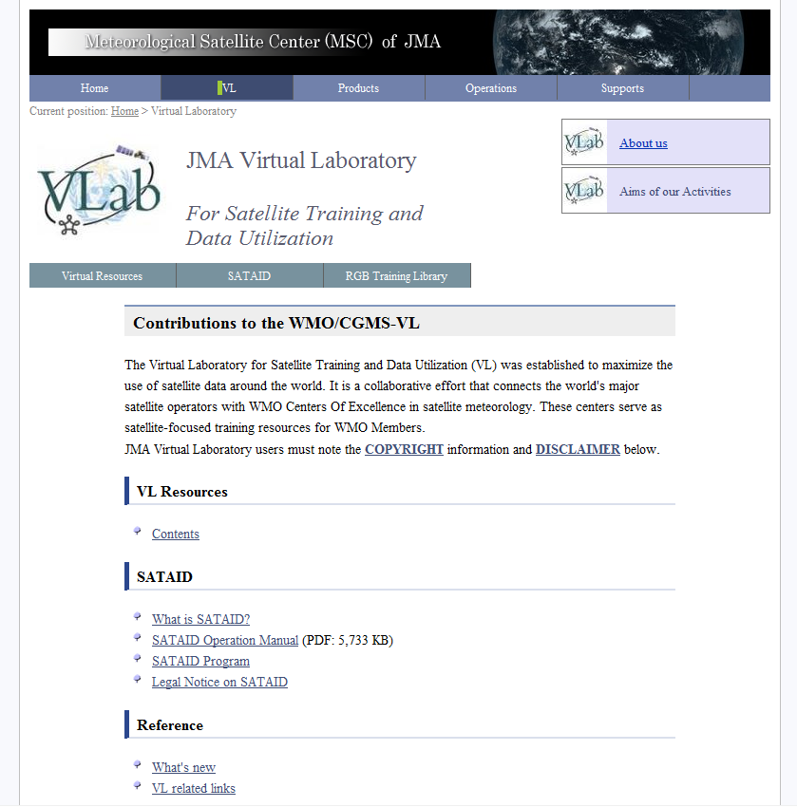
Updated top page
of JMA VLab site
Link button to the RGB training page has been added here!
http://www.data.jma.go.jp/mscweb/en/VRL/index.html

Slide 6
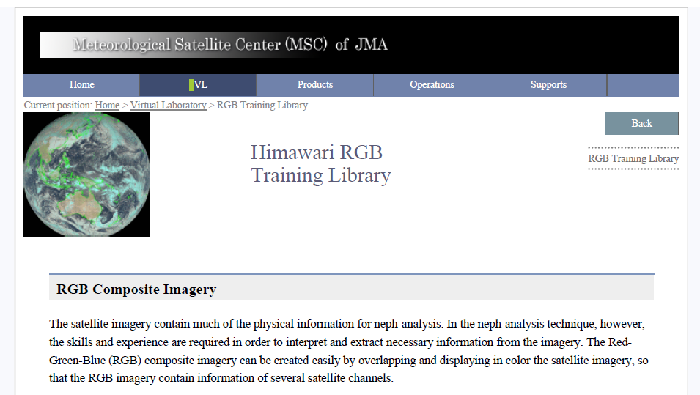
Introduction/outline
Training materials (PowerPoint and PDF)
Introduction/outline of RGB composite imagery
Useful links
Overview of the training library page of RGB composite imagery
http://www.data.jma.go.jp/mscweb/en/VRL/VLab_RGB/RGBimage.html

Slide 7
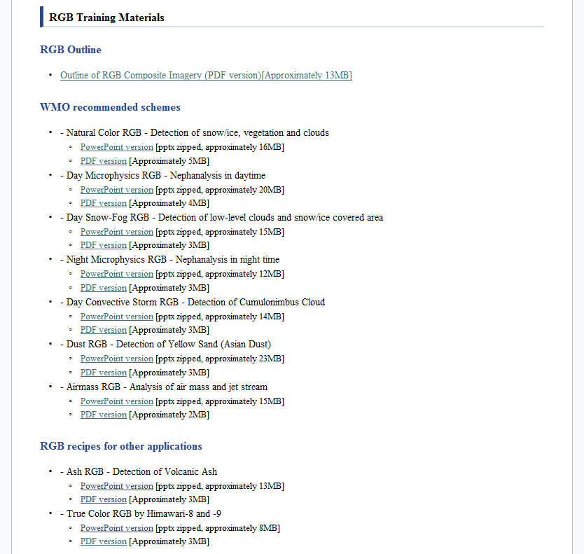
Training materials
Outline of RGB composite imagery based on EUMETSAT’s technique
Materials for seven WMO recommended schemes
Almost all imagery are derived from Himawari-8.
As for detailed case studies (e.g. Visibility obstruction by fog 2015/XX/XX/XX UTC), they will be prepared and open at the stage when knowledge still more deepened.
Materials except for WMO recommended schemes
JMA’s True Color RGB material is here!

Slide 8
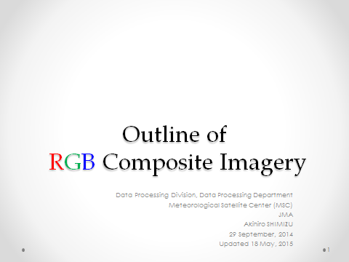
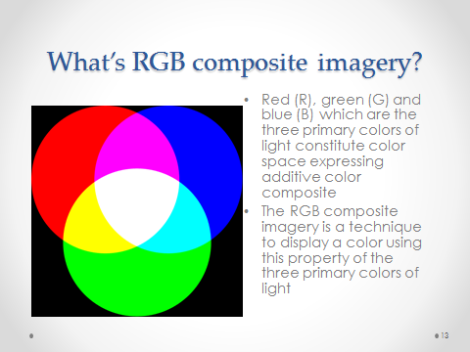
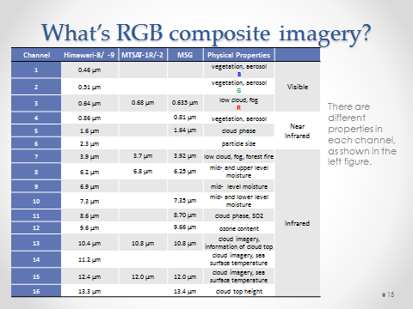
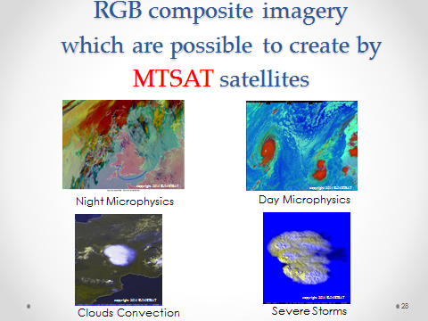
Example of materials
Outline material on RGB composite imagery
This material is based on the material of JICA training event 2014

Slide 9
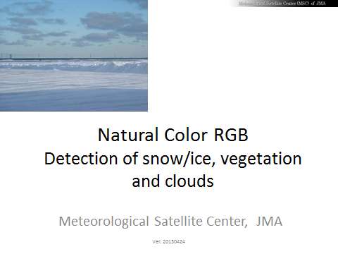
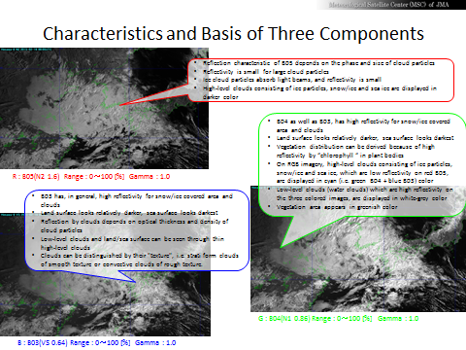
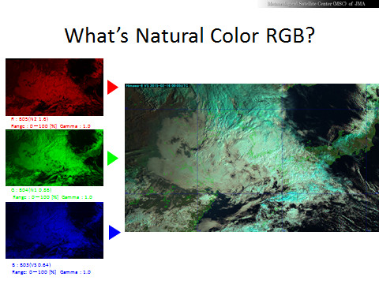
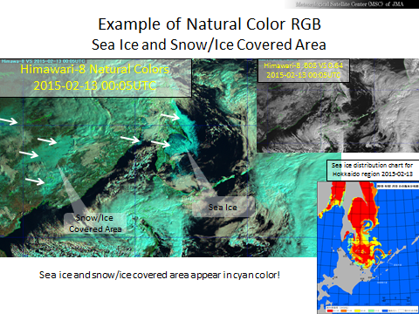
Example of materials
Natural Color RGB
This material reproduces the EUMETSAT/MSG recipe by using “Himawari8/AHI“ imagery.

Slide 10
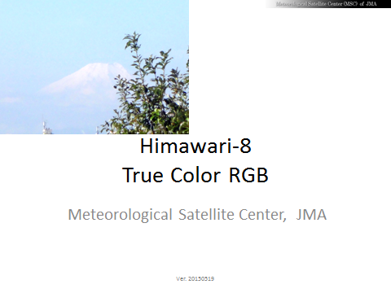
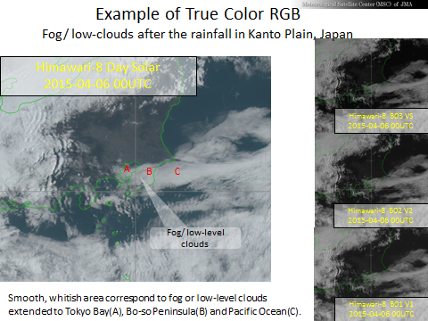
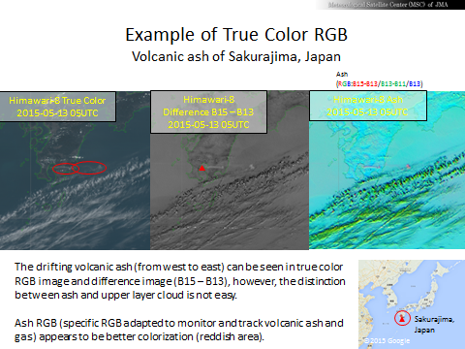
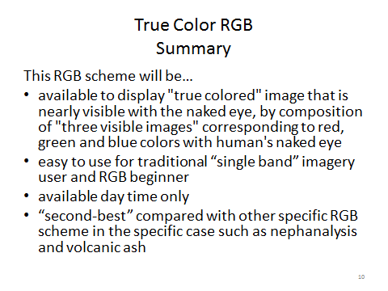
Example of materials
This scheme is Himawari's own recipe!
True Color RGB

Slide 11
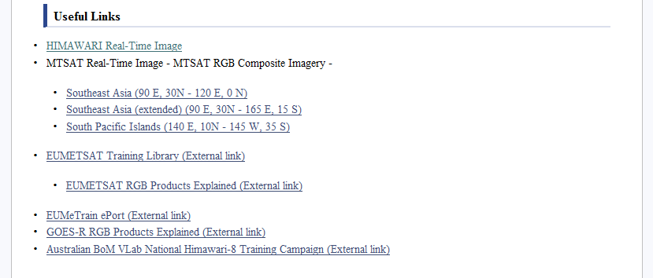
Useful links
Links to Himawari real-time image including the RGB composite imagery
Links to MTSAT real-time image including the RGB composite imagery
EUMETSAT Training Library
EUMEeTrain ePort
NOAA GOES-R RGB Products Explained website
Australian BoM VLab National Himawari-8 Training Campaign website is here!
Suitable links will be added here.

Slide 12
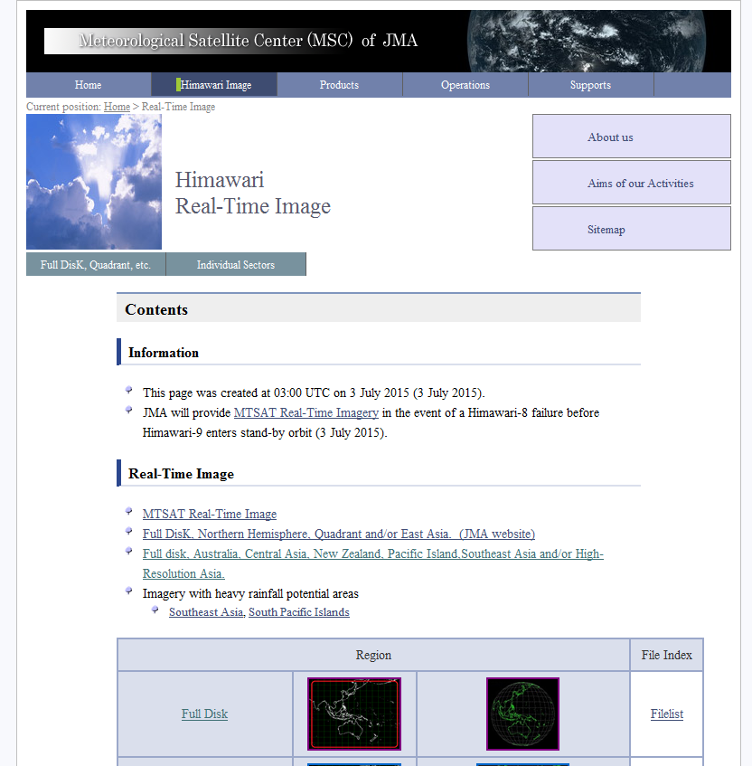
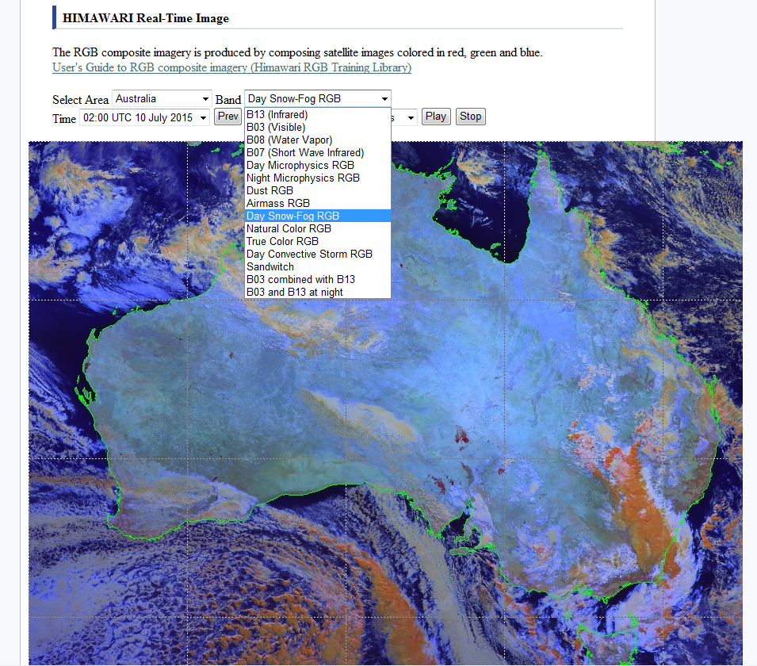
http://ds.data.jma.go.jp/mscweb/data/himawari/index.html
Useful links: HIMAWARI Real-Time Image
Select your favorite RGB!
Click your favorite region!

Slide 13
Future Plan of VLab Support Site on RGB composite imagery
First phase: materials based on “EUMETSAT” recipe
Second phase: materials on the imagery specifications of AHI’s sixteen bands
Third phase: materials of the tuned or optimized (color matching) and “new” RGB recipe
Continuously: enhance the contents of RGB case studies

Slide 14
Related Schedule of VLab Support Site on RGB composite imagery
2015
July
August
September
October
7 July
Start of Himawari-8 operation
7 July
Opening of VLab RGB website
WMO: 11-14 August
CBS OPAG on DPFS Meeting DPFS/RAII/SeA-SWFDP-RSMT
9-13 November
The Sixth Asia/Oceania Meteorological Satellite Users' Conference
BoM: 27-30 July Science Week 2015
BoM: ? July Advanced Satellite Meteorology training course
September - October JICA Training Course
Outcomes will be applied on the website as needed.
Investigation of adjustment of existing RGB and development of new RGB scheme
Preparations for page(s) of 16 bands properties
Case study investigation

Slide 15

Short lecture of RGB composite imagery by VLab support site material part1

Slide 16
Outline of
RGB Composite Imagery

Slide 17
Contents
What’s RGB composite imagery?
How to create RGB composite imagery
RGB composite imagery presented by EUMETSAT
  RGB composite imagery which are possible to create by traditional images of MTSAT satellites
  RGB composite imagery which are possible to create by Himawari-8 and -9 imagery
RGB composite imagery by Himawari-8 and -9
Practical training to create RGB composite imagery by SATAID

Slide 18
What’s RGB composite imagery?

Slide 19
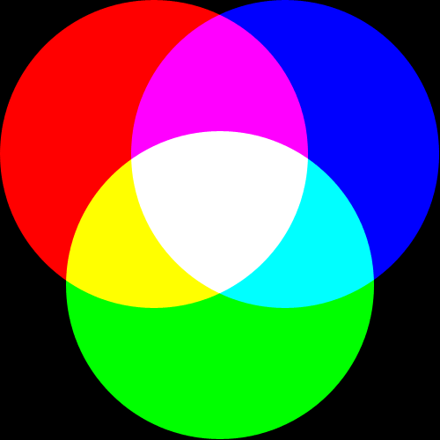
What’s RGB composite imagery?
Red (R), green (G) and blue (B) which are the three primary colors of light constitute color space expressing additive color composite
The RGB composite imagery is a technique to display a color using this property of the three primary colors of light

Slide 20
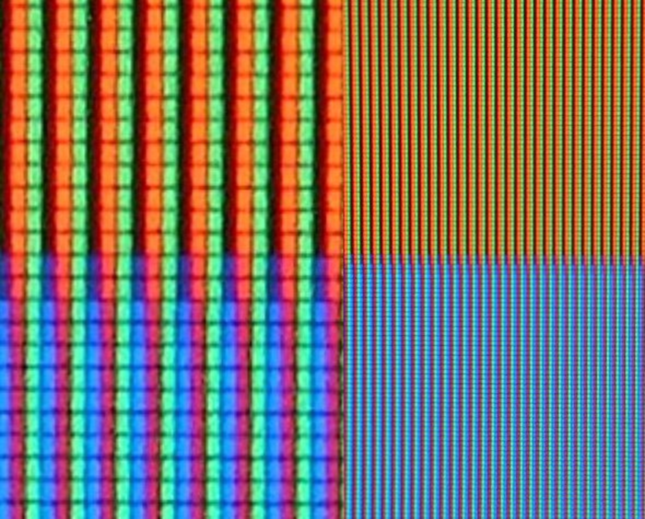

What’s RGB composite imagery?
RGB sub-pixels in an LCD TV
RGB phosphor dots in a CRT monitor
Ref: Wikipedia RGB color model: http://en.wikipedia.org/wiki/RGB_color_model

Slide 21
What’s RGB composite imagery?
List of satellites/imagers specifications
Channel | Himawari-8/ -9 | MTSAT-1R/-2 | MSG | Physical Properties
1 | 0.46 μm |  |  | vegetation, aerosol B | Visible
2 | 0.51 μm |  |  | vegetation, aerosol G
3 | 0.64 μm | 0.68 μm | 0.635 µm | low cloud, fog R
4 | 0.86 μm |  | 0.81 µm | vegetation, aerosol | Near Infrared
5 | 1.6 μm |  | 1.64 µm | cloud phase
6 | 2.3 μm |  |  | particle size
7 | 3.9 μm | 3.7 μm | 3.92 µm | low cloud, fog, forest fire | Infrared
8 | 6.2 μm | 6.8 μm | 6.25 µm | mid- and upper level moisture
9 | 6.9 μm |  |  | mid- level moisture
10 | 7.3 μm |  | 7.35 µm | mid- and lower level moisture
11 | 8.6 μm |  | 8.70 µm | cloud phase, SO2
12 | 9.6 μm |  | 9.66 µm | ozone content
13 | 10.4 μm | 10.8 μm | 10.8 µm | cloud imagery, information of cloud top
14 | 11.2 μm |  |  | cloud imagery, sea surface temperature
15 | 12.4 μm | 12.0 μm | 12.0 µm | cloud imagery, sea surface temperature
16 | 13.3 μm |  | 13.4 µm | cloud top height
There are different properties in each channel, as shown in the left figure.

Slide 22
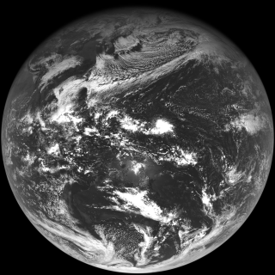
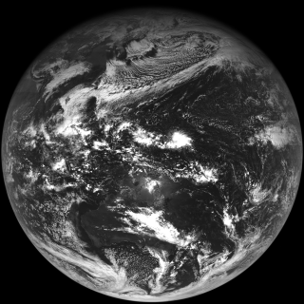
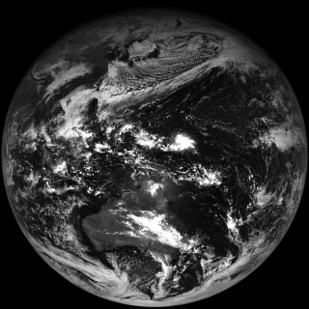
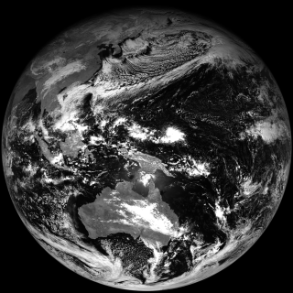
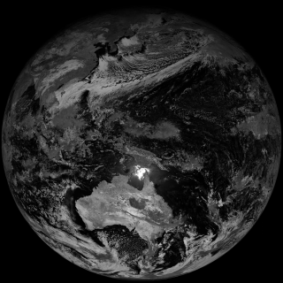
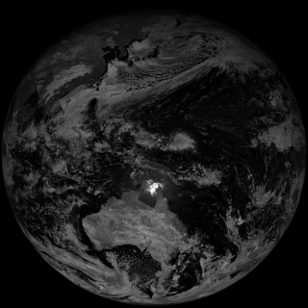
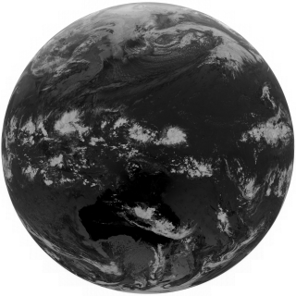
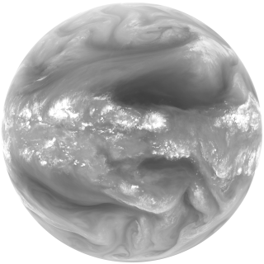
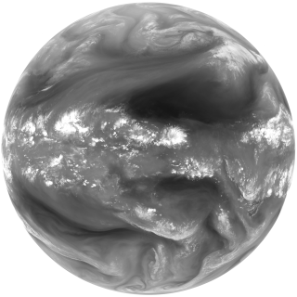
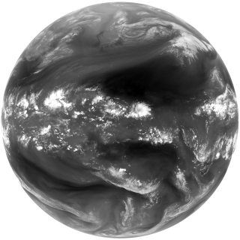
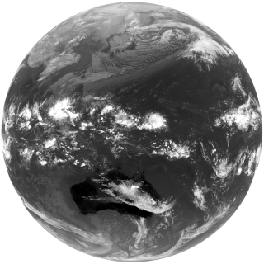
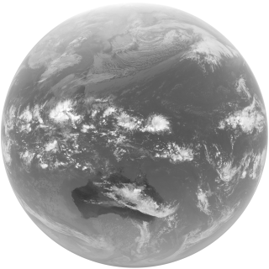


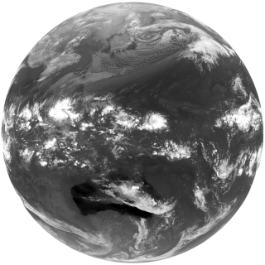
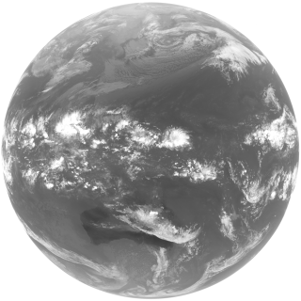
What’s RGB composite imagery?
16 bands Images by Himawari-8/AHI
B01
B01:
0.46 μm
Visible
Vegetation, aerosol
B02
B02:
0.51 μm
Visible
Vegetation, aerosol
B03
B03:
0.64 μm
Visible
Low cloud,
fog
B04
B04:
0.86 μm
Near infrared
Vegetation, aerosol
B05
B05:
1.6 μm
Near infrared
Cloud phase
B06
B06:
2.3 μm
Near infrared
Particle size
B07
B07:
3.9 μm
Infrared
Low cloud, fog, forest fire
B08
B08:
6.2 μm
Infrared
Mid- and upper level moisture
B09
B09:
6.9 μm
Infrared
Mid level moisture
B10
B10:
7.3 μm
Infrared
Mid- and lower level moisture
B11
B11:
8.6 μm
Infrared
Cloud phase, SO2
B12
B12:
9.6 μm
Infrared
Ozone content
B13
B13:
10.4 μm
Infrared
Cloud imagery, information of cloud top
B14
B14:
11.2 μm
Infrared
cloud imagery, sea surface temperature
B15
B15:
12.4 μm
Infrared
Cloud imagery, sea surface temperature
B16
B16:
13.3 μm
Infrared
Cloud top height

Slide 23
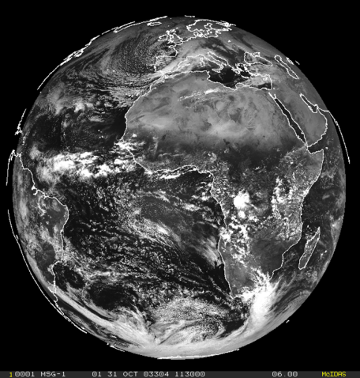
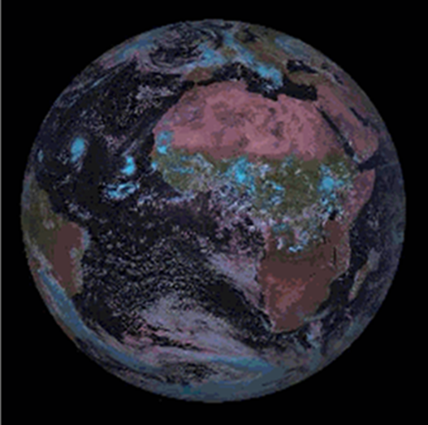
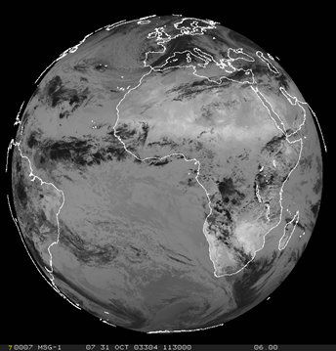

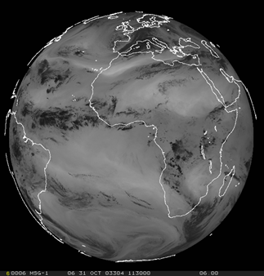
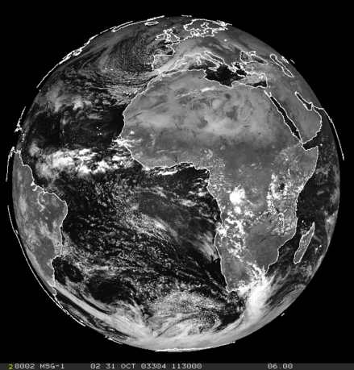
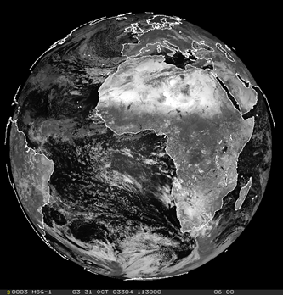
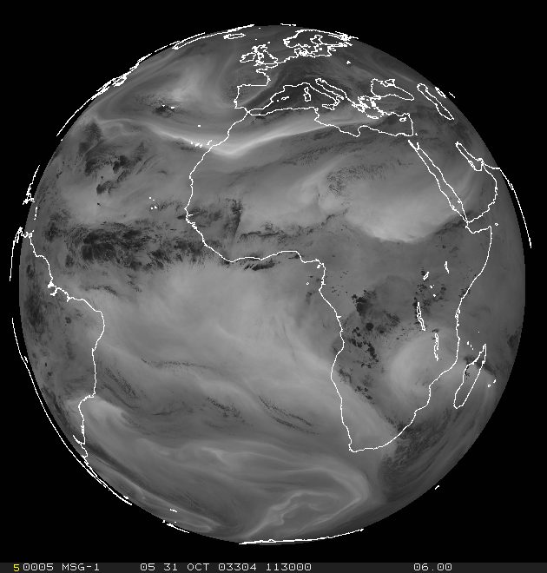
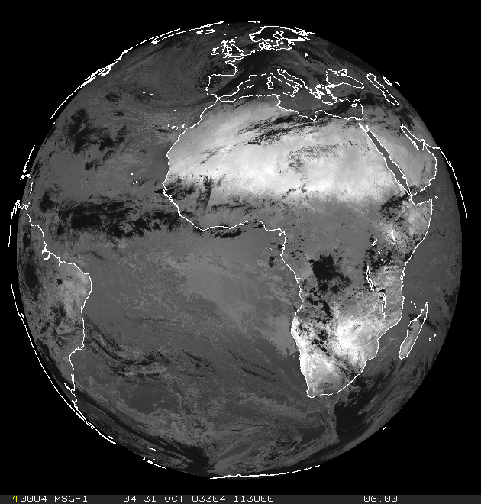
There are too many channels!
copyright 2014 EUMETSAT
copyright 2014 EUMETSAT
copyright 2014 EUMETSAT
copyright 2014 EUMETSAT
  The RGB technique is …
  Simple process by composition of images enable to create RGB imagery.
  Various information are derivable by one RGB image.
  RGB imagery retain “natural texture” of single channel images.
  → Various information can be derived by colorizing and composing imagery.
copyright 2014 EUMETSAT
copyright 2014 EUMETSAT
copyright 2014 EUMETSAT
copyright 2014 EUMETSAT

Slide 24
How to create RGB composite imagery

Slide 25
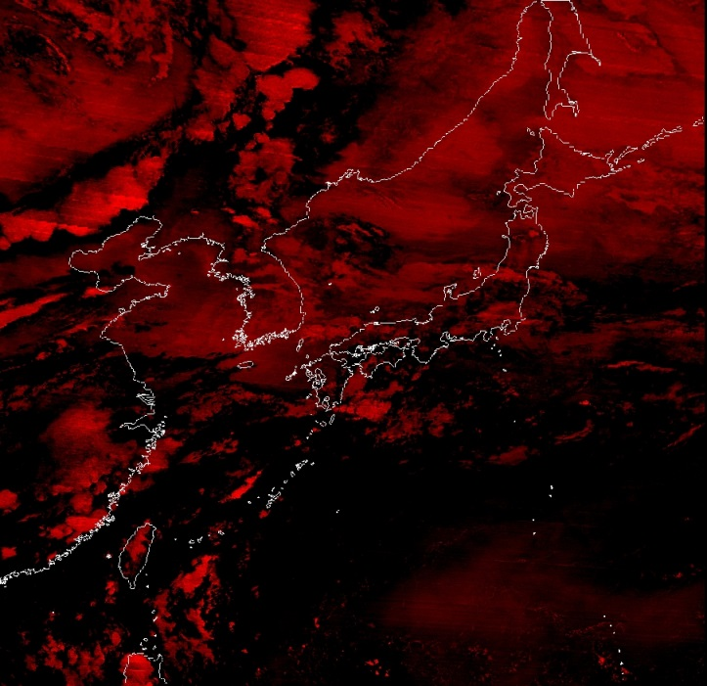
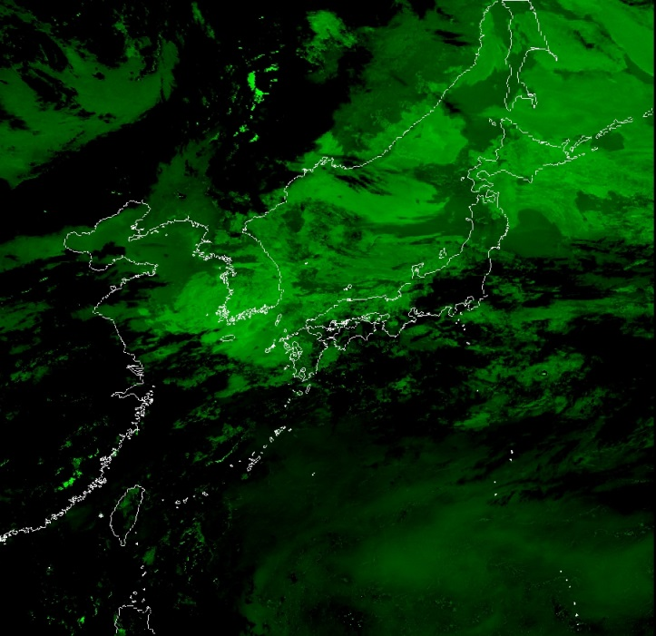
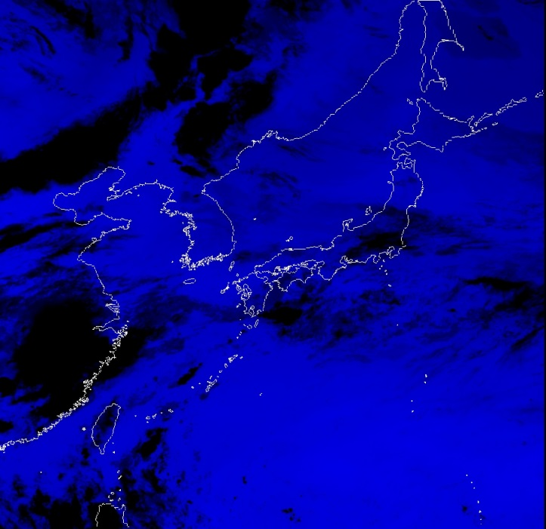
How to create RGB composite imagery
RGB composite imagery can be displayed by three individual colorized (red, blue or green) images of 2 or 3 channels (or channel differences) and by composing them.
IR10.8-IR12.0
IR3.7-IR10.8
IR10.8
By compositing these three images, what will happen?

Slide 26
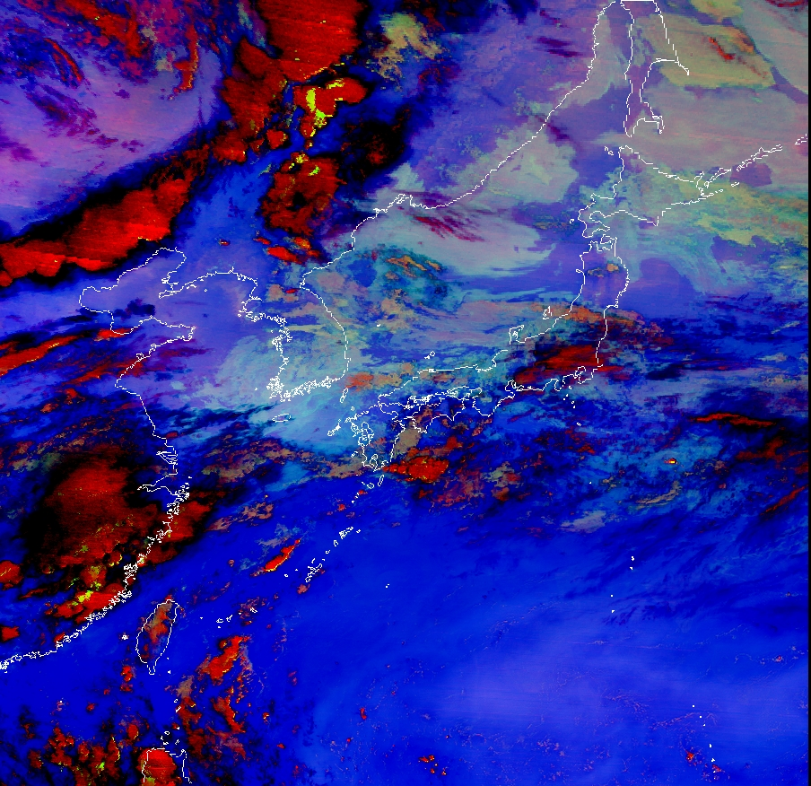
How to create RGB composite imagery
Hereby a RGB image is created.
Information can be derived from coloration by overlapping plural images.
In this example,
low cloud or fog, thin high cloud and
thick Cb cloud etc.

Slide 27
How to create RGB composite imagery
Adjustment of gradation
  For extracting and enhancing specific phenomenon
  Requirement to adjust visual aspects when compositing images
  The visual aspects of RGB composite imagery are manipulated by adjusting “gradation (gray-scale) range” and “gamma correction”

Slide 28
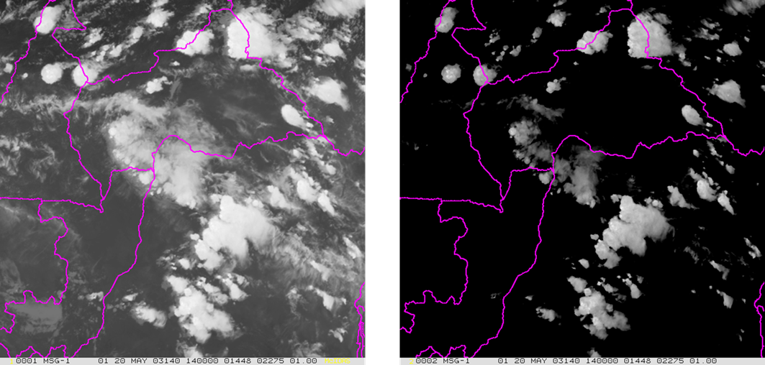
How to create RGB composite imagery
Example of gradation (gray-scale) adjustment (emphasis on “Cb”)
copyright 2014 EUMETSAT
copyright 2014 EUMETSAT
IR10.8
Range : 180～340K
Gamma: １
IR10.8
Range : 180～233K
Gamma : １

Slide 29
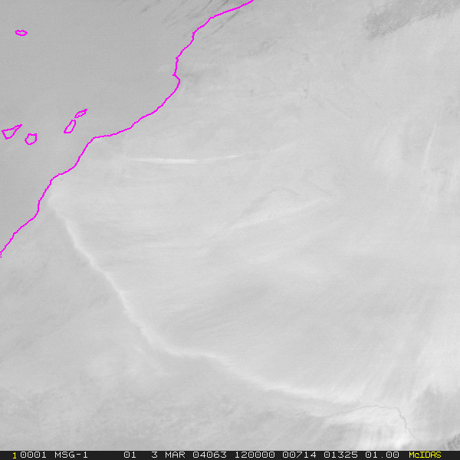
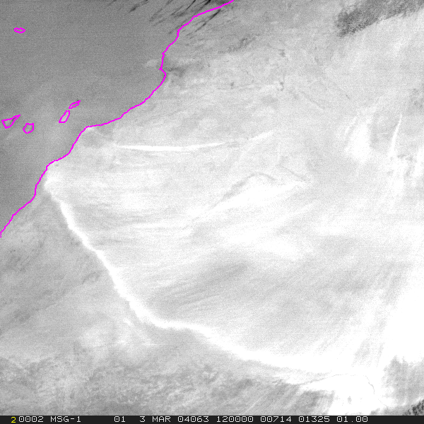
How to create RGB composite imagery
Example of gradation (gray-scale) adjustment (emphasis on “dust”)
copyright 2014 EUMETSAT
copyright 2014 EUMETSAT
IR12.0-IR10.8
Range : -15～5K
Gamma : １
IR12.0-IR10.8
Range : -4～2K
Gamma : １

Slide 30

How to create RGB composite imagery
Gradation (gray-scale) vs gamma value
bright
Mapping function for different gamma corrections
with calibration of 0 – 255 (8 bit)
It’s not easy to imagine this concept.
Let’s move on to the next slide!
dark
copyright 2014 EUMETSAT

Slide 31



How to create RGB composite imagery
Examples of gradation (gray-scale) adjustment (emphasis on “land”)
copyright 2014 EUMETSAT
copyright 2014 EUMETSAT
copyright 2014 EUMETSAT
VIS0.6
Range : 0～100%
Gamma : 0.5
VIS0.6
Range : 0～100%
Gamma : 1.0
VIS0.6
Range : 0～100%
Gamma : 2.0

Slide 32

Short lecture of RGB composite imagery by VLab support site material part2

Slide 33

Natural Color RGB
Detection of snow/ice, vegetation and clouds
Meteorological Satellite Center, JMA
http://www.data.jma.go.jp/mscweb/en/VRL/VLab_RGB/materials/RGB-Natural_Colors-Detection_of_snow-ice_vegetation_and_clouds.zip

Slide 34




What’s Natural Color RGB?
R : B05(N2 1.6)
Range : 0～100 [%] Gamma : 1.0
G : B04(N1 0.86)
Range : 0～100 [%] Gamma : 1.0
B : B03(VS 0.64)
Range: 0～100 [%] Gamma : 1.0

Slide 35
Components of “Natural Color” RGB scheme
Channel | Himawari-8/ -9 | MTSAT-1R/-2 | MSG | Physical Properties
1 | 0.46 μm |  |  | vegetation, aerosol B | Visible
2 | 0.51 μm |  |  | vegetation, aerosol G
3 | 0.64 μm | 0.68 μm | 0.635 µm | low cloud, fog R
4 | 0.86 μm |  | 0.81 µm | vegetation, aerosol | Near Infrared
5 | 1.6 μm |  | 1.64 µm | cloud phase
6 | 2.3 μm |  |  | particle size
7 | 3.9 μm | 3.7 μm | 3.92 µm | low cloud, fog, forest fire | Infrared
8 | 6.2 μm | 6.8 μm | 6.25 µm | mid- and upper level moisture
9 | 6.9 μm |  |  | mid- level moisture
10 | 7.3 μm |  | 7.35 µm | mid- and upper level moisture
11 | 8.6 μm |  | 8.70 µm | cloud phase, SO2
12 | 9.6 μm |  | 9.66 µm | ozone content
13 | 10.4 μm | 10.8 μm | 10.8 µm | cloud imagery, information of cloud top
14 | 11.2 μm |  |  | cloud imagery, sea surface temperature
15 | 12.4 μm | 12.0 μm | 12.0 µm | cloud imagery, sea surface temperature
16 | 13.3 μm |  | 13.4 µm | cloud top height
This scheme is displayed by compositing two near infrared channels (B05(N2 1.6) , B04(N1 0.86) ) and (traditional) visible channel (B03(VS 0.64) ).
These channels have reflection characteristics for land/ sea surface conditions (such as snow/ ice covered area , vegetation) respectively.
On the other hand, this scheme is available in day-time only.
A set of RGB “Natural Colors” scheme
(RGB:B05/B04/B03)
R : B05(N2 1.6)
Range : 0～100 [%] Gamma : 1.0
G : B04(N1 0.86)
Range : 0～100 [%] Gamma : 1.0
B : B03(VS 0.64)
Range : 0～100 [%] Gamma : 1.0

Slide 36



Characteristics and Basis of Three Components
Reflection characteristic of B05 depends on the phase and size of cloud particles
Reflectivity is small for large cloud particles
Ice cloud particles absorb light beams, and reflectivity is small
High clouds consisting of ice particles, snow/ice and sea ice are displayed in darker color
B04 as well as B03, has high reflectivity for snow/ice covered area and clouds
Land surface looks relatively darker, sea surface looks darkest
Vegetation distribution can be derived because of high reflectivity by “chlorophyll “ in plant bodies
On RGB imagery, high clouds consisting of ice particles, snow/ice and sea ice, which are low reflectivity on red B05, are displayed in cyan (i.e. green B04 + blue B03) color
Low clouds (water clouds) which are high reflectivity on the three colored images, are displayed in white-grey color
Vegetation area appears in greenish color
R : B05(N2 1.6) Range : 0～100 [%] Gamma : 1.0
B03 has, in general, high reflectivity for snow/ice covered area and clouds
Land surface looks relatively darker, sea surface looks darkest
Reflection by clouds depends on optical thickness and density of cloud particles
Low clouds and land/sea surface can be seen through thin high clouds
Clouds can be distinguished by their "texture", i.e. strati form clouds of smooth texture or convective clouds of rough texture.
G : B04(N1 0.86) Range : 0～100 [%] Gamma : 1.0
B : B03(VS 0.64) Range : 0～100 [%] Gamma : 1.0

Slide 37




Basis of snow/ice detection on RGB image
On 1.6 micron image, water clouds (in fog or low clouds) have high reflectivity. On the other hand, snow/ice covered areas have low reflectivity (appear in black on the left image).
∴ Snow/ice covered areas contain few “red” component on RGB image.
Natural Colors (RGB:B05/B04/B03)
Low reflectivity, appears in black color!
Red：1.6μm B05
Green：0.8μm B04
Blue：0.6μm B03
On 0.8 and 0.6 micron images, snow/ice covered areas (as well as water clouds) have high reflectivity (appear in white on the above images).
∴ Snow/ice covered areas contain “blue” + “green” components (appear in cyan) and low clouds contain “red” + “blue” + “green” components (appear in whitish) on RGB image.

Slide 38
Interpretation of Colors for “Natural Colors”
High-level ice clouds
Low-level water clouds
Ocean
Vegetation
Desert
Snow
Note: Based on SEVIRI/EUMETSAT interpretation

Slide 39



Example of Natural Color RGB
Sea Ice and Snow/Ice Covered Area
Himawari-8 Natural Colors
2015-02-13 00:05UTC
Himawari-8 B03 VS 0.64
2015-02-13 00:05UTC
Sea ice distribution chart for Hokkaido region 2015-02-13
Sea Ice
Snow/Ice Covered Area
Sea ice and snow/ice covered area appear in cyan color!

Slide 40


Example of Natural Color RGB
Vegetation, Snow/Ice Covered Area (Vicinity of China and Mongolia)
Himawari-8 Natural Colors
2015-02-13 04:05UTC
Snow/Ice Covered Area
Vegetation
Desert
Himawari-8 B03 VS 0.64
2015-02-13 04:05UTC
Vegetation appears in green,
desert or bare ground appear in brown!

Slide 41


Example of Natural Color RGB
Vegetation, Snow/Ice Covered Area
(Vicinity of Himalayas and Bay of Bengal )
Himawari-8 Natural Colors
2015-02-13 04:35UTC
High cloud
Low cloud
Vegetation
Snow/Ice Covered Area
Himawari-8 B03 VS 0.64
2015-02-13 04:35UTC
Snow covered area is seen along Himalayas!
Vegetation areas spread widely on the south of the mountains!

Slide 42



Example of Natural Color RGB
Fog/Low clouds
Himawari-8 Natural Colors
2015-02-16 00:05UTC
Fog/low clouds on the Yellow Sea and the East China Sea appear in whitish color!
Himawari-8 B13 IR 10.4 + Synop
2015-02-15 00:05UTC
Himawari-8 B03 VS 0.64
2015-02-15 00:05UTC

Slide 43


Example of Natural Color RGB
High cloud with ice particles
Himawari-8 Natural Colors
2015-02-13 03:05UTC
Himawari-8 B03 VS 0.64
2015-02-13 03:05UTC
Organized cloud area with Ci is on the North Japan
Low clouds and sea ice can be seen through thin high clouds

Slide 44



Example of Natural Color RGB
Tapering cloud with high cloud
Himawari-8 Natural Colors
2015-02-16 03:35UTC
High cloud on the developing Cb appears in cyan color
Himawari-8 Day Convection Storms
2015-02-16 03:35UTC
Himawari-8 B13 IR 10.8 + Radar + Synop
2015-02-16 03:05UTC

Slide 45
Natural Color RGB
Detection of snow/ice, vegetation and clouds
Summary
Available to distinguish vegetation, desert and snow/ice
Easy to distinguish between high-level ice clouds and low-level water clouds
But in day-time only

Slide 46
Thank you!
A
M
J

