Slide 1
Sea Surface Wind Estimation Using Rapid Scan AMVs
Masahiro Hayashi (Mr.),
Meteorological Satellite Center (MSC) /
Japan Meteorological Agency (JMA)

Slide 2
Today’s talk
Introduction
  Rapid-Scan Operation (RSO)
  Atmospheric Motion Vectors (AMVs)
  Rapid-Scan AMVs
Sea Surface Wind Estimation
  Sea Surface Wind Estimation
Summary

Slide 3
Today’s talk
Introduction
  Rapid-Scan Operation (RSO)
  Atmospheric Motion Vectors (AMVs)
  Rapid-Scan AMVs
Sea Surface Wind Estimation
  Sea Surface Wind Estimation
Summary

Slide 4

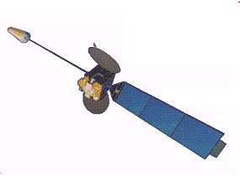
What is Rapid Scan Operation?
MTSAT-1R can scan whole Earth in about 30 minutes.
So, if MTSAT-1R scan Full Disk repeatedly, we could provide Full Disk Earth’s Images with about 30-minute intervals.

Slide 5
What is Rapid Scan Operation?
MTSAT-1R’s scan speed is constant. So, if we want to get shorter interval Images, we need to limit observation area
We call this kind of operation with smaller area and shorter interval as “Rapid Scan Operation”

Slide 6
Summary of MTSAT-1R Rapid-Scan Operation
Normal Operation
(about 30 min for Full Disk)
Rapid-Scan Observation
(about 5 min around Japan region)
Rapid-Scan operation
Observation Period | Jun. – Sep.
Observation Time | 00 UTC – 09 UTC
Observation Area | Around Japan
Time Interval | 5 min.
The Rapid-scan (RS) operation is conducted every summer from 2011

Slide 7
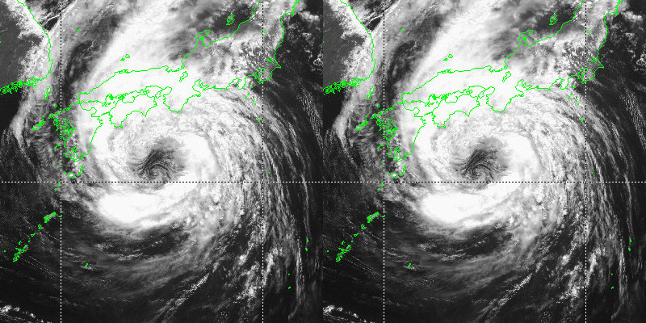
Rapid Scan imageries
We can obtain “smoother” images by Rapid Scan Operation
Short time-interval images are effective for severe weather events such as Tropical Cyclone (TC) cloud systems and deep convection that have short lifetime
MTSAT-1R Rapid Scan
Operational MTSAT-2

Slide 8
Today’s talk
Introduction
  Rapid-Scan Operation (RSO)
  Atmospheric Motion Vectors (AMVs)
  Rapid-Scan AMVs
Sea Winds Estimation
  Sea Winds Estimation
Summary

Slide 9


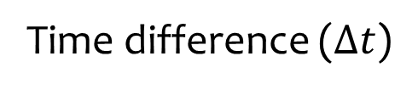
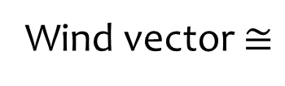
What is Atmospheric Motion Vectors (AMVs)
Wind vectors estimated from satellite imageries called Atmospheric Motion Vectors (AMVs)
AMVs are computed by tracking the clouds on satellite imageries
Tracked cloud
Cloud to be tracked
Wind vector
Previous Image$(t=0)$
Next Image $(t=∆t)$
Cloud displacement
Wind vector $≅$
Time difference ($∆t$)
Assumption: Cloud drifts with the surrounding wind

Slide 10
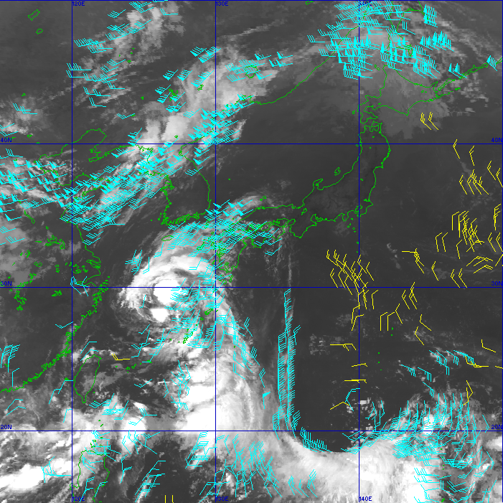
What is AMVs?
AMVs can be derived even in sea area (usually observation data is sparse)
AMVs are know as very important dataset for data assimilation (for NWP model)
2010/09/05/00-23UTC

Slide 11
Today’s talk
Introduction
  Rapid-Scan Operation (RSO)
  Atmospheric Motion Vectors (AMVs)
  Rapid-Scan AMVs
Sea Surface Wind Estimation
  Sea Surface Wind Estimation
Summary

Slide 12
AMVs by short-time interval imageries
We cannot track short-lifetime cloud system with long-interval imageries
AMVs from shorter-interval imageries (Rapid Scan-AMVs) can track short-lived cloud system
Rapid Scan AMV can be derived even in the area around TC center, where clouds deform rapidly
We cannot track clouds after its deformations
Time sequence
Notes:
As you know, cloud deforms as time goes by.
So, by long time interval imageries, we cannot trace (in automatically) cloud, because cloud were completely deformed during the period.
Using a short-time interval image, such as Himawari-8 or MTSAT-1R, we can track cloud even in typhoon vicinity where clouds rapidly deform by strong wind and wind shear.

Slide 13
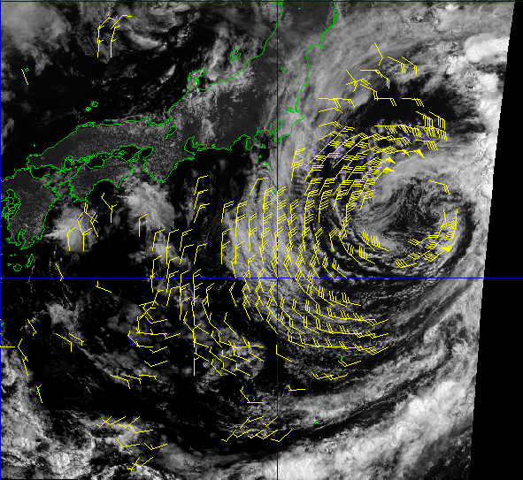
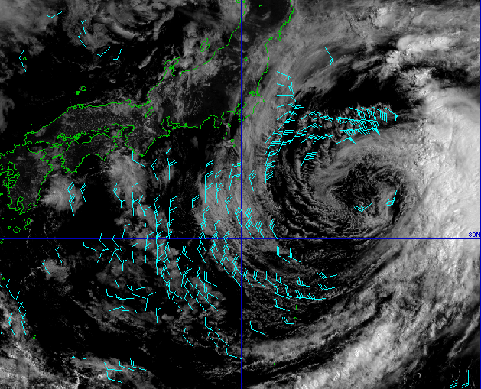
Characteristies of Rapid-Scan AMVs
Increase temporal frequencies
Increase AMVs around strong wind area where the cloud deforms quickly
2011/10/01 00UTC
Rapid-Scan AMVs (5 min interval)
Operational AMVs (15 min interval)

Slide 14
Today’s talk
Introduction
  Rapid-Scan Operation (RSO)
  Atmospheric Motion Vectors (AMVs)
  Rapid Scan AMVs
Sea Surface Wind Estimation
  Sea Surface Wind Estimation
Summary

Slide 15
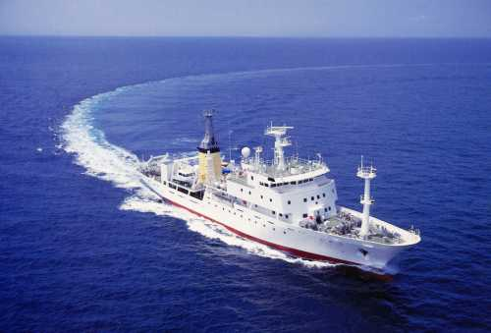
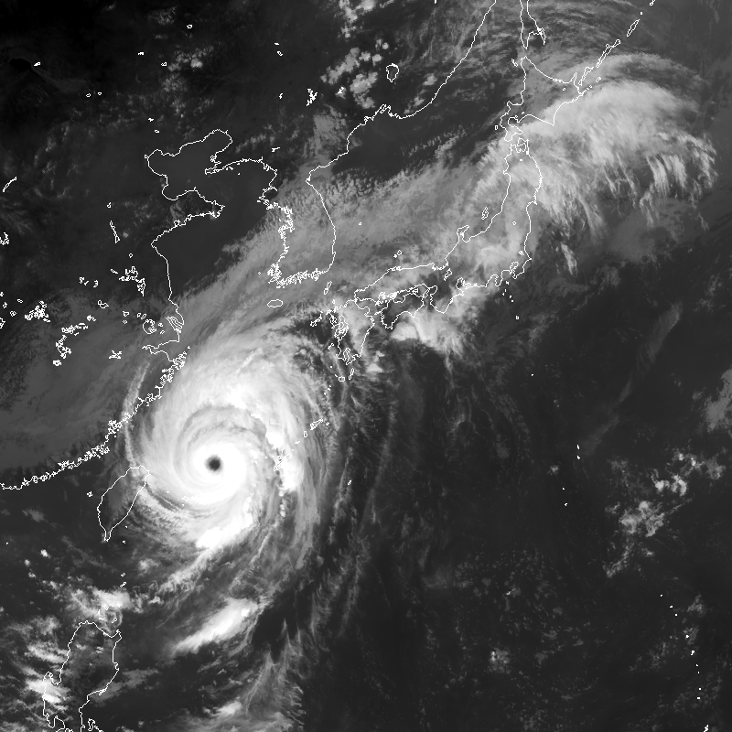
Sea Surface wind estimation
Why does sea wind estimation be needed?
  Ships sailing on the sea surface are strongly affected by strong winds over ocean
  So, especially in typhoon vicinity, sea surface wind data is one of the important data for a ship’s safe sailing
  In general, however, wind observation data is sparse over ocean
MES

Slide 16
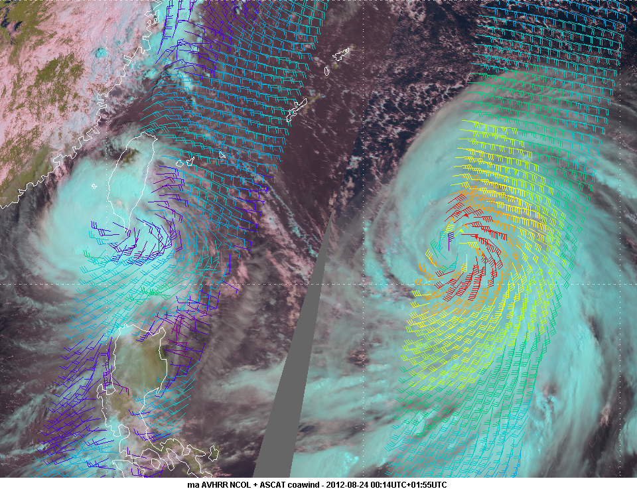
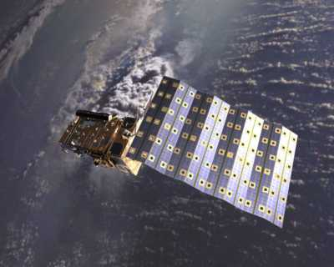
Sea Surface wind estimation
As for Typhoon Wind Analysis
  Sea surface winds estimated from scatterometer carried on LEO satellite (e.g. ASCAT on Metop) provide useful wind information for Typhoon winds analysis owing to its high spatial resolution and its good quality
  But it has coarse resolution with respect to time (two times/day)
  On the other hand, Rapid-Scan AMV which are considered to be effective around Typhoon can be derived relatively high frequency
  Rapid-Scan AMVs may compensate the data-void region where there are no scatterometer winds
Metop (EUMETSAT)
EUMETSAT

Slide 17
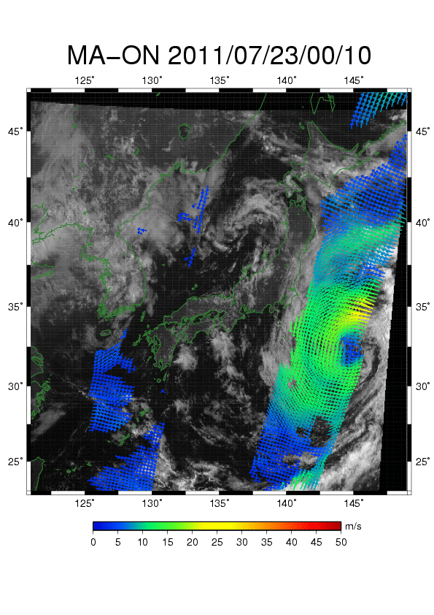
To validate the quality of Rapid-Scan AMVs,
We had compared AMVs from MTSAT-1R visible channel
and ASCAT winds in typhoon vicinity
(up to 1000 km from TC center)
Notes:
This animation shows ASCAT wind and low-level AMVs from MTSAT-1R rapid-scan visible imageries.
ASCAT winds are temporally sparse but AMVs obtain 5-min interval.
And it seems that AMVs and ASCAT are highly correlated.
We compared AMVs and ASCAT wind in typhoon vicinity.

Slide 18
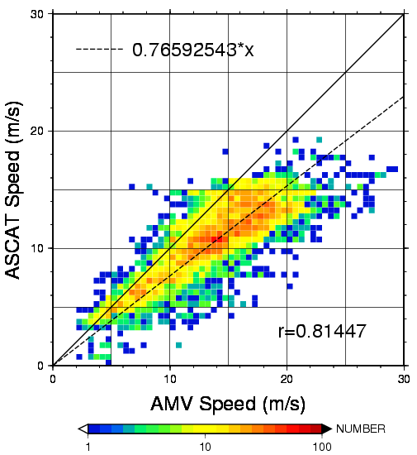
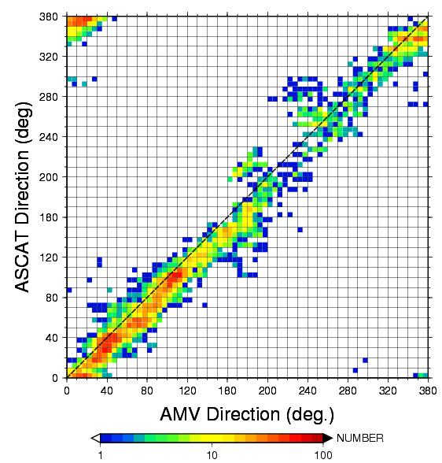
Rapid-Scan AMV vs. ASCAT winds
ASCAT wind speed (m/s)
ASCAT wind direction (deg.)
Rapid Scan AMVs wind speed (m/s)
Rapid Scan AMVs wind direction (deg.)
Period: 2011 – 2012 (case of MA-ON is not included)
Rapid-Scan AMVs and ASCAT winds shows good correlation in typhoon vicinity
Estimated sea surface wind speed ~ 0.766 x AMV wind speed

Slide 19
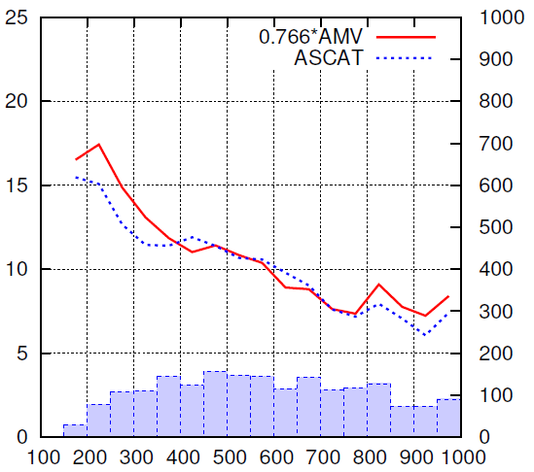
Estimated Sea Surface Winds (ESSW)
(Compared to independent ASCAT winds, case of MA-ON 2011)
Number compared | 1885
Average wind speed of ESSW | 10.49 (m/s)
Wind speed bias (ESSW – ASCAT) | 0.54 (m/s)
Standard Deviation | 2.00 (m/s)
Wind speed (m/s)
Number of collocations
Distance from TC center (km)
Average wind speed for AMVs (red) and ASCAT winds (blue) from TC center
Collocation numbers are shown in blue bins

Slide 20




In the future satellite Himawari-8
Full Disk Observation
in every 10 min.
Over Japan (1)
every 2.5 min.
Over Japan (2)
every 2.5 min.
Typhoon monitoring
every 2.5 min.
Land-mark
extraction (1)
every 30 sec.
Land-mark
extraction (2)
every 30 sec.
A combination of
one “Full Disk” and “small sectored” Imagery in 10 minutes
Rapid Scan operation in full disk! (compared to the current operation..)

Slide 21
Today’s talk
Introduction
  Rapid-Scan Operation (RSO)
  Atmospheric Motion Vectors (AMVs)
Sea Wind Estimation
  Sea Wind Estimation
Summary

Slide 22
Summary
JMA conducts Rapid Scan Operation by MTSAT-1R in every summer
AMVs from Rapid-Scan imageries (Rapid-Scan AMVs) are considered to be very effective for estimating winds field structure in typhoon vicinity
A comparison study between MTSAT-1R Rapid-Scan AMVs and ASCAT winds shows these winds are highly correlated in typhoon vicinity
Validity of AMVs as typhoon analysis’s ancillary data is under investigating at MSC/JMA
Next generation satellite “Himawari-8” can take imageries more frequently (Full Disk “Rapid Scanning”!)

