Slide 1
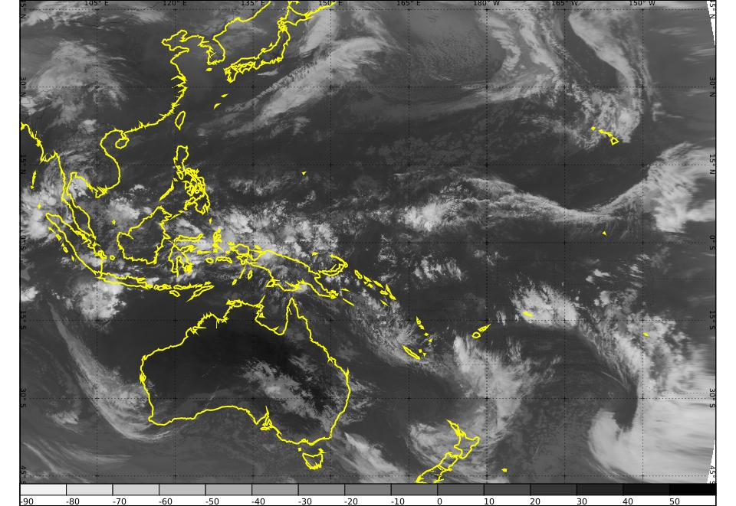
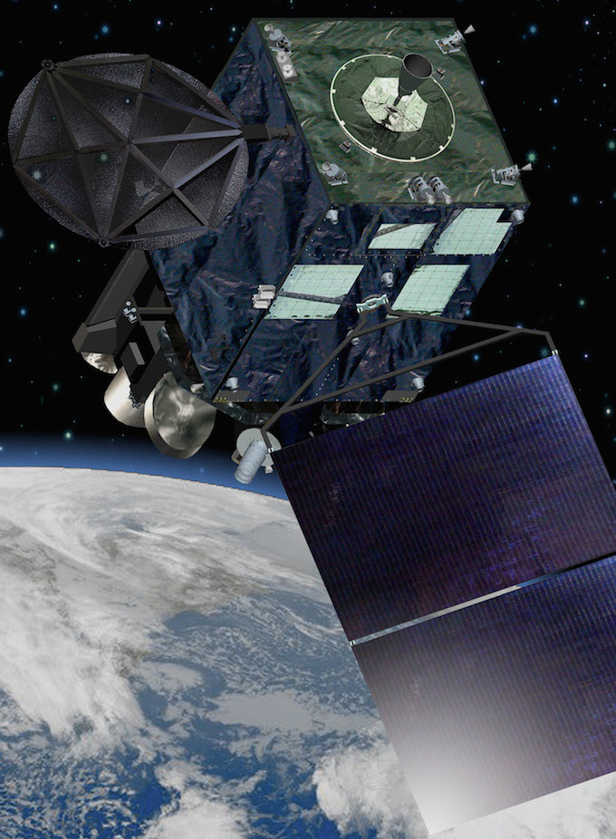
National Himawari-8 Training Campaign Tutorial Session 3 pre-session material 11 February 2015
Australian VLab Centre of Excellence

Slide 2
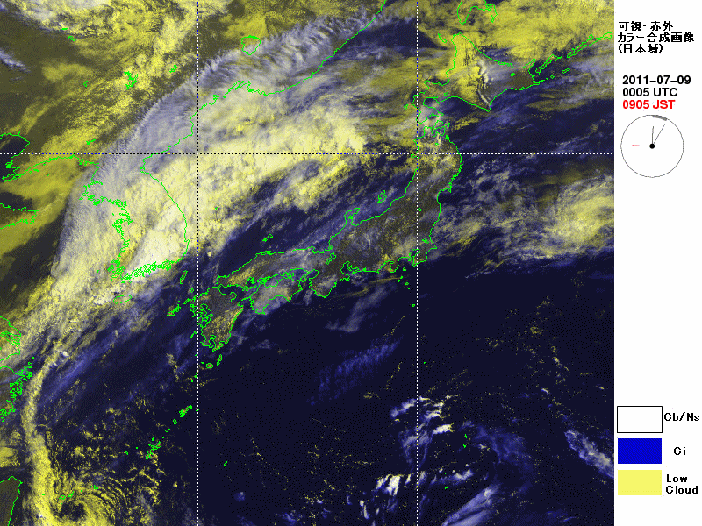
Japan region, 9 July 2011 (5 minute rapid scan animation)
These animation files were provided by Himawari-6 (MTSAT-1R) Rapid Scan Observations. These were performed for the sake of aviation users. Japanese Meteorological Agency.
1000 km

Slide 3
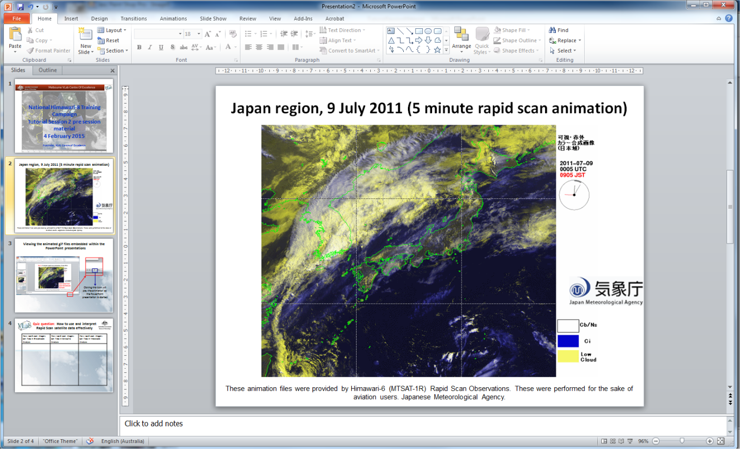
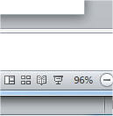
Viewing the animated gif files embedded within the PowerPoint presentations
Clicking this icon will play the animation as the PowerPoint presentation is started

Slide 4
Quiz question: Inspect the animation in slide 2 and try to answer the following
How rapid scan imagery can help in Synoptic Analysis (dimension several hundred to several thousand km, AMS Glossary) | How rapid scan imagery can help in Mesoscale Analysis (dimension a few to several hundred km, AMS Glossary)
Example: Synoptic scale rapid movement can identify Jet Streams. | Example: Better monitoring / nowcasting / short term forecasting of diurnal convection

