Slide 1
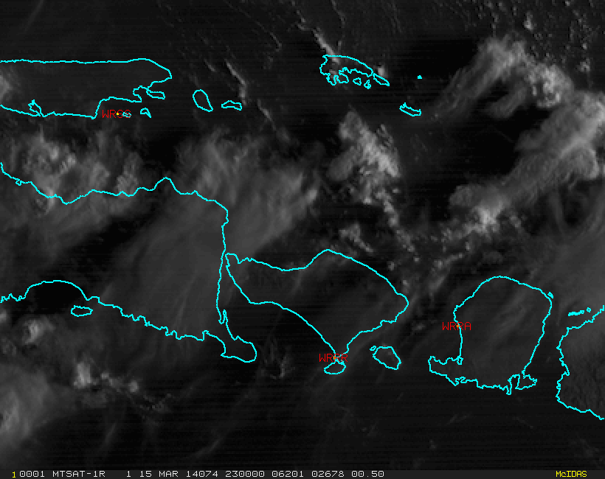
An example of navigation issues with satellite data (MTSAT-1R)
Bali, 15th March 2014
animation courtesy JMA and BOM

