Slide 1
Science Week 2014, Second Practical Session – using water vapour imagery in detecting lee waves
Participant exercises: to assist in making this session more interactive, please complete these exercises before the 29th July.
Annotate the slides as appropriate and save a copy.
We will discuss your answers and address any questions during the session.

Slide 2
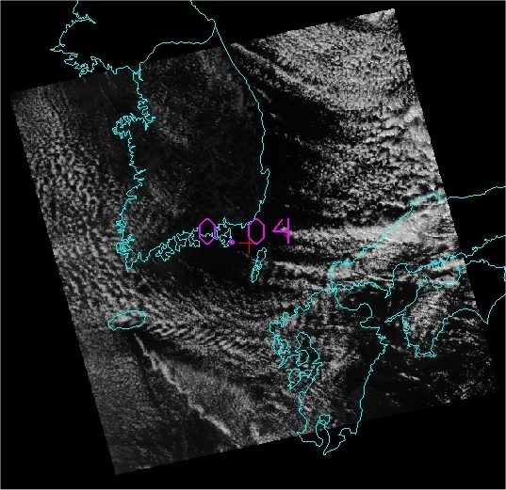
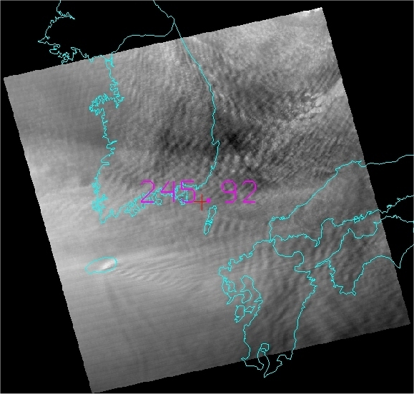
Case Study 1: Identifying clear air turbulence using the Water Vapour channels - Japan / Korea 11 March 2012 0415UTC
visible
6.8 microns water vapour
Task: Annotate where the 6.8 micron water vapour channel is giving more information than the visible channel ?.

Slide 3
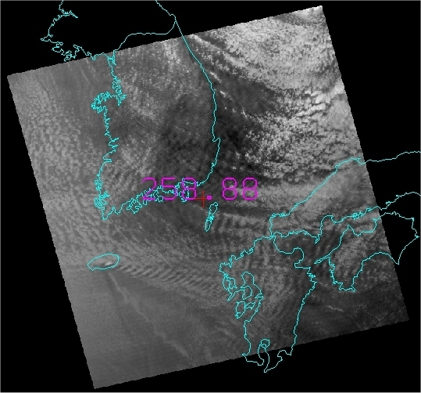
Case Study 1: Identifying clear air turbulence using the Water Vapour channels - Japan / Korea 11 March 2012 0415UTC
visible
7.3 microns water vapour
Task: Annotate where the 7.3 micron water vapour channel giving more information than the visible channel ?.

Slide 4
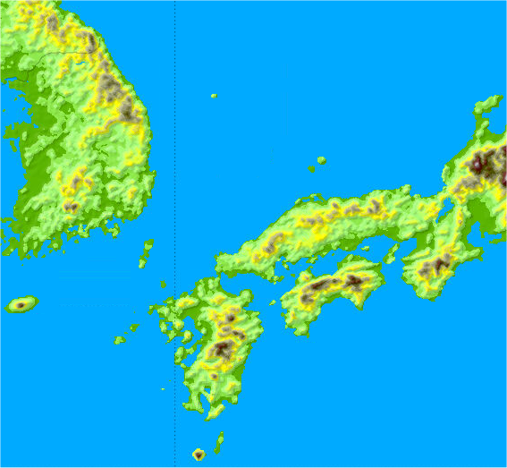
Case Study 1: Identifying clear air turbulence using the Water Vapour channels - Japan / Korea 11 March 2012 0415UTC
6.8 microns
7.3 microns
Japan / Korea 11 March 2012 0415UTC
Task: Please annotate the "mountain waves"
(note the 850 and 700 hPa wind is from the W/NW = red arrow)
topography

Slide 5
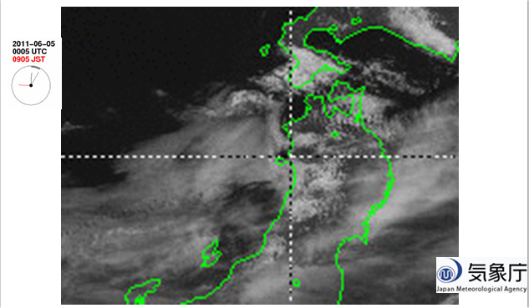
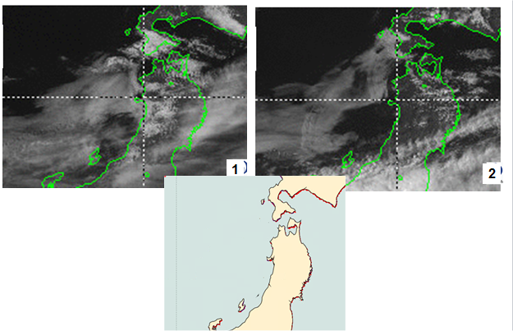
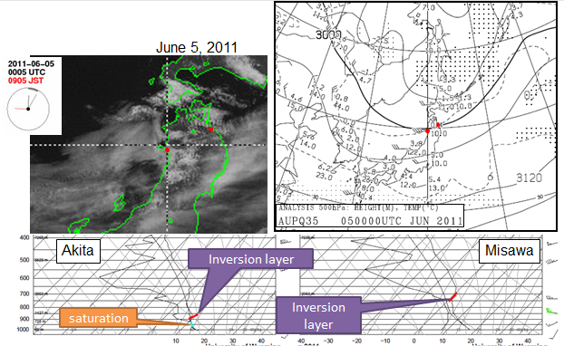
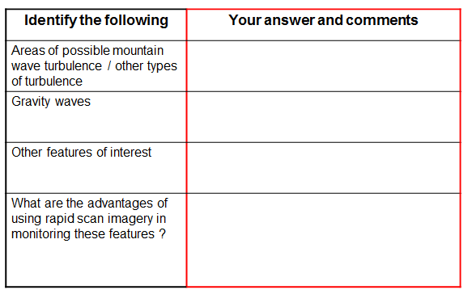
Case Study 2: How to conduct this brainstorming / data mining session
1 - watch animation on computer 2 – panel display for annotations
3 – additional data 4 – questions to answer

Slide 6
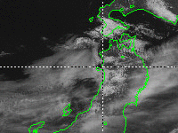
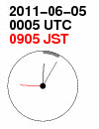
Case Study 2 – boundary layer features, gravity waves, northern Honshu, Japan (June 5, 2011)
These animation files were provided by Himawari-6 (MTSAT-1R) Rapid Scan Observations. These were performed for the sake of aviation users. Japanese Meteorological Agency.
Meteorological Satellite Center
Notes:
Due to the influence of the cold vortex that has passed through the Hokkaido near dawn from the early morning of the 5th, Temperature was reduced at most 09 5 days in the lower of the two points. Wind with a north component slightly below the are growing,: inversion layer (2.6 ~ 2.8km altitude) in Misawa Vertical shear was increased. Stability of the layer is clear: lower small (1.0 ~ 1.3km altitude) in Akita Humidity layer below the stable layer (Advanced 0.3 ~ 0.7km) was supported fog situation close to 100%.
6

Slide 7
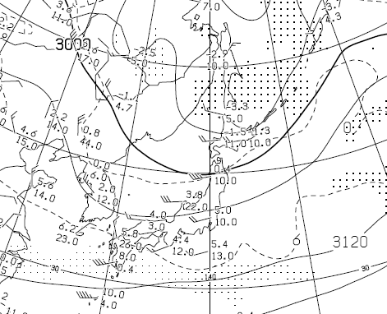
Case Study 2 – boundary layer features, gravity waves, northern Honshu, Japan (June 5, 2011)
June 5, 2011
Akita
Misawa
Inversion layer
Inversion layer
saturation
Meteorological Satellite Center
Meteorological Satellite Center System Management Division Hiroki Mori
Notes:
Due to the influence of the cold vortex that has passed through the Hokkaido near dawn from the early morning of the 5th, Temperature was reduced at most 09 5 days in the lower of the two points. Wind with a north component slightly below the are growing,: inversion layer (2.6 ~ 2.8km altitude) in Misawa Vertical shear was increased. Stability of the layer is clear: lower small (1.0 ~ 1.3km altitude) in Akita Humidity layer below the stable layer (Advanced 0.3 ~ 0.7km) was supported fog situation close to 100%.
7

Slide 8
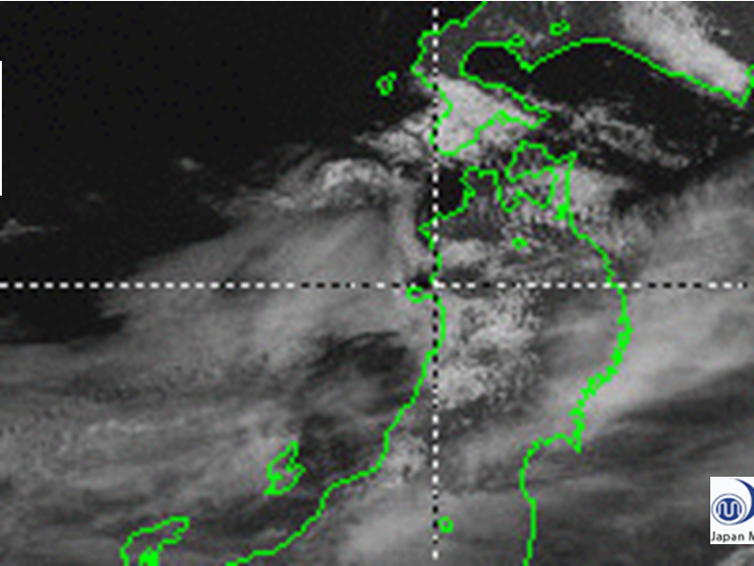
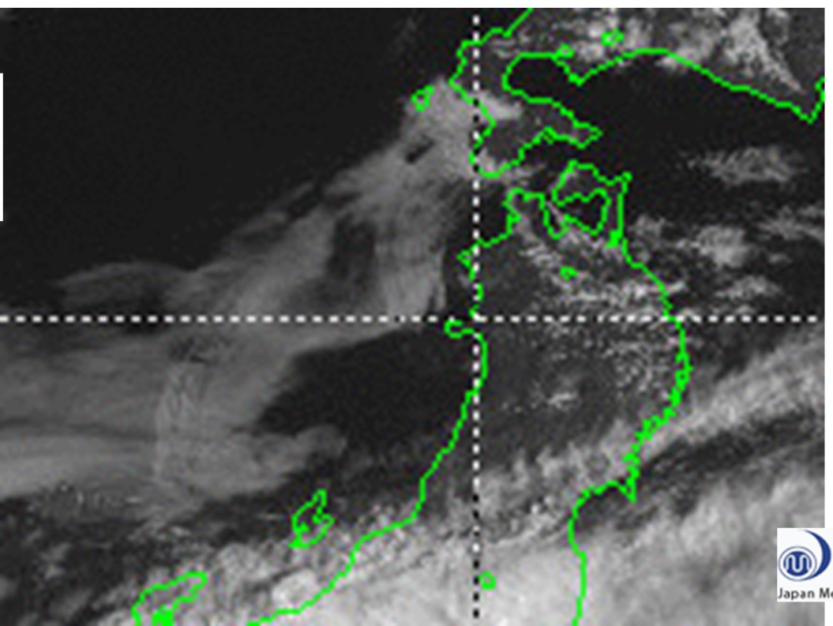
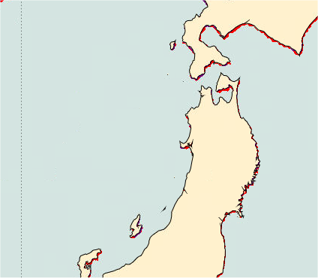
Case Study 2 – boundary layer features, gravity waves, northern Honshu, Japan (June 5, 2011)
1
2

Slide 9
Case Study 2 – boundary layer features, gravity waves, northern Honshu, Japan (June 5, 2011)
Identify the following | Your answer and comments
Areas of possible mountain wave turbulence / other types of turbulence
Gravity waves
Other features of interest
What are the advantages of using rapid scan imagery in monitoring these features ?

