Slide 1
Science Week 2014, First Practical Session – using Rapid Scan Data effectively (case study 3)
Participant exercises: to assist in making this session more interactive, please complete these exercises before the 29th July.
Annotate the slides as appropriate and save a copy.
We will discuss your answers and address any questions during the session.

Slide 2
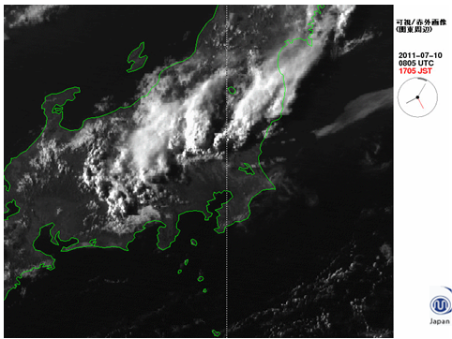
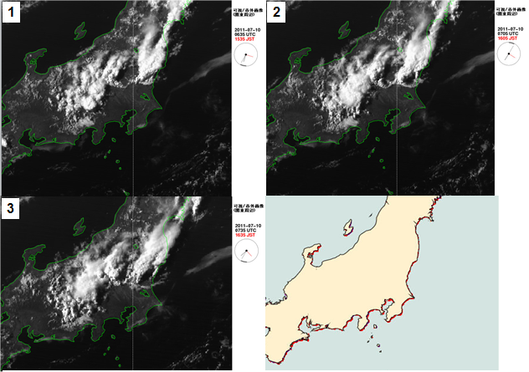
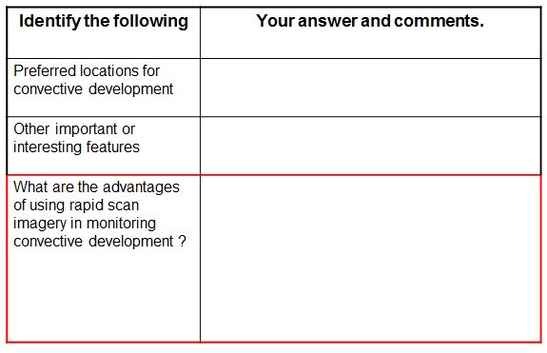
Case Study 3: How to conduct this brainstorming / data mining session
1 - watch animation on computer 2 – panel display for annotations
3 – questions to answer

Slide 3
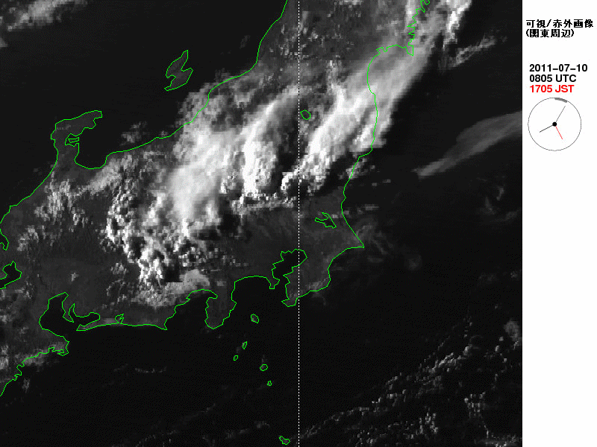
Case Study 3: Convection over Honshu, Japan (10 July 2011)
These animation files were provided by Himawari-6 (MTSAT-1R) Rapid Scan Observations. These were performed for the sake of aviation users. Japanese Meteorological Agency.
Notes:
3

Slide 4
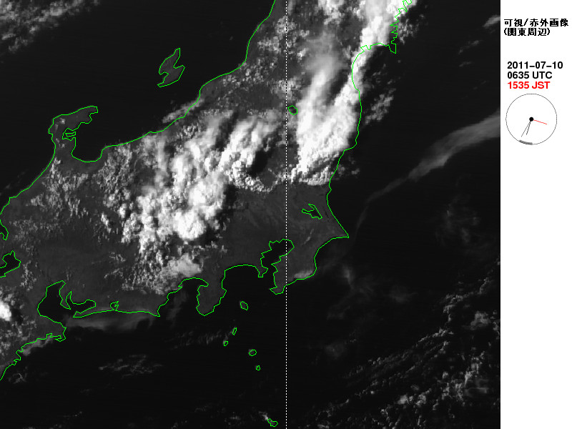
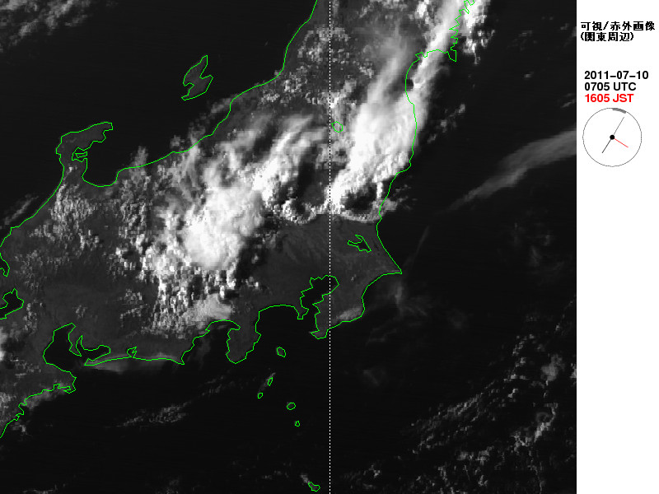
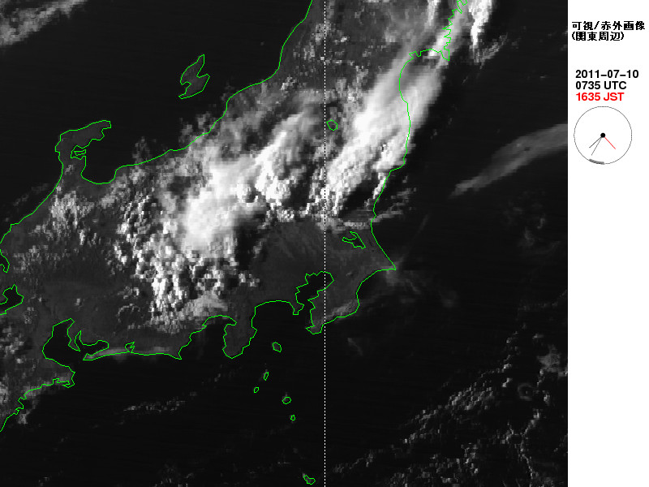
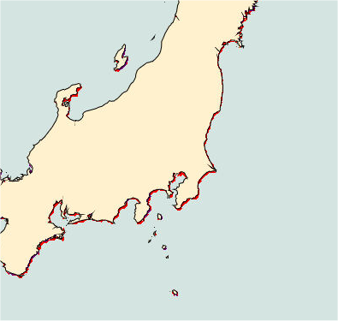
1
2
3
These files were provided by Himawari-6 (MTSAT-1R) Rapid Scan Observations. These were performed for the sake of aviation users. Japanese Meteorological Agency
Notes:
4

Slide 5
Case Study 3: Convection, thunderstorm formation (10 July 2011) - tasks
Identify the following | Your answer and comments.
Preferred locations for convective development
Other important or interesting features
What are the advantages of using rapid scan imagery in monitoring convective development ?

