Slide 1
Science Week 2014, First Practical Session – using Rapid Scan Data effectively (case study 1)
Participant exercises: to assist in making this session more interactive, please complete these exercises before the 29th July.
Annotate the slides as appropriate and save a copy.
We will discuss your answers and address any questions during the session.

Slide 2
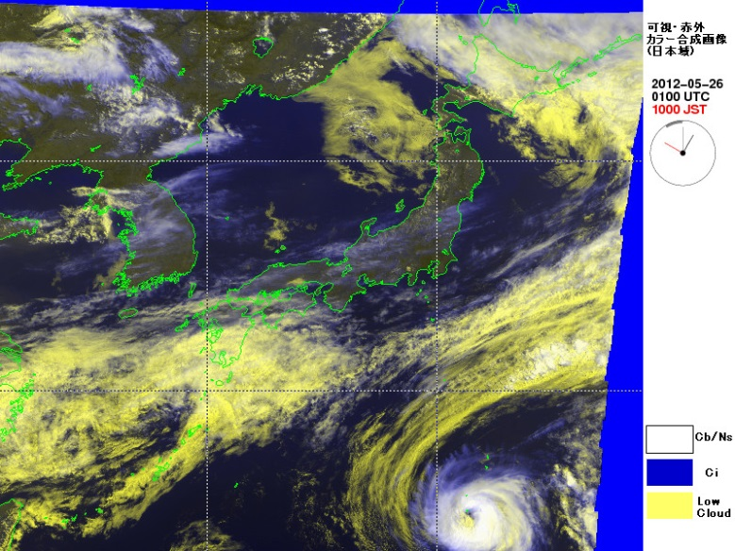
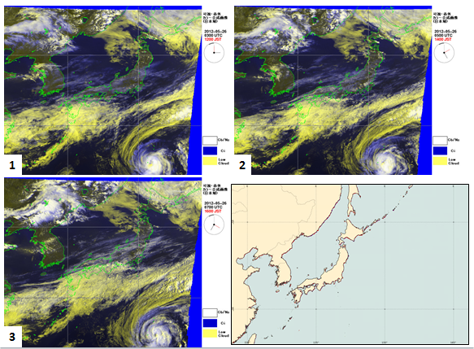
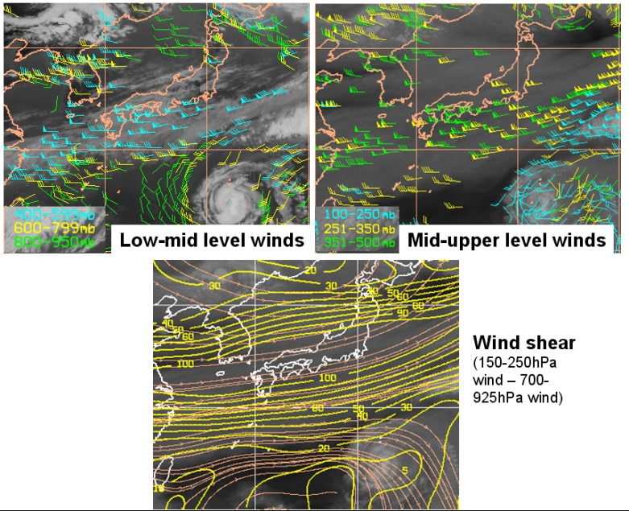
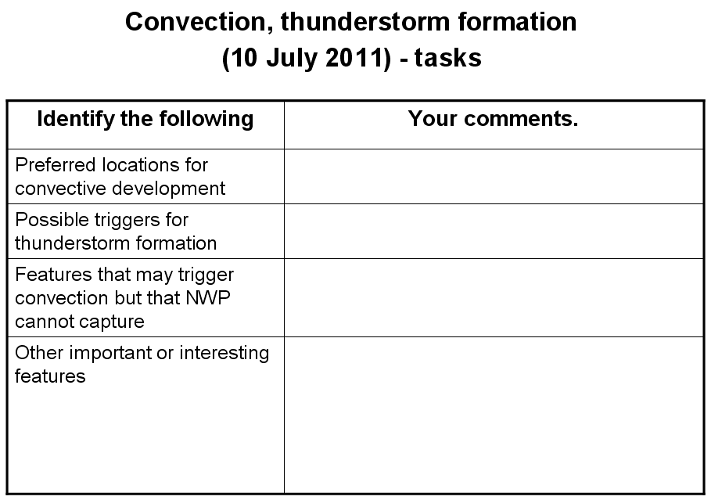
Case Study 1: How to conduct this brainstorming / data mining session
1 - watch animation on computer 2 – panel display for annotations
3 – additional data 4 – questions to answer

Slide 3
Case Study 1: 26 May 2012 – explaining the slide
This is a Red-Green-Blue (RGB) product where the Red and Green beams are represented by the visible channel (0.7 micron) and the Blue beam by the infrared channel (10.8 micron)
Land is dark green
Low cloud is yellow
High cloud is white / blue
Ocean is a deep blue
These files were provided by Himawari-6 (MTSAT-1R) Rapid Scan Observations. These were performed for the sake of aviation users. Japanese Meteorological Agency

Slide 4
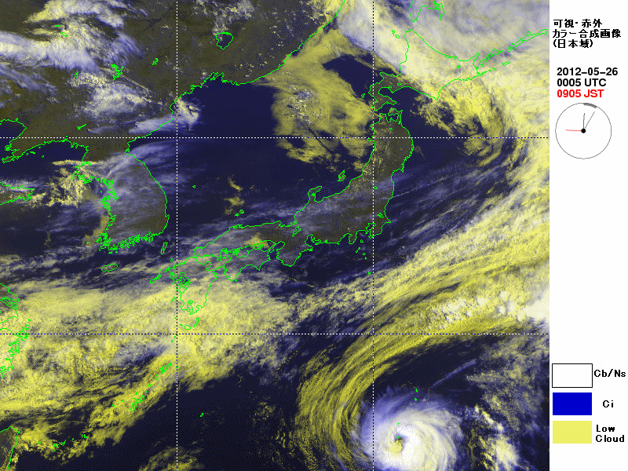
Case Study 1: 26 May 2012, 5 minute MTSAT-1R rapid scan
These animation files were provided by Himawari-6 (MTSAT-1R) Rapid Scan Observations. These were performed for the sake of aviation users. Japanese Meteorological Agency

Slide 5
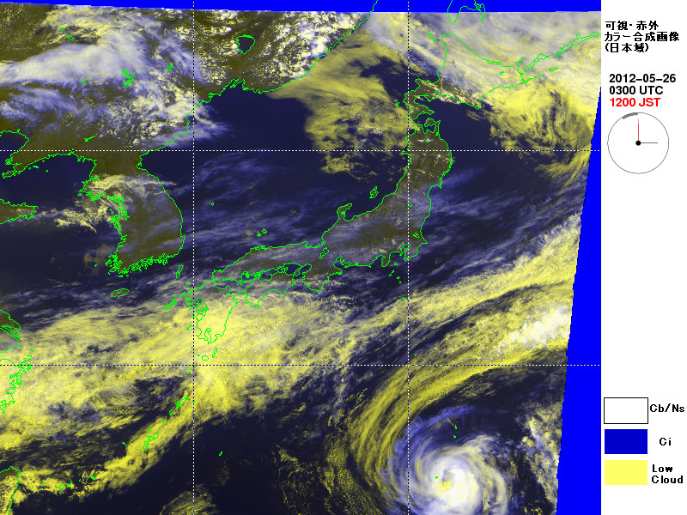
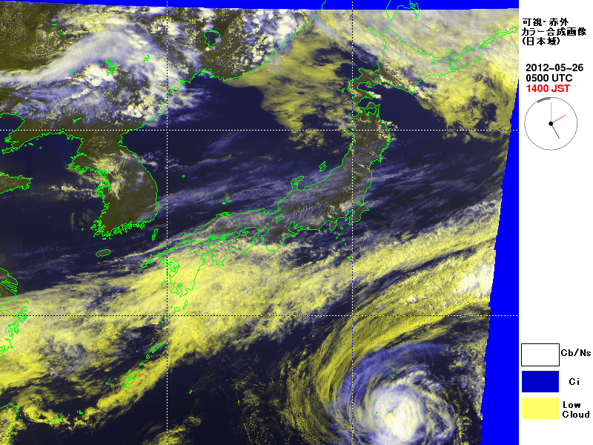
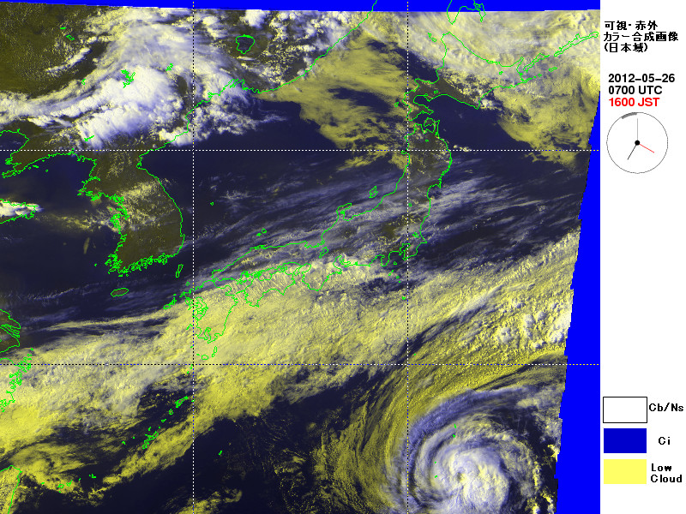
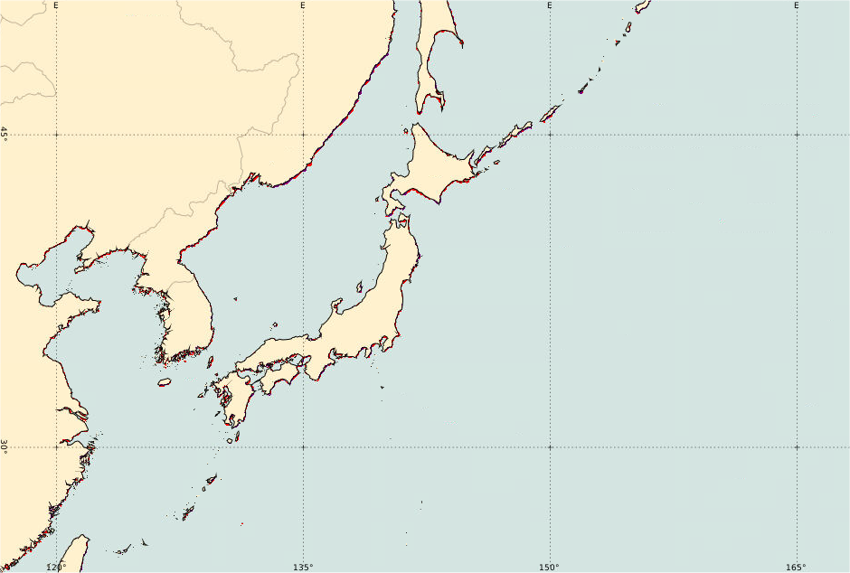
Case Study 1: 26 May 2012, panel display
1
2
3

Slide 6
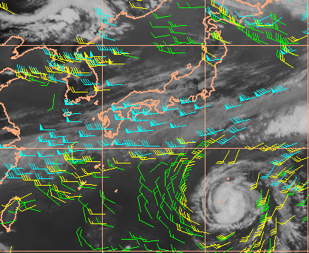
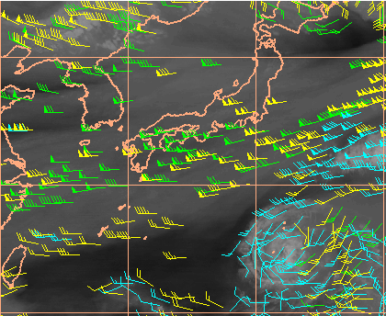
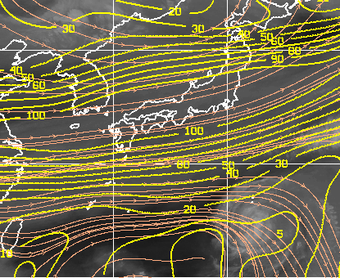
Case Study 1: CIMSS products: 26 May 2012 06UTC
Low-mid level winds
Mid-upper level winds
Wind shear
(150-250hPa wind – 700-925hPa wind)

Slide 7
Case Study 1: Questions (26 May 2012)
Identify the following | Your comments
Utilising the image panels and the table for this question, describe / annotate as many features of interest to the forecaster in this animation.
Give reasons why the features would be of interest to the forecaster
How is rapid scan imagery helping you here ?

