Slide 1


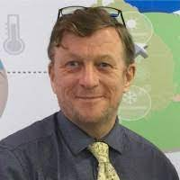
The VLab activities of the Australian, Indonesian and Korean VLab Centres of Excellence
Mr Bodo Zeschke Teacher, Australian Bureau of Meteorology Training Centre Point of Contact, Australian VLab Centre of Excellence
Notes:
Accessibility information – delete after reading
We're all responsible for producing accessible documents. Use the accessibility checker to make sure your content is accessible to everyone.

Slide 2
Topics to be presented
Brief overview of the VLab Centres of Excellence
The past year of activities at the Australian VLab Centre of Excellence.
The past year of activities at the Indonesian VLab Centre of Excellence.
The past year of activities at the Korea VLab Centre of Excellence.

Slide 3
Topics to be presented
Brief overview of the VLab Centres of Excellence
The past year of activities at the Australian VLab Centre of Excellence.
The past year of activities at the Indonesian VLab Centre of Excellence.
The past year of activities at the Korea VLab Centre of Excellence.

Slide 4
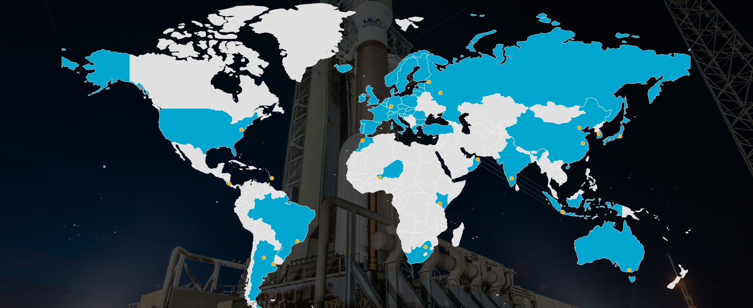
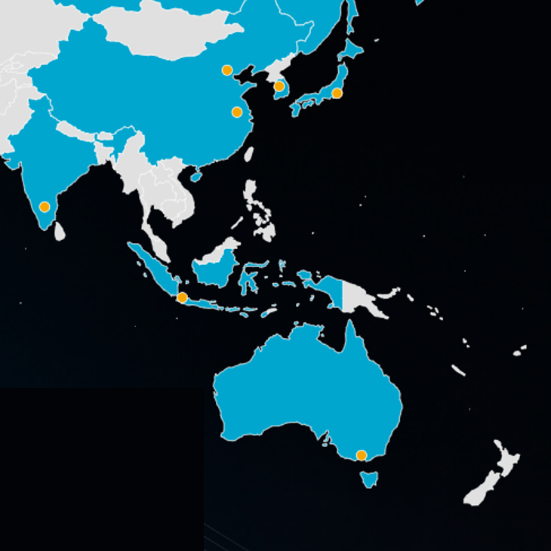
The Australia, China, Indonesia and Korea VLab Centres of Excellence (CoE)
China VLab CoE (Beijing)
Region II
CMA
JMA
KMA
China VLab CoE (Nanjing)
Korea VLab CoE
Region V
Indonesian VLab CoE
Australian VLab CoE
WMO Regions
Satellite Providers
Centres of Excellence
image modified from https://wmo-sat.info/vlab/

Slide 5
Topics to be presented
Brief overview of the VLab Centres of Excellence
The past year of activities at the Australian VLab Centre of Excellence.
The past year of activities at the Indonesian VLab Centre of Excellence.
The past year of activities at the Korea VLab Centre of Excellence.

Slide 6
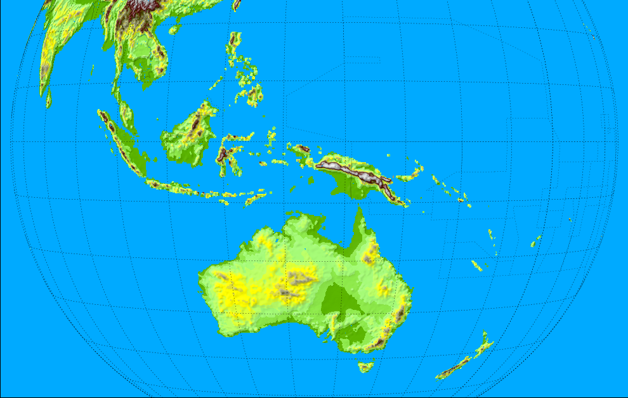



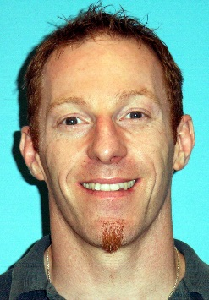

The Australian VLab Centre of Excellence and contacts 2013 to 2025
Philippines
Malaysia
Roger Deslandes
(Head of CoE)
Singapore
Peter Davidson
(Head of CoE)
Mick Pope
(Head of CoE)
DuncanTippins
(Head of CoE)
Solomon Islands
Indonesia
Timor-Leste
Tuvalu
Other important contacts:
JMA
CMA
KMA
USA
EUMETSAT
PNG
Vanuatu
Fiji
Tonga
Samoa
RAV
Satellite Champions
RAV/RAII contacts
Melbourne
New Zealand
Bodo Zeschke
(Main Point of Contact)

Slide 7
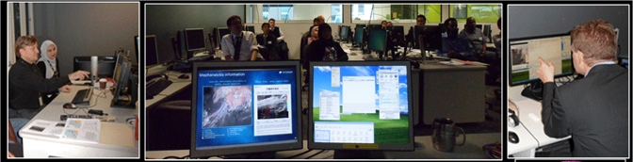
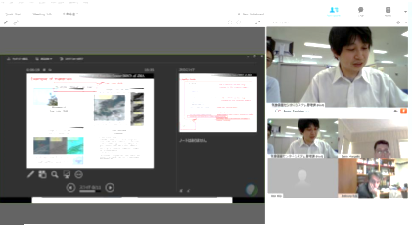

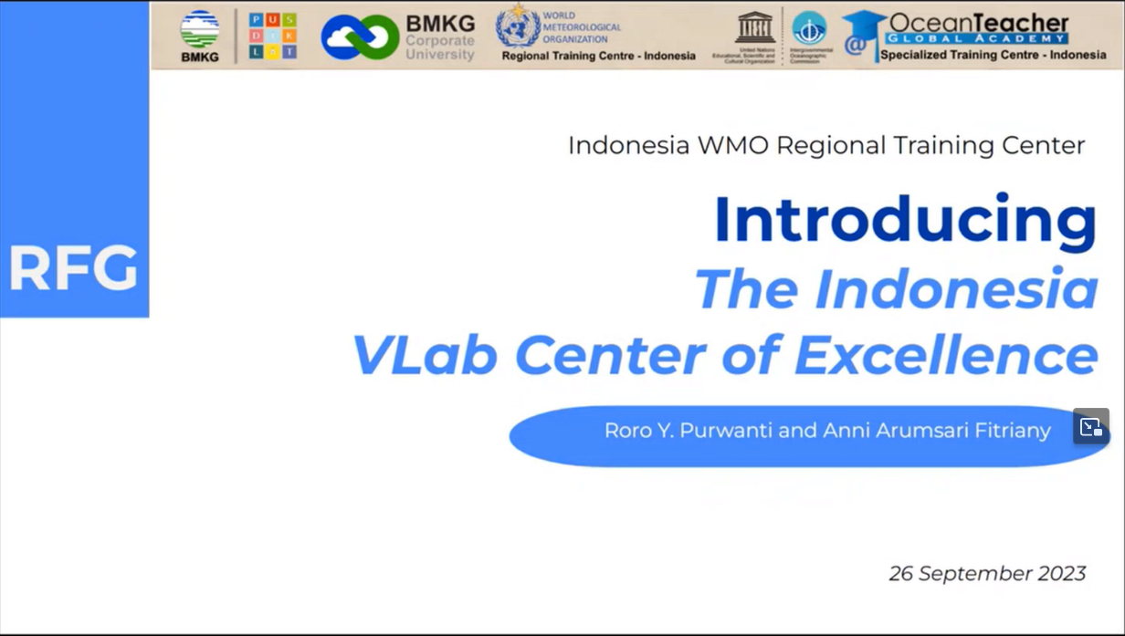
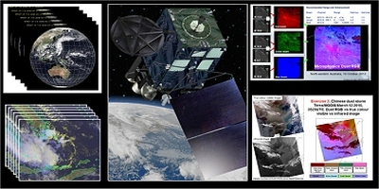
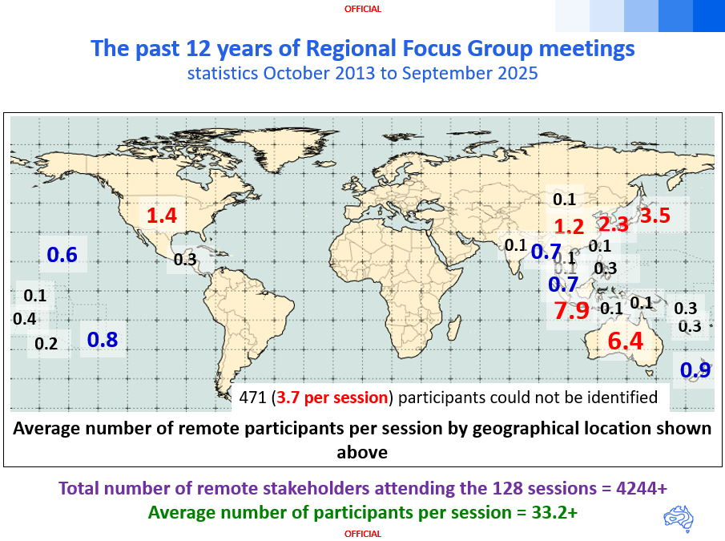
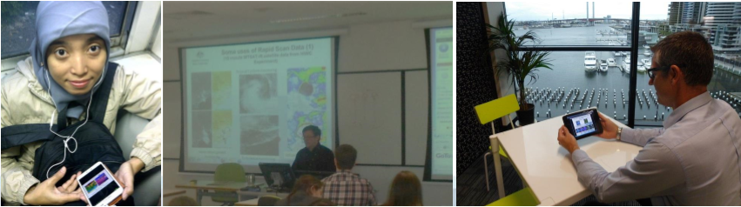
First Regional Focus Group meeting October 2013
12th
4244+ attendees, 33.2 per meeting
…128 meetings:
formerly monthly, bimonthly since August 2025

Slide 8
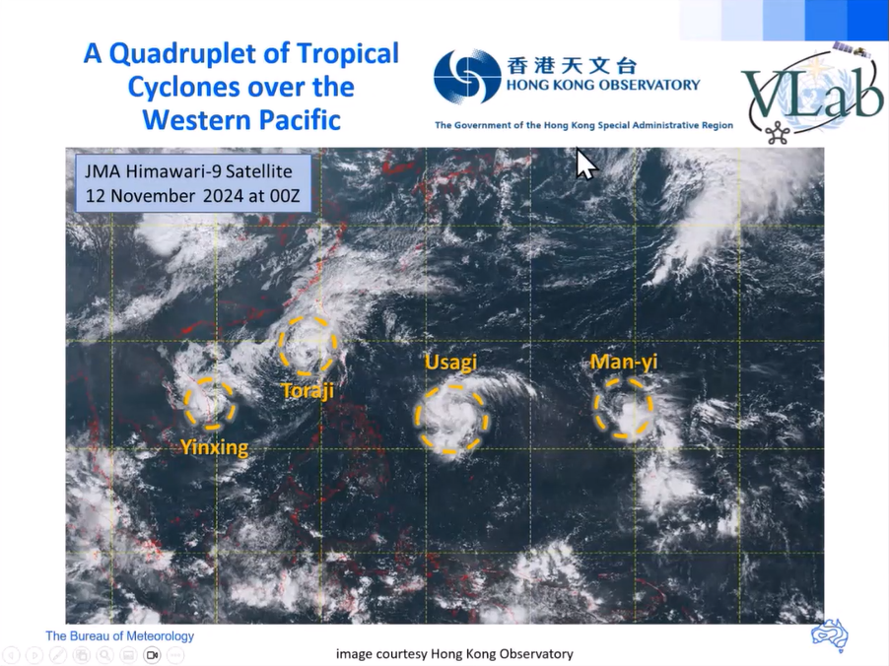
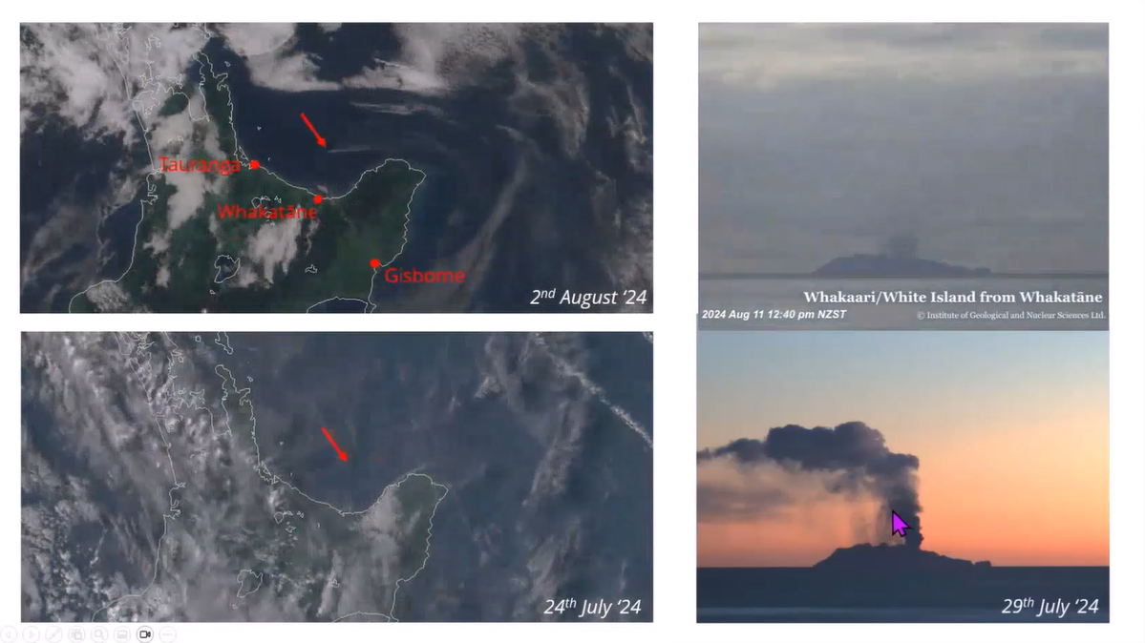
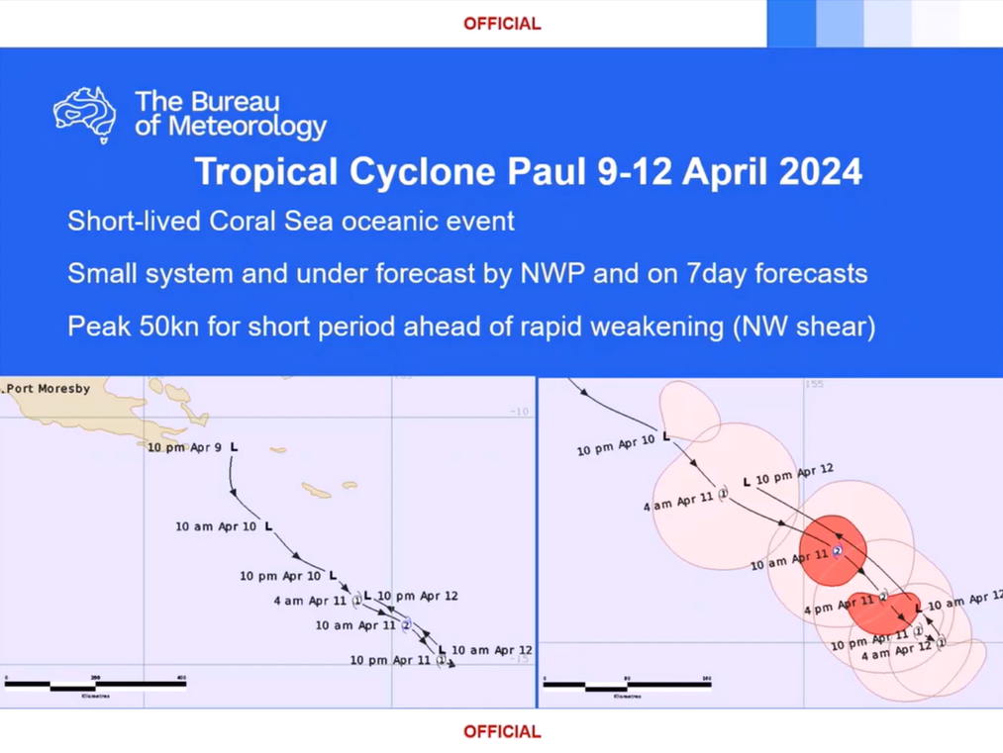
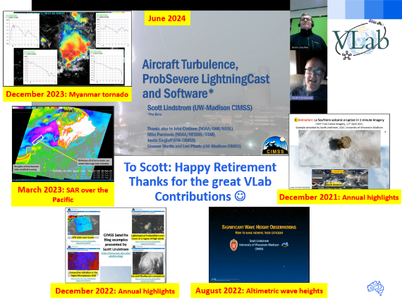
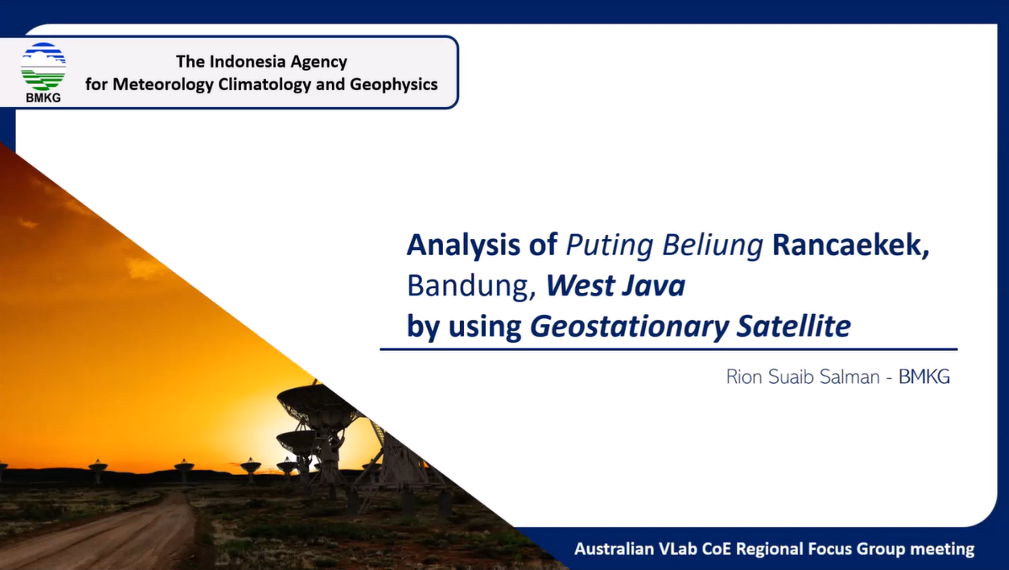






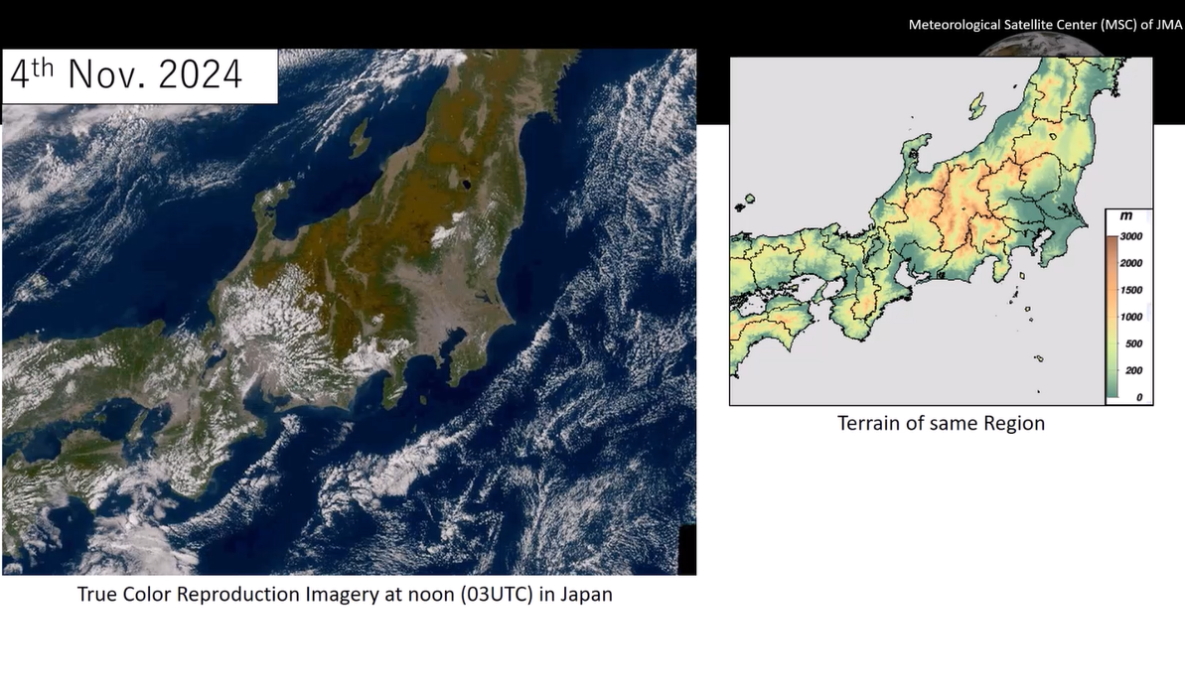
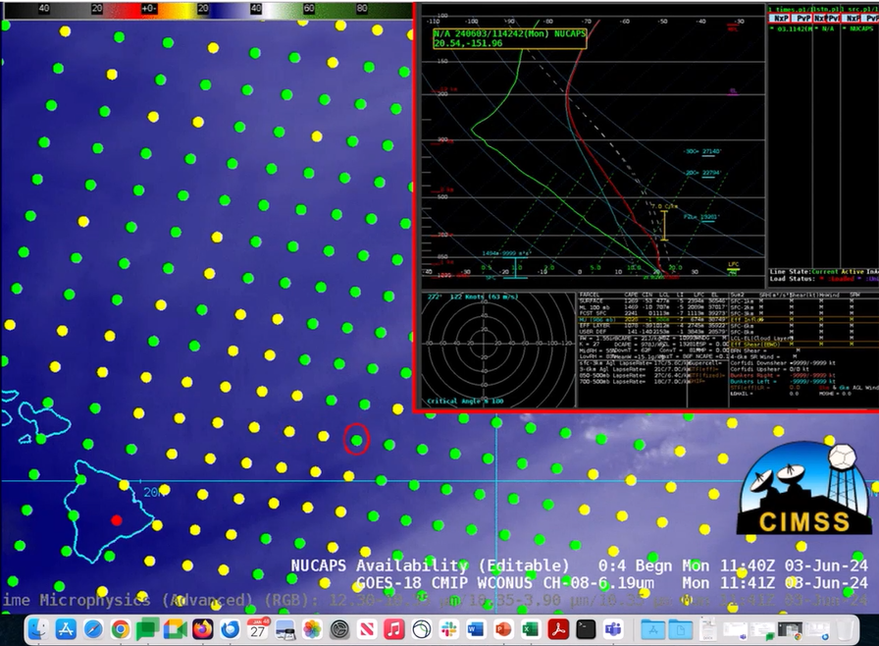
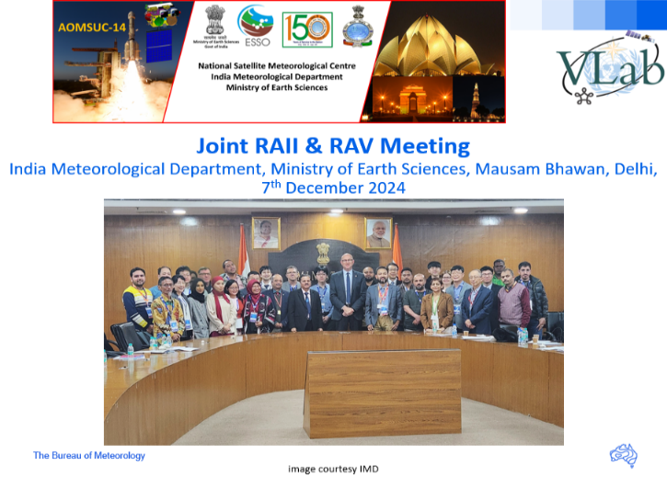
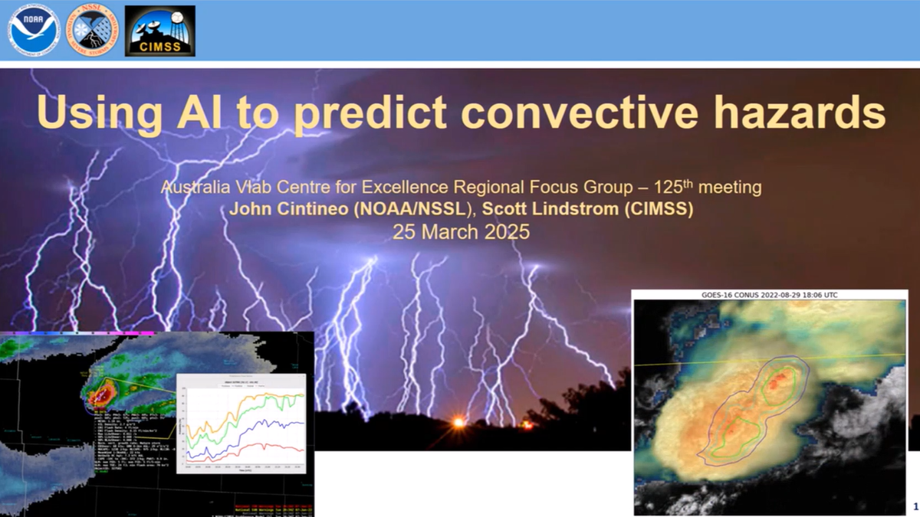
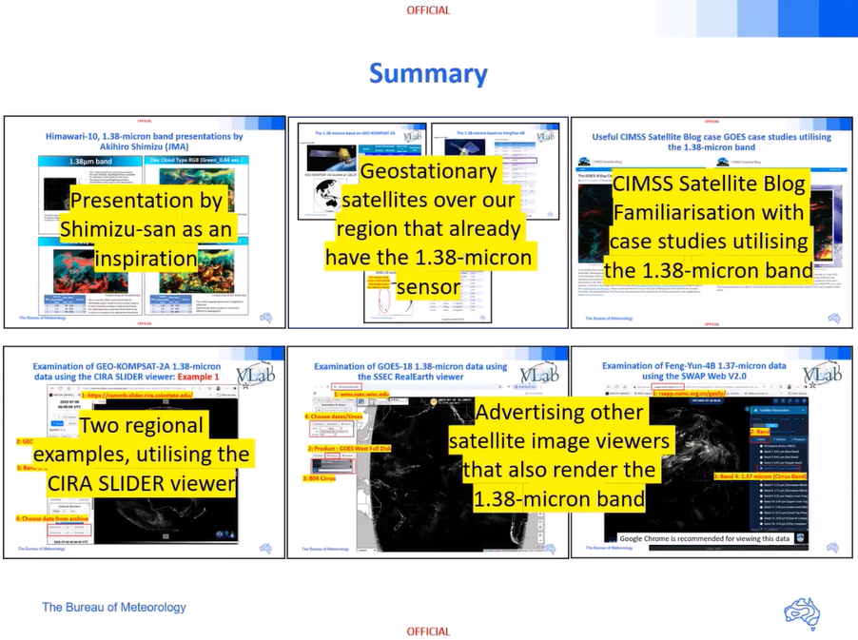

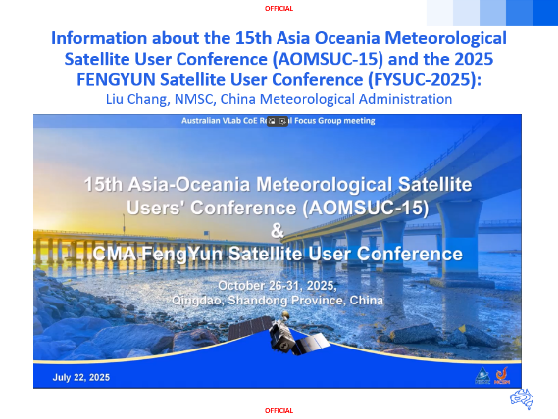
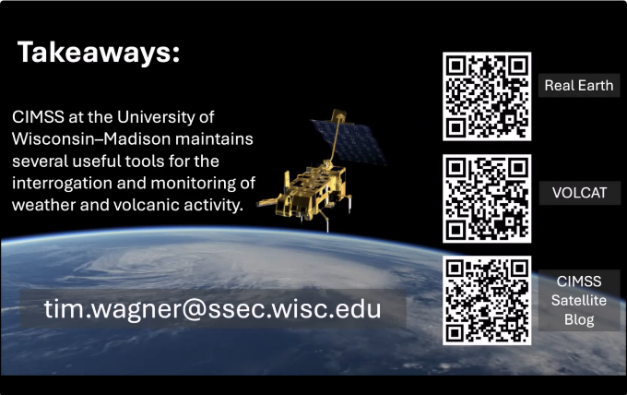
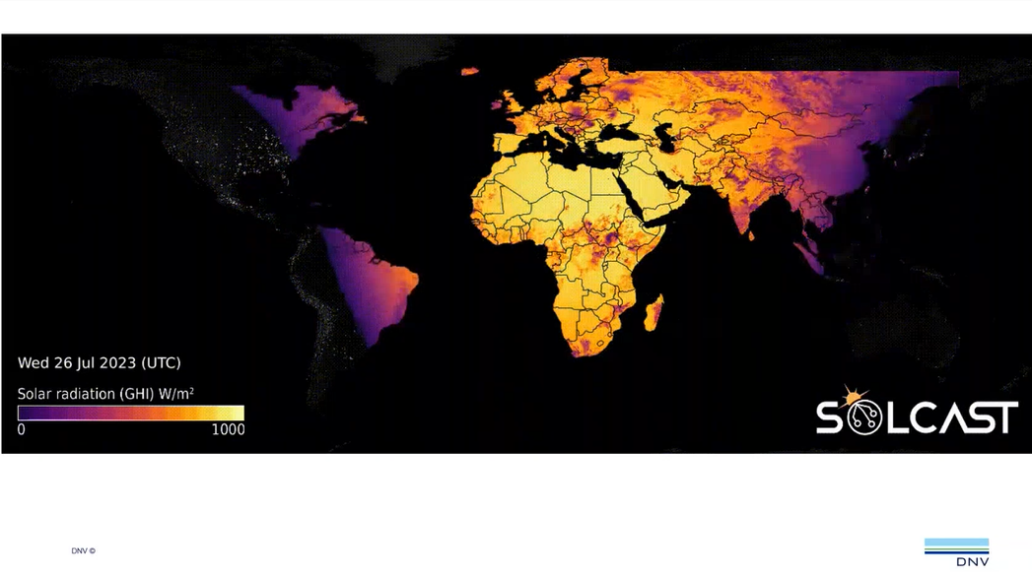
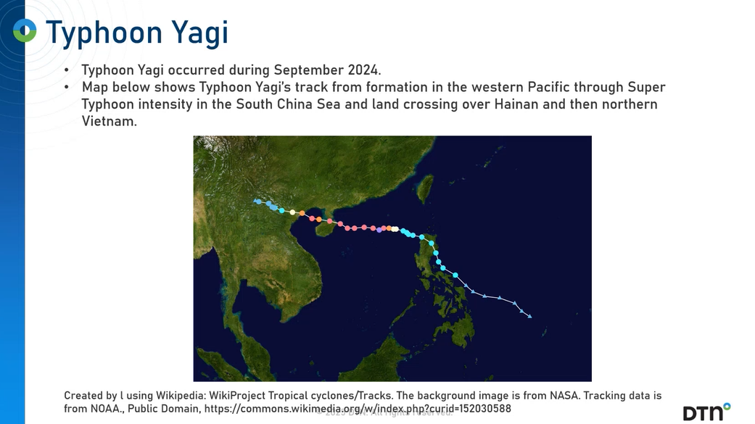
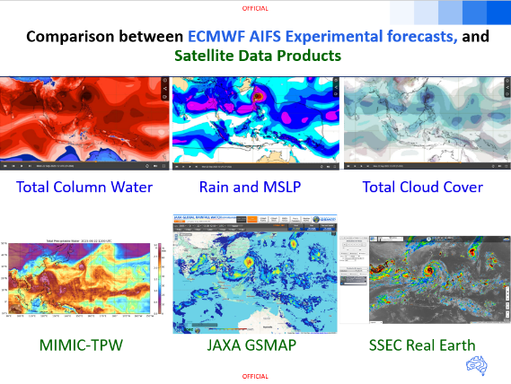

VLab Regional Focus Group meeting highlights since AOMSUC-14 A constellation of presenters from across the region

Slide 9
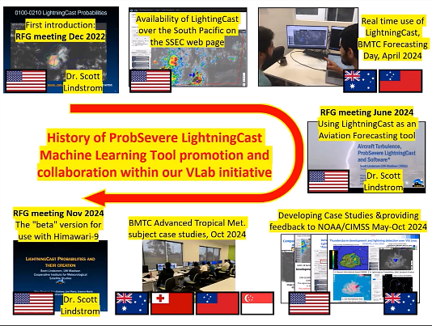
Collaboration with the USA and VLab colleagues in advertising and trialling the NOAA/CIMSS LightningCast Machine Learning Tool
RFG meeting Mar2025
Using AI to predict convective hazards

Slide 10
One of the AOMSUC-14 "finds" that has been worked on
Comparing ECMWF forecasts, including the Artificial Intelligence Forecasting System (AIFS) with Derived Satellite Products (RFG meeting September 2025)

Slide 11
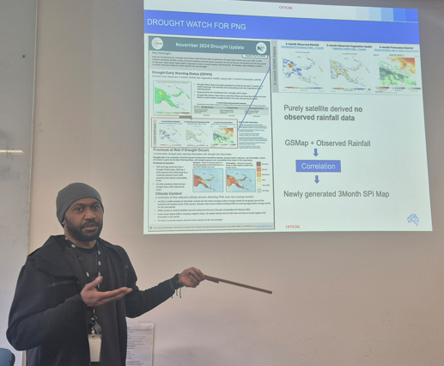
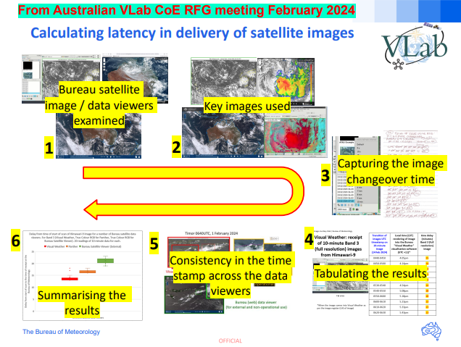
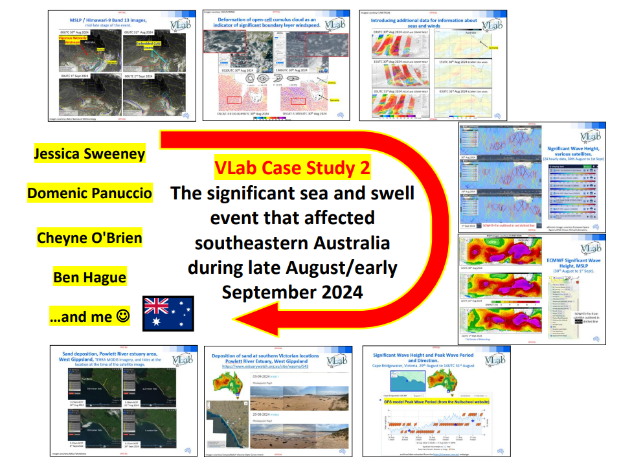
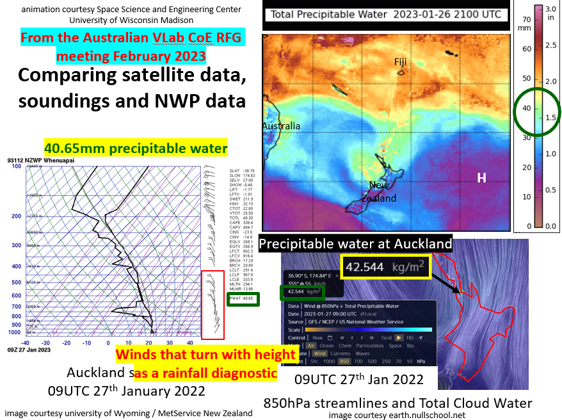
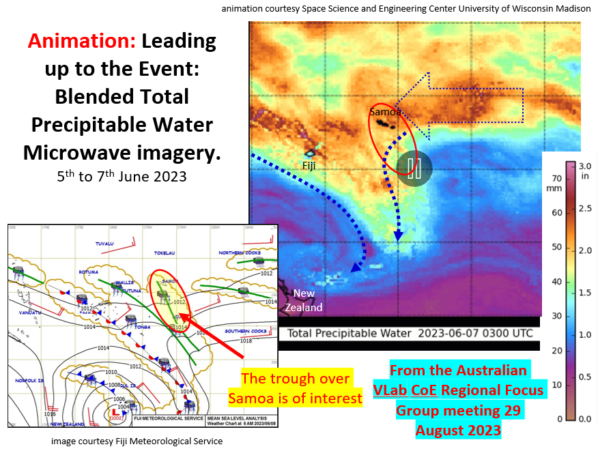
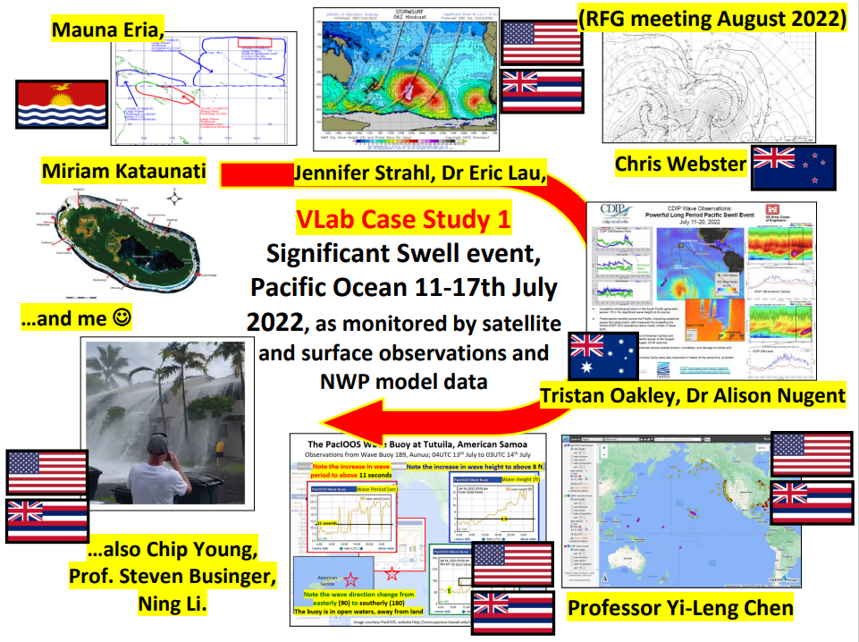
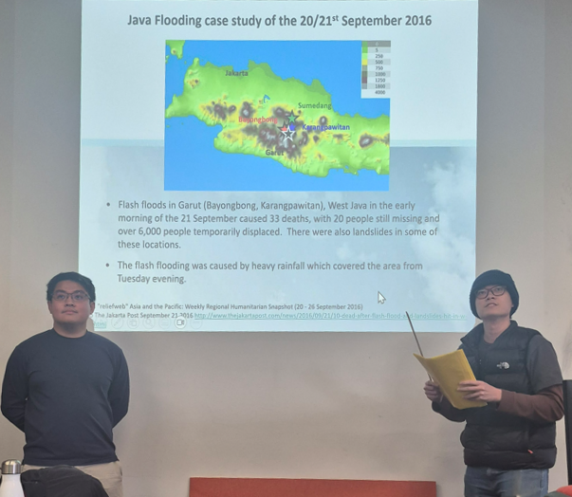
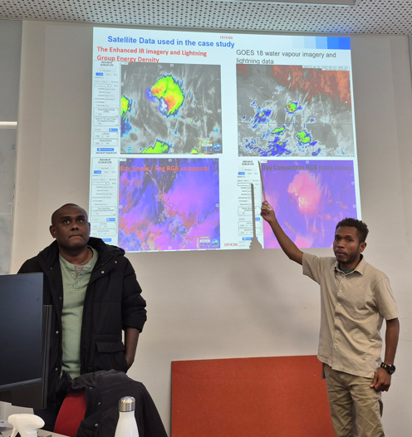
VLab resources incorporated into our Graduate Diploma of Meteorology Training at BMTC during 2025
BMTC Satellite and Tropical Meteorology: content includes Regional Focus Group meeting content
Advanced Tropical Meteorology: students study a Regional Focus Group meeting recording and then summarise this to their peers

Slide 12
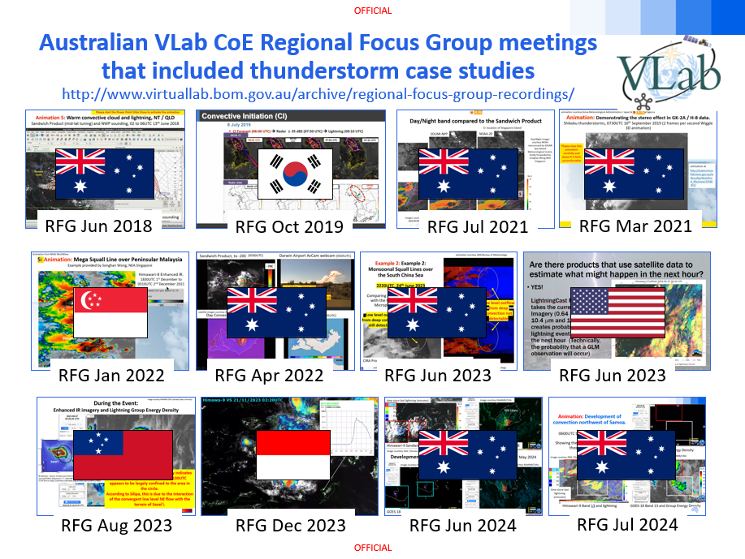
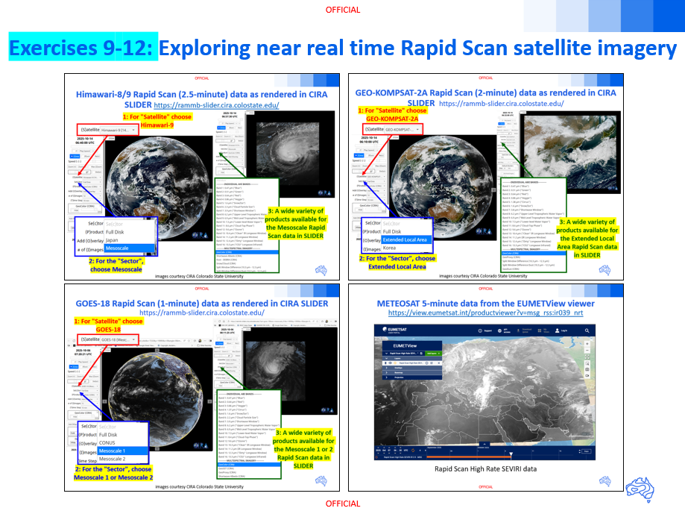
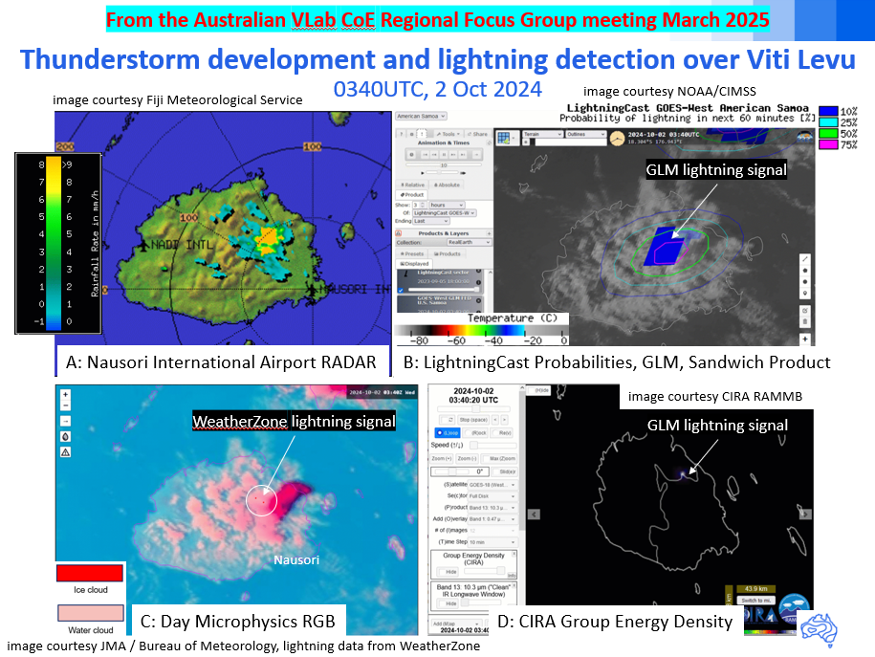
VLab resources incorporated into my AOMSUC-15 Training Event session
Regional Focus Group (RFG) meeting resources advertised
Exploring near real time satellite meteorology resources
advertised during RFG meetings
RFG case studies demonstrating how satellite data is combined with other data

Slide 13
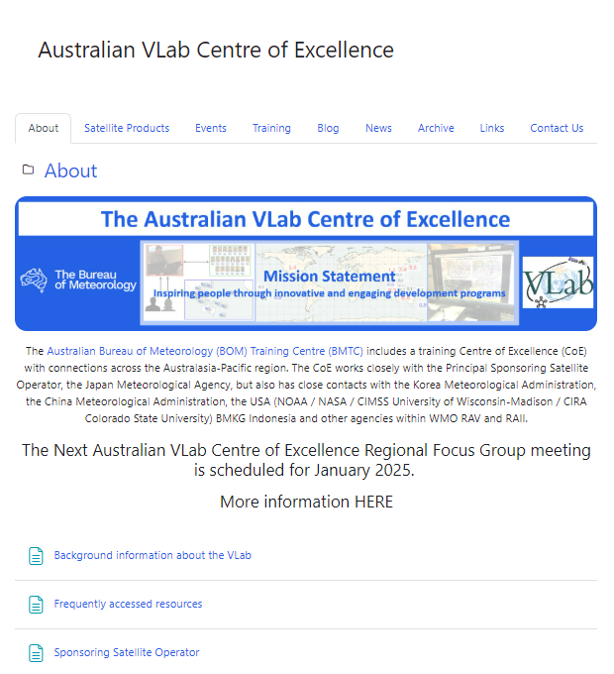
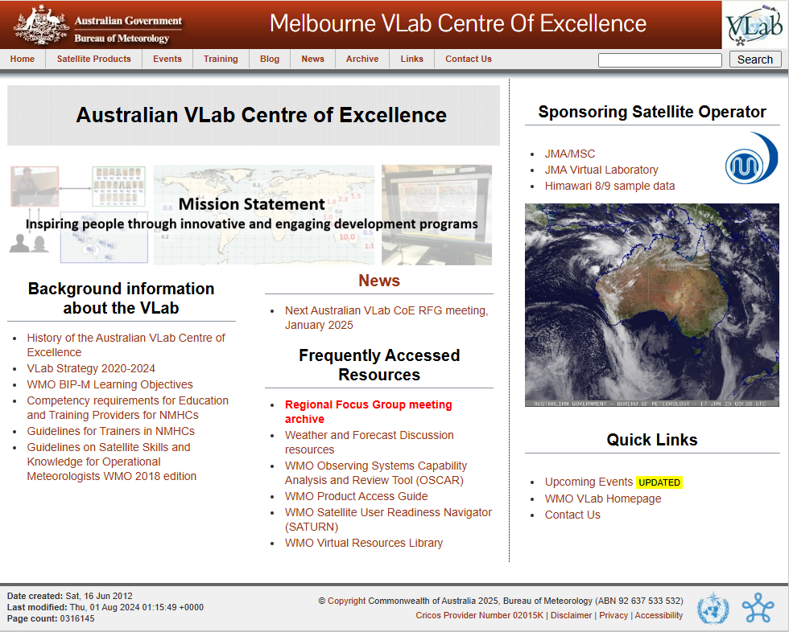
Transitioning of Australian VLab CoE resources onto our BMTC Moodle site. Proposed for the end of 2025.
Existing Web Page
http://www.virtuallab.bom.gov.au/
New BMTC Moodle Web Page

Slide 14
Topics to be presented
Brief overview of the VLab Centres of Excellence
The past year of activities at the Australian VLab Centre of Excellence.
The past year of activities at the Indonesian VLab Centre of Excellence.
The past year of activities at the Korea VLab Centre of Excellence.

Slide 15
Topics to be presented
Brief overview of the VLab Centres of Excellence
The past year of activities at the Australian VLab Centre of Excellence.
The past year of activities at the Indonesian VLab Centre of Excellence.
The past year of activities at the Korea VLab Centre of Excellence.

Slide 16
Summary
Presented a brief overview of the VLab Centres of Excellence
The past year of activities at the Australian VLab Centre of Excellence.
The past year of activities at the Indonesian VLab Centre of Excellence.
The past year of activities at the Korea VLab Centre of Excellence.

Slide 17
Thank you
Bodo Zeschke
Teacher, Australian Bureau of Meteorology Training Centre Point of Contact, Australian VLab Centre of Excellence
Bodo.Zeschke@bom.gov.au

