Slide 1
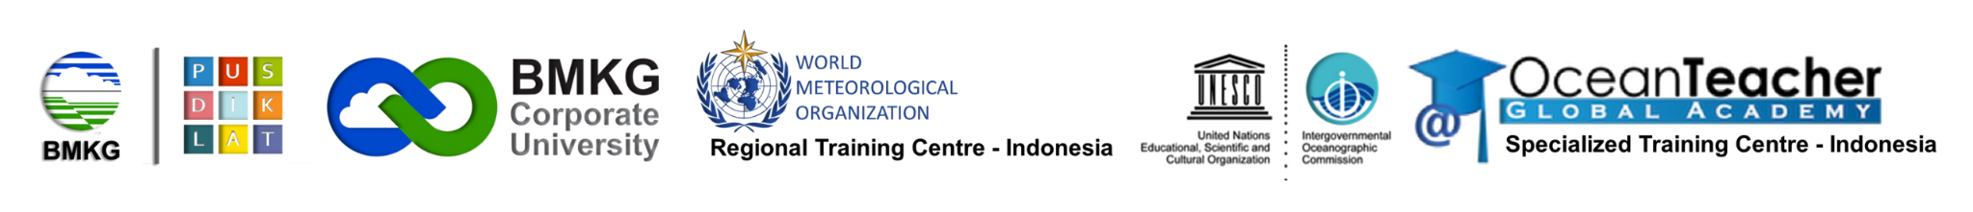
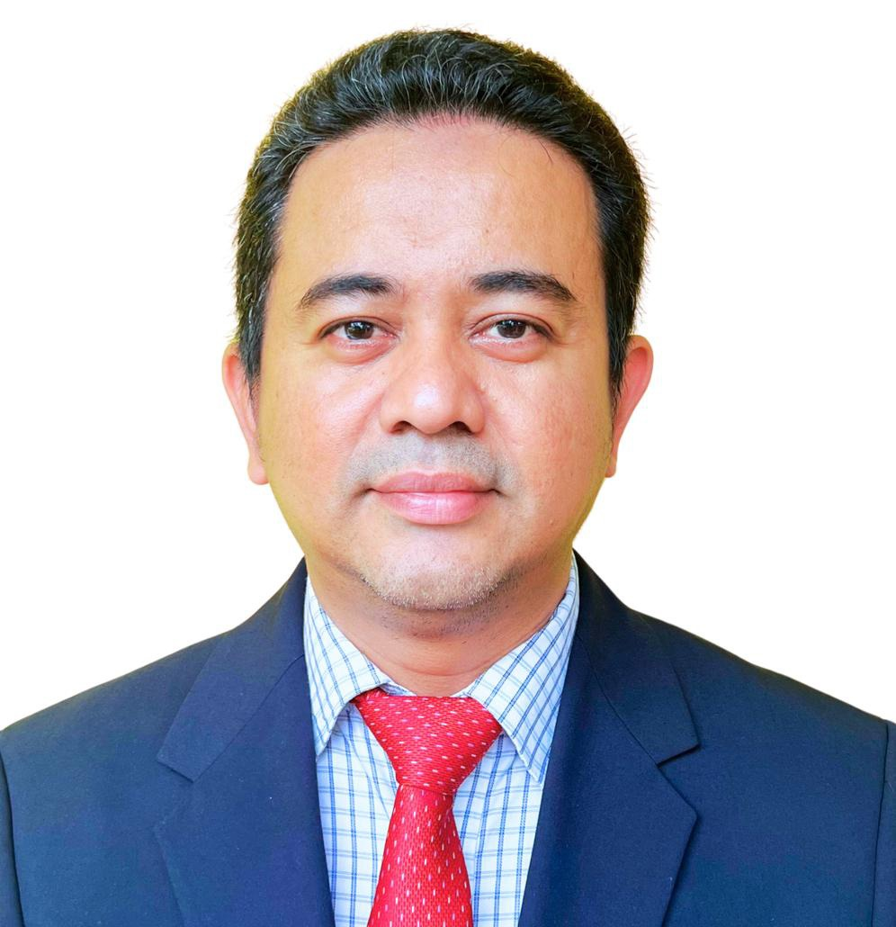
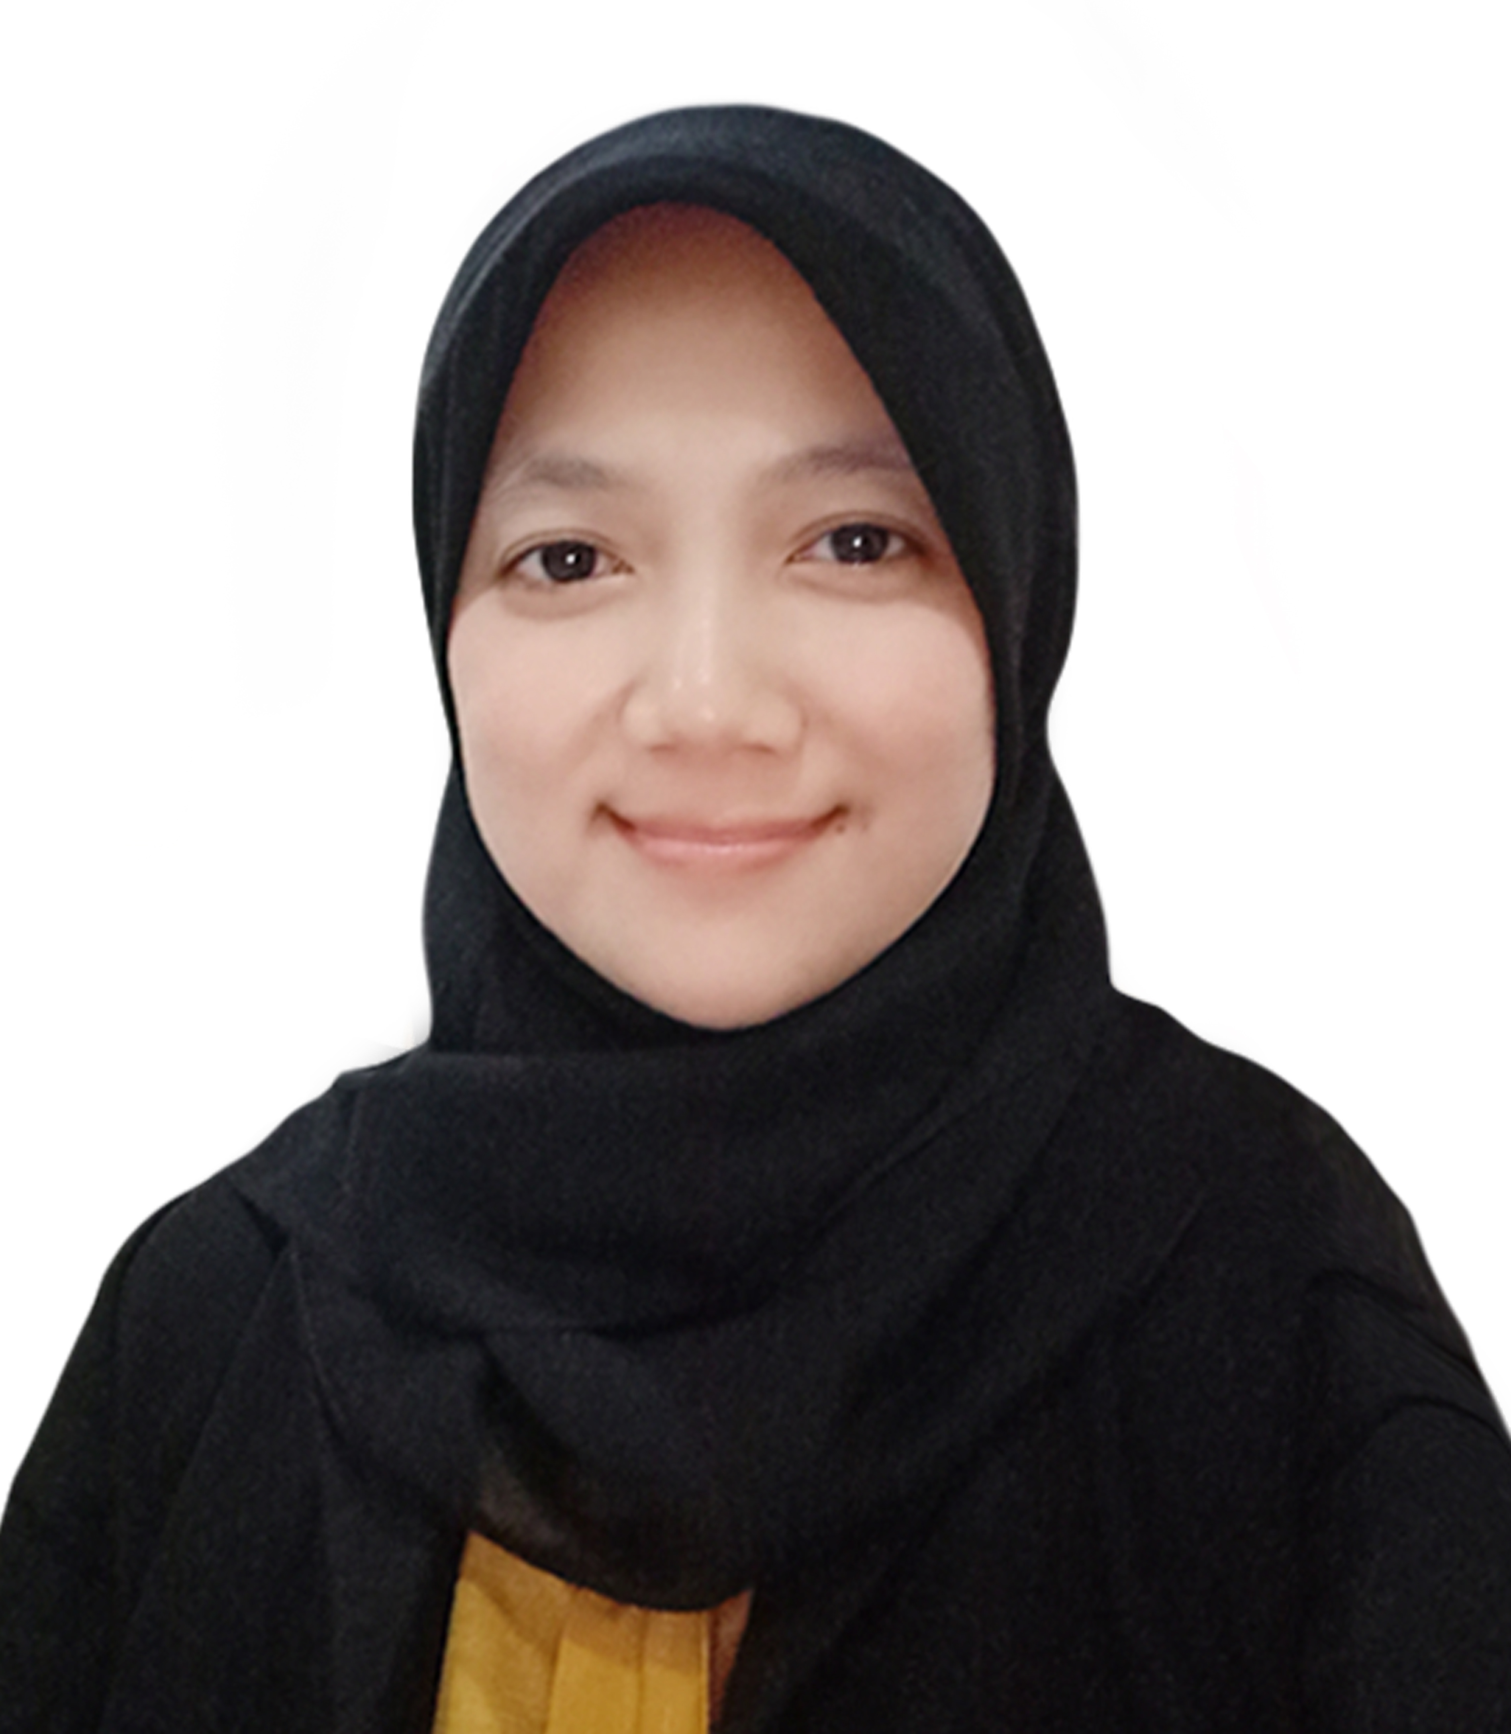
Indonesia Virtual Laboratory (VLab) Center of Excellence (CoE) for Education and Training in Satellite Meteorology Programme Activities
Focal Point Mr. Adityawarman Director of Indonesia RTC | Point of Contact Ms. Anni Arumsari Fitriany Coordinator of International Training Team
The 46th Meeting of the Sub-Committee on Meteorology and Geophysics (SCMG-46), 19-20 October 2025

Slide 2
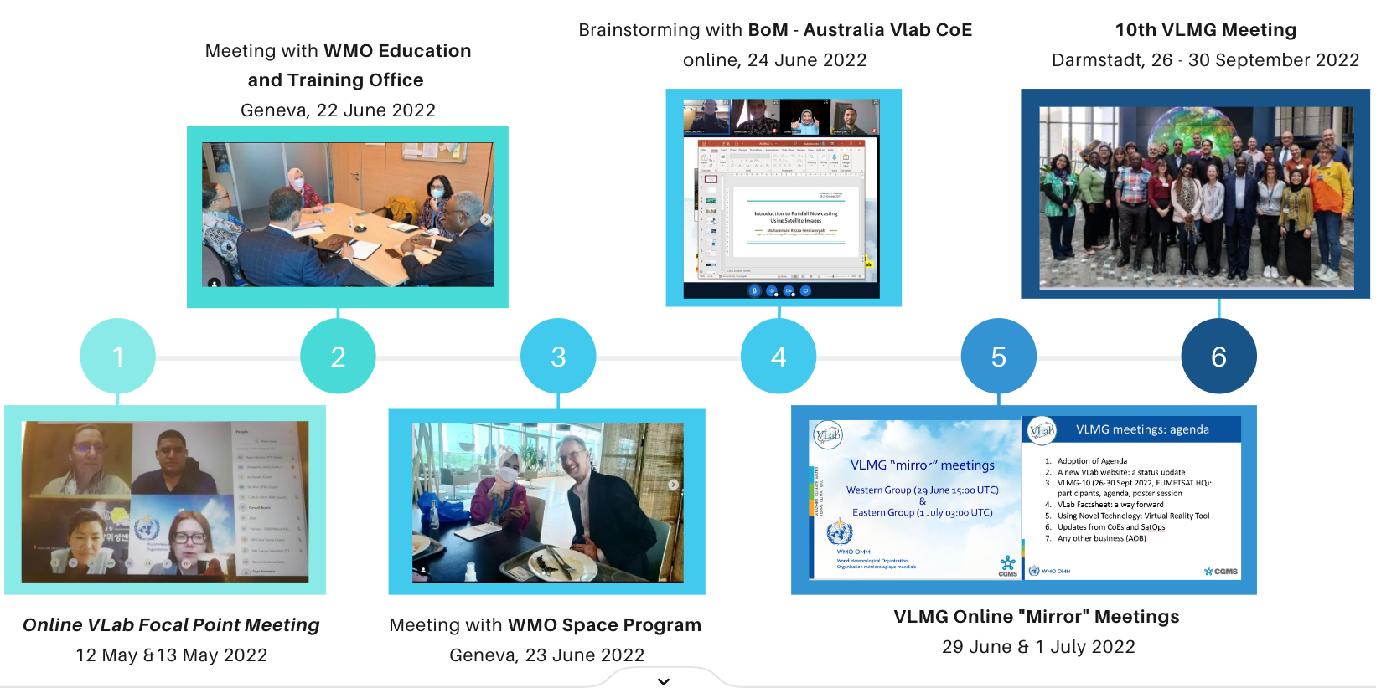
BMKG Pathways to Vlab CoE started in 2013
BMKG is approved as WMO Vlab CoE on July 2023

Slide 3
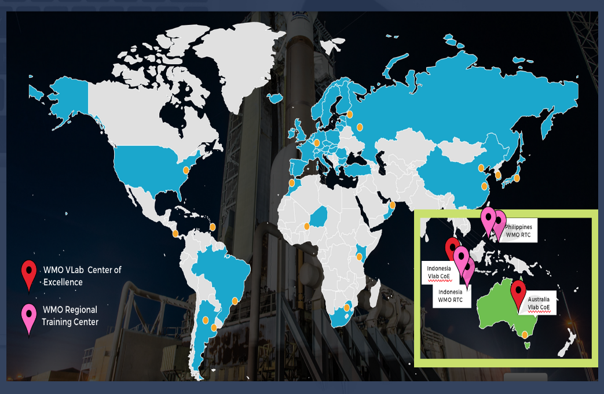

Slide 4

2024 Program Activities

Slide 5
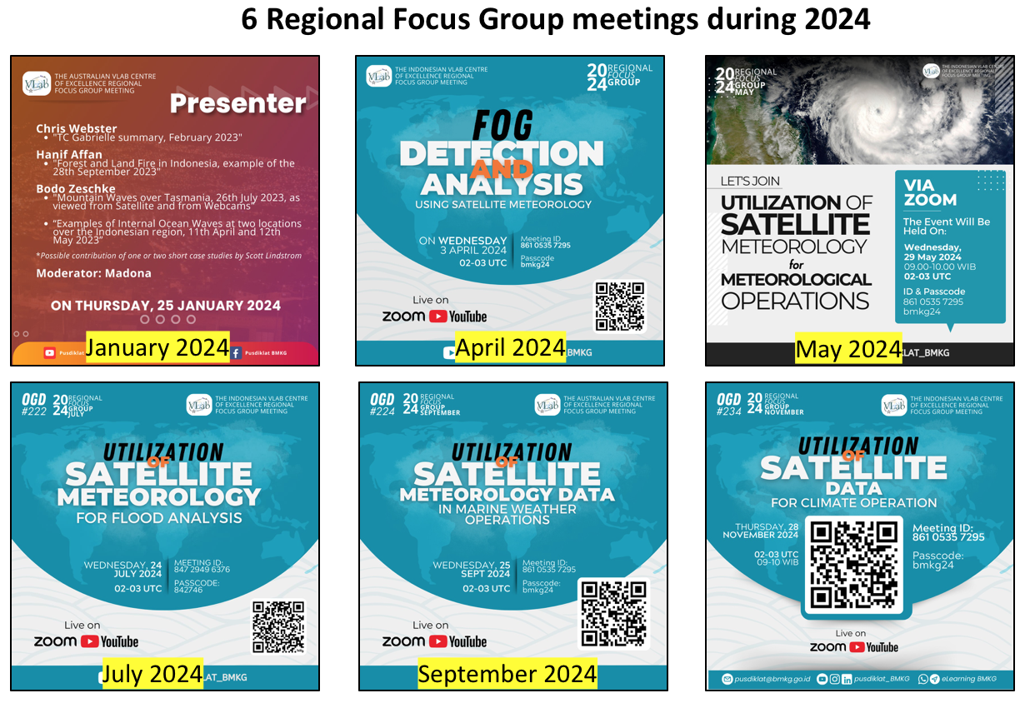
November 2024

Slide 6
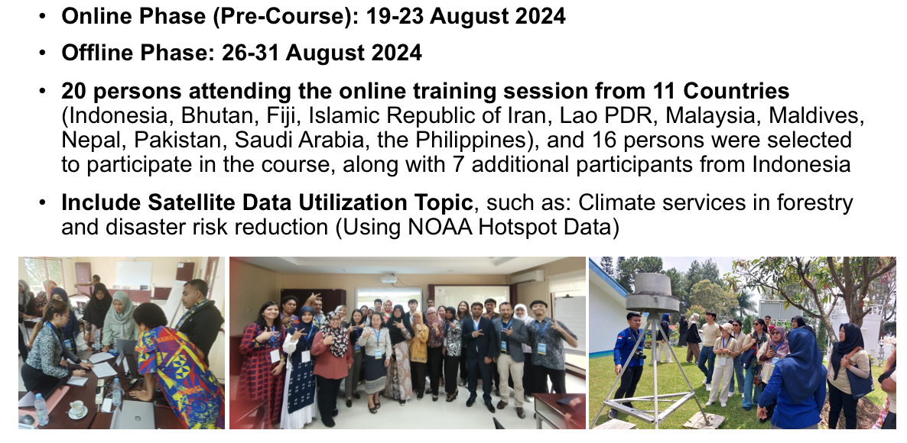
Training on the Development of Climate Services for Sectors for Colombo Plan Member Countries 2024

Slide 7
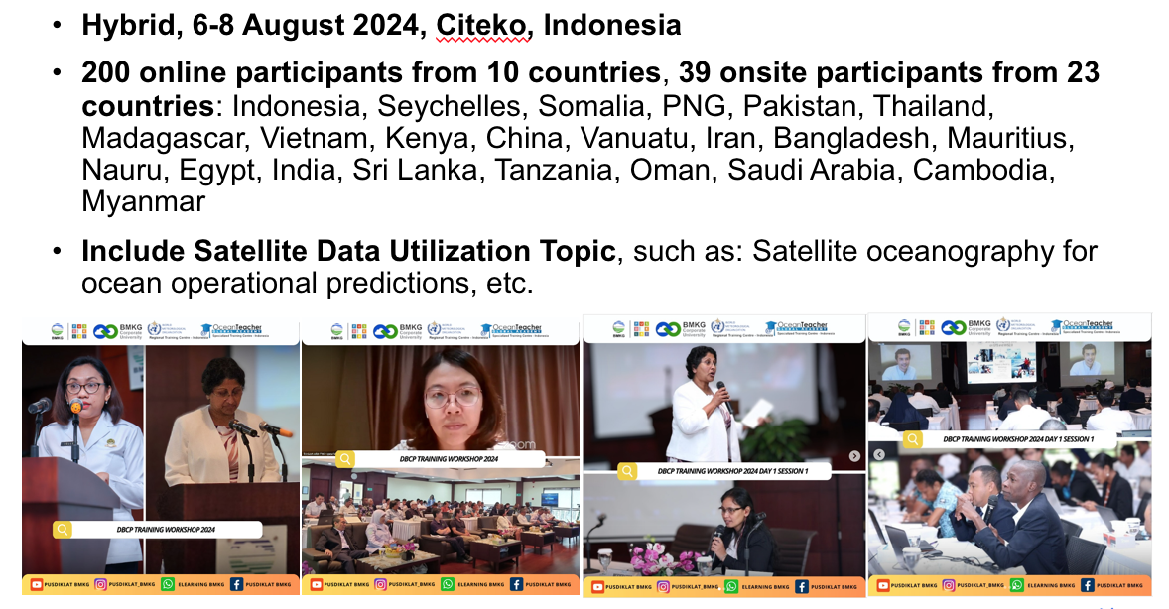
Data Buoy Cooperation Panel (DBCP) Training Workshop on Ocean Observations for Weather Forecast and Climate Prediction 2024

Slide 8
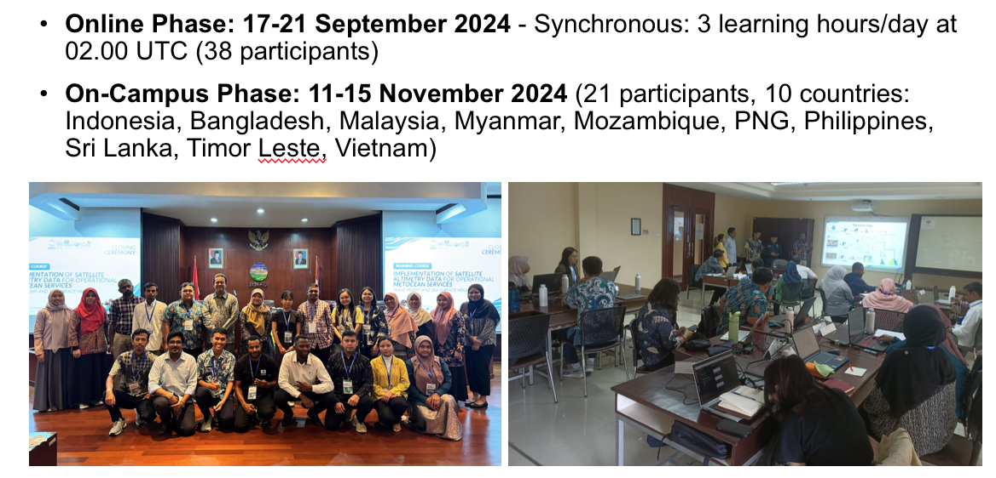
IOC/OTGA/WMO/BMKG: Training Course on the Implementation of Satellite Altimetry Data for Operational Met-ocean Services: Wave Height and Sea Surface Height 2024

Slide 9
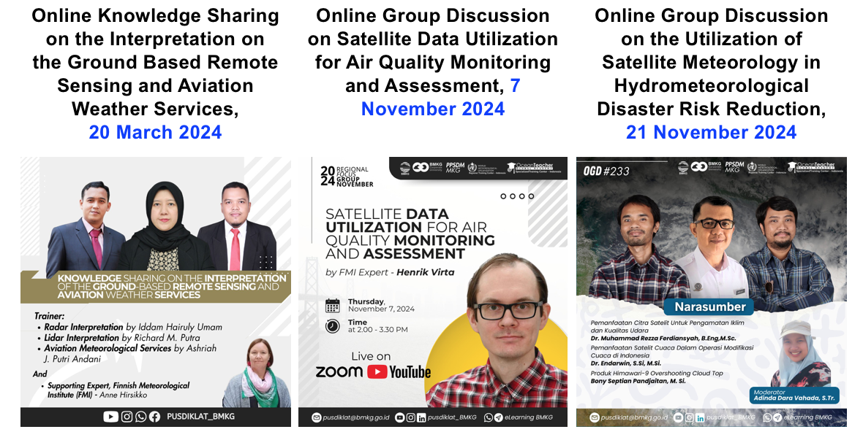
Other 2024 Activities

Slide 10
Other Contribution of Indonesia Vlab CoE, in collaboration with WMO in 2024:
Expertise contribution to the Revised WMO Satellite Enabling Skills
Expertise contribution to the Structured Basic Satellite Training

Slide 11

2025 Program Activities

Slide 12
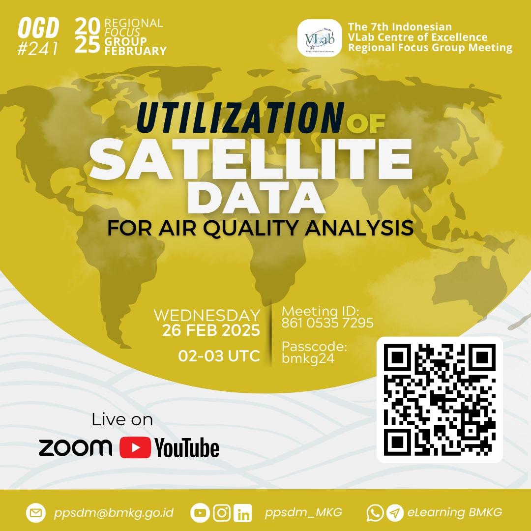
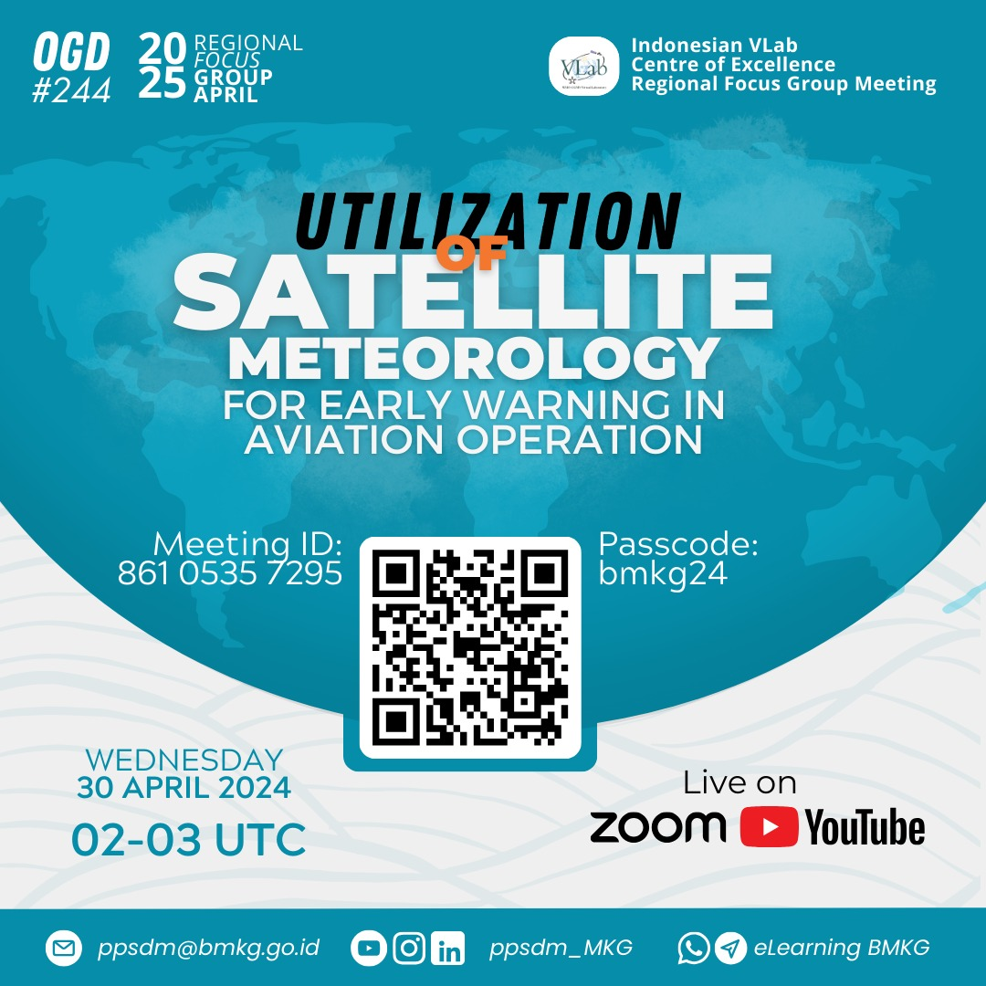
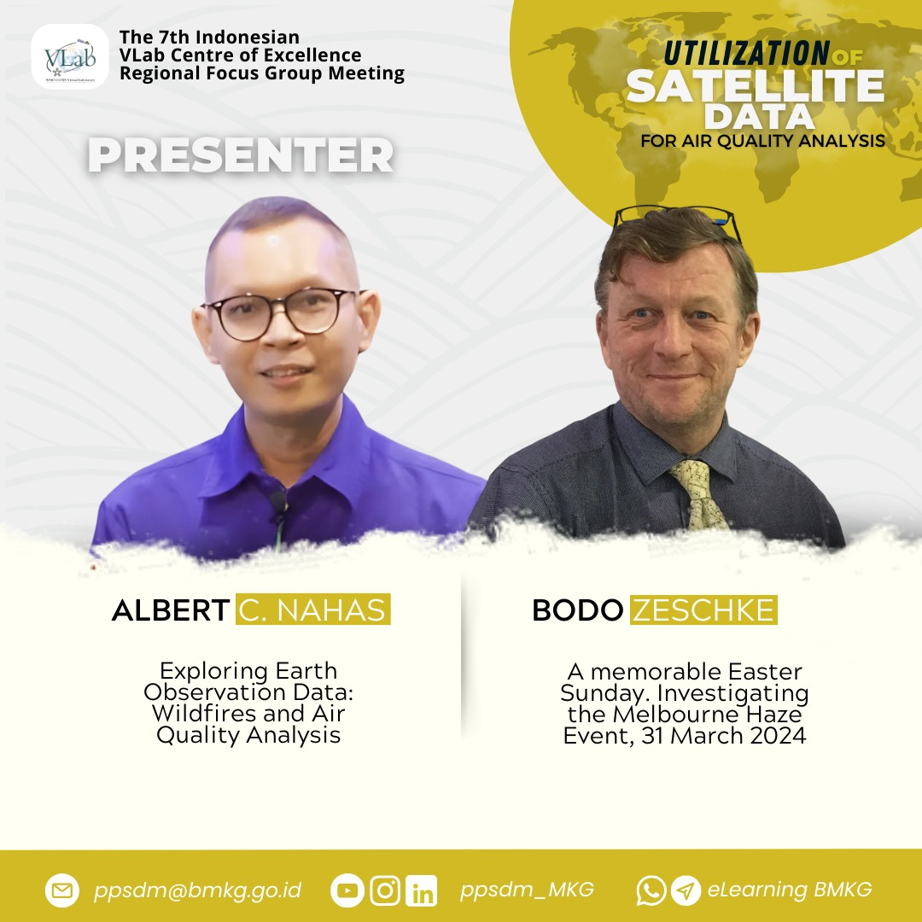
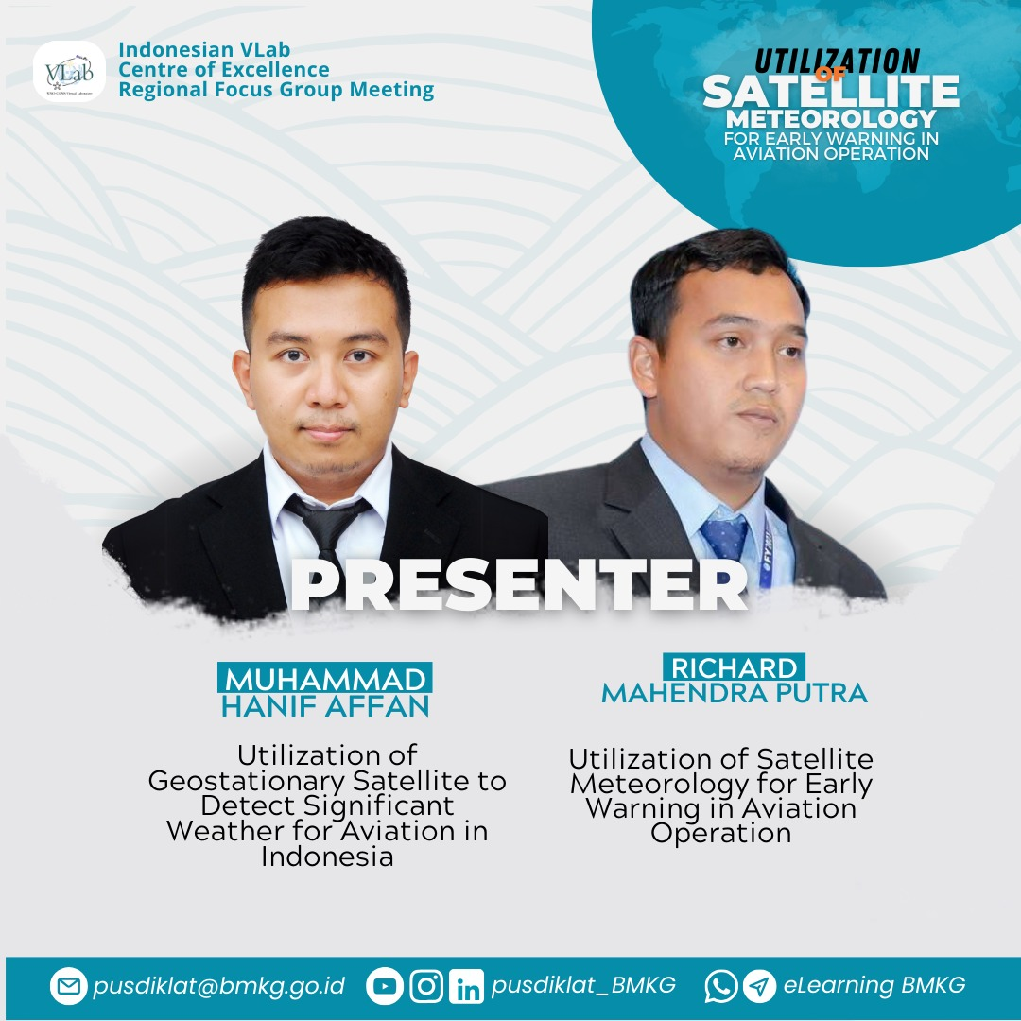
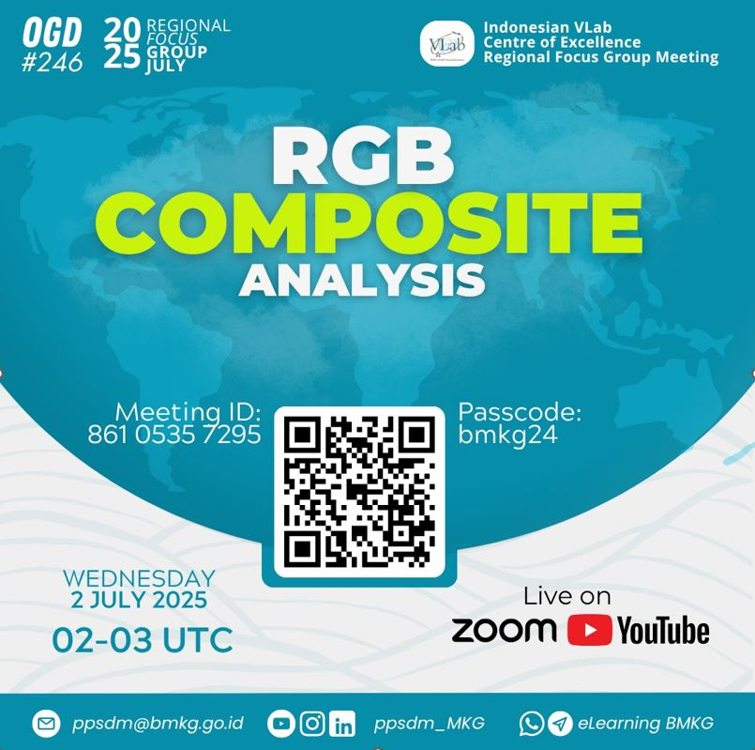
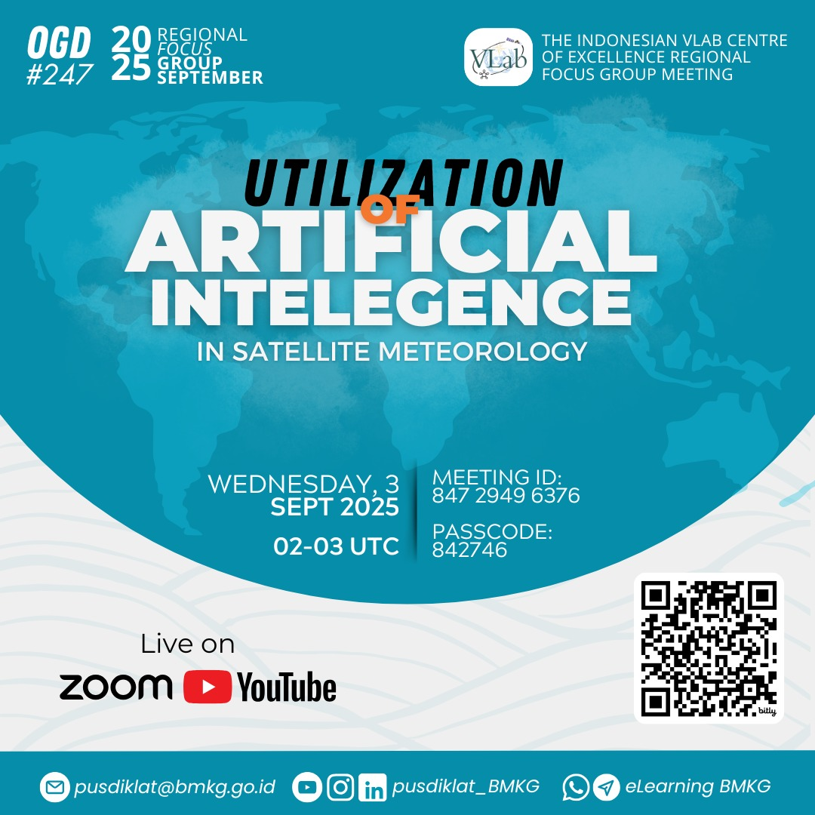
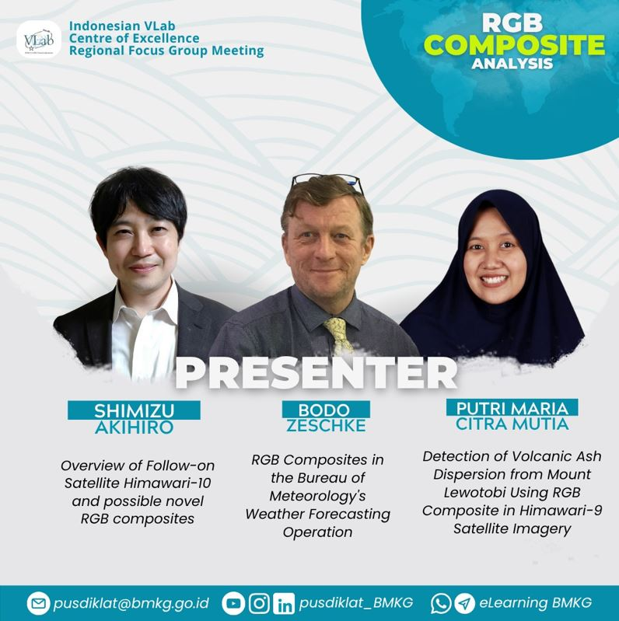
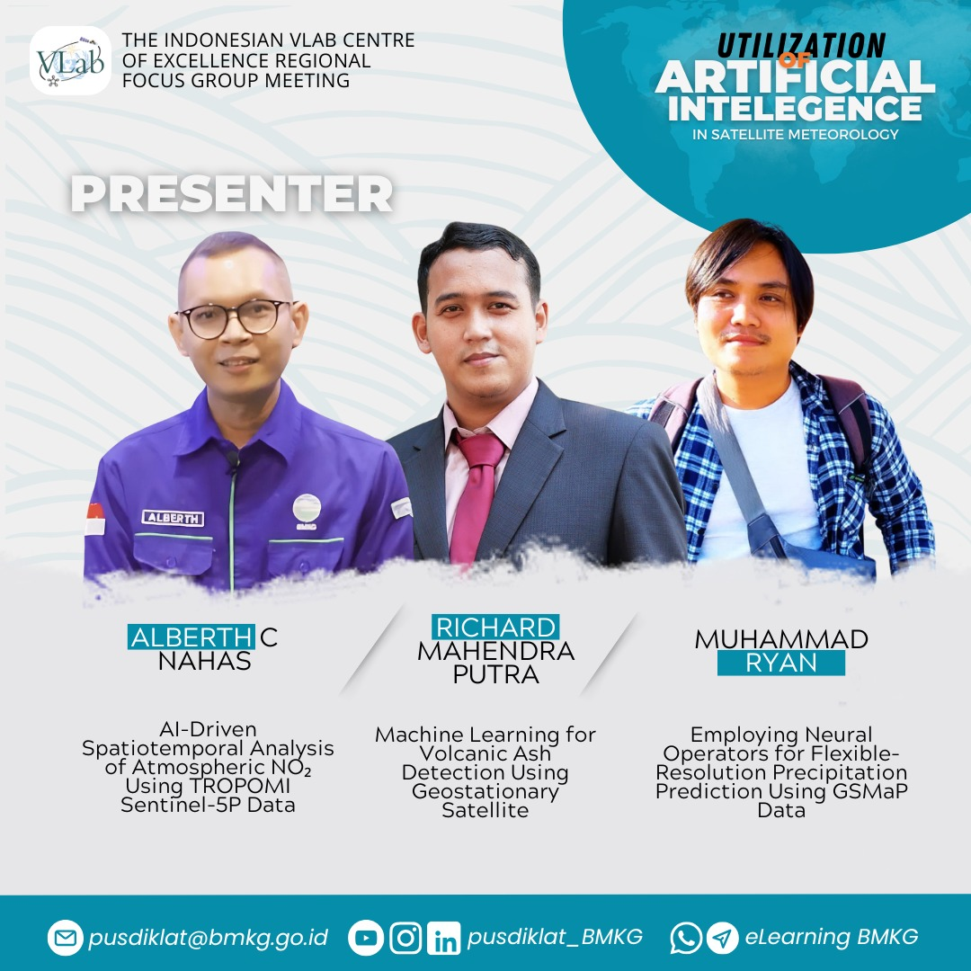
4 Indonesia Vlab CoE Regional Focus Group Meeting during 2025 (up to Sept 2025) – Collaboration with Australian Vlab CoE (Bureau of Meteorology Australia)
February 2025
April 2025
February 2025
April 2025
July 2025
September 2025
July 2025
September 2025

Slide 13
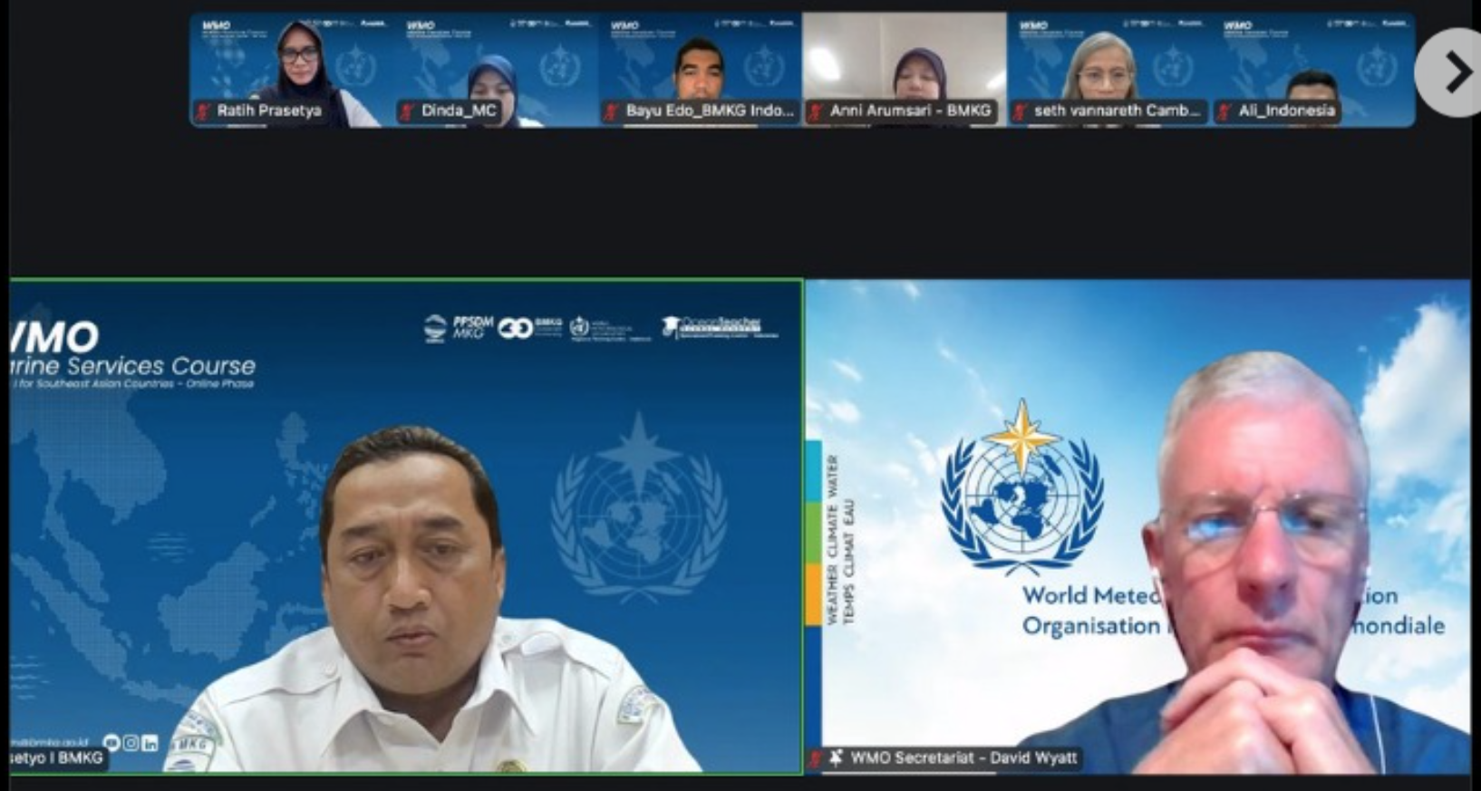
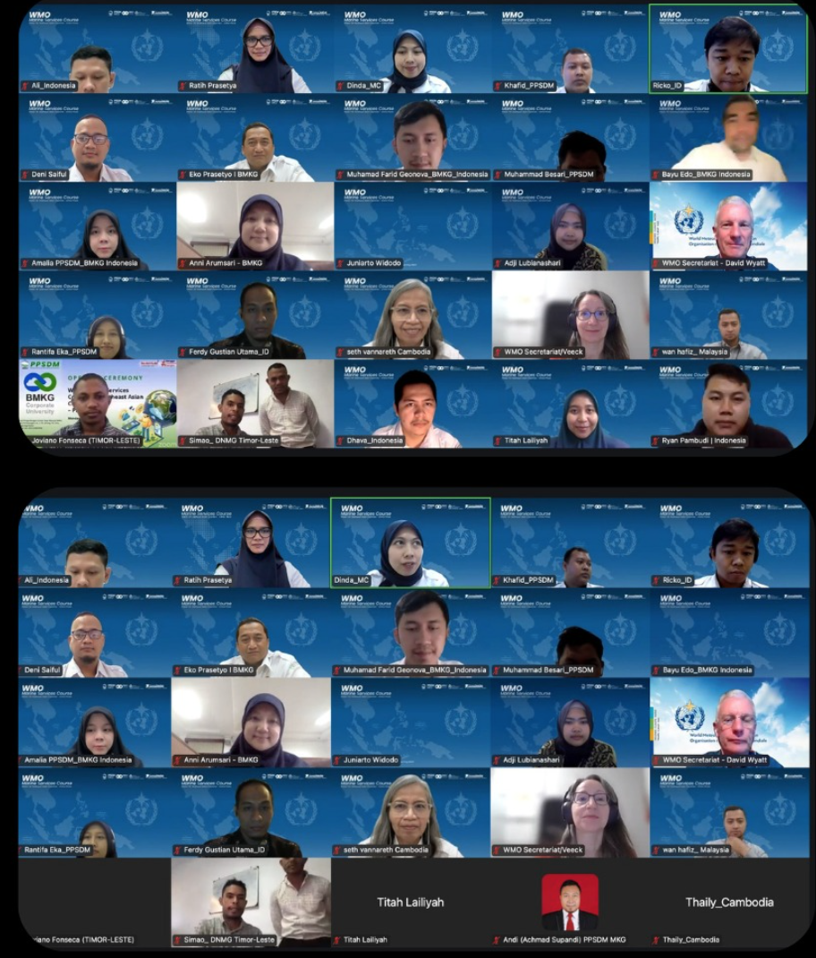
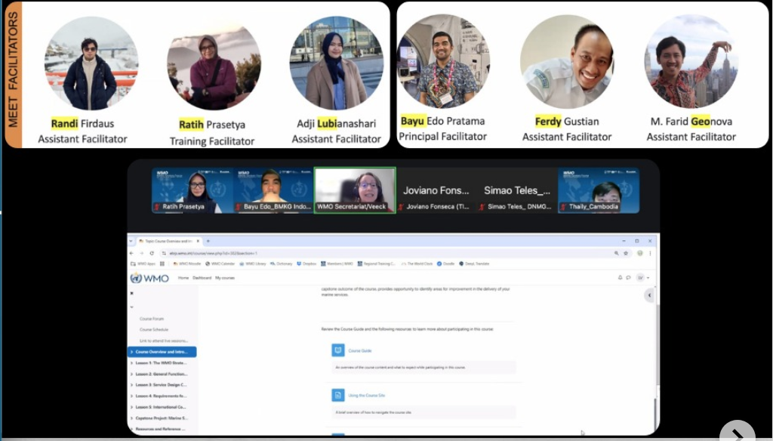
[WMO RTC of BMKG Indonesia/WMO] Marine Services Course Phase I for Southeast Asian Countries
Zoom Platform, 28 April – 21 July 2025 (online)
16 participants from: Myanmar, Cambodia, Malaysia, Indonesia, and Timor-Leste
Aim: to strengthen marine meteorological services and regional cooperation across Southeast Asia

Slide 14
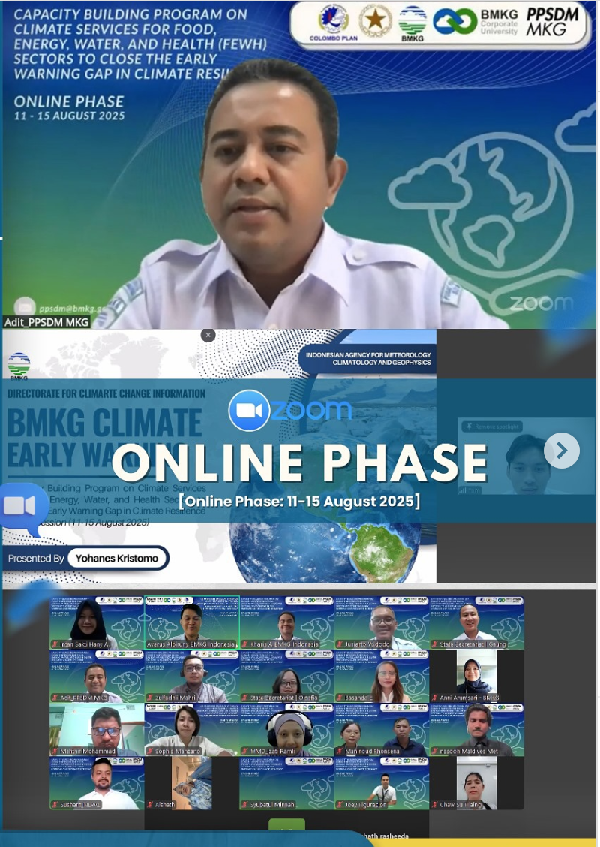
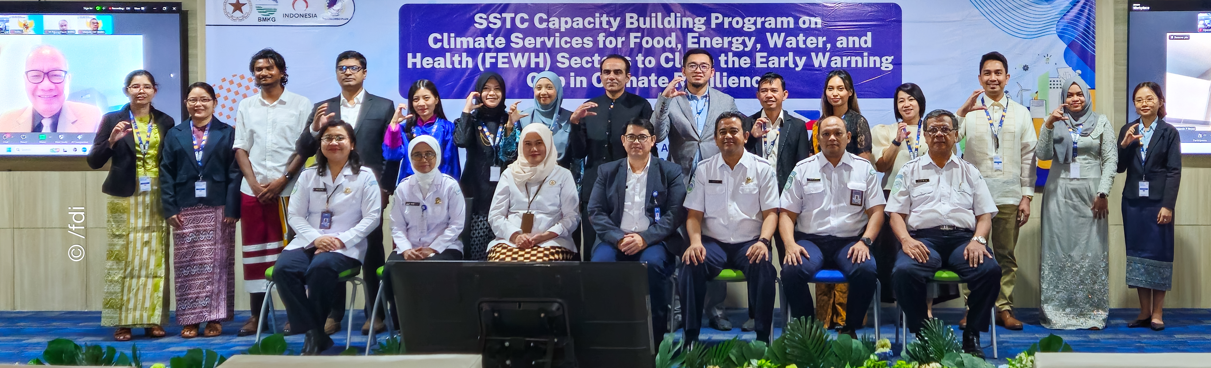
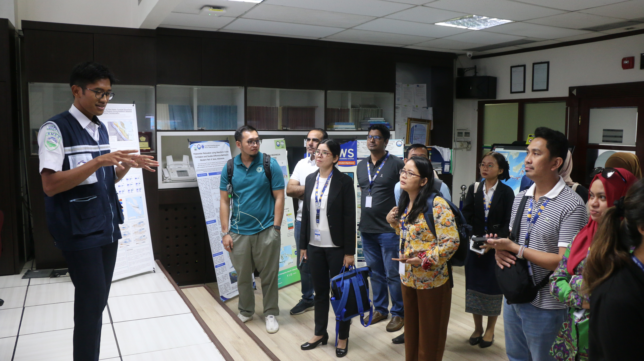
WMO RTC of BMKG Indonesia/STMKG/Ministry of State Secretariat RI/Colombo Plan] SSTC Capacity Building Program on Climate Services for Food, Energy, Water, and Health (FEWH) Sectors to Close the Early Warning Gap in Climate Resilience
Zoom Platform, 11 – 15 August 2025 (online) and
Tangerang, Indonesia, 24 – 30 August 2025 (offline)
Online: 16 participants from: Bangladesh, Bhutan, Brunei Darussalam, Indonesia, Lao PDR, Maldives, Myanmar, Nepal, Pakistan, and the Philippines
Offline: 15 participants from: Bangladesh, Bhutan, Brunei Darussalam, Indonesia, Lao PDR, Maldives, Myanmar, Pakistan, and the Philippines

Slide 15
Thank You
Anni Arumsari Fitriany
- Point of Contact of Indonesian Vlab CoE
- Coordinator of International Activities of the Center for Human Resources Development on MCG of BMKG Indonesia
Email: anni.arumsari@bmkg.go.id
Mobile/WhatsApp: +6281.399.39.7999

