Slide 1
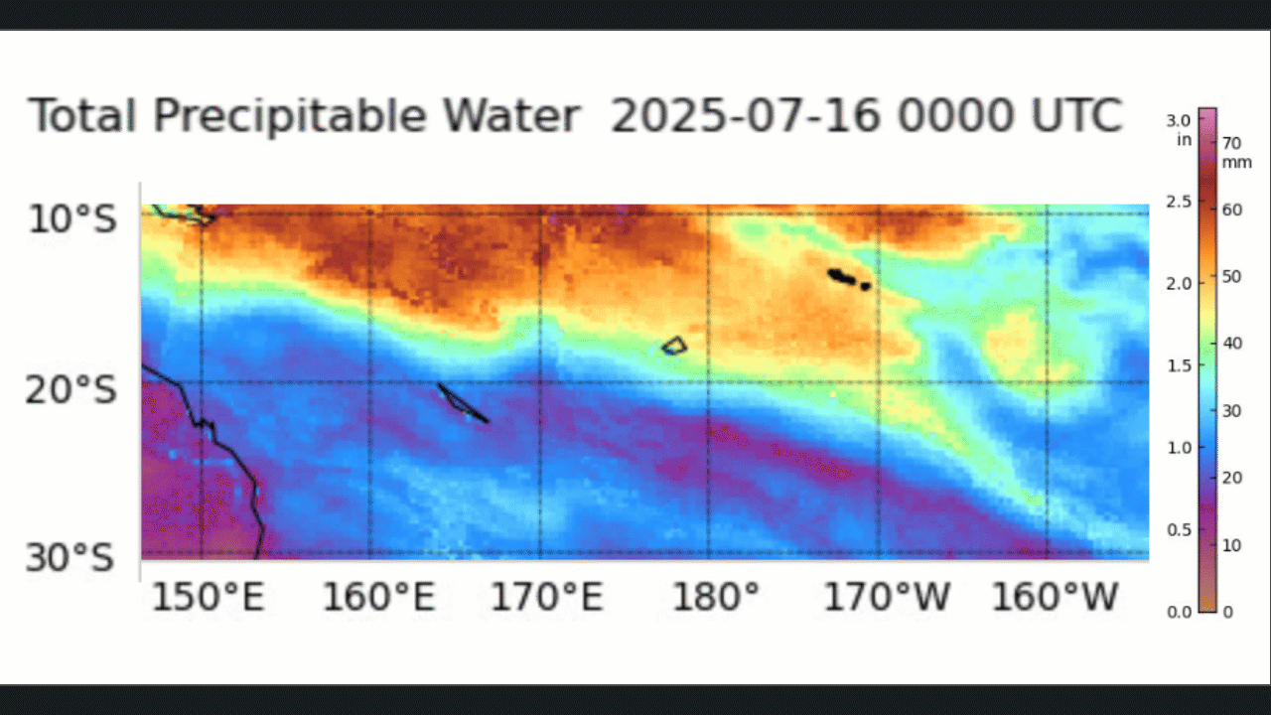
MIMIC TPW animation over Fiji 00UTC 16th July to 06UTC 17th July 2025
Fiji
Australia
Animation courtesy CIMSS University of Wisconsin Madison

Slide 2
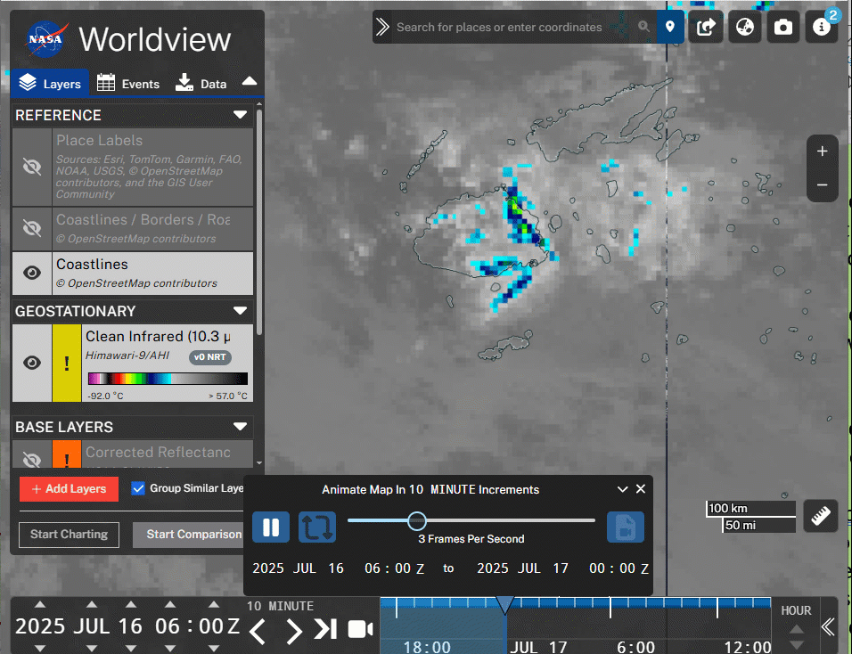
Fiji cloud development (Himawari-9 band 13, 06UTC 16th July to 00UTC 17th July 2025)
Tb
-92C
-20C
57C
Viti Levu
Animation courtesy NASA Worldview

