Slide 1
Indonesian VLab Centre of Excellence Regional Focus Group meeting, 02UTC 2 July 2025
Contents
Overview of Follow-on Satellite Himawari-10 and possible novel RGB composites: presenter Akihiro Shimizu, Japan Meteorological Agency
RGB composites in the Bureau of Meteorology's Weather Forecasting Operations: presenter Bodo Zeschke, Bureau of Meteorology Training Centre.
Detection of Volcanic Ash Dispersion from Mount Lewotobi using RGB Composite in Himawari-9 Satellite Imagery: presenter Putri Maria Citra Mutia, BMKG Indonesia.
The Bureau of Meteorology

Slide 2
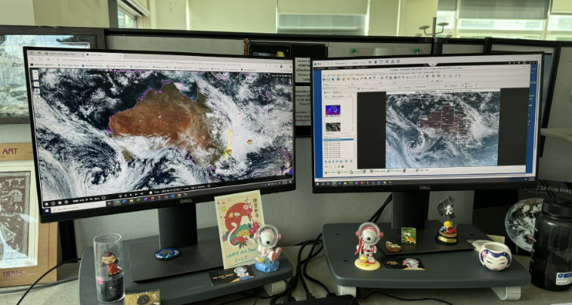
Satellite imagery as commonly displayed within the Bureau
satellite images courtesy JMA / Bureau of Meteorology
The Bureau of Meteorology
Notes:
https://panther.bom.gov.au/

Slide 3
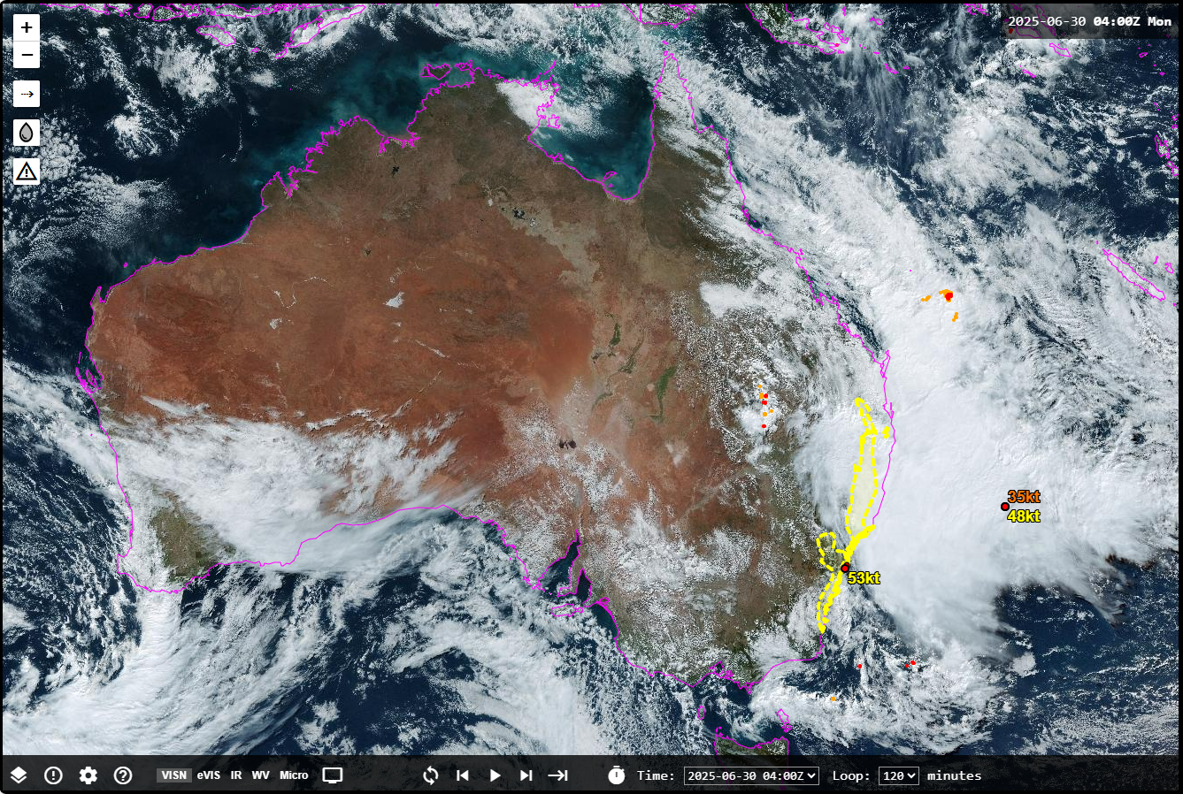
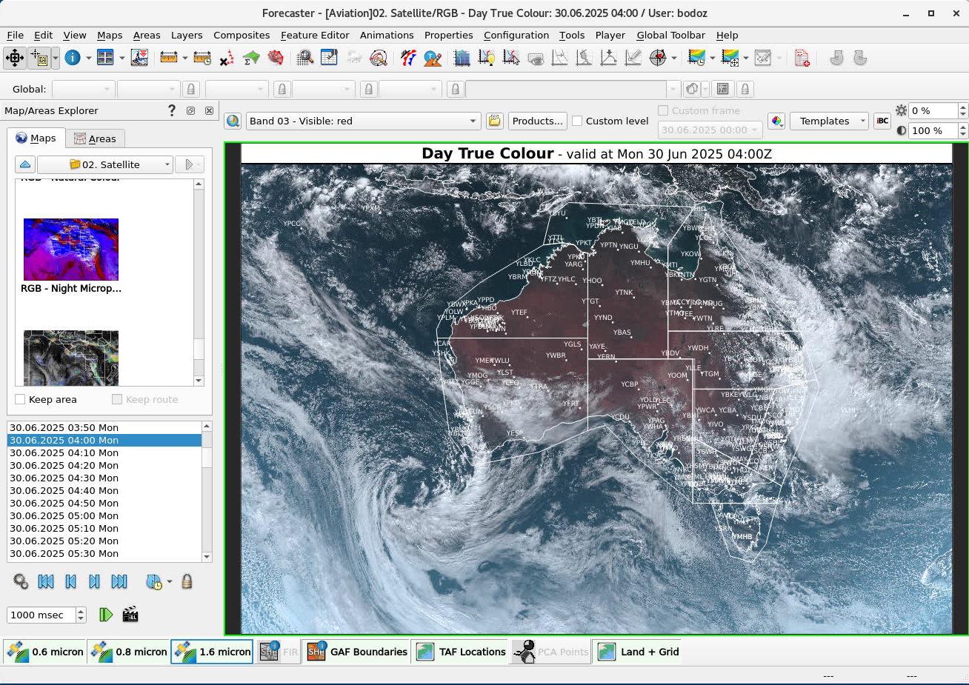
Satellite imagery as commonly displayed within the Bureau
Web based Panther Viewer
Visual Weather Viewer
Developed by Bureau Forecasters
Displays EUMETSAT RGB composites
Quick to render
Can overlay other observational data
Layers cannot be edited
Can render any RGB composite using Himawari-9 data
Can overlay other observational and NWP data
Layers can be edited
The Bureau of Meteorology
Notes:
https://panther.bom.gov.au/

Slide 4
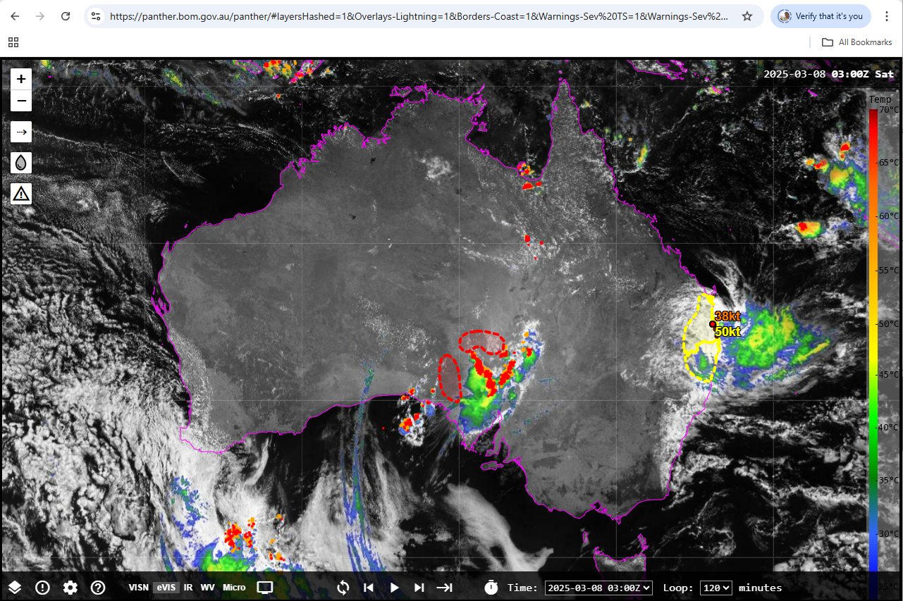
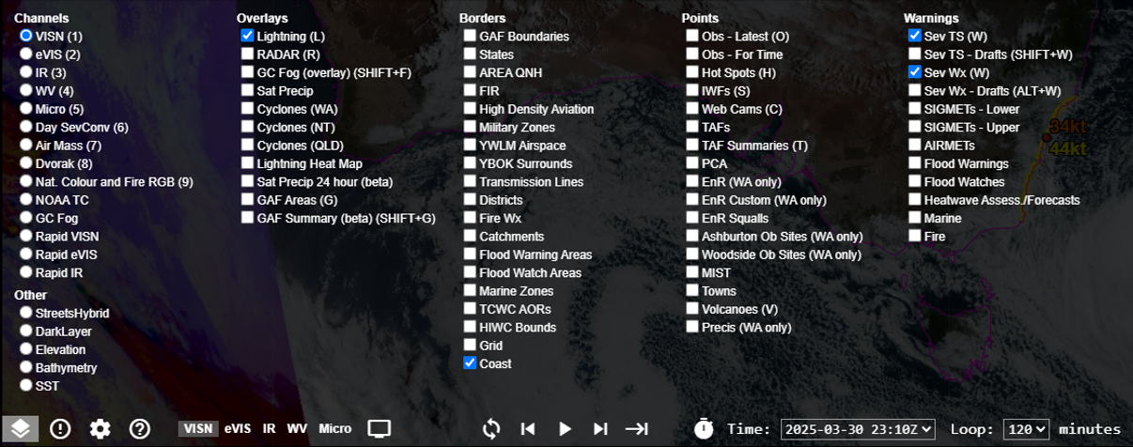
RGB composite satellite imagery in the Bureau Panther viewer
satellite image courtesy JMA / Bureau of Meteorology
The Bureau of Meteorology
Notes:
https://panther.bom.gov.au/

Slide 5
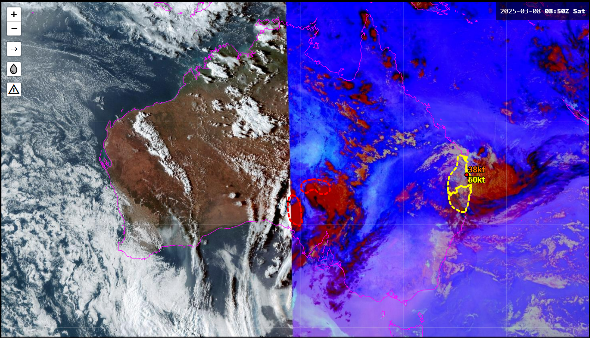
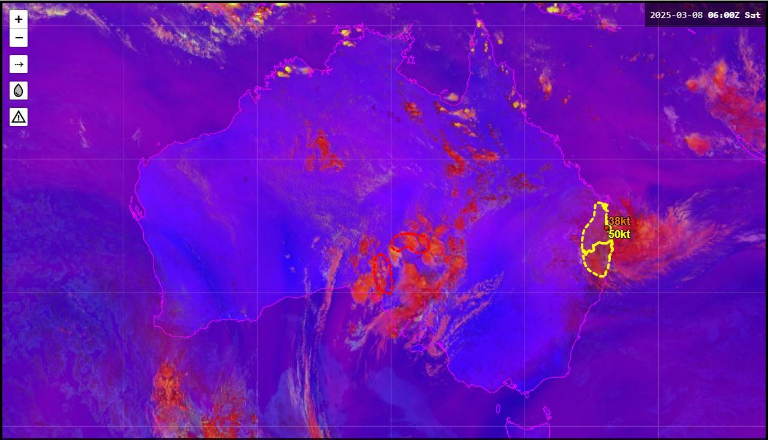
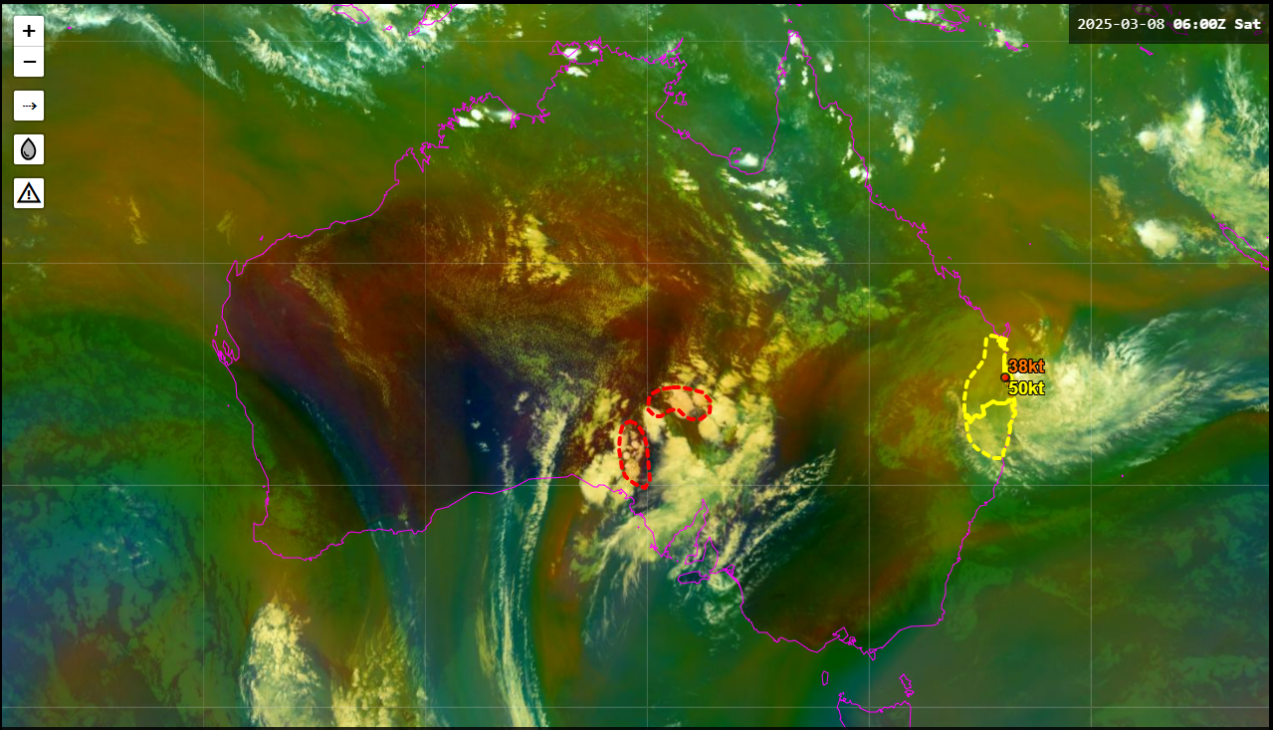
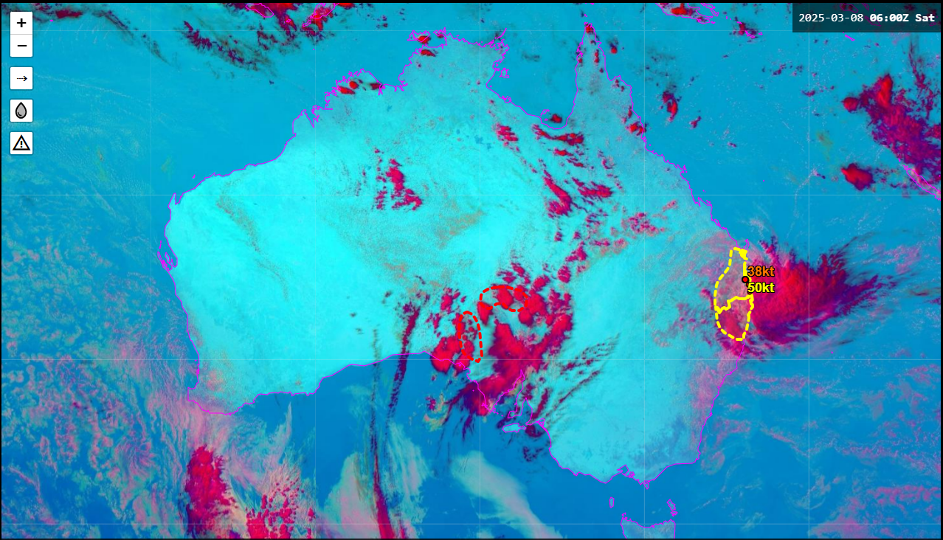
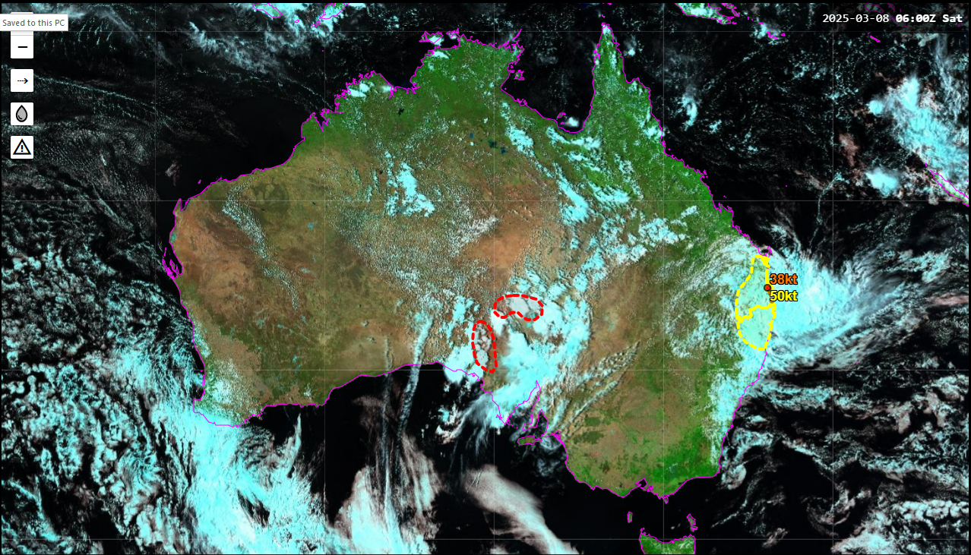
RGB composite satellite imagery in the Bureau Panther viewer
Night Microphysics RGB
Day Severe Convection RGB
True Colour RGB
Airmass RGB
The Bureau of Meteorology
Day Microphysics RGB
Natural Colour / Fire RGB
Notes:
https://panther.bom.gov.au/

Slide 6
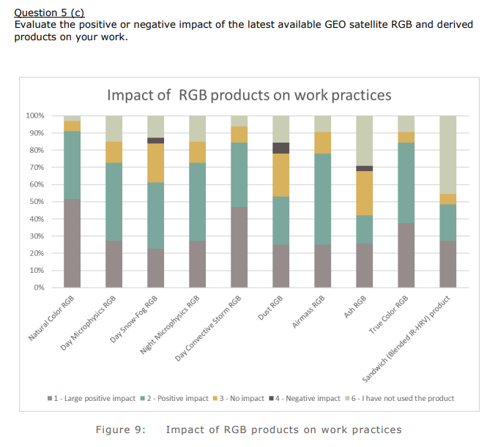
WMO Space Programme RAII and RAV Survey on the Use of Satellite Data, 2020.
Natural Colour RGB
Day Convection RGB
True Colour RGB
Day Micro RGB
70%*
70%*
* Large Positive impact / Positive impact
Airmass RGB
Night Micro RGB

Slide 7
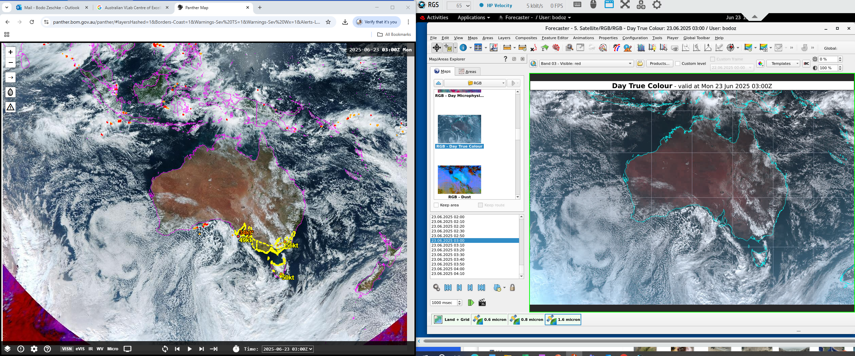
RGB composites popular with Aviation and Severe Weather Forecasters
Panther Viewer Visual Weather Viewer
The Bureau of Meteorology
satellite images courtesy JMA / Bureau of Meteorology
Notes:
https://panther.bom.gov.au/

Slide 8
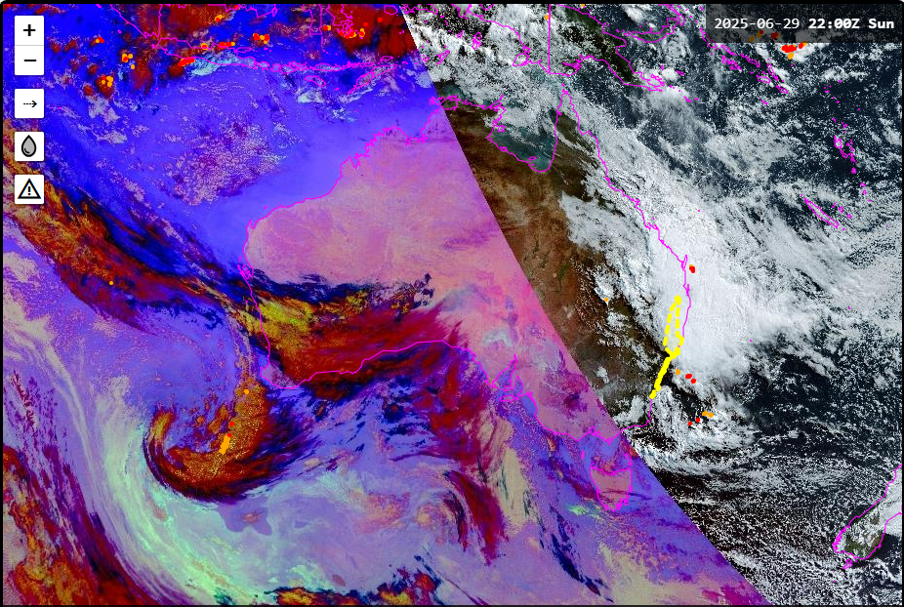
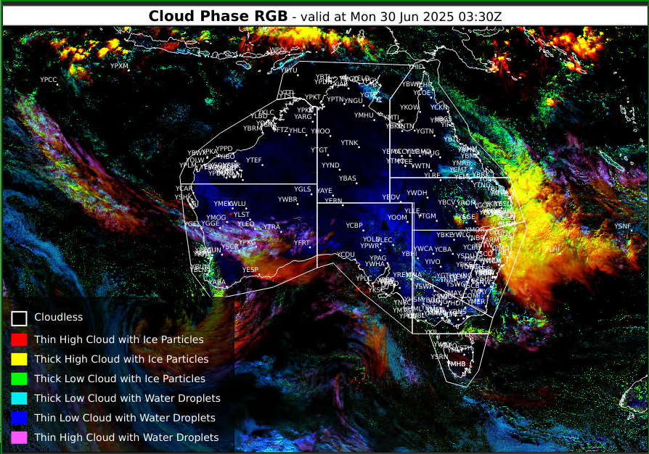
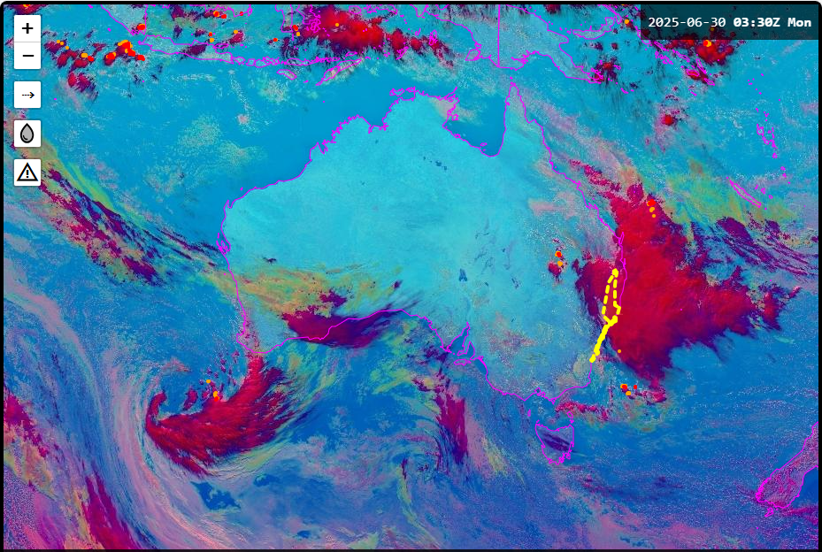
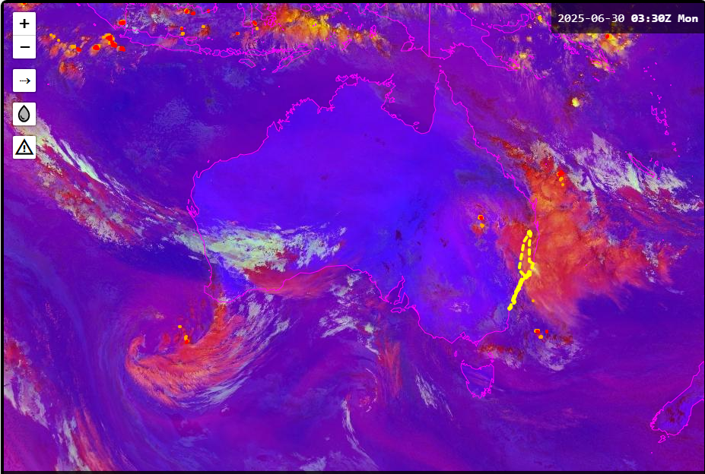
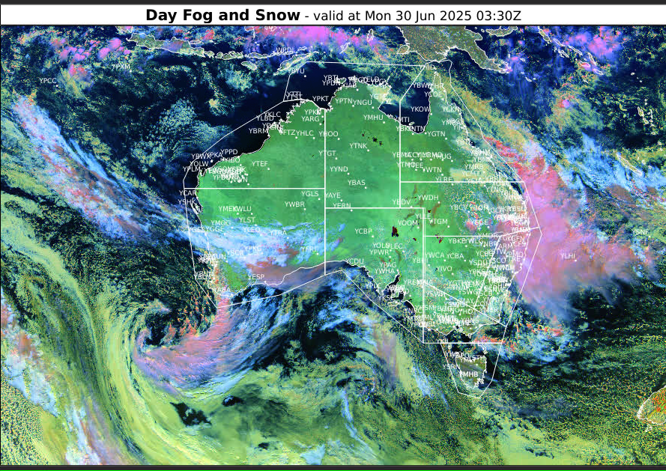
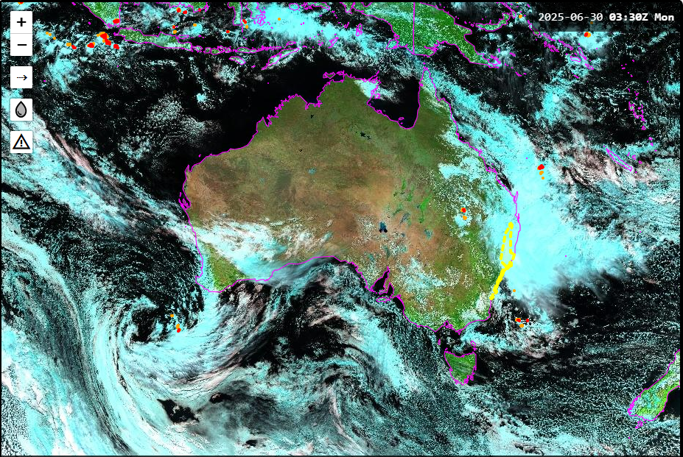
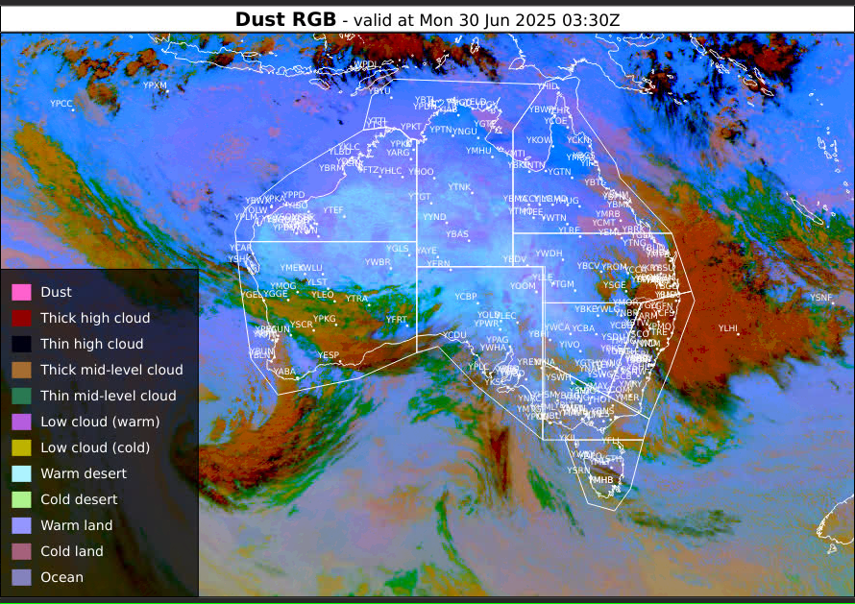
RGB composites popular with Aviation and Severe Weather Forecasters
Night Microphysics / True Colour RGB
Cloud Phase RGB
Day Microphysics RGB
Day Convection RGB
Day Fog and Snow RGB
Panther Viewer Visual Weather Viewer
Natural Colour and Fire RGB
satellite images courtesy JMA / Bureau of Meteorology
Dust RGB
The Bureau of Meteorology
Notes:
https://panther.bom.gov.au/

Slide 9
RGB composites popular with Aviation and Severe Weather Forecasters
Fog / low cloud monitoring
Hot spot / smoke monitoring
Commencement of convection monitoring, Storm severity
Convective monitoring
Aviation Icing monitoring
Night Microphysics / True Colour RGB
Cloud Phase RGB
Hot spot monitoring
Aviation Icing monitoring
Convective monitoring
Storm severity
Distinction between fog and snow on the ground
Day Microphysics RGB
Day Convection RGB
Day Fog and Snow RGB
Hot spot monitoring
Distinction between fog and snow on the ground
Panther Viewer Visual Weather Viewer
Dust monitoring
Natural Colour and Fire RGB
Dust RGB
The Bureau of Meteorology
satellite images courtesy JMA / Bureau of Meteorology
Notes:
https://panther.bom.gov.au/

Slide 10
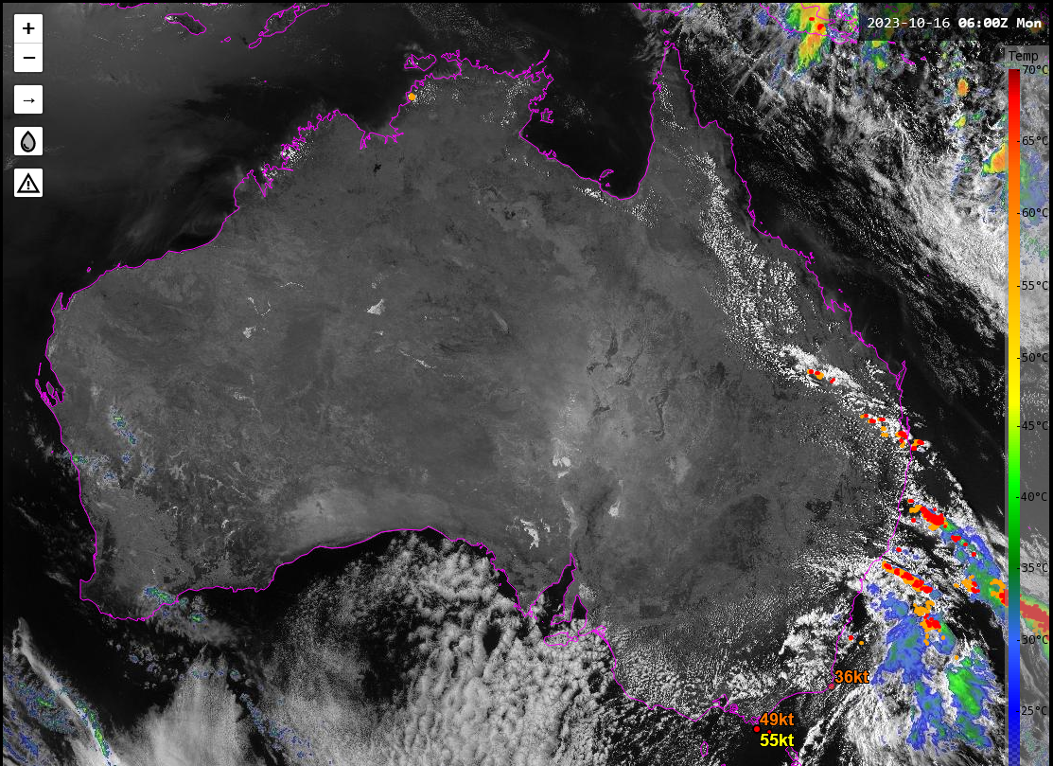
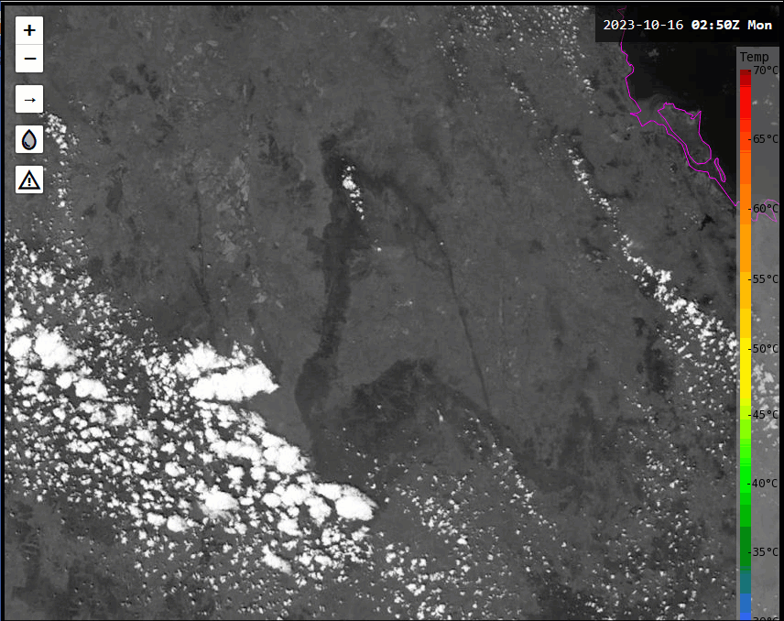
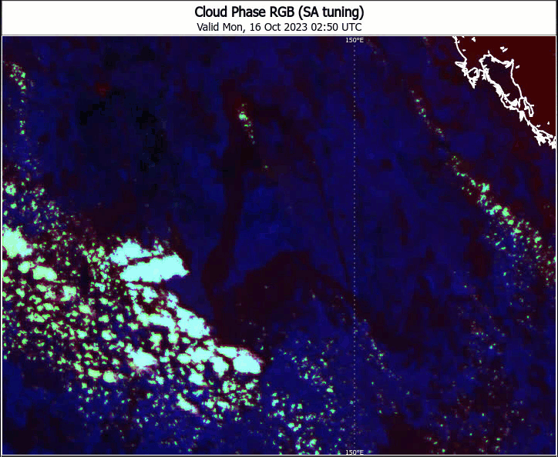
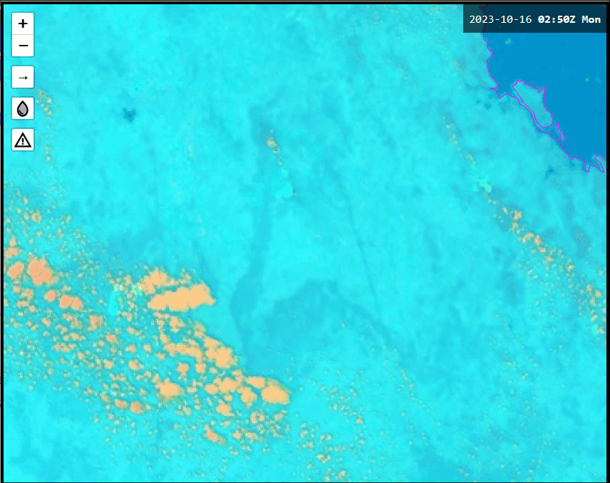
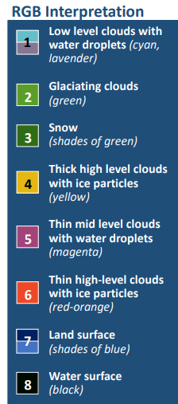
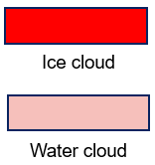
RGB composites and warm topped storms, Australia, 16th Oct 2023.
animations courtesy JMA / Bureau of Meteorology. Lightning data courtesy Weatherzone
Sandwich Product, 0250UTC to 0640UTC
Australia
Cloud Phase RGB, 0250UTC - 0640UTC
Day Microphysics RGB, 0250UTC to 0640UTC

Slide 11
RGB composites popular with Fire Weather and Air Quality Forecasters
Panther Viewer Visual Weather Viewer
The Bureau of Meteorology
satellite images courtesy JMA / Bureau of Meteorology
Notes:
https://panther.bom.gov.au/

Slide 12
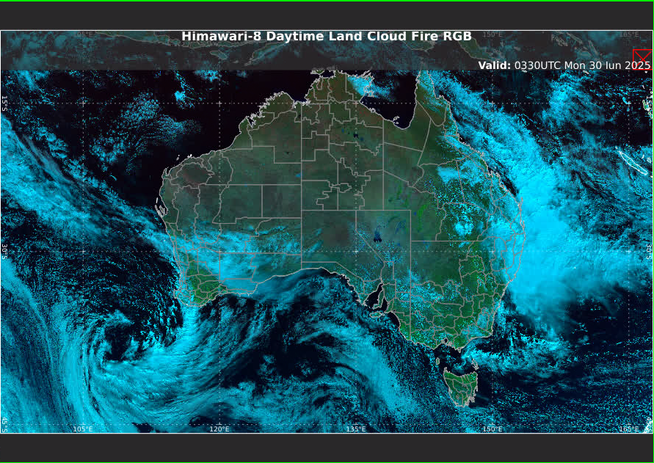
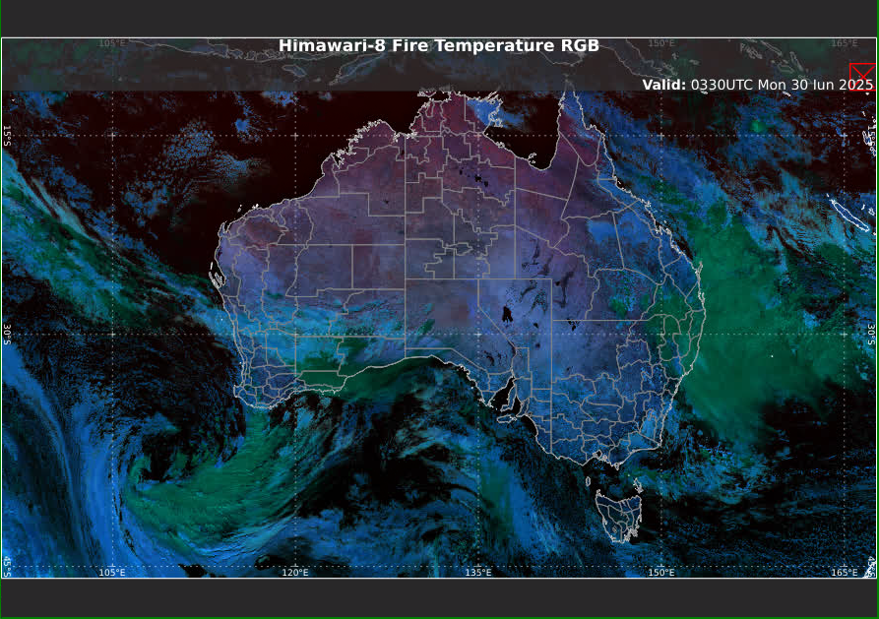
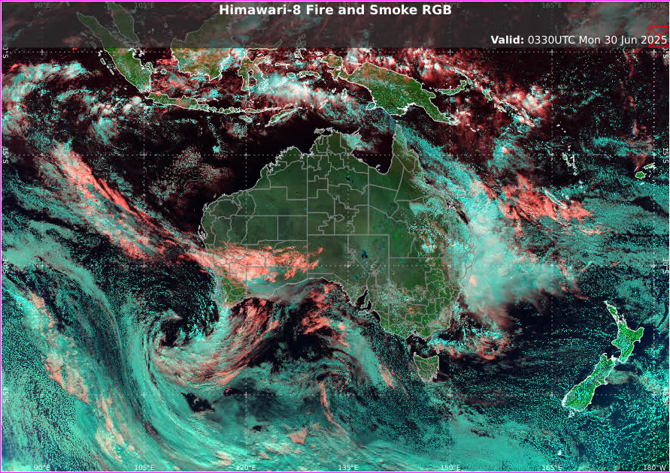
RGB composites popular with Fire Weather and Air Quality Forecasters
Smoke/ pollution monitoring
Hot spot monitoring
Hot spot monitoring
Burn scar monitoring
Night Microphysics / True Colour RGB
Daytime Land Cloud Fire RGB
Hot spot monitoring
Hot spot monitoring
Fire temperature monitoring (relative)
Day Microphysics RGB
Fire Temperature RGB
Hot spot monitoring
Burn scar monitoring
Vegetation monitoring
Panther Viewer Visual Weather Viewer
Hot spot monitoring
Smoke monitoring
Natural Colour and Fire RGB
satellite images courtesy JMA / Bureau of Meteorology
The Bureau of Meteorology
Fire and Smoke RGB
Notes:
https://panther.bom.gov.au/

Slide 13
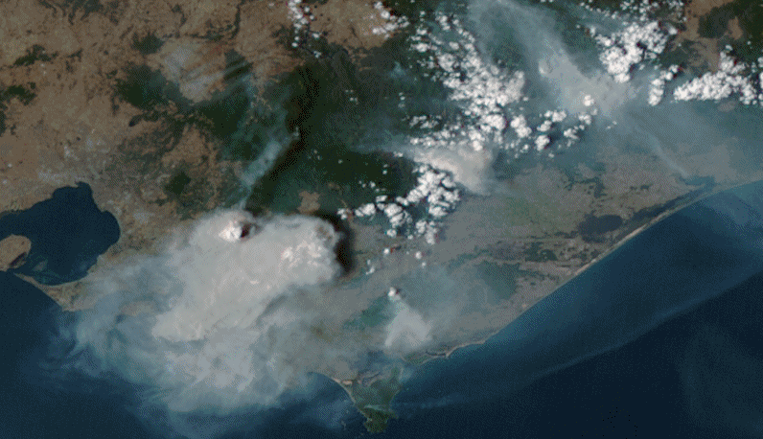
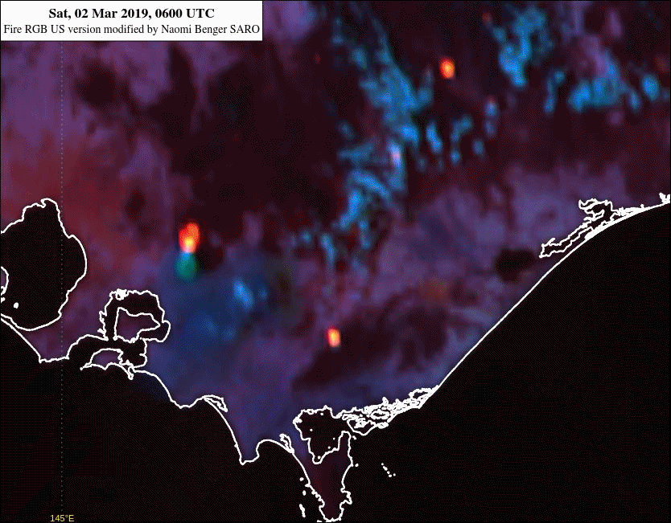
Animation 2: Night Microphysics / True Colour RGB compared to Fire RGB for sunset transition (10 minute data) 06 to 11UTC 2nd March 2019
animation courtesy JMA/BOM
True Colour / Night Microphysics RGB
Melbourne
Fire Temperature RGB
(SARO version)
Regional Focus Group Weather and Forecasting Discussion 26th March 2019

Slide 14
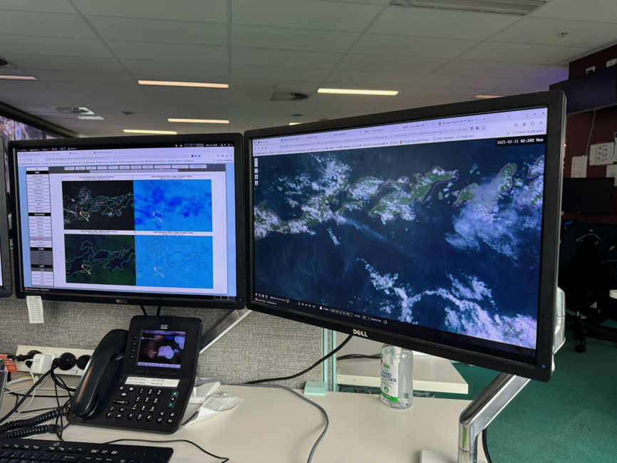
Use of RGB composites at our Darwin Volcanic Ash Advisory Centre
images courtesy JMA/Bureau of Meteorology, Darwin VAAC
Panther viewer
Volcanic Ash viewer
The Bureau of Meteorology

Slide 15
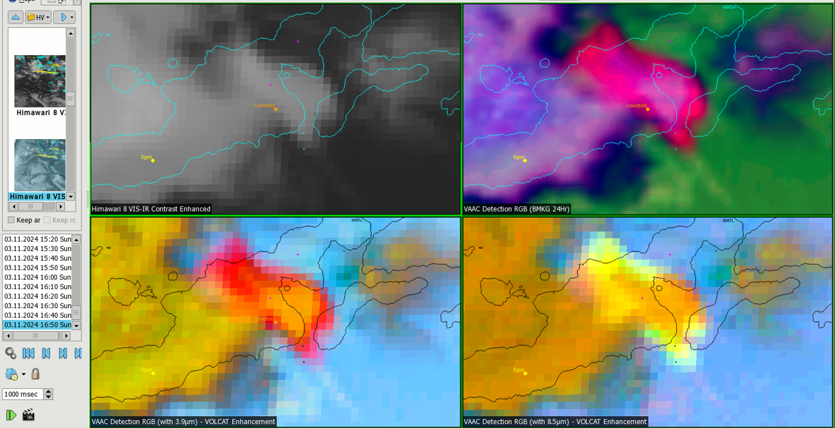
The Darwin VAAC Volcanic Ash viewer over Lewotobi volcano, Indonesia, 11th March 2024
images courtesy JMA/Bureau of Meteorology, Darwin VAAC
VISHR (Himawari-8 CE IR/VIS) BMKG (24 hour) Volcanic Ash RGB
Lewotobi
Flores Island
3.9 micron RGB VOLCAT Enhancement 8.5 micron RGB VOLCAT Enhancement
The Bureau of Meteorology

Slide 16
The Darwin VAAC Volcanic Ash viewer over Lewotobi volcano, Indonesia, 11th March 2024
images courtesy JMA/Bureau of Meteorology, Darwin VAAC
VISHR (Himawari-8 CE IR/VIS) BMKG (24 hour) Volcanic Ash RGB
Colour | Wavelength (μm) | Scaling (K)
Red | 10.4 -12.4 | -1 to +5
Green | 10.4-3.8 | -15 to +10
Blue | 3.8 | 213 to 318
Lewotobi
Flores Island
Colour | Wavelength (μm) | Scaling (K)
Red | 12.4 -10.4 | -8 to 0
Green | 10.4-3.8 | -30 to +5
Blue | 10.4 | 243 to 293
Colour | Wavelength (μm) | Scaling (K)
Red | 12.4 -10.4 | -8 to 0
Green | 10.4-8.6 | -6 to +6
Blue | 10.4 | 243 to 293
3.9 micron RGB VOLCAT Enhancement 8.5 micron RGB VOLCAT Enhancement
The Bureau of Meteorology

Slide 17
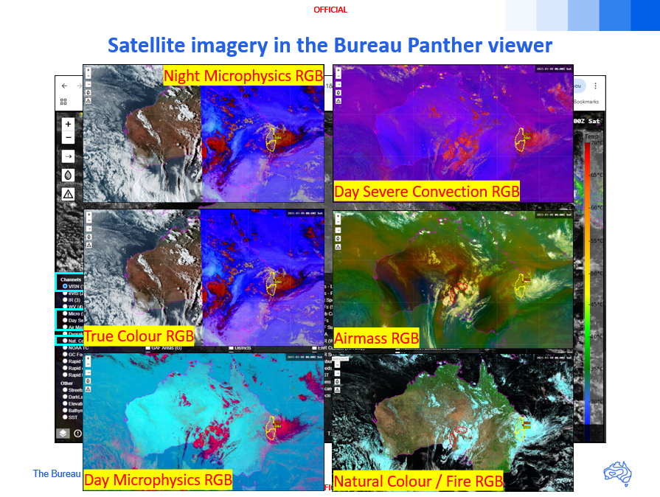
Summary
Panther Viewer
Visual Weather Viewer
Panther Viewer
RGB composites
Popularity of RGB composites
RGB composites used by Bureau Aviation and Severe Weather Forecasters
RGB composites used by Bureau Fire Weather and Air Quailty Forecasters
RGB composites used by Bureau Volcanic Ash Advisory Centre Forecasters

Slide 18
Thank You ☺
Bodo Zeschke
bodo.zeschke@bom.gov.au

