Slide 1
Indonesian VLab Centre of Excellence Regional Focus Group meeting, 02UTC 26 February 2025
Contents
Exploring Earth Observation Data: Wildfires and Air Quality Analysis: presenter Albert C. Nahas, Air Quality and Climate Analyst, BMKG Indonesia.
A memorable Easter Sunday. Investigating the Melbourne Haze Event, 31 March 2024: presenter Bodo Zeschke, Bureau of Meteorology Training Centre.
The Bureau of Meteorology

Slide 2
A memorable Easter Sunday. Investigating the Melbourne Haze Event, 31 March 2024
Initial Observations
Observations during my walk (St Kilda Beach, Melbourne City Gardens)
Facebook post; earlier episode of Mie scattering off the Eureka Tower.
The scattering table and regimes.
Further investigations, local Melbourne area.
Himawari-9 True Colour RGB satellite data. Compared with polar orbiter images from NASA Worldview.
Soundings, visibility and ceilometer observations.
Impact on aviation operations.
Further investigations, broader Victorian region.
NASA Worldview resources; Aerosol Optical Thickness, Aerosol Type.
The importance of PM 2.5 and its impact

Slide 3
A memorable Easter Sunday. Investigating the Melbourne Haze Event, 31 March 2024
Initial Observations
Observations during my walk (St Kilda Beach, Melbourne City Gardens)
Facebook post; earlier episode of Mie scattering off the Eureka Tower.
The scattering table and regimes.
Further investigations, local Melbourne area.
Himawari-9 True Colour RGB satellite data. Compared with polar orbiter images from NASA Worldview.
Soundings, visibility and ceilometer observations.
Impact on aviation operations.
Further investigations, broader Victorian region.
NASA Worldview resources; Aerosol Optical Thickness, Aerosol Type.
The importance of PM 2.5 and its impact

Slide 4
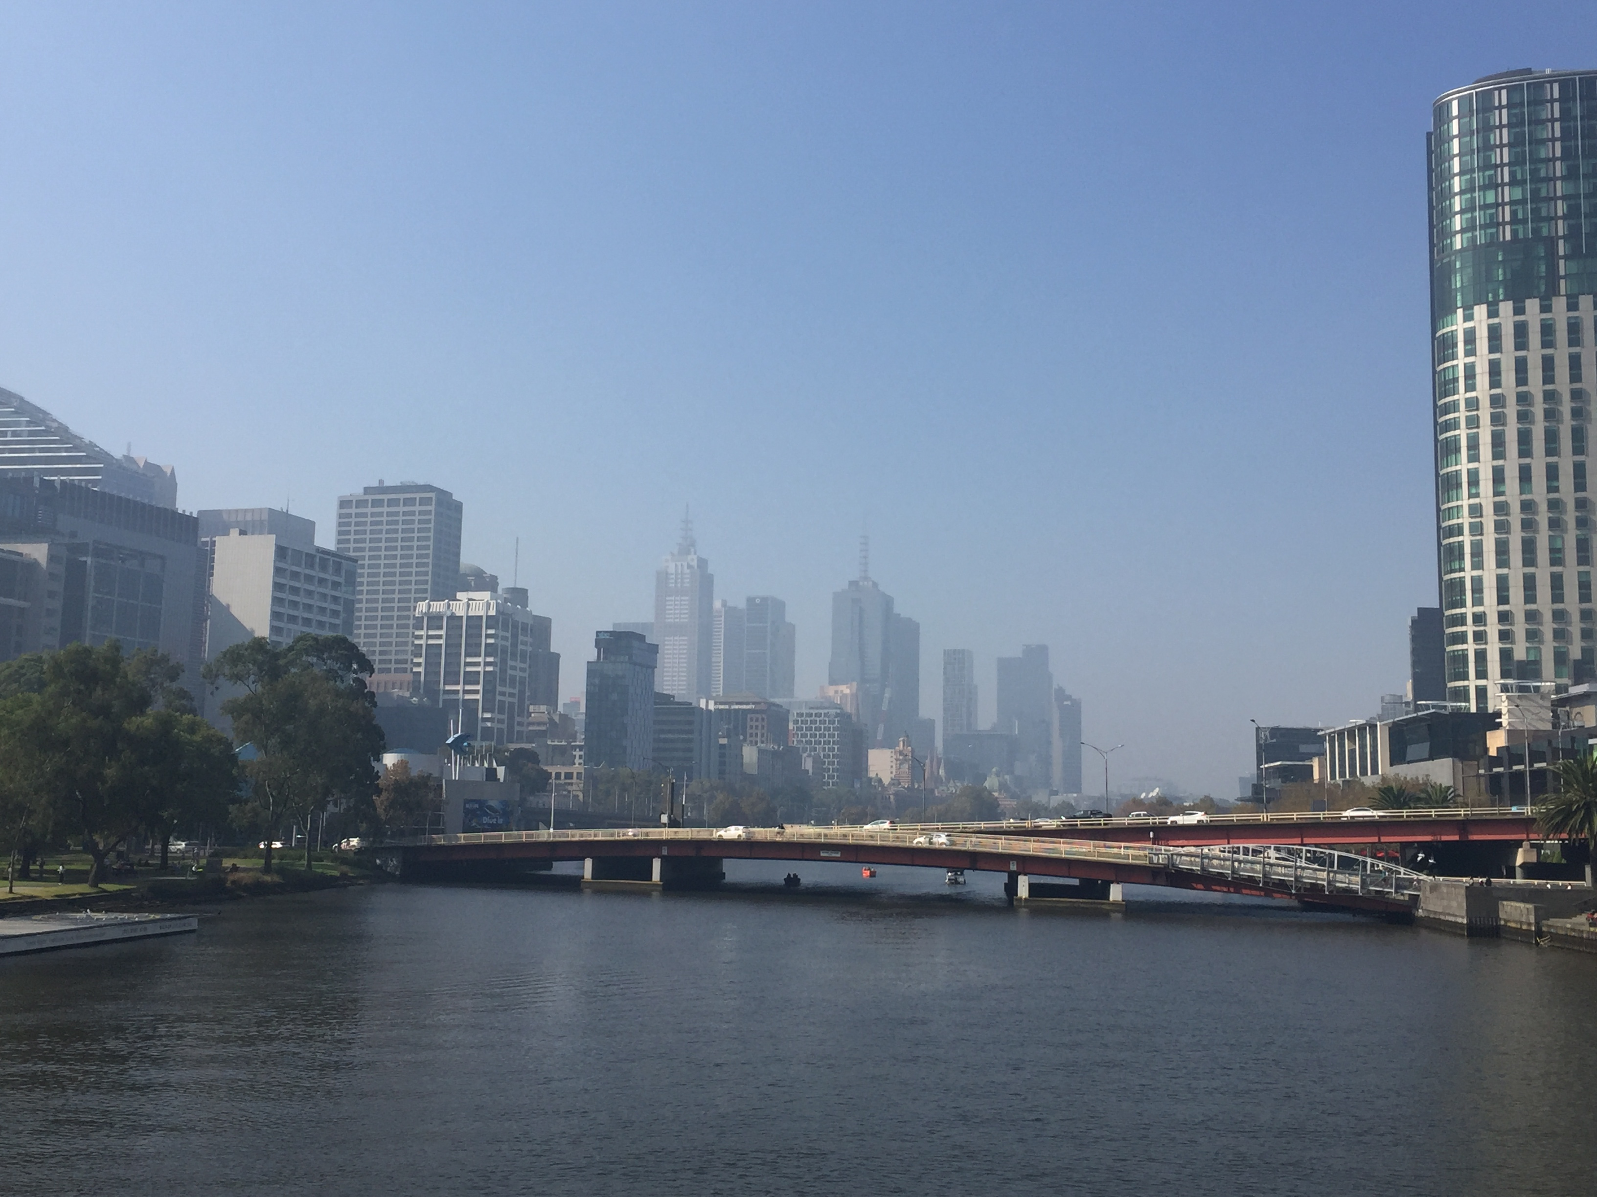
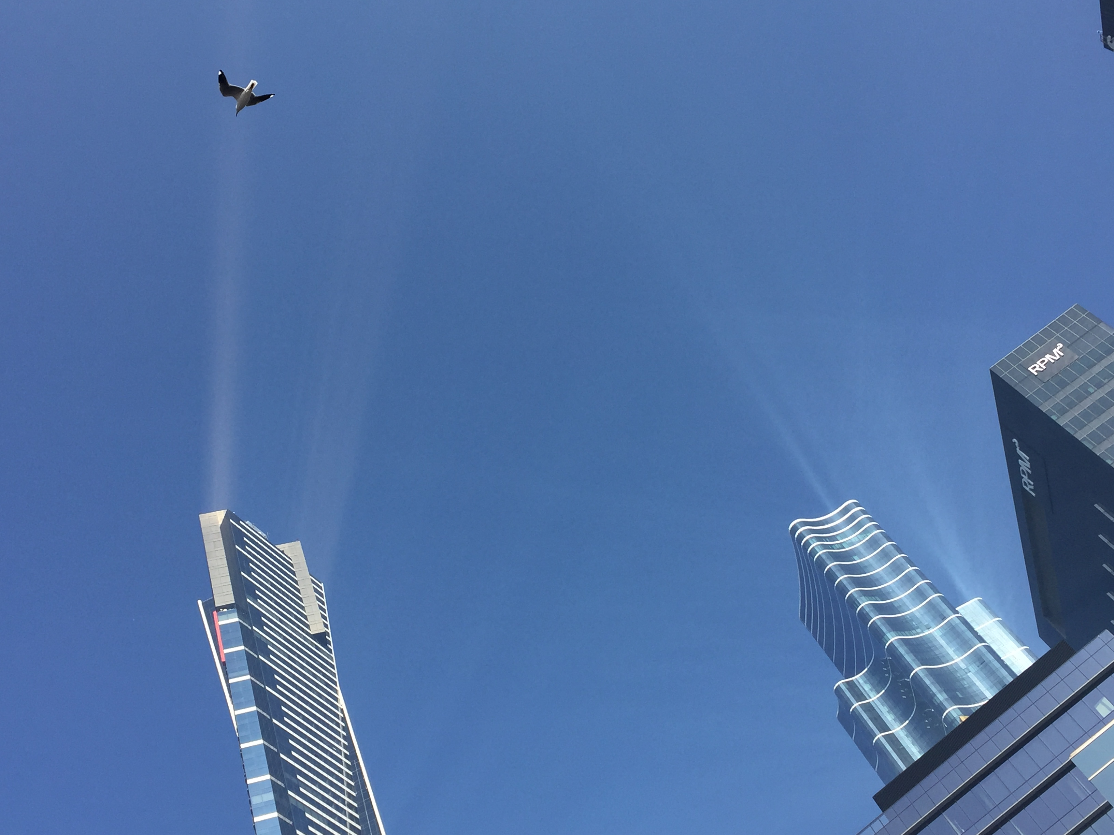
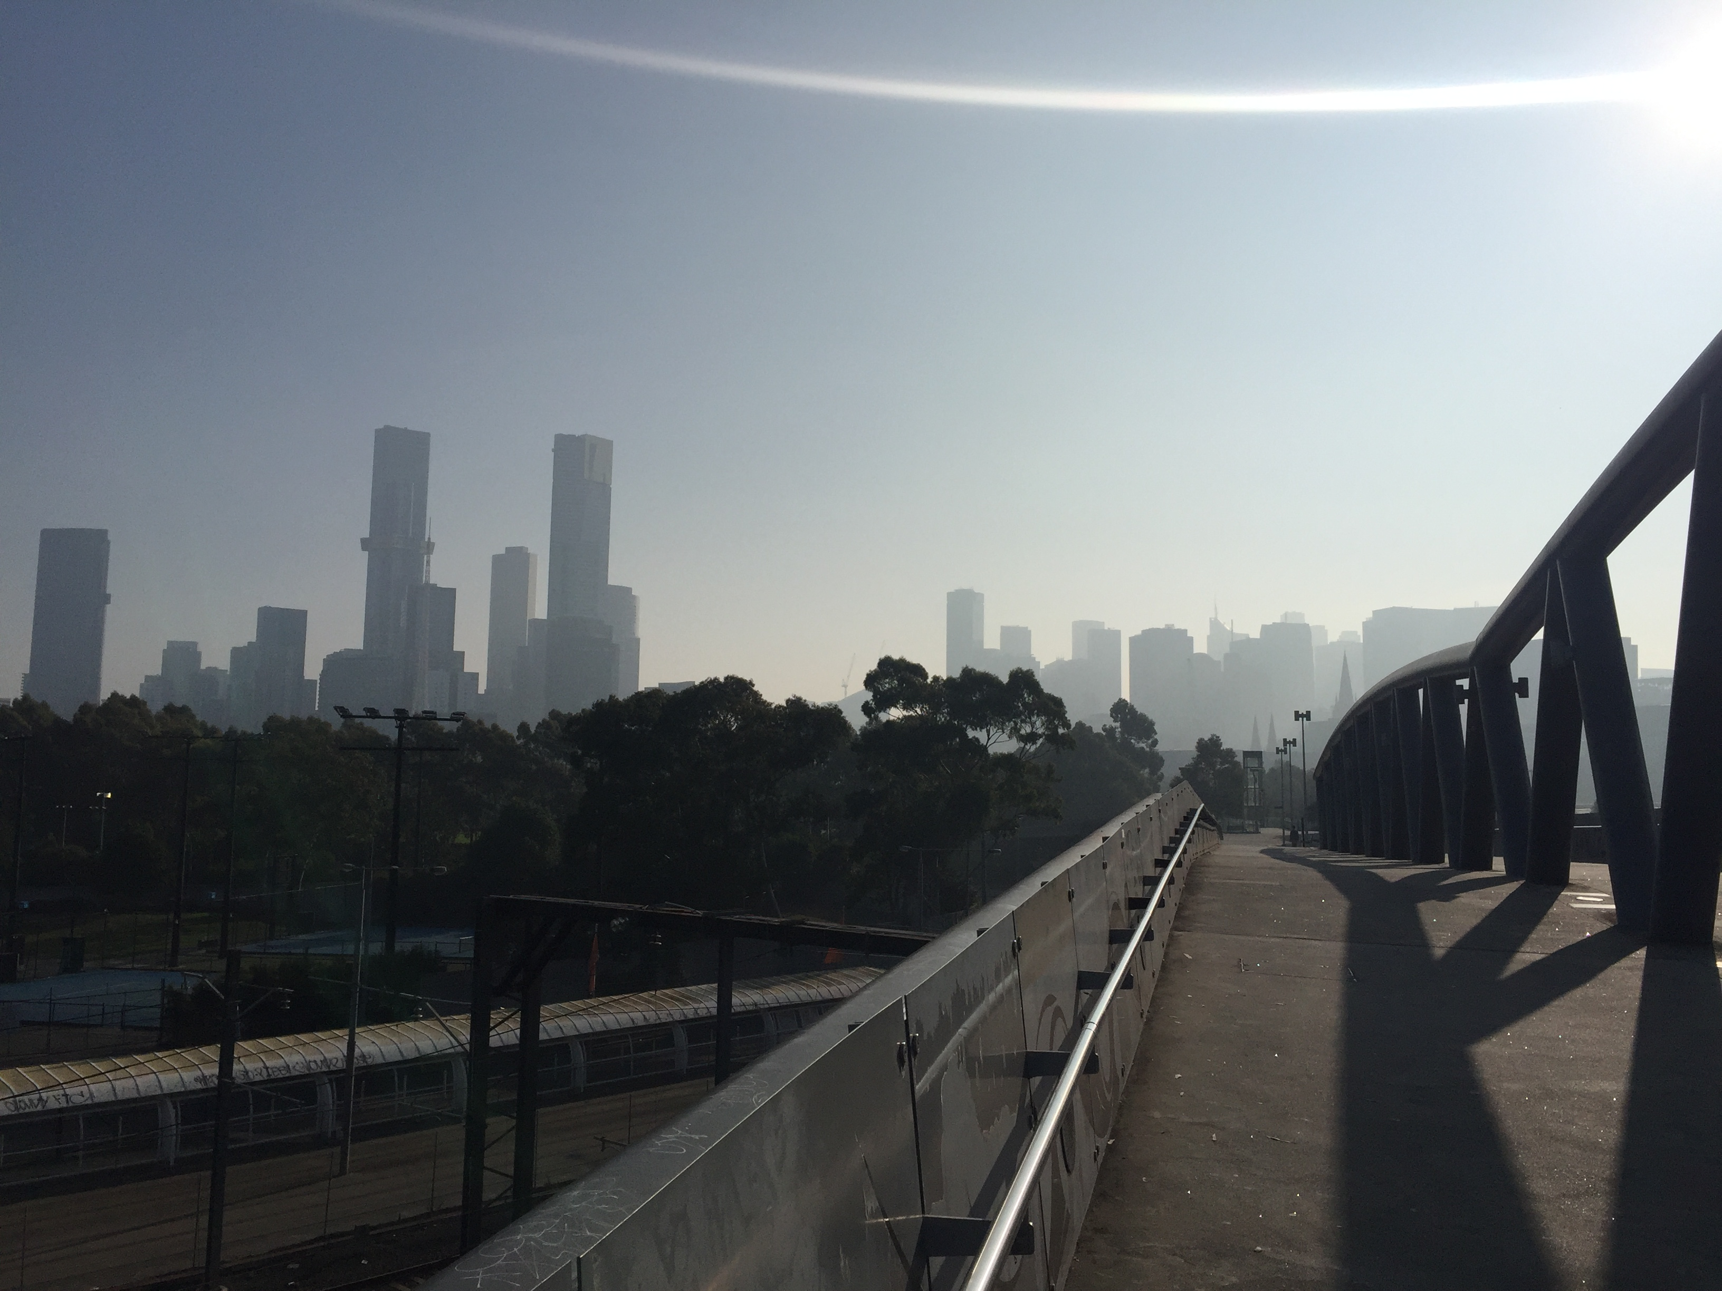
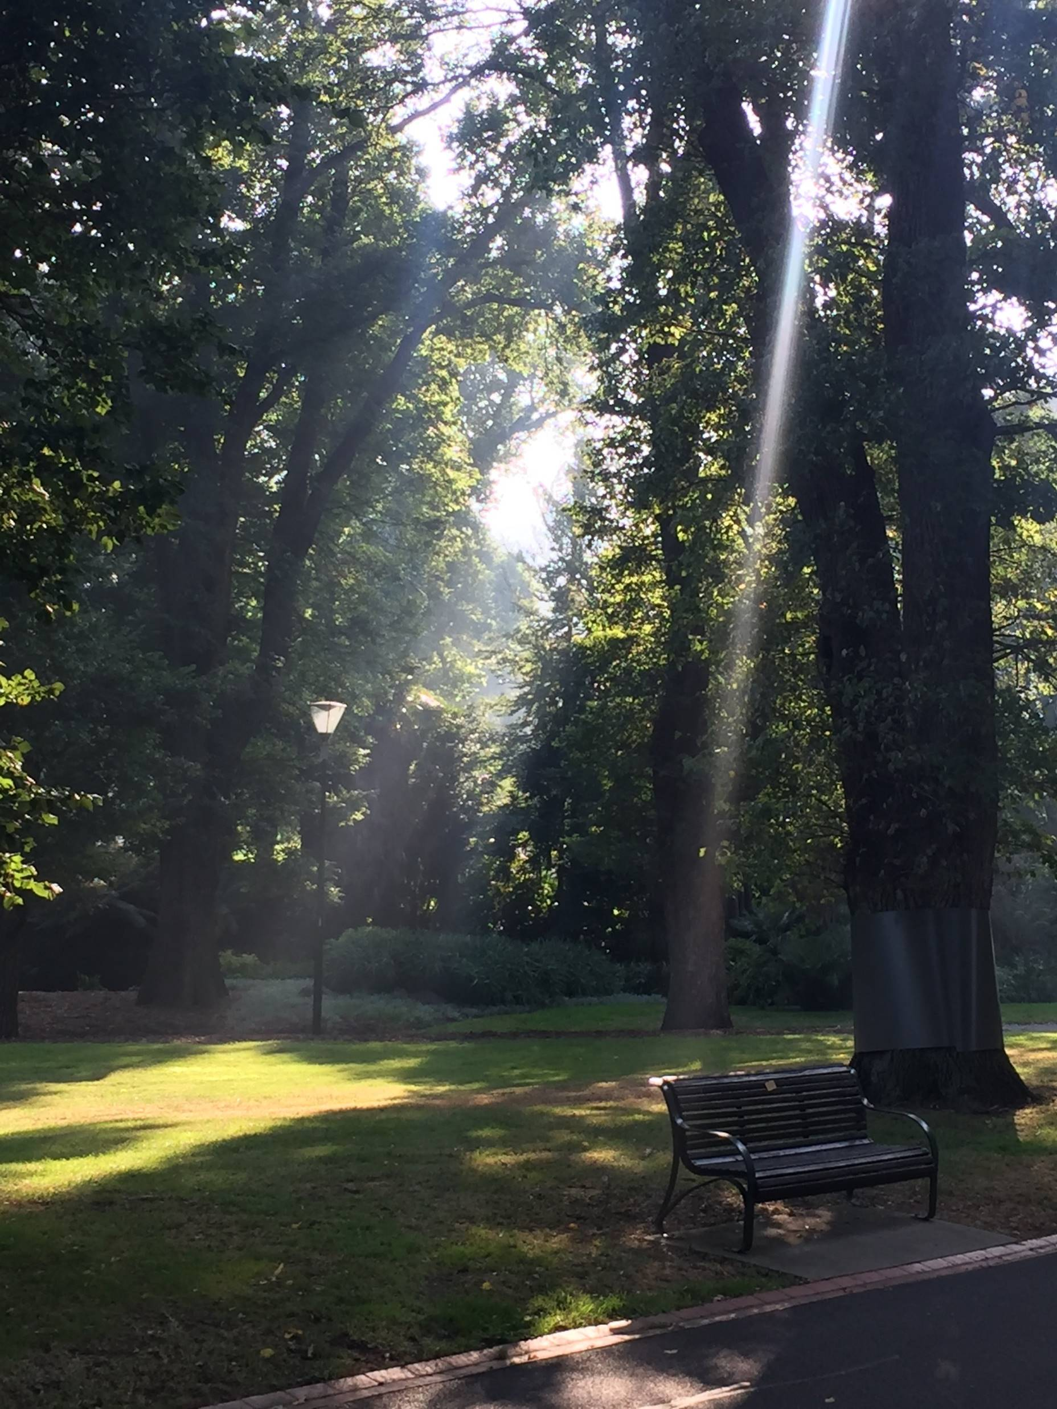
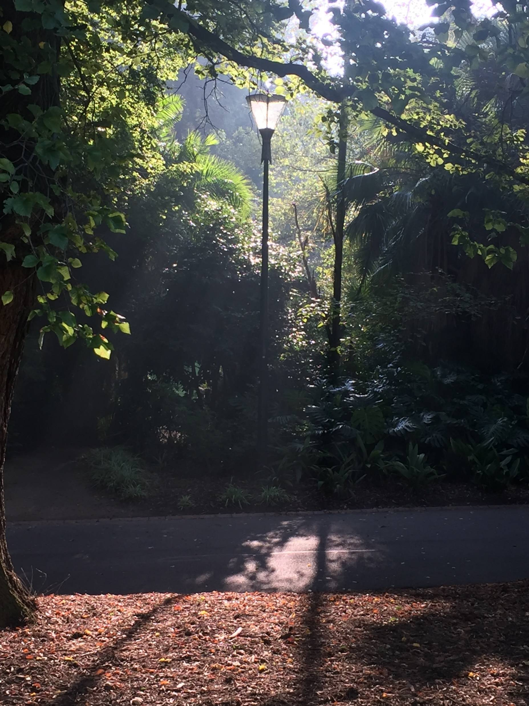
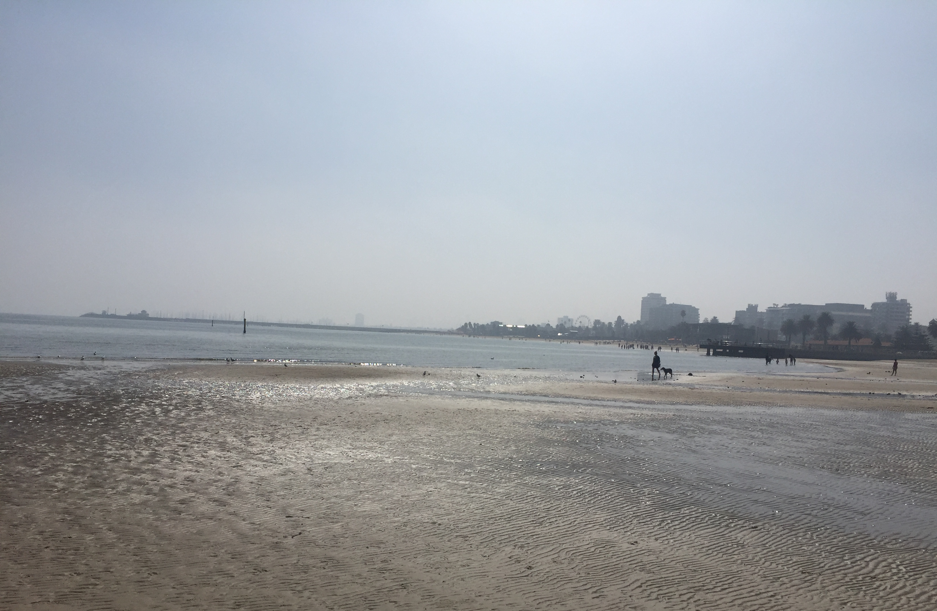
My Easter Sunday Outing

Slide 5
Milky, hazy sky
Milky, hazy sky
light rays emanating from windows
My Easter Sunday Outing
incandescent
"glowing"
atmosphere
incandescent
"glowing"
atmosphere
Milky, hazy sky

Slide 6
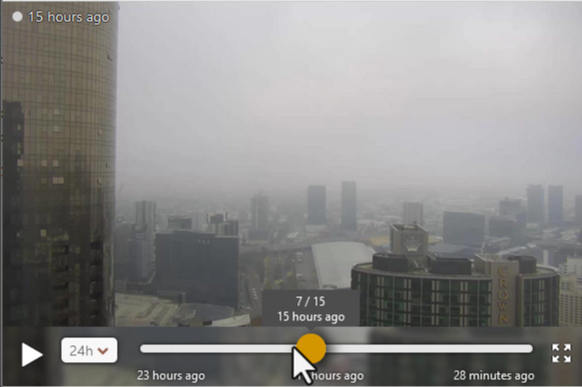
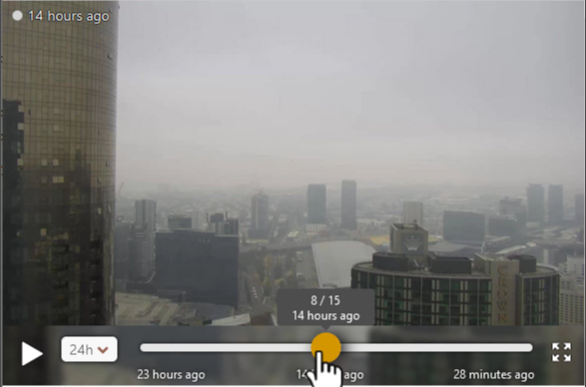
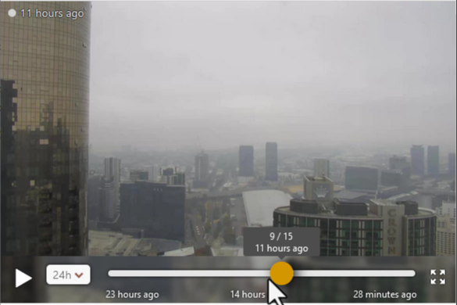
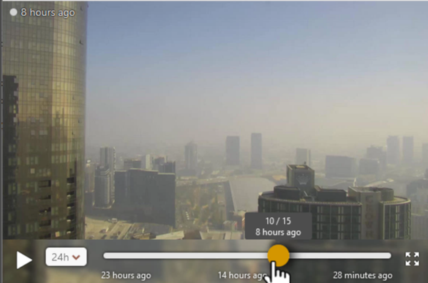
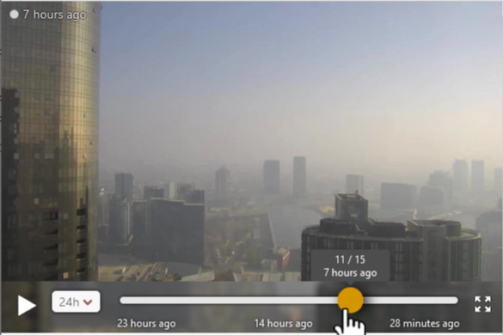
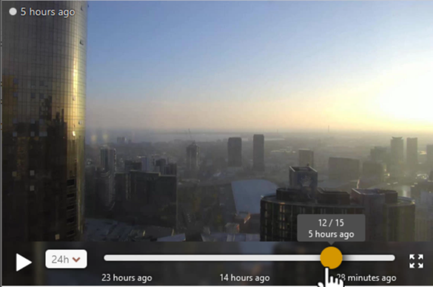
Windy webcam over Melbourne as archived at 11.39pm local time 31st March 2024. (looking southwest from Southbank)
Low cloud and Mie scattering from haze
8.39am 9.39am 12.39pm
Mie scattering from haze
3.39pm 4.39pm 6.39pm
images courtesy Windy.com

Slide 7
A memorable Easter Sunday. Investigating the Melbourne Haze Event, 31 March 2024
Initial Observations
Observations during my walk (St Kilda Beach, Melbourne City Gardens)
Facebook post; earlier episode of Mie scattering off the Eureka Tower.
The scattering table and regimes.
Further investigations, local Melbourne area.
Himawari-9 True Colour RGB satellite data. Compared with polar orbiter images from NASA Worldview.
Soundings, visibility and ceilometer observations.
Impact on aviation operations.
Further investigations, broader Victorian region.
NASA Worldview resources; Aerosol Optical Thickness, Aerosol Type.
The importance of PM 2.5 and its impact

Slide 8
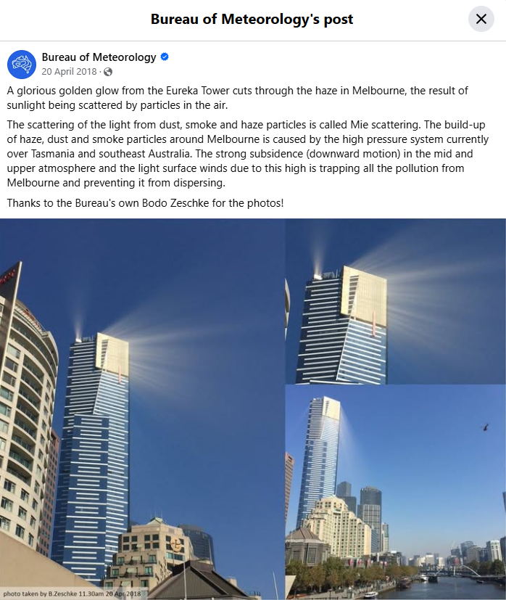
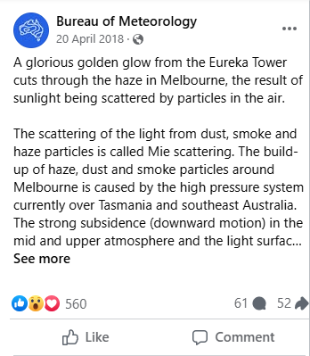
An earlier event on the Bureau Facebook page

Slide 9
A memorable Easter Sunday. Investigating the Melbourne Haze Event, 31 March 2024
Initial Observations
Observations during my walk (St Kilda Beach, Melbourne City Gardens)
Facebook post; earlier episode of Mie scattering off the Eureka Tower.
The scattering table and regimes.
Further investigations, local Melbourne area.
Himawari-9 True Colour RGB satellite data. Compared with polar orbiter images from NASA Worldview.
Soundings, visibility and ceilometer observations.
Impact on aviation operations.
Further investigations, broader Victorian region.
NASA Worldview resources; Aerosol Optical Thickness, Aerosol Type.
The importance of PM 2.5 and its impact

Slide 10
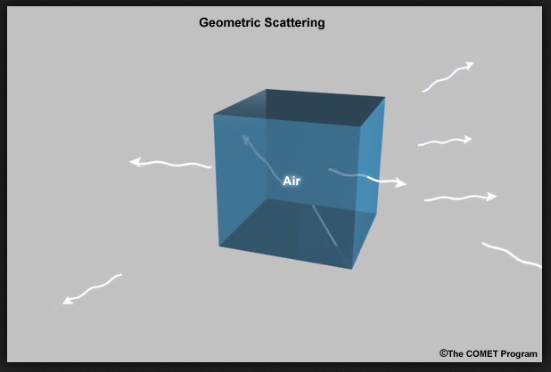
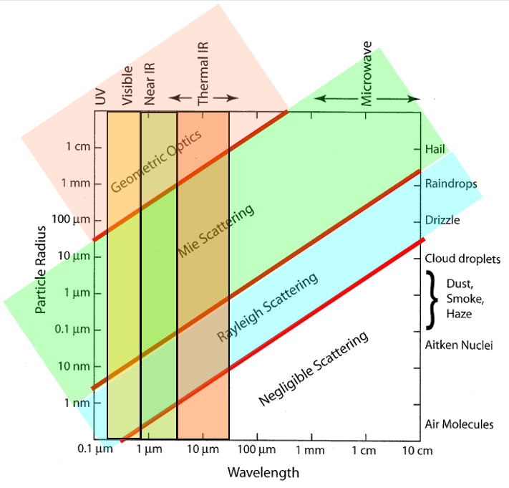
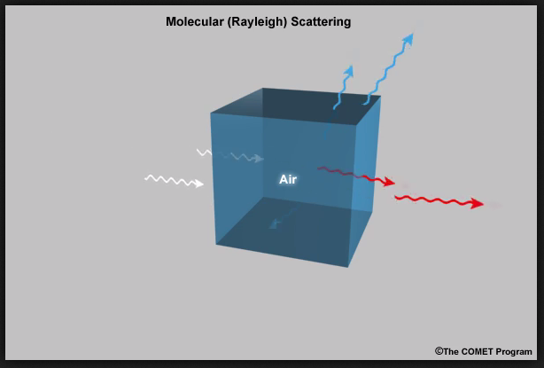
Atmospheric Scattering Regimes
Geometric Scattering
Visible
Mie Scattering
Geometric
Mie Scattering
Mie Scattering
Cloud droplets
Dust
Smoke
Haze
Rayleigh Scattering
Negligible
Scattering
images from MetED / COMET
Rayleigh Scattering
Figure: Modified from Fig. 12.1 in Petty
Notes:
https://www.meted.ucar.edu/oceans/emeo/print.php

Slide 11
A memorable Easter Sunday. Investigating the Melbourne Haze Event, 31 March 2024
Initial Observations
Observations during my walk (St Kilda Beach, Melbourne City Gardens)
Facebook post; earlier episode of Mie scattering off the Eureka Tower.
The scattering table and regimes.
Further investigations, local Melbourne area.
Himawari-9 True Colour RGB satellite data. Compared with polar orbiter images from NASA Worldview.
Soundings, visibility and ceilometer observations.
Impact on aviation operations.
Further investigations, broader Victorian region.
NASA Worldview resources; Aerosol Optical Thickness, Aerosol Type.
The importance of PM 2.5 and its impact

Slide 12
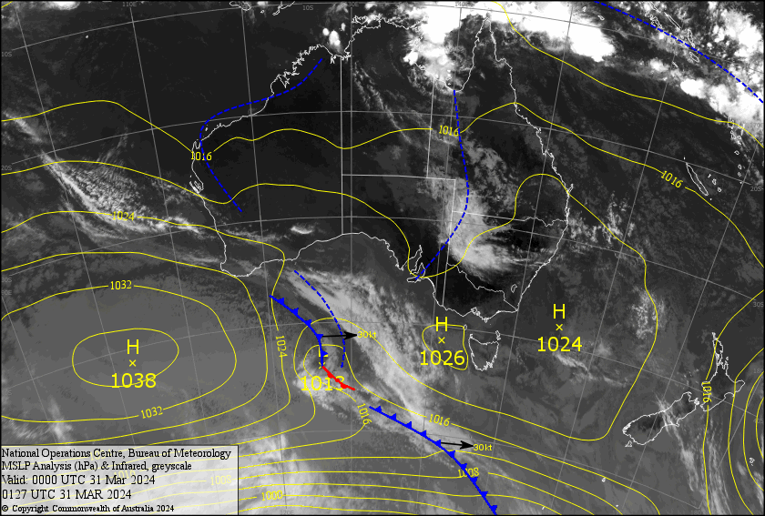
Synoptic setting: MSLP and IR satellite image on the morning of the event, 00UTC 31st March 2024
High pressure centres
Light surface winds
Coastal sea breezes
Fog / low cloud a possibility
image courtesy JMA / Bureau of Meteorology
Notes:
http://bnoc-aifs-op.bom.gov.au/images/osa/month.html

Slide 13
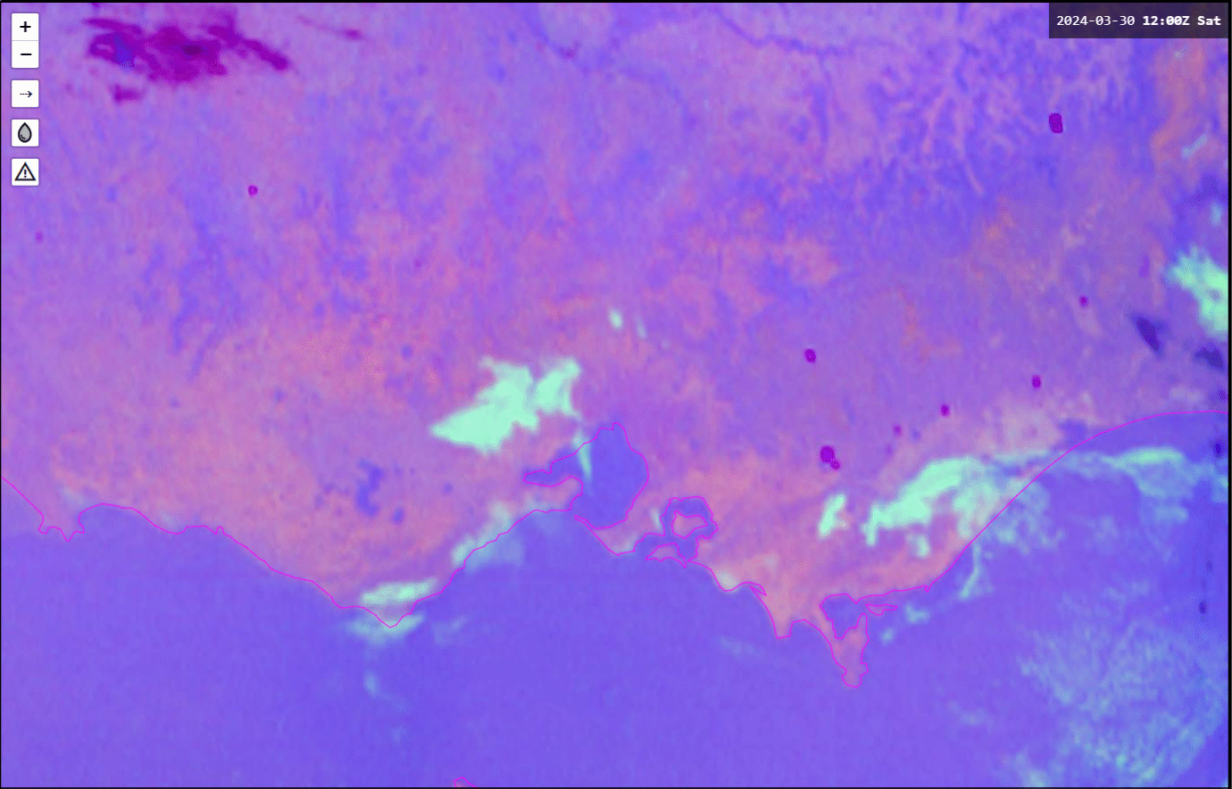
Animation: The "Haze" over Melbourne. Broad view. Night Microphysics and True Colour RGB, 12UTC 30th March to 06UTC 31st March 2024
Melbourne area in white ellipse
animation courtesy JMA / Bureau of Meteorology

Slide 14
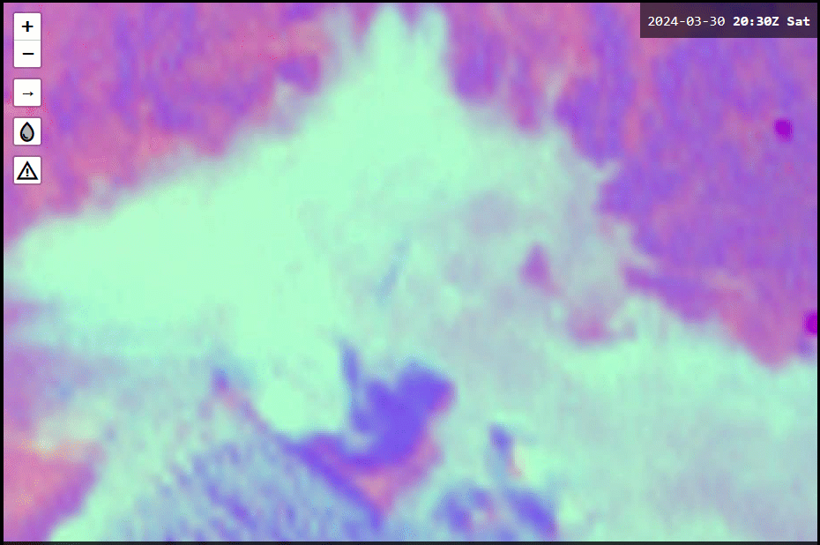
Animation: The "Haze" over Melbourne. Closer view. Night Microphysics and True Colour RGB, 2030UTC 30th March to 0750UTC 31st March 2024
animation courtesy JMA / Bureau of Meteorology

Slide 15
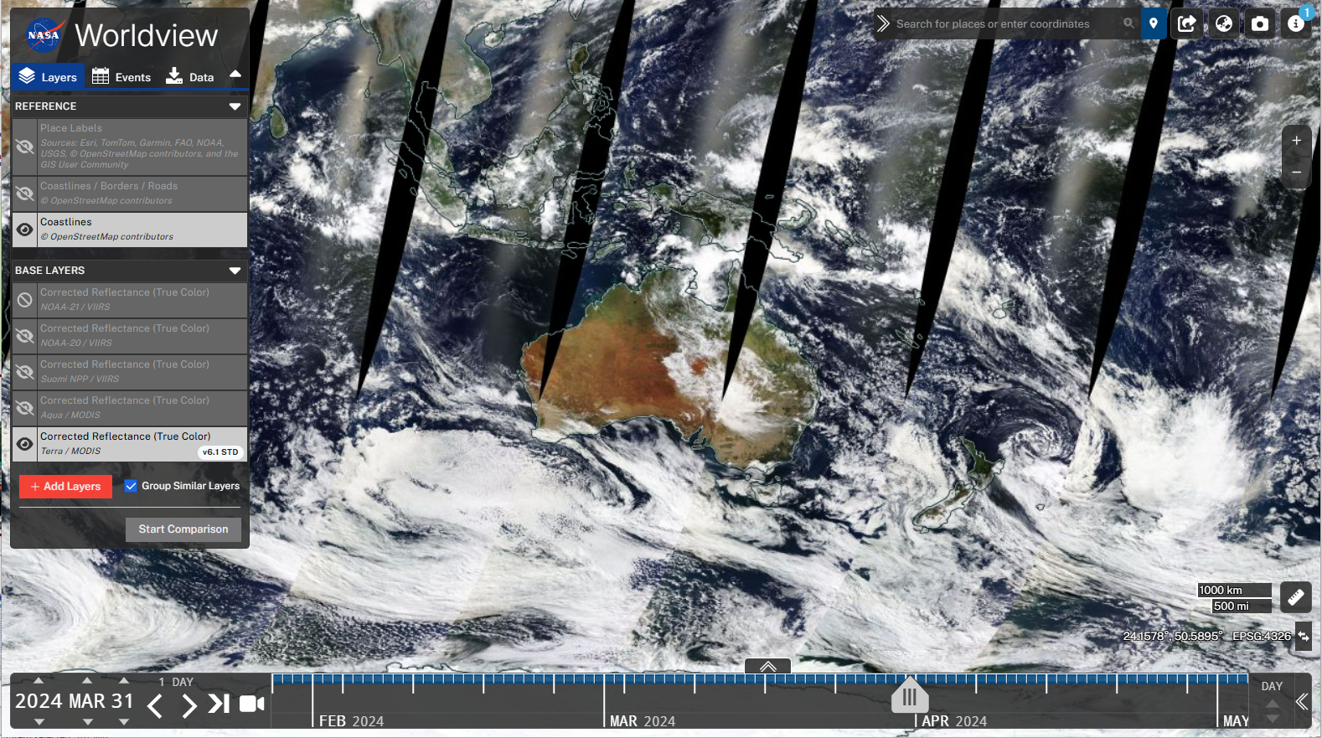
Exploring the NASA Worldview web page for polar orbiter satellite data. The Suomi NPP VIIRS, GOES-20 VIIRS and Terra / Aqua MODIS data Imagery at https://worldview.earthdata.nasa.gov/index.html
3: choose the satellite
2: zoom into the area of interest
(scroll with the mouse wheel)
1: choose 31 March 2024

Slide 16
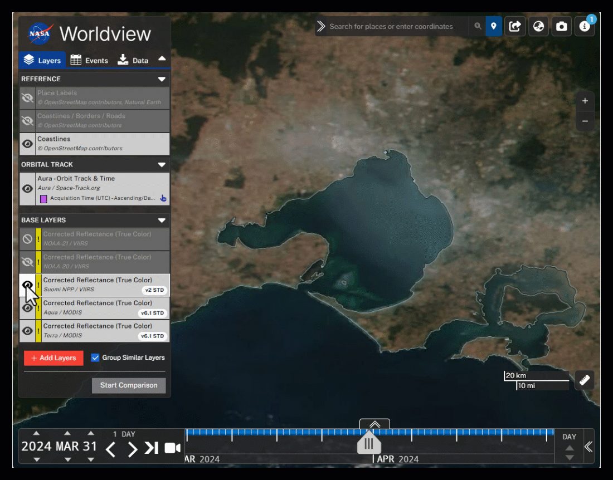
Animation: 0336UTC Soumi NPP and AQUA MODIS 0426UTC True Colour RGB images from NASA Worldview shows the migration of the haze well
animation courtesy NASA Worldview

Slide 17
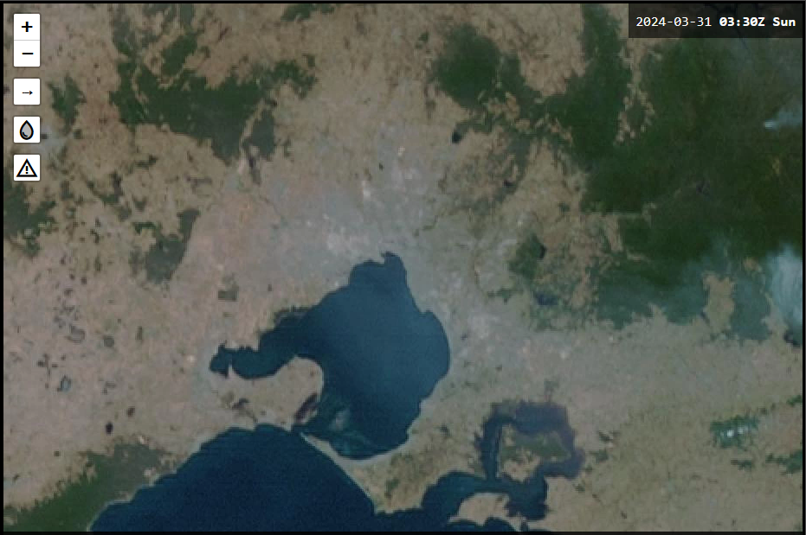
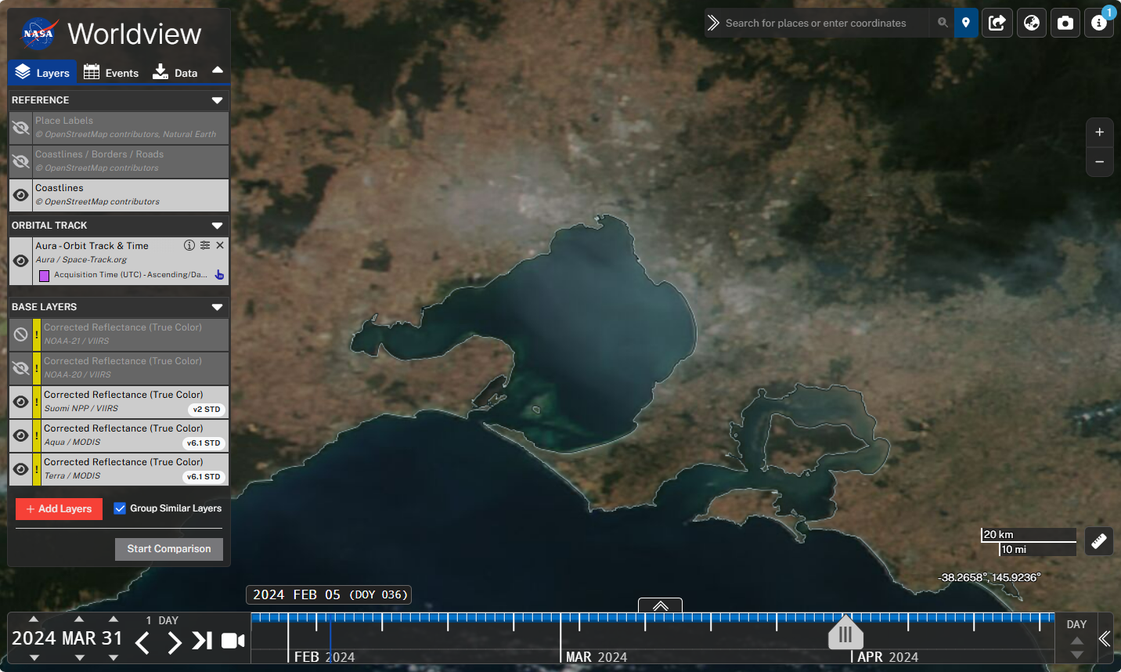
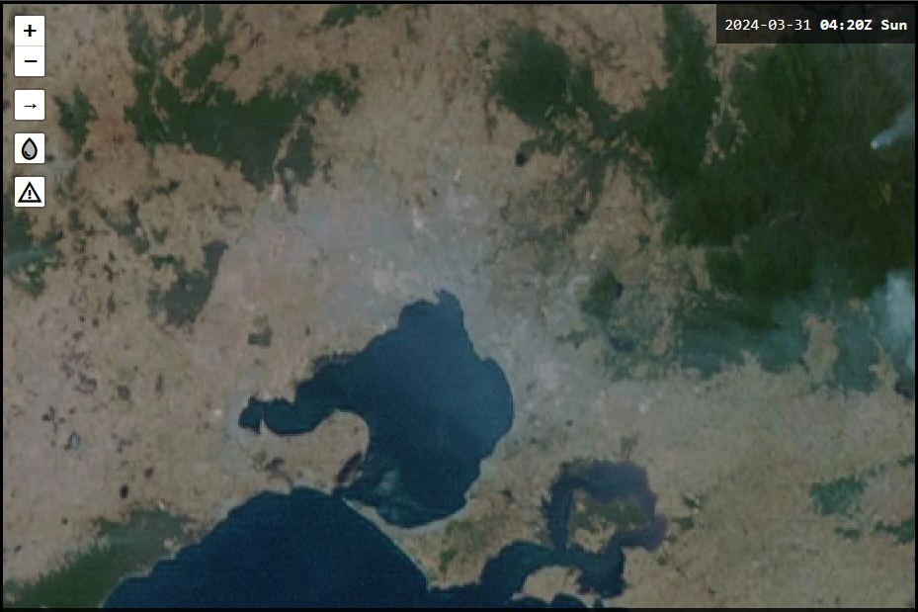
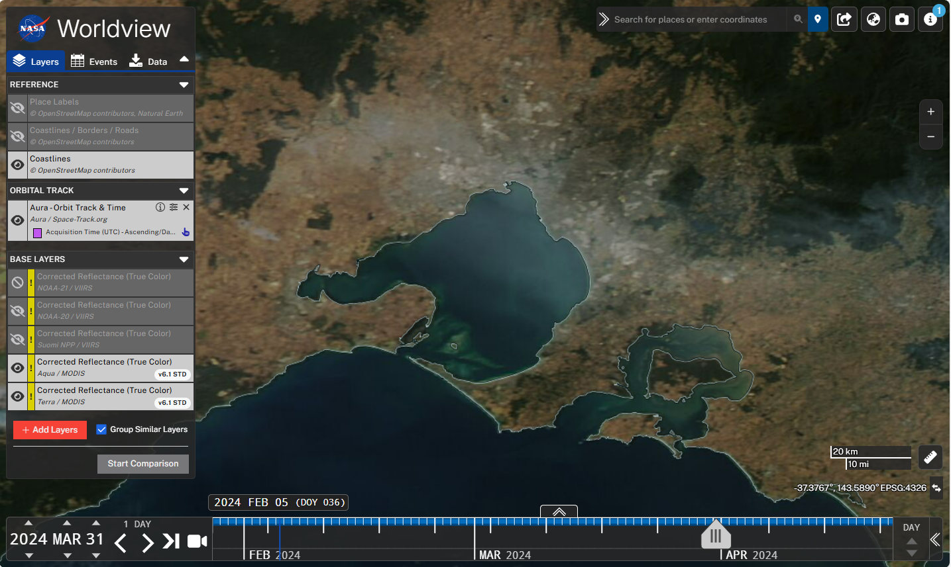
Comparing Himawari-9 imagery with polar orbiter imagery from the NASA Worldview web site
images courtesy JMA / Bureau of Meteorology images courtesy NASA Worldview
Soumi NPP/ True Colour RGB 0336UTC 31/3/24
Himawari-9 True Colour RGB 0330UTC 31/3/24
AQUA MODIS True Colour RGB 0426UTC 31/3/24
Himawari-9 True Colour RGB 0420UTC 31/3/24

Slide 18
A memorable Easter Sunday. Investigating the Melbourne Haze Event, 31 March 2024
Initial Observations
Observations during my walk (St Kilda Beach, Melbourne City Gardens)
Facebook post; earlier episode of Mie scattering off the Eureka Tower.
The scattering table and regimes.
Further investigations, local Melbourne area.
Himawari-9 True Colour RGB satellite data. Compared with polar orbiter images from NASA Worldview.
Soundings, visibility and ceilometer observations.
Impact on aviation operations.
Further investigations, broader Victorian region.
NASA Worldview resources; Aerosol Optical Thickness, Aerosol Type.
The importance of PM 2.5 and its impact

Slide 19
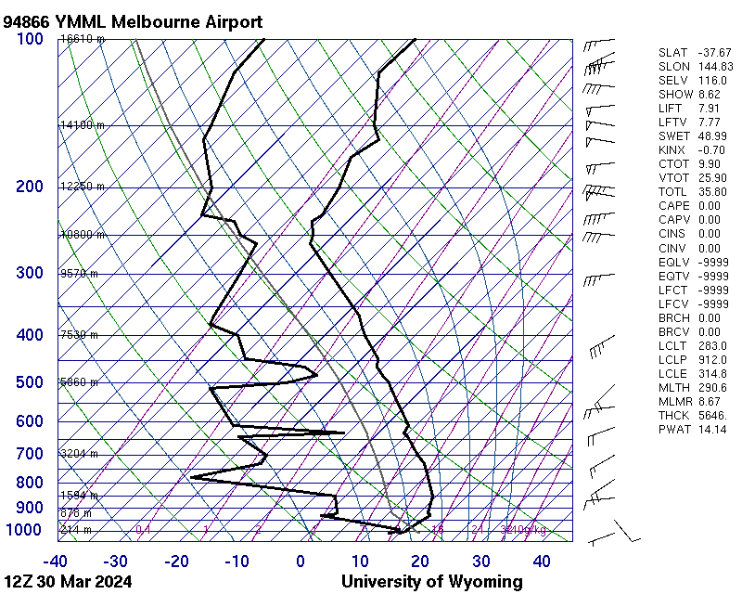
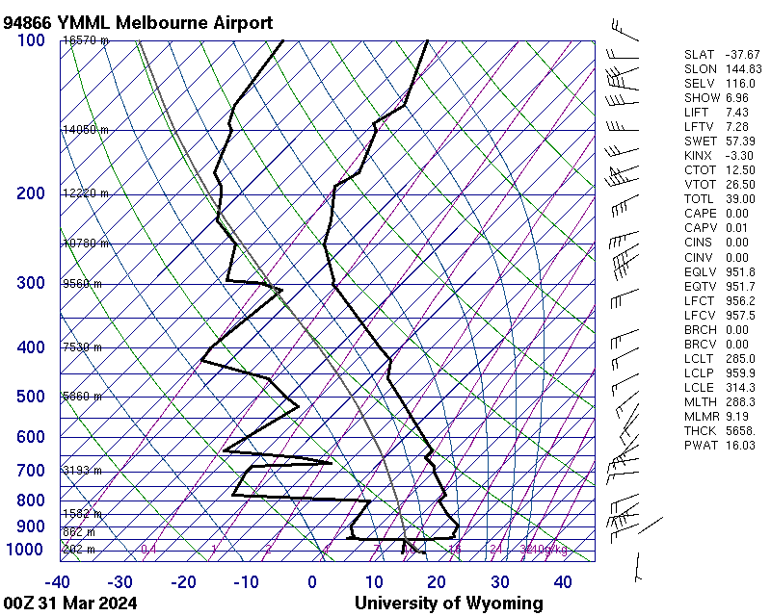
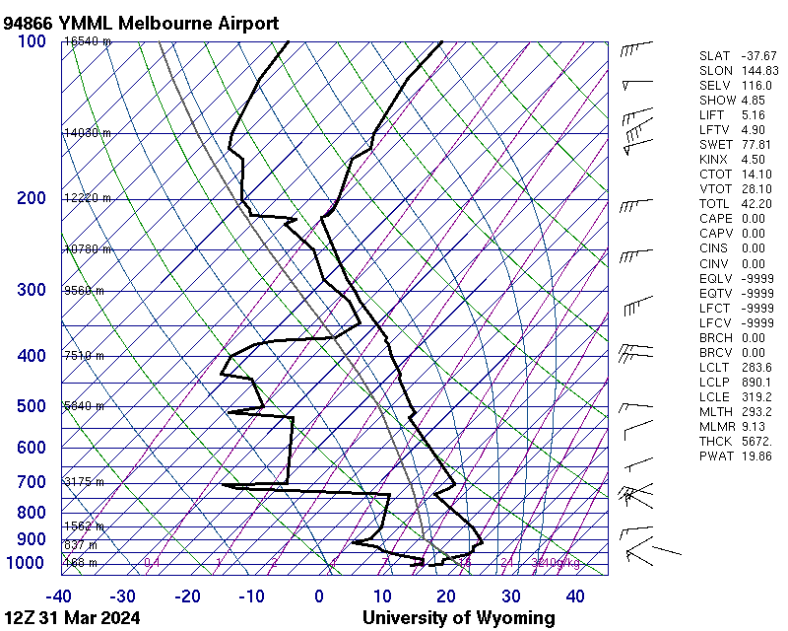
Melbourne (Tullamarine) Airport soundings during the event.
images courtesy University of Wyoming
12UTC 30th March 2024
Fog
images courtesy University of Wyoming
00UTC 31st March 2024
12UTC 31st March 2024
Inversion weakened, low cloud dissipated
Strong inversion at 950hPa trapping pollution
Southerly surface winds, advecting pollution northwards

Slide 20
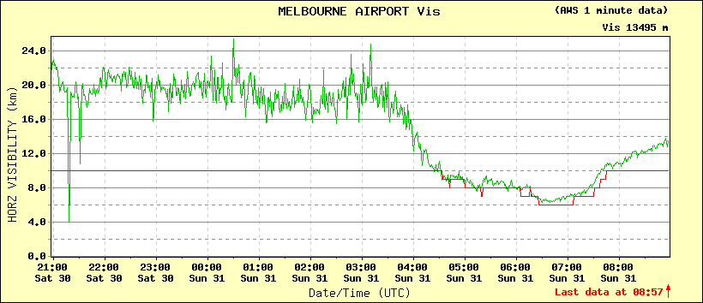
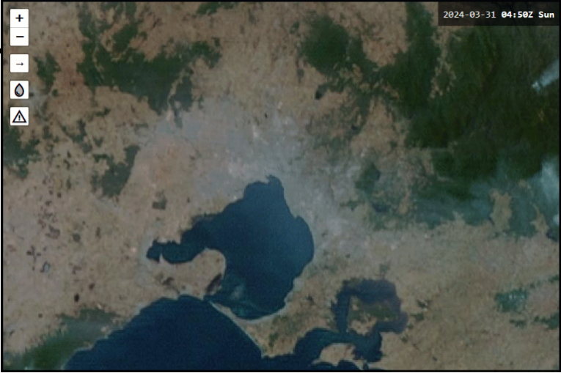
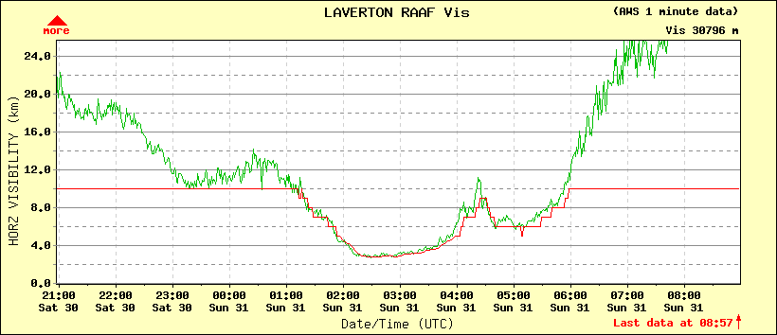
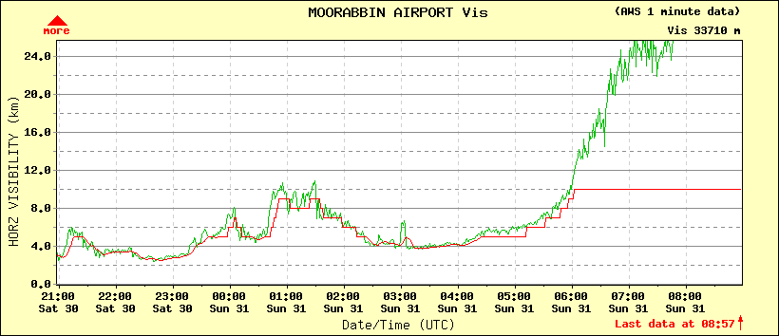
Visibility reduction over Melbourne Airports. 21UTC 30th to 09UTC 31st March.
Melbourne Airport
late in the day
Laverton Airport
Moorabbin Airport
during the day
earliest and longest
Satellite image courtesy JMA / Bureau of Meteorology
vismeter images Bureau of Meteorology

Slide 21
A memorable Easter Sunday. Investigating the Melbourne Haze Event, 31 March 2024
Initial Observations
Observations during my walk (St Kilda Beach, Melbourne City Gardens)
Facebook post; earlier episode of Mie scattering off the Eureka Tower.
The scattering table and regimes.
Further investigations, local Melbourne area.
Himawari-9 True Colour RGB satellite data. Compared with polar orbiter images from NASA Worldview.
Soundings, visibility and ceilometer observations.
Impact on aviation operations.
Further investigations, broader Victorian region.
NASA Worldview resources; Aerosol Optical Thickness, Aerosol Type.
The importance of PM 2.5 and its impact

Slide 22
Visibility and Highest Alternate Minima over Melbourne Airports.
Melbourne Airport
7000m
Laverton Airport
Moorabbin Airport
8000m
6000m
Satellite image courtesy JMA / Bureau of Meteorology
vismeter images Bureau of Meteorology

Slide 23
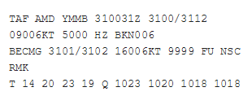
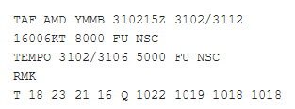
Visibility reduction over Moorabbin Airport, and TAF Aerodrome Forecasts.
At 00UTC
Mean condition haze with visibility 5000m.
Broken low cloud, base 600ft
Visibility improving to 10km after 02UTC
At 05UTC
Mean condition smoke with visibility 8000m
Periods 30-60 minutes with of visibility to 5000m with smoke till 06UTC
Moorabbin Airport
6000m
06UTC
Satellite image courtesy JMA / Bureau of Meteorology
vismeter images Bureau of Meteorology

Slide 24
A memorable Easter Sunday. Investigating the Melbourne Haze Event, 31 March 2024
Initial Observations
Observations during my walk (St Kilda Beach, Melbourne City Gardens)
Facebook post; earlier episode of Mie scattering off the Eureka Tower.
The scattering table and regimes.
Further investigations, local Melbourne area.
Himawari-9 True Colour RGB satellite data. Compared with polar orbiter images from NASA Worldview.
Soundings, visibility and ceilometer observations.
Impact on aviation operations.
Further investigations, broader Victorian region.
NASA Worldview resources; Aerosol Optical Thickness, Aerosol Type.
The importance of PM 2.5 and its impact

Slide 25
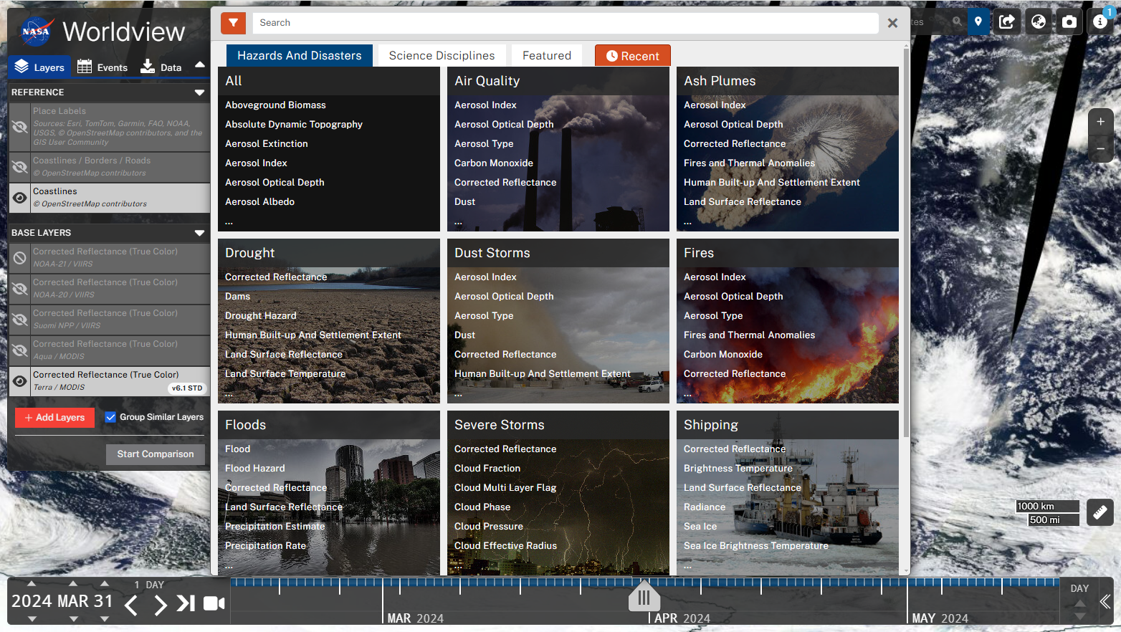
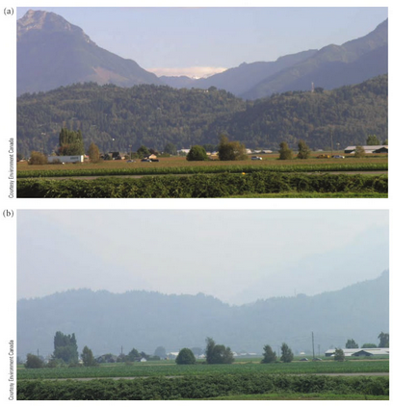
Exploring the NASA Worldview web page for polar orbiter satellite data. Air Quality. Aerosol Optical Depth. at https://worldview.earthdata.nasa.gov/index.html
2: Air Quality
3: choose Aerosol Optical Depth
Aerosol Optical depth: The optical depth due to extinction by the aerosol component of the atmosphere (AMS Glossary).
Aerosol Optical depth ~ 0
Aerosol Optical depth ~ 1
1: add layers
images from Meteorology Today, Ahrens, Jackson and Jackson, 2011

Slide 26
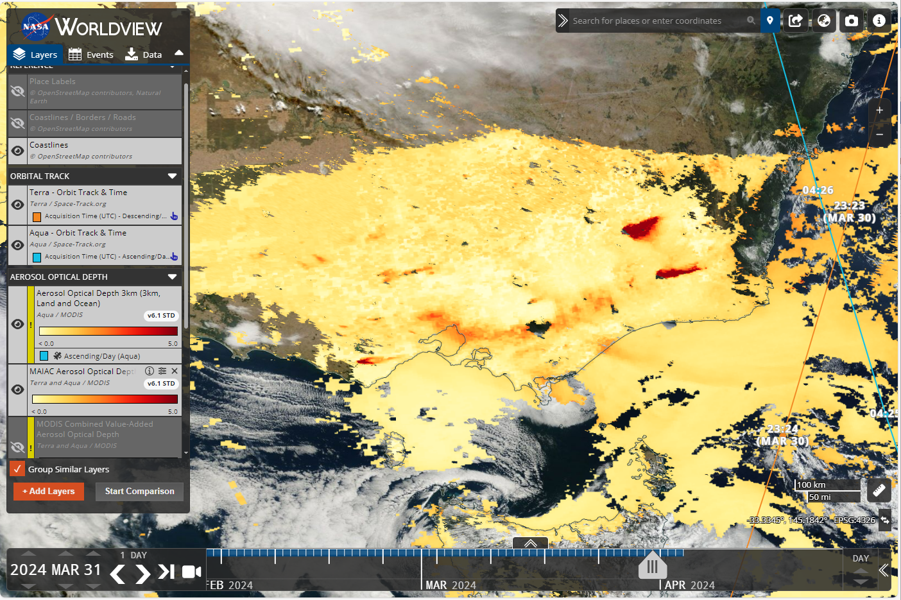
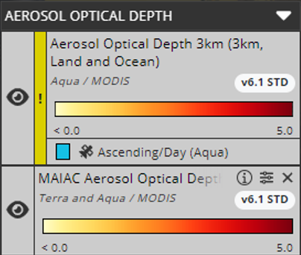
Aerosol Optical Depth over Victoria and Melbourne. (Aqua / Terra MODIS data, Terra overpass 2323UTC 30th March, Aqua overpass 0426UTC, 31st March)
Smoke from Fires
Melbourne Haze
Melbourne
Smoke from Fire
image courtesy NASA Worldview https://worldview.earthdata.nasa.gov/

Slide 27
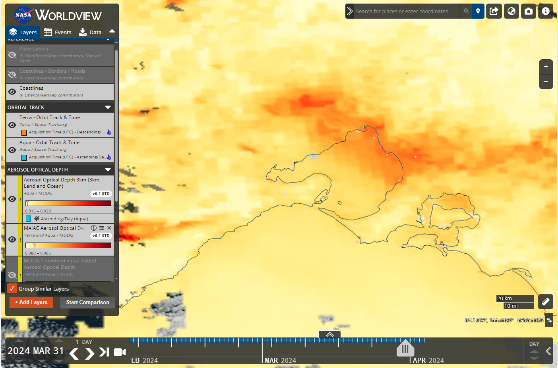
Aerosol Optical Depth over Melbourne (M). (Aqua / Terra MODIS data, Terra overpass 2323UTC 30th March, Aqua overpass 0426UTC, 31st March)
M
image courtesy NASA Worldview https://worldview.earthdata.nasa.gov/

Slide 28
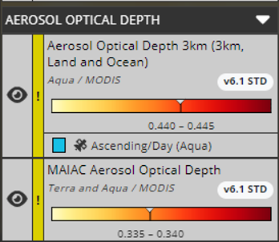
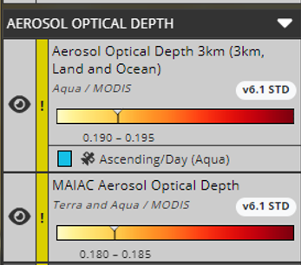
Aerosol Optical Depth over Melbourne (M). (Aqua / Terra MODIS data, Terra overpass 2323UTC 30th March, Aqua overpass 0426UTC, 31st March)
X
M
X
0.180-0.195
0.335-0.445
image courtesy NASA Worldview https://worldview.earthdata.nasa.gov/

Slide 29
Exploring the NASA Worldview web page for polar orbiter satellite data. Air Quality. Aerosol Type. at https://worldview.earthdata.nasa.gov/index.html
2: Air Quality
3: choose Aerosol Type
1: add layers

Slide 30
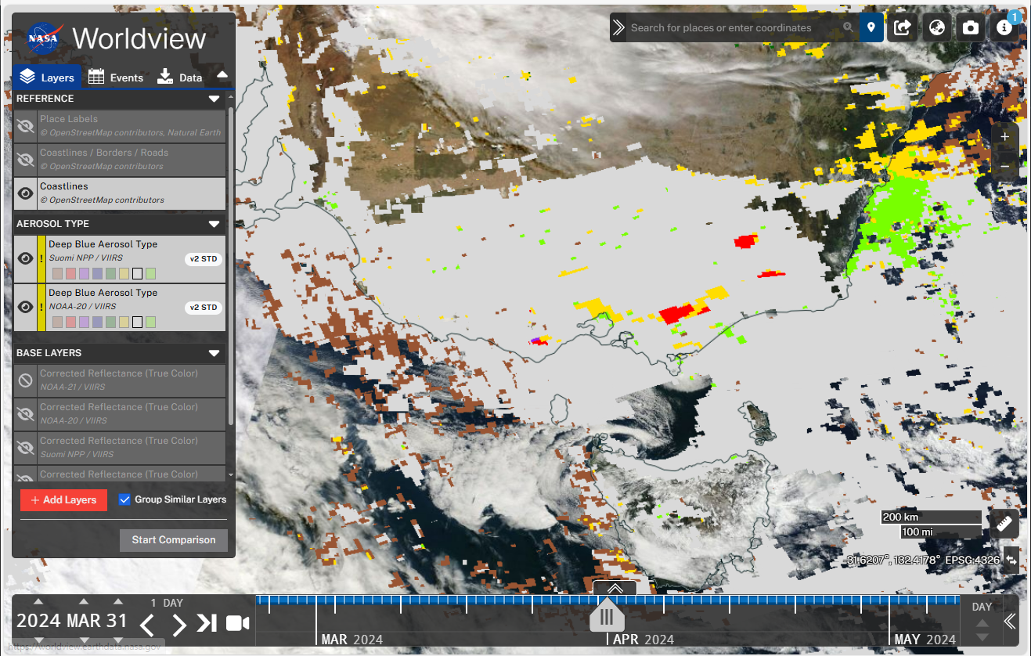
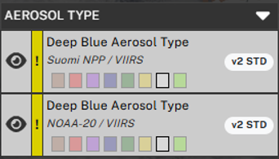
Types of pollutant. NASA Worldview website. Suomi NPP and NOAA-20 VIIRS data.
image courtesy NASA Worldview https://worldview.earthdata.nasa.gov/
High Altitude Smoke
Dust
Fine Dominated
Smoke
Mixed

Slide 31
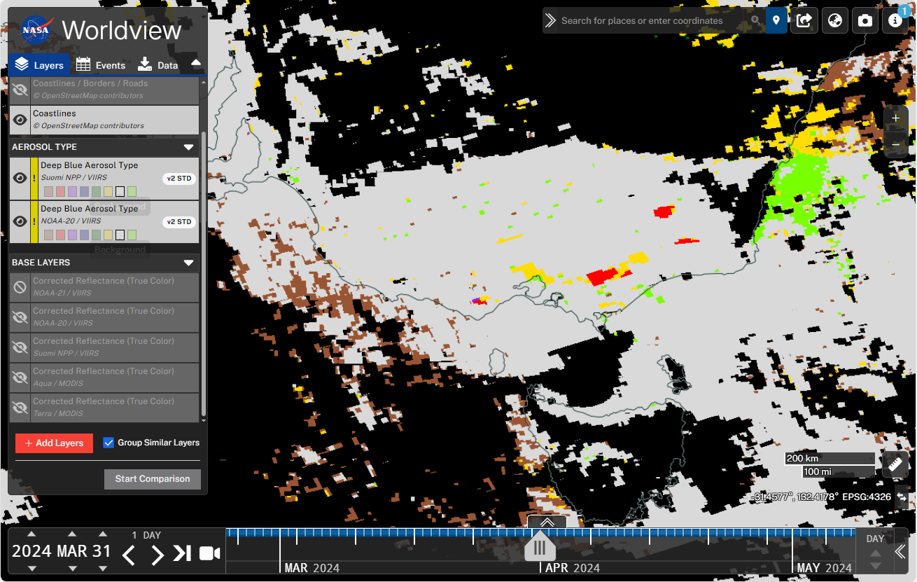
Types of pollutant. NASA Worldview website. Suomi NPP and NOAA-20 VIIRS. Background satellite image removed.
image courtesy NASA Worldview https://worldview.earthdata.nasa.gov/
High Altitude Smoke
Dust
Fine Dominated
Smoke
Mixed

Slide 32
A memorable Easter Sunday. Investigating the Melbourne Haze Event, 31 March 2024
Initial Observations
Observations during my walk (St Kilda Beach, Melbourne City Gardens)
Facebook post; earlier episode of Mie scattering off the Eureka Tower.
The scattering table and regimes.
Further investigations, local Melbourne area.
Himawari-9 True Colour RGB satellite data. Compared with polar orbiter images from NASA Worldview.
Soundings, visibility and ceilometer observations.
Impact on aviation operations.
Further investigations, broader Victorian region.
NASA Worldview resources; Aerosol Optical Thickness, Aerosol Type.
The importance of PM 2.5 and its impact

Slide 33
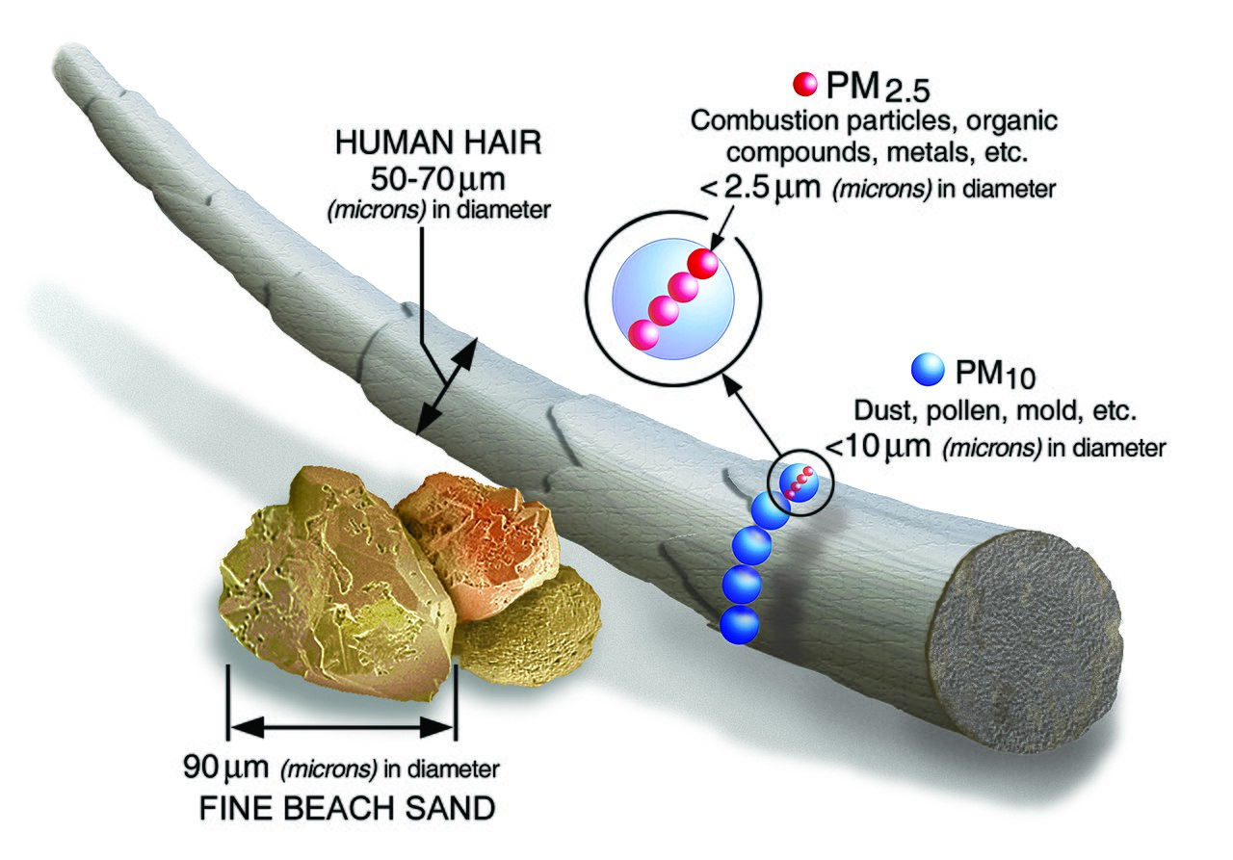
Particulate matter 2.5 microns or less (PM_{2.5})
PM_{2.5} is particulate matter 2.5 micrometers or less in diameter.
PM_{2.5} is generally described as fine particles.
PM2. 5 (particles less than 2.5 micrometers in diameter) can penetrate deeply into the lung, irritate and corrode the alveolar wall, and consequently impair lung function.
image from Environmental Protection Agency, rendered in Wikimedia
https://www.epa.gov/pm-pollution/particulate-matter-pm-basics
Notes:
https://www.dcceew.gov.au/environment/protection/npi/substances/fact-sheets/particulate-matter-pm10-and-pm25#:~:text=Description,be%20placed%20on%20its%20width
https://pmc.ncbi.nlm.nih.gov/articles/PMC4740125/#:~:text=raising%20worldwide%20concerns.-,PM2.,and%20consequently%20impair%20lung%20function.

Slide 34
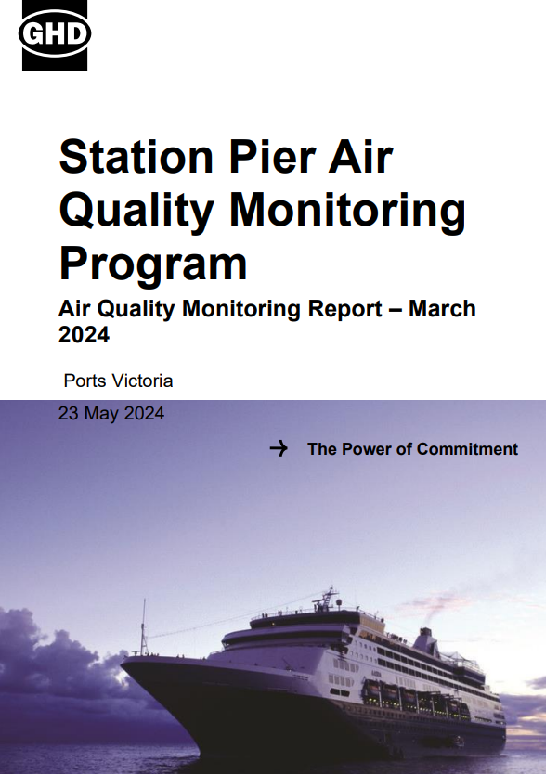
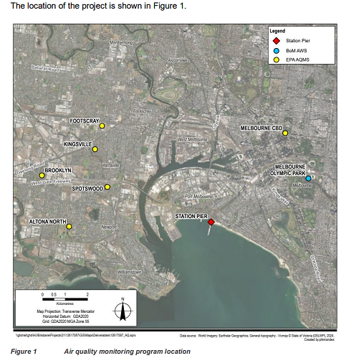
PM_{2.5} monitoring in Melbourne on the 31st March 2024
Melbourne
CBD
Station Pier
image from https://ports.vic.gov.au/wp-content/uploads/aqm-report-station-pier-2403.pdf
Notes:
https://www.dcceew.gov.au/environment/protection/npi/substances/fact-sheets/particulate-matter-pm10-and-pm25#:~:text=Description,be%20placed%20on%20its%20width
https://pmc.ncbi.nlm.nih.gov/articles/PMC4740125/#:~:text=raising%20worldwide%20concerns.-,PM2.,and%20consequently%20impair%20lung%20function.

Slide 35
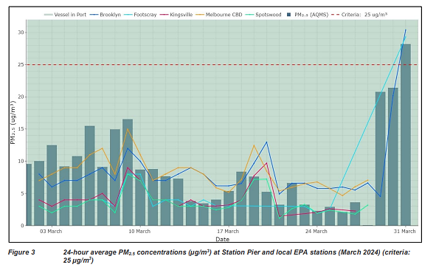
PM_{2.5} monitoring in Melbourne on the 31st March 2024
image from https://ports.vic.gov.au/wp-content/uploads/aqm-report-station-pier-2403.pdf
Notes:
https://www.dcceew.gov.au/environment/protection/npi/substances/fact-sheets/particulate-matter-pm10-and-pm25#:~:text=Description,be%20placed%20on%20its%20width
https://pmc.ncbi.nlm.nih.gov/articles/PMC4740125/#:~:text=raising%20worldwide%20concerns.-,PM2.,and%20consequently%20impair%20lung%20function.

Slide 36
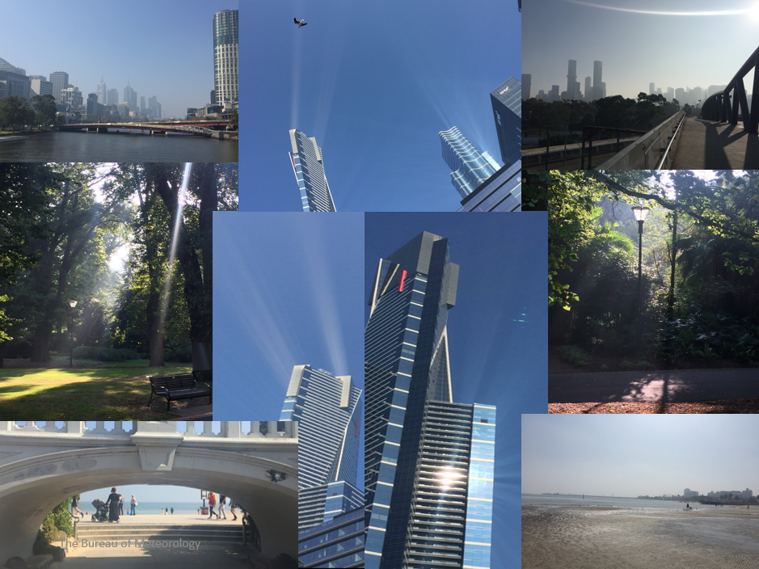
Summary
Using geostationary and polar orbiting satellite data to detect the extent of the haze
Surface and upper air observations also used in the investigation
An Easter Sunday full of Light.
Haze can be beautiful! ☺
Examining appropriate satellite derived products on the NASA Worldview web page to interrogate the nature and origins of the haze
Surface observations of particulate matter less than 2.5 microns.
Would be great to have these from satellite data also

