Slide 1
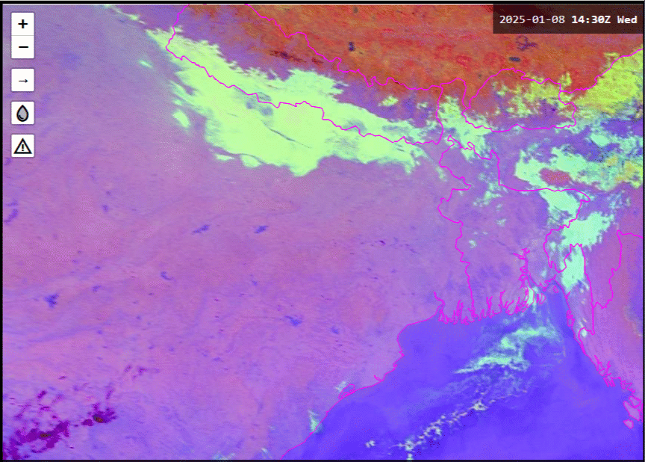
Animation: North-eastern India fog and stratus, 1440UTC 8th to 0250UTC 9th January 2025
animation courtesy Japan Meteorological Agency (JMA)/Bureau of Meteorology
Lucknow
Kolkata
Likely valley fog = red
Likely fog forming locally = green
Likely mobile stratus = blue

