Slide 1
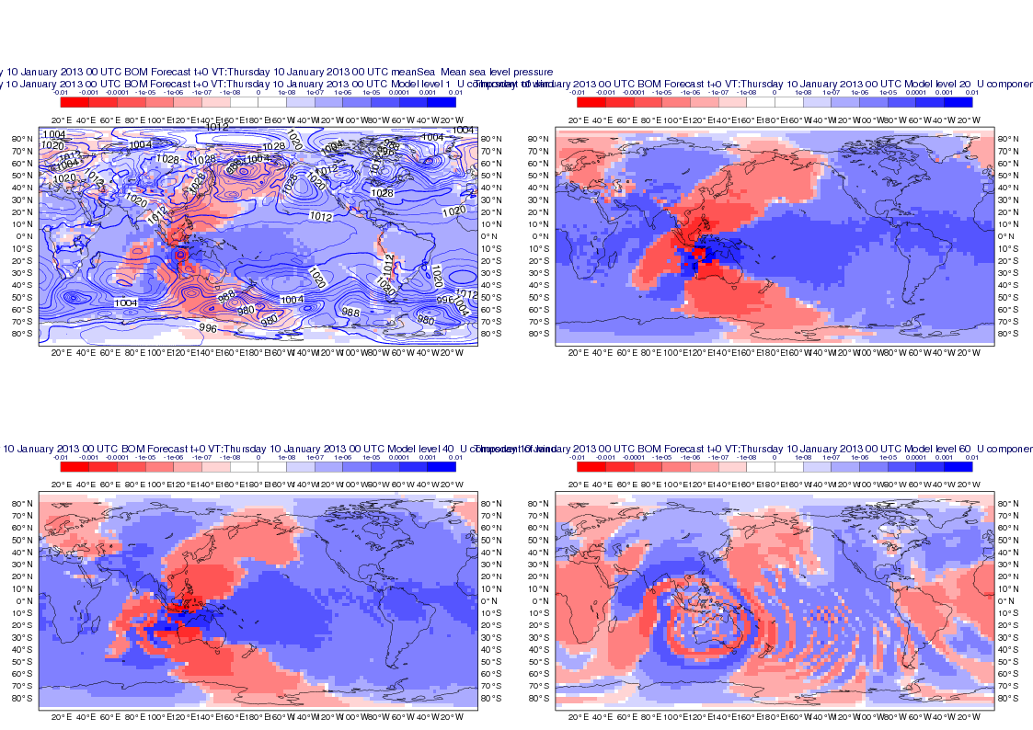
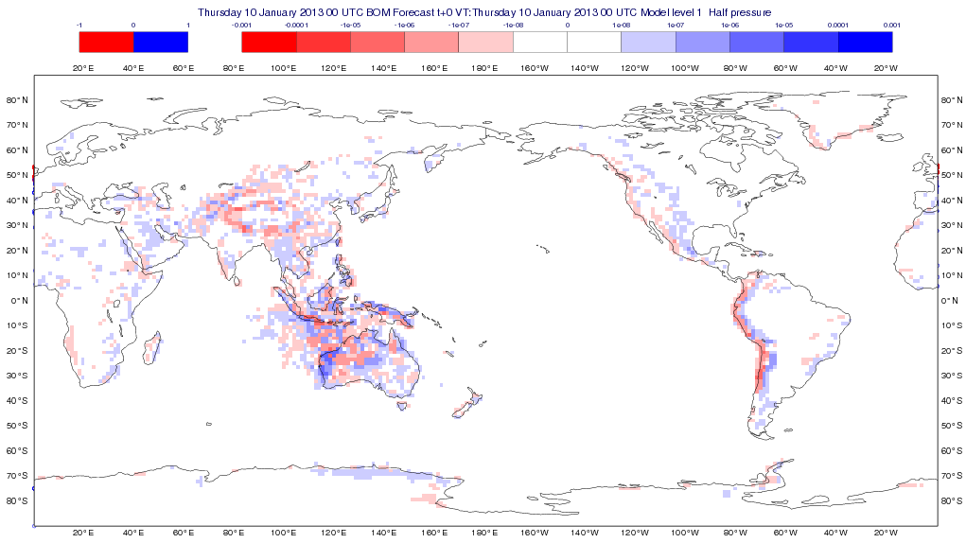
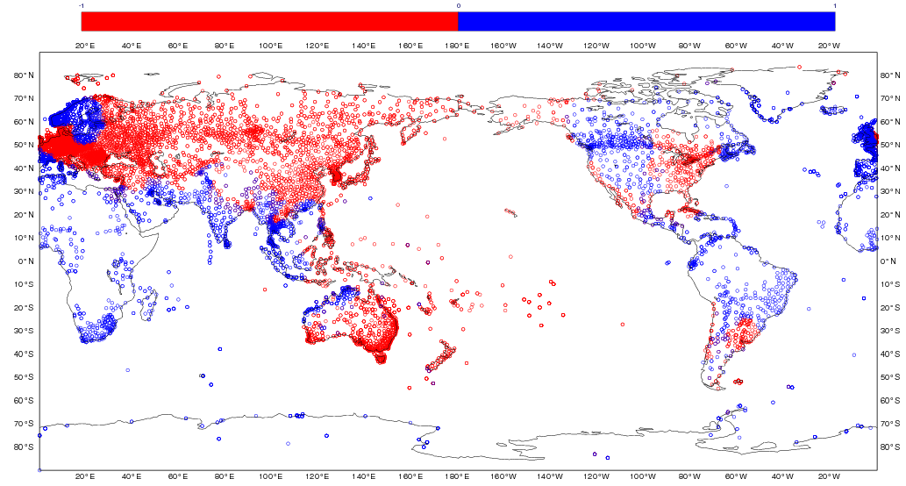
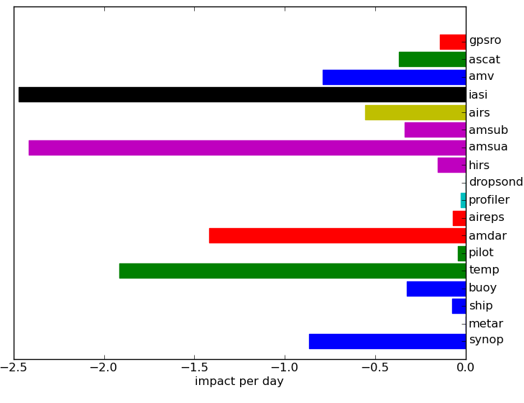
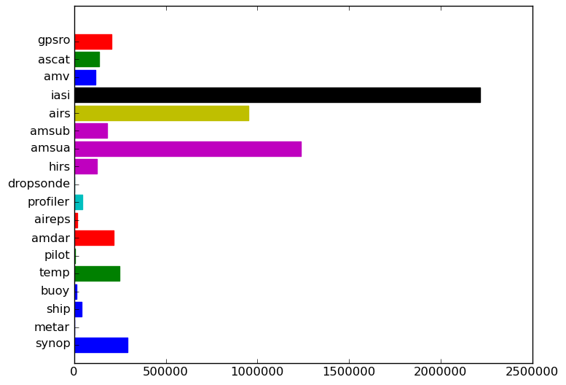
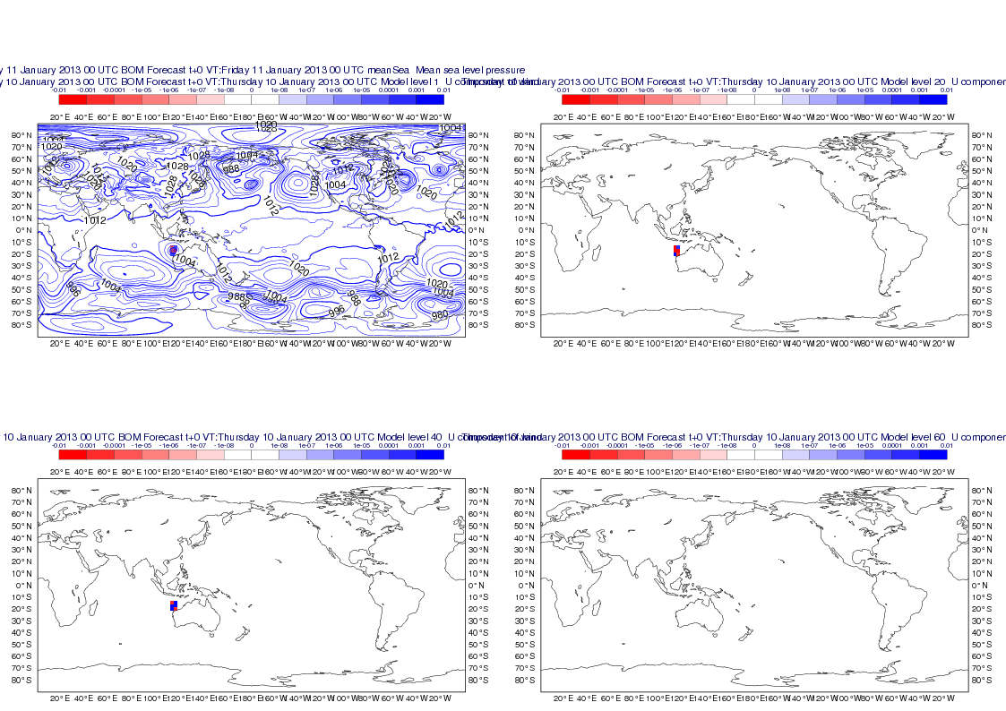
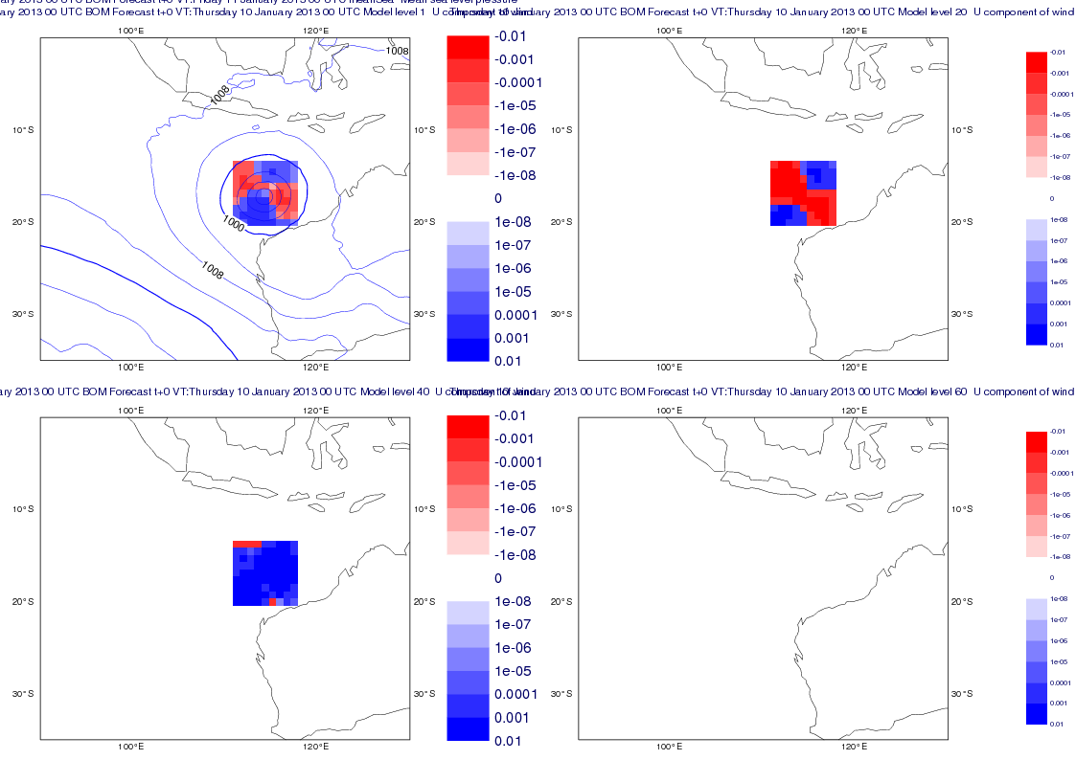
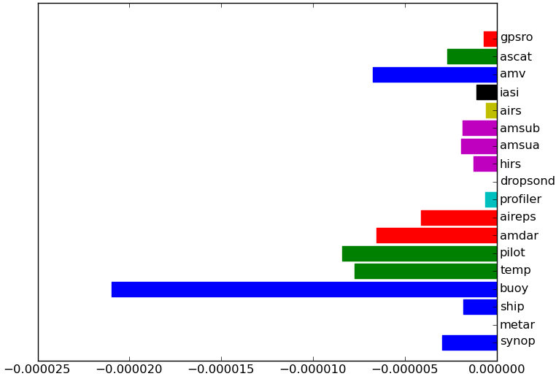
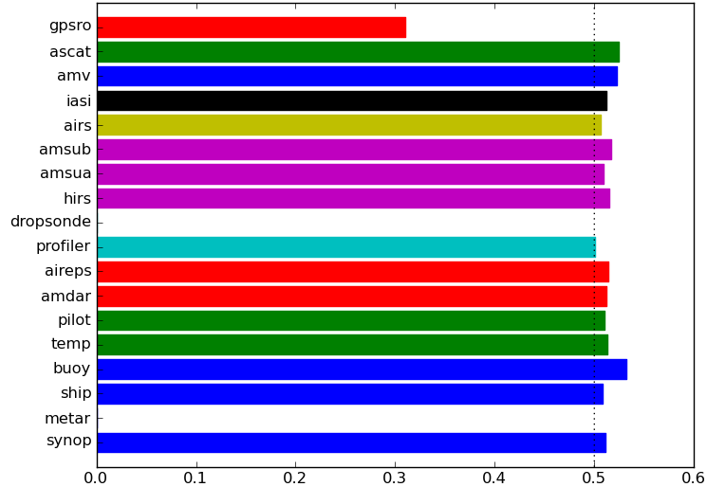
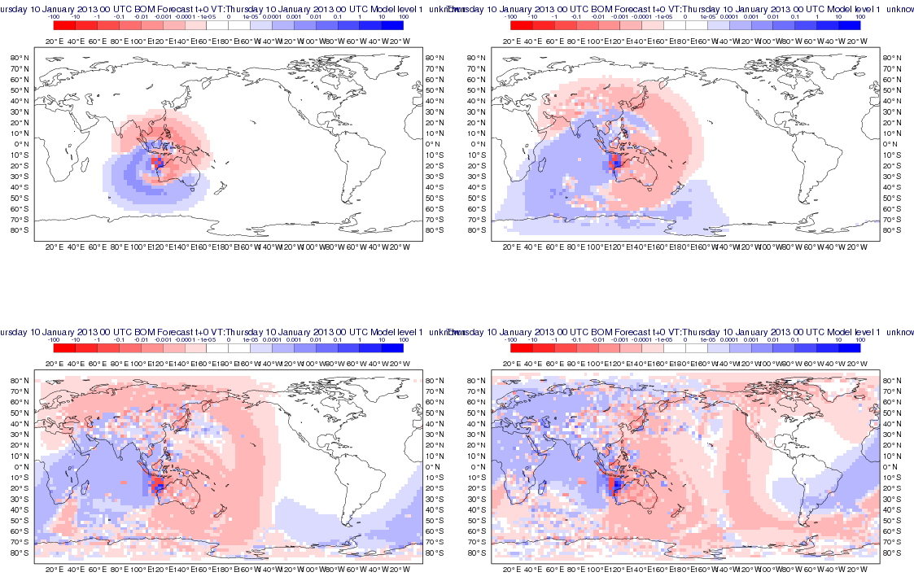
Assessing ACCESS-G Global Data Assimilation Using Adjoint-Based Forecast Sensitivity to Observations Jin LEE¹ and Paul GREGORY² Centre for Australian Weather and Climate Research (CAWCR), Bureau of Meteorology^{1,2}
1. Introduction
Traditionally the impact of observations on NWP model forecasts were assessed using Observing System Experiments (OSEs) but these are computationally expensive and do not give fine-grained results. For example if we are interested in channel-by-channel impacts of hyperspectral sounder observations it's almost impossible for an OSE to answer this type of question. Forecast Sensitivity to Observations (FSO) is a methodology which is much more affordable and allows evaluation of many aspects of observation impact.
3.3 Sensitivity with respect to analysis state
The adjoint sensitivity field at the final time is integrated by the adjoint model for -27 hours to produce the sensitivity with respect to the initial state. Figure 4 shows the forecast sensitivity with respect to the initial u-component wind, ${\left(\frac{∂e}{∂u}\right)}_{0}$. The valid time is 20130109 21Z. The panels are at different vertical model levels and are consistent with Figure 2.
2. Theory
1.1 First-order accurate approximation
First we define a measure of forecast error expressed as a scalar function that depends on the forecast state and verifying truth. Most commonly a quadratic measure is used. See Figure 1.
state vector
Forecast error measure is:
$$e={\left(x^{f}−x^{t}\right)}^{T}C\left(x^{f}−x^{t}\right)$$
$$x^{t}$$
Figure 1. A forecast, $x^{f}$is produced from an unperturbed initial state, $x^{0}$. The we perturb the initial state by an infinitesimal amount $δx^{0}$. Then we obtain another forecast, $x^{f}+δx^{f}$ which is produced from the perturbed initial state, $x^{0}+δx^{0}$. Here $x^{t}$ is the "truth".
Figure 4. Forecast sensitivity to initial forecast u-component wind. See Figure 2 for an explanation.
$$x^{f}+δx^{f}$$
3.4 Sensitivity with respect to observations
Model-space sensitivity to initial state is mapped to observation-space sensitivity using the adjoint of 4DVAR:
${\frac{∂e}{∂y^{o}}=K}^{T}\frac{∂e}{∂x^{0}}$ where $K^{T}={\left(HBH^{T}+R\right)}^{−1}H^{T}B$
$$x^{f}$$
$$x^{0}+δx^{0}$$
$$x^{0}$$
time
1. An infinitesimal change in the forecast error measure $\left(δe\right)$ due to a change in the forecast state $\left(δx^{f}\right)$ is:
$δe={\left(δx^{f}\right)}^{T}\frac{∂e}{∂x^{f}}$
2. An infinitesimal change in the forecast error measure $\left(δe\right)$ due to a change in the initial state $\left(δx^{0}\right)$ is:
$$δe={\left(δx^{0}\right)}^{T}\frac{∂e}{∂x^{0}}$$
${=\left(δx^{0}\right)}^{T}{\left(\frac{{δx}^{f}}{∂x^{0}}\right)}^{T}\frac{∂e}{∂x^{0}}$
${=\left(δx^{0}\right)}^{T}M^{T}\frac{∂e}{∂x^{0}}$ where $M$ is the adjoint of Perturbation Forecast Model (PFM)
3. Since the analysis increment is $δx^{0}=K δy^{0}$ the impact of observations is,
$δe={\left(δy^{0}\right)}^{T} K^{T} M^{T}\frac{∂e}{∂x^{f}}$ where $K$ is the Kalman gain
Figure 5. The left panel shows the sensitivity to initial pressure on model level 1. The right panel shows the sensitivity to SYNOP surface pressure observations.
4. Application of FSO to assessing ACCESS-G 4DVAR
4.1 Set-up of experiment
The FSO technique outlined above was applied to assess data usage by the Bureau's global 4DVAR assimilation. Its configuration is as follows:
Total energy norm was used including moisture
The nonlinear model used was Unified Model (UM) with resolution of N320L70 – model grid spacing of 50 km in mid-latitudes
The adjoint model used was the adjoint of PFM and its resolution was N144L70
Cycled assimilation/forecast ran from 14 May 2012 to 14 June 2012 but only 28 days were used
1.2 Third-order accurate approximation
Higher-order approximations of $δe$ can be found by keeping higher order terms in a Taylor series expansion of $δe$ as described in Errico (2007). An alternative, finite-impact estimate was derived by Lorenc and Marriott (2013). The finite-impact estimate is nearly identical to the third-order approximation of Errico (2007).
1.3 Forecast error norms
The choice of forecast error norm depends on what aspect of the forecast we are most interested in and hence what is of most relevance. The total energy norm which measures kinetic and potential energies, and possibly latent heat release due to condensation is most commonly used. Other measures including localised norm area can also be used.
4.2 Results
3. Adjoint Sensitivity
3.1 Sensitivity with respect to forecast state
Figure 2 shows sensitivity with respect to forecast zonal wind, ${\left(\frac{∂e}{∂u}\right)}_{t}$. Forecast error measure is a localised norm centred around a mature tropical cyclone, TC Narelle. Valid time is 20130111 00Z.
Figure 6. Average forecast impact for each observation type (left panel). Observation counts for each observation type (right panel).
Figure 2. The left panels show the sensitivity to forecast u-component wind over the global domain. The right panels show the same sensitivity but for a domain around TC Narelle. The panels are on different model levels: model level 1, model level 20 (2.5 km), model level 40 (11 km) and model level 60 (31 km) ordered left to right and top to bottom.
Figure 7. Average forecast impact per observation for each observation type (left panel). Fraction of observations giving beneficial impacts (right panel).
3.2 Adjoint model integration
The sensitivity to forecast state is evolved using the PF adjoint model,
$$\frac{∂e}{∂x^{0}}=M^{T}\frac{∂e}{∂x^{f}}$$
and this is shown in Figure 3. The sensitivity field propagates back in time as the PF adjoint model is integrated -3, -6, -9 and -12 hours.
5. Further work
FSO for limited area model – convective-scale NWP
Impact of different channels from satellite radiometers
Use of forecast error measure relevant for tropical cyclones – TC centre finder
Investigate possible problems with the way we are assimilating AMSU-A and GPSRO
6. Reference
Errico, R., M., 2007: Interpretation of an adjoint-derived observational impact. Tellus 59A, 273-276.
Lorenc, AC and Marriott, RT, 2013. Forecast sensitivity to observations in the Met Office numerical weather prediction system. Q. J. R. Meteorol. Soc. DOI:10.1002/qj2122.
Figure 3. Evolution of sensitivity field at model level 1. Adjoint model integration times are -3 (top left), -6 (top right), -9 (bottom left) and -12 hours (bottom right).
Notes:
After talking to a few there’s some unanswered questions
What will happen if obs which are too far from background are allowed in and presented to VAR? In this case the background will be very different to the obs
Will this depend on background and observation error covariances?
Will this make the cost function more non-quadratic?
In the geographic obs sensitivity there are positive and negative values – why?
Is q_T PFM prognostic variable or are q_v and q_c?
For understanding the PFM physics which models moisture
Is there a radiative effect on cloud?
Normally in a parametrisation size distribution depends on temperature and pressure
Try running an ensemble of perturbations and see whether the results are consistent with tangent linear approximation

