Slide 1
Singapore Heavy Rainfall Event 14th October 2024 Himawari-9 Band 13, 1900UTC 13th to 0630UTC 14th October
animation courtesy CIRA / RAMMB and JMA
Location of Singapore at the centre of the circled region.

Slide 2
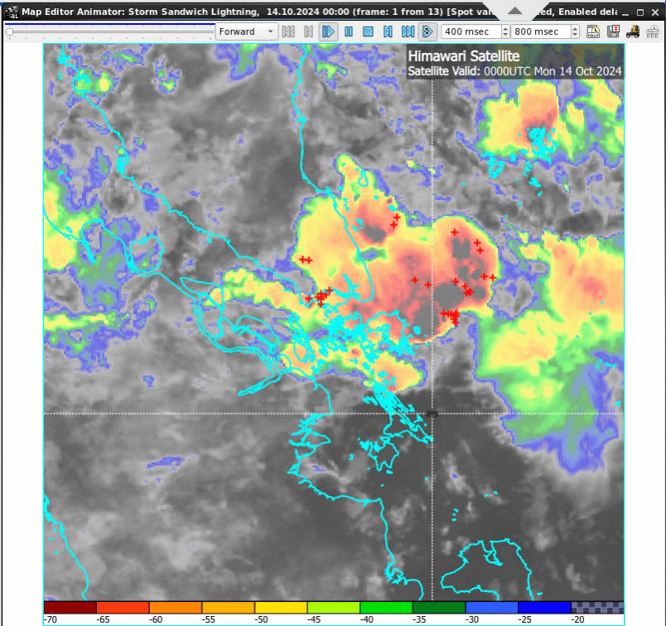
Sandwich Product and Weatherzone Lightning, 00UTC to 02UTC 14th October 2024
animation courtesy JMA / Bureau of Meteorology. Lighting data courtesy Weatherzone

Slide 3
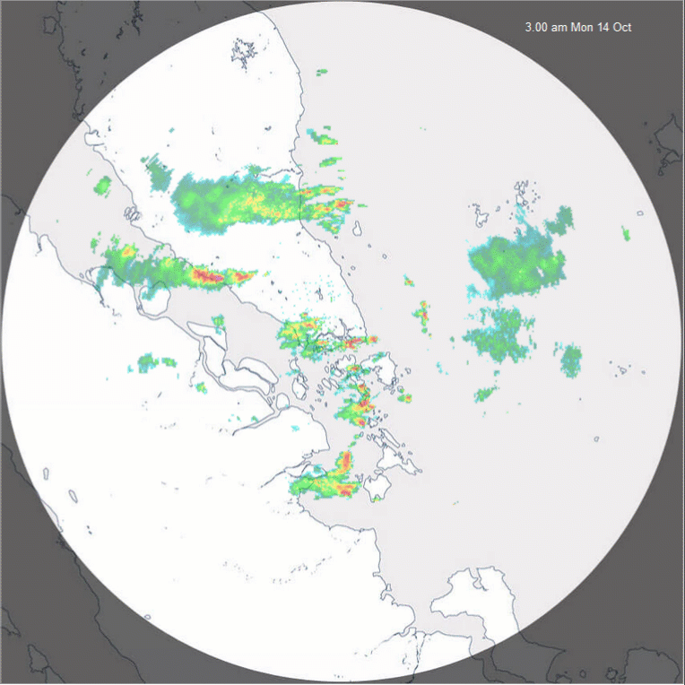
Singapore (S) 480km RADAR, 1900UTC 13th to 0630UTC 14th October 2024
S
animation courtesy NEA Singapore

Slide 4
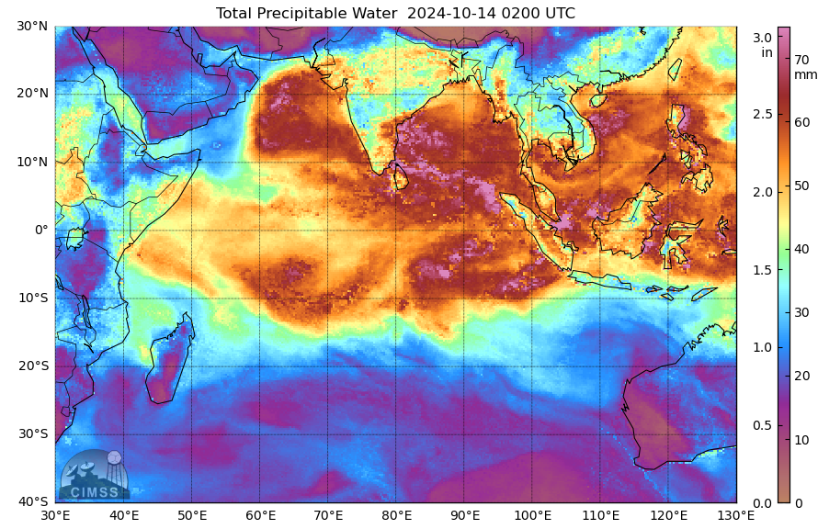
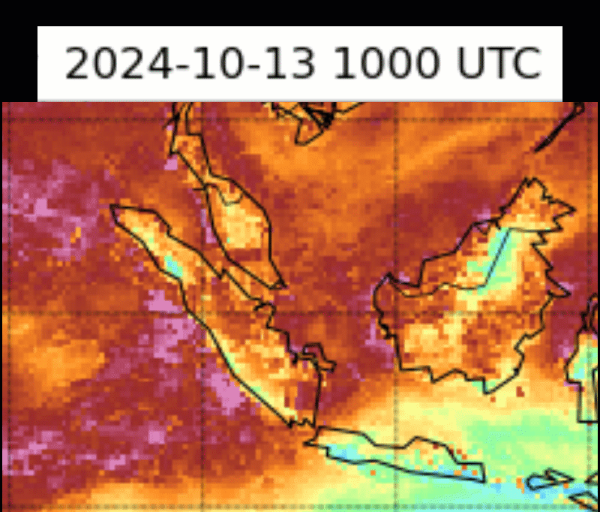
MIMIC Total Precipitable Water, 1000UTC 13th to 0200UTC 14th October 2024
S
S
animation courtesy SSEC / CIMSS

Slide 5
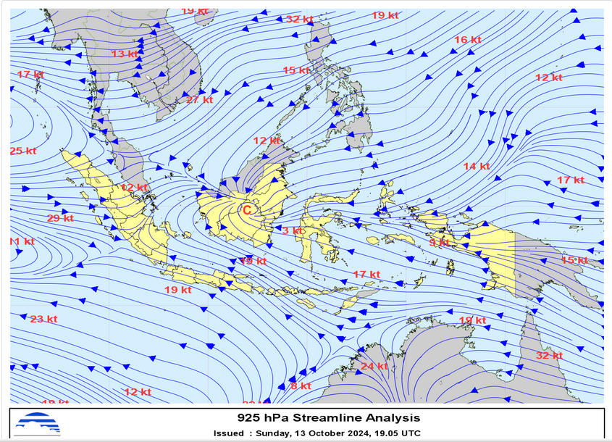
Streamline analysis chart from BMKG Indonesia
image courtesy BMKG Indonesia
Notes:
https://web-meteo.bmkg.go.id/id/pengamatan/streamline

Slide 6
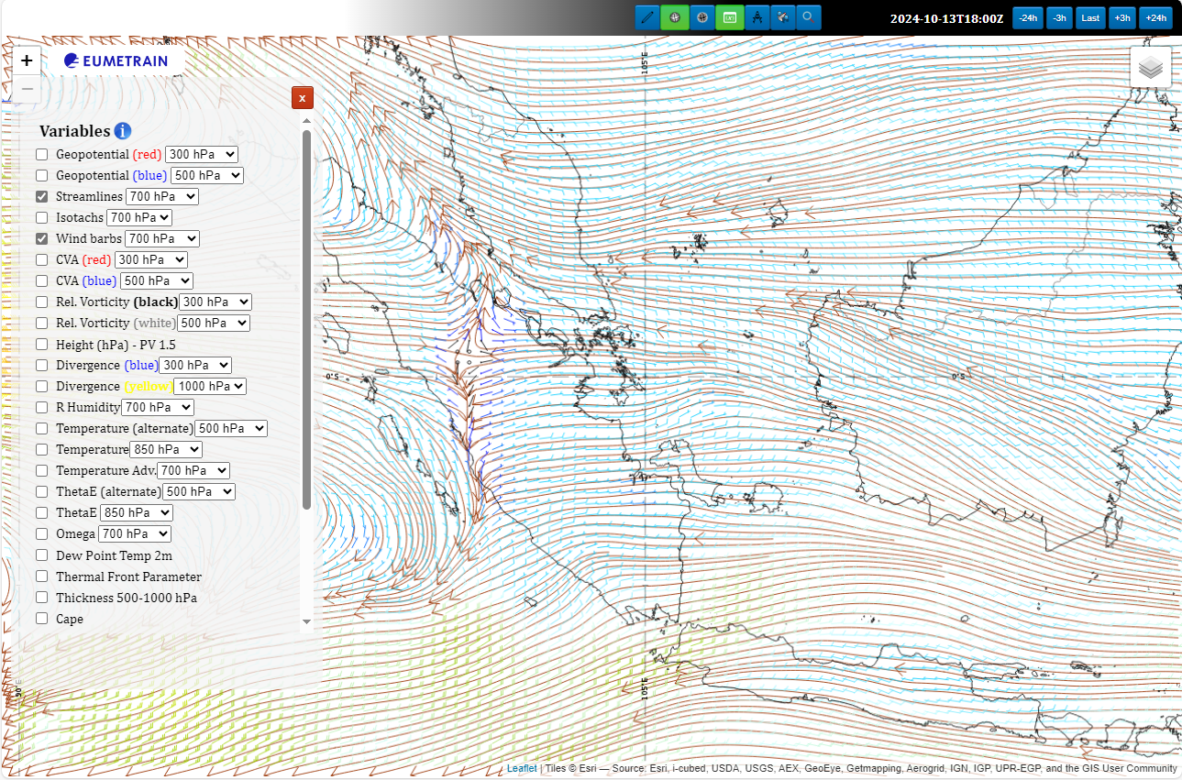
ECMWF 700hPa Streamline Analysis
image courtesy EUMETRAIN

Slide 7
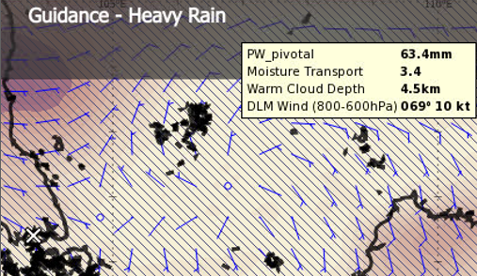
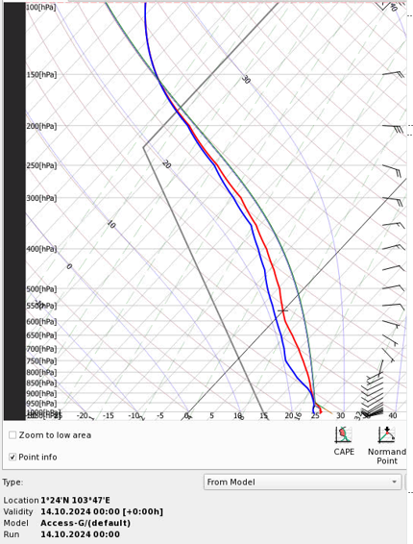
NWP model data and Heavy Rainfall thresholds
ACCESS-G Heavy Rainfall Diagnostics, 00UTC 14th October 2024
Bureau of Meteorology Criteria
Heavy Rain indicated when:
DLM Winds (800-600hpa) =<10knots,
Warm Cloud depth >=3km
Average RH (SFC-600hPa) >=70%
Precipitable Water >=25mm
Higher values of 850hPa Moisture Transport
Strong anticlockwise turning of winds
ACCESS-G Singapore sounding
00UTC 14th October 2024
images courtesy Bureau of Meteorology

Slide 8
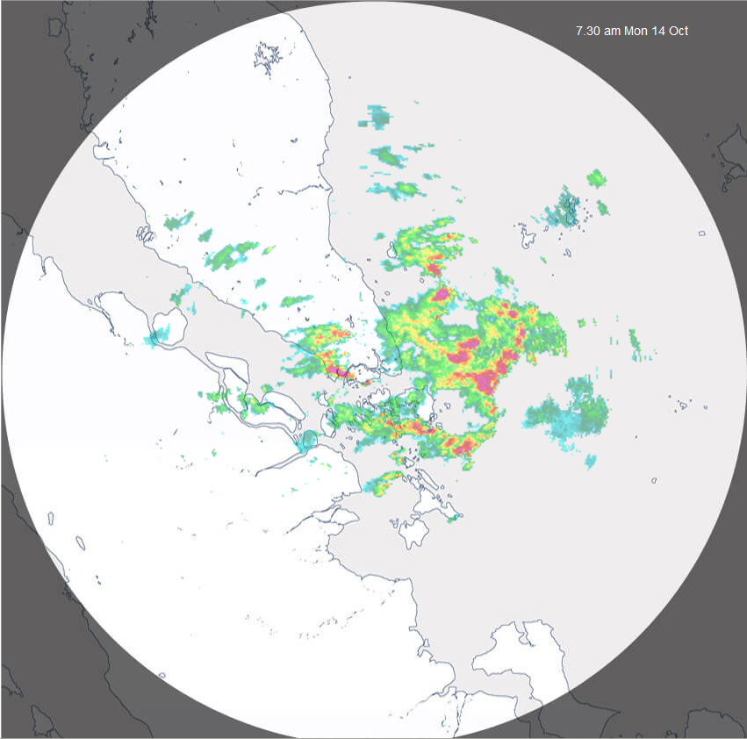
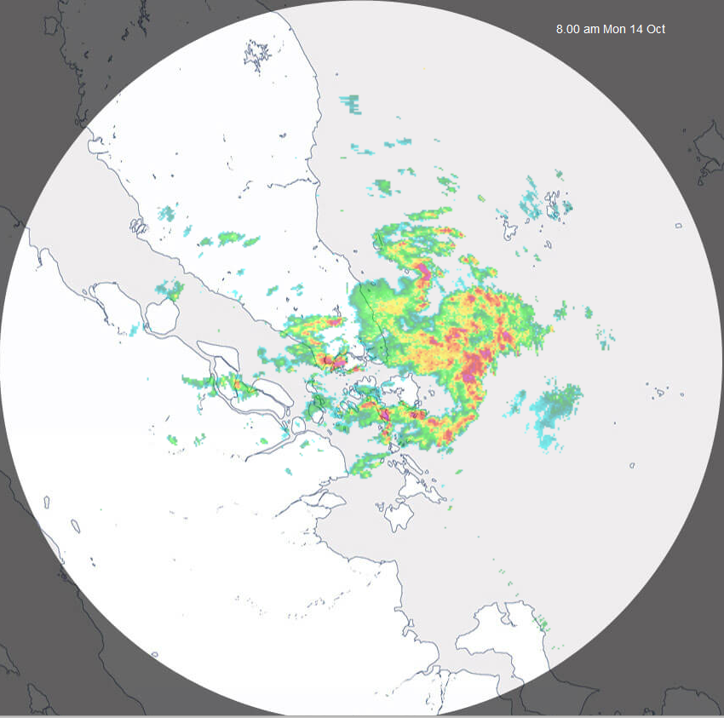
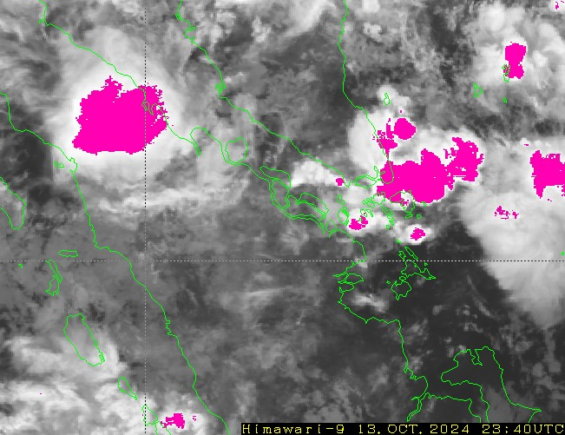
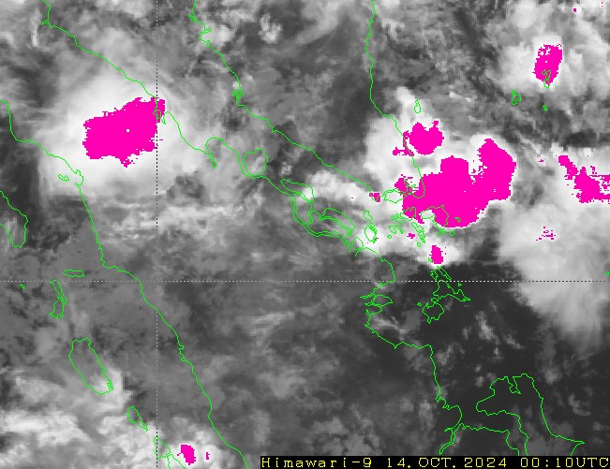
Various products and Singapore RADAR, 23UTC 13th Oct - 00UTC 14th Oct 24
7.30am SGT
8am SGT
NEA Singapore RADAR (480km)
2340UTC
0010UTC
Himawari-9 Rainfall Potential, BMKG (00UTC)
JMA Heavy Rainfall Potential Area product (note the JMA product has timestamp at end of scan)

Slide 9
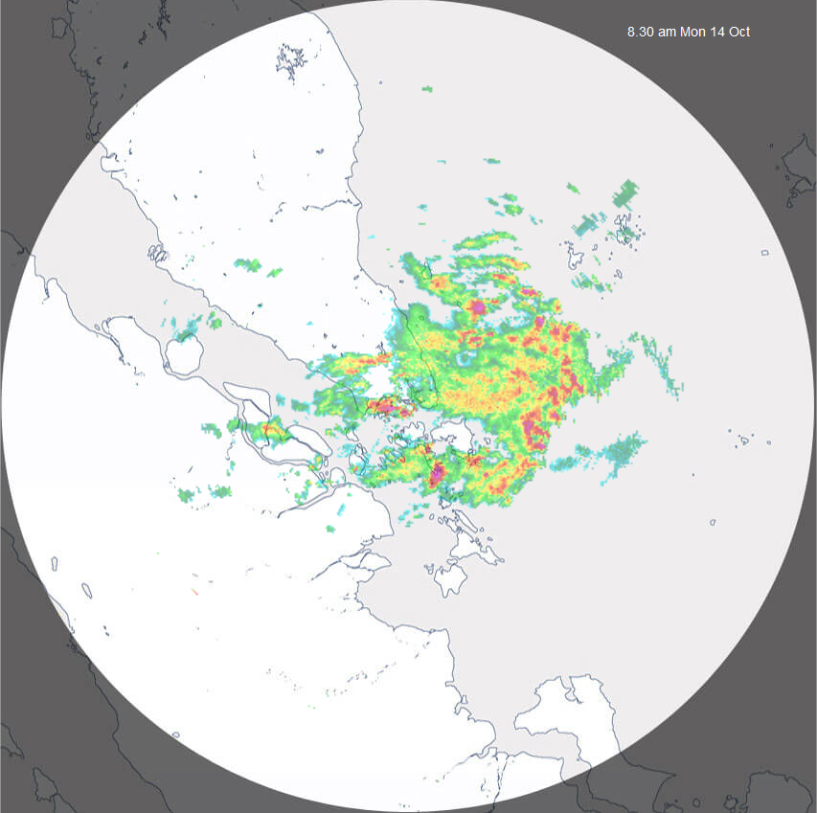
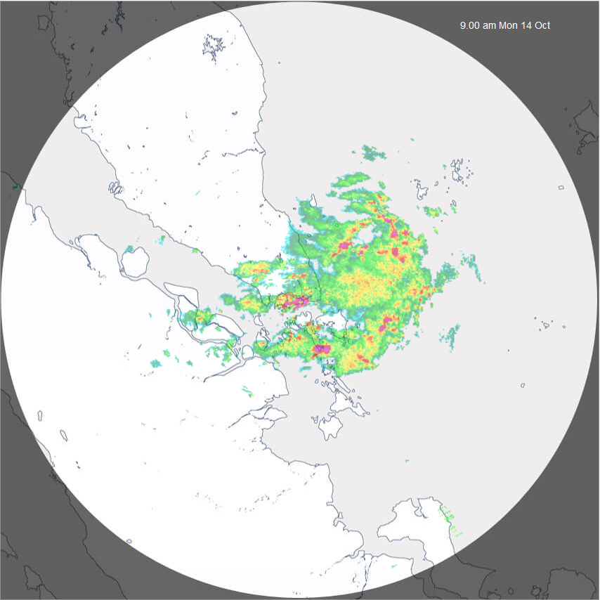
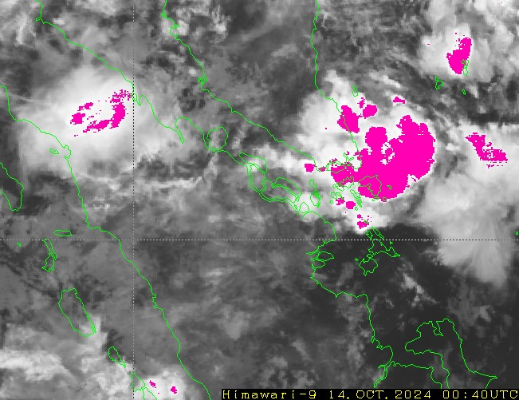
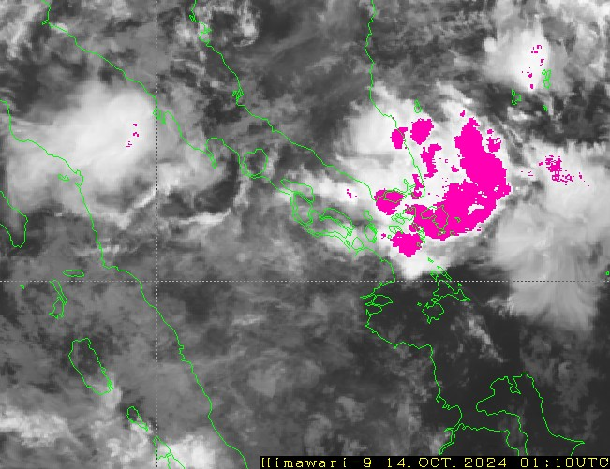
Various products and Singapore RADAR, 00-01UTC 14th Oct 24
8.30am SGT
9am SGT
NEA Singapore RADAR (480km)
0040UTC
0110UTC
Himawari-9 Rainfall Potential, BMKG (01UTC)
JMA Heavy Rainfall Potential Area product (note the JMA product has timestamp at end of scan)

Slide 10
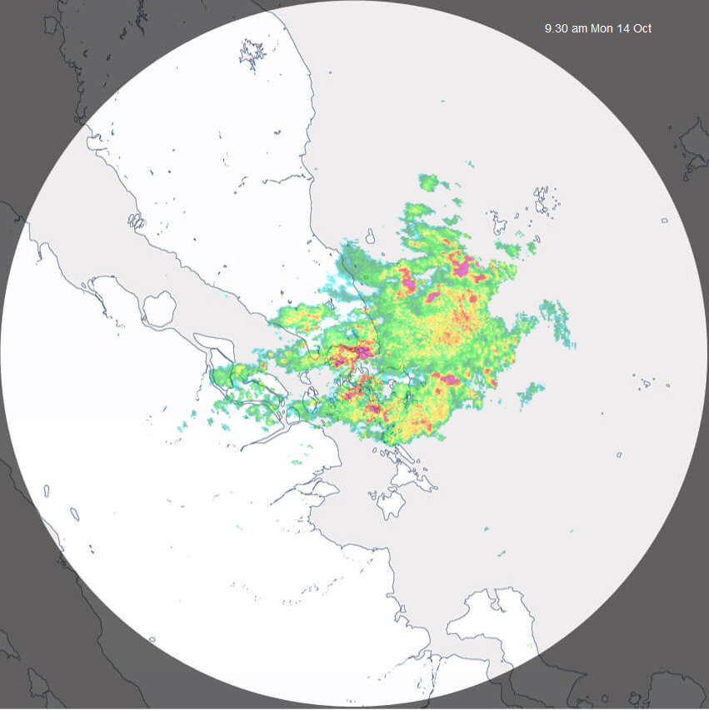
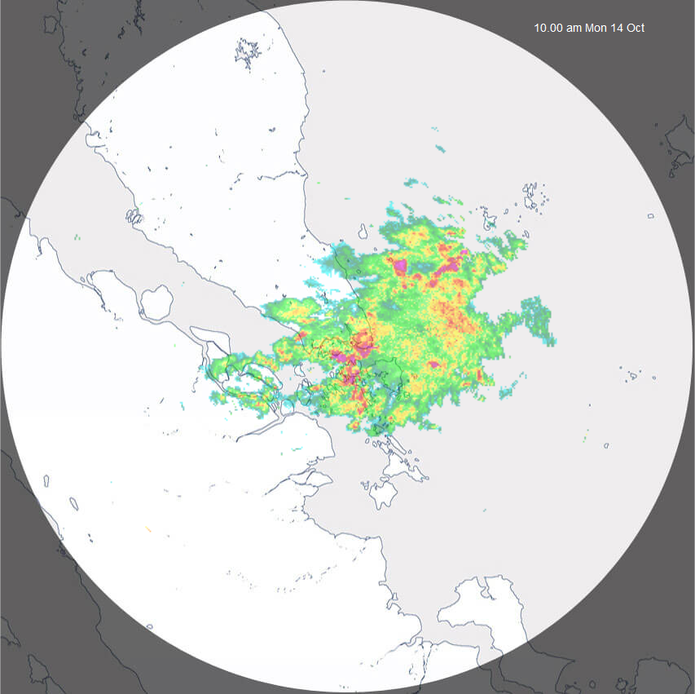
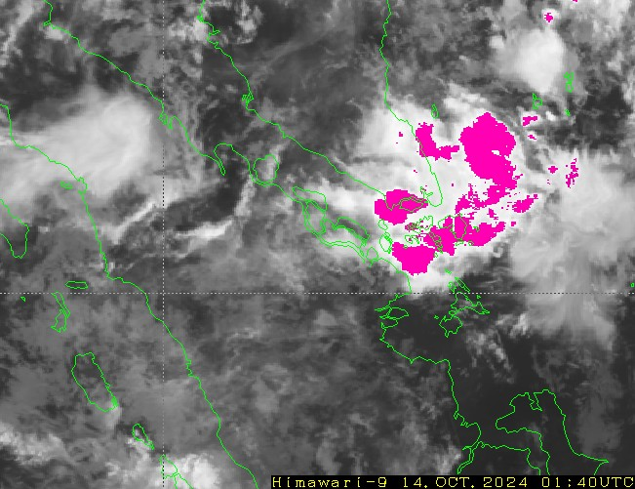
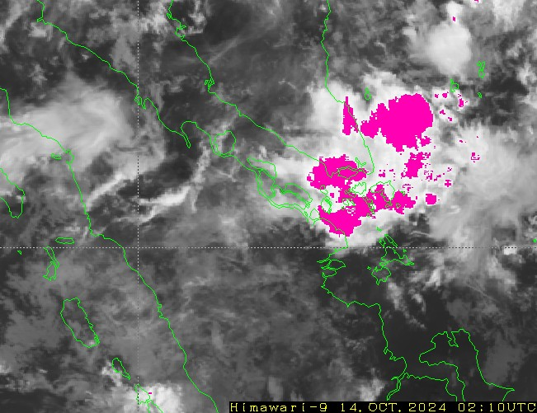
Various products and Singapore RADAR, 01-02UTC 14th Oct 24
9.30am SGT
10am SGT
NEA Singapore RADAR (480km)
0140UTC
0210UTC
Himawari-9 Rainfall Potential, BMKG (02UTC)
JMA Heavy Rainfall Potential Area product (note the JMA product has timestamp at end of scan)

Slide 11
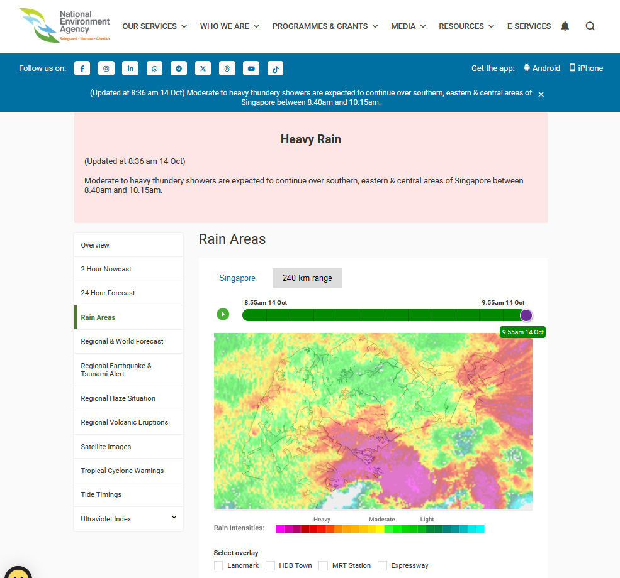
Heavy Rainfall Alert from NEA Singapore
image courtesy NEA Singapore
Notes:
https://www.nea.gov.sg/weather/rain-areas

Slide 12
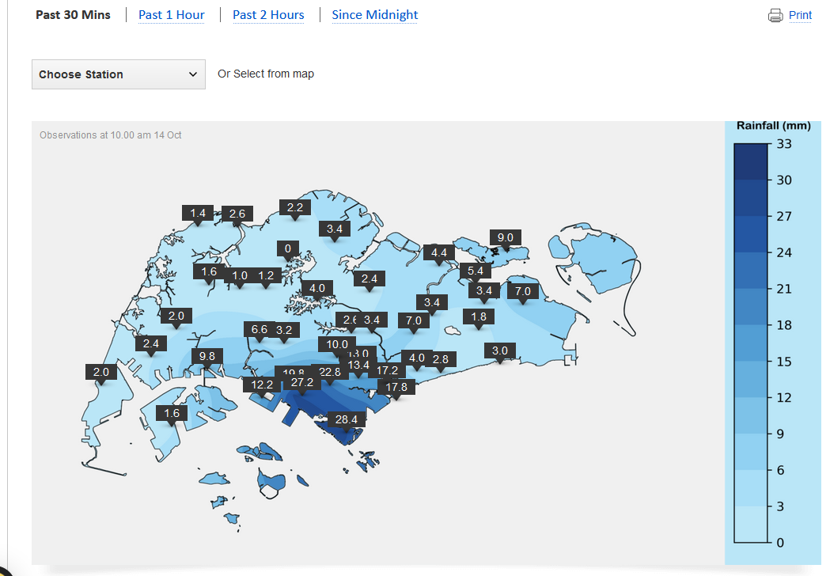
Rainfall observations, 0135-0205UTC, 14th October 2024
image courtesy NEA Singapore
Notes:
https://www.weather.gov.sg/weather-currentobservations-rainfall/

Slide 13
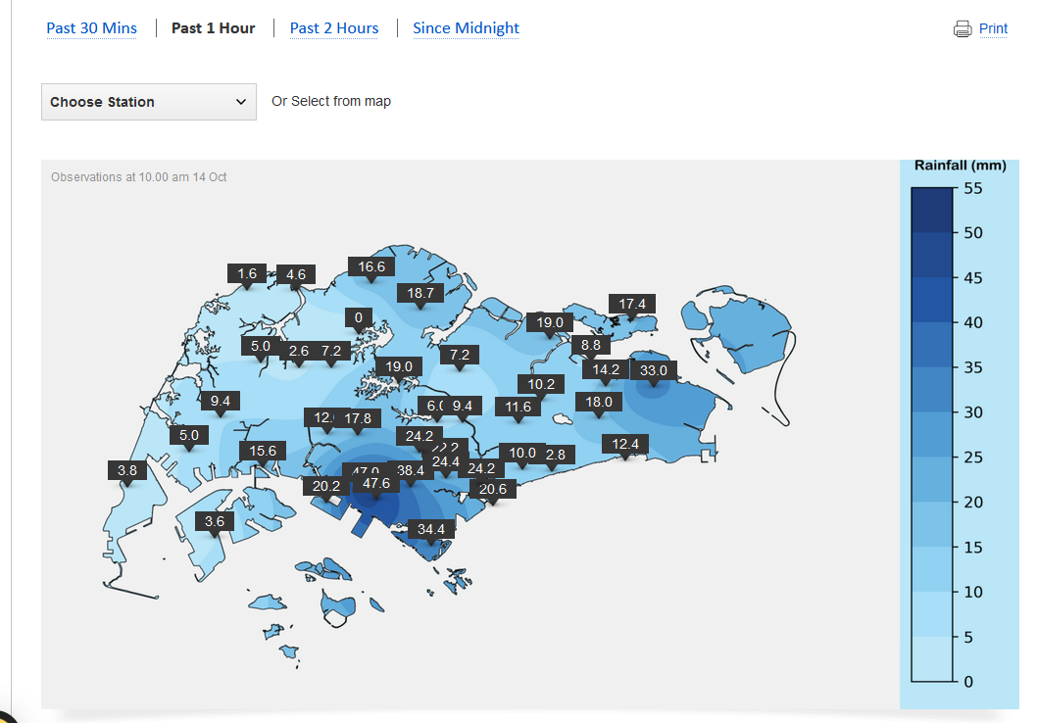
Rainfall observations, 0105-0205UTC, 14th October 2024
image courtesy NEA Singapore
Notes:
https://www.weather.gov.sg/weather-currentobservations-rainfall/

Slide 14
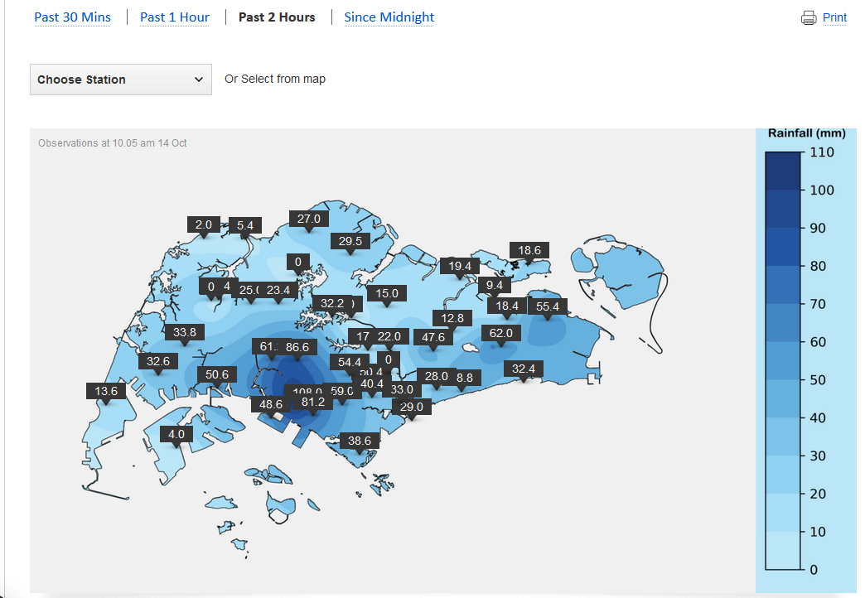
Rainfall observations, 0005-0205UTC, 14th October 2024
image courtesy NEA Singapore
Notes:
https://www.weather.gov.sg/weather-currentobservations-rainfall/

Slide 15
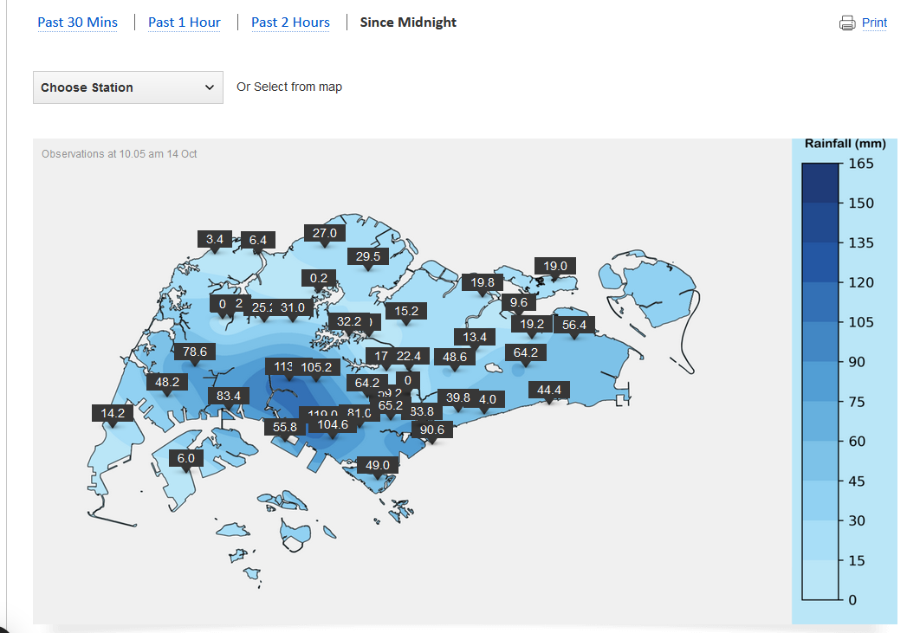
Rainfall observations, 1605-0205UTC, 14th October 2024
image courtesy NEA Singapore
Notes:
https://www.weather.gov.sg/weather-currentobservations-rainfall/

Slide 16
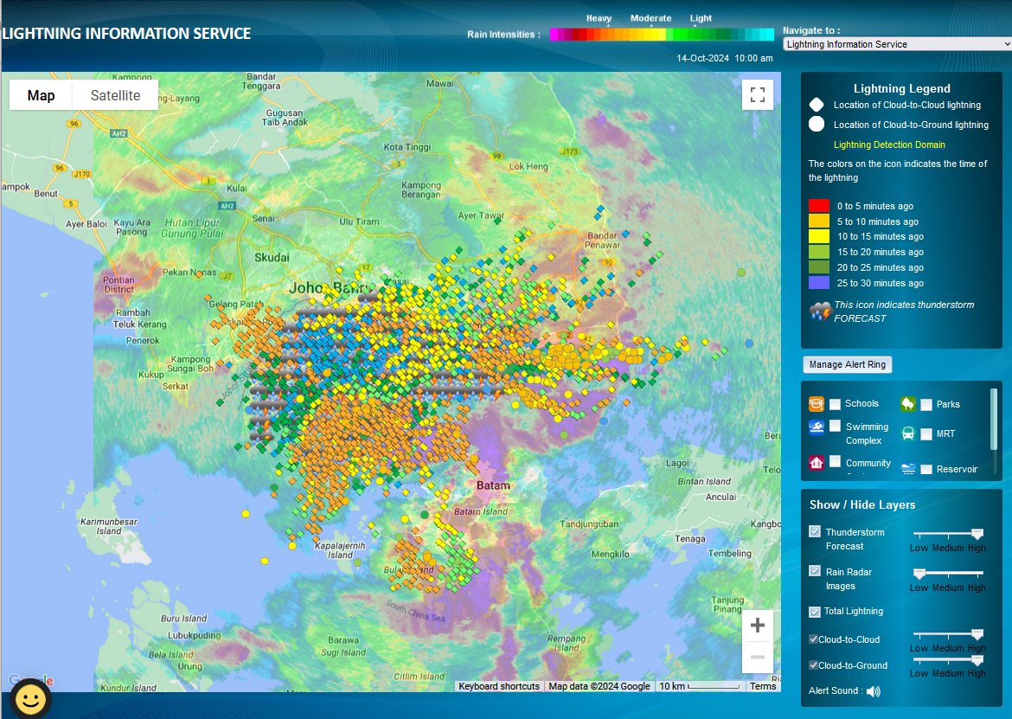
Lightning data, 0130-0200UTC 14th October 2024
image courtesy NEA Singapore

Slide 17
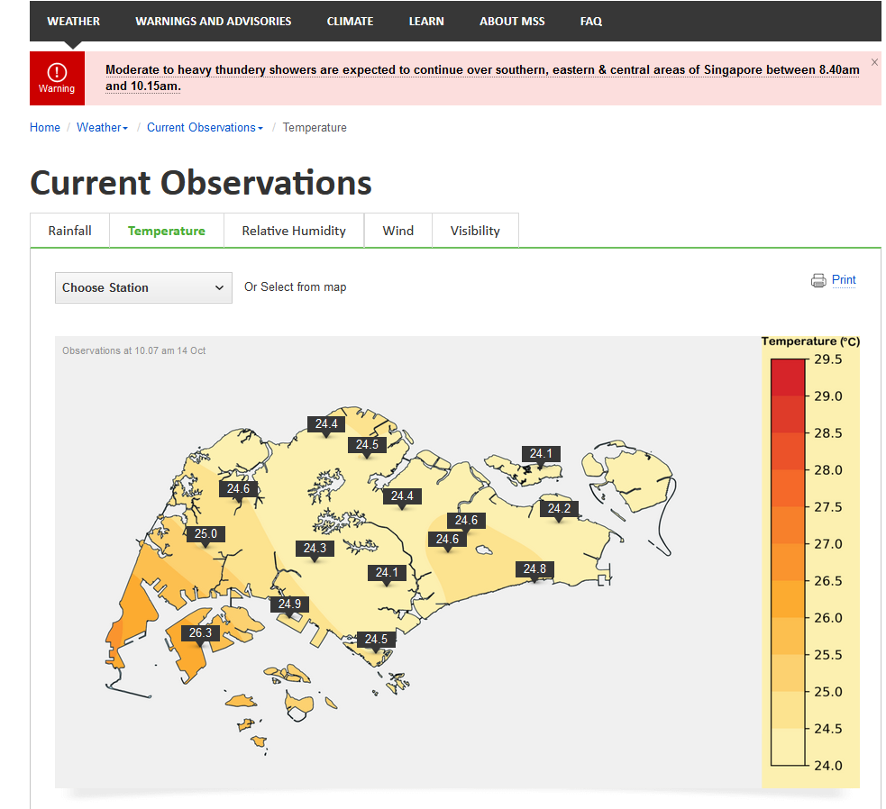
Singapore temperatures at 0207UTC 14th October 2024
images courtesy NEA Singapore

Slide 18
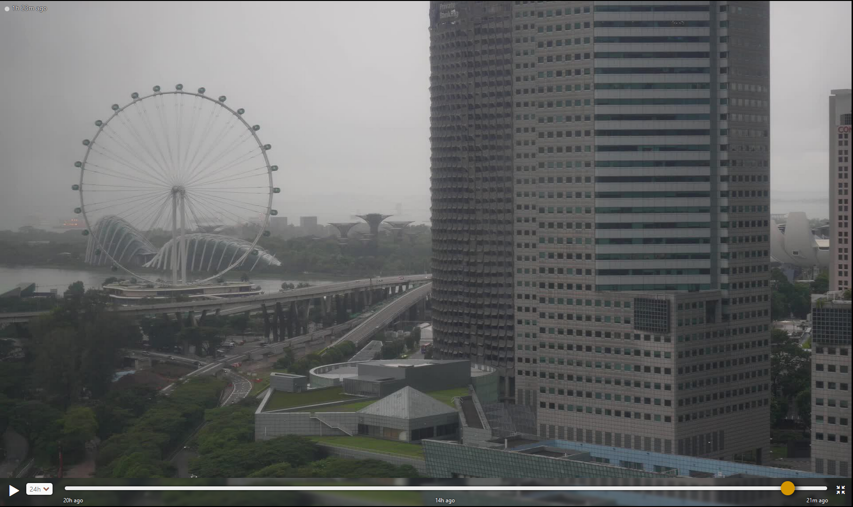
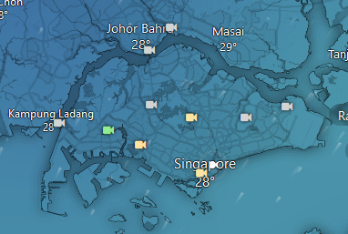
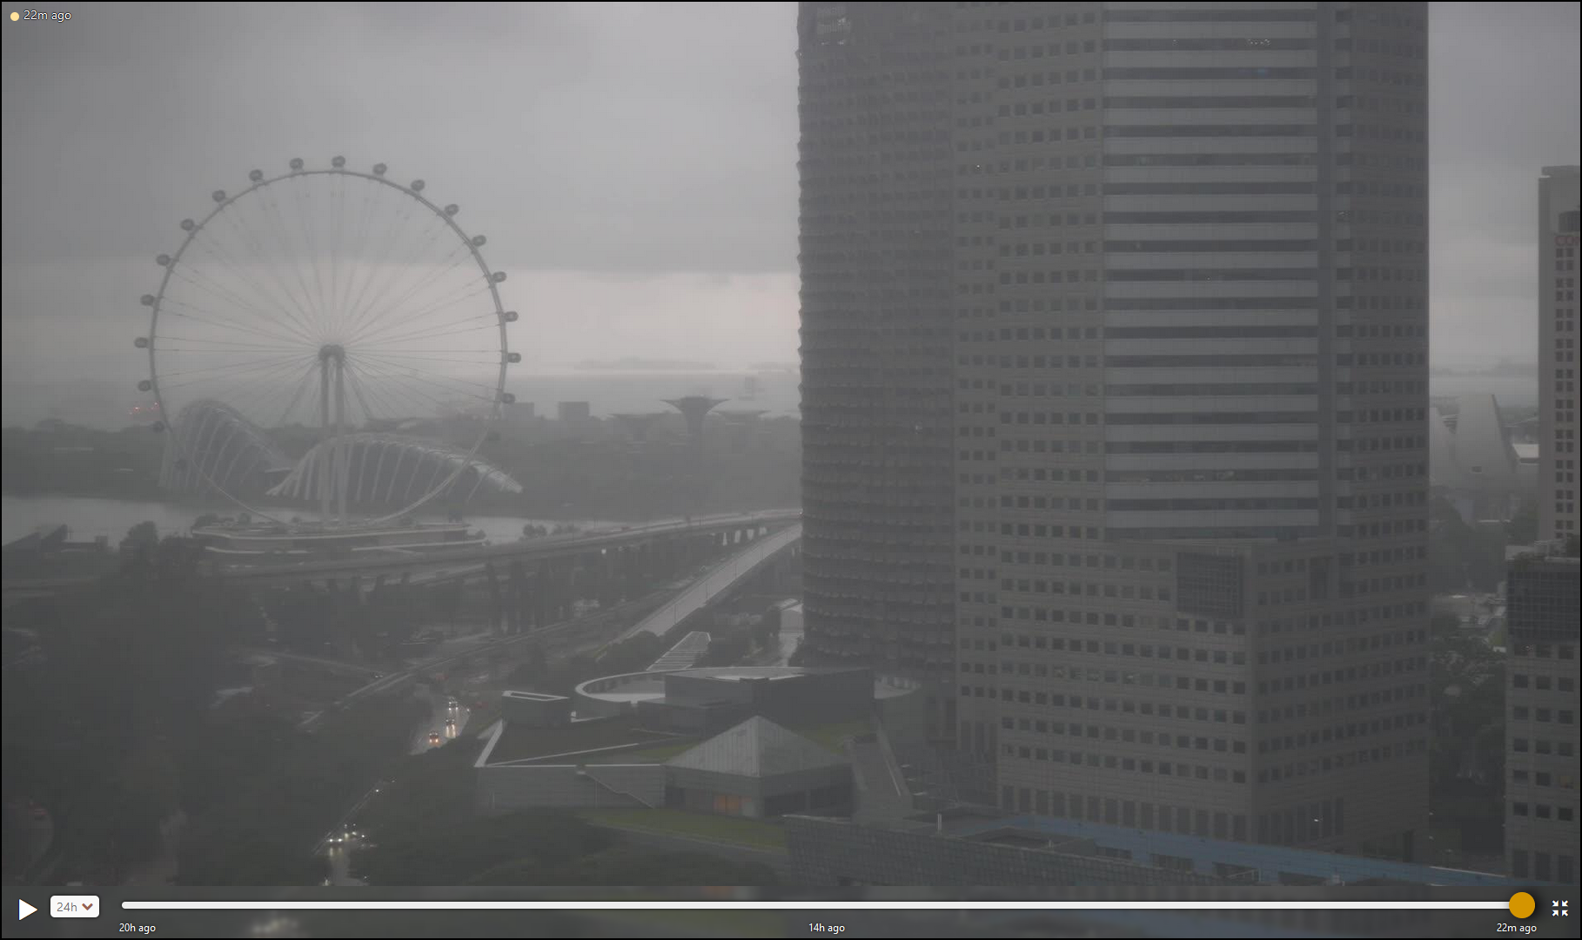
Webcam view from Marina Centre, Singapore
01UTC
images courtesy windy.com
Webcam images at 1.23pm Melbourne time, 14th October 2024
02UTC
Notes:
https://www.windy.com/-Webcams-Singapore/webcams/1676831781?1.289,103.865,10

Slide 19
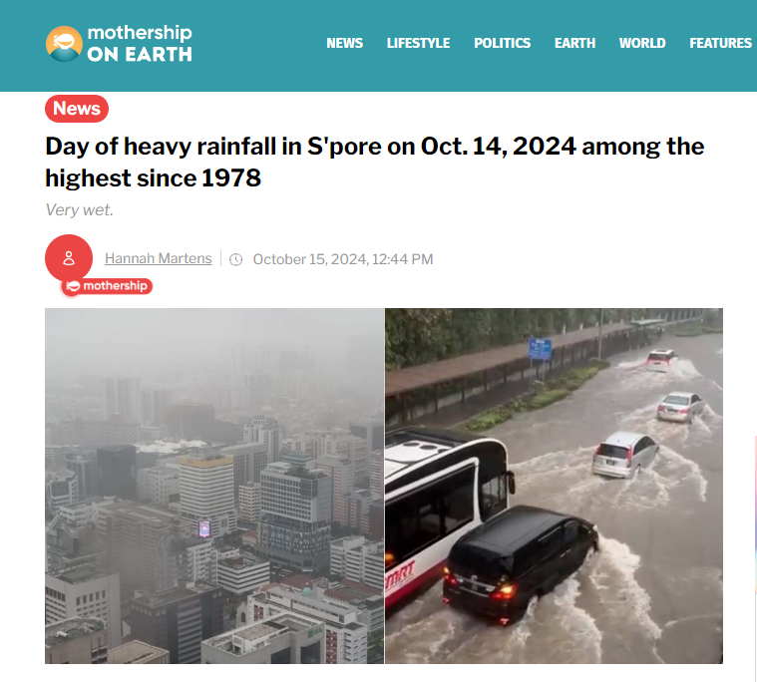
Impact of the Singapore Flooding Event
image courtesy "mothership ON EARTH", recommended by Madeline Ang

Slide 20
Impact of the Singapore Flooding Event
"According to PUB, 134.8mm of rainfall was recorded in western Singapore from 8:15am to 1:50pm, which is among the highest recorded in over 40 years."
"This corresponds to 80 per cent of Singapore's average monthly rainfall in October and is within the top one per cent of maximum daily rainfall records since 1978."
"Due to high water levels in the adjacent drains and Bukit Timah Canal, the pedestrian sidewalks and bus stops along Dunearn Road were flooded. However, PUB stated the floodwaters subsided within 20 minutes."
"Several TikTok videos captured the Bukit Timah area submerged in murky waters."
"The road markings on all lanes could not be seen due to the knee-deep waters at times."
"Pedestrians had to stand on the benches at the bus stop."
"Buses and cars were also partially submerged but still moving through the waters."
image courtesy "mothership ON EARTH", recommended by Madeline Ang

