Slide 1
Indonesian VLab Centre of Excellence Regional Focus Group meeting, 02UTC XX Sept 2024
Contents
Topic 1: presenter 1.
Topic 2: presenter 2.
Utilization of Satellite Meteorology for Marine Weather Operations: presenter Bodo Zeschke, Australian Bureau of Meteorology.

Slide 2
Background info from James Taylor
Players involved event writeup - Ben Hague, Isabela, Dom, Yuelong....
https://bom365.sharepoint.com/:o:/r/sites/Coastal_Hazard_Services/publicfiles/Verification%20Onenote%20-%20CH%20and%20Marine?d=w3536f703f0b9499d908a16b3c5f9fa8b&csf=1&web=1&e=VGB9N3

Slide 3
Structuring this according to a previous VLab marine case study

Slide 4
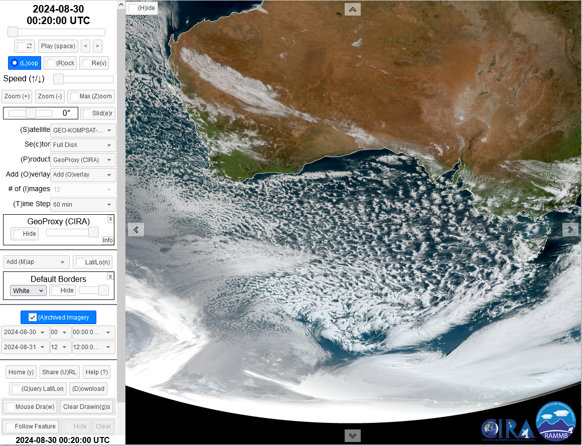
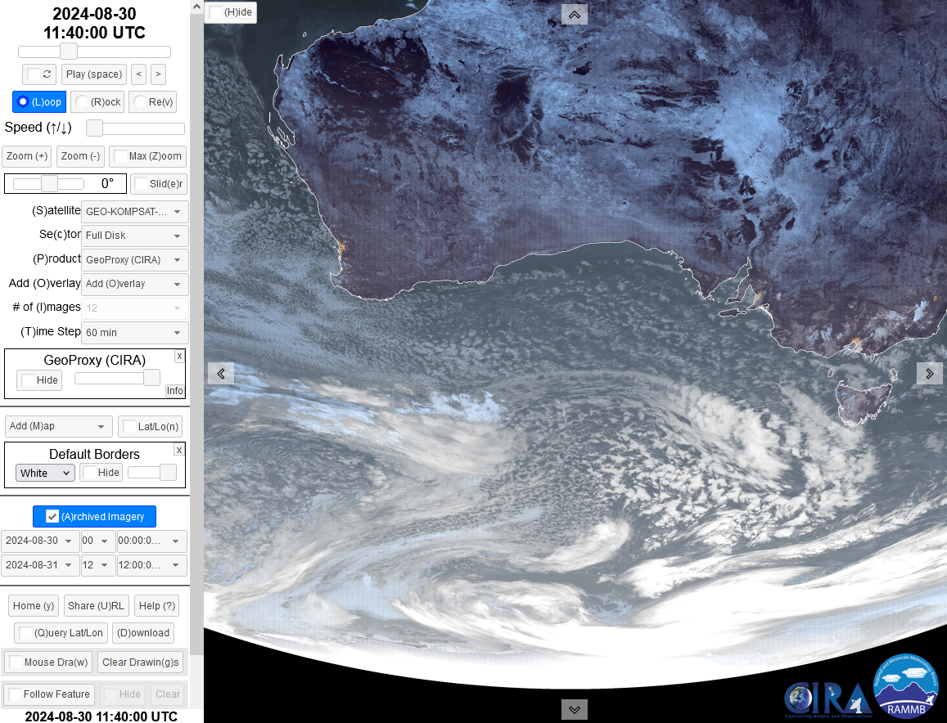
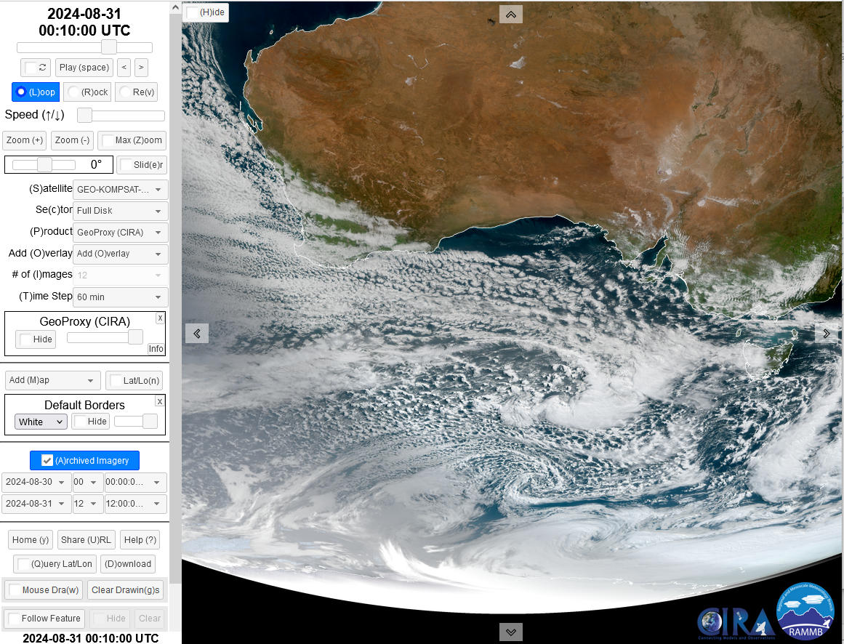
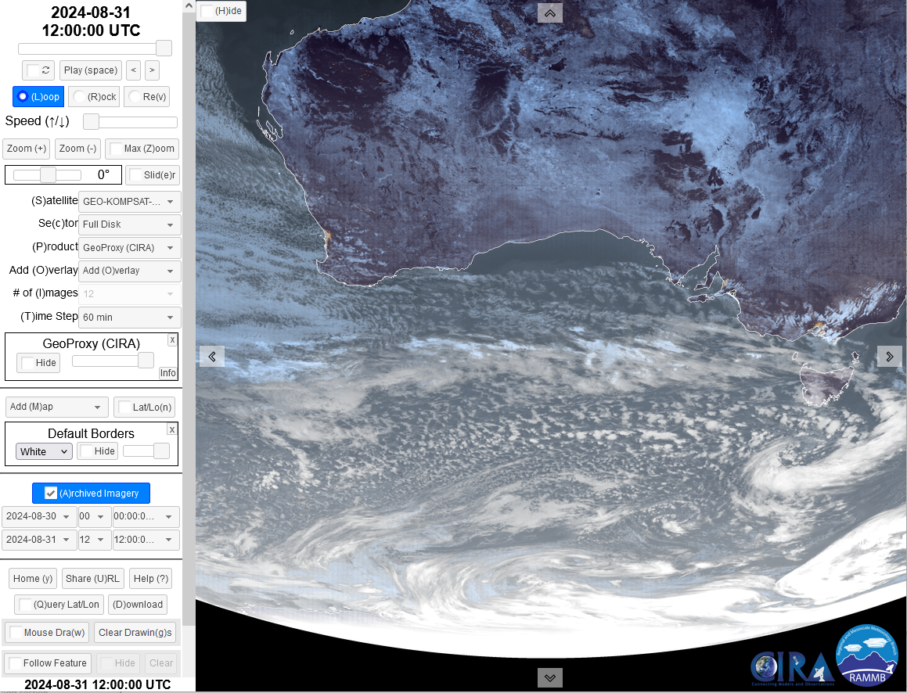
The broadscale / synoptic view, 30-31st August 2024 Showcasing GeoProxy imagery from the GEO-KOMPSAT-2A satellite (CIRA SLIDER)
images courtesy CIRA/RAMMB
0020UTC
30th Aug 2024
1140UTC
30th Aug 2024
0010UTC
31st Aug 2024
1200UTC
31st Aug 2024
Notes:
https://rammb-slider.cira.colostate.edu/

Slide 5
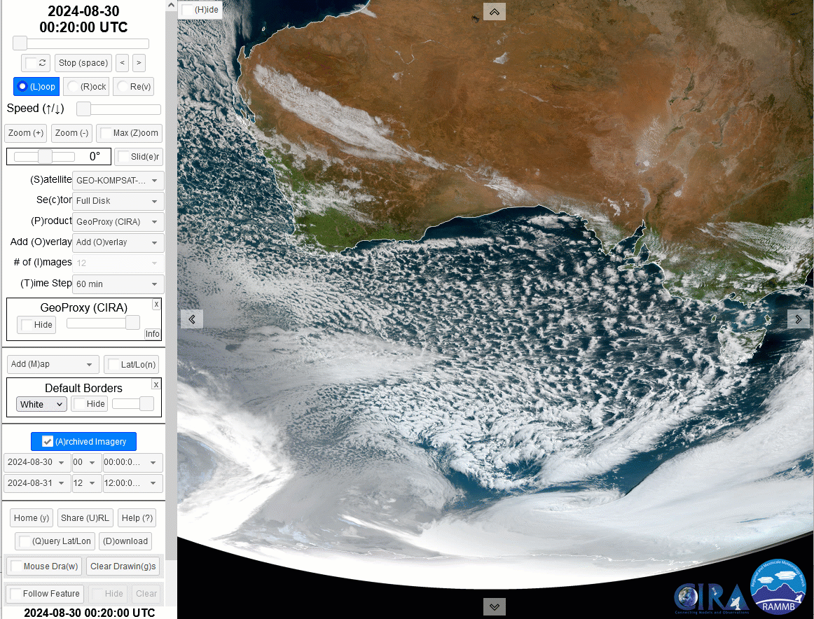
The broadscale / synoptic view, 30-31st August 2024 Showcasing GeoProxy imagery from the GEO-KOMPSAT-2A satellite (CIRA SLIDER)
animation courtesy CIRA/RAMMB
Australia
Tasmania
Notes:
https://rammb-slider.cira.colostate.edu/

Slide 6
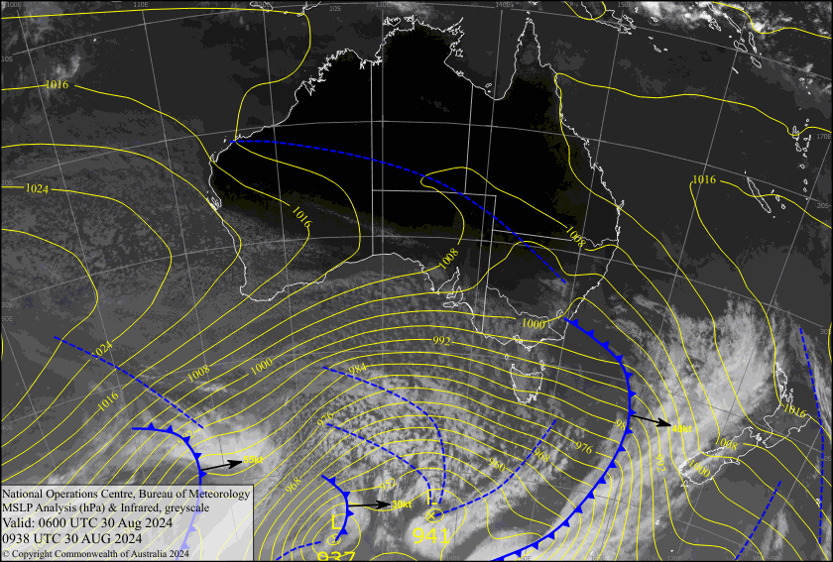
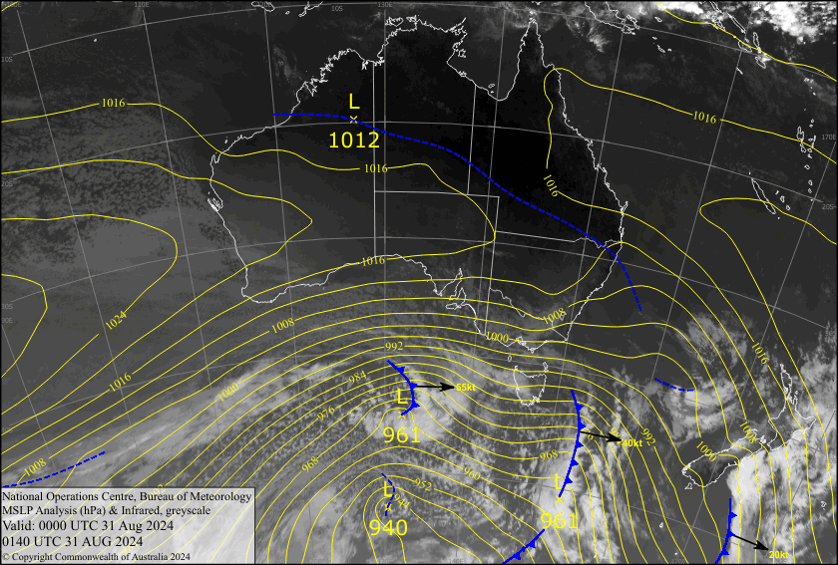
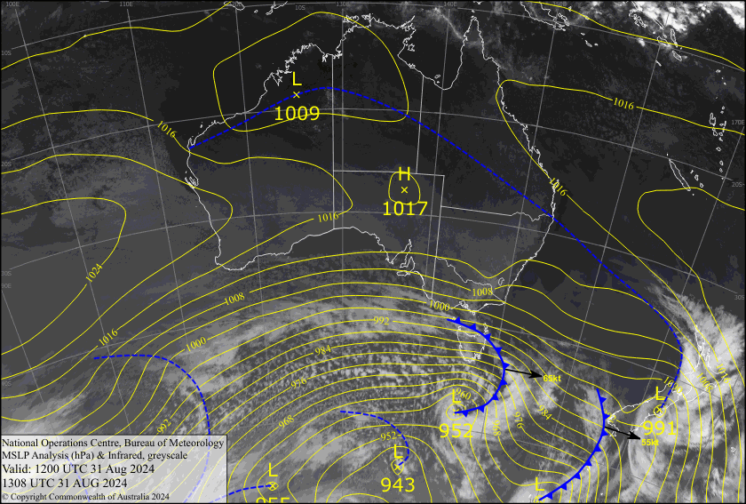
MSLP / Himawari-9 Band 13 images, 00UTC 30th to 12UTC 31st August 2024
00UTC 30th Aug 2024
12UTC 30th Aug 2024
Australia
Tasmania
00UTC 30th Aug 2024
12UTC 30th Aug 2024
Images courtesy Bureau of Meteorology
Notes:
http://bnoc-aifs-op.bom.gov.au/images/osa/month.html

Slide 7
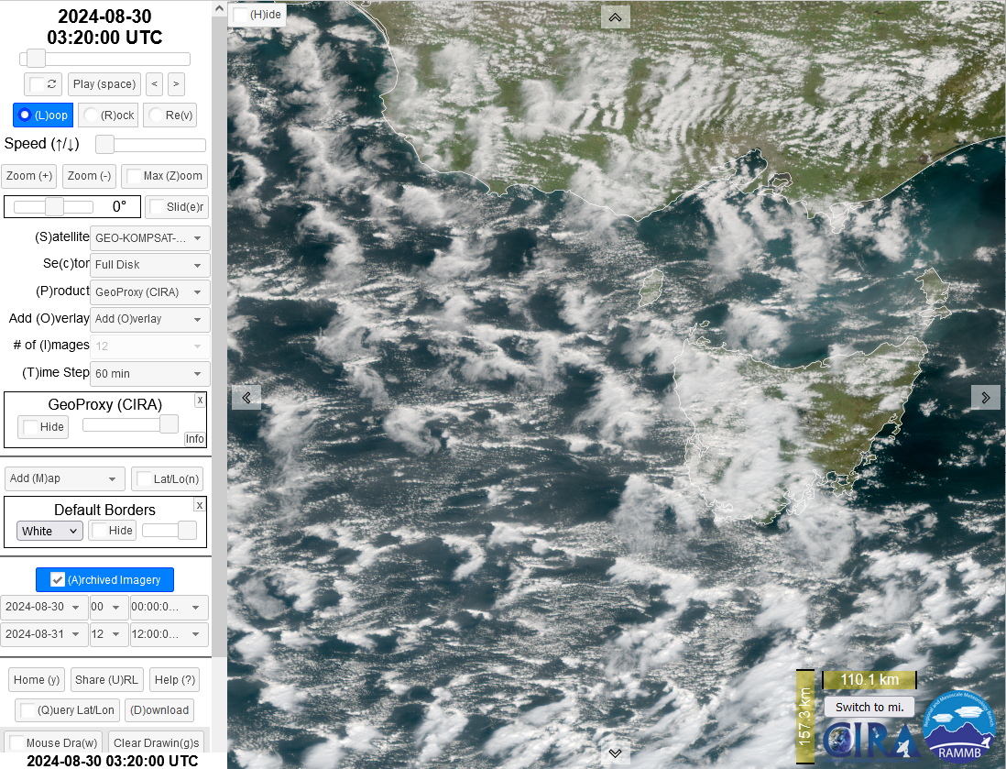
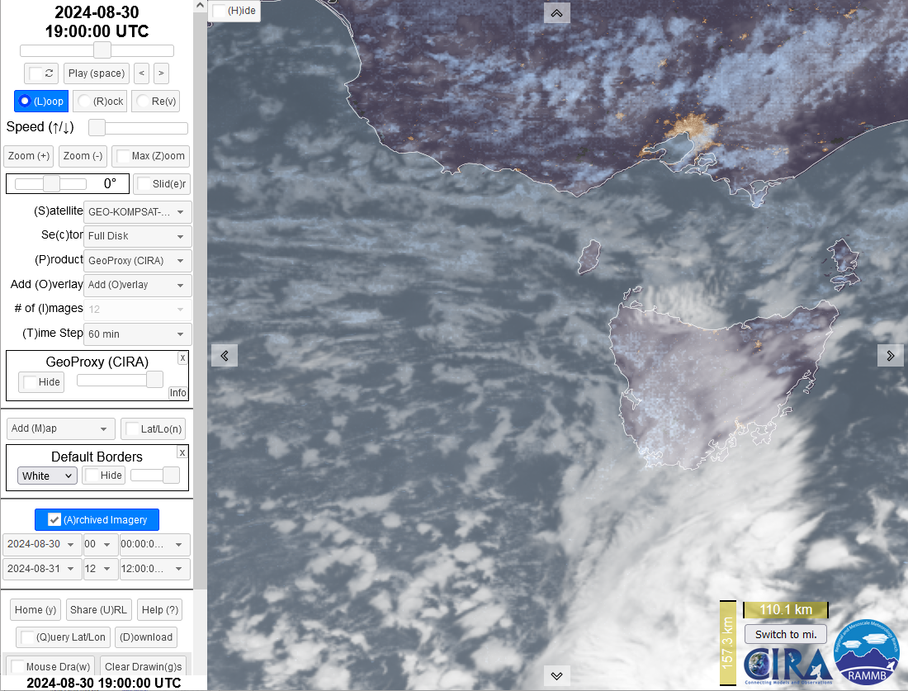
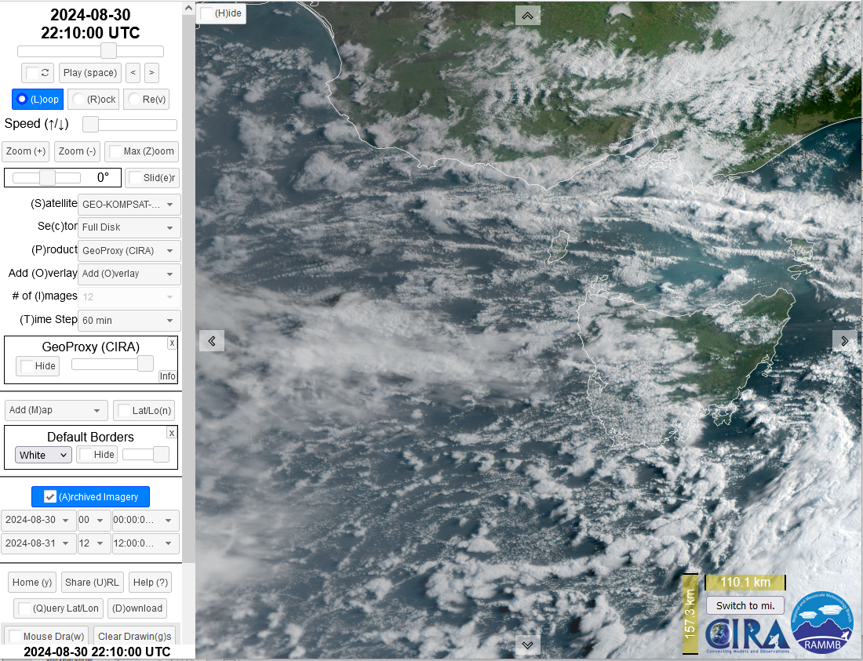
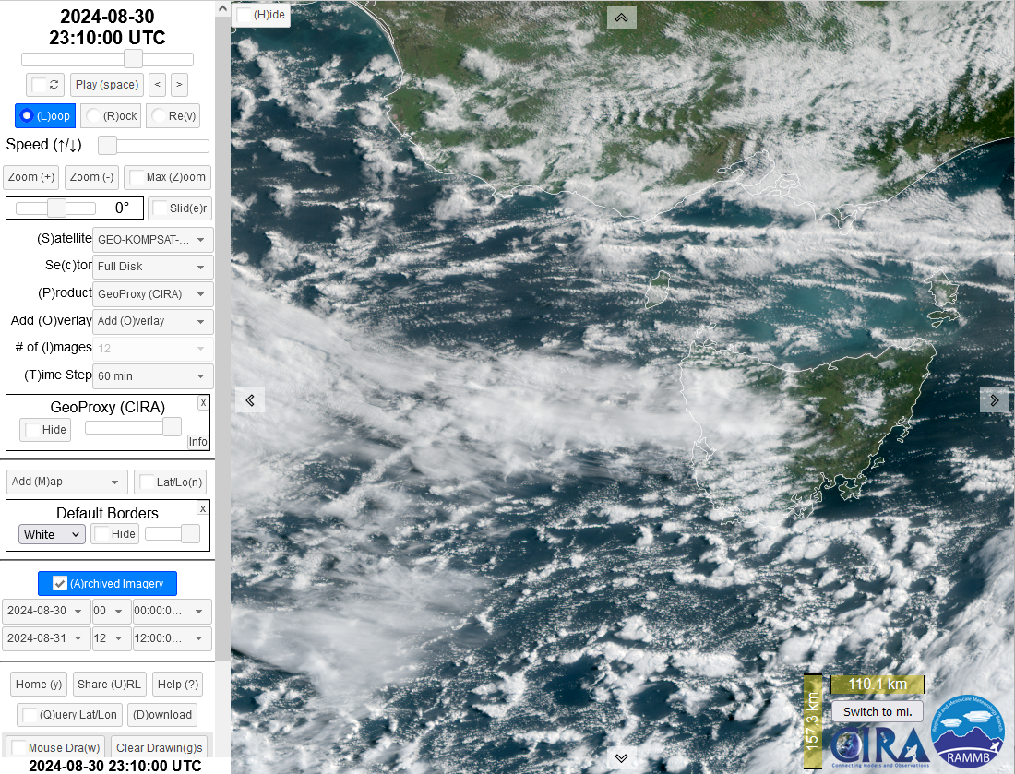
Consider deformation of open cell cumulus cloud as an indicator of significant boundary layer windspeed.
images courtesy CIRA/RAMMB
0320UTC 30th Aug 2024
1900UTC 30th Aug 2024
Tasmania
2210UTC 30th Aug 2024
2310UTC 30th Aug 2024

Slide 8
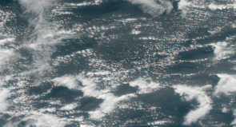
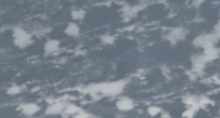
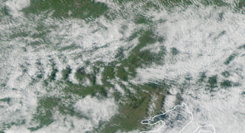
Consider deformation of open cell cumulus cloud as an indicator of significant boundary layer windspeed.
images courtesy CIRA/RAMMB
0320UTC 30th Aug 2024
1900UTC 30th Aug 2024
Tasmania
2210UTC 30th Aug 2024
2310UTC 30th Aug 2024

Slide 9
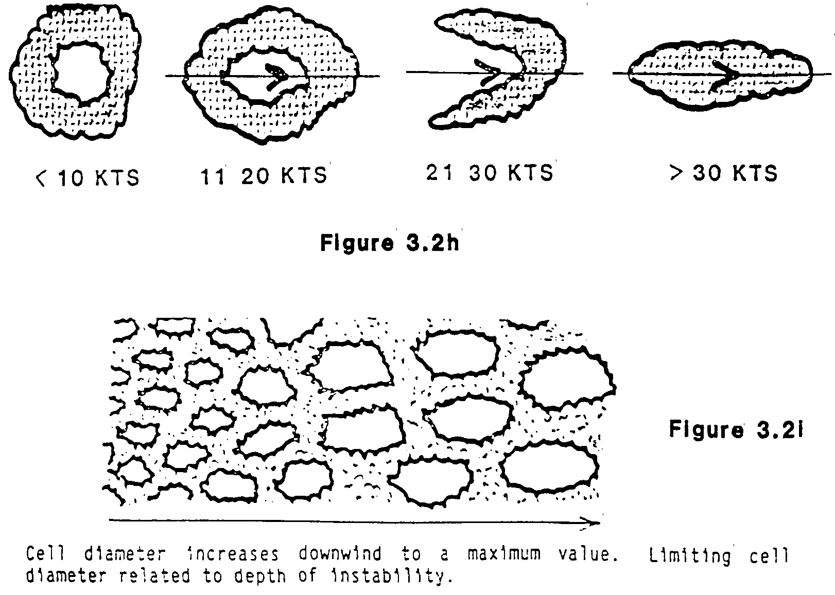
Cloud cells and boundary layer wind / instability
Wind strength
dictates cell shape
Instability depth
dictates size
9

Slide 10
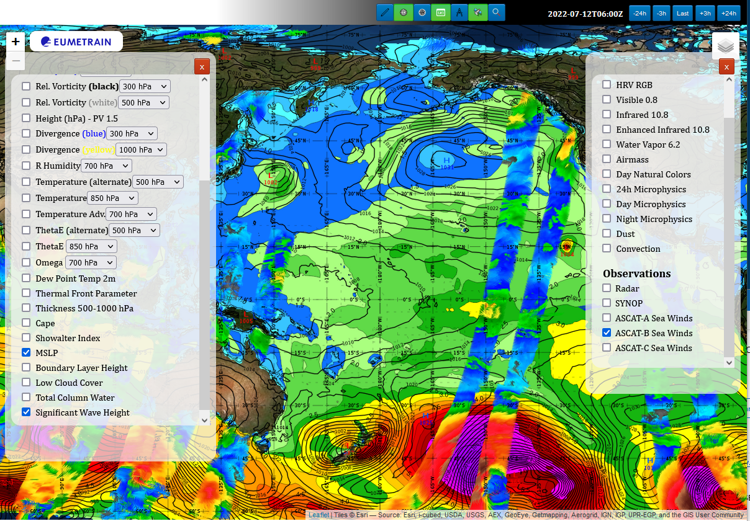
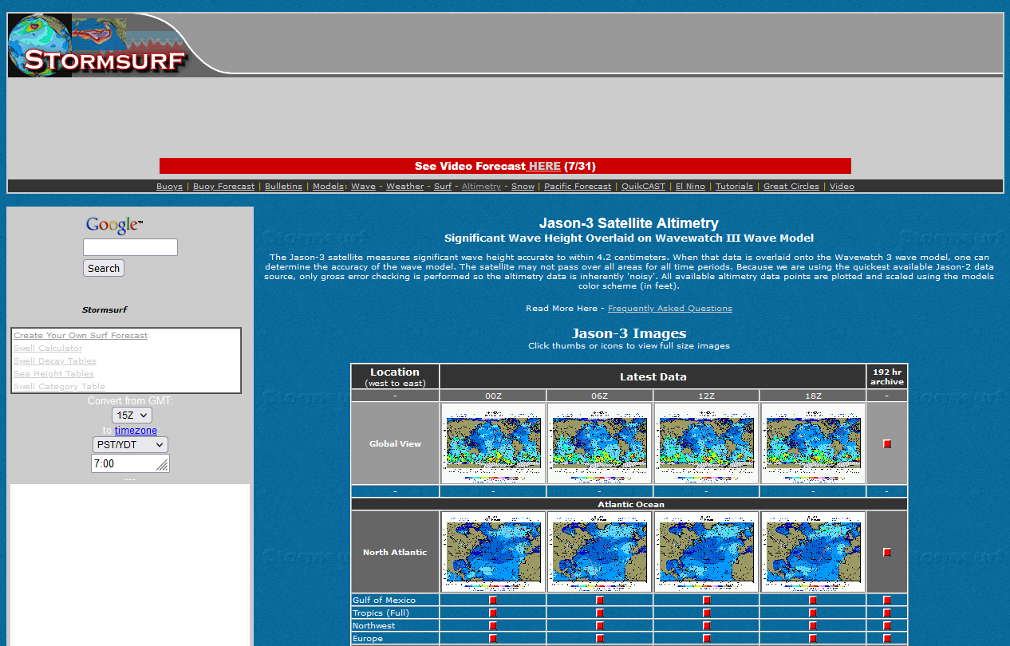
Introducing additional data for information about seas and winds
EUMETRAIN Map Viewer
http://resources.eumetrain.org/ePort_MapViewer/index.html
Stormsurf Web Page
http://www.stormsurf.com/mdls/menu_alt.html
Does this web page have an archive?

Slide 11
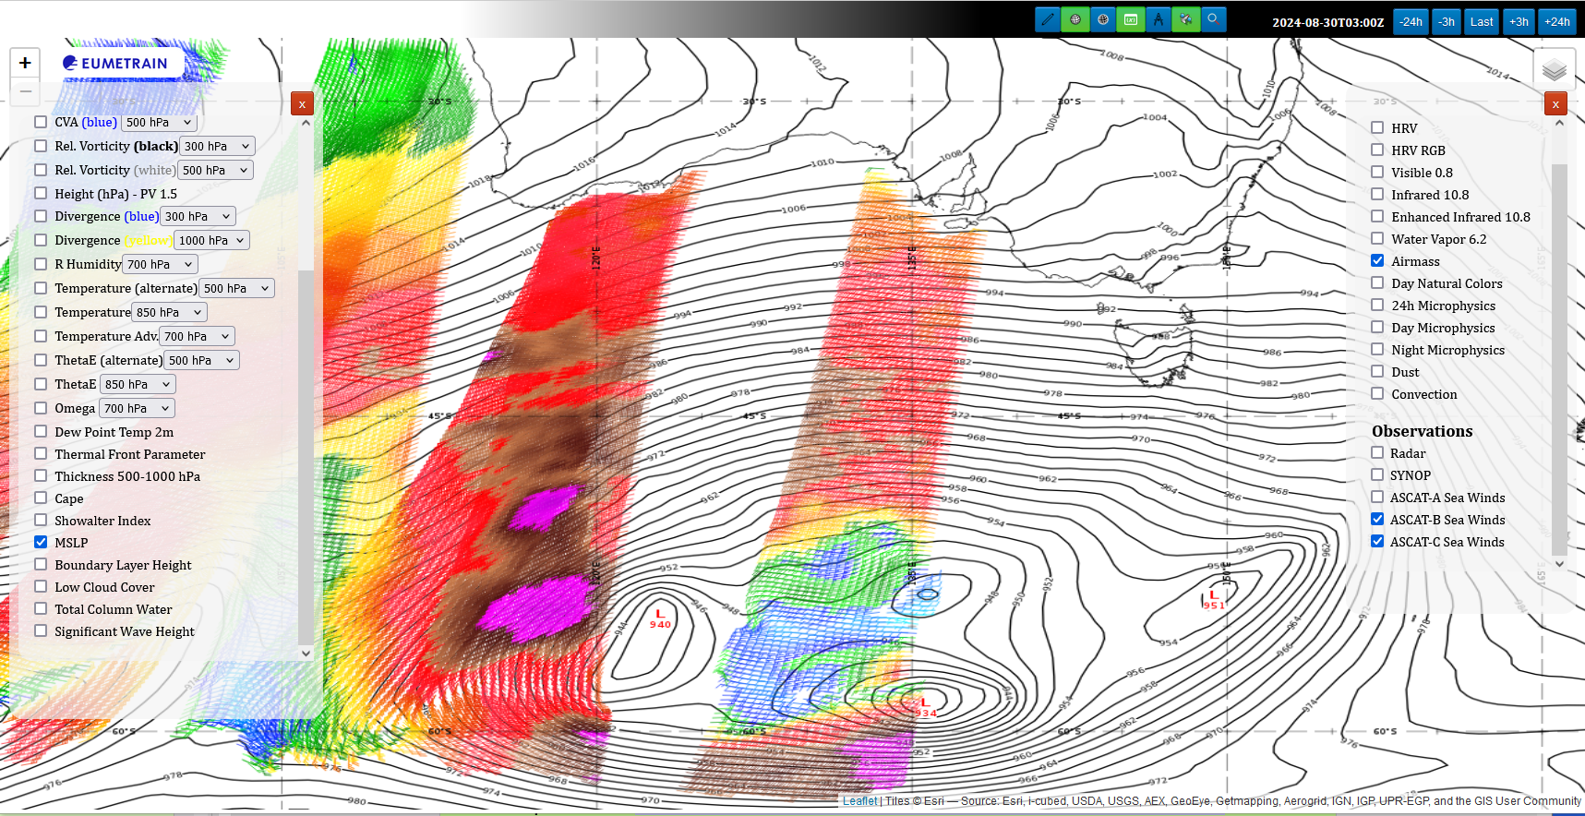
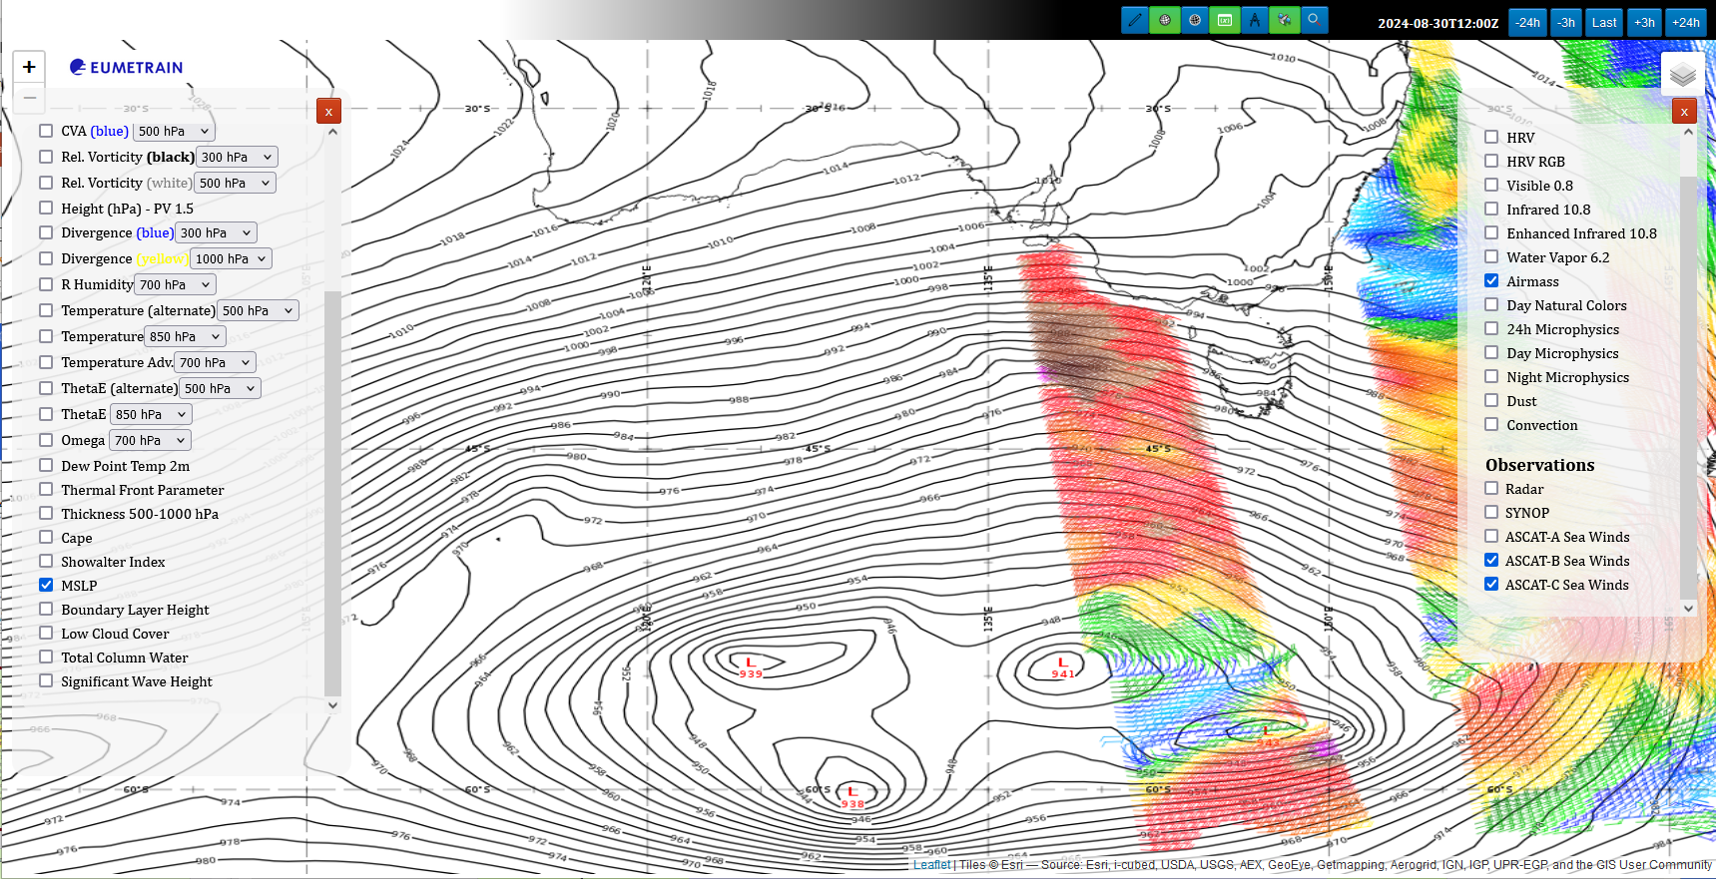
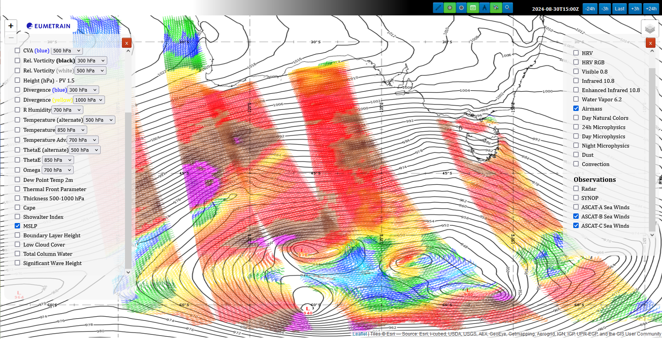
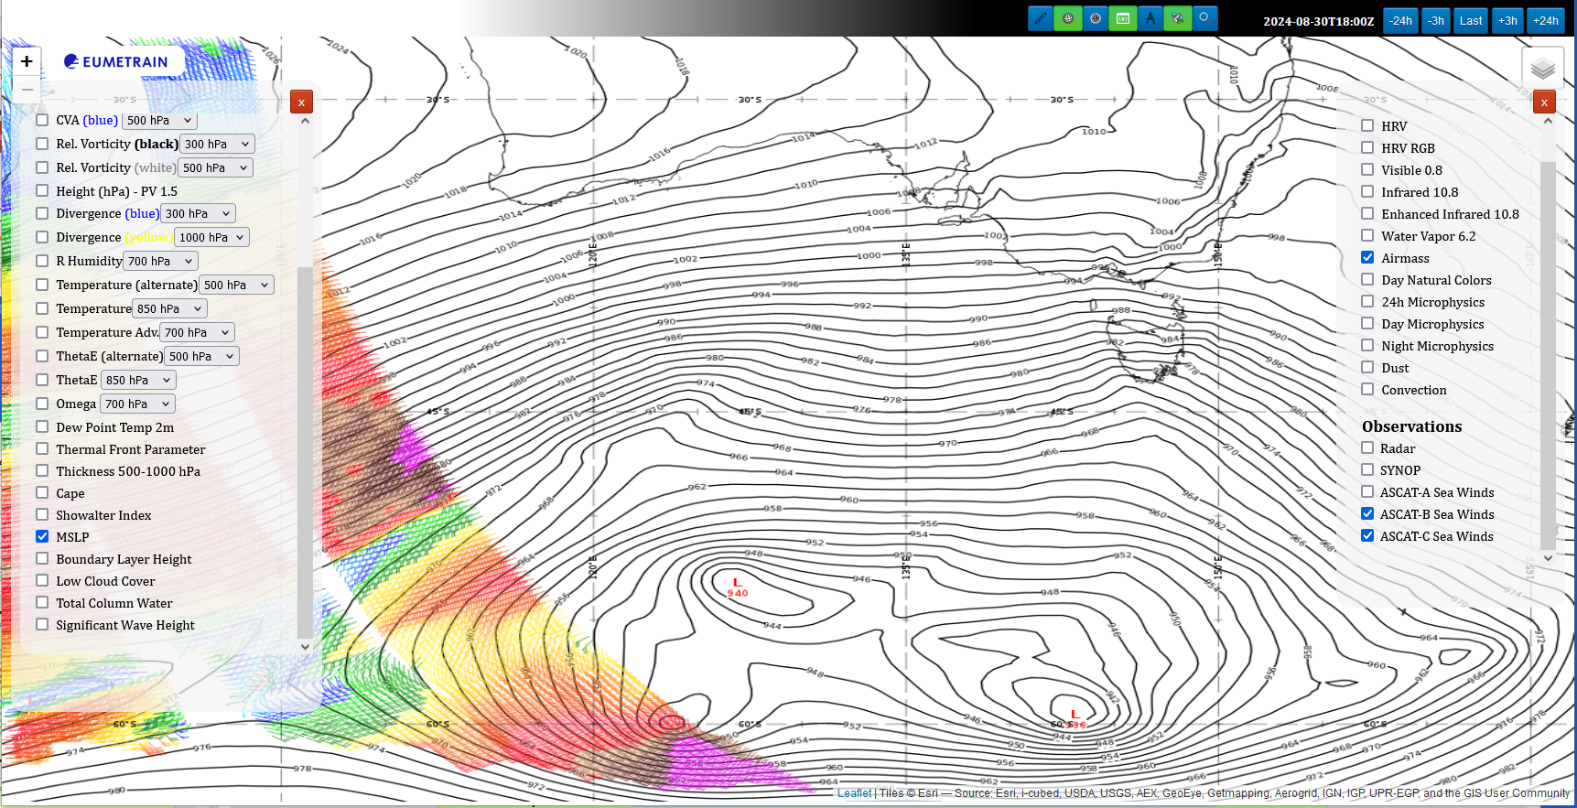
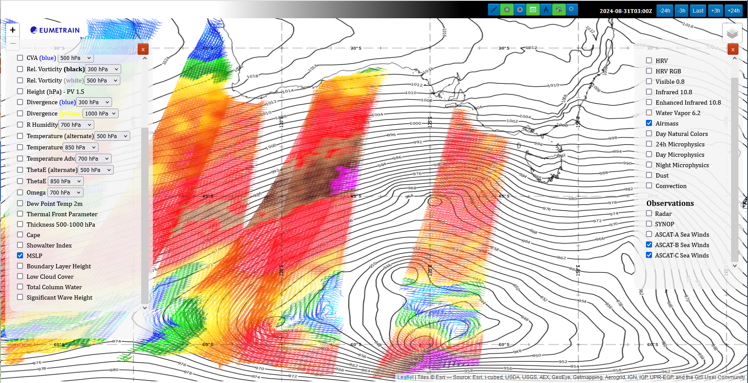
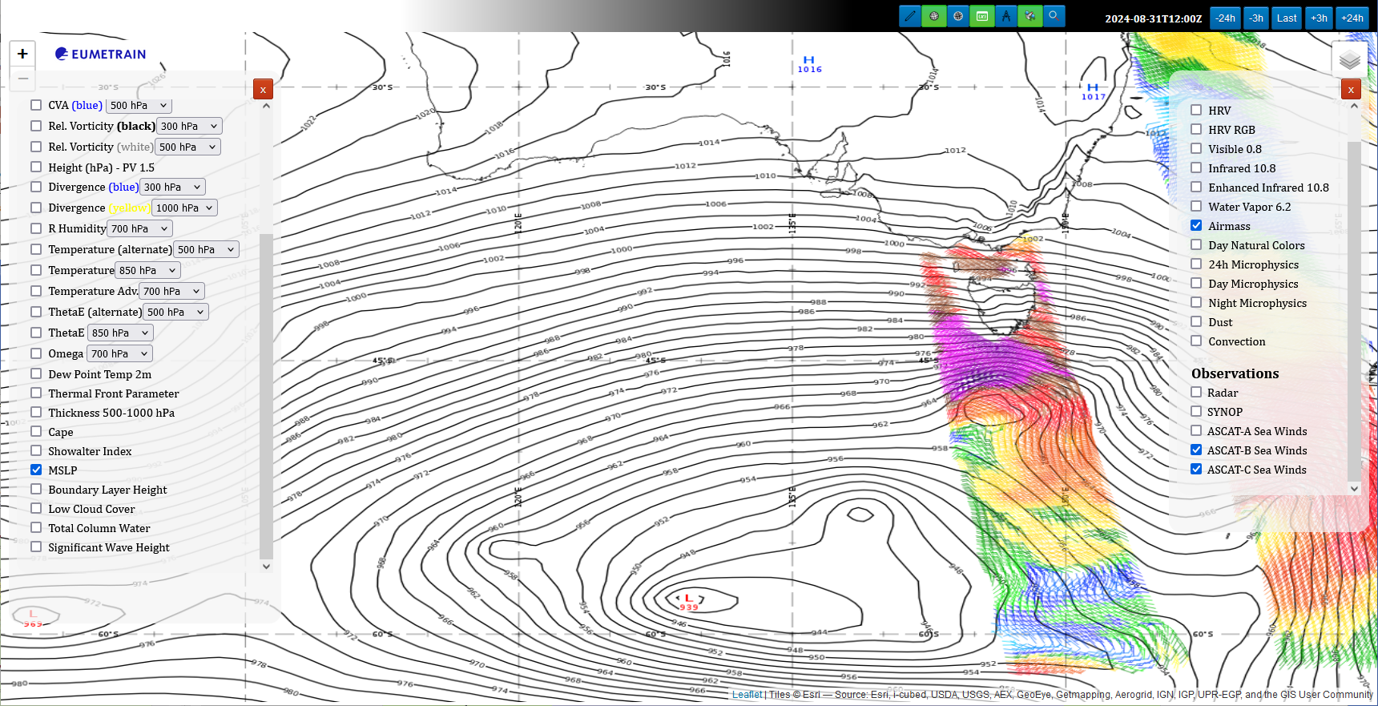
ASCAT B and C surface winds and ECMWF MSLP
images courtesy EUMETRAIN
03UTC 30th Aug 2024
12UTC 30th Aug 2024
15UTC 30th Aug 2024
18UTC 30th Aug 2024
Tasmania
03UTC 31st Aug 2024
12UTC 31st Aug 2024
Notes:
http://resources.eumetrain.org/ePort_MapViewer/index.html

Slide 12
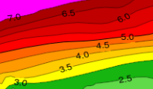
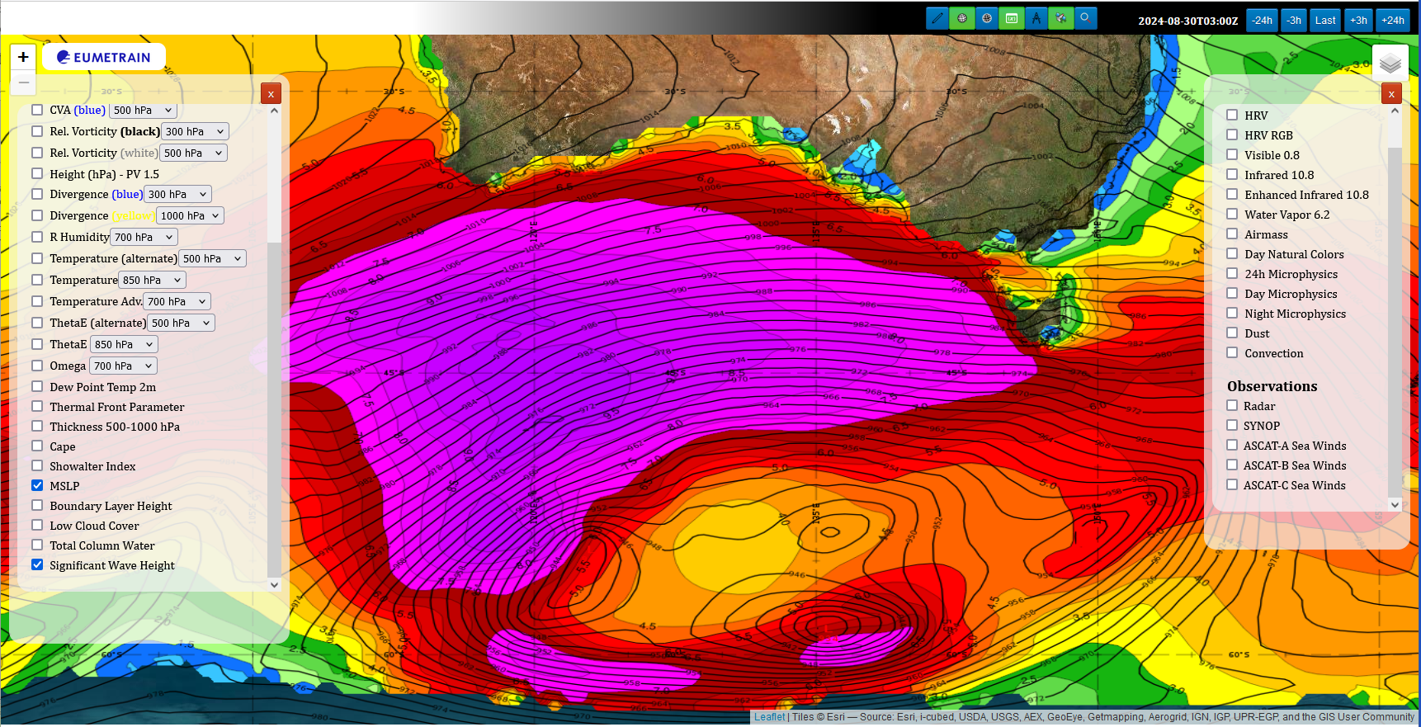
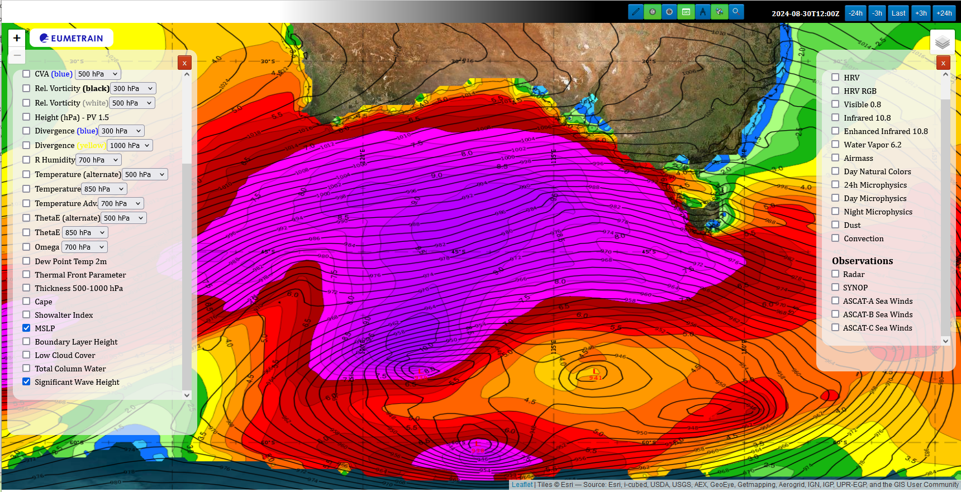
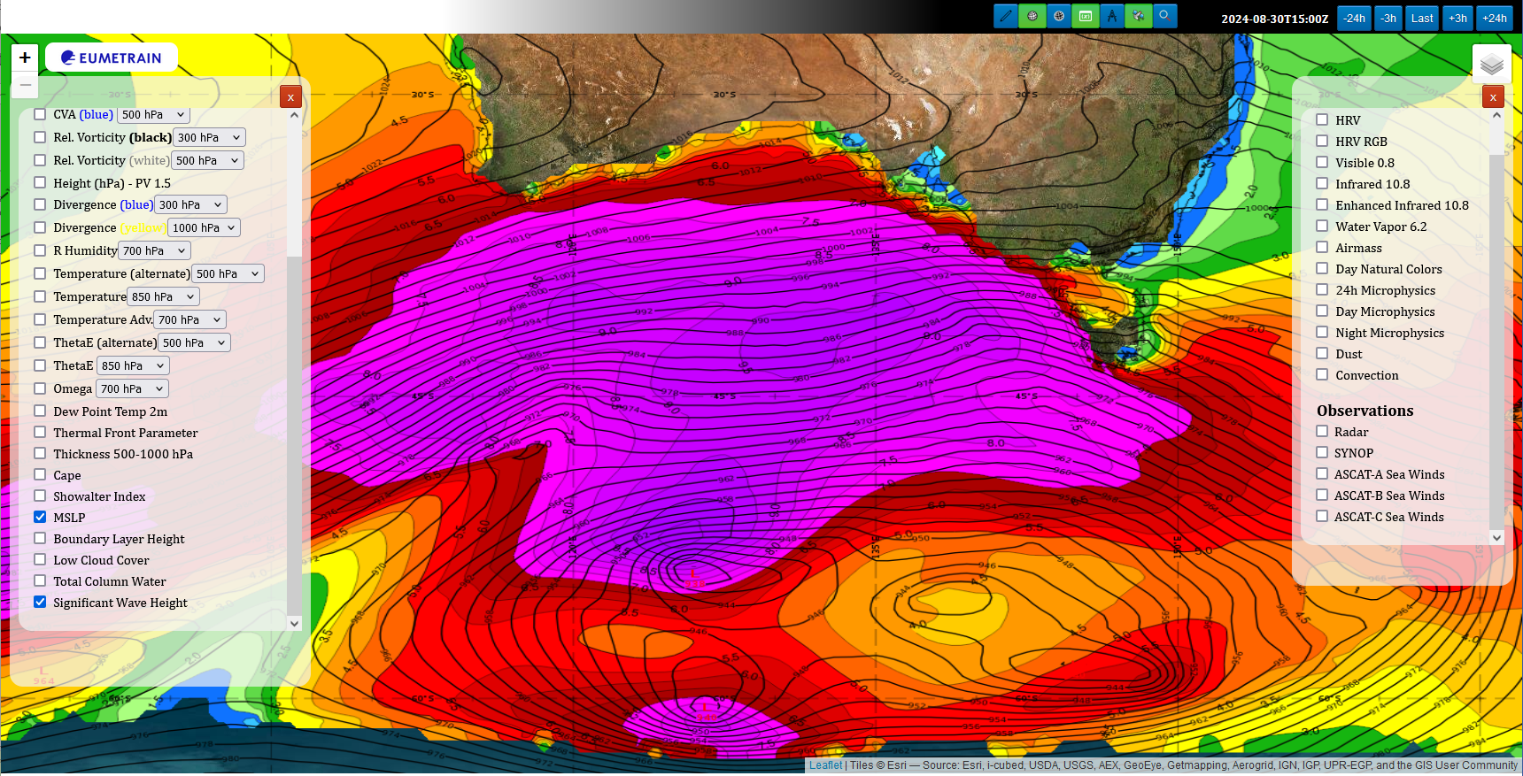
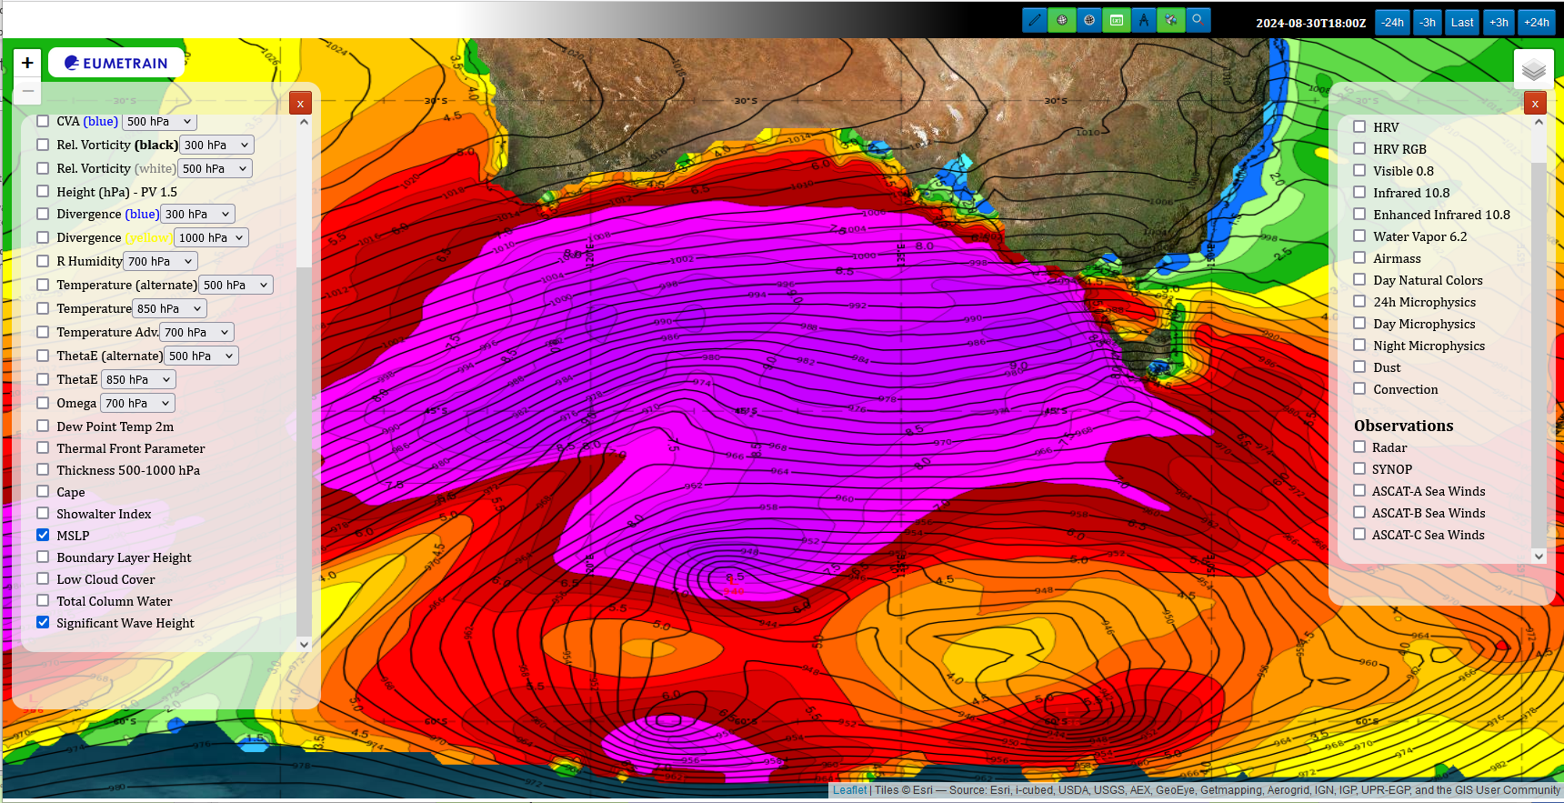
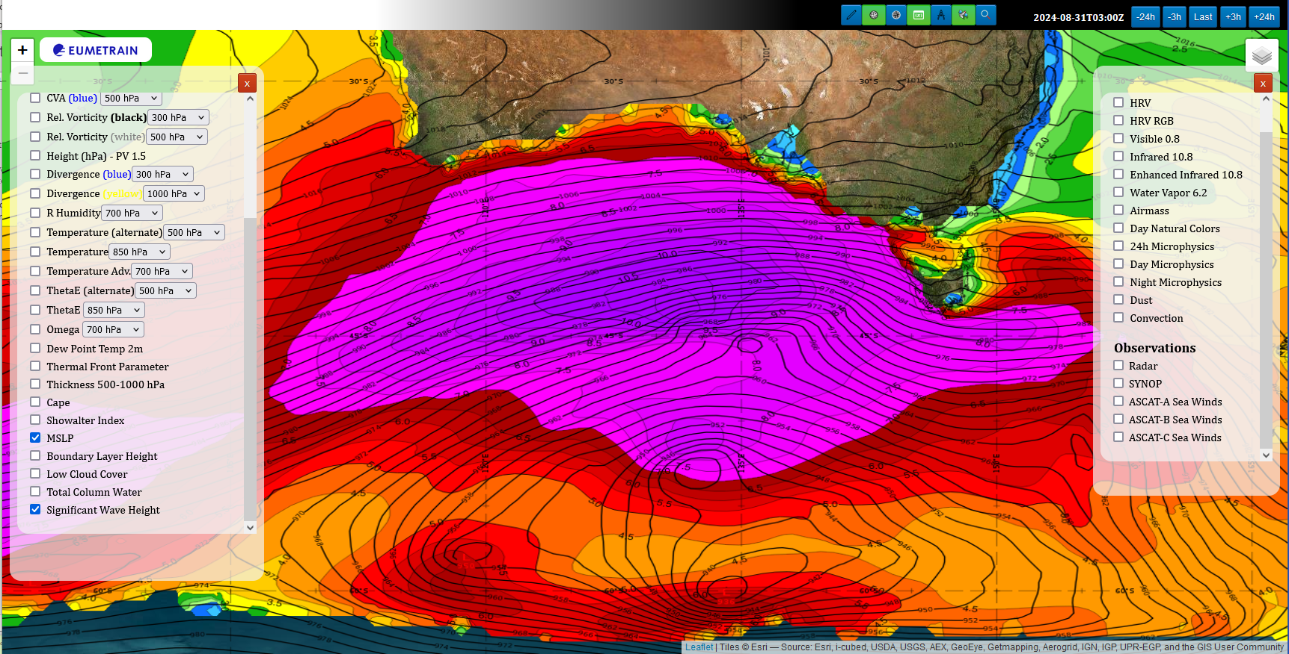
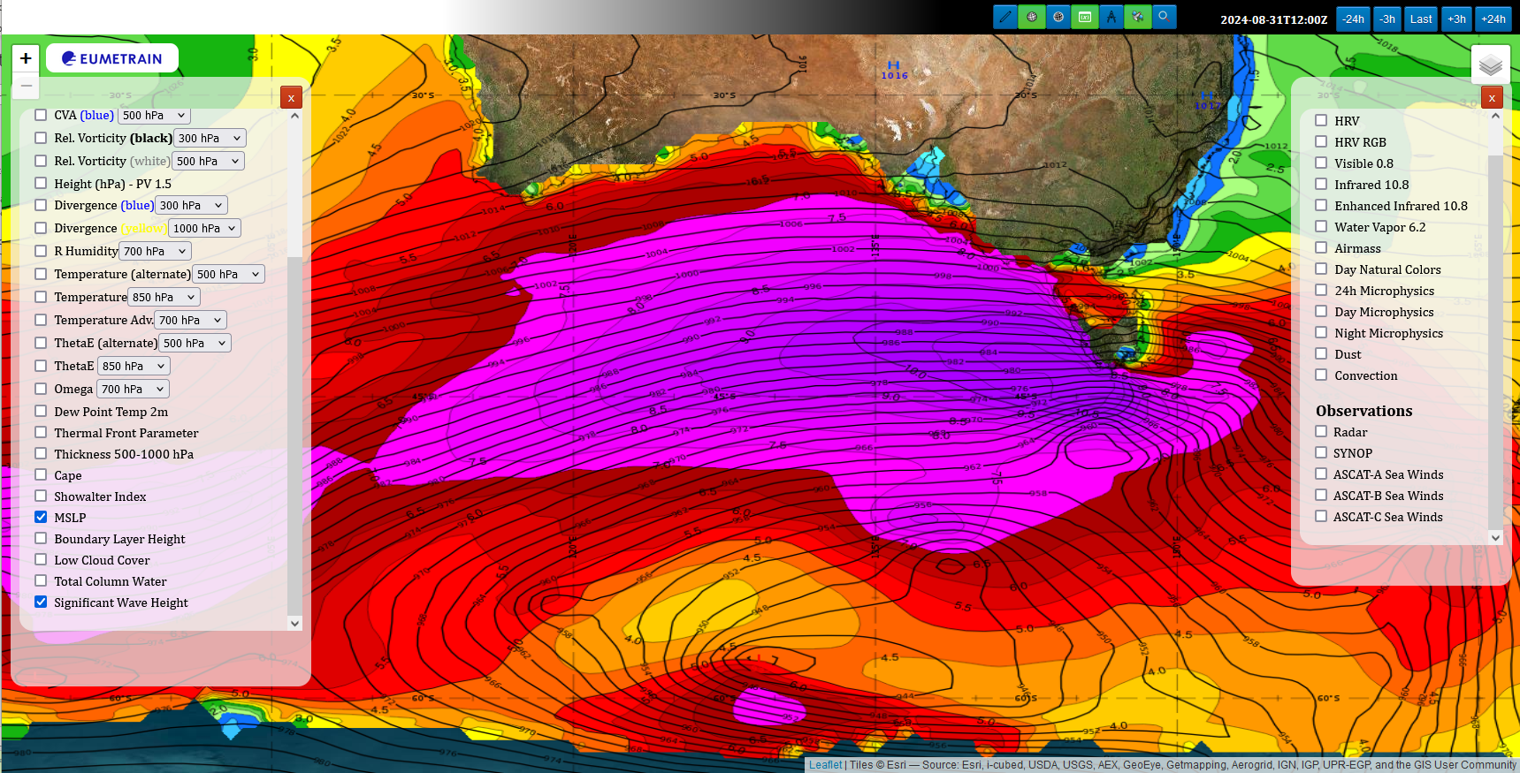
ECMWF Significant Wave Height and MSLP
images courtesy EUMETRAIN
03UTC 30th Aug 2024
12UTC 30th Aug 2024
15UTC 30th Aug 2024
18UTC 30th Aug 2024
Tasmania
03UTC 31st Aug 2024
12UTC 31st Aug 2024
Notes:
http://resources.eumetrain.org/ePort_MapViewer/index.html

Slide 13
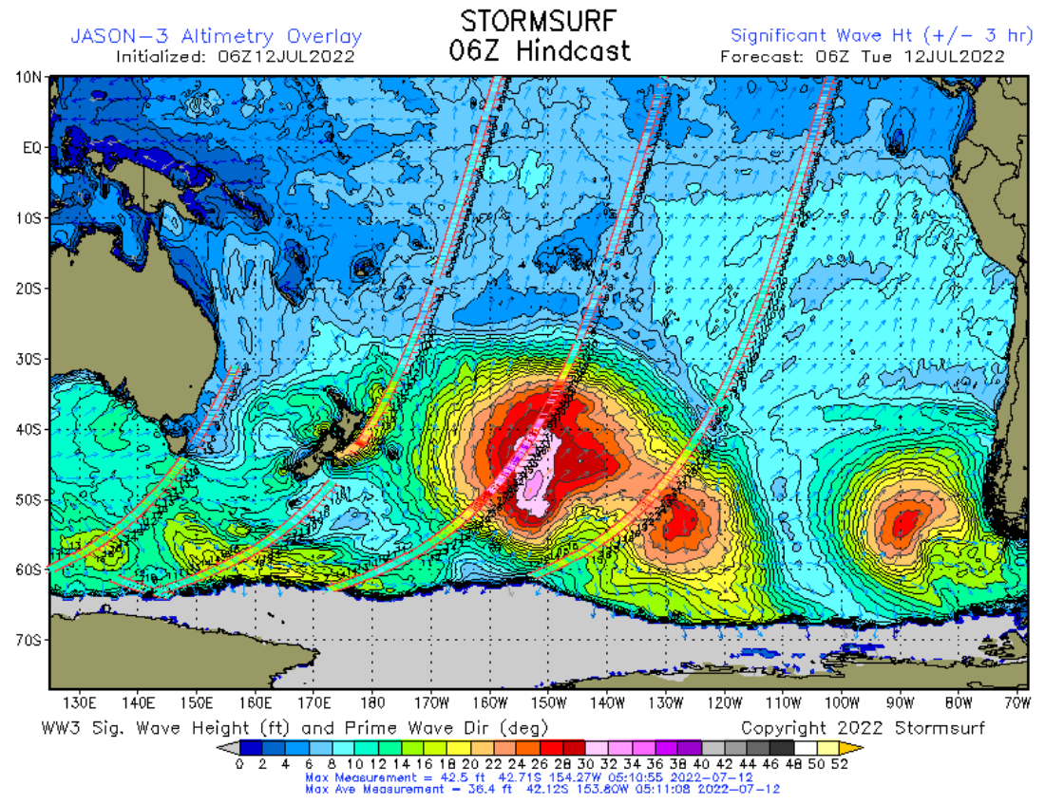
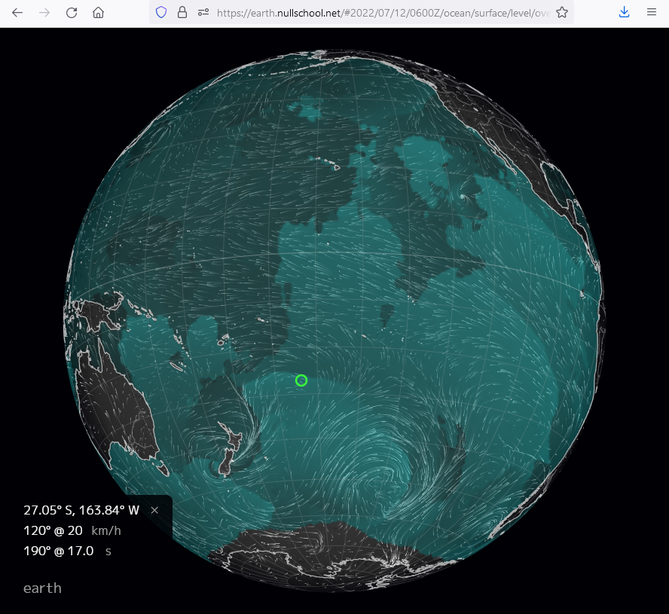
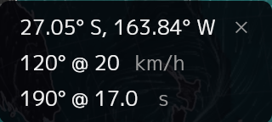
Introducing additional data for information about seas and winds
image from Stormsurf
Stormsurf Web Page
http://www.stormsurf.com/mdls/menu_alt.html
Earth NullSchool Viewer (Cameron Beccario)
https://earth.nullschool.net/
Does this web page have an archive?
H
NOAA Wavewatch III with JASON-3 Altimetry overlay
35-36ft JASON-3 Altimetry
A
in excess of 30 feet
Significant Wave Height (ft)

Slide 14
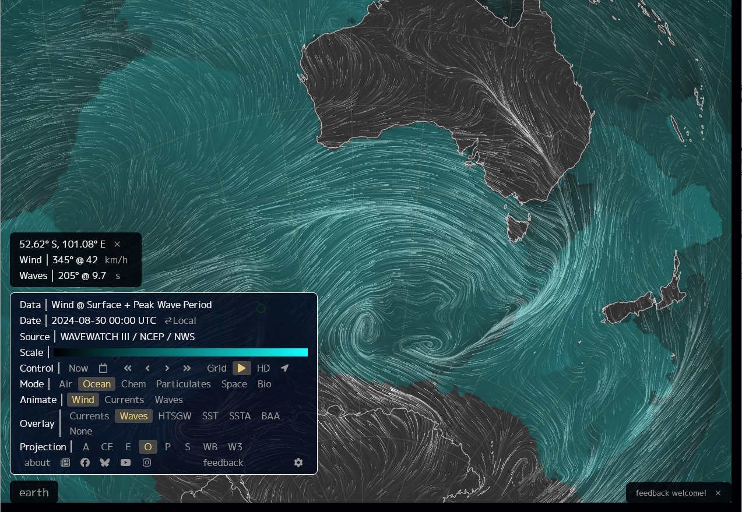
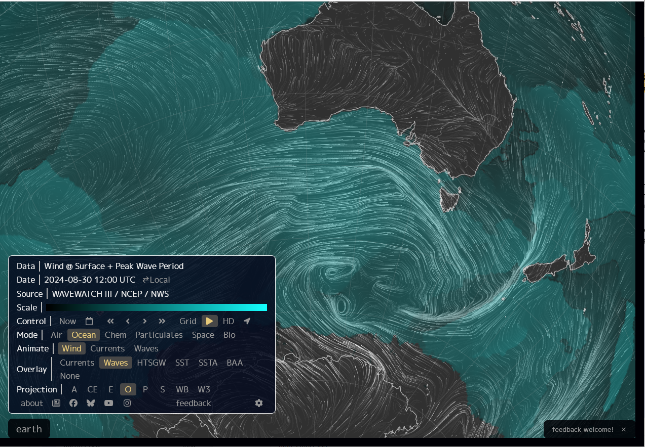
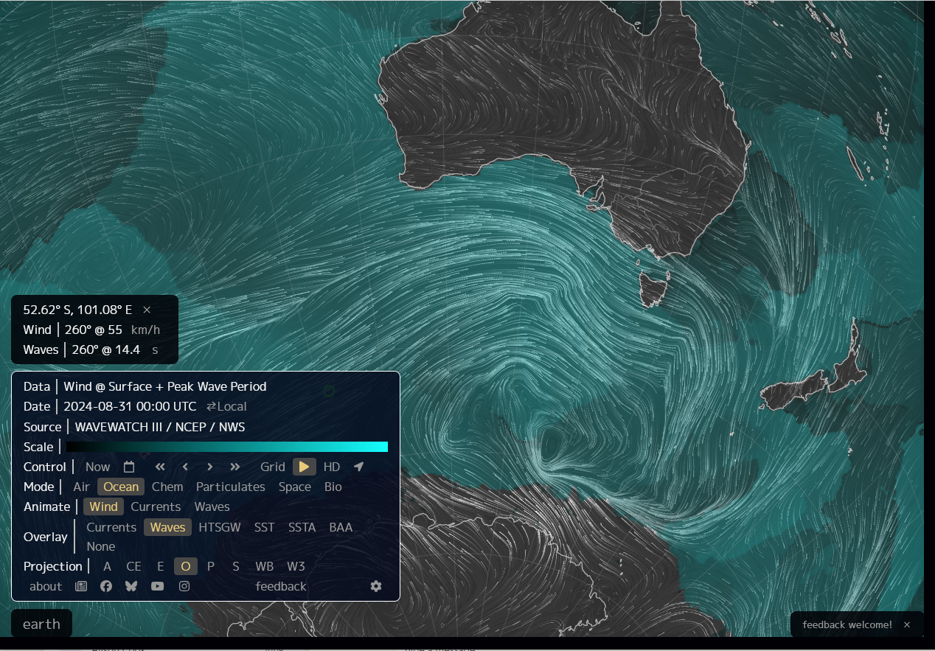
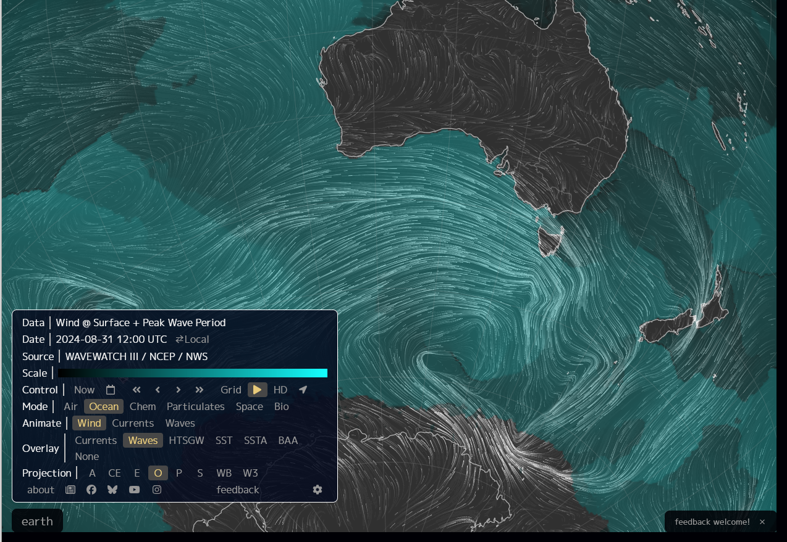
Surface wind and Peak Wave Period (GFS)
images courtesy Earth Nullschool Viewer / Cameron Beccario
00UTC 30th Aug 2024
12UTC 30th Aug 2024
Tasmania
00UTC 30th Aug 2024
12UTC 30th Aug 2024
Notes:
https://earth.nullschool.net/#2024/08/30/0100Z/ocean/surface/level/overlay=primary_waves/orthographic=-238.02,-47.53,832/loc=101.081,-52.619

Slide 15
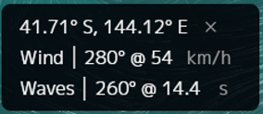
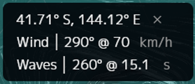
Surface wind and Peak Wave Period (GFS)
images courtesy Earth Nullschool Viewer / Cameron Beccario
00UTC 30th Aug 2024
12UTC 30th Aug 2024
Tasmania
00UTC 30th Aug 2024
12UTC 30th Aug 2024
Notes:
https://earth.nullschool.net/#2024/08/30/0100Z/ocean/surface/level/overlay=primary_waves/orthographic=-238.02,-47.53,832/loc=101.081,-52.619

Slide 16
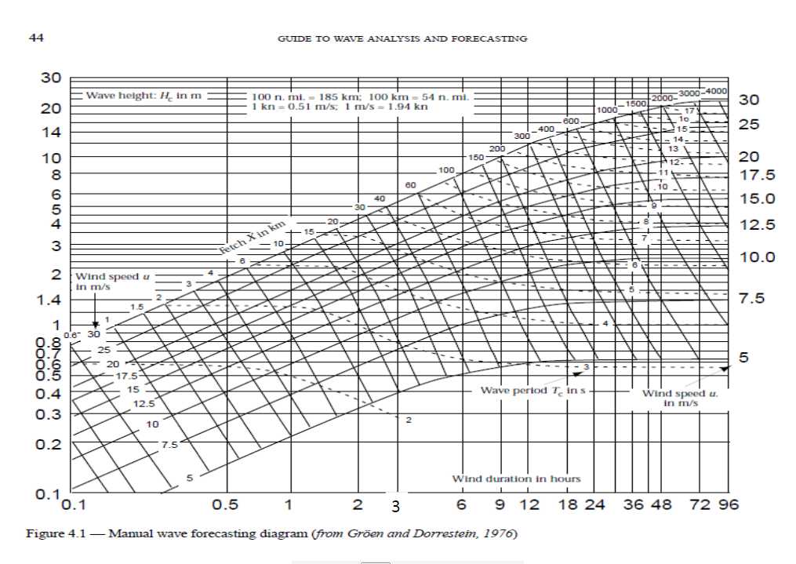
Manual Wave Forecasting Diagram (Groen and Dorrestein 1976) forwarded by Tristan Oakley (BOM)
2800km fetch
30-45 knots wind
(15 – 23 m/s)
24 hour wind duration, as per our data

Slide 17
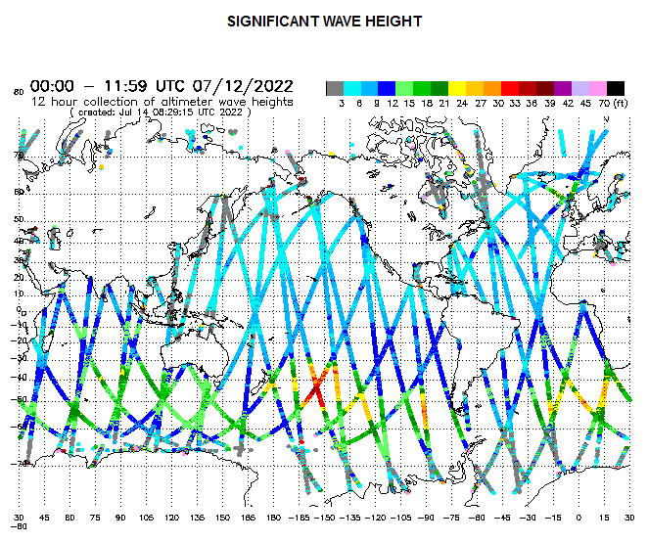
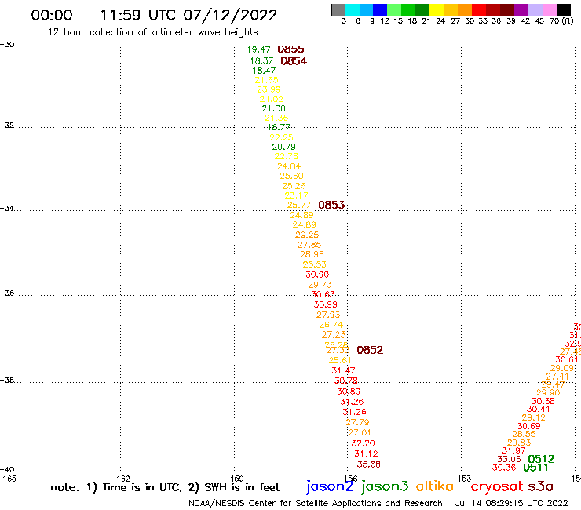
Satellite Altimeter measurements 05-09UTC 12th July 2022 from NOAA/NESDIS/STAR website
Sentinel 3A
NOT AVAILABLE
Wave heights in excess of 25 feet
Sentinel 3A
Jason 3
images from the NOAA/NESDIS/STAR website at https://manati.star.nesdis.noaa.gov/datasets/SGWHData.php

Slide 18
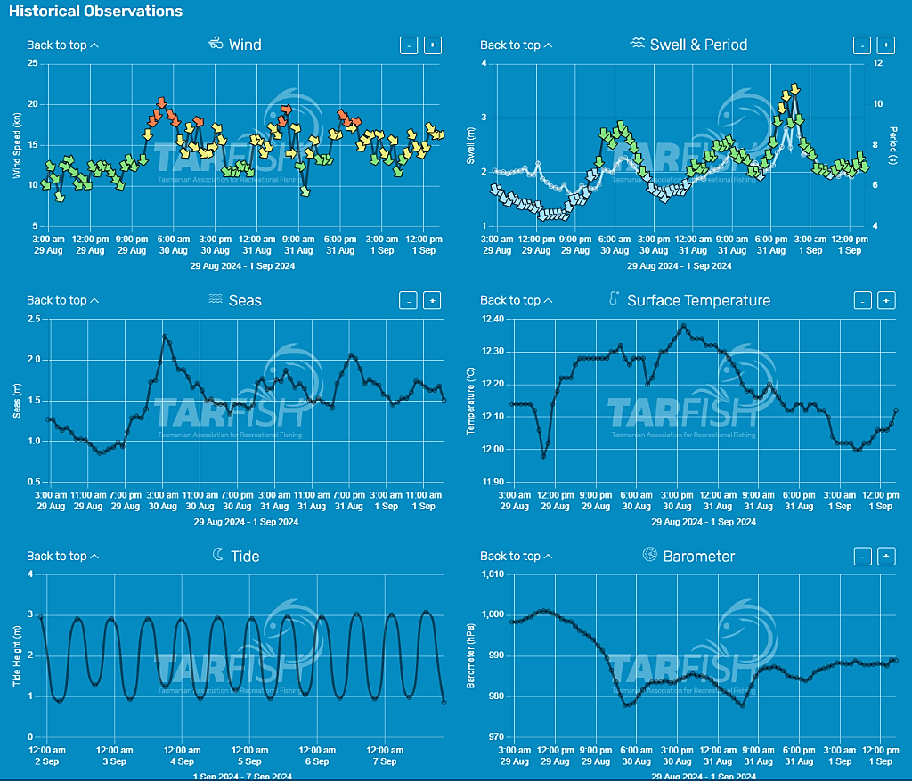
TARFISH Buoy at Burnie 3am 29th August to 12pm 1st September
image courtesy TARFISH Weather https://weather.tarfish.org/
Notes:
https://bom365.sharepoint.com/sites/Coastal_Hazard_Services/_layouts/15/Doc.aspx?sourcedoc={3536f703-f0b9-499d-908a-16b3c5f9fa8b}&action=view&wd=target%28Event%20based.one%7Ce6432997-8ee3-4327-8001-611634175108%2F2024-09-01%20TAS%20CHW%7C92d21d57-2cd9-4f02-bba2-f0edb49d0c66%2F%29&wdorigin=NavigationUrl

Slide 19
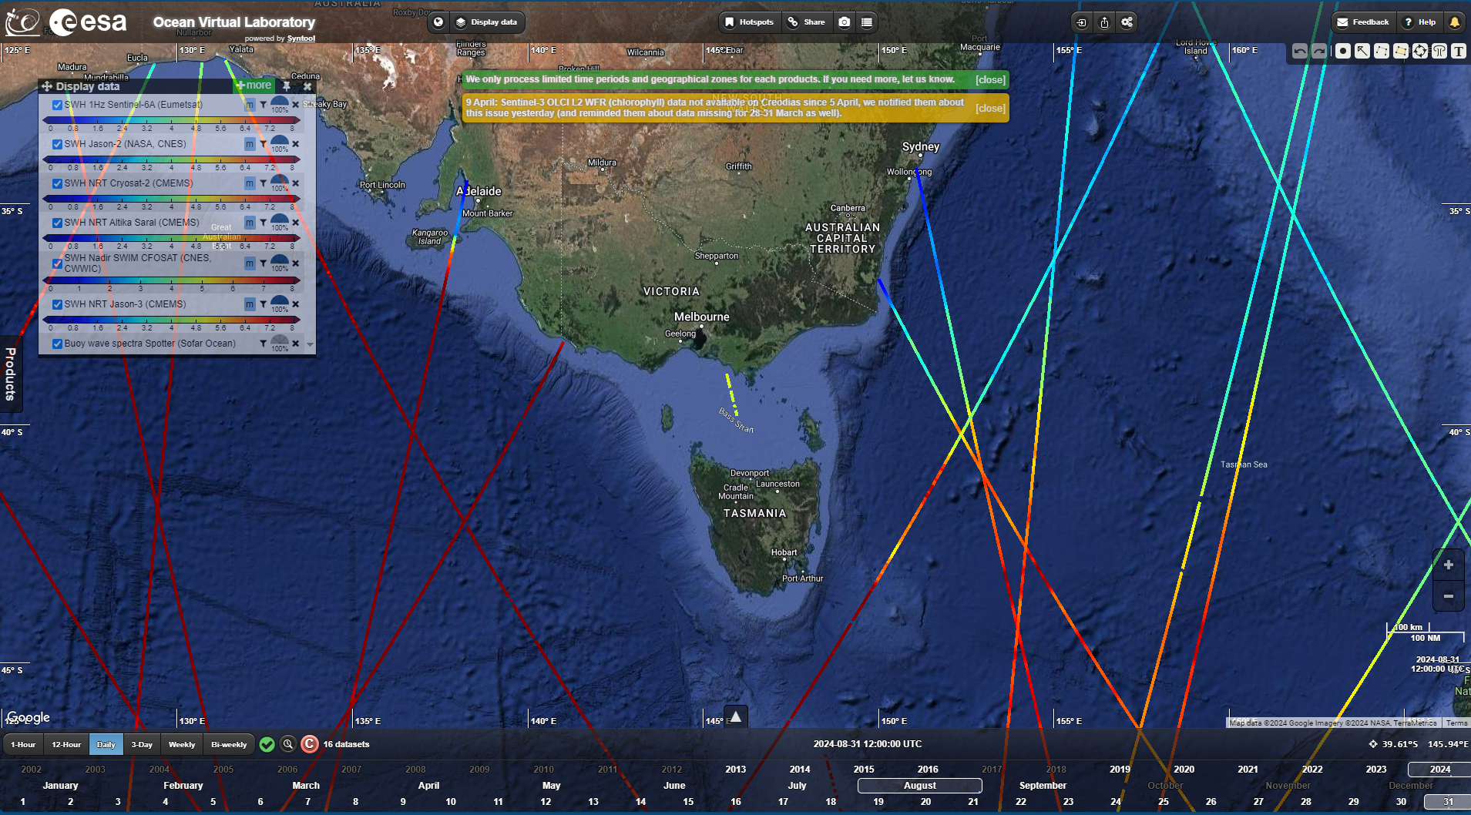
Altimeter data, 12UTC 31st August 2024
Notes:
https://bom365.sharepoint.com/sites/Coastal_Hazard_Services/_layouts/15/Doc.aspx?sourcedoc={3536f703-f0b9-499d-908a-16b3c5f9fa8b}&action=view&wd=target%28Event%20based.one%7Ce6432997-8ee3-4327-8001-611634175108%2F2024-09-01%20TAS%20CHW%7C92d21d57-2cd9-4f02-bba2-f0edb49d0c66%2F%29&wdorigin=NavigationUrl

Slide 20
Reports on the Bureau's OneNote Verification page
TIDES
Local Inundation throughout TAS
Impacts would have been significant if astronomical tides hadn't been low.
TAS
Warning cancelled at 0625 Mon 02/09/2024
Reference to past event (10/08/2018)
Abnormally High Tide over SE TAS 10th August 2018 (bom.gov.au)
Worth collecting the same data for comparison??
Impacts
Cancellation of shipping in Northern Ports, including the Spirit of Tas
Gale winds disrupt shipping operations at all Tasmanian ports - Pulse Tasmania
Spirit Tas Evening Saturday voyage to Geelong postponed to Sunday morning
Sailing to Devonport rescheduled to Monday, and further sailings impacted and double sailings scheduled
Cement ship Wyuna delayed arrival to Devonport until MOnday

Slide 21
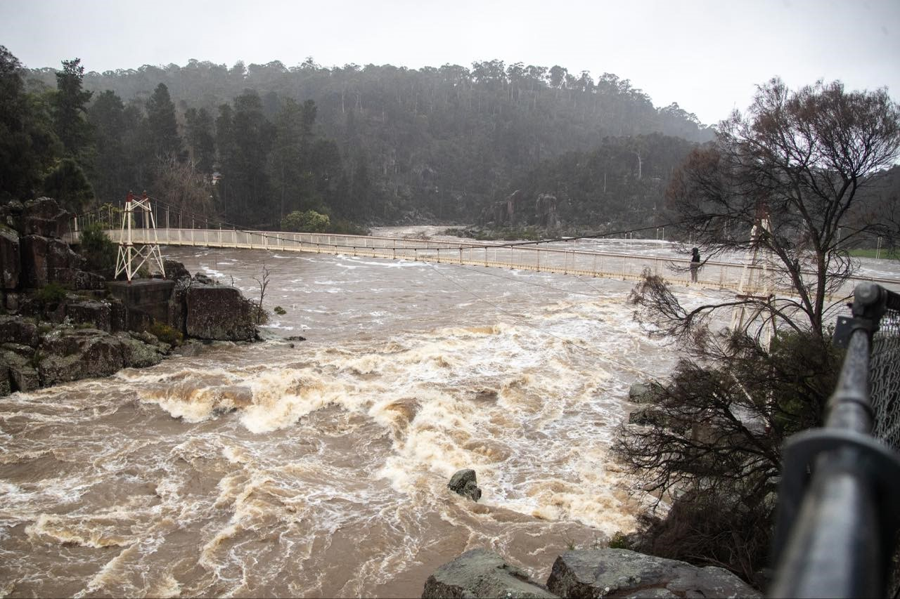
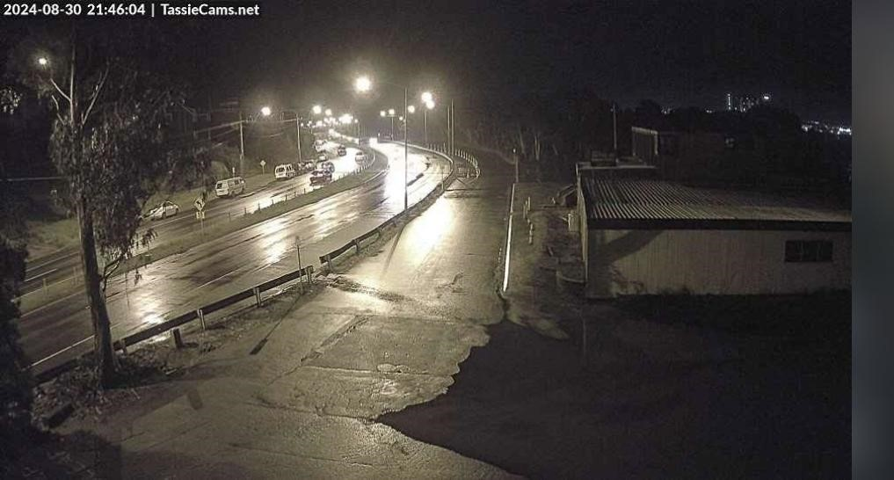
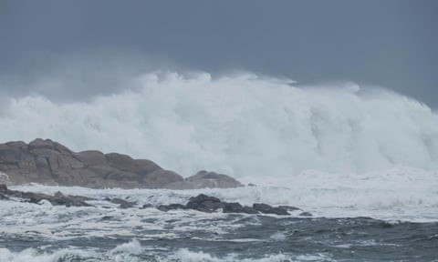
Impacts from the Bureau's OneNote Verification page
Minor impacts reported in Macquarie Harbour near Strahan Sat-Sun with high tides (followup with DSS who said this)
Midway pt causeway, Bridgewater bridge, New Norfolk all saw imporessive tides Sat evening (again see DSS)
Flooding at Launceston Gorge afternoon 31/08
"Maelstrom at Granville Harbour, on Tasmania’s west coast. Photograph: Andrew Klapton Photography
Published 02/09
From <https://www.theguardian.com/australia-news/live/2024/sep/02/australia-news-live-tens-of-thousands-of-victorians-without-power-flood-evacuations-in-tasmania-after-night-of-wild-storms?page=with:block-66d4ef938f08e26124795f89&filterKeyEvents=false#liveblog-navigation>
Notes:
https://bom365.sharepoint.com/sites/Coastal_Hazard_Services/_layouts/15/Doc.aspx?sourcedoc={3536f703-f0b9-499d-908a-16b3c5f9fa8b}&action=view&wd=target%28Event%20based.one%7Ce6432997-8ee3-4327-8001-611634175108%2F2024-09-01%20TAS%20CHW%7C92d21d57-2cd9-4f02-bba2-f0edb49d0c66%2F%29&wdorigin=NavigationUrl

Slide 22
Reports on the Bureau's OneNote Verification page
Friday 30/08 Extract from DSS_TAS Key Messages
Seas and Swells
• Tides are elevated through the weekend, coinciding with large waves into the west and through Bass Strait. Significant wave heights are expected to reach 10 metres about the west of Tasmania over the weekend, and over 6 metres through Bass Strait.
• A Coastal Hazard Warning for Abnormally High Tides and Damaging Surf around King Island will be issued later today for period starting Saturday morning and continuing throughout Saturday into Sunday. Later Saturday, this risk extends to northern coasts with significant wave heights well above normal for Bass Strait.
• Strong winds across the Derwent Estuary on Friday could once again bring water onto the South Arm Highway at Lauderdale, with water levels to peak around 5:30pm with the high tide.
• High tides coinciding with onshore gale force winds and rough seas Saturday night may cause abnormally high water level rises in the Tamar River. This situation is being closely assessed and a warning will be issued if required

Slide 23
Reports on the Bureau's OneNote Verification page
Tas SES Report: Foreshore at Franklin fully inundated on Friday 30/08/2024. The council EM manager said it was the highest they can recall. (Received from Alex Melitsis at 4:50 pm Saturday 31/08/2024).

Slide 24
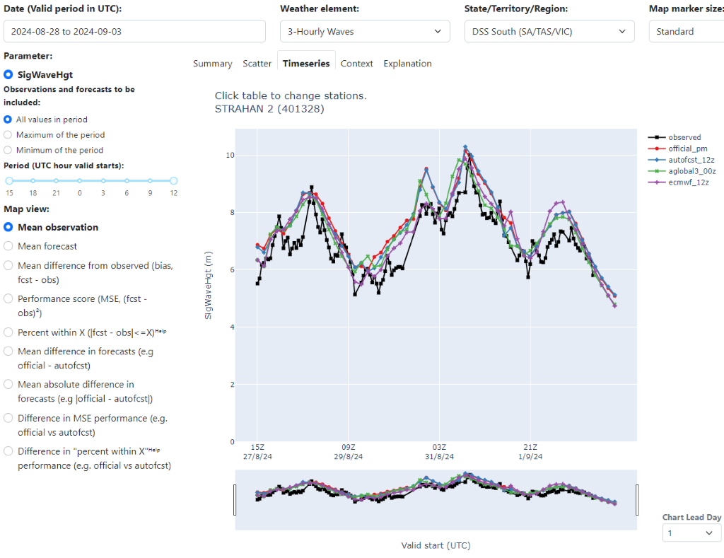
Strahan 3-Hourly Waves, 27th August – 2 September 2024
Notes:
https://bom365.sharepoint.com/sites/Coastal_Hazard_Services/_layouts/15/Doc.aspx?sourcedoc={3536f703-f0b9-499d-908a-16b3c5f9fa8b}&action=view&wd=target%28Event%20based.one%7Ce6432997-8ee3-4327-8001-611634175108%2F2024-09-01%20TAS%20CHW%7C92d21d57-2cd9-4f02-bba2-f0edb49d0c66%2F%29&wdorigin=NavigationUrl

Slide 25
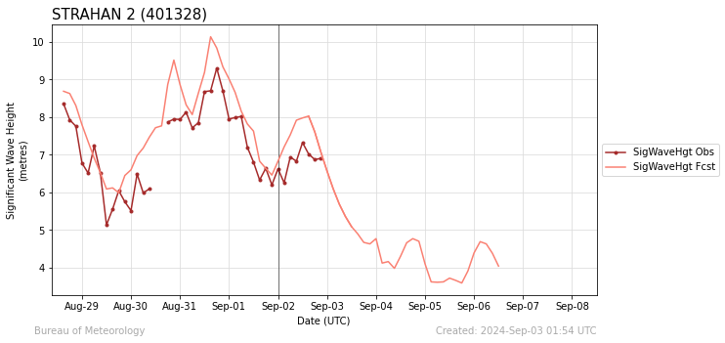
Strahan SigWaveHgt, forecast vs observed
Notes:
https://bom365.sharepoint.com/sites/Coastal_Hazard_Services/_layouts/15/Doc.aspx?sourcedoc={3536f703-f0b9-499d-908a-16b3c5f9fa8b}&action=view&wd=target%28Event%20based.one%7Ce6432997-8ee3-4327-8001-611634175108%2F2024-09-01%20TAS%20CHW%7C92d21d57-2cd9-4f02-bba2-f0edb49d0c66%2F%29&wdorigin=NavigationUrl

Slide 26
Summary
Point 1
Point 2
Point 3

