Slide 1
Indonesian VLab Centre of Excellence Regional Focus Group meeting, 02UTC 29th May 2024
Contents
Monitoring of Tropical Cyclone in Indonesia using Satellite: presenter Muhammad Hanif Affan, BMKG Indonesia.
The Role of Weather Satellites for Aviation Weather Services in Indonesia: presenter Richard M. Putra, BMKG Indonesia.
Ocean Surface Responses During the Process of Tropical Cyclone in Indonesia Using Satellite Data: presenter Faradiva Claudia, BMKG Indonesia.
An aviation turbulence event over southeastern Australia, with characteristic signature in the satellite imagery and as verified by a pilot, 24th March 2024: presenter Bodo Zeschke, Australian Bureau of Meteorology.

Slide 2
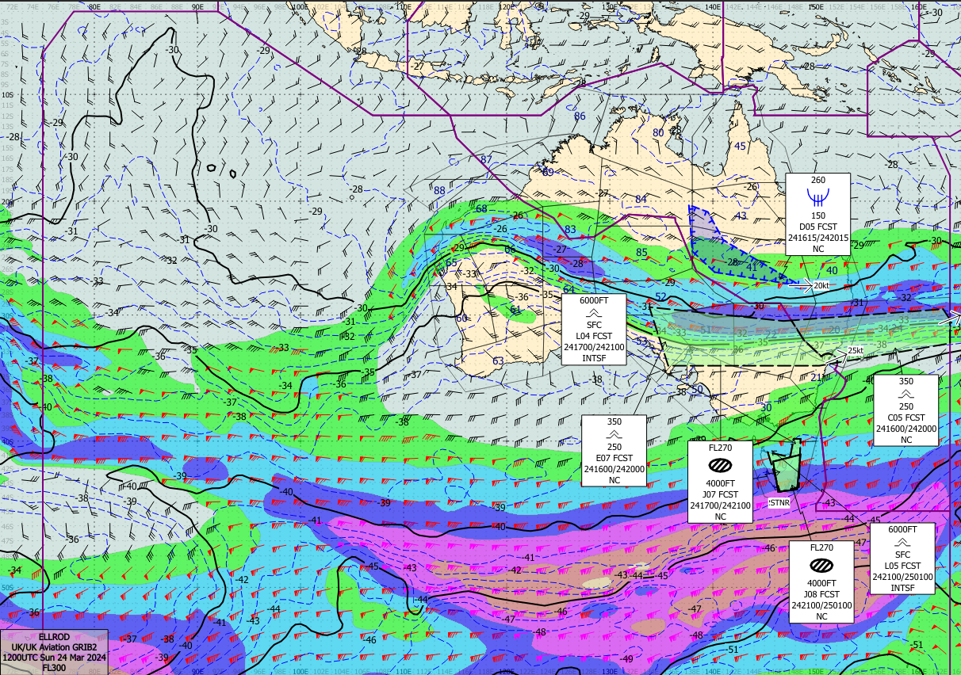
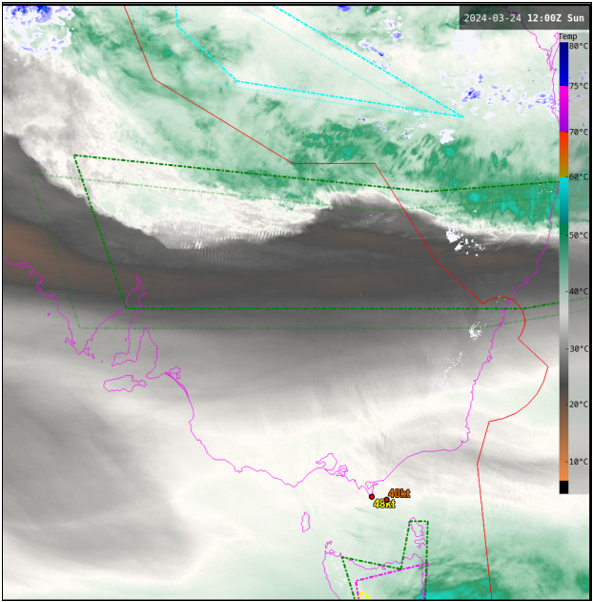
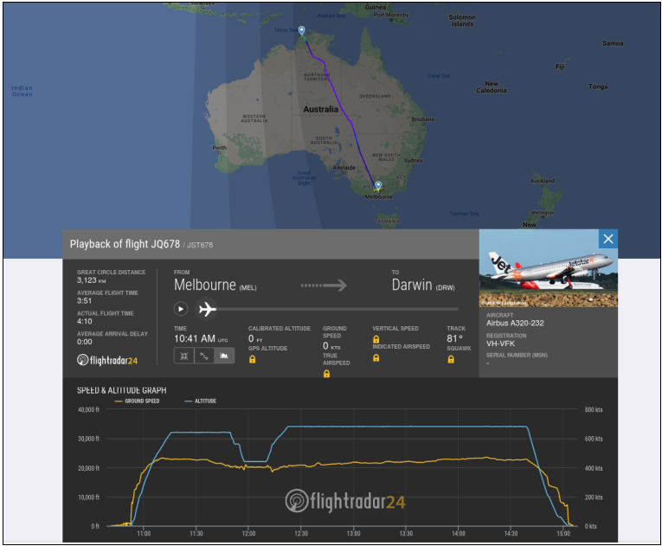
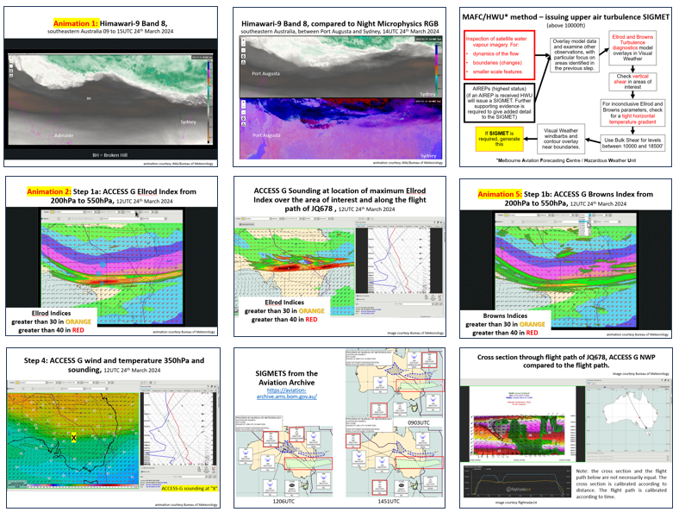
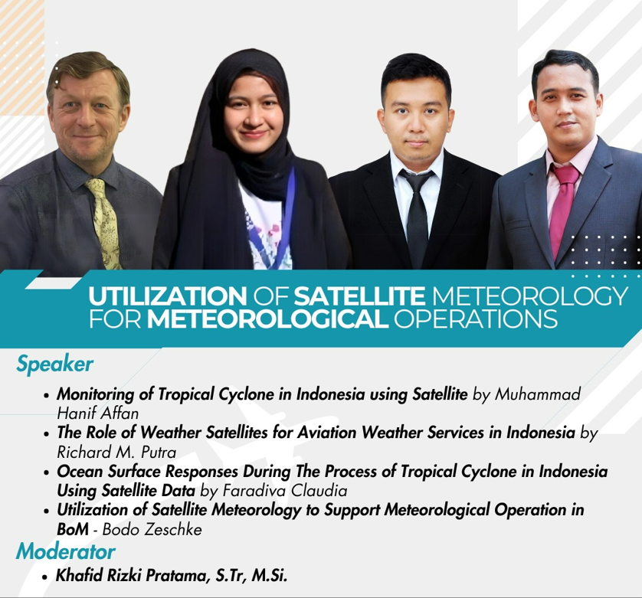
Sequence of "Happenings". From my perspective.
I received the initial information from an Operational Forecaster (Ronik Kumar) via email. Ronik provided me with some information that he extracted whilst working "on the bench" at the time.
I added additional satellite images, NWP data, forecasts etc. and passed these back to Ronik for comment.
Ronik made some suggestions for improvement and the preliminary case study was composed.
I finalised this case study for presentation at this Indonesian VLab Centre of Excellence Regional Focus Group meeting.

Slide 3
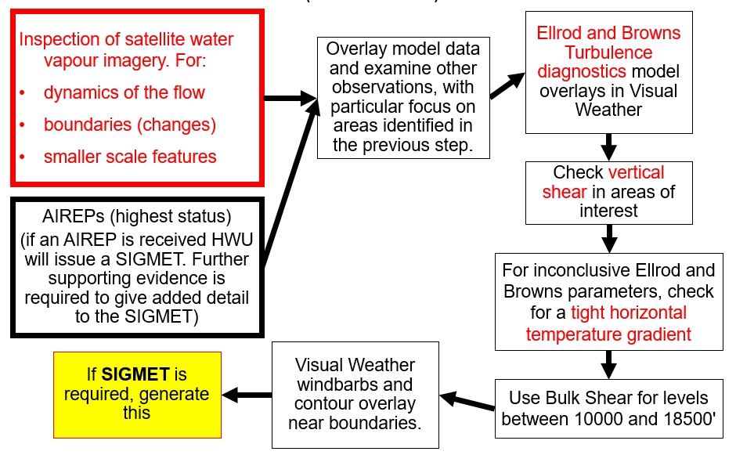
MAFC/HWU* method – issuing upper air turbulence SIGMET (above 10000ft)
*Melbourne Aviation Forecasting Centre / Hazardous Weather Unit

Slide 4
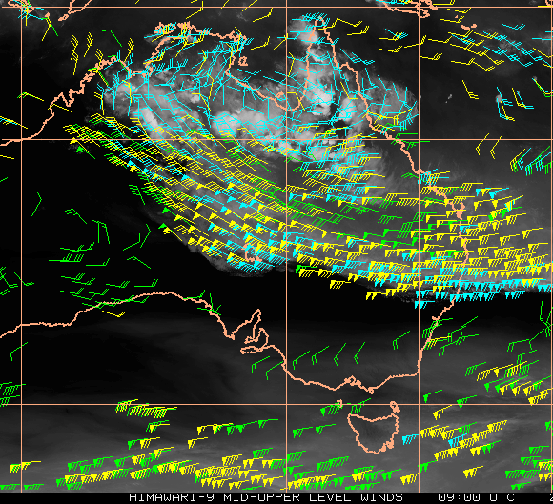
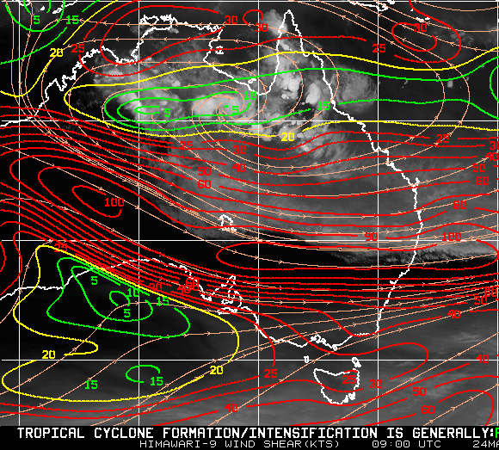
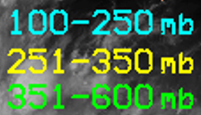
Situation leading up to the event. Himawari-9 Band 8 and mid-upper-level atmospheric motion vectors and water vapour imagery 09UTC 24th March 2024
Darwin
Darwin
Australia
Australia
Adelaide
Sydney
Adelaide
Sydney
Melbourne
Melbourne
Mid-upper-level Atmospheric Motion Vectors
Deep Layer Shear
AMV components are averaged over an upper layer (150, 200, 250, and 300 hPa) and a lower layer (700, 775, 850, and 925 hPa).
images courtesy CIMSS Tropical Cyclones Archive University of Wisconsin Madison

Slide 5
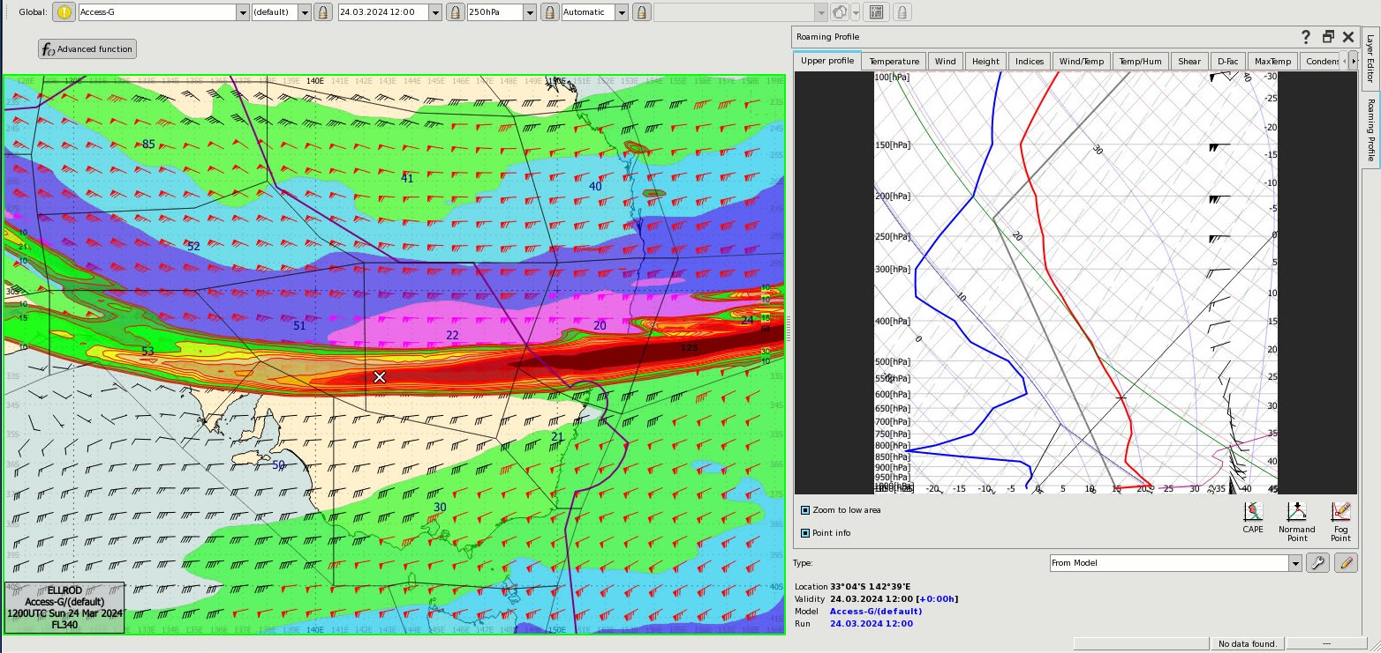
Situation leading up to the event. ACCESS G Ellrod Index and Winds and Isotachs 250hPa (FL340) and sounding at location "X", 12UTC 24th March 2024
Australia
-44C
X
Sydney
Adelaide
Melbourne
Ellrod Indices
greater than 30 in ORANGE
greater than 40 in RED
image courtesy Bureau of Meteorology

Slide 6
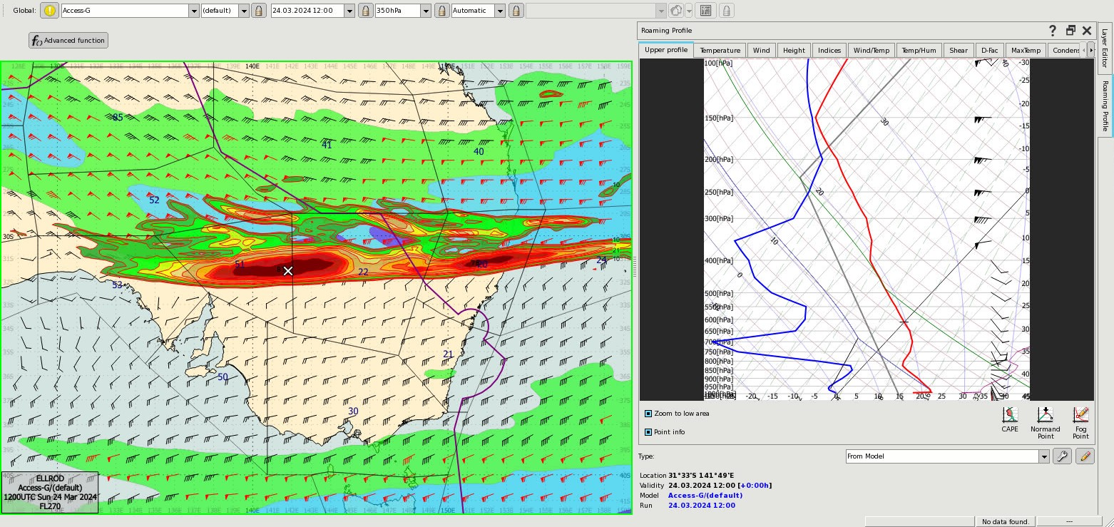
Situation leading up to the event. ACCESS G Ellrod Index and Winds and Isotachs 350hPa (FL270) and sounding at location "X", 12UTC 24th March 2024
Australia
-25C
X
Sydney
Adelaide
Melbourne
Ellrod Indices
greater than 30 in ORANGE
greater than 40 in RED
image courtesy Bureau of Meteorology

Slide 7
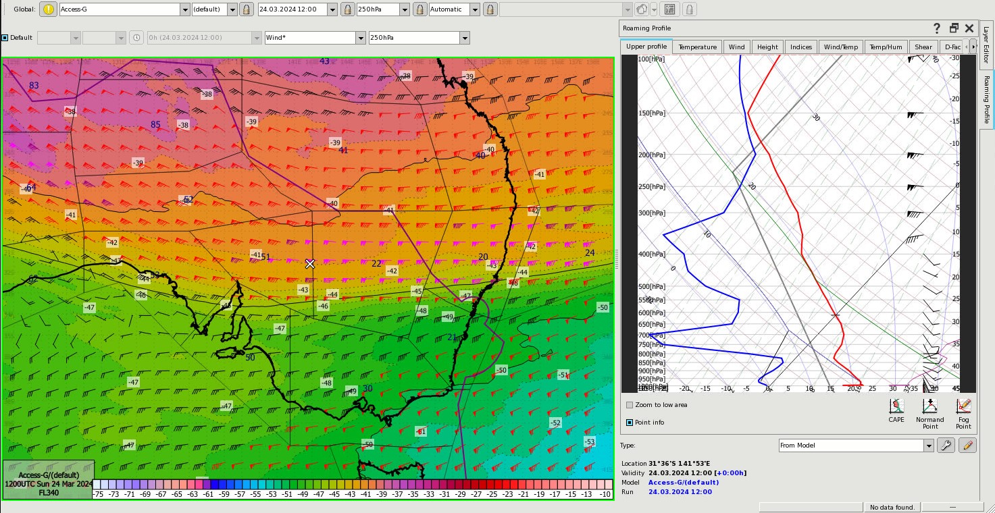
Situation leading up to the event. ACCESS G Wind and Temperature 250hPa (FL340) and Sounding at location "X", 12UTC 24th March 2024
Australia
-40C
X
Sydney
Adelaide
Melbourne
image courtesy Bureau of Meteorology

Slide 8
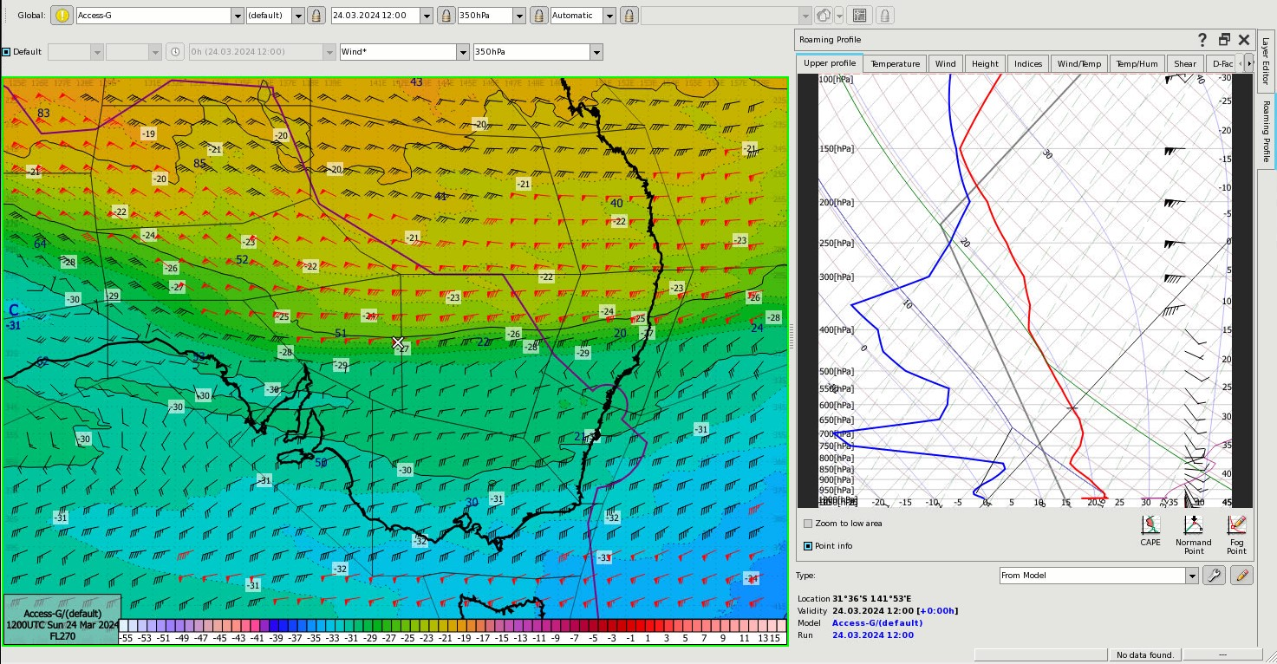
Situation leading up to the event. ACCESS G Wind and Temperature 350hPa (FL270) and Sounding at location "X", 12UTC 24th March 2024
Australia
-25C
X
Sydney
Adelaide
Melbourne
image courtesy Bureau of Meteorology

Slide 9
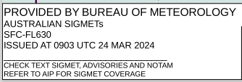
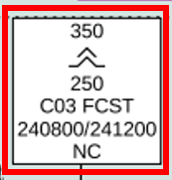
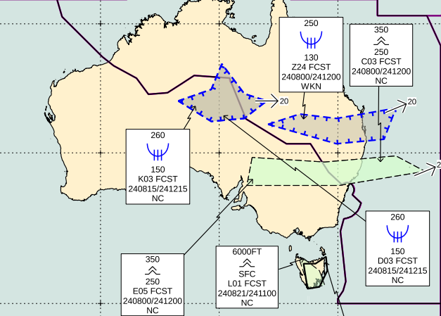
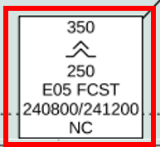
Situation leading up to the event. The SIGWX forecast issued at 0903UTC, 24th March 2024
image courtesy JMA/Bureau of Meteorology
Notes:
https://aviation-archive.ams.bom.gov.au/

Slide 10
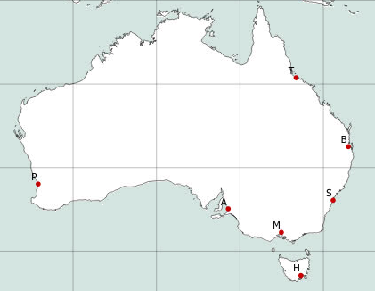
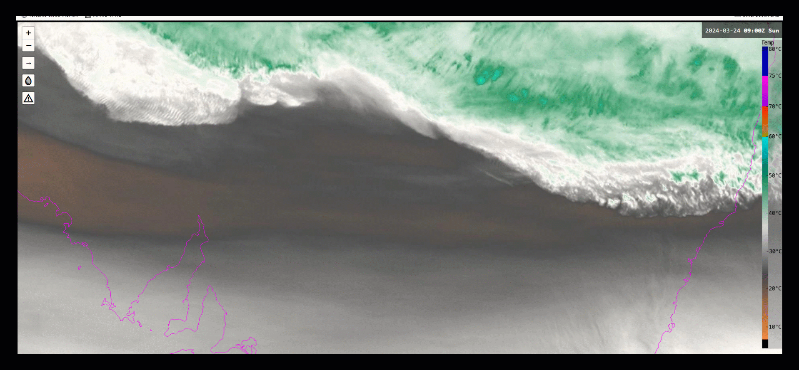
Situation leading up to the event. Himawari-9 Band-8 satellite imagery. 09-12UTC, 24th March 2024.
Australia
BH
note the "billow clouds" forming
Sydney
Adelaide
animation courtesy JMA/Bureau of Meteorology

Slide 11
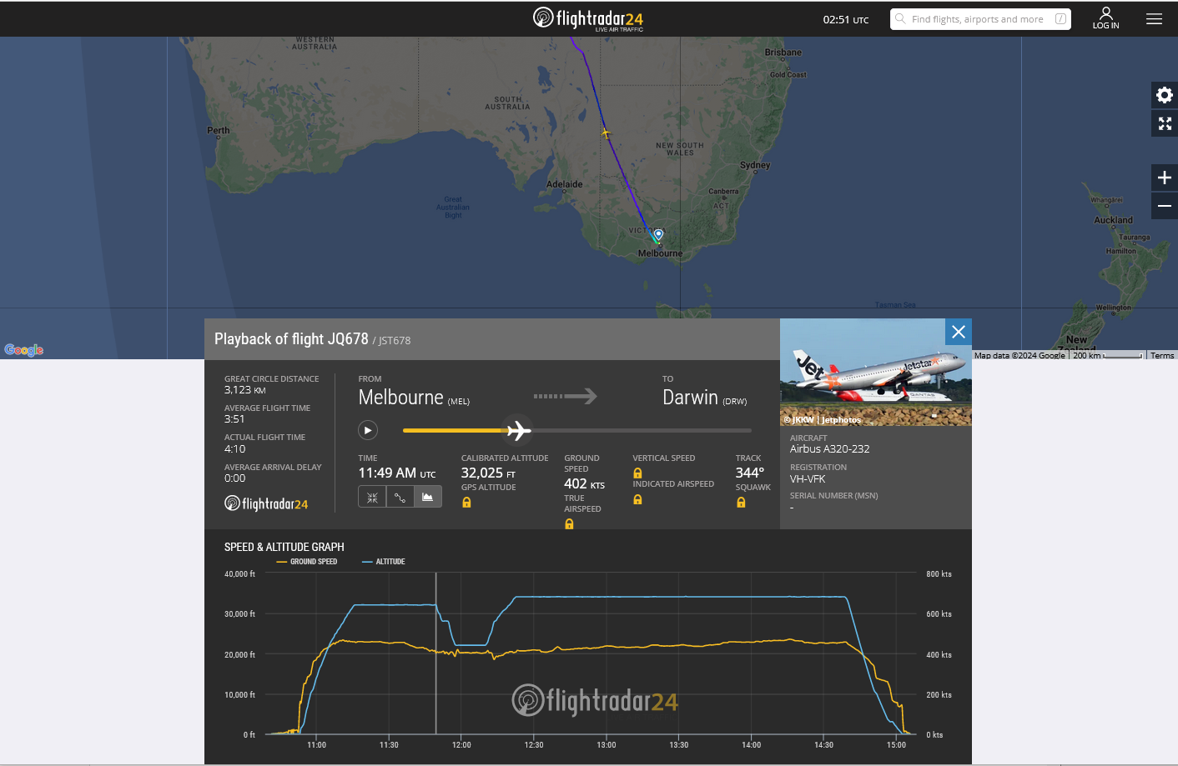
The Event 11.48-11.58UTC 24th March 2024
image courtesy flightradar24
Australia
Melbourne
Melbourne
Darwin

Slide 12
The Event 11.48-11.58UTC 24th March 2024
image courtesy flightradar24
Here is a case of SEV TURB SIGMET issued and verified
ARS JSY678 BHI360030 1158 F320 YOOM 1220
RMK/MOD TO SEVERE TURB. WESTERL WIND CHANGED FROM 80KT TO 100KT
BHI - Broken Hill
Call sign is actually JST678 (Jetstar) rather than JSY678
At 11:48Z the aircraft was cruising at FL320. It then encountered SEV TURB and dropped down to FL220 when it reported at 11:58Z
The delay in reporting perhaps had been that the crew were dealing with the SEV TURB event and when things settled a bit then they reported.
Good striations were seen in WV imagery.
Good verification case.
Australia
Melbourne
Melbourne
Darwin

Slide 13
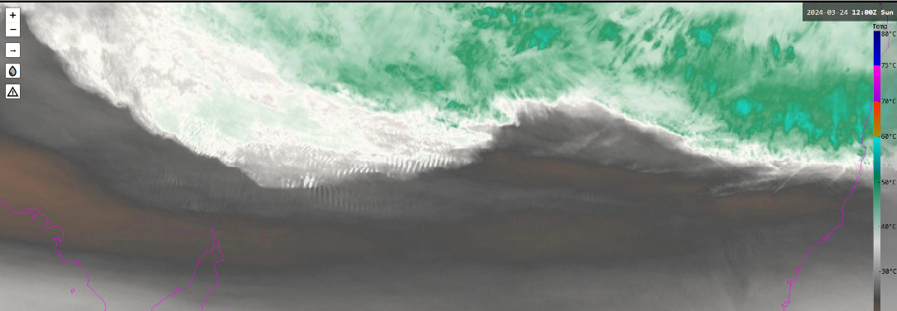
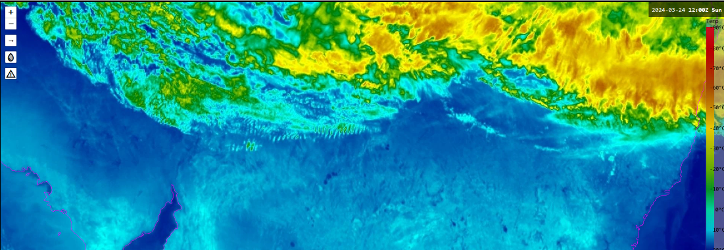
Himawari-9 satellite imagery at the time of the event southeastern Australia, 12UTC 24th March 2024
Port Augusta
Water vapour image (Band 8)
Sydney
X
Port Augusta
X = location of the aeroplane
NOAA TC enhanced IR (Band 13)
Sydney
images courtesy JMA/Bureau of Meteorology

Slide 14
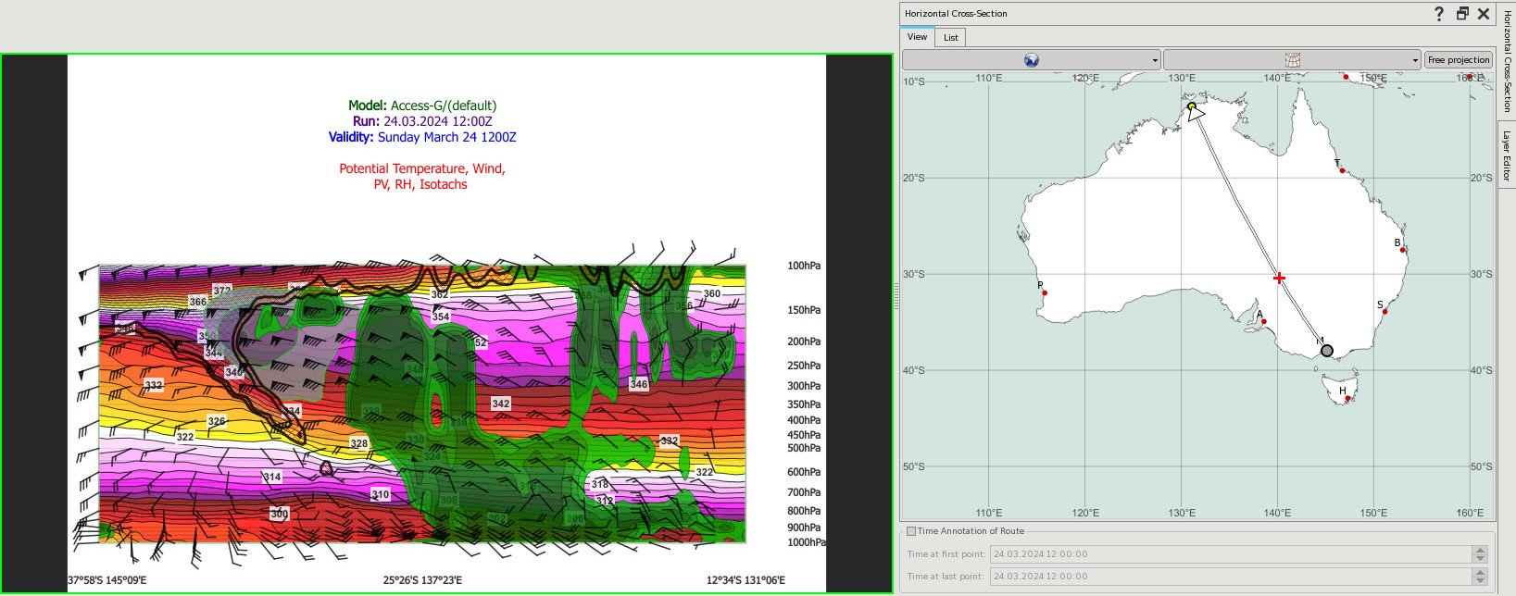
Cross section through flight path of JQ678, ACCESS G NWP compared to the flight path.
image courtesy Bureau of Meteorology
Note: the cross section and the flight path below are not necessarily equal. The cross section is calibrated according to distance. The flight path is calibrated according to time.
Melbourne
Darwin
image courtesy flightradar24

Slide 15
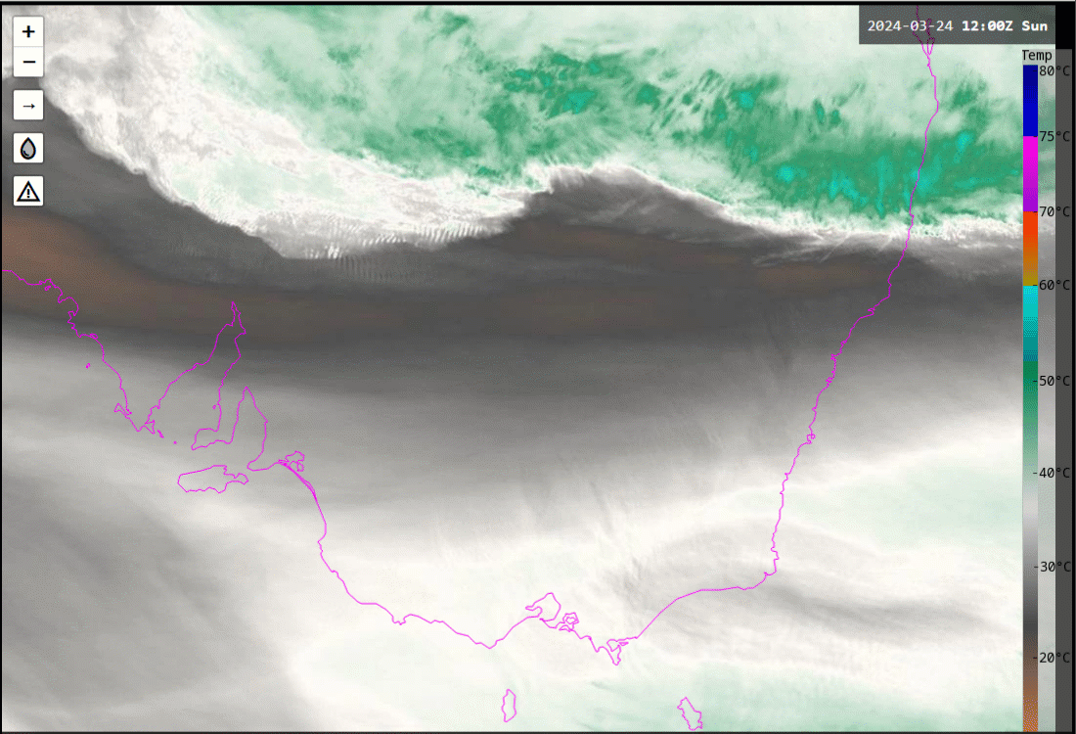
Post event evolution 12-21UTC 24th March 2024
image courtesy Bureau of Meteorology
Australia
Sydney
Adelaide
16-20UTC
(24th)
Melbourne
20UTC (24th)
-02UTC (25th )
SIGMET issued at 1952UTC Water vapour images (Band 8)
animation courtesy JMA/Bureau of Meteorology

