Slide 1
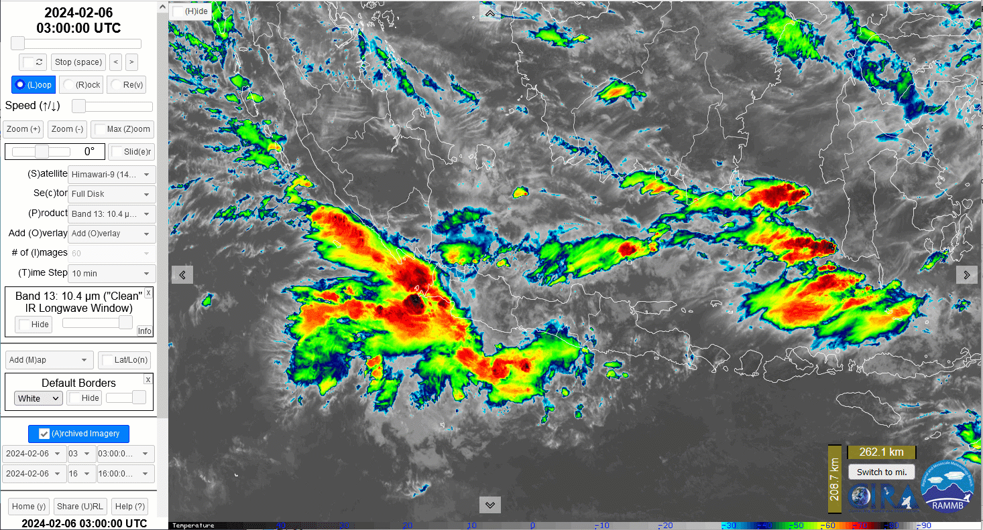
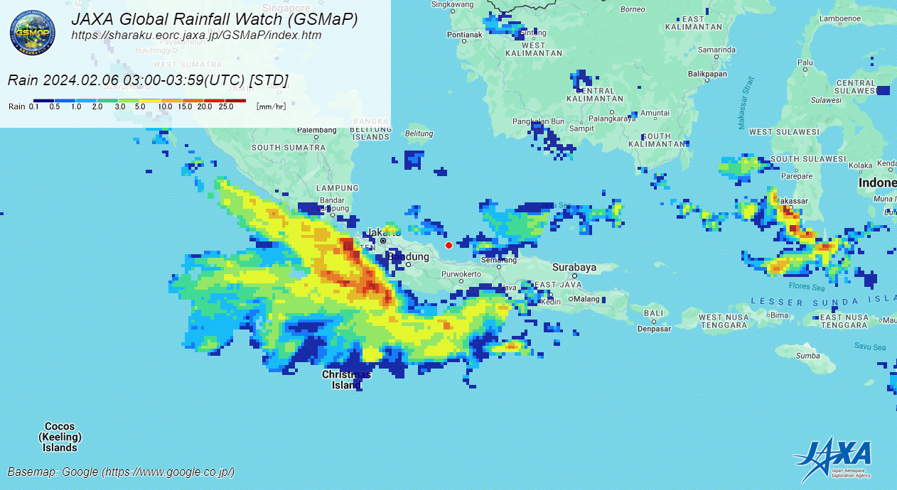
Example 1: JAXA data Version 5 (STD)
(Java / Sumatra Squall Line, 03 to 16UTC 6th February 2024)
(Java, Sumatra and Kalimantan coastlines highlighted)
animation courtesy JMA / RAMMB/CIRA
Kalimantan
Sumatra
Java
Top: Enhanced Himawari-9 10-minute Band 13 from the RAMMB/CIRA SLIDER viewer
Bottom: Hourly JAXA "GSMaP" precipitation data.
animation courtesy JAXA/EORC

Slide 2
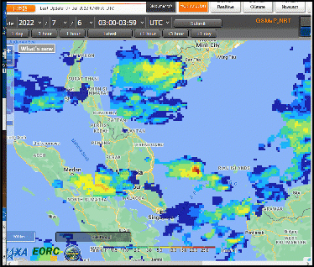
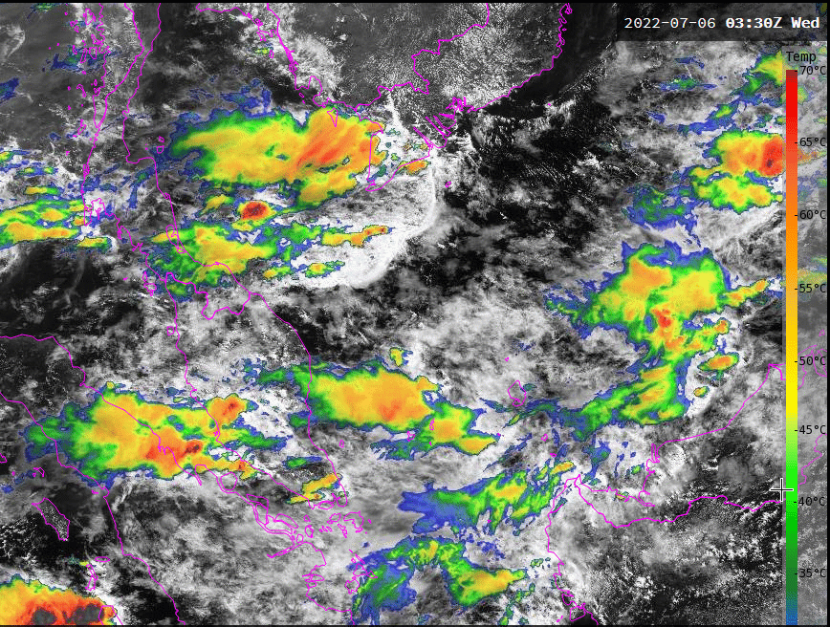

Example 2: JAXA data (Version 3) compared to Sandwich Product for South China Sea Squall Line
animation courtesy JAXA/EORC
animation courtesy JMA/Bureau of Meteorology
Vietnam
-70C
S
S
-20C
Singapore
JAXA Global Rainfall Watch data
South China Sea area
03UTC to 11UTC 6th July 2022
Sandwich Product
South China Sea area
0330UTC to 1030UTC 6th July 2022

