Slide 1
Post AOMSUC-13 Training Event Session T 15 "Early Warning of Hazardous Weather based on Satellite Data" Focus on Delay in Receipt of data
UNOFFICIAL
Mr Bodo Zeschke Teacher, Australian Bureau of Meteorology Training Centre Point of Contact, Australian VLab Centre of Excellence
UNOFFICIAL

Slide 2
Application of satellite data in anticipating Hazardous Weather. PART 1
Main hazardous weather that countries represented by the attendees need to monitor and warn against.
Data latency in countries represented by the attendees.
Satellite data latency, compared to latency of other observational data including RADAR data etc. for Panther.
Satellite data that can be viewed from outside the Bureau firewall and the delay in receipt of this data as viewed from the Bureau.
How to cope with data delay of 30 minutes (back to pre-Himawari days).
Request services and use of these

Slide 3
Application of satellite data in anticipating Hazardous Weather. PART 1
Main hazardous weather that countries represented by the attendees need to monitor and warn against.
Data latency in countries represented by the attendees.
Satellite data latency, compared to latency of other observational data including RADAR data etc. for Panther.
Satellite data that can be viewed from outside the Bureau firewall and the delay in receipt of this data as viewed from the Bureau.
How to cope with data delay of 30 minutes (back to pre-Himawari days).
Request services and use of these

Slide 4
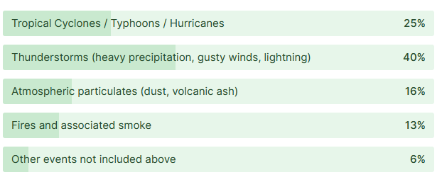
AOMSUC-13 Training Event Session T-15 Question 1 What are the main Hazardous Weather events that you need to monitor and warn against in your country? 30 attendees applied to the question. "Other" answers in red.
17/30
27/30
11/30
9/30
4/30
(heatwaves, tornadoes, flooding)

Slide 5
Application of satellite data in anticipating Hazardous Weather. PART 1
Main hazardous weather that countries represented by the attendees need to monitor and warn against.
Data latency in countries represented by the attendees.
Satellite data latency, compared to latency of other observational data including RADAR data etc. for Panther.
Satellite data that can be viewed from outside the Bureau firewall and the delay in receipt of this data as viewed from the Bureau.
How to cope with data delay of 30 minutes (back to pre-Himawari days).
Request services and use of these

Slide 6
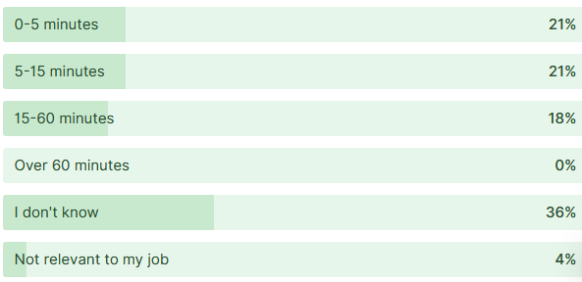
AOMSUC-13 Training Event Session T-15 Question 2 What is the delay in the receipt of geostationary satellite data, from the time of "satellite overpass" at your workplace? 28 attendees applied to the question.
6/28
6/28
5/28
0/28
10/28
1/28

Slide 7
Additional evidence of data delay
Agnes: AOMSUC-13 debriefing Teams session with Bureau Satellite Science staff, 15th November 2023
During the Members Reports at the 5th Joint RAII and RAV Coordination Meeting some representatives from Pacific Islands and other small nations reported issues such as:
30-minute delay in receipt of GEO data
Receiving GEO data at 30-minute intervals
Feedback from Avester Lau, NEA Singapore
We only actively use Himawari-8 data, and it’s usually delayed by 45 – 60 minutes. This does indeed limit thunderstorm nowcasting, although we’ve still found it very useful for SIGMETs and tracking large cells across a larger area, such as the South China Sea, in which Singapore FIR is based in. We also make use of RDCA analysis by JMA, I believe.
Feedback from Silipa Mulitalo, Samoa Meteorological Service:
Samoa note that the ProbSevere LightningCast data has a delay of 10 minutes.
REFERENCE

Slide 8
Application of satellite data in anticipating Hazardous Weather. PART 1
Main hazardous weather that countries represented by the attendees need to monitor and warn against.
Data latency in countries represented by the attendees.
Satellite data latency, compared to latency of other observational data including RADAR data etc. for Panther.
Satellite data that can be viewed from outside the Bureau firewall and the delay in receipt of this data as viewed from the Bureau.
How to cope with data delay of 30 minutes (back to pre-Himawari days).
Request services and use of these

Slide 9
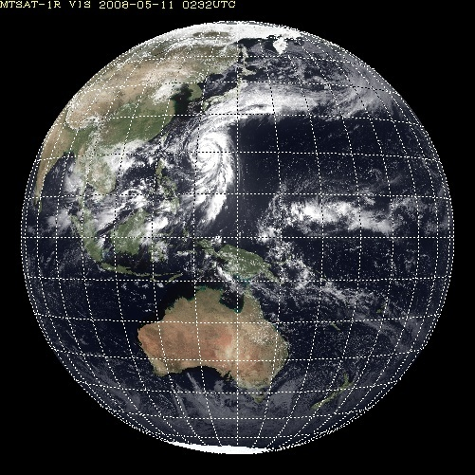
Himawari-9 scanning
0-1 minute
1-2 minute
2-3 minute
3-4 minute
4-5 minute
5-6 minute
6-7 minute
7-8 minute
8-9 minute
9-10 minute
Data is scanned from west to east, starting at the north pole.
10 segments compose a full disk scan of 10-minute duration.
The date / time stamp of the images refers to the start of the scan
Full disk
Interval: 10 minutes (6 times per hour)
Image from "Status of Current and Future Satellite Programs of Japan Meteorological Agency" K. Bessho

Slide 10
Himawari-8/9 data distribution (feedback from Vince Villani, 23rd August 2023)
REFERENCE
The sequence of Himawari-9 data collection and distribution for the 0000UTC image (for example) is as follows;
0000UTC: The scan starts from the north pole region. This corresponds to the time stamp on the image.
~0006UTC: Australia starts being observed
~0008UTC: Australia finishes being observed
0010UTC: The 0000UTC full disk scan is finished
0012UTC: Raw Himawari data from the 0000UTC scan is available and on the Bureau system.
0012UTC ~ 0013UTC: All bands are calibrated and converted to NetCDF4 files, primarily for ingestion into Visual Weather.
0015UTC~0016UTC: All imagery should be delivered and available in Panther (a short delay for Panther to ingest/cut the data up into tiles)

Slide 11
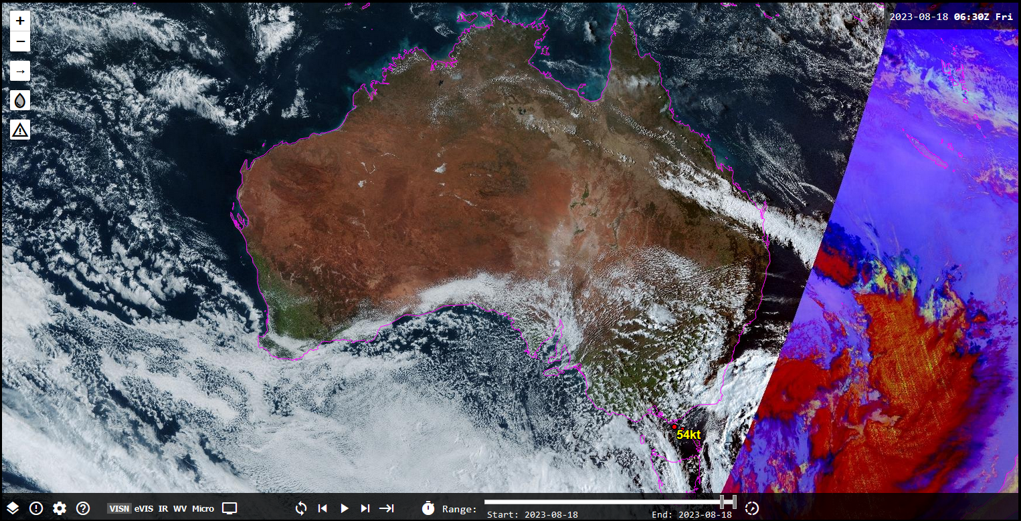
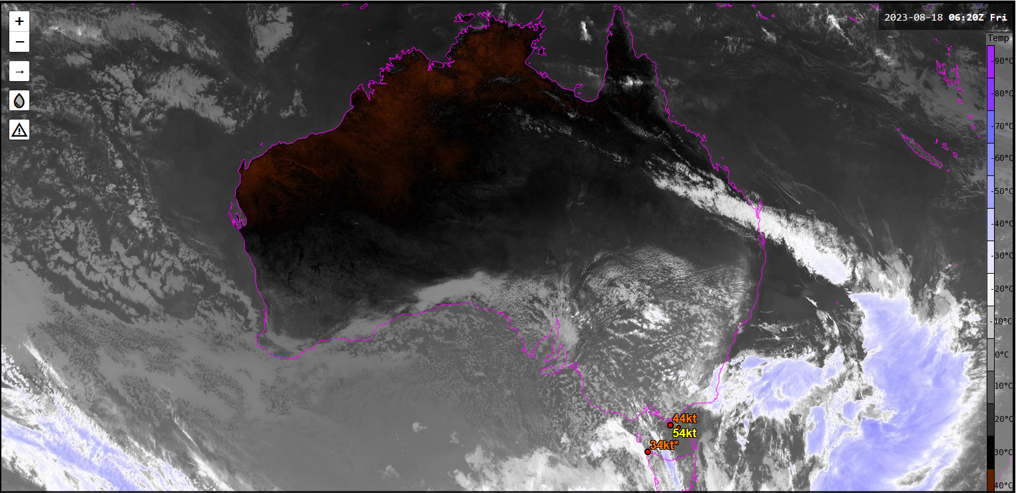
Evaluating the delay in the receipt of real-time 10-minute Himawari-9 data at the Bureau (18th August 2023)
images courtesy JMA / Bureau of Meteorology
UTC timestamp on 10-minute image | Local time receipt of image into the Bureau "Panther" visualisation software (UTC +10) | time delay (minutes) for True Colour RGB image
0620 | 1637 LST | 17
0630 | 1646 LST | 16
0640 | 1957 LST | 17
Darwin
Tasmania
UTC timestamp on 10-minute image | Local time receipt of image into the Bureau "Panther" visualisation software (UTC +10) | time delay (minutes) for IR (Band 13) image
0620 | 1635 LST | 15
0630 | 1644 LST | 14
0640 | 1654 LST | 14
Darwin
Tasmania

Slide 12
Time delay between overpass time and receipt of 10-minute Himawari-9 data (18th August 2023)
images courtesy JMA / Bureau of Meteorology
Overpass time over Australia (UTC) | Local time receipt of image into the Bureau "Panther" visualisation software (UTC +10) | time delay (minutes) for True Colour RGB image
0626-0629 | 1637 LST | 8-11
0636-0639 | 1646 LST | 7-10
0646-0649 | 1957 LST | 8-11
Darwin
6-7 minute
7-8 minute
8-9 minute
Tasmania
Overpass time over Australia (UTC) | Local time receipt of image into the Bureau "Panther" visualisation software (UTC +10) | time delay (minutes) for IR (Band 13) image
0626-0629 | 1635 LST | 6-9
0636-0639 | 1644 LST | 5-8
0646-0649 | 1654 LST | 5-8
Darwin
6-7 minute
7-8 minute
8-9 minute
Tasmania

Slide 13
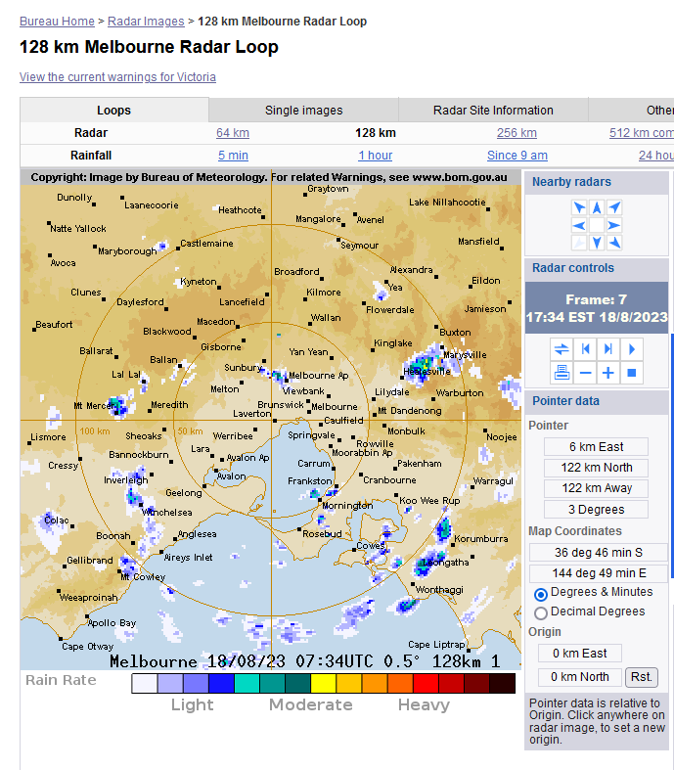
Receipt of RADAR images on the Bureau of Meteorology external web site (Melbourne RADAR)
UTC timestamp on the RADAR image | Local time receipt of image onto (UTC +10) | time delay for receipt of RADAR images (minutes)
0734 | 1736 LST | 2
0739 | 1741 LST | 2
0744 | 1746 LST | 2
0749 | 1754 LST | 5
0754 | 1758 LST | 4
0759 | 1803 LST | 4
Note: Timestamp on the RADAR image corresponds to the end of the observation period / the scan. (Leon Majewski, 23rd August 2023). Each scan takes 5 minutes.
image courtesy Bureau of Meteorology

Slide 14
Time delay from scanning to receipt of RADAR data (Melbourne RADAR)
RADAR image scanning time UTC | Local time receipt of image onto (UTC +10) | time delay for receipt of RADAR images (minutes)
0729-0734 | 1736 LST | 2-7
0734-0739 | 1741 LST | 2-7
0739-0744 | 1746 LST | 2-7
0744-0749 | 1754 LST | 5-10
0749-0754 | 1758 LST | 4-9
0754-0759 | 1803 LST | 4-9
Note: Timestamp on the RADAR image corresponds to the end of the observation period / the scan. (Leon Majewski, 23rd August 2023). Each scan takes 5 minutes.
image courtesy Bureau of Meteorology

Slide 15
Time delay from overpass (Himawari-9) and scanning (RADAR data) and receipt of this data by Bureau forecasters
Himawari-9 overpass time over Australia (UTC) | Local time receipt of image into the Bureau "Panther" visualisation software (UTC +10) | time delay (minutes) for True Colour RGB image
0626-0629 | 1637 LST | 8-11
0636-0639 | 1646 LST | 7-10
0646-0649 | 1957 LST | 8-11
RADAR image scanning time UTC | Local time receipt of image onto (UTC +10) | time delay for receipt of RADAR images (minutes)
0729-0734 | 1736 LST | 2-7
0734-0739 | 1741 LST | 2-7
0739-0744 | 1746 LST | 2-7
0744-0749 | 1754 LST | 5-10
0749-0754 | 1758 LST | 4-9
0754-0759 | 1803 LST | 4-9
Activity: Why don't you try a similar exercise to determine the delay in receipt of satellite and RADAR data at your workplace.
image courtesy Bureau of Meteorology

Slide 16
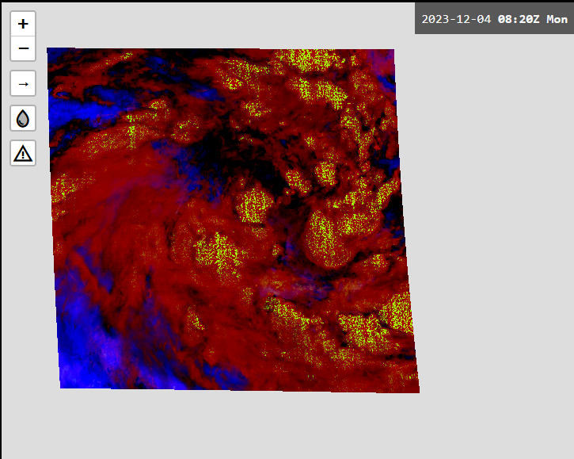
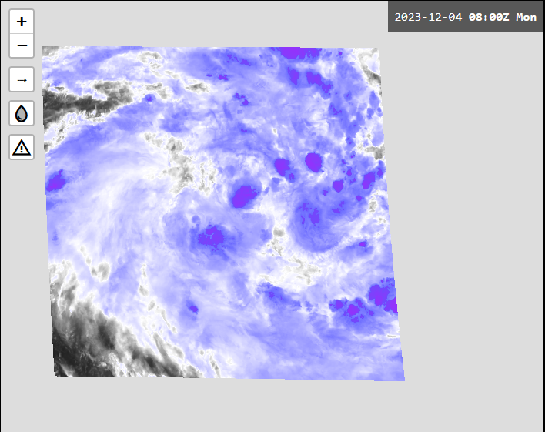
Evaluating the delay in the receipt of real-time 2.5-minute Himawari-9 data at the Bureau (4th December 2023)
images courtesy JMA / Bureau of Meteorology
UTC timestamp on 2.5-minute image | Local time receipt of image into the Bureau "Panther" visualisation software (UTC +10) | time delay (minutes) for True Colour / Night Micro RGB image
0837-0840 | 1949 LST | 9
0840-0842 | 1952 LST | 10
0845-0847 | 1957 LST | 10
UTC timestamp on 2.5-minute image | Local time receipt of image into the Bureau "Panther" visualisation software (UTC +10) | time delay (minutes) for IR (Band 13) image
0855-0857 | 2004 LST | 7
0857-0900 | 2008 LST | 8
0900-0902 | 2010 LST | 8

Slide 17
Application of satellite data in anticipating Hazardous Weather. PART 1
Main hazardous weather that countries represented by the attendees need to monitor and warn against.
Data latency in countries represented by the attendees.
Satellite data latency, compared to latency of other observational data including RADAR data etc. for Panther.
Satellite data that can be viewed from outside the Bureau firewall and the delay in receipt of this data as viewed from the Bureau.
How to cope with data delay of 30 minutes (back to pre-Himawari days).
Request services and use of these

Slide 18
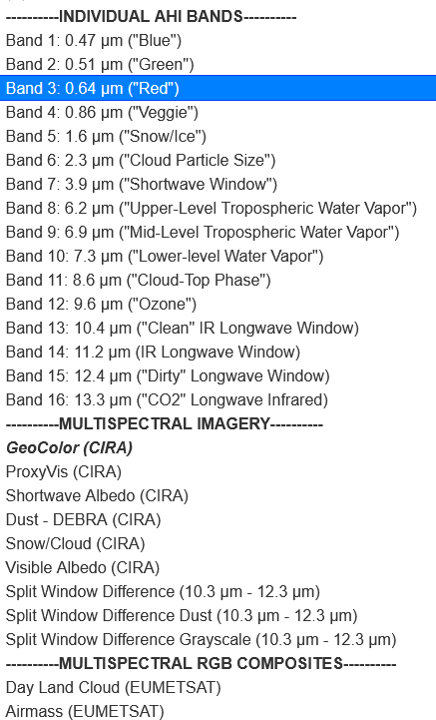
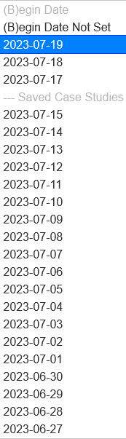
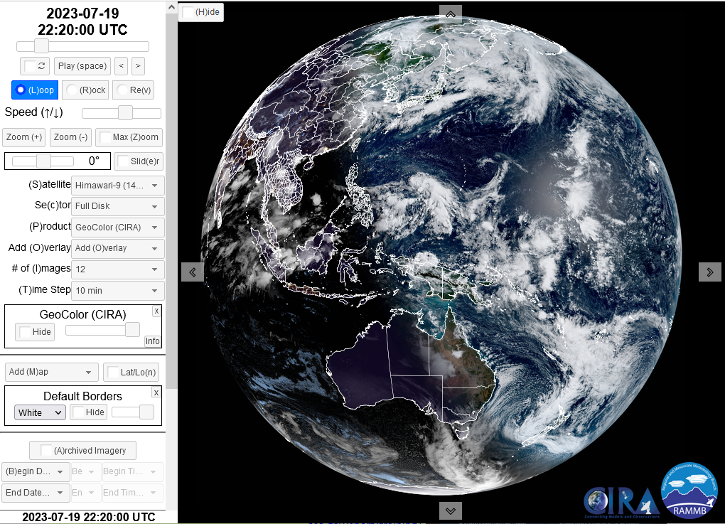
Himawari-9 data on the web (CIRA SLIDER)
CIRA Slider https://rammb-slider.cira.colostate.edu/ | Three weeks | 10 minute data
Himawari-9
(P)roduct

Slide 19
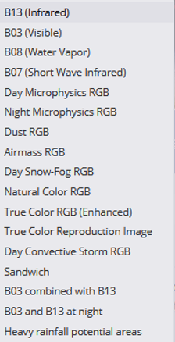
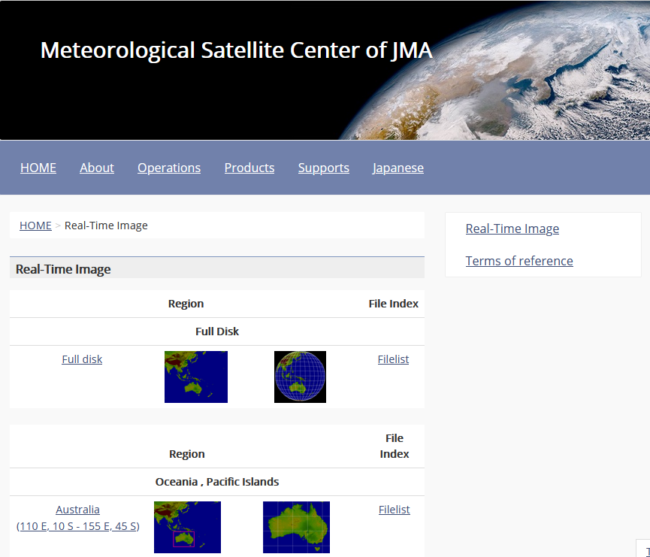
Himawari-9 data on the web (JMA website)
Various band and combinations, RGB composites. Heavy Rainfall Potential
JMA website https://www.data.jma.go.jp/mscweb/data/himawari/index.html | The last 24 hours (particular sectors) | 10 minute data

Slide 20
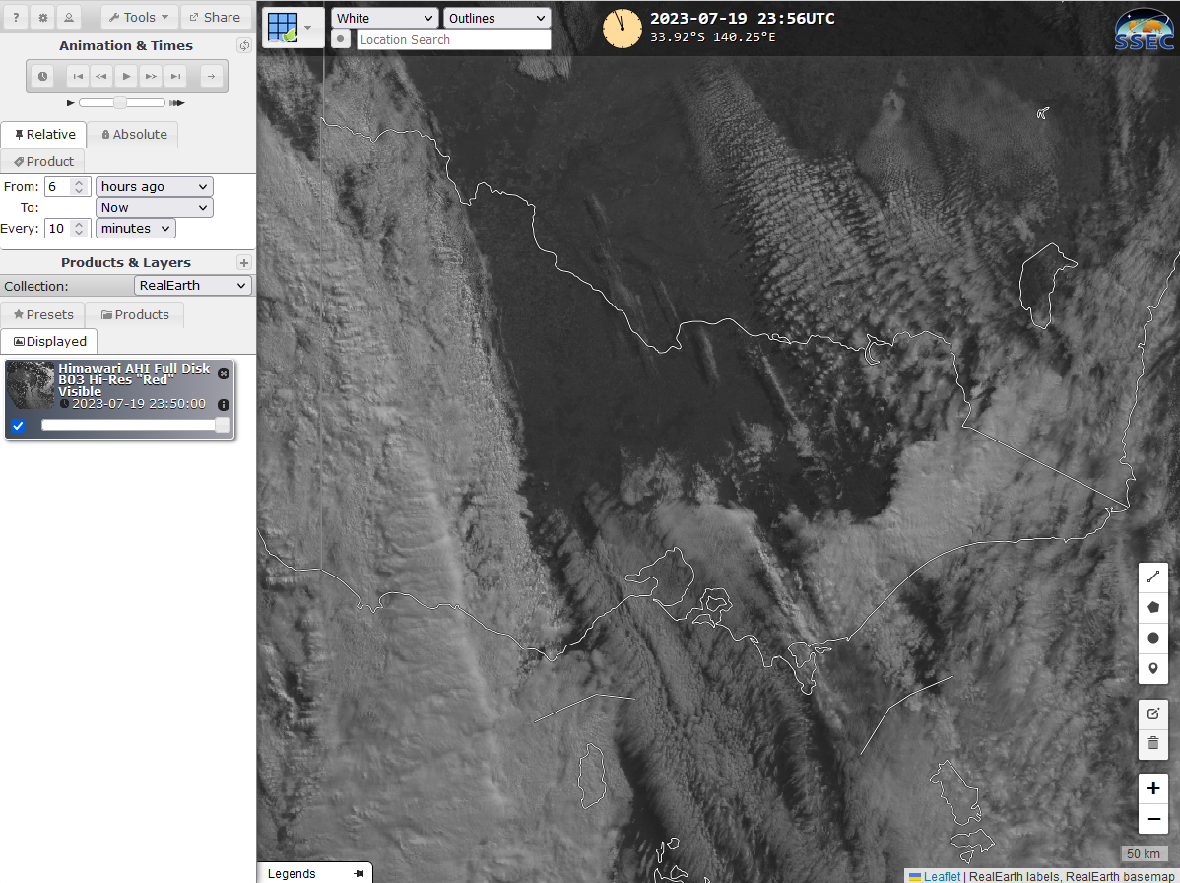
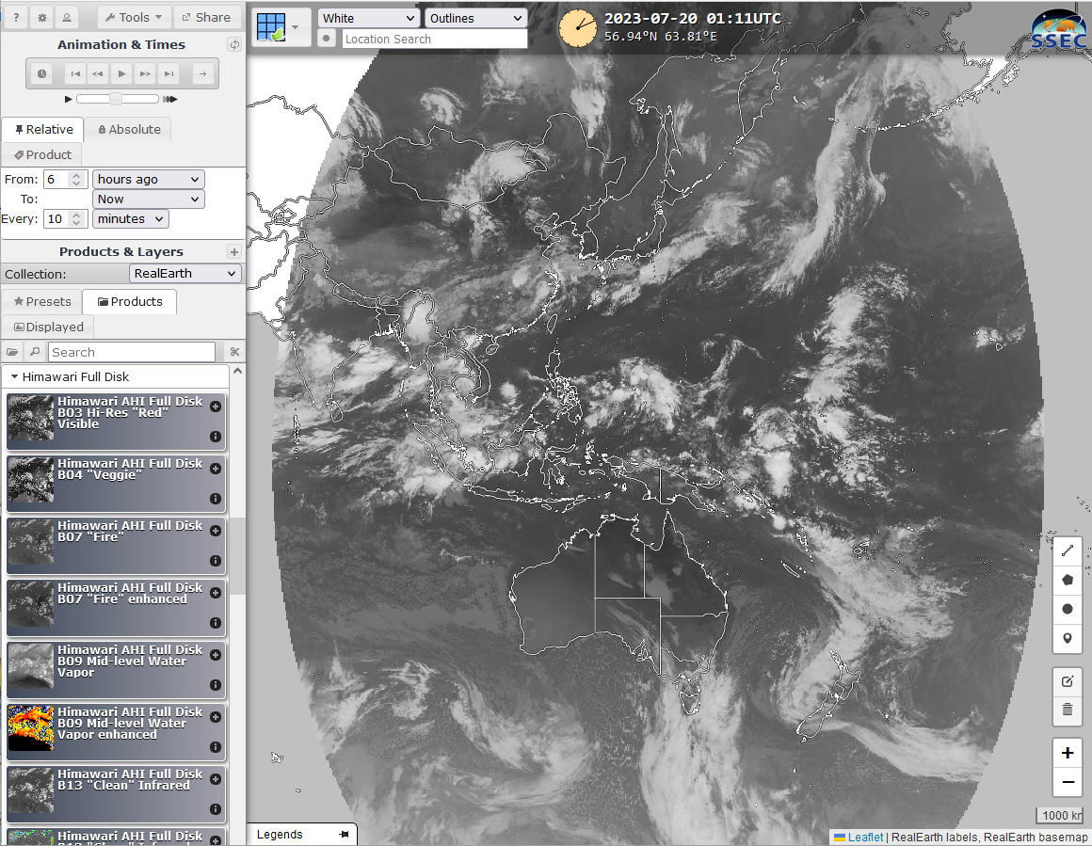
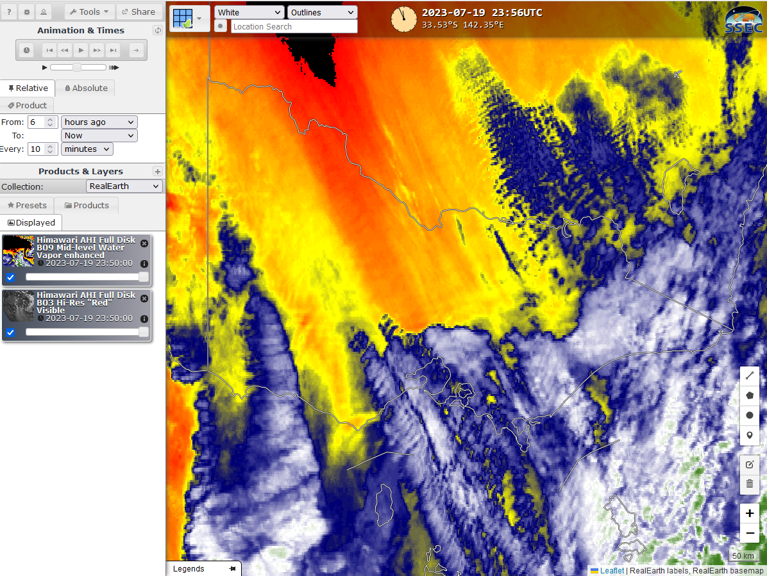
Himawari-9 data on the web (SSEC Real Earth)
SSEC Real Earth https://realearth.ssec.wisc.edu/ | 3 days of data | 10 minute data
Various band and RGB composites
Choose a time range
Choose Himawari Full Disk

Slide 21
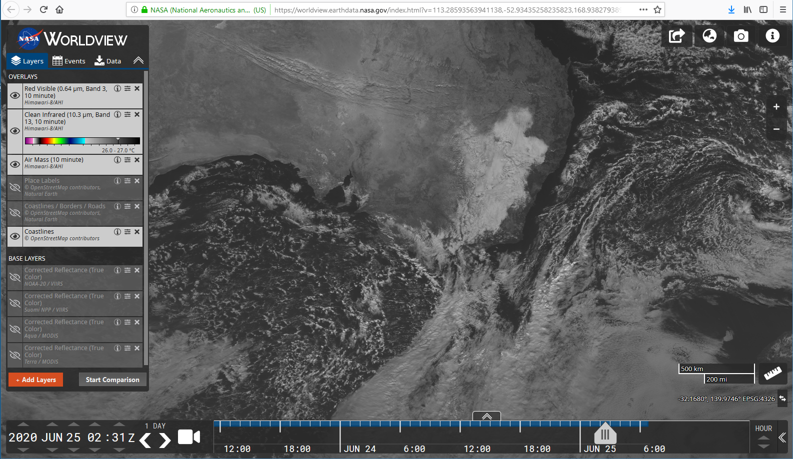
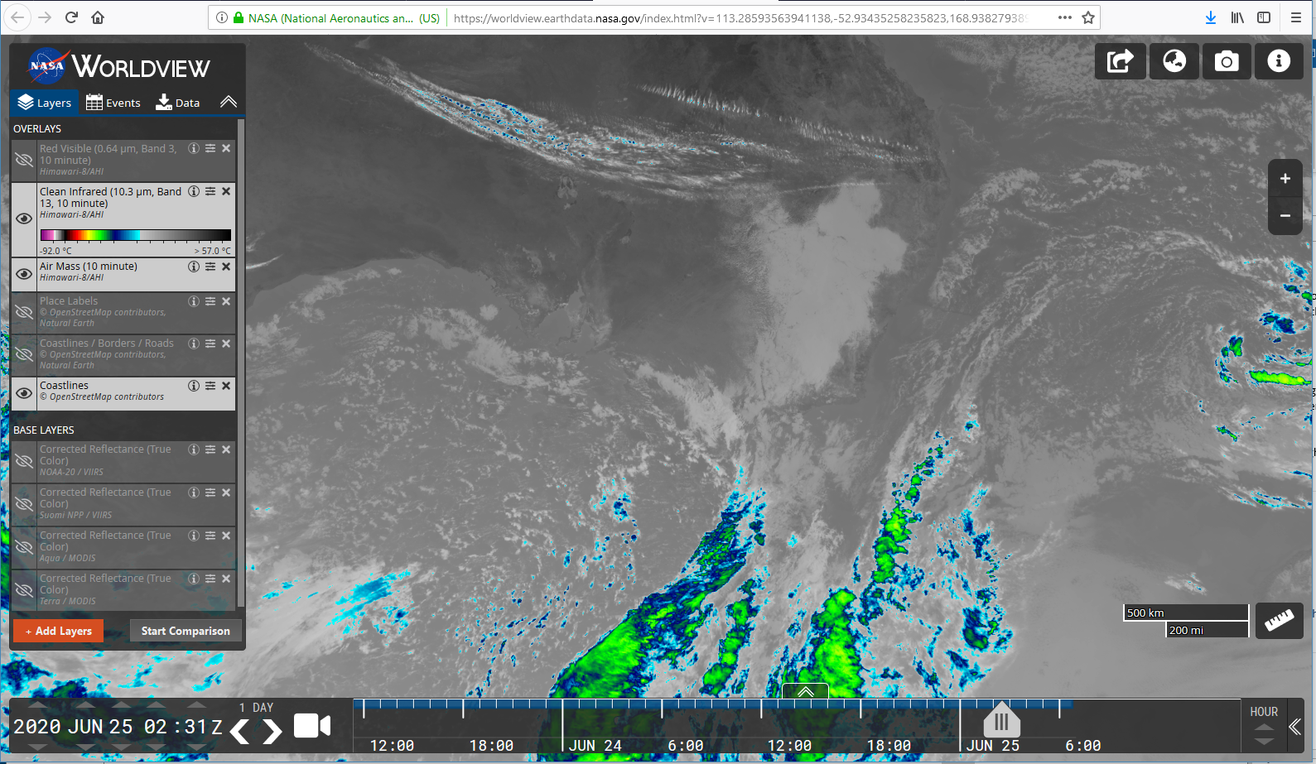
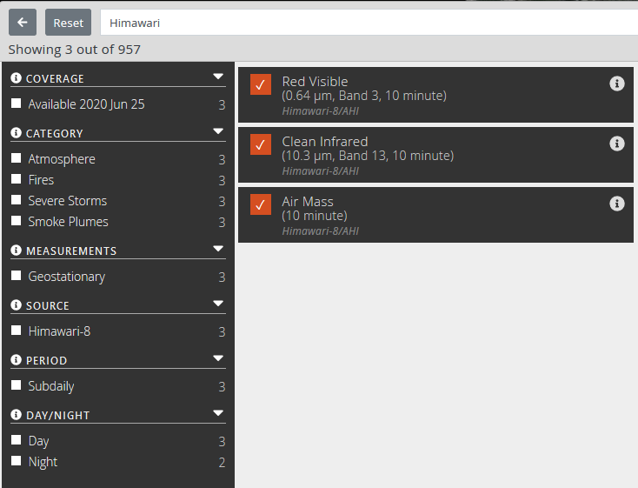
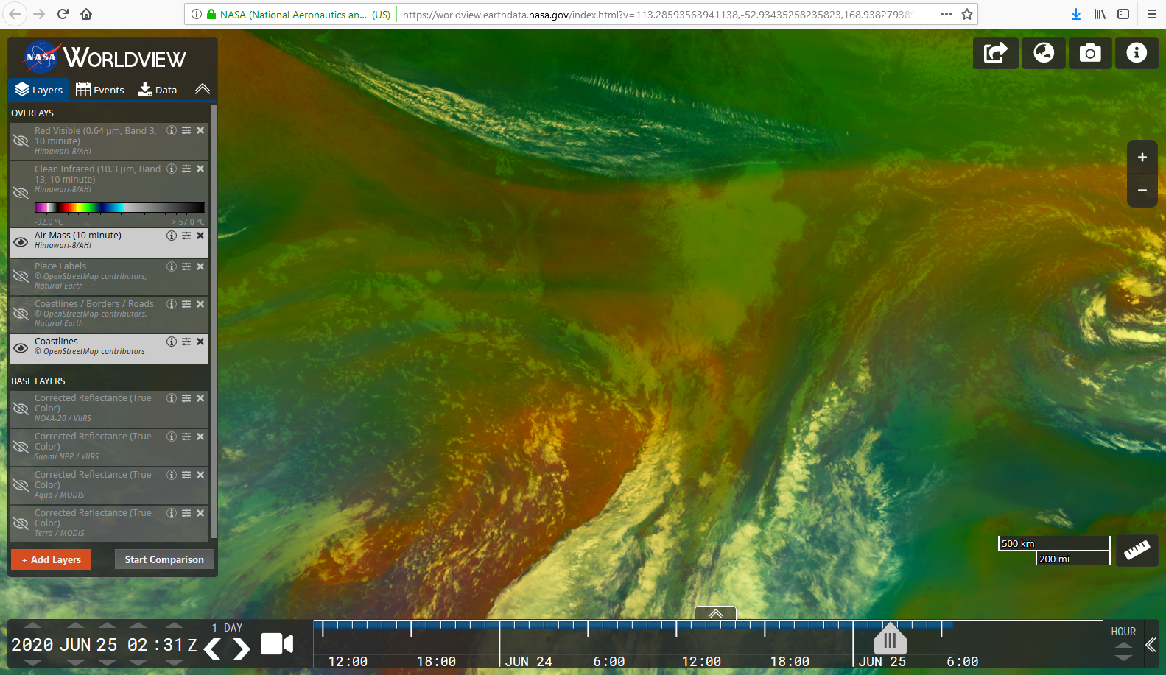
Himawari-9 data on the web (NASA Worldview)
NASA Worldview https://worldview.earthdata.nasa.gov/ | The last 90 days. Certain historical ranges also | 10 minute data
High resolution visible
Himawari
Enhanced Infrared
In the "+ Add Layers" menu option type in "Himawari"
Airmass RGB composite

Slide 22
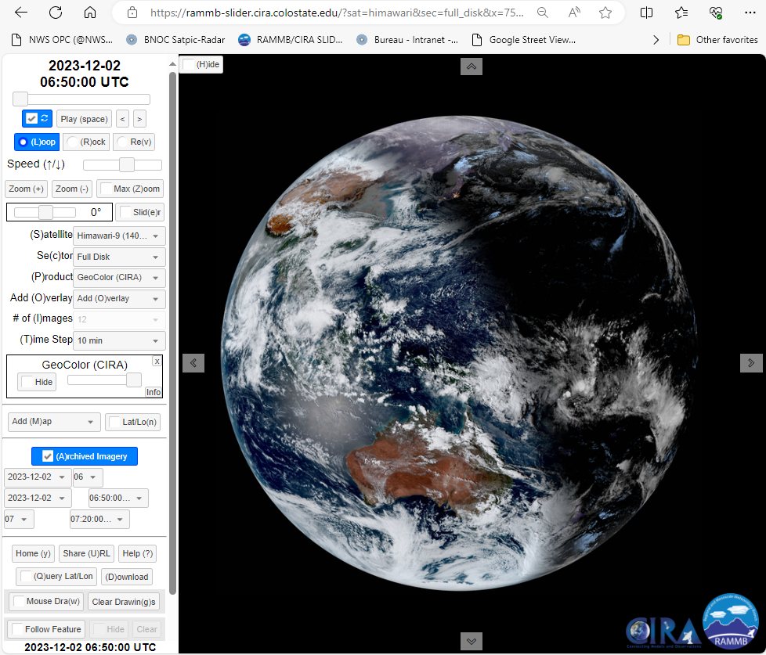
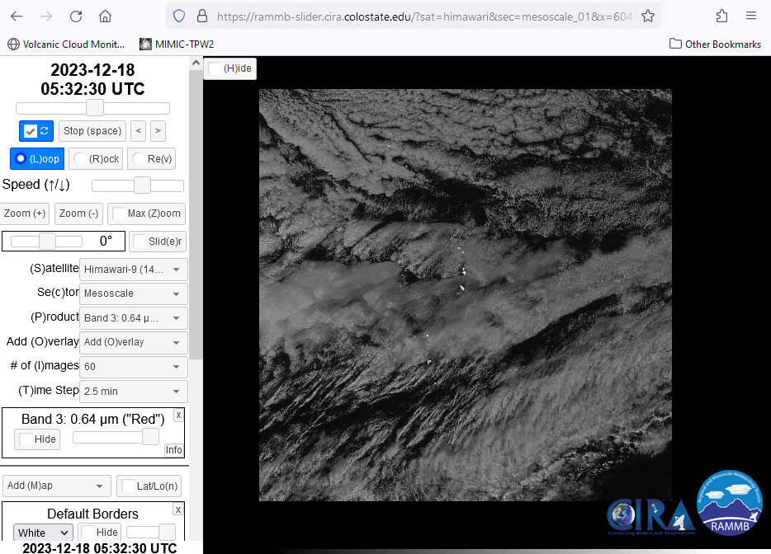
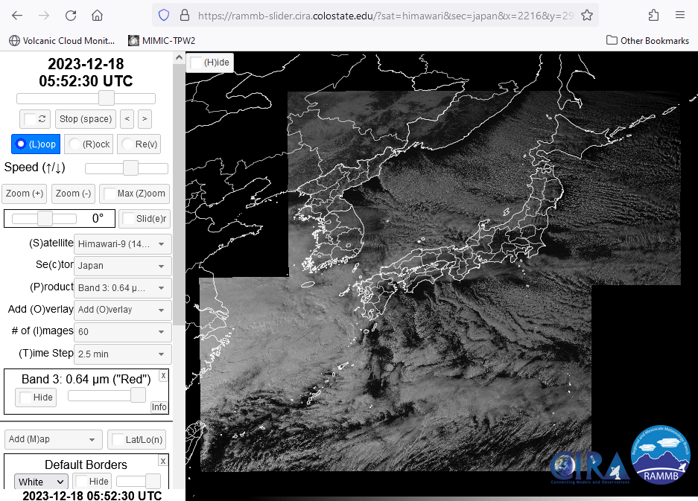
Evaluating the delay in the receipt of real-time 10-minute Himawari-9 data on CIRA SLIDER
images courtesy JMA / CIRA RAMMB
UTC timestamp on 10-minute Himawari-9 image 2 Dec 23 | Local time receipt of image into the CIRA SLIDER visualisation software (UTC +11) | time delay (minutes) for True Colour RGB image
Transition 0650UTC-0700UTC | 6.37pm LST (0737UTC) | 37
Transition 0700UTC- 0710UTC | 6.44pm LST (0744UTC) | 34
Transition 0710UTC-0720UTC | 6.54pm LST 0754UTC | 34
Rapid Scan 18th December 2024 (Japan)
Band 3, 0620-0625UTC (2 time steps) at 5.39pm. ~14 minute delay
Band 3, 0625-00630UTC (2 time steps) at 5.43pm. ~13 minute delay

Slide 23
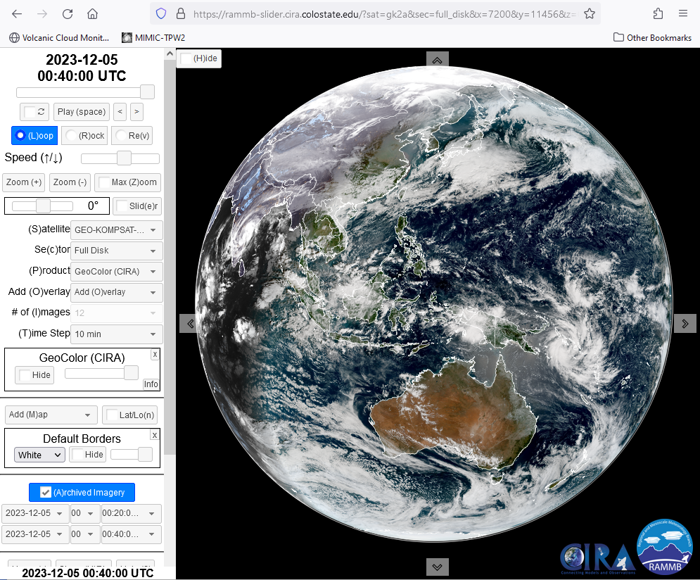
Quick analysis of the delay in the receipt of real-time 10-minute GK-2A data on CIRA SLIDER
images courtesy JMA / CIRA RAMMB
CIRA SLIDER GK2A
TC RGB 5th Dec 23 0020-0040UTC changeover at 12.19pm 39 minute delay
Band 3 Need to test this. Refreshing required. Possibly a 25 minute delay.

Slide 24
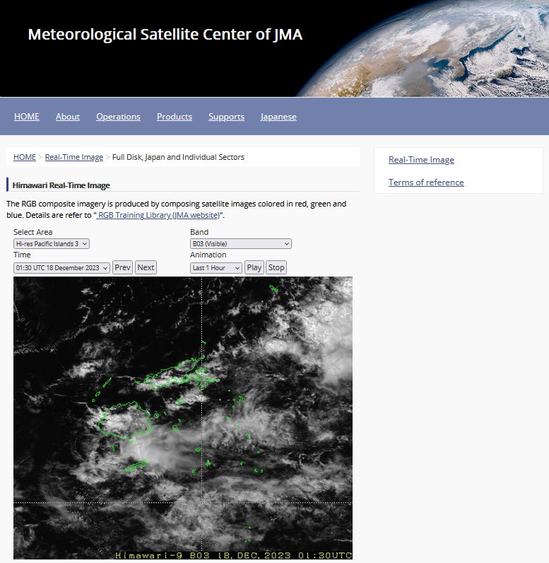
Quick analysis of the delay in the receipt of real-time 10-minute JMA Himawari viewer (JMA) https://www.data.jma.go.jp/mscweb/data/himawari/ Fiji area
images courtesy JMA / CIRA RAMMB
JMA Himawari viewer (Fiji area)
Band 3, 0130-0140UTC at 1246pm. 6 minute delay
Band 3, 0140-0150UTC at 12.56pm. 6 minute delay

Slide 25
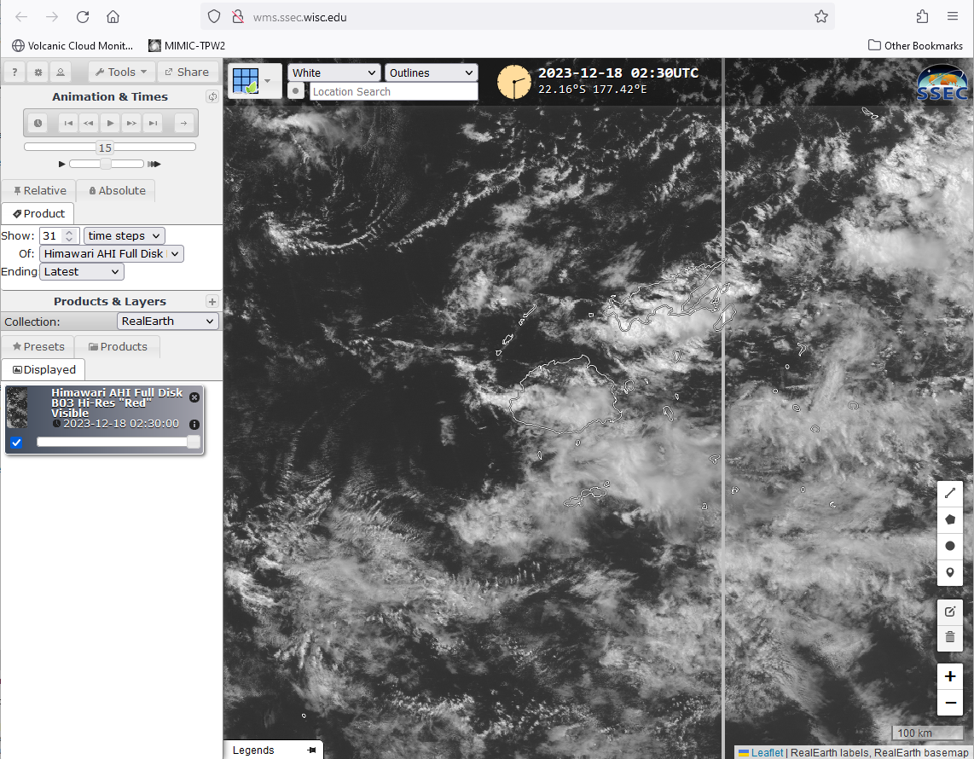
Quick analysis of the delay in the receipt of real-time 10-minute Himawari-9 data as rendered by the SSEC Real Earth http://wms.ssec.wisc.edu/ Fiji area
images courtesy JMA / SSEC University Wisconsin Madison
SSEC Real Earth (Fiji area)
5th Dec 2023
Band 3, 0220-0230UTC at 1.52pm. 22 minute delay.
Band 3, 0250-0300UTC at 2.23pm. 23 minute delay

Slide 26
Application of satellite data in anticipating Hazardous Weather. PART 1
Main hazardous weather that countries represented by the attendees need to monitor and warn against.
Data latency in countries represented by the attendees.
Satellite data latency, compared to latency of other observational data including RADAR data etc. for Panther.
Satellite data that can be viewed from outside the Bureau firewall and the delay in receipt of this data as viewed from the Bureau.
How to cope with data delay of 30 minutes (back to pre-Himawari days).
Request services and use of these

Slide 27
For countries that have a 30-minute delay in the display of satellite images (PART1)
How can you use the existing data to the best effect
Can obtain the 10-minute interval Himawari imagery with a time delay of 6 minutes from timestamp from the JMA Himawari Viewer. Unfortunately, the domains are fixed, and it is not possible to zoom in.
Other viewers of 10-minute interval Himawari imagery have a delay of 15-35 minutes.
Rapid scan imagery is an option also, though this has to be over the domain of interest, and it is likely to be so only when there is a severe weather event over the area.
For CIRA SLIDER the rapid scan delay is around 14 minutes for 2.5 minute data. Can use the Mesoscale mode (10 minute refreshment with delay of ~13 minutes) for Himawari-9 though there is no equivalent for GK2A .
Rapid scan imagery has a delay of 30-60 minutes from request (Bessho-san).

Slide 28
For countries that have a 30-minute delay in the display of satellite images (PART 2)
Techniques to cope with ~30 minute delays in imagery
24 hour comparison of High resolution visible data on the morning of the day in question. Relative activity.
Short loops of 10 minute CIRA SLIDER data, even if it is 15-35 minutes behind, can give an idea of the evolution of the features. Data will be at 10 minute intervals. Comparison with yesterday.
Where does the first convection occur.
Where does the convective cloud start to "clump"
Where does the connective cloud start to glaciate (Day Micro on SLIDER, or use 3.9 or 1.6 or 2.3 micron imagery).
When is the first signal apparent in the RADAR data (Fiji)
When is the first signal apparent in the lightning data (Samoa, also other Pacific Islands). Try for some GOES-18 case studies?
How much lead time do you need?

Slide 29
For countries that have a 30-minute delay in the display of satellite images. (PART 3)
Techniques to cope with ~30 minute delays in imagery
From Convective Analysis
24 hour comparison of soundings. Features of interest:
T/Td (unmodified) / modified?
Relative stability / instability of trace.
Dry slots in the trace. Inversions in the trace.
CAPE
Wind structure (direction, strength, critical features e.g., jet at 700hPa). Organised vs unorganised storms.
Precipitable water in the trace. Moist low levels (below 5000ft?)

Slide 30
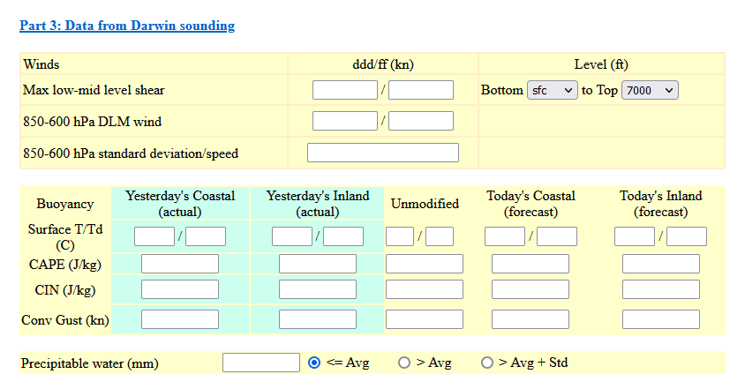
Darwin Convective Analysis Sheet (1)

Slide 31
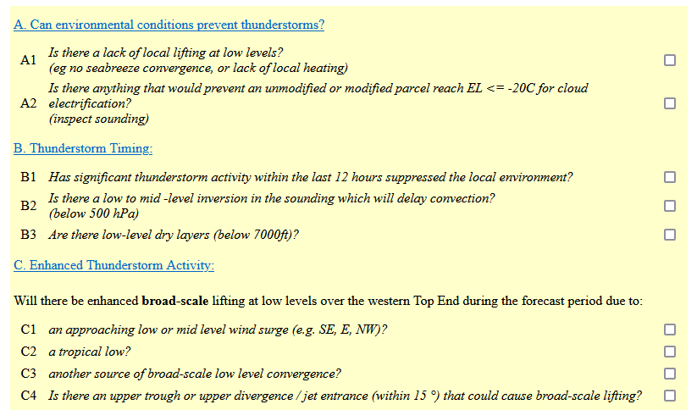
Darwin Convective Analysis Sheet (2)

Slide 32
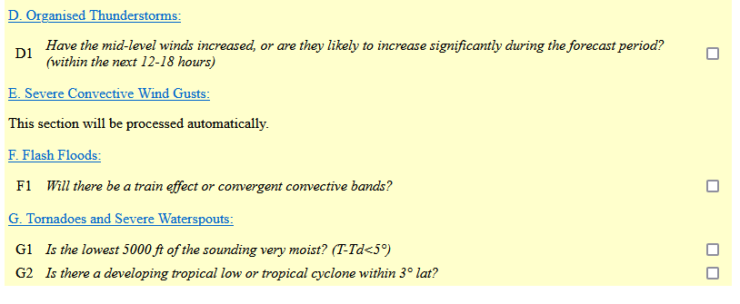
Darwin Convective Analysis Sheet (3)

Slide 33
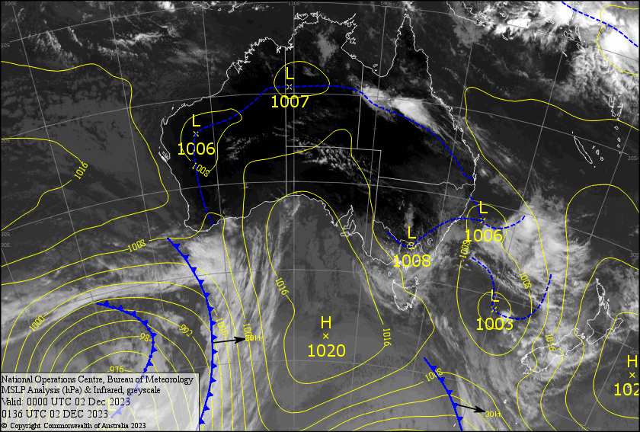
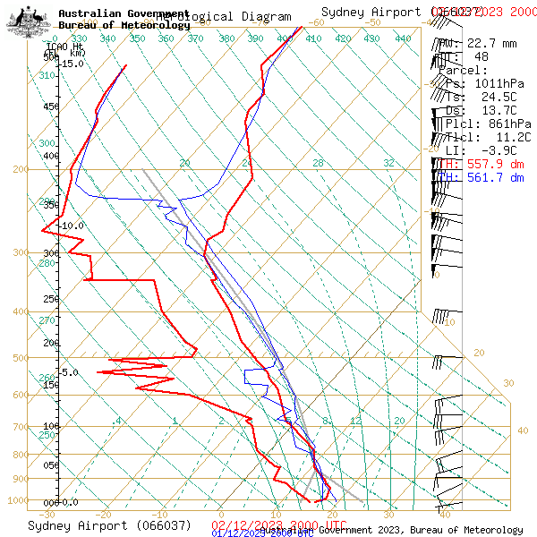
24-hour synoptic situation and soundings

Slide 34
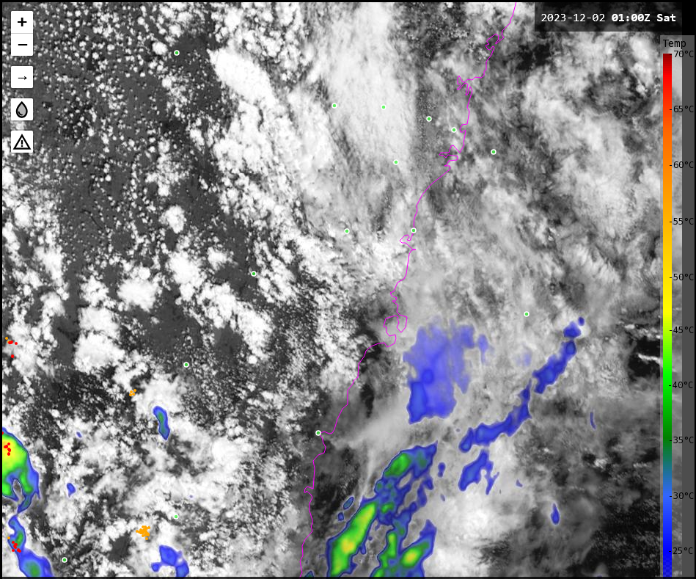
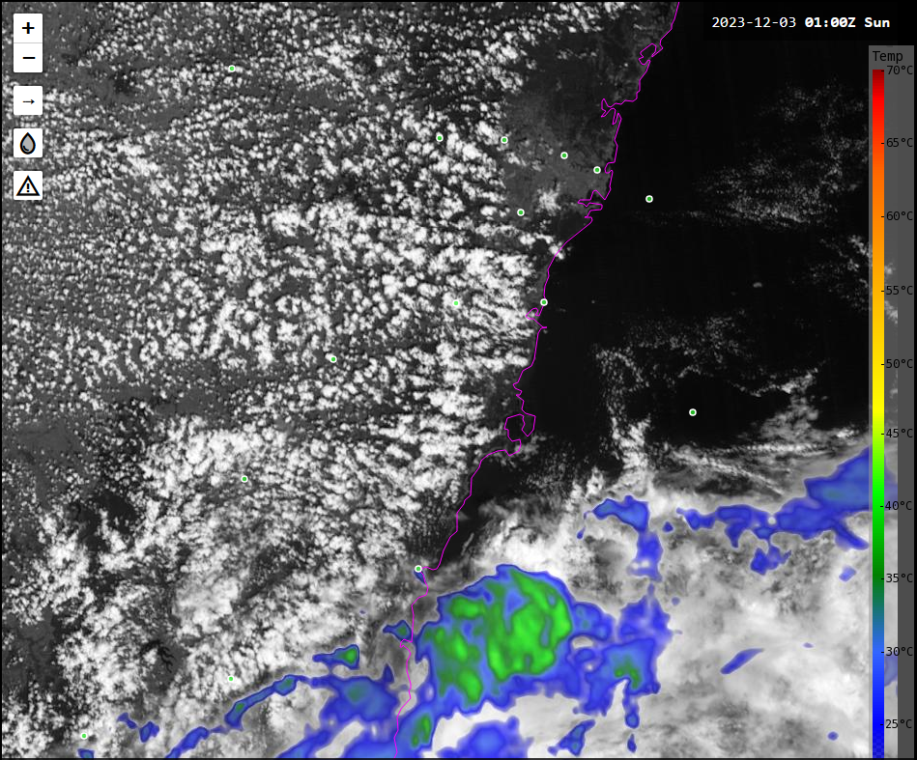
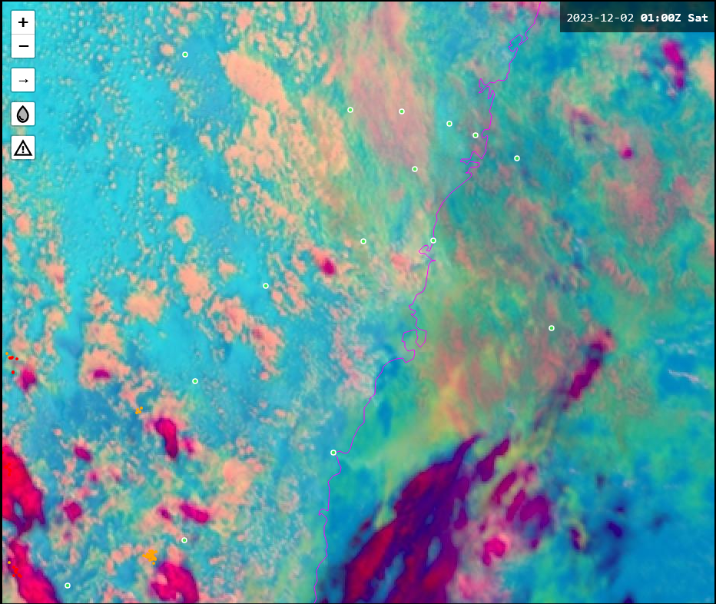
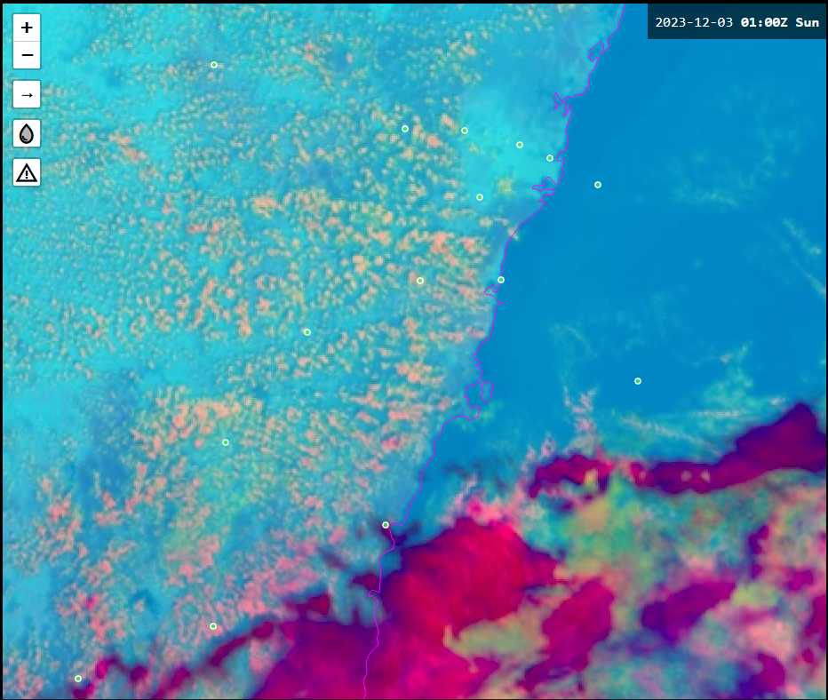
24-hour comparison of satellite imagery (01UTC)

Slide 35
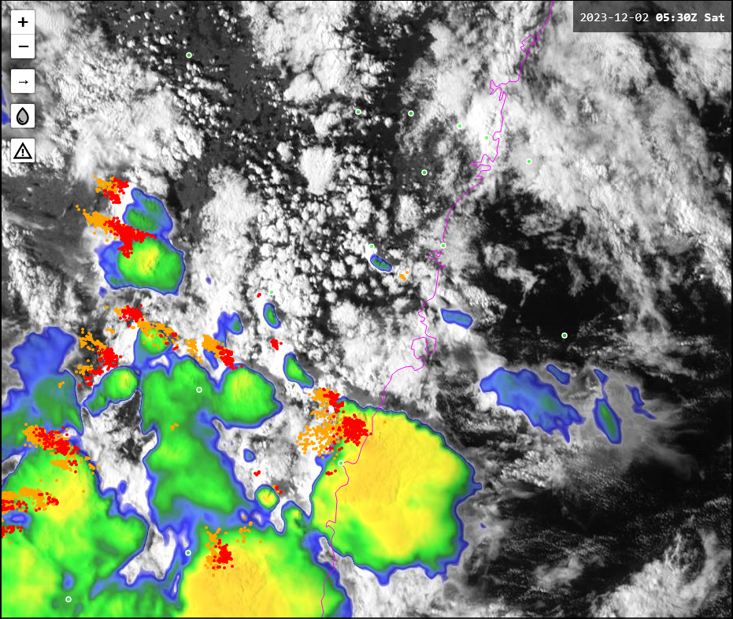
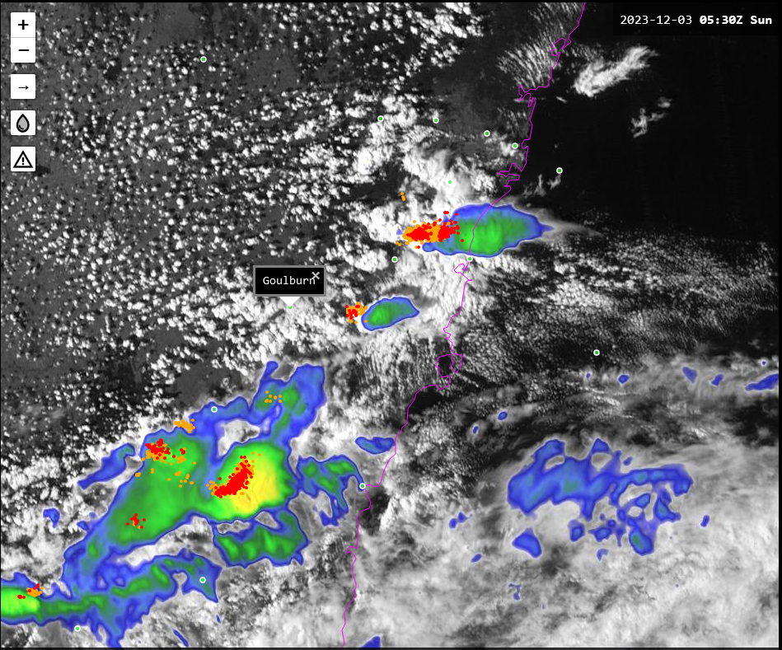
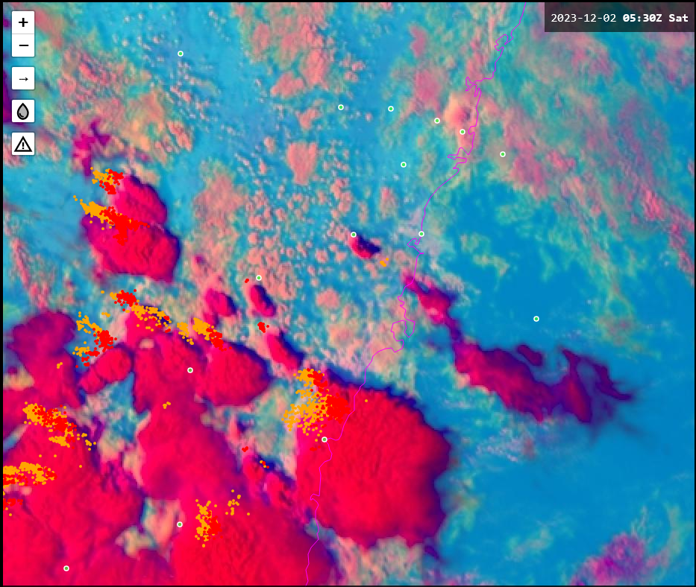
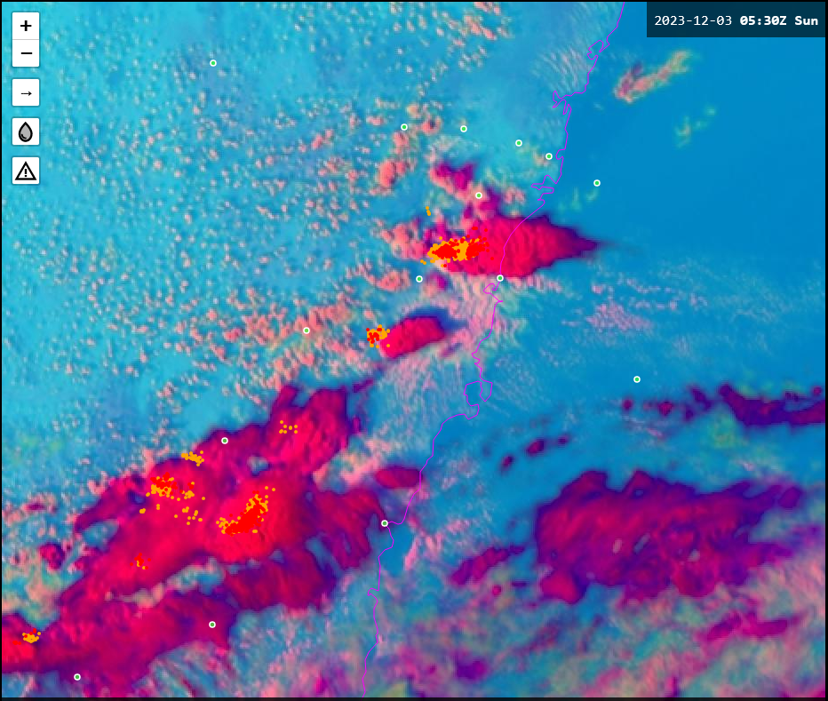
24-hour comparison of satellite imagery (0530UTC)

Slide 36
Application of satellite data in anticipating Hazardous Weather. PART 1
Main hazardous weather that countries represented by the attendees need to monitor and warn against.
Data latency in countries represented by the attendees.
Satellite data latency, compared to latency of other observational data including RADAR data etc. for Panther.
Satellite data that can be viewed from outside the Bureau firewall and the delay in receipt of this data as viewed from the Bureau.
How to cope with data delay of 30 minutes (back to pre-Himawari days).
Request services and use of these

Slide 37
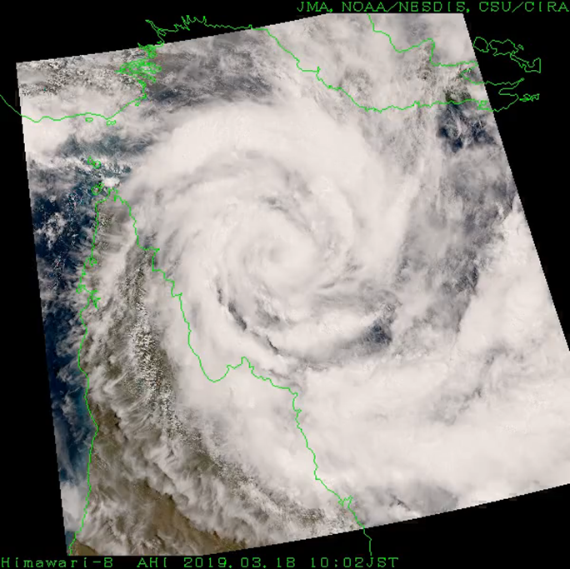
HimawariRequest
HimawariRequest was started from January 2018 in cooperation with Bureau of Meteorology (BoM), Australia.
International service for NMHSs in Himawari-8/9 coverage area to request Target Area observation(1,000 x 1,000 km area
every 2.5 minutes).
JMA expects this service to support disaster risk reduction activities in the
Asia Oceania region.
Status as of 08 September 2023
Registration: 22 NMHSs
185 requests for TC, volcanic
eruption, wildfires, etc.
HimawariRequest from BoM on 13-19 Mar. 2019
slide kindly forwarded to me by Mr Hiroshi Suzue, Japan Meteorological Agency

Slide 38
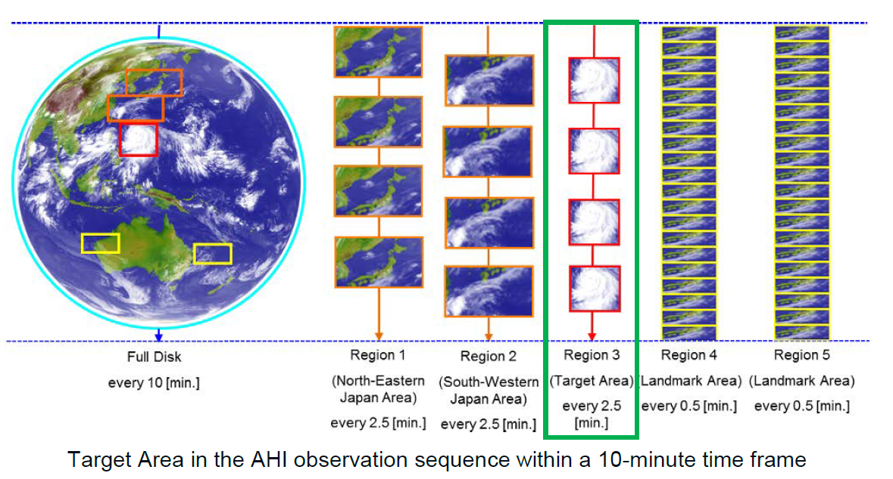
Request driven Himawari-8/9 rapid scan (2.5-minute) data
Note: As per feedback from Kotaro Bessho, JMA, the HimawariRequest service can be activated by JMA within 30-60 minutes of receiving the request.
image courtesy JMA

Slide 39
Himawari Request Service (feedback from Kazutaka Yamada, JMA)
In the past, just under 90% of all requests came from the Australian Bureau of Meteorology.
Before 2020 JMA has accepted requests from New Zealand, Philippines, Fiji, Singapore and Indonesia for monitoring tropical cyclones, haze, and volcanic activities.
After 2021, JMA have accepted requests for monitoring tropical cyclones from NOAA and India.
JMA provide this observational data via Himawari cloud service and MSCWEB.

Slide 40
Request driven GEO-KOMPSAT-2A rapid scan (2-minute) data (slide from Dr Sung-Rae Chung's presentation at the joint Korea Australia VLab CoE's Regional Focus Group meeting of 29th October 2019)

Slide 41
KMA's GEO-KOMPSAT-2A Request Driven Rapid Scan Service (feedback from Dr Sung-Rae Chung, Korea Meteorological Administration)
Both the Australian Bureau of Meteorology and Hong Kong (China) have requested this service in the past.
Agnes – feedback from KMA regarding more GK-2A case studies.

Slide 42
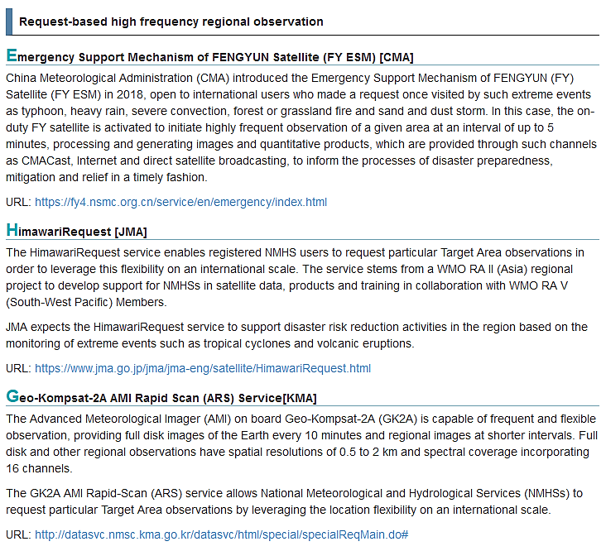
About Rapid Scan data from CMA, JMA and KMA (https://www.jma.go.jp/jma/jma-eng/satellite/ra2wigosproject/ra2wigosproject-intro_en_jma.html )
FY ESM
(CMA)
HimawariRequest
(JMA)
Geo-Kompsat-2A AMI ARS Service (KMA)
Notes:
https://www.beaconstac.com/qr-code-generator

Slide 43
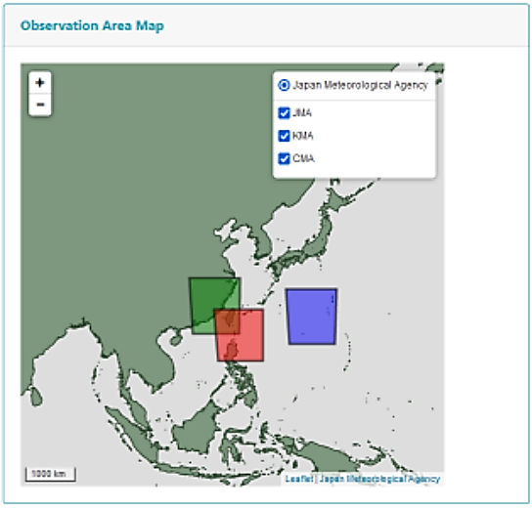
Request-based high frequency regional observations Note: Kotaro Bessho of JMA mentioned that this is a future plan. It has not yet been implemented
image forwarded by Yamada Kazutaka Japan Meteorological Agency
FY ESM
(CMA)
HimawariRequest
(JMA)
Geo-Kompsat-2A AMI ARS Service (KMA)
Japan Meteorological Agency
JMA
KMA
CMA
Notes:
https://www.beaconstac.com/qr-code-generator

Slide 44
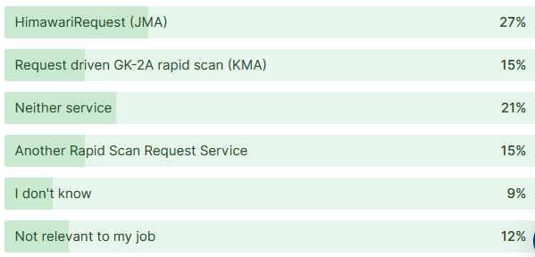
AOMSUC-13 Training Event Session T-15 Question 3 Which Rapid Scan Request Service has been used at your workplace in the past to monitor Hazardous Weather in your country? 28 attendees applied to the question.
9/28
5/28
7/28
5/28
3/28
4/28

Slide 45
Thank You ☺
Bodo Zeschke
Notes:
Accessibility information – delete after reading
We're all responsible for producing accessible documents. Use the accessibility checker to make sure your content is accessible to everyone.

