Slide 1
Australian VLab Centre of Excellence Regional Focus Group meeting 1st August 2023 Examining the performance of the GOES-18 Geostationary Lightning Mapper as rendered in SLIDER and over the Pacific region, 28th June 2023
UNOFFICIAL
Bodo Zeschke Australian VLab Centre of Excellence Point of Contact
UNOFFICIAL

Slide 2
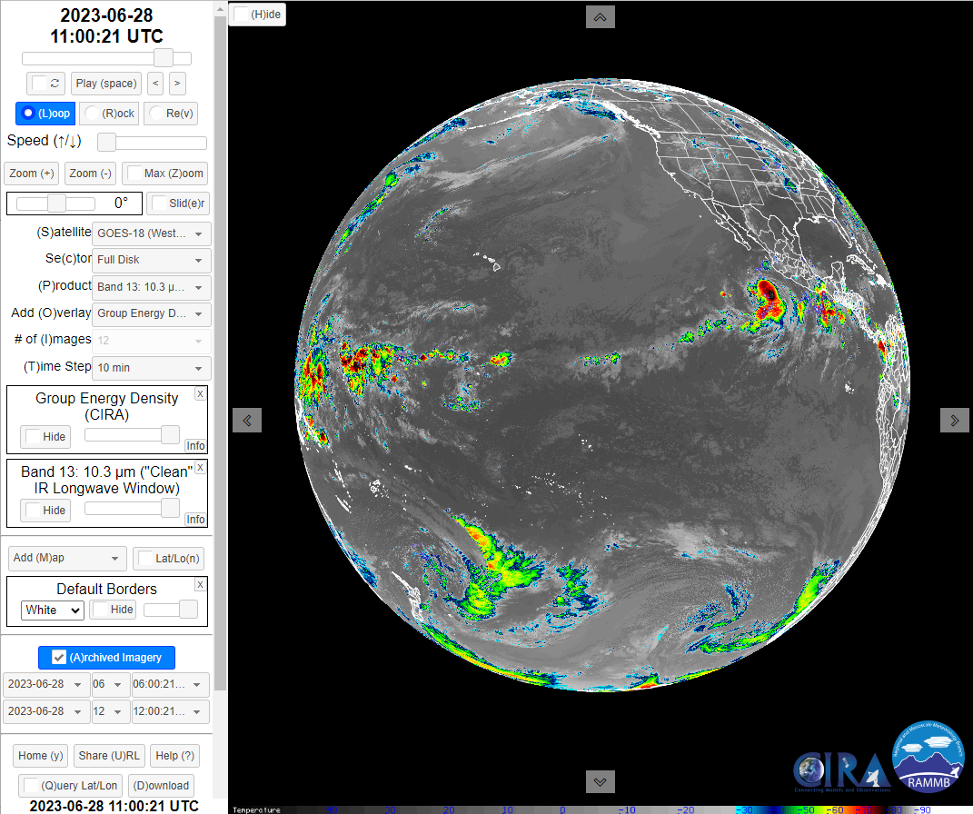
Examining the GOES-18 GLM Lightning Group Energy Density and the enhanced Band 13 in SLIDER, 28th June 2023
https://rammb-slider.cira.colostate.edu/
1: Satellite
USA
2: Choose GOES-18
Hawaii
Mexico
3: Product
Domain 2
4: Choose Band 13
5: Add overlay
Kiribati
Domain 1
6: Choose Geostationary Lightning Mapper Group Energy Density (CIRA)
Domain 3
New
Zealand

Slide 3
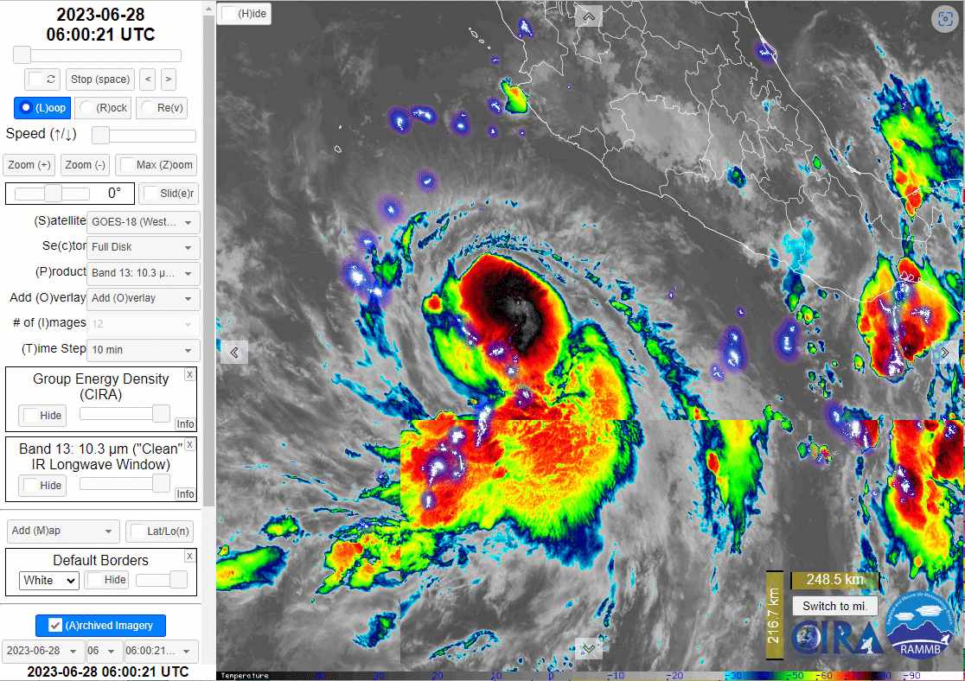
Performance of the GOES-18 GLM Lightning Group Energy Density / enhanced Band 13 in Domain 1
animation courtesy RAMMB CIRA Colorado State University
https://rammb-slider.cira.colostate.edu/
Warm cloud top lightning
Mexico
Hurricane
Adrian
Lightning associated with Hurricane Adrian

Slide 4
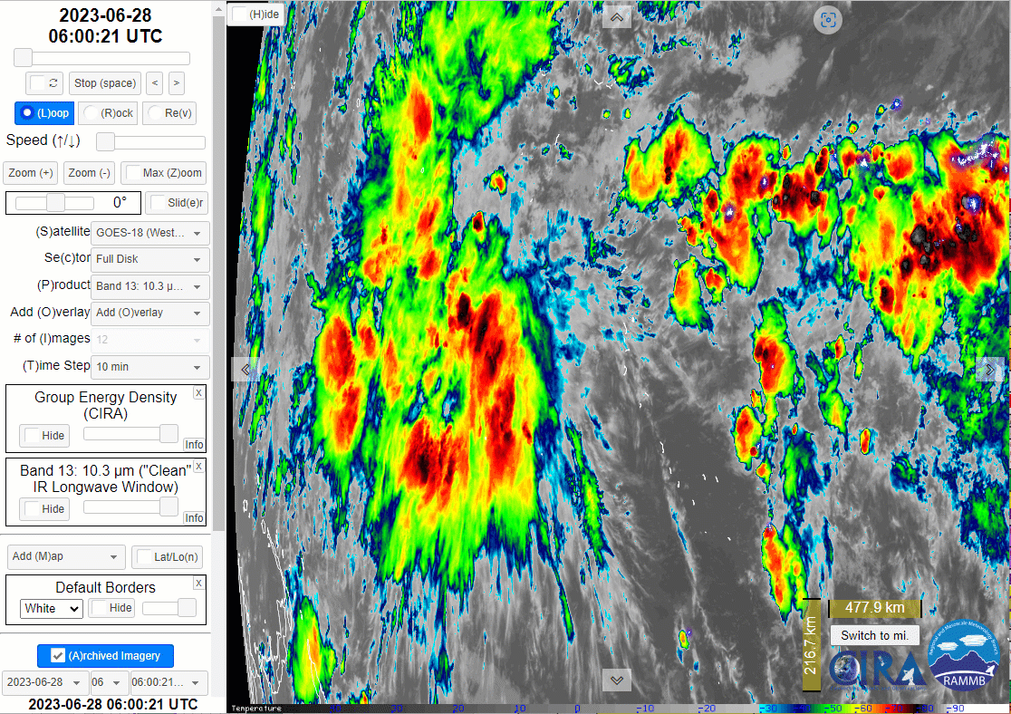
Performance of the GOES-18 GLM Lightning Group Energy Density / enhanced Band 13 in Domain 2
animation courtesy RAMMB CIRA Colorado State University
https://rammb-slider.cira.colostate.edu/
Deep convection lightning
Kiribati
No lightning in this deep convection. Why?
Papua New Guinea

Slide 5
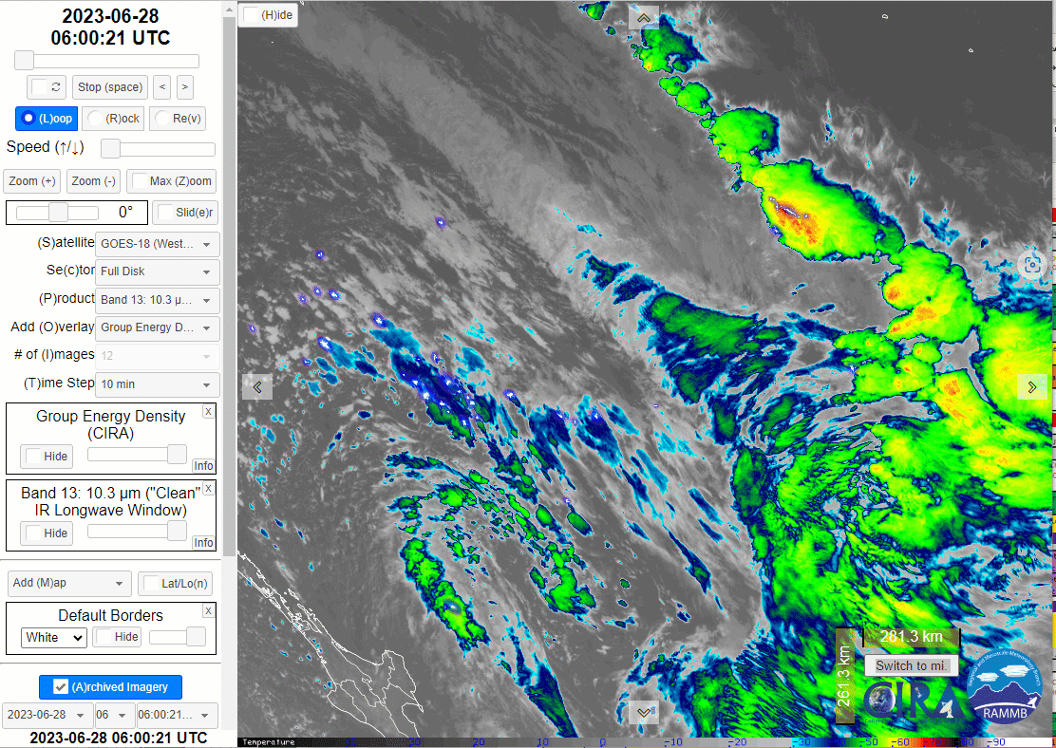
Performance of the GOES-18 GLM Lightning Group Energy Density / enhanced Band 13 in Domain 3
animation courtesy RAMMB CIRA Colorado State University
https://rammb-slider.cira.colostate.edu/
Frontal cloud band lightning
Post frontal lightning
New Zealand
New Zealand lightning

