Slide 1
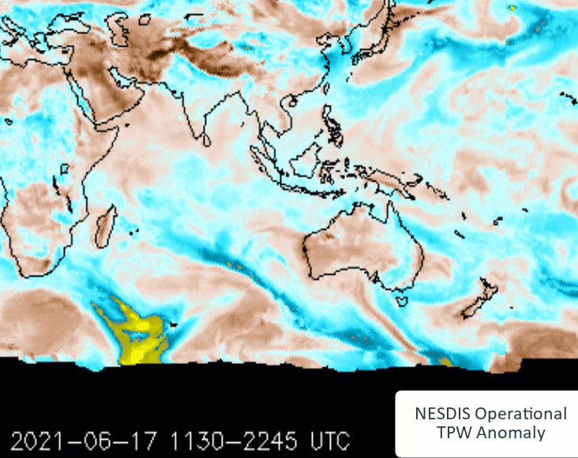
Animation: NESDIS Total Precipitable Water Anomalies Daily data 18th June to 18th July 2021
images courtesy NOAA OSPO
Meiyu Baiu Front activity
Drier than average Asian Monsoon
-IOD
Winter Fronts enhancing SPCZ
Passage of Winter Fronts
Notes:
http://www.ospo.noaa.gov/Products/bTPW/TPW_Animation.html

