Slide 1
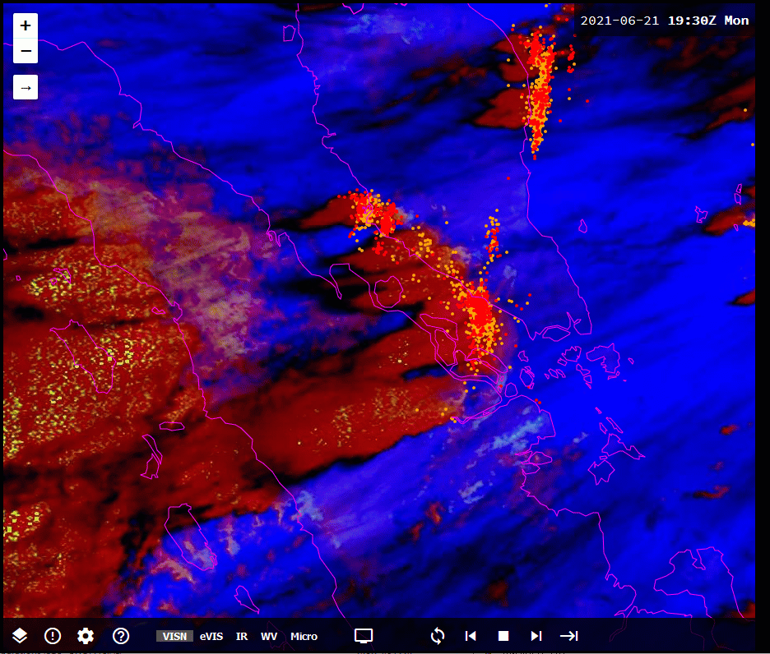
Animation 3: Xavi, the "Singapore Heartbreaker" (Night Micro / True Colour RGB, and lightning 1930UTC 21st June - 0400UTC 22nd June)
animation courtesy JMA/BOM, lightning data from WeatherZone
Night Microphysics RGB colour palette
S
Location of Singapore as "S"

