Slide 1
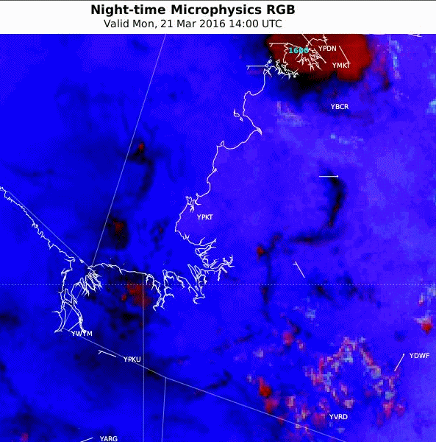
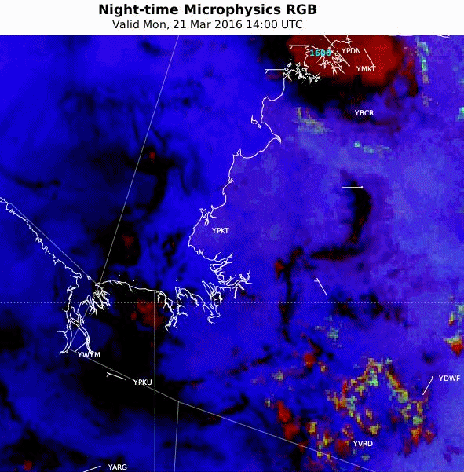
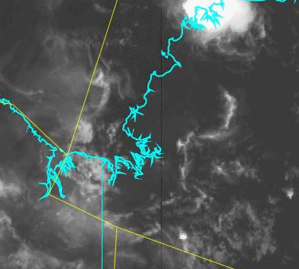
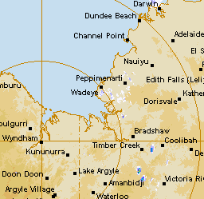
Animation Tropical and Midlatitude versions of the Night Microphysics RGB product. Northern Territory, 21st March 2016, 14 – 22UTC
A: JMA version 2
B: TROP Hybrid (scaled)
10.4 micron IR
Darwin
Wyndham RADAR
Port Keats
satellite animation courtesy BOM/JMA
radar animation courtesy BOM

