Slide 1
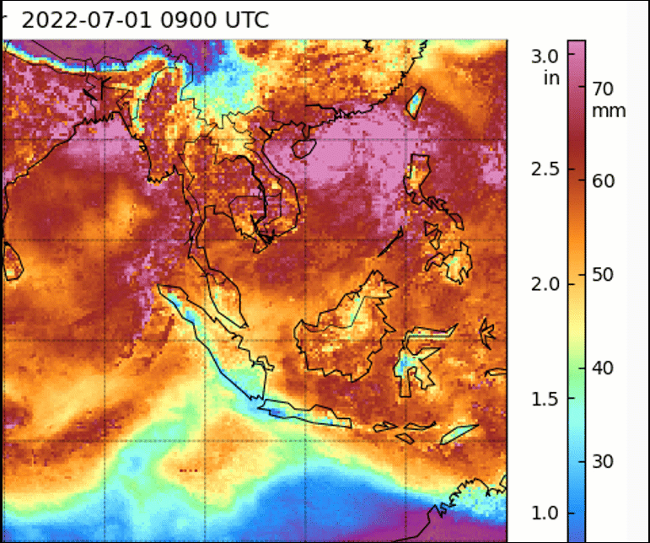
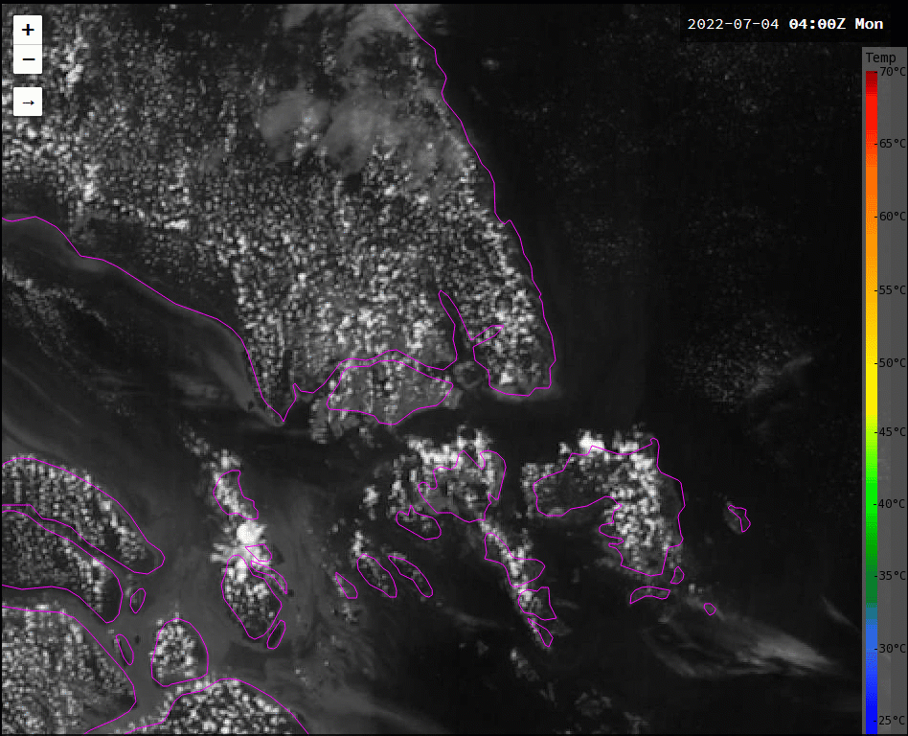
Can you also get "atmospheric dry rivers"? Consider the case of the delayed convection, Singapore area 4th July 2022
Sandwich product images JMA/BOM, MIMIC TPW data from image courtesy SSEC University of Wisconsin Madison
From Revision Session 1
NEA Singapore Forecasters "Drier than usual airmass around the 700 hPa level".
-70C
S
S
-20C
Sandwich Product
Singapore area
04UTC to 10UTC 4th July 2022
("S" is the location of Singapore)
MIMIC TPW
09UTC 1st July to 15UTC 4th July 2022
("S" is the location of Singapore)

