Slide 1
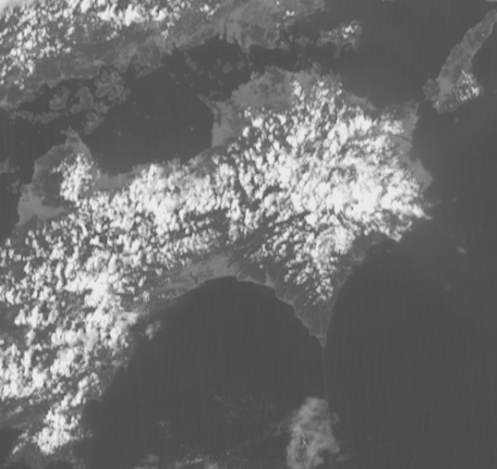
Himawari-8 / GEO-KOMPSAT-2A stereo animation.
Shikoku convection, 0400 to 0910UTC 10th September 2019, 5 frames per second Wiggle 3D animation
Please start the Power Point Slide Show to activate the animation
Shikoku
Please view this animation carefully and desist if it feels uncomfortable
images forwarded by Vincent Villani BOM, animation constructed by B.Zeschke BOM/BMTC

