Slide 1
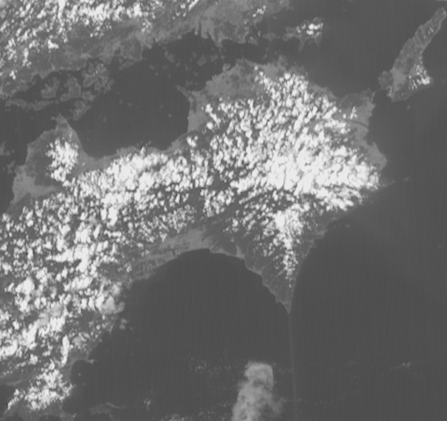
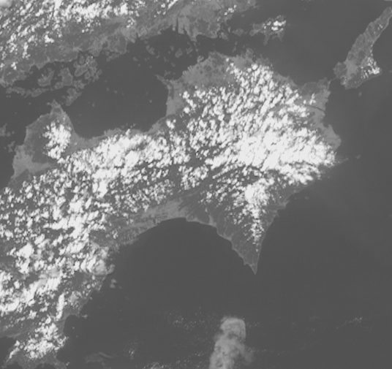
Himawari-8 / GEO-KOMPSAT-2A stereo animation. Shikoku convection, 0400 to 0910UTC 10th September 2019, 5 frames per second rocking animation
Shikoku
Shikoku
Himawari-8 Band 3
(courtesy Japan Meteorological Agency)
GEOKOMPSAT-2A Band 3
(data courtesy Korea Meteorological Administration)
images forwarded by Vincent Villani BOM, animation constructed by B.Zeschke BOM/BMTC

