Slide 1
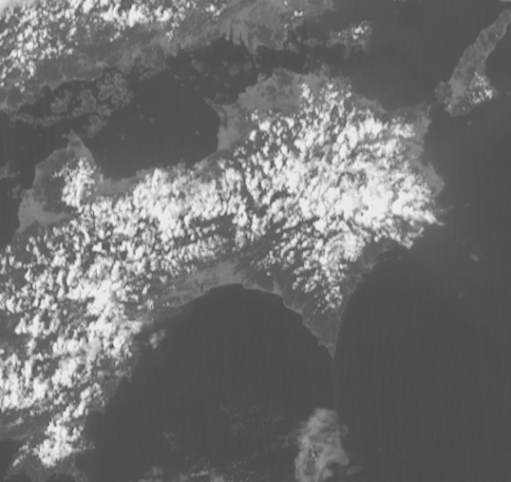
Himawari-8 / GEO-KOMPSAT-2A stereo animation. Shikoku convection, 0400 to 0910UTC 10th September 2019, 5 frames per second rocking animation
Shikoku
(Himawari-8 data courtesy Japan Meteorological Agency)
(GEO-KOMPSAT-2A data courtesy Korea Meteorological Administration)
Please start the Power Point Slide Show to activate the animation
images forwarded by Vincent Villani BOM, animation constructed by B.Zeschke BOM/BMTC

