Slide 1
Introduction to Nowcasting using Satellite Data and Products: Precipitation examples
Andersen Panjaitan
Agency for Meteorology, Climatology and Geophysics (BMKG), Indonesia

Slide 2
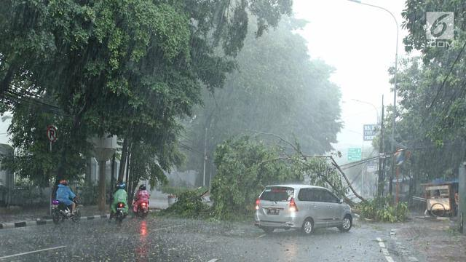
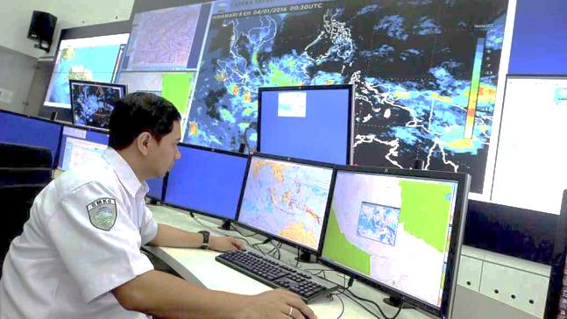
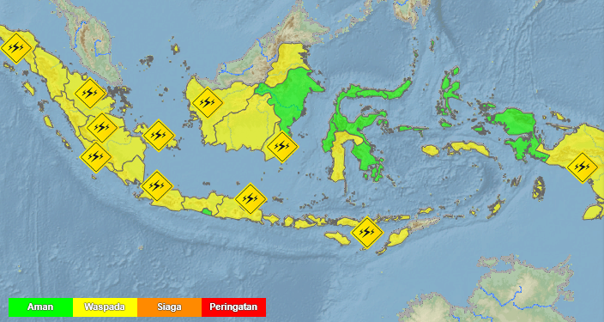
Nowcasting
Definition : Forecasts obtained by extrapolation for a period of 0 to 6 hours ahead
Tools : radar, satellite and ground observational data
Target : small features such as individual storms
Output : warning the public of hazardous, high-impact weather including tropical cyclones, thunderstorms and tornados which cause flash floods, lightning strikes and destructive winds
(WMO)

Slide 3
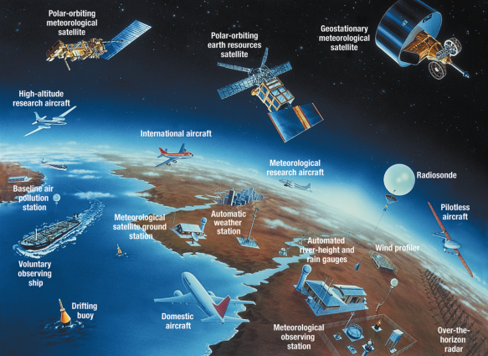
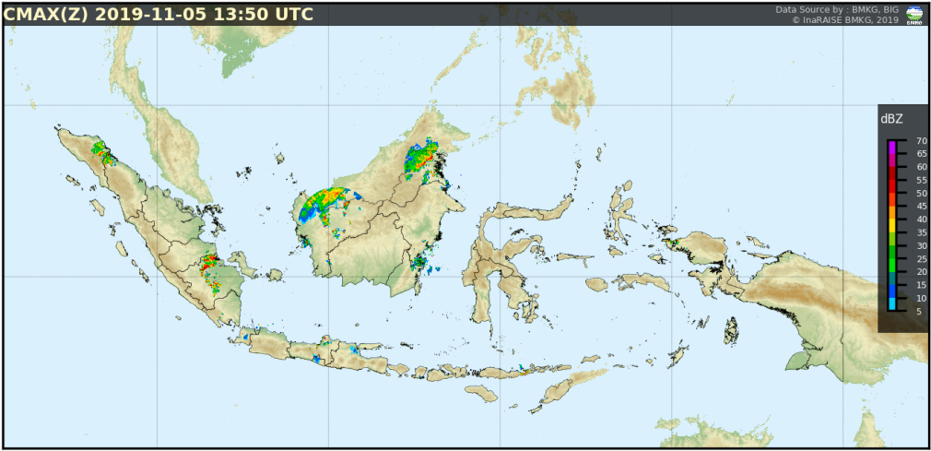
Why Satellite?
Raingauge data are available on land only (densely populated area)
Radar is effective tool for observe precipitation, but high cost and limited to maximum range detection (about 300km)
Most of geostationary metorological satellite data can be accessed freely and available for global coverage with short time interval observation

Slide 4
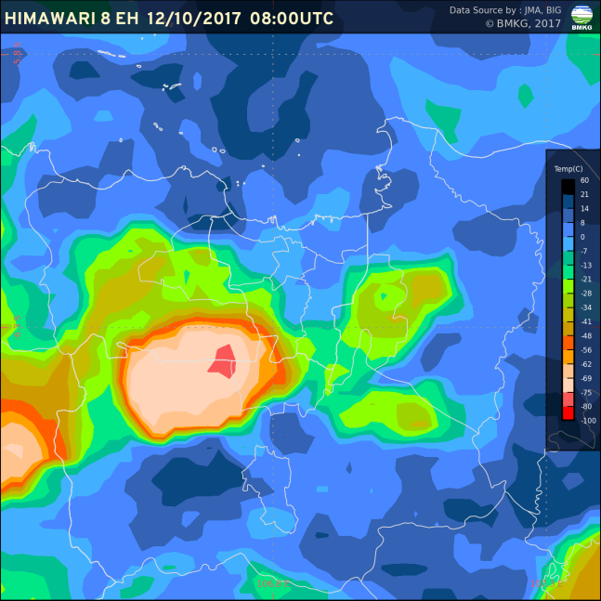
IR-VIS-Precipitation
Satellite inferred precipitation indirectly from emitted infrared radiation and reflectance by clouds
Higher the cloud albedo means the more droplets and/or ice crystals it contains and the deeper it tends to be.
Lower the IR brightness temperature means higher the cloud top
Better combine both for cirrus removal

Slide 5
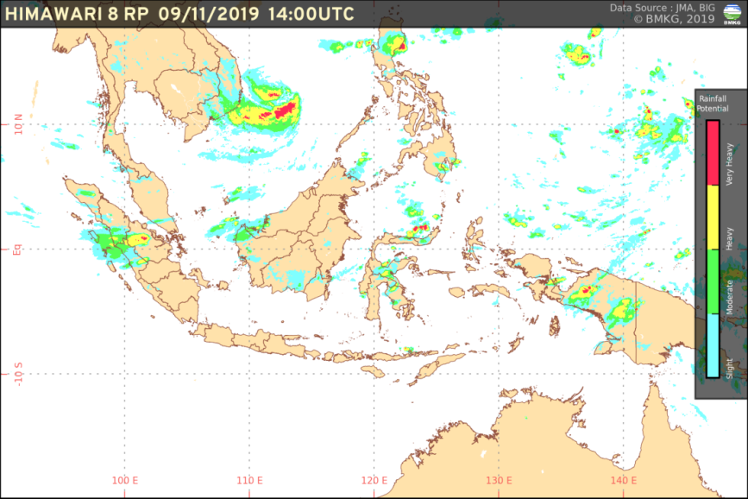
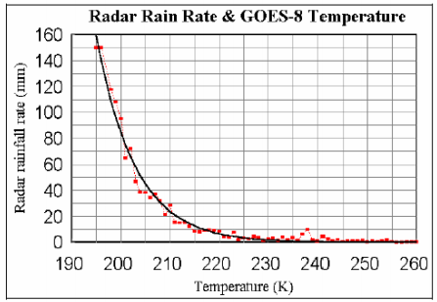
Precipitation Estimation
Various techniques have been developed to estimate rainfall from visible and/or infrared (IR) radiation
Vicente et al (1998) :
R = 1.1183 x 10¹¹ x
exp ( - 3.6382 x 10⁻² x T^{0.5})

Slide 6
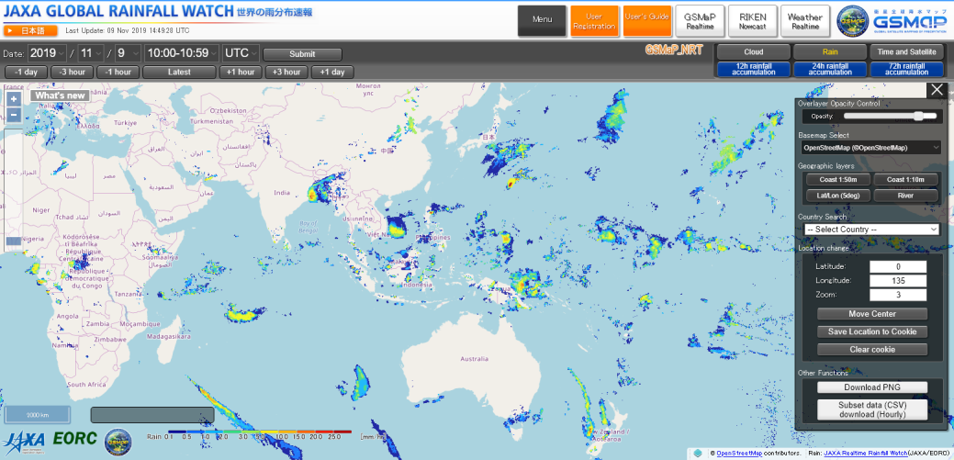
Precipitation Estimation
IMERG and GSMaP are rainfall estimation based on satellite products which inferred not only from IR but also microwave radiation from polar satellites

Slide 7
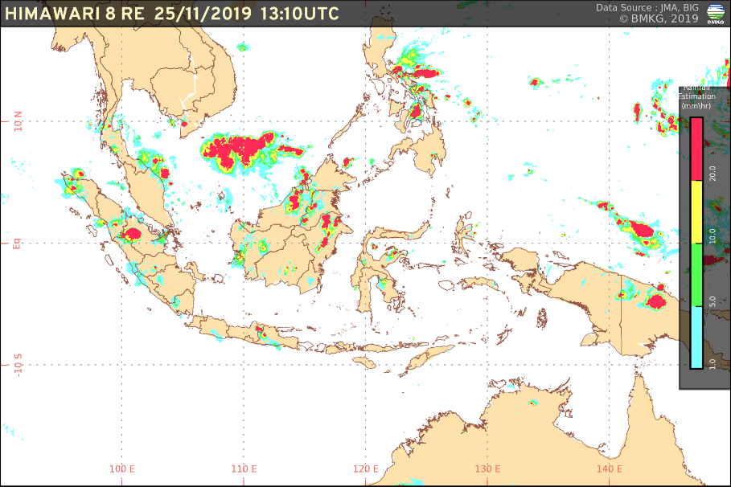
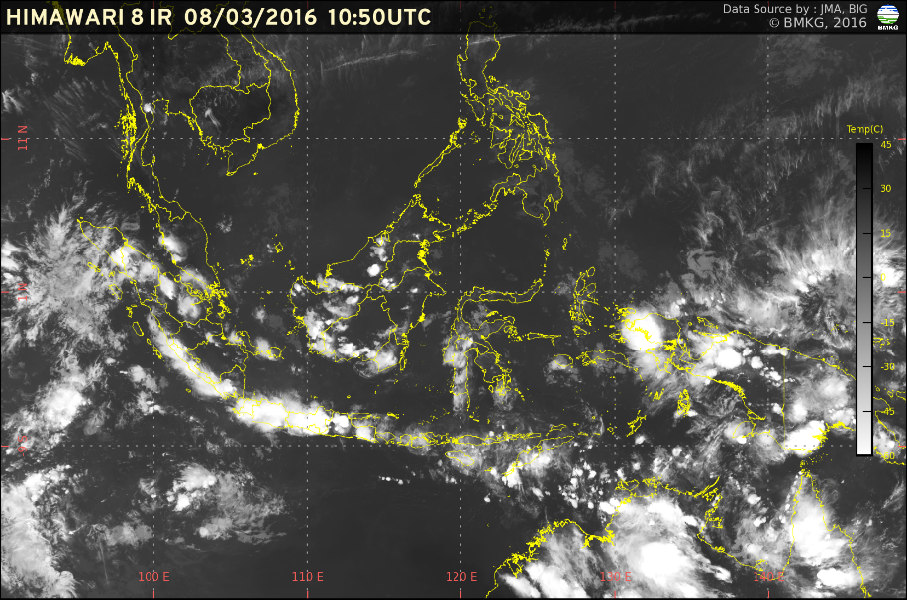
Socrative Question (1)
Rainfall Estimation Product
Have you used rainfall estimation product derived from infrared/microwave satellite data?
Yes
No
I have used it, but prefer doing rainfall analysis from reflectance/brightness temperature image
Brightness Temperature Infrared

Slide 8
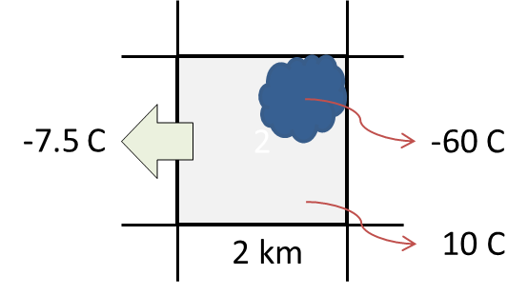
Limitation
Cirrus filtering due to absency of visible imagery at night
Short convective cloud lifetime
Sub-grid cumulonimbus
Slanted view for higher latitude
Data latency

Slide 9
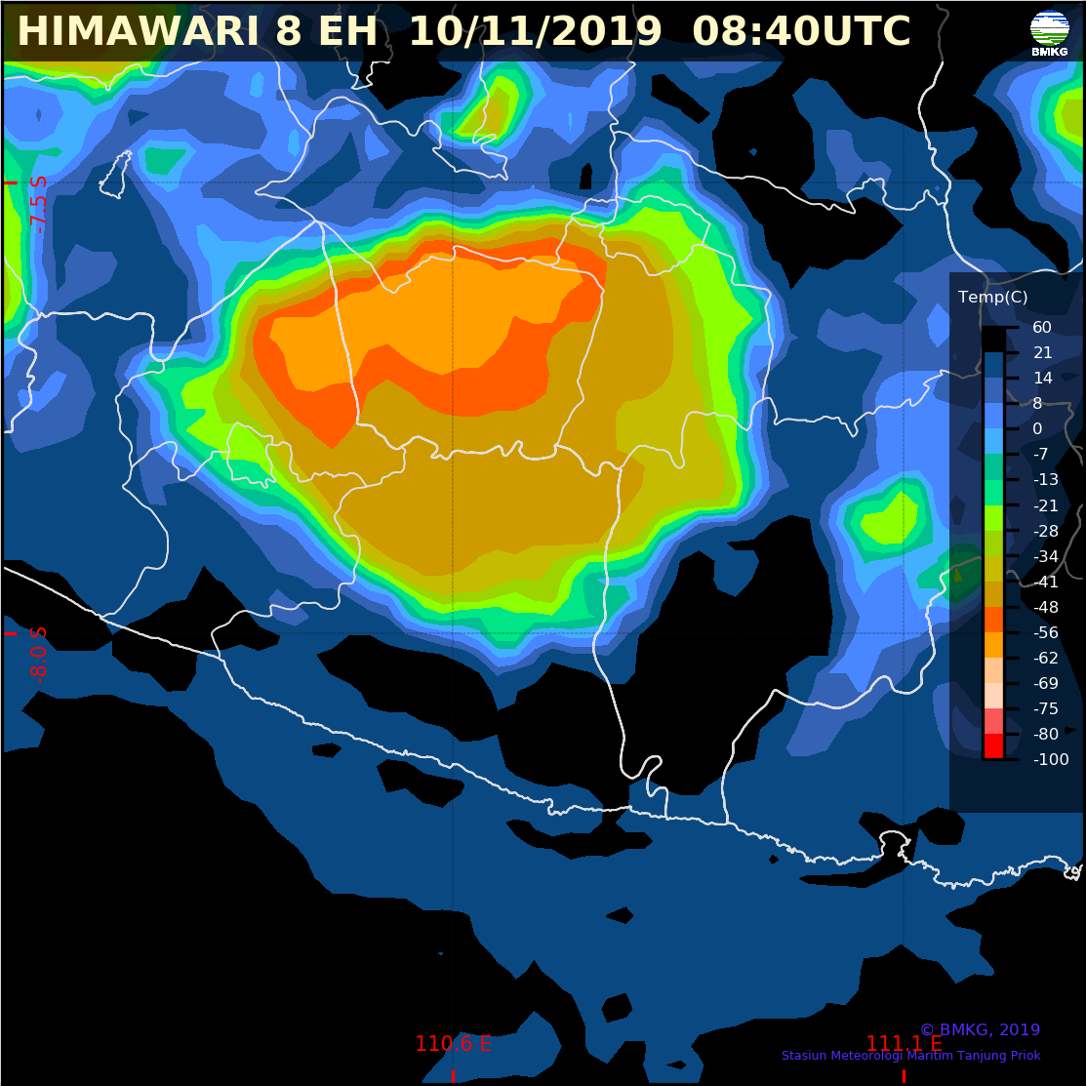
Socrative Question (2)
Enhanced Infrared Image
Which areas has the highest potential for heavy rainfall?
A
B
C
D
E
C
A
E
B
D

Slide 10
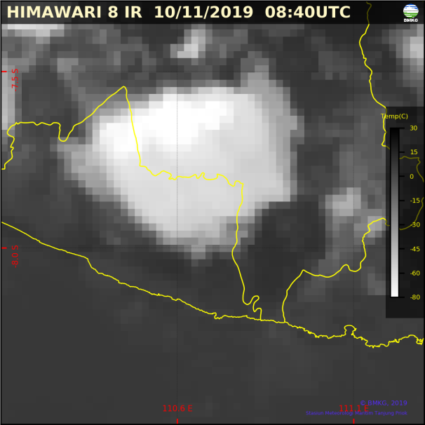
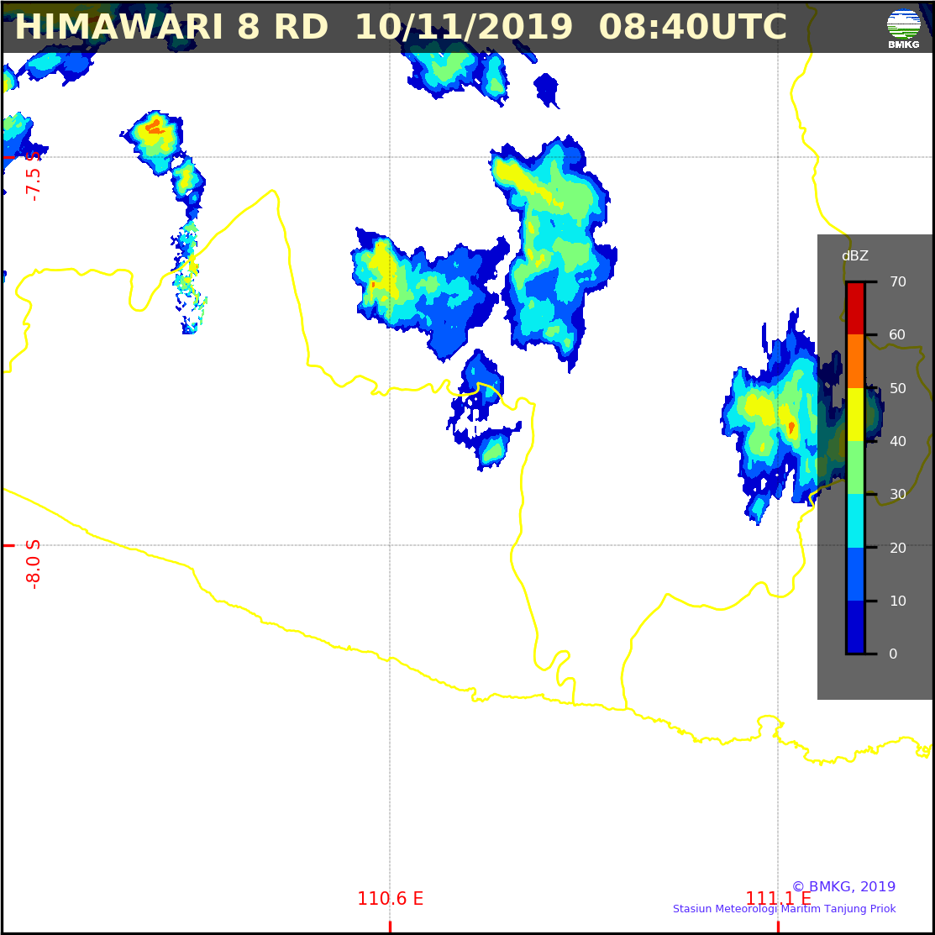
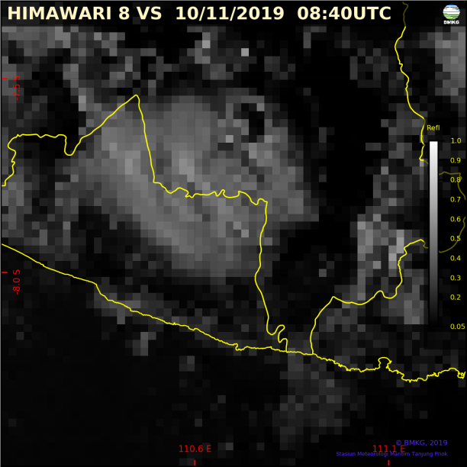
Convective Cloud
Stratiform rainfall :
Continous
Small drops
Uniform
Convective rainfall :
Short duration
Heavy and large drops
Varies
A
C
A Himawari-8 B13 (IR)
B Himawari-8 B03 (VS)
C C-Band Radar Reflectivity
B

Slide 11
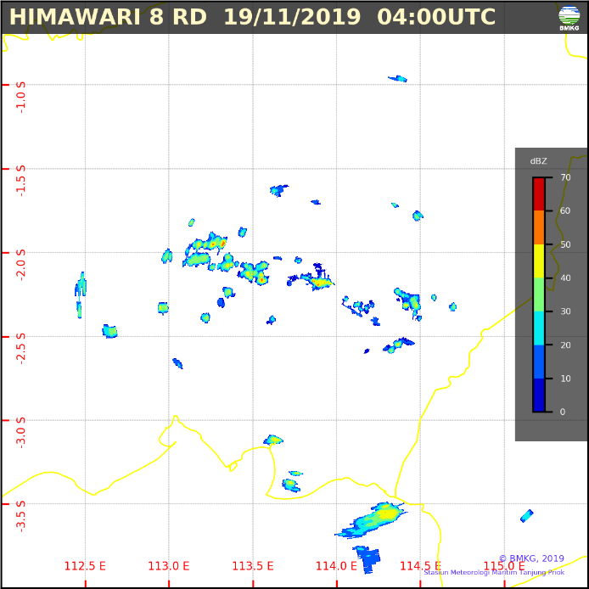
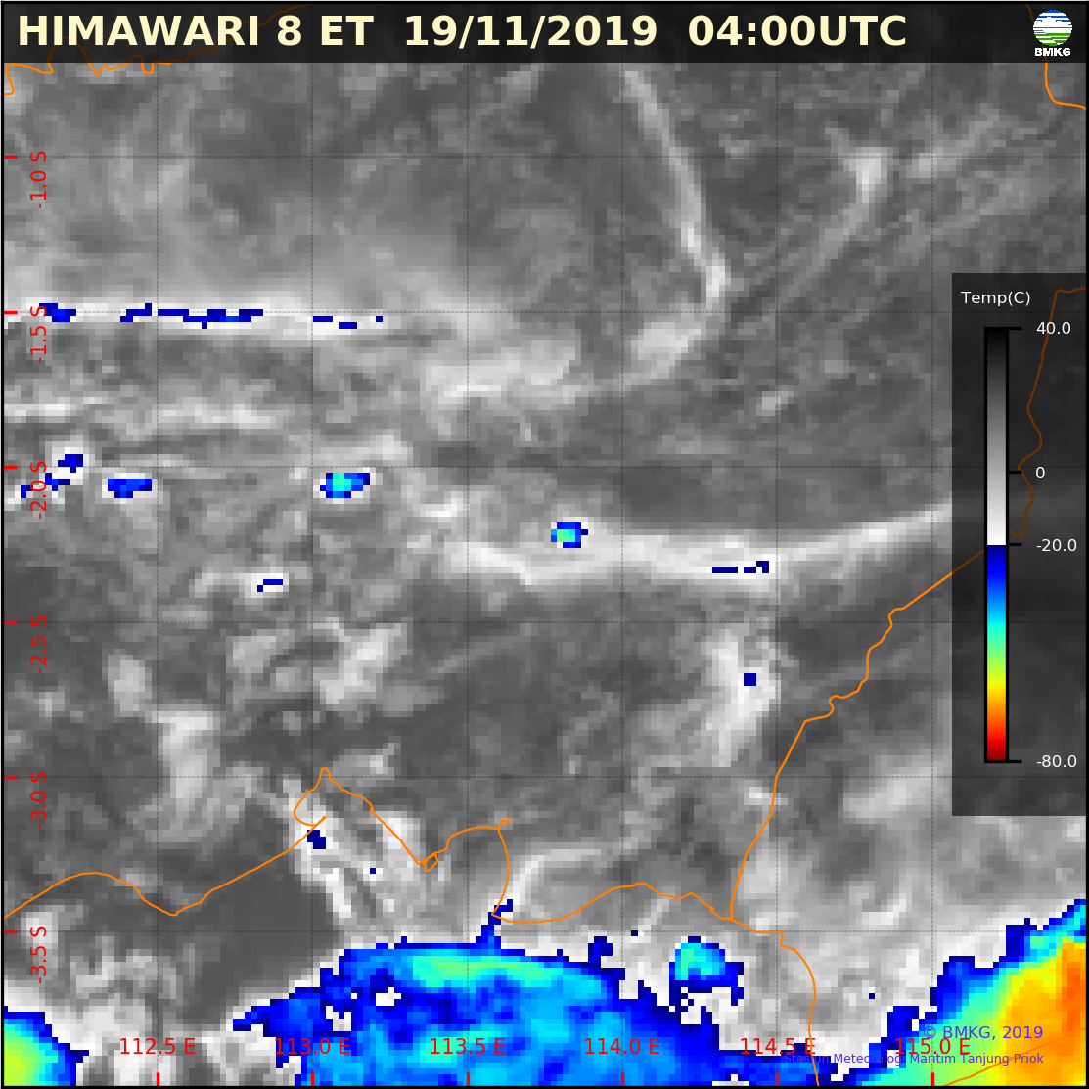
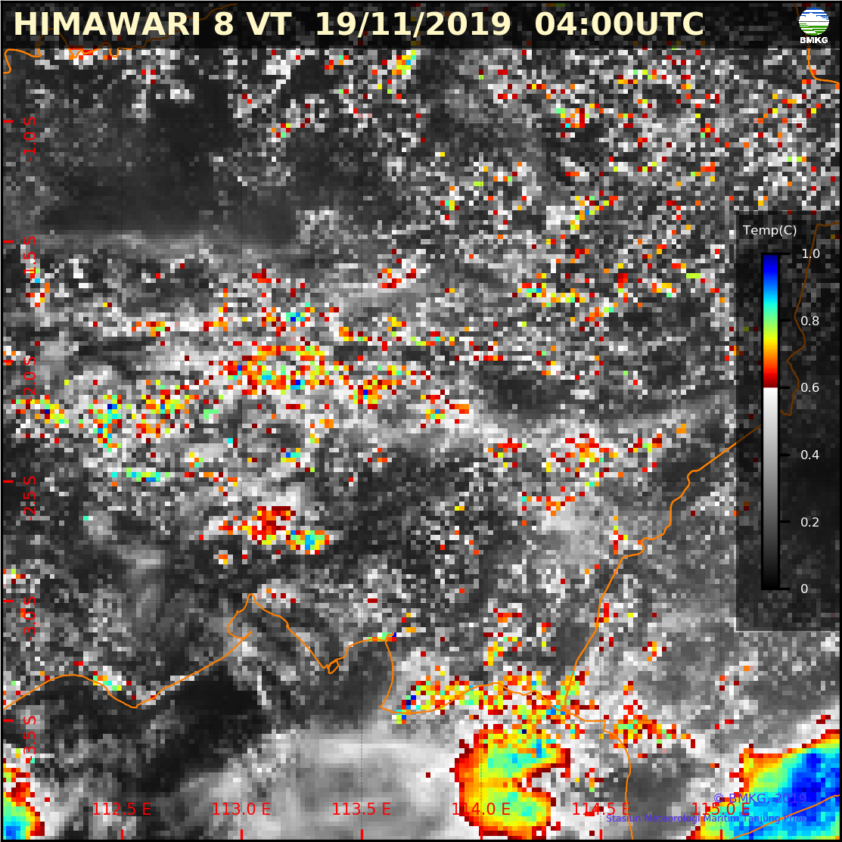
Local Convective Cloud
Local convective rainfall cells (diameter : 2-3 km) are detected in radar image.
Cb
A
B
C
Statistic at Cb cell
medium-heavy rainfall (30-60 dBZ) :
A Himawari-8 B13 (IR Enhanced)
B Himawari-8 B03 (VS Enhanced)
C C-Band Radar Reflectivity
IR
VS

Slide 12
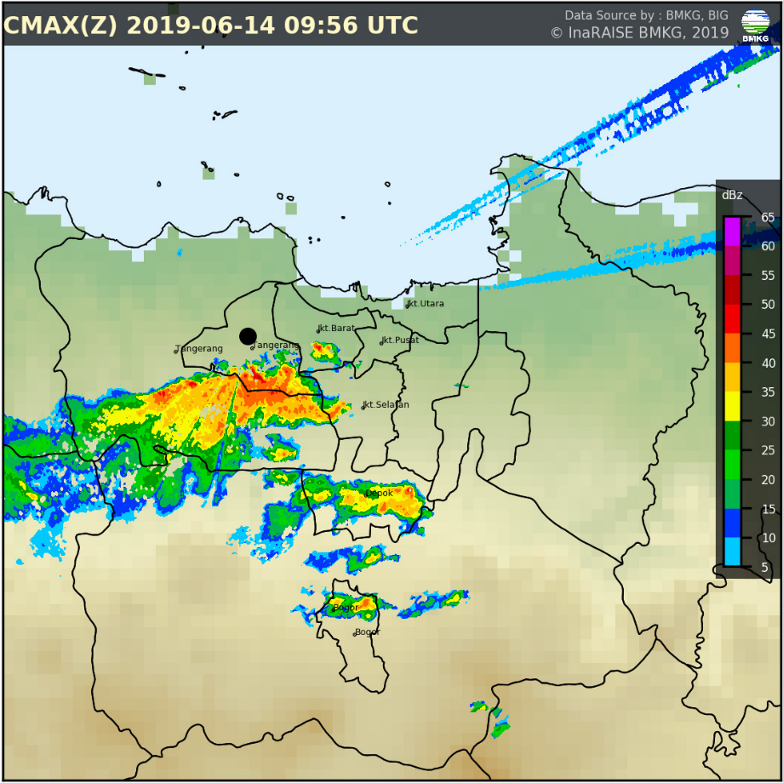
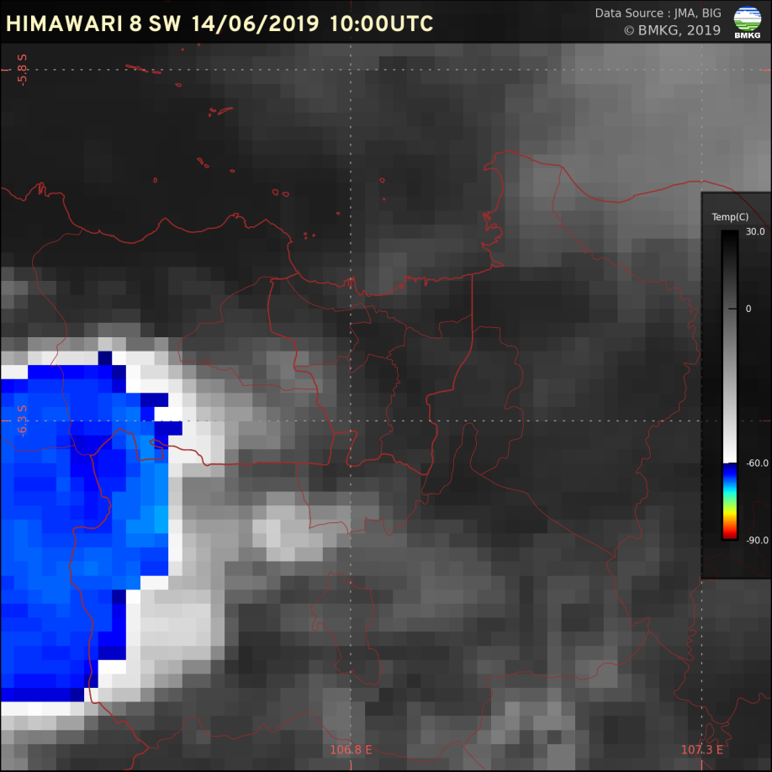
Satellite Parallax Correction
Rainfall shift under top of Cumulonimbus (height: 15km)
around 20 km to east

Slide 13
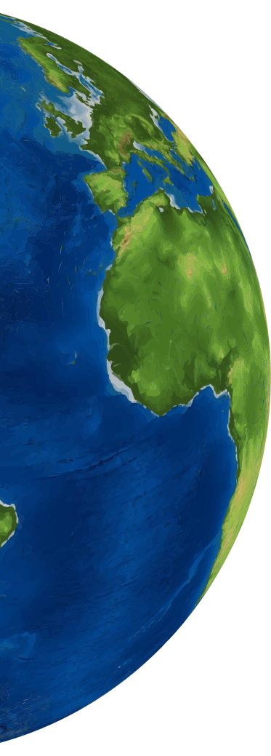
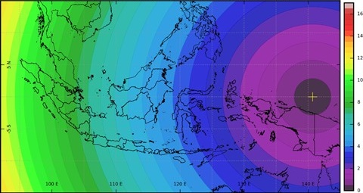
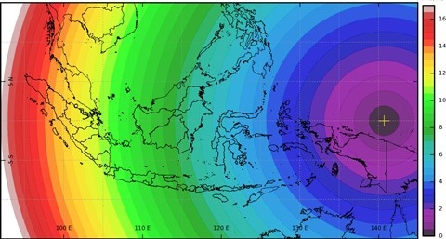
Satellite Parallax Correction
A : Apparent Top Cloud Location
B : Actual Top Cloud Location
Distance A-B : Parallax
Depends on :
Cloud top height
Cloud distance from subsatellite point
B
A
Himawari-8
140.7 E
Himawari-8
140.7 E
Cloud Top Height :
10 km
Cloud Top Height :
15 km

Slide 14
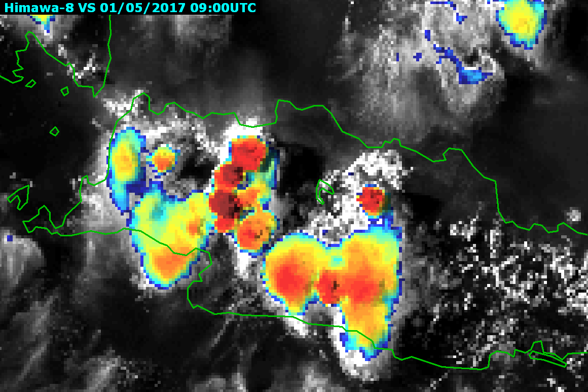
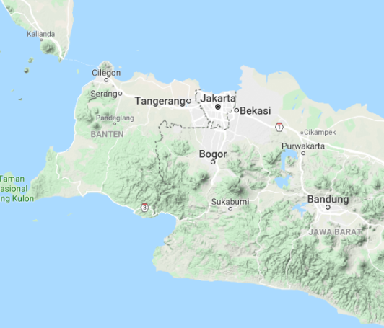
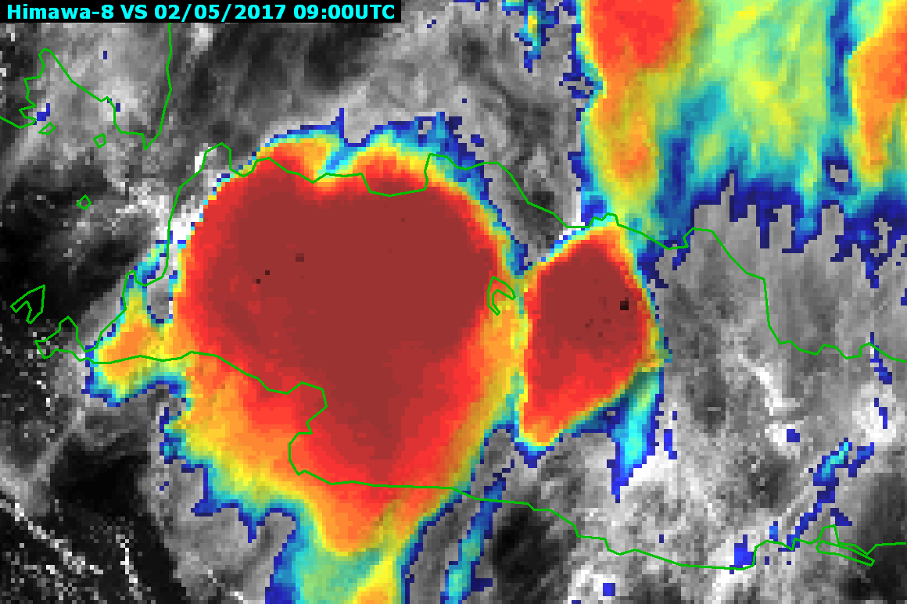
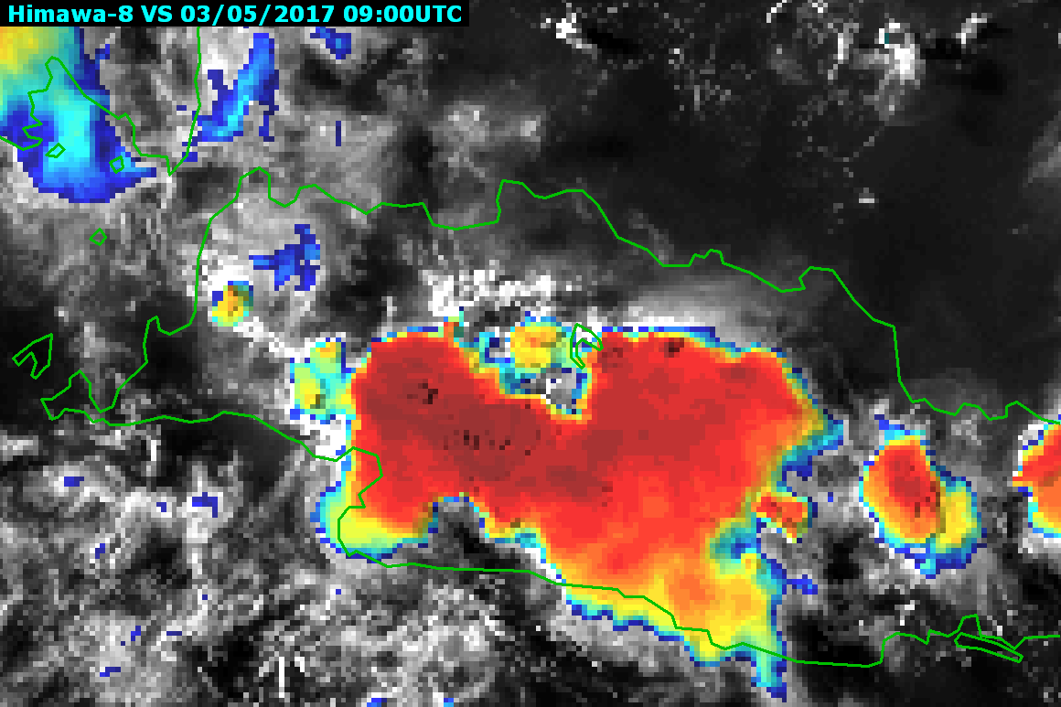
Diurnal Circulation
Oceanic deep convection tends to reach its maximum in the early morning and continental convection generally peaks in the late afternoon
Day-1
Day-2
Day-3

Slide 15
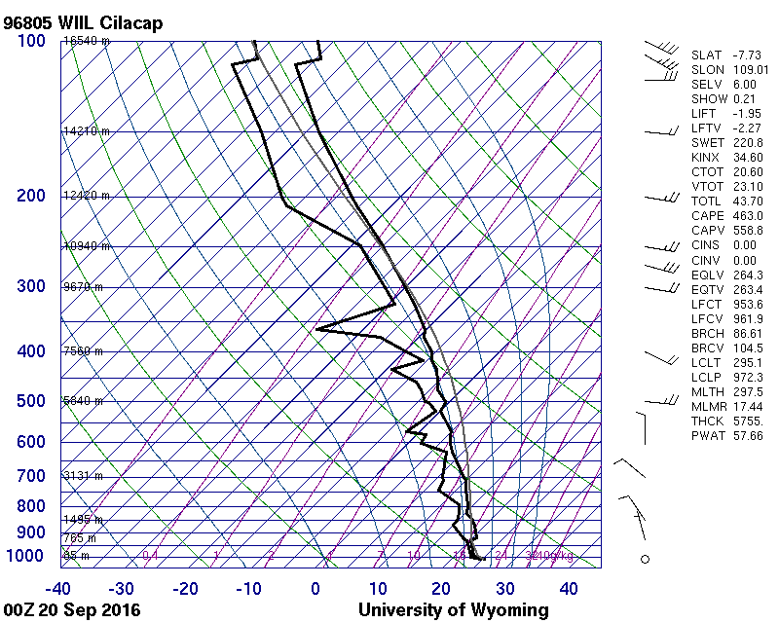
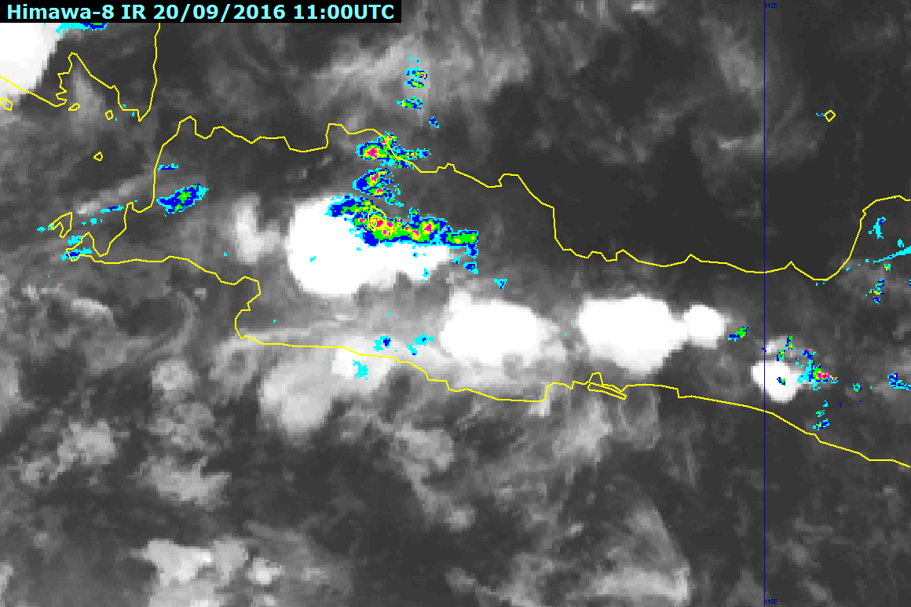
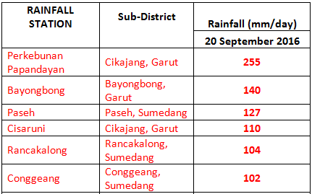
Heavy Rainfall
C
Heavy rain from 20 September caused a landslide and flash flooding in parts of West Java,and it reported as the worst affected with 33 people killed, 20 missing, and over 6,000 homeless.
A
B
Flash Flood
location
A Composite Radar Reflectivity and Himawari IR
B Stations with 24 hour precipitation > 100mm
C Radiosonde 00 UTC (KI 34.6)

Slide 16
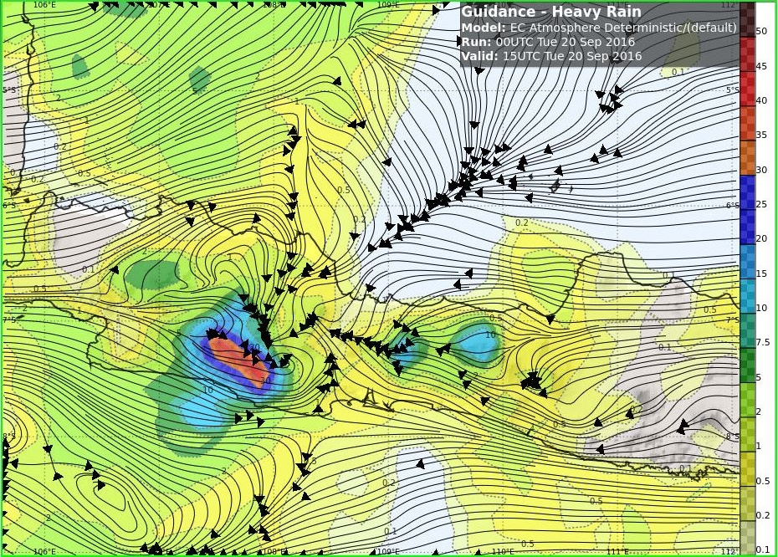
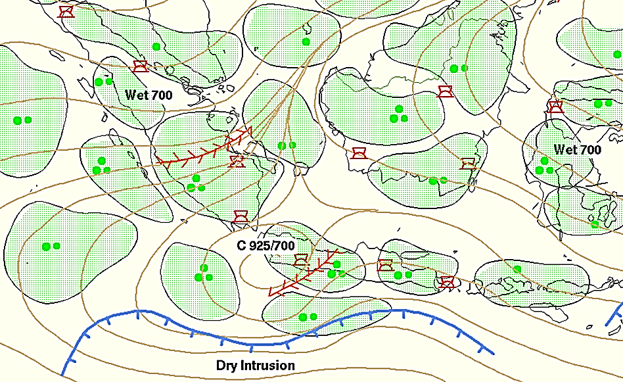
Heavy Rainfall
Image Courtesy JAXA
A
B
Image Courtesy BoM
images courtesy BOM
A GSMaP 24hr Accumulation
B EC Deterministic (Gradient wind + Precipitation)
C Sig Weather Chart
C

Slide 17
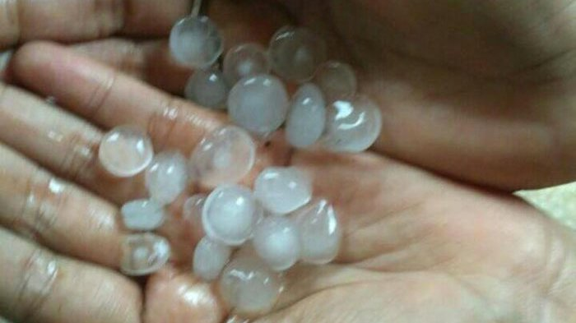
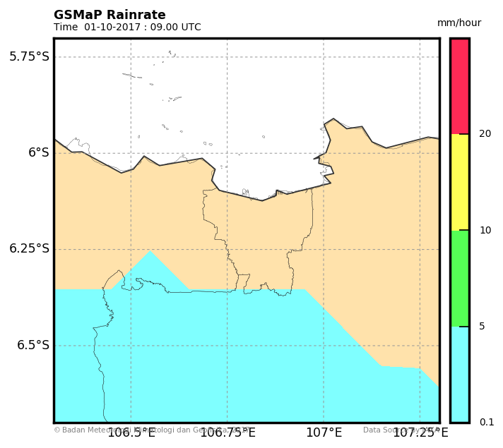
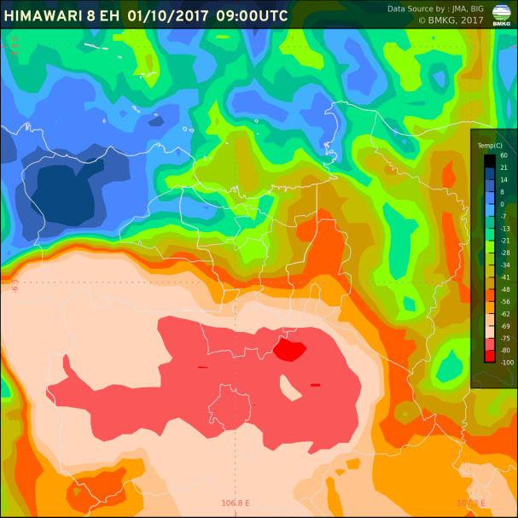
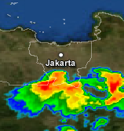
Hail Precipitation
Hail event at South of Jakarta
(01 Oct 17 09UTC)
GSMaP product used to locate distribution of heavy rainfall. However at the event time, only slight rain is detected over south of Jakarta. It is a bit difficult to see small scale heavy precipitation at GSMaP due to its spatial resolution.
A GSMaP NRT
B Himawari-8 B13 (IR Enhanced)
C C-Band Radar Reflectivity
Jakarta
A
B
C

Slide 18
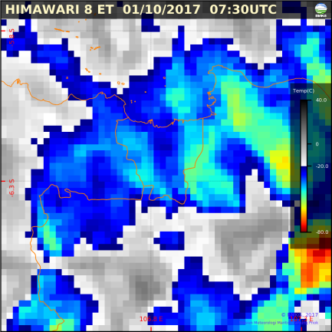
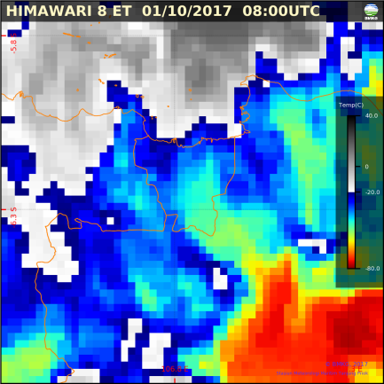
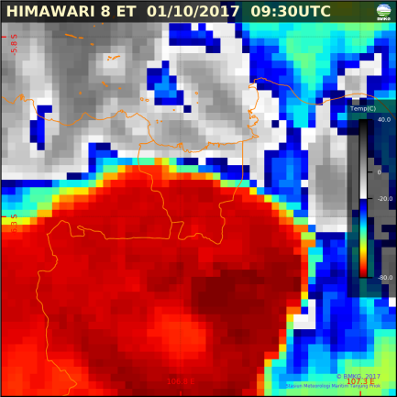
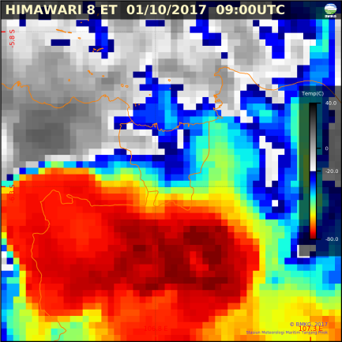
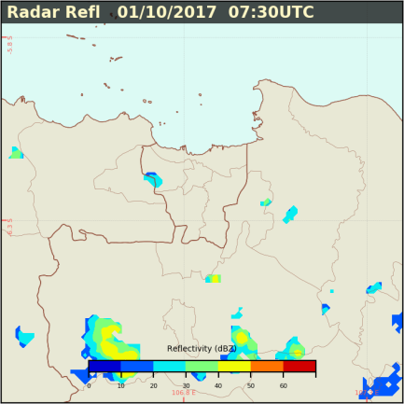
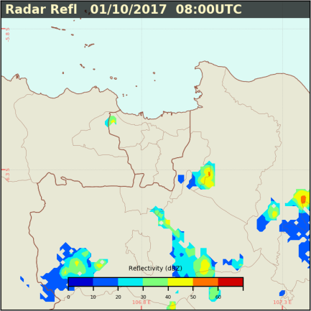
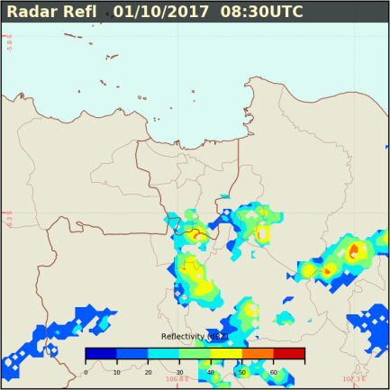
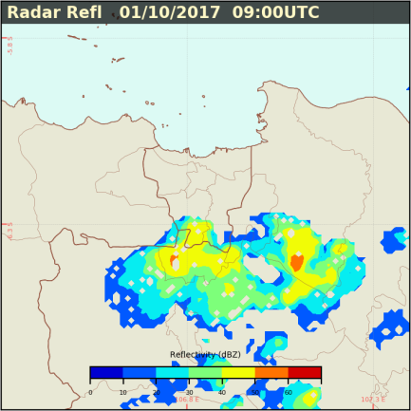
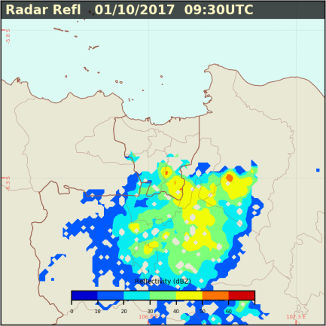
Hail Precipitation
Hail
event
Top Himawari 8 IR Enhanced
Bottom Radar Reflectivity
Category | dBZ | mm/hr
Slight Rain | 30-38 | 1-5
Mod Rain | 38-48 | 5-10
Heavy Rain | 48-58 | 10-20
Very heavy Rain | >58 | >20

Slide 19
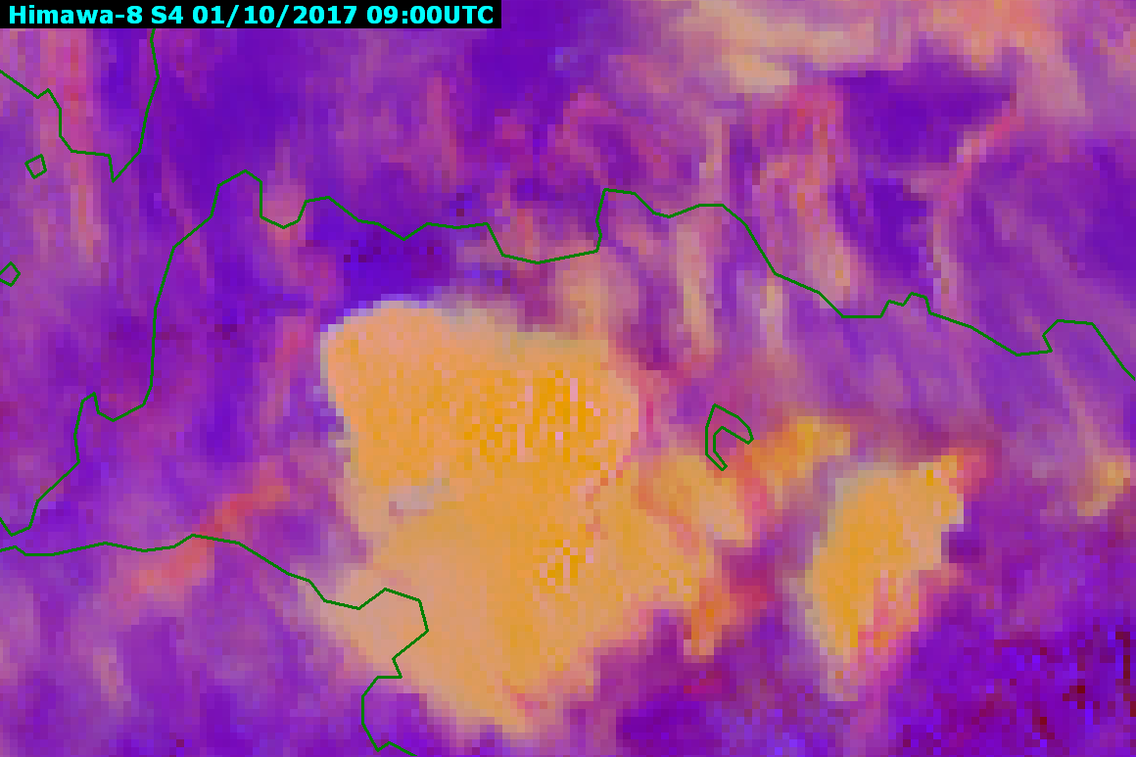
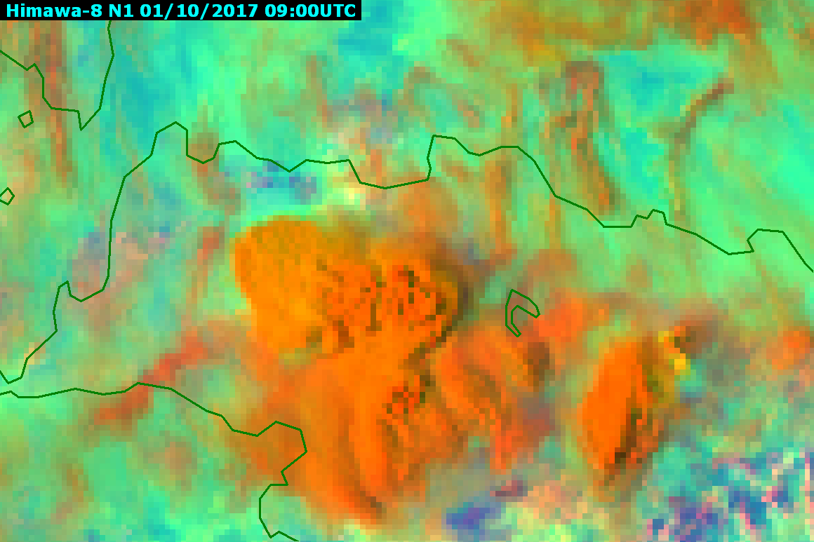
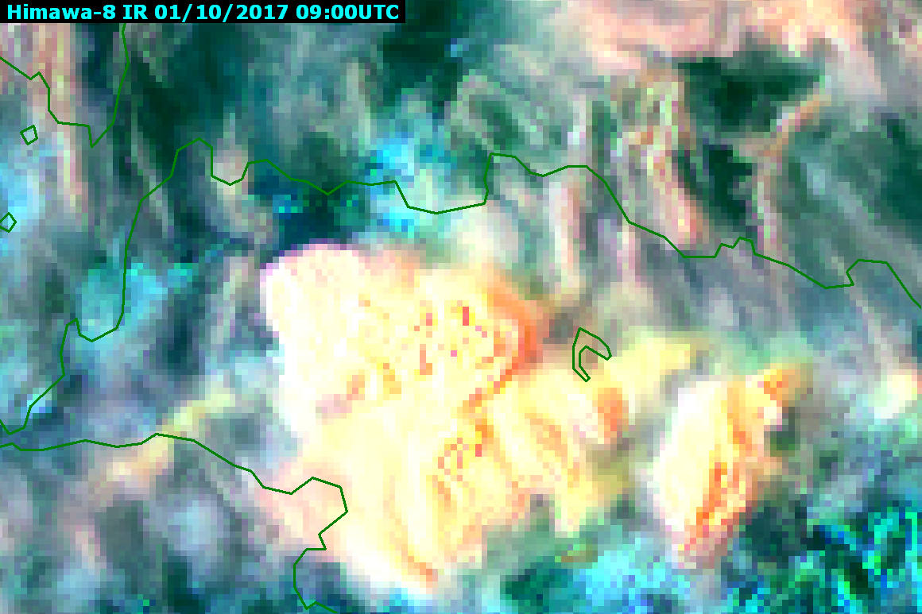
Hail Precipitation
RGB True Color
RGB Day Convective Storm
RGB Day Microphysics
RGB Cloud Phase Distinction

Slide 20
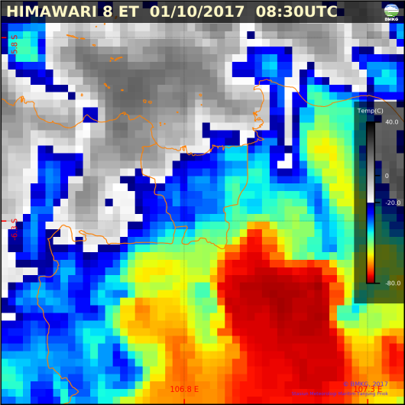
Socrative Question (3)
What satellite product do you prefer to monitor the thunderstorms (heavy rain/hail) over western Java?
IR Enhanced
RGB True Color
RGB Day Convective Storm
RGB Day Microphysics
RGB Cloud Phase Distinction

Slide 21
Tropical Cyclone
Tropical Cyclone Cempaka was a tropical cyclone that impacted the island of Java and Bali, Indonesia in November 2017. Although it did not make landfall and only developed to a category 1 cyclone, Cempaka managed to cause 41 deaths with more than 20,000 people evacuated and around US$83.6 millions in damages
A
C
A Himawari-8 B13 (IR)
B Himawari-8 B03 (VS)
C GSMaP NRT
B

Slide 22
Tropical Cyclone
GPM Satellite
KaPr
Target : Weak rainfall and snowfall
Swath : 125 km
KuPr
Target : Heavier Rainfall
Swath : 245 km
GMI
Multi Channels : 13 (9 TMI + 4 Channels)
Swath : 850 km
A
Near Real Time Viewer :
https://storm.pps.eosdis.nasa.gov/storm/cesium/GPMNRTView.html
A GPM (GMI)
B GPM (DPR-Ku)
C C-Band Radar Reflectivity
B
C

Slide 23
MJO Propagation
A Himawari-8 Water Vapor
B GSMaP NRT
A
B
Because most tropical rainfall is convective, and convective cloud tops are very cold (emitting little longwave radiation), the MJO is most obvious in the variation of brightness temperature measured by an infrared sensor.

Slide 24
Summary
If radar observations are not available, doing local analysis using both infrared and visible image are helpful to find very small convective rainfall.
Carefully issuing local warning based on heavy rainfall interpretation on satellite image due to parallax error
NWP products can also used for nowcasting
Various rainfall estimation satellite products can be used to fullfill gap in scarce ground observations (e.g. GSMaP, IMERG). Microwave satellite data was of limited use, showing only the large scale precipitation.
The development of MCS, Cyclone, and MJO, which triggering very heavy rainfall and could causing hydro meteorological hazard can be predicted using satellite

