Slide 1


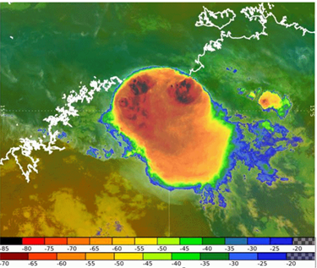
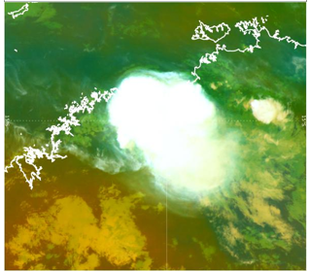
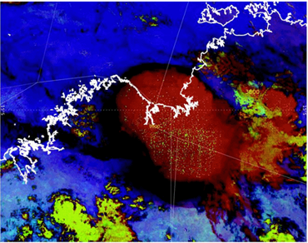
Introduction to now-casting using satellite data and products
Thunderstorm examples
Dean Narramore
Extreme Weather Desk Bureau of Meteorology

Slide 2


Content
Satellite products for monitoring convection. What do you use?
How useful is satellite data in the lead up to thunderstorm development?
Examples of using satellite data in identifying thunderstorms and where they might form.
Can we identify where the first storm will form, using satellite data?
Satellite surprise.

Slide 3
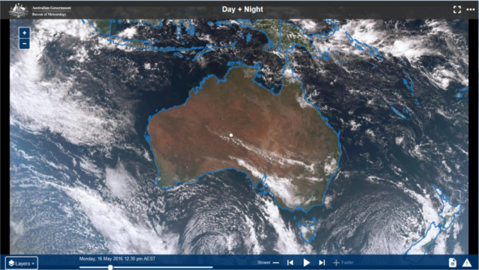
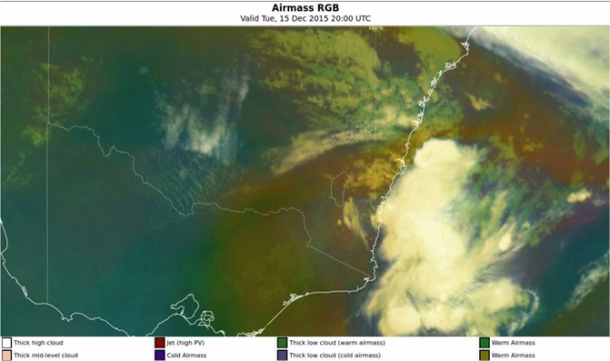
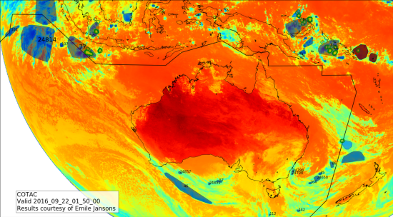
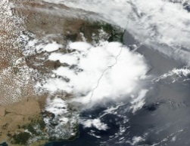
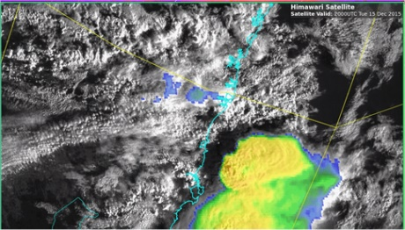
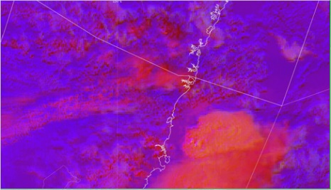
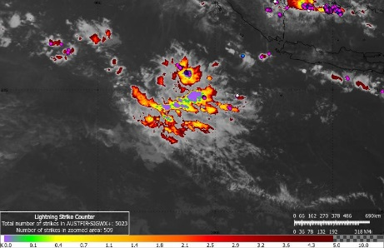
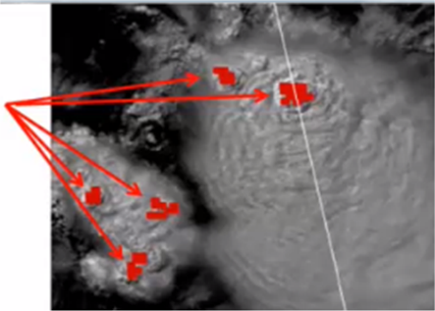
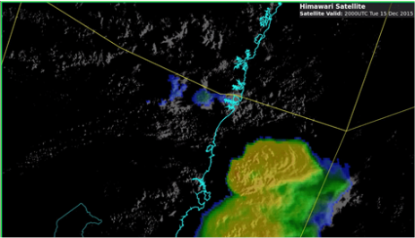
Using Himawari-8 data to analyse convective development
Alerting (machine learning) algorithms (COTAC)
Overview: Visible / Enhanced IR / Sandwich
Broadscale setting – Airmass RGB
Sandwich product
Day Convective RGB
Monitoring tool
(IR-WV)
Severe Storm Algorithms
Images courtesy BOM/JMA

Slide 4
Socrative Question 1

Slide 5
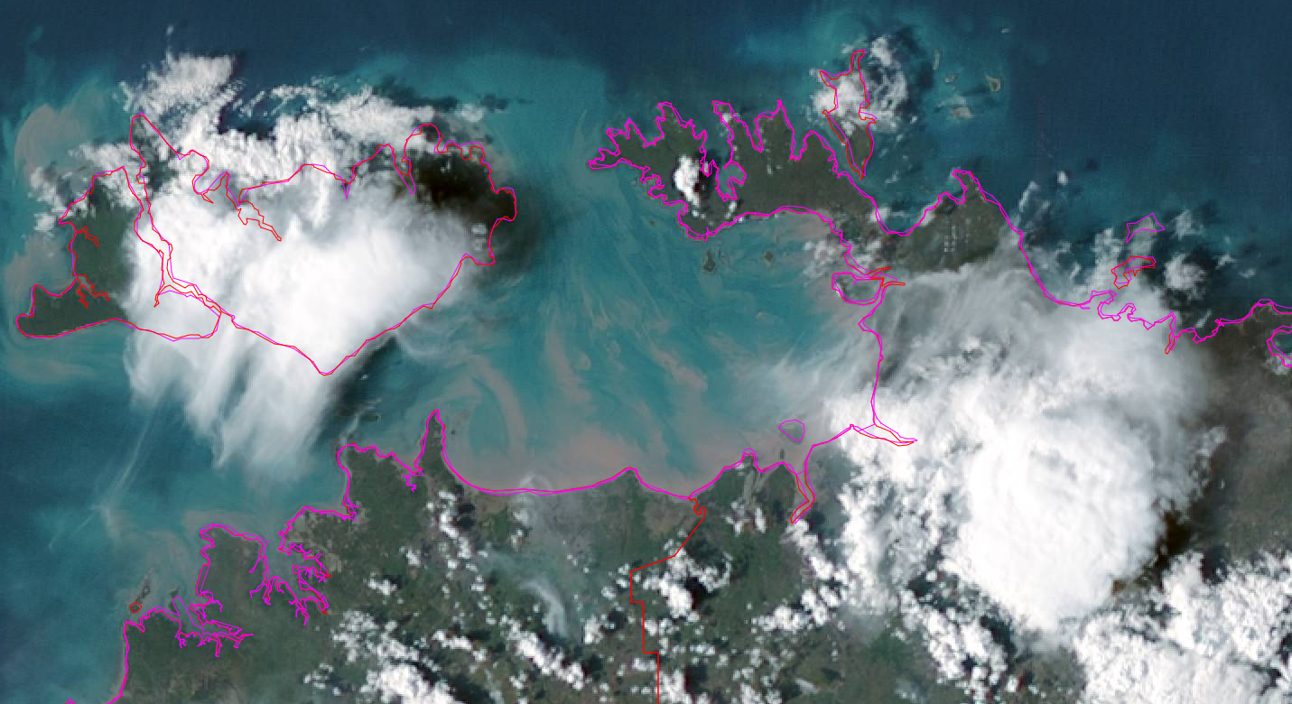
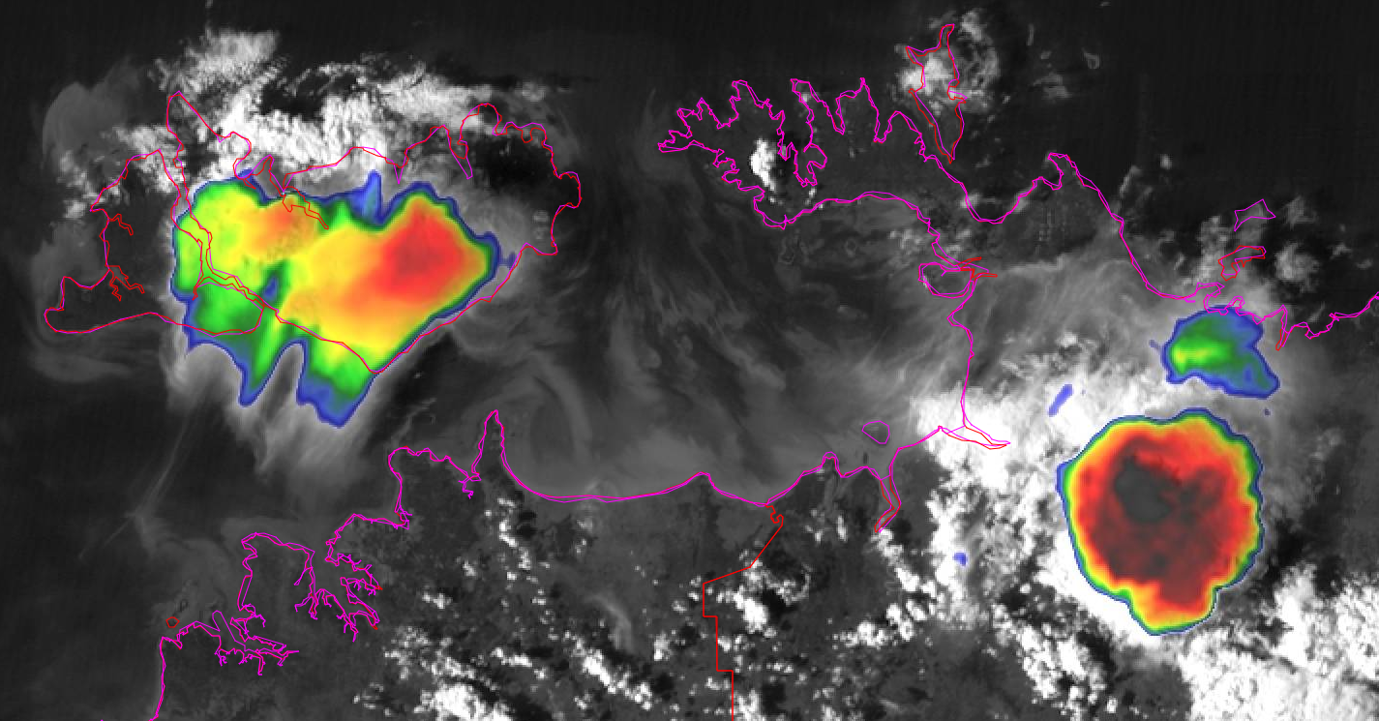
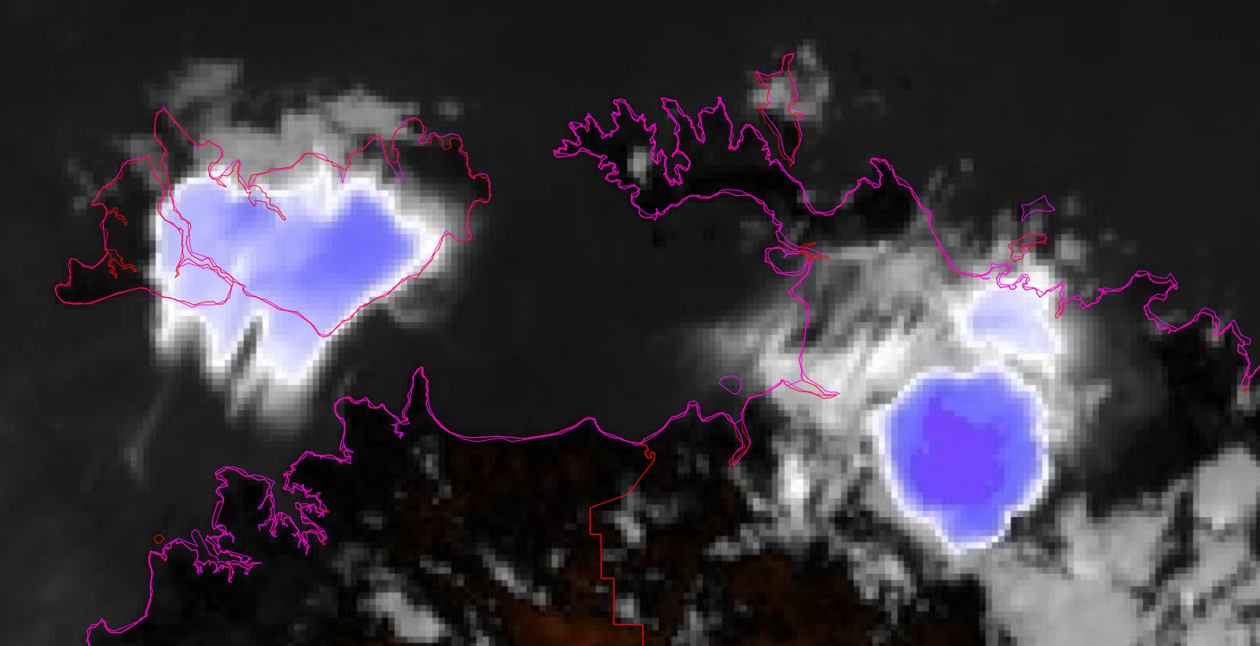
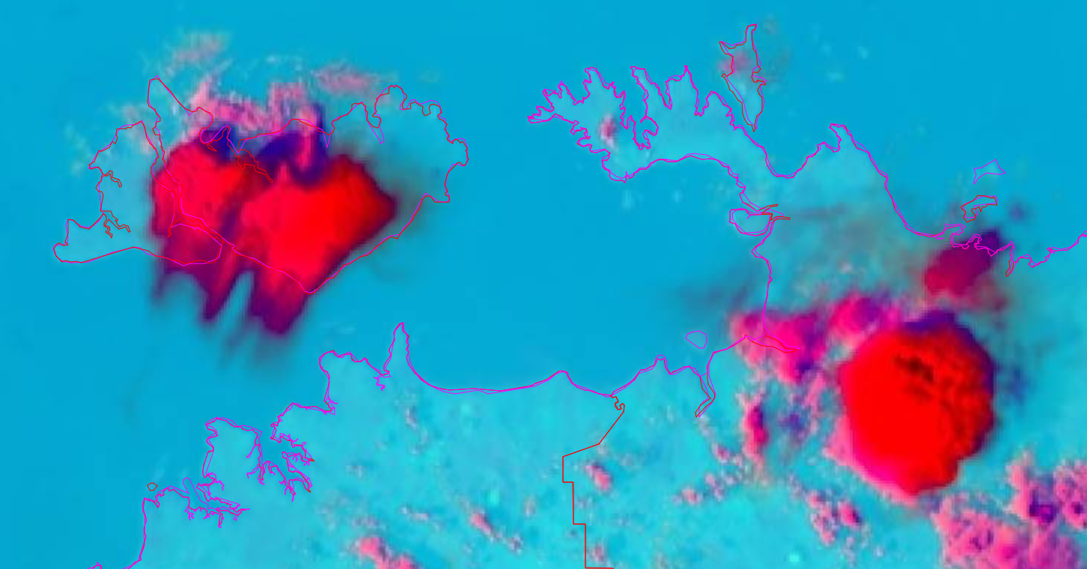
One Thunderstorm. Same Time. Multiple channels.
images courtesy JMA/BOM

Slide 6
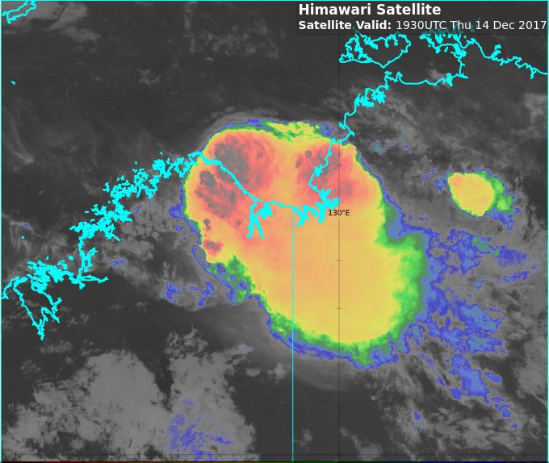
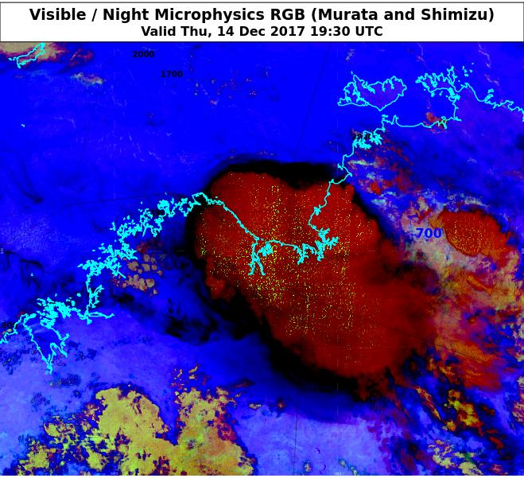
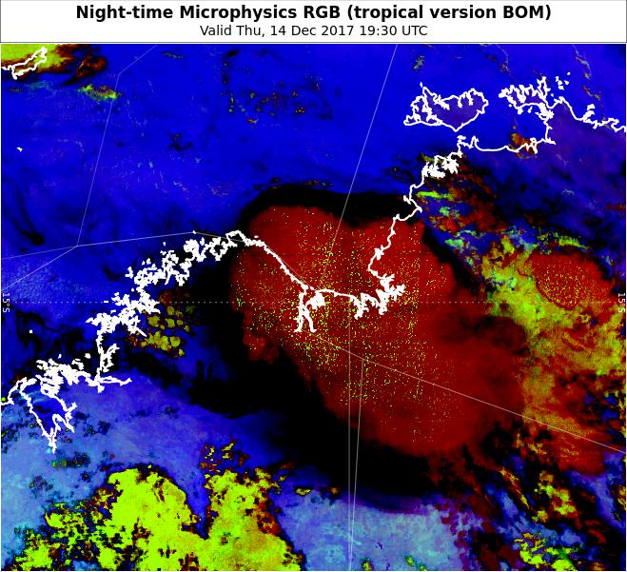
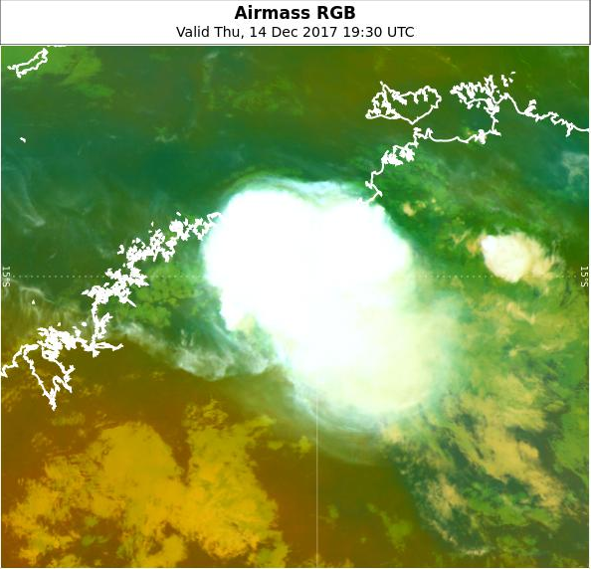
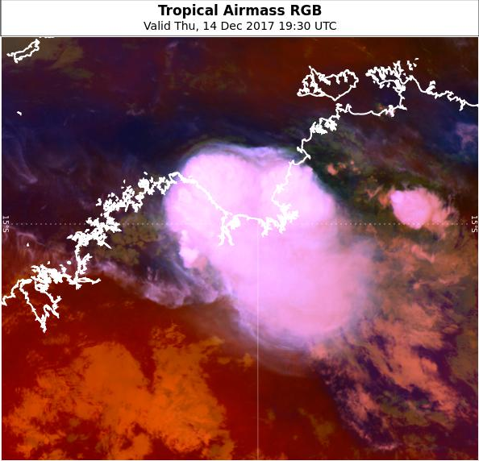
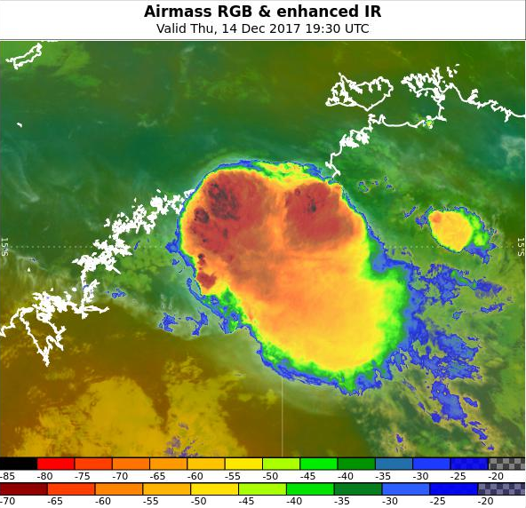
Another example of multiple channels, one storm, this time at night. RGB products examined during the night time.
(situation at 1930UTC, 14th December)
images courtesy JMA/BOM
Enhanced IR (Tropical)
Night Micro RGB (Midlat)
Night Micro RGB (Tropical)
Airmass RGB
Airmass RGB (Tropical)
Airmass RGB and enhanced IR
Darwin

Slide 7


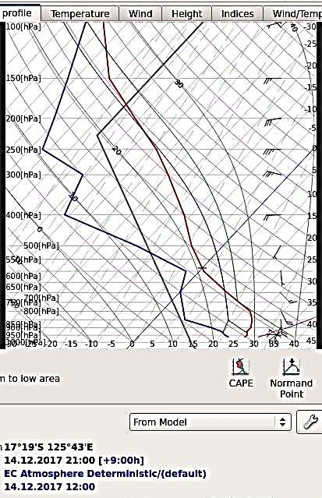
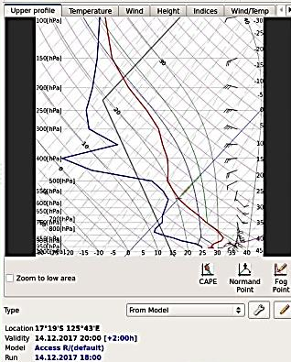





Summary: RGB products examined during the night time
(situation at 1930UTC)
images courtesy JMA/BOM
Enhanced IR (Tropical)
Night Micro RGB (Midlat)
Night Micro RGB (Tropical)
Airmass RGB
Airmass RGB (Tropical)
Airmass RGB and enhanced IR
Stormtops best defined

Slide 8
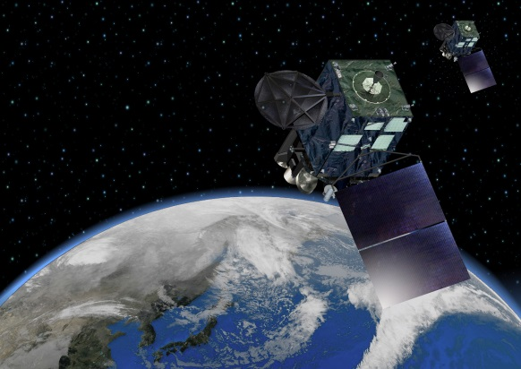
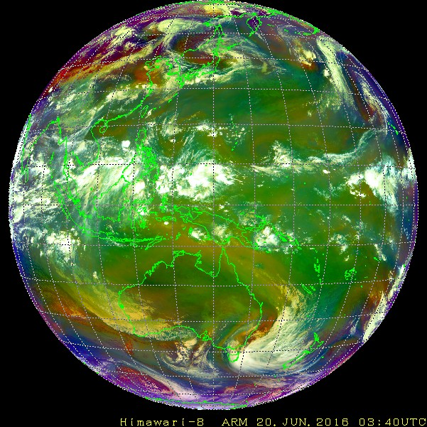
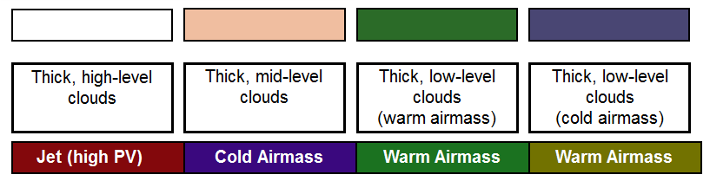




The Airmass RGB
images courtesy JMA / Eumetsat
Airmass RGB | Range | Gamma
6.2 – 7.3 micron | -26.2 to 0.6 | 1.0
9.6 - 10.4 micron | -43.2 to 6.7 | 1.0
6.2 micron | 243.9 to 208.5 | 1.0
CHANNEL COMBINATION (BOM/JMA recipe)
Himawari-8 channels
Himawari-8 RGB Composite
Colour interpretation palette

Slide 9
Socrative Question 2

Slide 10
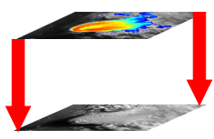

Kimberley thunderstorms. Early stages: the "clumping" of cumulus cloud in Himawari-8 satellite data
4th November 2019, from 04 to 0420UTC
Satellite images courtesy JMA/BOM, Lightning data courtesy WeatherZone
Visible channel and RADAR
Heavy
pptn
Light
Sandwich Product and Lightning
Sandwich Product (Vis and IR)
-80C
IR10.4 BT
HR Vis
-20C

Slide 11
Kimberley thunderstorms:
RADAR signals detected
4th November 2019, from 0430UTC
Satellite images courtesy JMA/BOM, Lightning data courtesy WeatherZone
Visible channel and RADAR
Heavy
pptn
Light
Sandwich Product and Lightning
Sandwich Product (Vis and IR)
-80C
IR10.4 BT
HR Vis
-20C

Slide 12
Kimberley thunderstorms:
First Lightning detected
4th November 2019, from 0540UTC
Satellite images courtesy JMA/BOM, Lightning data courtesy WeatherZone
Visible channel and RADAR
Heavy
pptn
Light
Sandwich Product and Lightning
Sandwich Product (Vis and IR)
-80C
IR10.4 BT
HR Vis
-20C

Slide 13
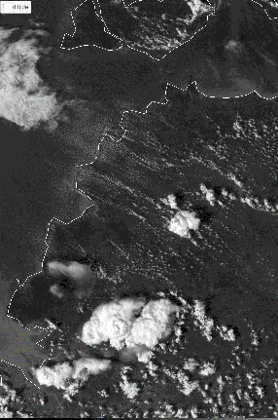
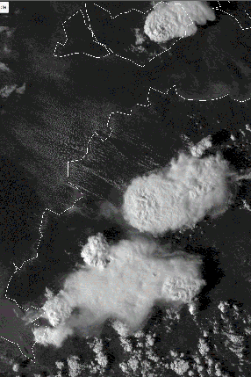
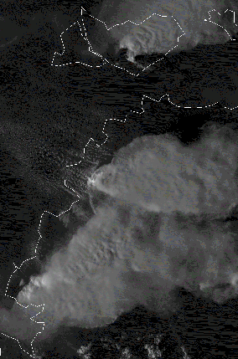
Storm relative animation: western Top End, Australia
10 FPS Rocking animations of storms developing over the northwest Top End, Australia
0400 to 0820UTC 6th December 2018 using the RAMMB/CIRA SLIDER functionality
Storms weakening as they encounter the seabreeze boundary
Storm propagating along the seabreeze front boundary
Darwin
0550UTC 0700UTC 0820UTC
Storm propagating into a local convergence area, (a line of Cu)
satellite animations courtesy JMA / CIRA RAMMB

Slide 14
System centric vs earth centric animation
System (storm) vs earth centric. System centric. Can do System Centric in SLIDER (NT storms example)
Can monitor rotation of the storm better, without the additional "translational" component of storm movement.
Can monitor the inflow of environmental air (and the source of this) into the storm and also the outflow from the system into the environment, without the additional "translational" component of storm movement.
Can resolve the shear associated with the storms development, without the additional "translational" component of storm movement.
Can resolve the interaction between storms , without the additional "translational" component of storm movement.

Slide 15
Socrative Question 3

Slide 16
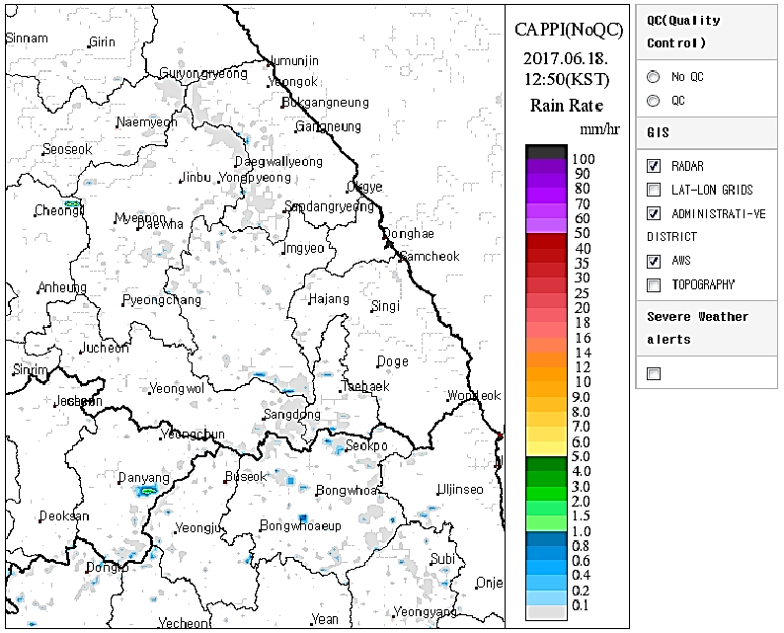
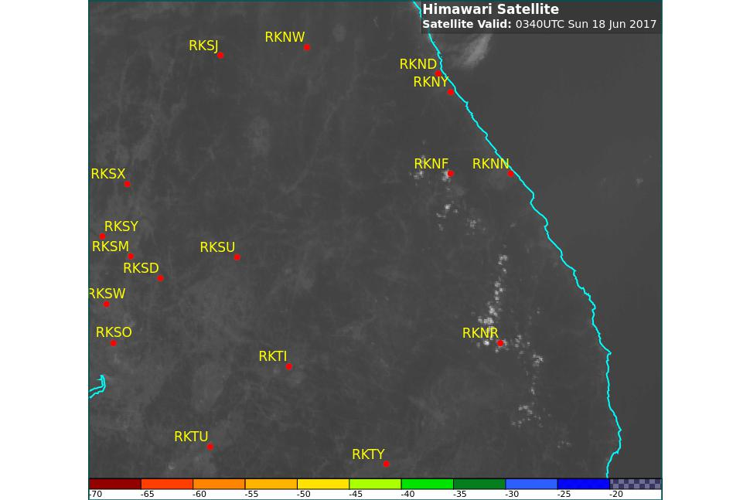
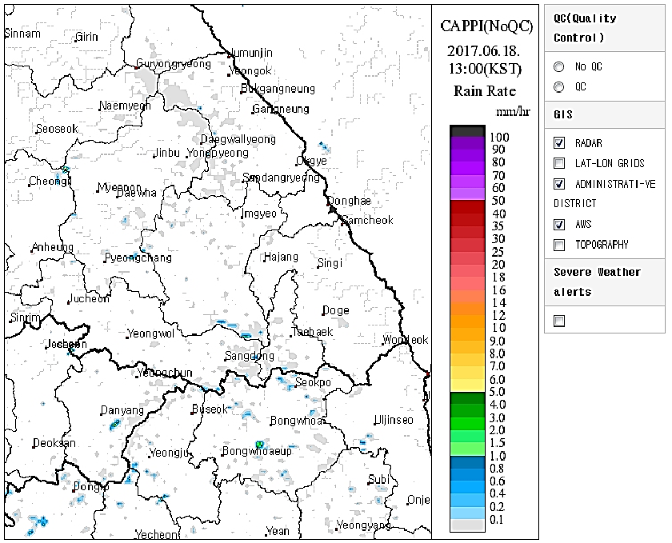
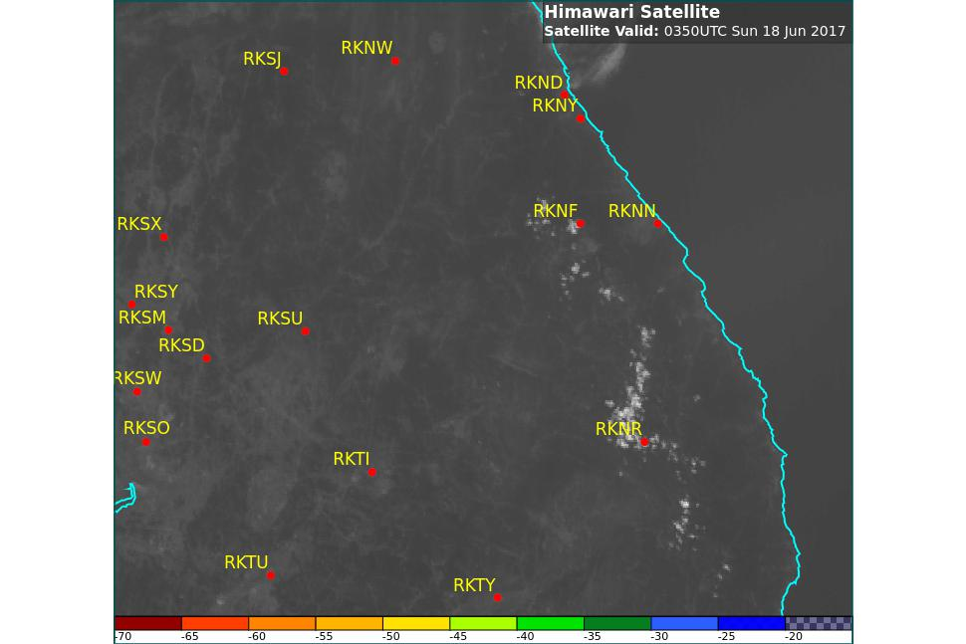
Korea thunderstorms: cumulus develops in satellite imagery; cumulus clumping:
0340-0350UTC (1240-1250KST)
RADAR images courtesy Korea Meteorological Administration (KMA)
satellite images courtesy JMA/BOM

Slide 17
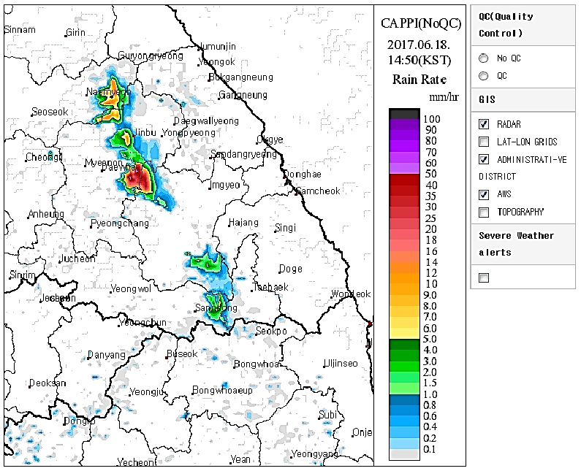
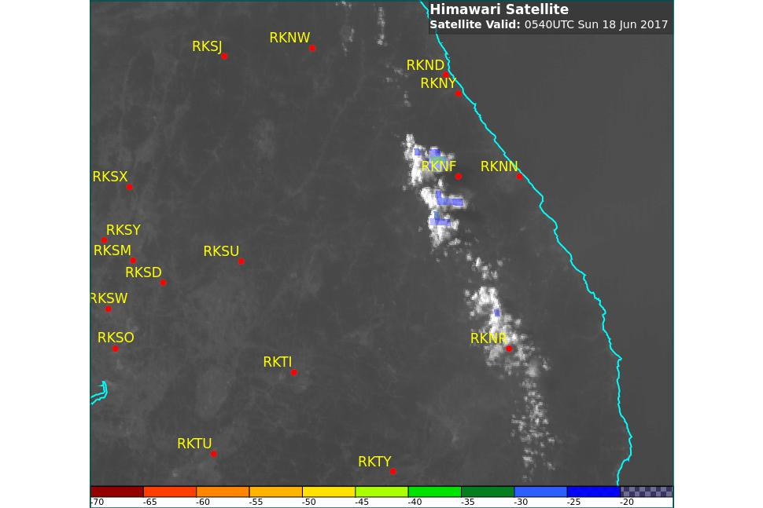
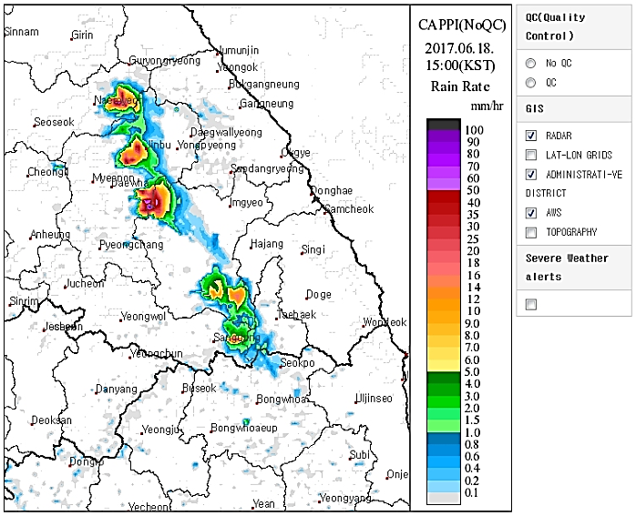
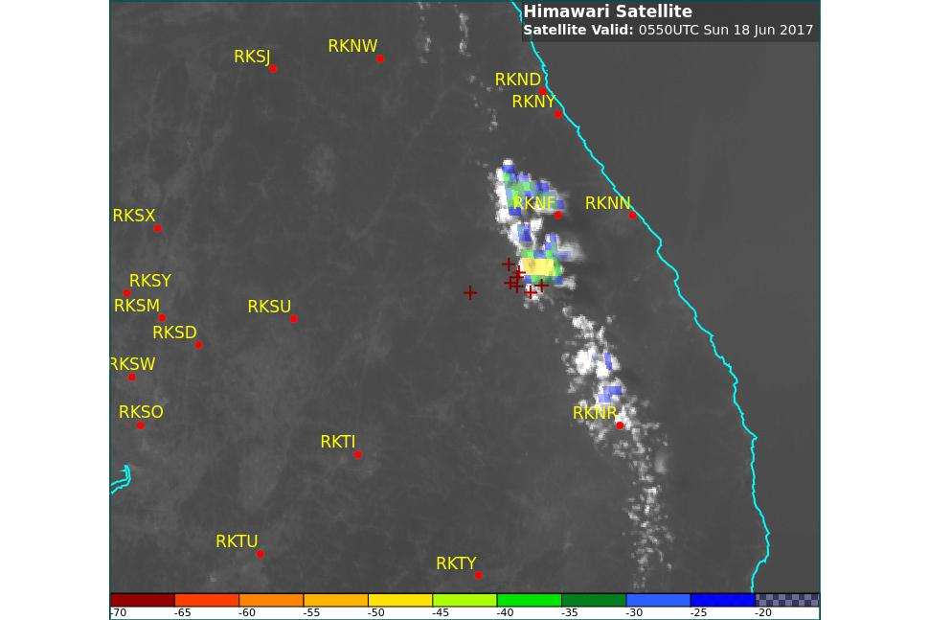
Korea thunderstorms: first lightning strikes recorded:
0550-0600UTC (1450-1500KST)
RADAR images courtesy Korea Meteorological Administration (KMA)
satellite images courtesy JMA/BOM

Slide 18
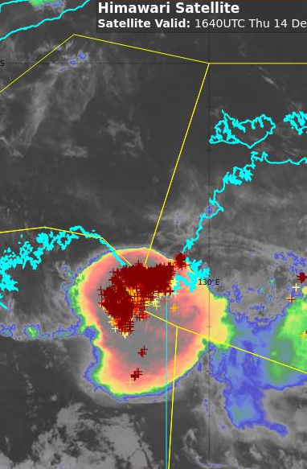
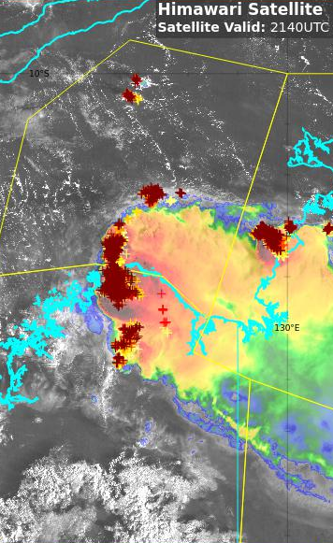
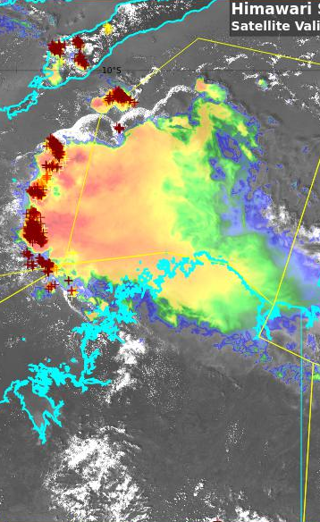

Overview of a Thunderstorm event, north Australia
Enhanced Infrared / Sandwich product and 10 minute lightning data at 1620UTC and 2140UTC, 14th December and 0450UTC 15th December
images courtesy JMA/BOM, lightning data from WeatherZone
1640UTC
14th Dec
2140UTC
14th Dec
0450UTC
15th Dec
Storm outflow
YKAL 45.8mm from 2116 to 0100UTC
110/20kt gust 31kt
at 2100UTC
Gustfront separating from deep convection

Slide 19
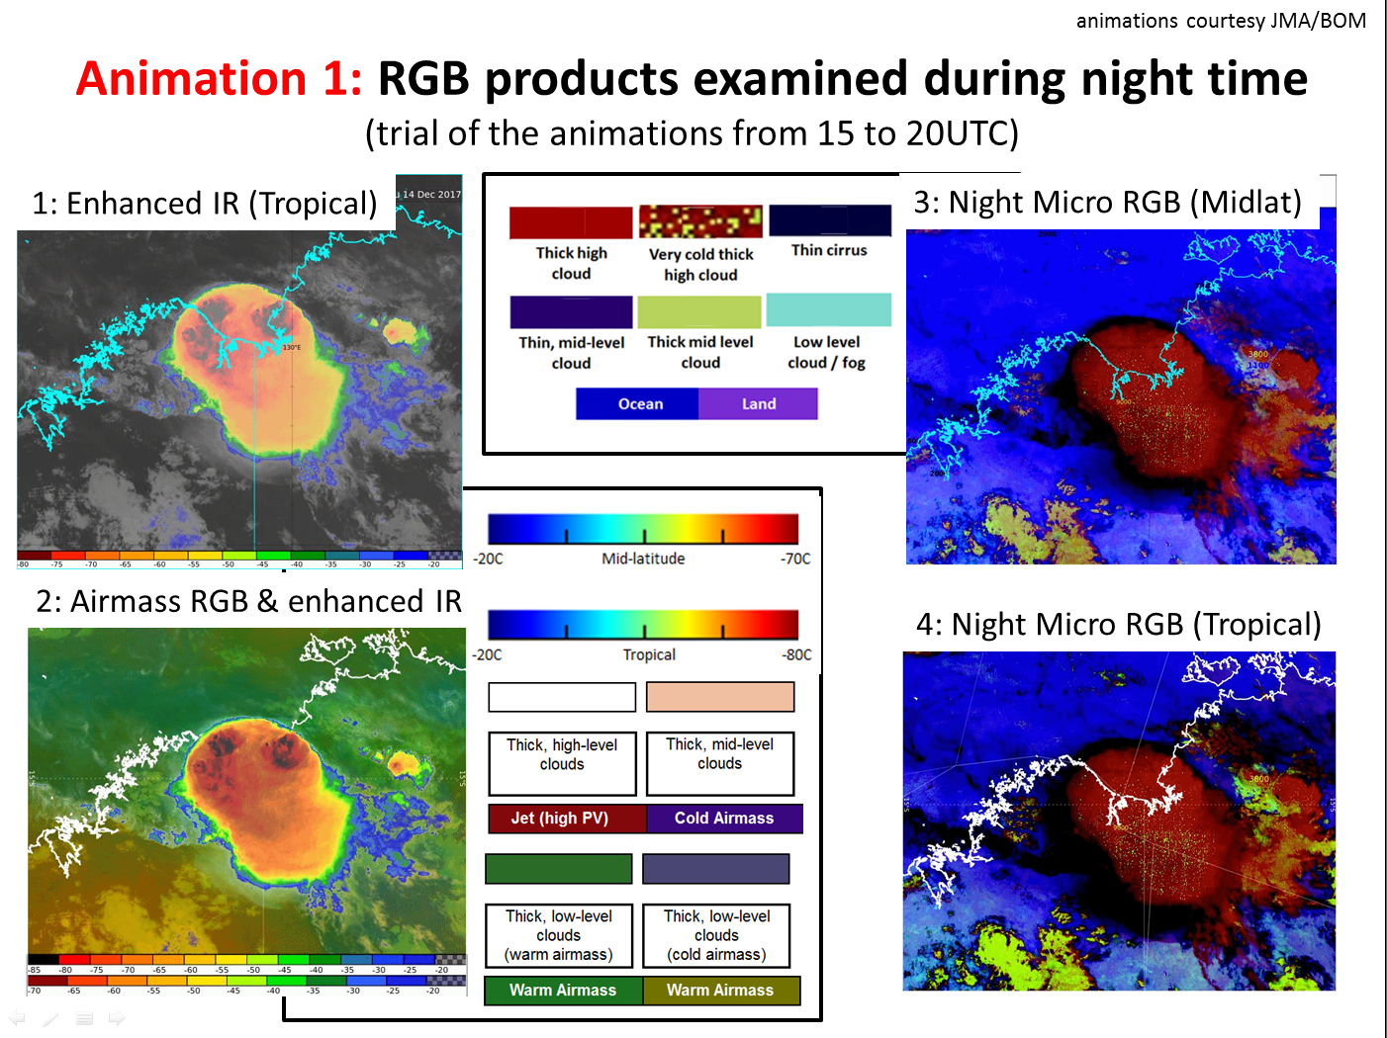
RGB products examined during night time
(trial of the animations from 15 to 20UTC)
Question: What RGB composite(s) do you prefer ?
Darwin

Slide 20
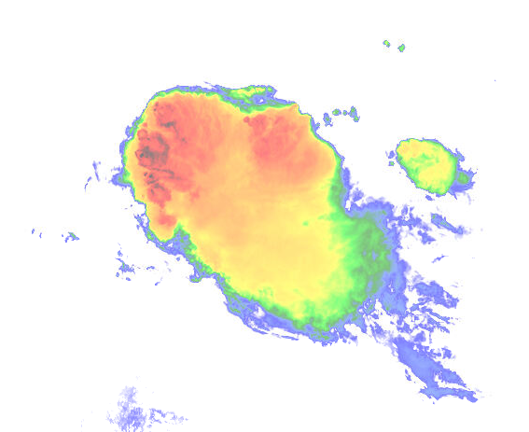
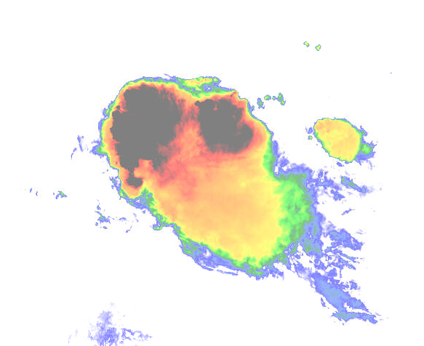
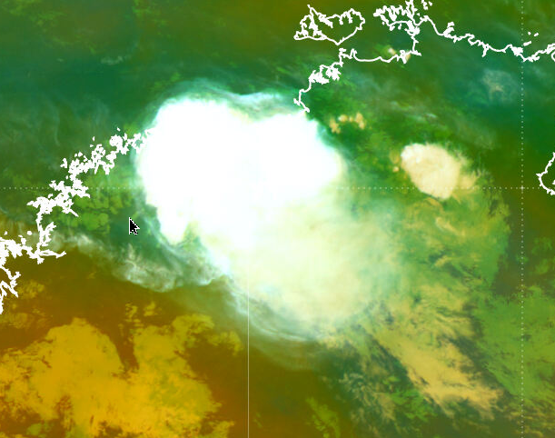
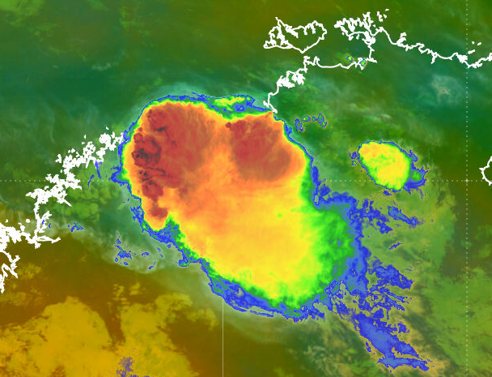
Example 4: "Airmass RGB Sandwich Product" (HansPeter Roesli)
Modification by BOM staff, including Operational Forecasters and B.Zeschke
images courtesy JMA/BOM
Top layer: IR10.4 BT tropical scale
-20C Tropical -80C
scale as adapted from Australian Bureau of Meteorology forecasters
Mid layer: IR10.4 BT midlat scale
-20C Mid-latitude -70C
Upper and mid layer opacity set to 50%
Bottom layer (“background”): Airmass RGB (midlat tuned)
Before After
Blending options – applied to the upper layer
satellite images courtesy JMA/BOM

Slide 21
Socrative Question 4

Slide 22
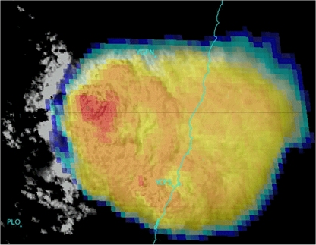
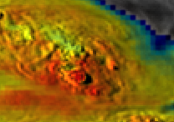
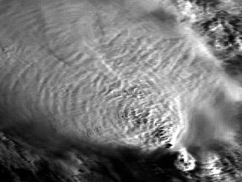






Storm-Top Features
Overshooting top
Pancake formation
Gravity waves
Radial cirrus
Ship wake
Cold U-shaped storm
Cold ring shaped storm
Above anvil cirrus plume
Jumping cirrus

Slide 23




Singapore thunderstorm event, 28th June 2017 at the time 16:20 LST, 0810UTC
satellite data courtesy BOM/JMA, lightning data from Weather Zone
Modified Tropical Sandwich Product
(vis brightness -170, contrast 400)
Comparing RADAR, Himawari-8 satellite and lightning data.
RADAR data courtesy NEA Singapore
Tropical Sandwich Product
20km

Slide 24

Singapore thunderstorm event, 28th June 2017 at the time 16:20 LST, 0820UTC
satellite data courtesy BOM/JMA, lightning data from Weather Zone
24 hour precipitation (mm)
Modified Tropical Sandwich Product
(vis brightness -170, contrast 400)
Comparing RADAR, Himawari-8 satellite and lightning data.
RADAR and precipitation data courtesy NEA Singapore
Tropical Sandwich Product
20km

Slide 25



Explaining the Parallax error
from http://www-das.uwyo.edu/~geerts/cwx/notes/chap02/parallax.html
image modified from Satellite Liaison Blog submission by B.Line
Singapore location | 1.35° N, 103.82° E
Himawari-8 sub-satellite | 0, 140.7E
Distance from sub-satellite point | ~37 degrees
Normalise cloud offset | ~ 0.8 to 0.9
Stormtop height | ~14km (Tbb ~-65C)
Offset | ~12 km away from (to west) of sub-satellite point
image from University of Wyoming
Notes:
https://physics.stackexchange.com/questions/25917/parallax-cloud-displacement-angular-distance-from-geostationary-satellite

Slide 26

Summary
So many possibilities when looking at satellite data and all the channels.
Visible satellite images are a powerful tool in identifying where thunderstorms will form in real time.
Sandwich products are useful in identifying storm details especially storm tops and were the strongest updraughts are occurring.
Animations are awesome
RGB can tell us so much

Slide 27
The End
Dean Narramore
Extreme Weather Desk Bureau of Meteorology
Australia

