Slide 1
WMO Initiative for promoting Space-based Weather and Climate Extremes Monitoring (SWCEM)
from Demonstration to Operation
Yuriy Kuleshov
Australia Bureau of Meteorology
Werner Balogh, Toshiyuki Kurino
WMO Space Programme

Slide 2
Contents
Weather and Climate Extremes
WMO Regional Climate Centres
Satellite-derived Products for Extremes Monitoring
Development of the WMO Space-based Weather and Climate Extremes Monitoring (SWCEM) Demonstration Project (SEMDP)
SWCEM in Operation after 2020

Slide 3
What is “Weather and Climate Extremes”?

Slide 4
WMO Meteoterm Definition
An Extreme Weather Event is an event that is “rare” at a particular place and time of year. Definitions of “rare” vary, but an extreme weather event would normally be “as rare as or rarer than” the 10th or 90th percentile of a probability density function estimated from observations.
By definition, the characteristics of what is called extreme weather may vary from place to place in an absolute sense.
When a pattern of extreme weather persists for some time, such as a season, it may be classed as an Extreme Climate Event, especially if it yields an average or total that is itself extreme (e.g., drought or heavy rainfall over a season).
(DEFINITION SOURCE: IPCC 5th Assessment Report, WG 1 Glossary)

Slide 5
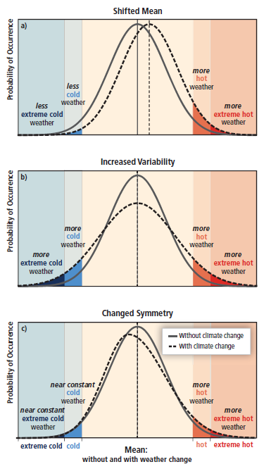
According to IPCC Report
Some types of extreme weather and climate events have increased in frequency or magnitude, but populations and assets at risk have also increased, with consequences for disaster risk.
Opportunities for managing risks of weather- and climate-related disasters exist or can be developed at any scale, local to international.
(IPCC report on “Managing the Risks of Extreme Events and Disasters to Advance Climate Change and Adaptation”, 2012)

Slide 6
What is WMO Regional Climate Centres?

Slide 7
WMO Regional Climate Centres
The World Meteorological Organization's (WMO) basic infrastructure has been extended to strengthen the National Meteorological and Hydrological Services (NMHSs) capabilities in operationally generating and delivering up-to-date climate information and prediction products for climate services, especially in support of climate adaptation and risk management.
Furthermore, WMO designated Regional Climate Centres (RCCs) are being implemented to generate and deliver more regionally-focused high-resolution data and products as well as training and capacity building.

Slide 8
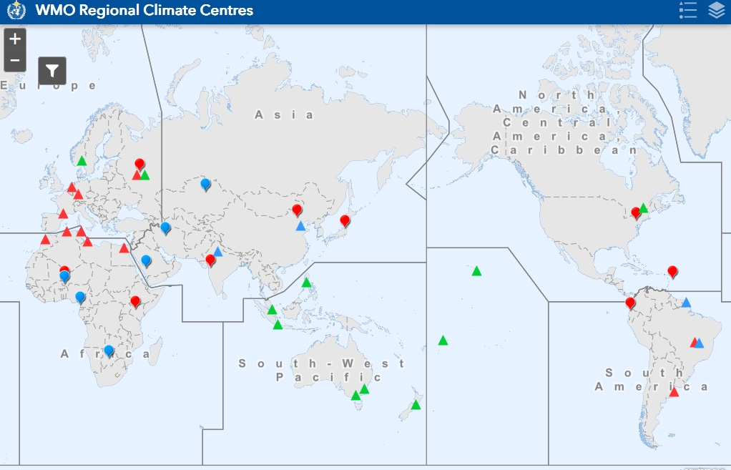
RA-II
Southeast Asia Regional Climate Centre Network (SEA RCC-Network)
Pacific RCC-Network
RA-V

Slide 9
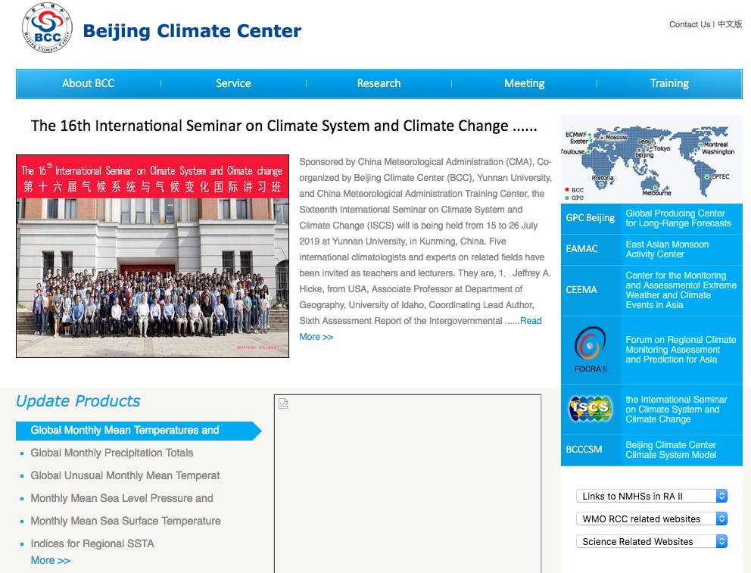
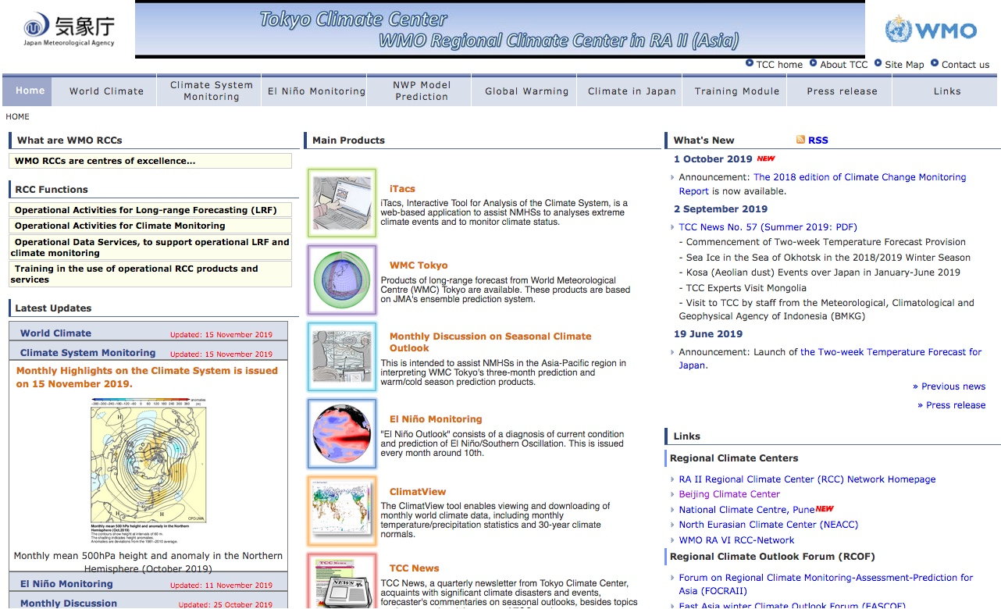
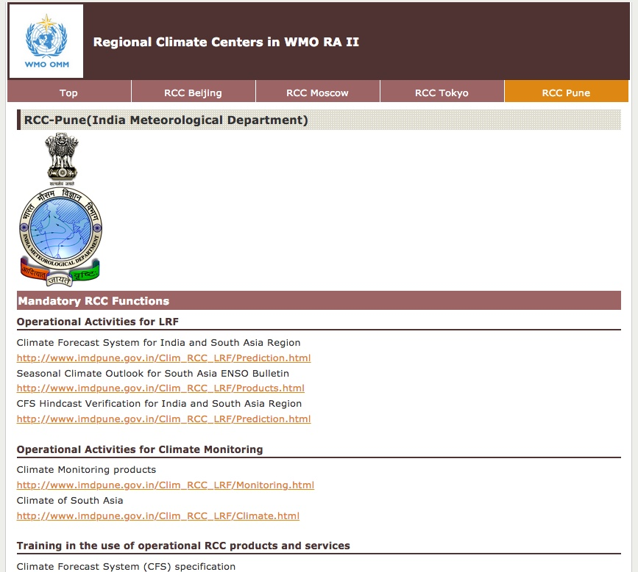

Slide 10
Socrative Question 1
Have you heard about the WMO Regional Climate Center (RCC) activities?
Yes I am fully aware of WMO RCCs and the potential benefits and I am taking advantage of these
Yes I have heard about WMO RCCs but I would like more information
No, I have not heard about WMO RCCs but I would like more information
No, I have not heard about WMO RCCs and I do not think it is relevant to me and my workplace.

Slide 11
Why WMO to promote Weather and Climate Extremes Monitoring from Space?

Slide 12
The problem is that WMO RCCs will not use Satellite-derived Products for Climate Extremes Monitoring.....Why?

Slide 13
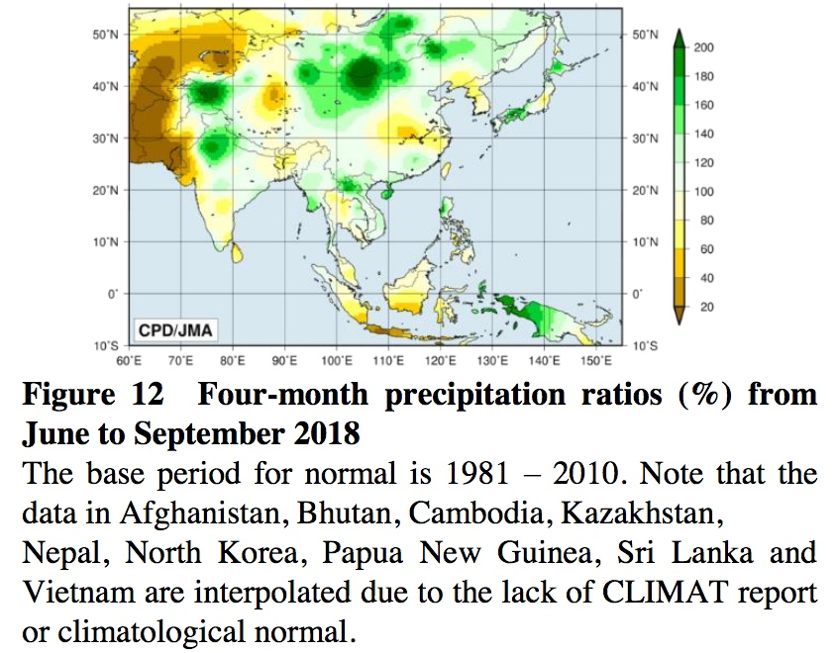
interpolate/extrapolate of CLIMAT data
TCC/JMA Extreme Climate Monitoring
TCC/JMA Extreme Climate Event Criteria
TCC/JMA defines Extreme climate events as phenomena occurring once every 30 years or less. Monthly, seasonal and annual reports are based on CLIMAT data submitted by National Meteorological and Hydrological Services (NMHS) around the world.
“Summary of the 2018 Asian Summer Monsoon” issued by Tokyo Climate Center (JMA)
http://ds.data.jma.go.jp/tcc/tcc/products/clisys/reports/report/report20181130.pdf

Slide 14
The answer is that No reliable satellite-derived rainfall product with 30 years Climate Normal available for RCCs in Operation
excepting following two products;
NOAA OLR (Out-going Longwave Radiation)
NOAA Land Snow/Sea Ice Coverage
produced by NOAA/NESDIS
with 30 years Climate Normal

Slide 15
However, some satellite-derived rainfall products are “promising” in use at RCCs

Slide 16
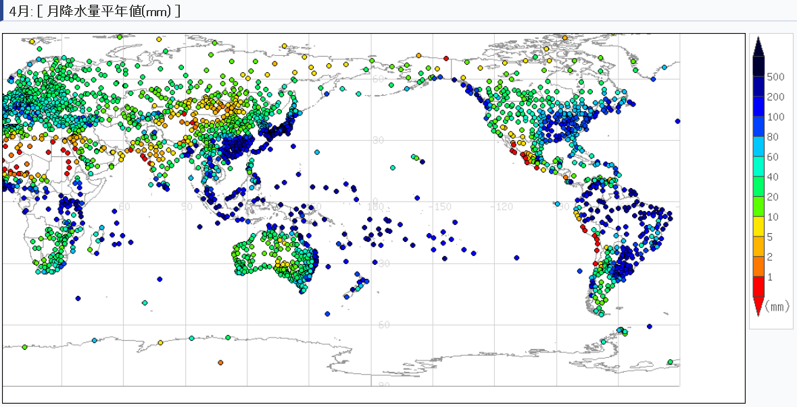
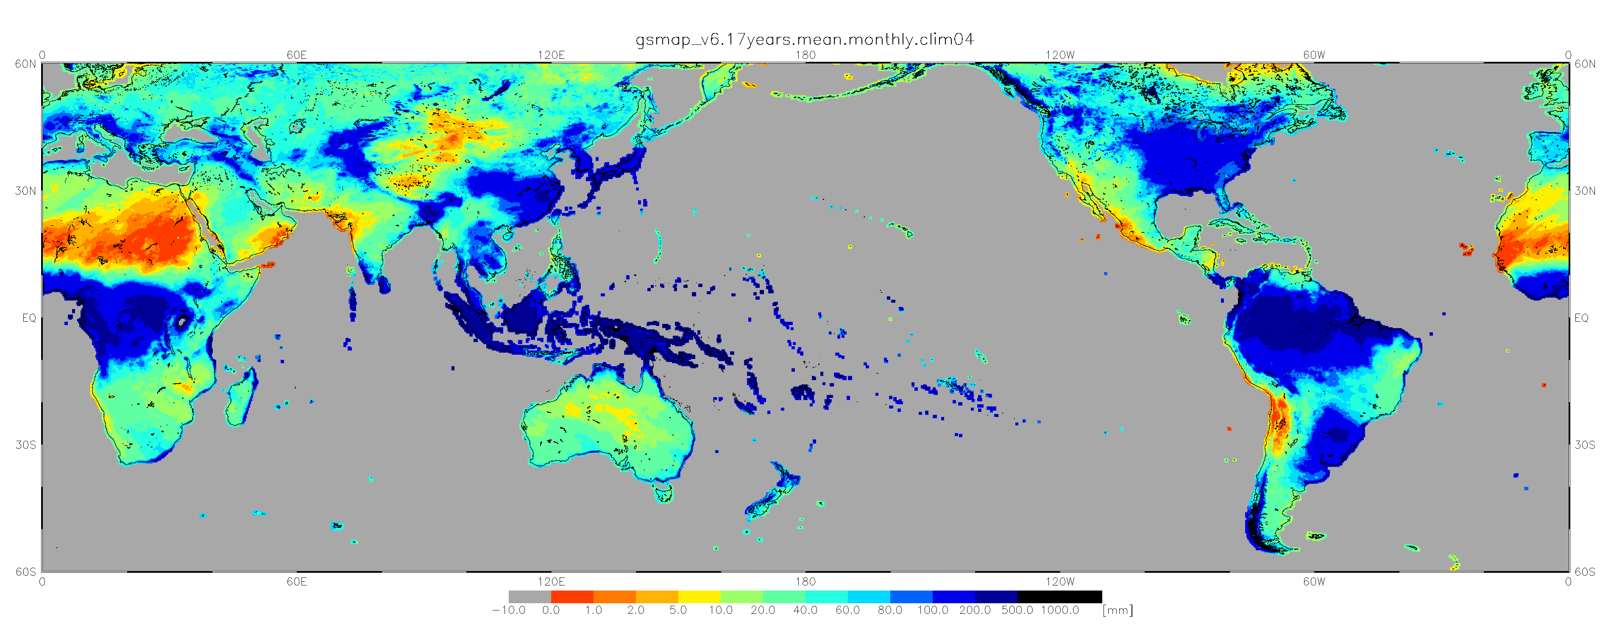
Monthly Mean Precipitation (mm) in April - CLIMAT (30-year mean) vs GSMaP (18-year mean)
JMA CLIMAT Viewer: http://www.data.jma.go.jp/gmd/cpd/monitor/climatview/frame.php?&s=1&r=0&y=2015&m=4&e=7&t=22&l=87&k=0&s=1
CLIMAT
JAXA/EORC
GSMaP

Slide 17
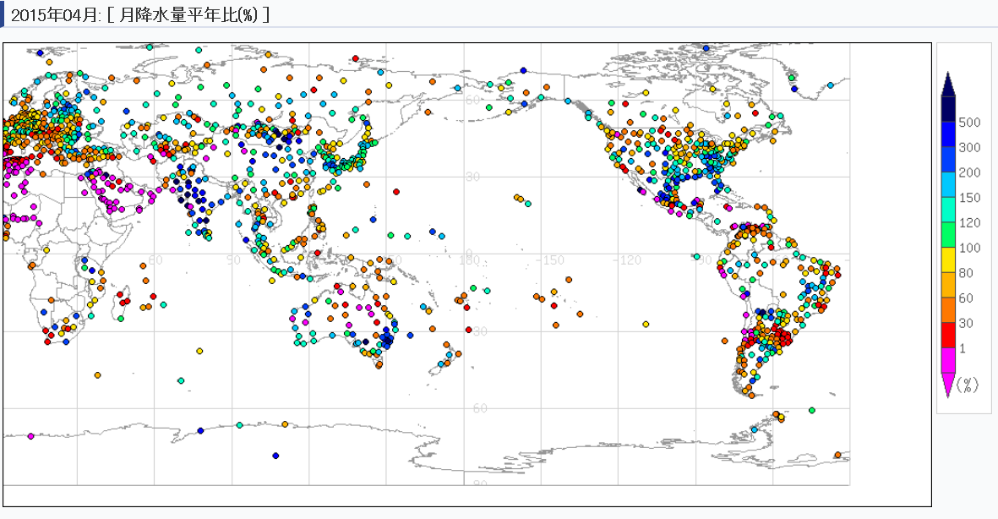
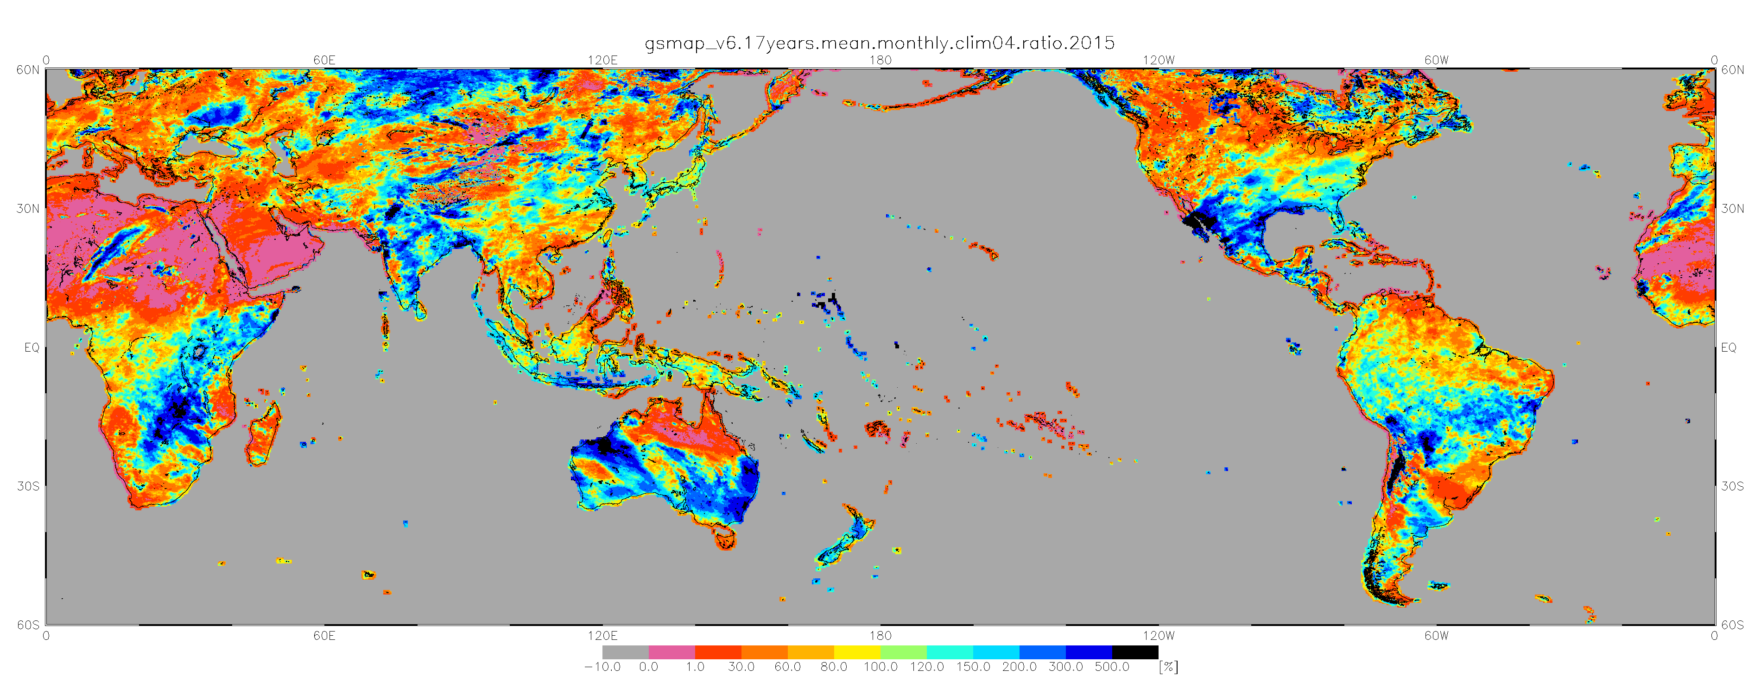
Monthly Mean Precipitation ratio (%) in April, 2015 - CLIMAT (30-year normal) vs GSMaP (18-year normal)
JMA CLIMAT Viewer: http://www.data.jma.go.jp/gmd/cpd/monitor/climatview/frame.php?&s=1&r=0&y=2015&m=4&e=5&t=22&l=87&k=0&s=1
CLIMAT
JAXA/EORC
GSMaP

Slide 18
Microwave-based Combined Rainfall Products with “relatively” long term (20 years) Climate Data Record will be ready in use at RCCs. It is expected to be validated with CLIMAT rain gauge analysis as an “ancillary” dataset in operation.

Slide 19
Satellite Operators have contributed to Climate Extremes Monitoring by producing satellite-derived products, taking into account of climate monitoring and diagnostics.
Why Not?!?!
WMO Regional Climate Centres (RCCs) will not use satellite estimation of rainfall for extremes monitoring monthly/weekly/pentad basis in operation.

Slide 20
There still remains problem on “Data Latency” in operational use at RCCs.....

Slide 21
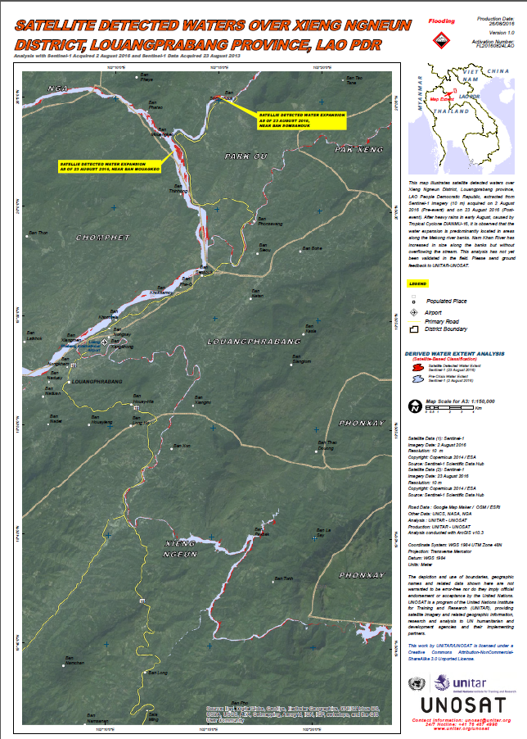
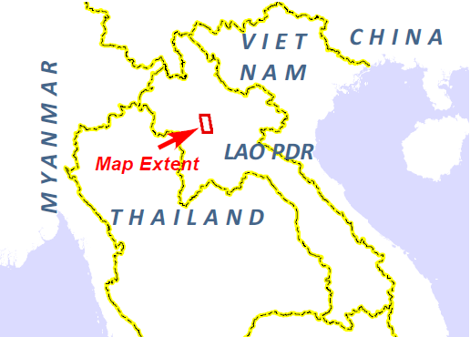
UNOSAT Report
Satellite Detected Waters over Xieng Ngneun District, Louangprabang Province, Lao PDR
This map illustrates satellite detected waters over Xieng Ngneun District, Louangprabang province, LAO People Democratic Republic, extracted from Sentinel-1 imagery (10 m) acquired on 2 August 2016 (Pre-event) and on 23 August 2016 (Post-event).
After heavy rains in early August, caused by Tropical Cyclone DIANMU-16, it is observed that the water expansion is predominantly located in areas along the Mekong river banks. Nam Khan River has increased in size along the banks but without overflowing the stream.
Satellite Data (1): Sentinel-1
Imagery Date: 2 August 2016
Imagery Date: 23 August 2016
Resolution: 10 m
Copyright: Copernicus 2014 / ESA
Source: Sentinel-1 Scientific Data Hub
http://www.unitar.org/unosat/node/44/2448?utm_source=unosat-unitar&utm_medium=rss&utm_campaign=maps

Slide 22
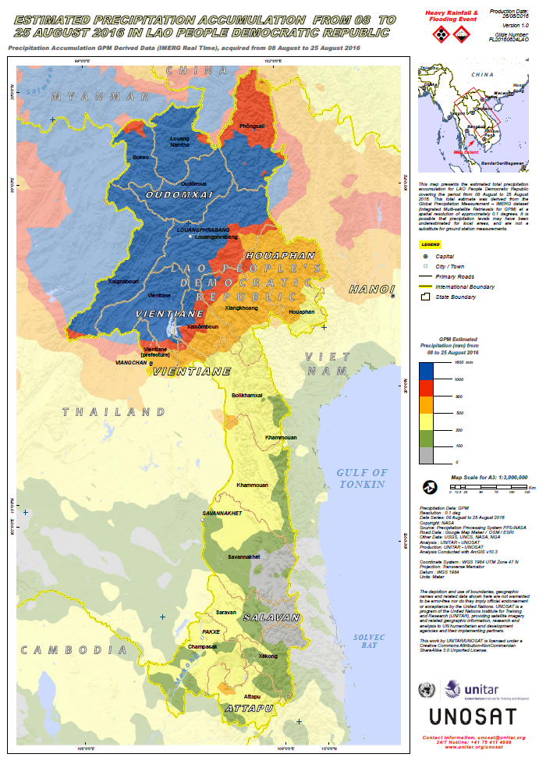
UNOSAT Report Estimated Precipitation Accumulation from 08 to 25 August 2016 in Lao People Democratic Republic
This map presents the estimated total precipitation accumulation for LAO People Democratic Republic covering the period from 08 August to 25 August 2016. This total estimate was derived from the Global Precipitation Measurement – IMERG dataset (Integrated Multi-satellite Retrievals for GPM) at a spatial resolution of approximately 0.1 degrees. It is possible that precipitation levels may have been underestimated for local areas, and are not a substitute for ground station measurements.
http://www.unitar.org/unosat/node/44/2447?utm_source=unosat-unitar&utm_medium=rss&utm_campaign=maps

Slide 23
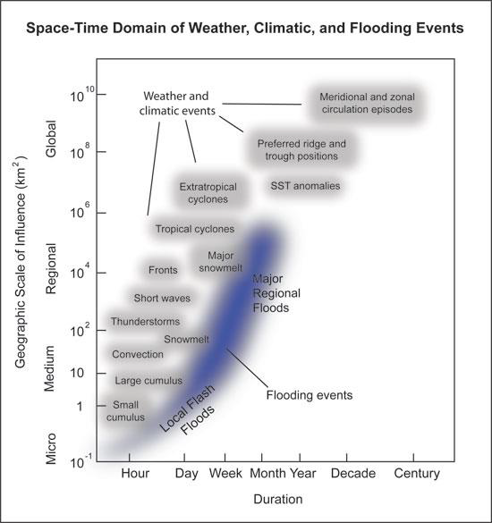
monitoring weather and climate extremes in short duration on pentad or weekly basis up to monthly basis
filling a gap between space-based “nowcasting” and “climate change monitoring”
Space-time domain of weather, climatic, and flooding events
(Katie Hirschboeck, The University of Arizona)
(http://www.southwestclimatechange.org/impacts/water/floods#references)

Slide 24
Our Challenges are;
1. Satellite Operators to produce satellite-derived products with;
low data latency (less than 1 day),
long term (more than 20 years data record),
high spatial resolution (less than 0.1 degrees),
low bias with rain gauge observation,
gridded,
global land coverage,
monthly/weekly/pentad statistics available via on-line environment
2. WMO RCCs to utilize products with validation in operation to place recent extremes in historic context.

Slide 25
Developments of WMO Space-based Weather and Climate Extremes Monitoring (SWCEM)

Slide 26
Socrative Question 2
Have you heard about the WMO the Space-based Weather and Climate Extremes Monitoring (SWCEM) Demonstration Project (SEMDP)?
Yes I am fully aware of SEMDP and the potential benefits and I am taking advantage of these
Yes I have heard about SEMDP but I would like more information
No, I have not heard about SEMDP but I would like more information
No, I have not heard about SEMDP and I do not think it is relevant to me and my workplace.

Slide 27
WMO Secretariat proposed the Space-based Weather and Climate Extremes Monitoring (SWCEM) Demonstration Project (SEMDP) to the 69th WMO Executive Council (EC-69) in May 2017 and approved. EC-69 decided;
(a) Establish SEMDP and decide on priority WMO Region(s) starting in 2018 for a two year duration;
(b) Identify the deliverables of the demonstration project, concentrating on products at national and regional levels:
i. Monitoring persistent heavy precipitation and droughts;
ii. Making best use of existing and newly developed satellite derived products and time series of measurements;
iii. Making best use of products that combine satellite information with in situ data;
(c) Assess the SEMDP products and other results, and recommend which should be transitioned from research to operations;

Slide 28
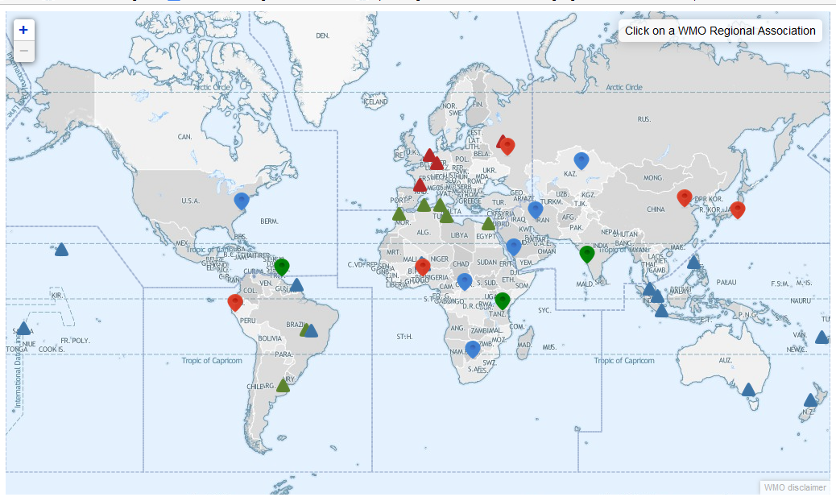
WMO SEMDP targeting Area

Slide 29
WMO Secretariat requested the Coordination Group for Meteorological Satellites (CGMS), in its 45th meeting in June 2017 to support the SEMDP implementation with placing actions on CGMS members, the IPWG and the joint CEOS-CGMS WG Climate. The following actions were agreed.
- NOAA/NESDIS to support SEMDP by providing satellite observations of persistent heavy precipitation events, and land surface parameters for monitoring droughts. The observations are required with a short latency of about one day. Furthermore the project requires the creation of climate reference data sets which will be used by the RCCs to classify observations as extreme event or not. (A45.05)
- JAXA to support SEMDP by providing a short term (from 5-day up to monthly) climate normal from GSMaP data archives as a reference precipitation data set for the initial SEMDP areas. JAXA is also requested to set-up the on-line environment to provide GSMaP data with short latency to be utilized in the SEMDP. (A45.06)
- CGMS/International Precipitation Working Group (IPWG) co-chairs and rapporteur to provide guidance on the estimation of uncertainties and representativeness of the short-latency precipitation products related to SEMDP. (A45.07)
- CEOS/CGMS Working Group on Climate to provide feedback on the proposed definition for the Interim Climate Data Record (ICDR). (A45.08)

Slide 30
Fundamental or Thematic Climate Data Record (FCDR or TCDR) are to be produced in the “sustained architecture of climate” whereas a common and accepted definition of an Interim Climate Data Record (ICDR) is still needed to provide best practices to WMO RCCs in setting up operations on extreme monitoring in short latency, e.g. 1 day after observation.
“CEOS/CGMS Working Group on Climate” to provide feedback on the proposed definition for ICDR;
Definition: An Interim Climate Data Record (ICDR) is a Fundamental or Thematic Climate Data Record regularly updated with an algorithm/system having maximum consistency to the FCDR or TCDR generation algorithm/system. The update cycle depends on the user needs for climate extremes and might range from pentad to monthly.

Slide 31
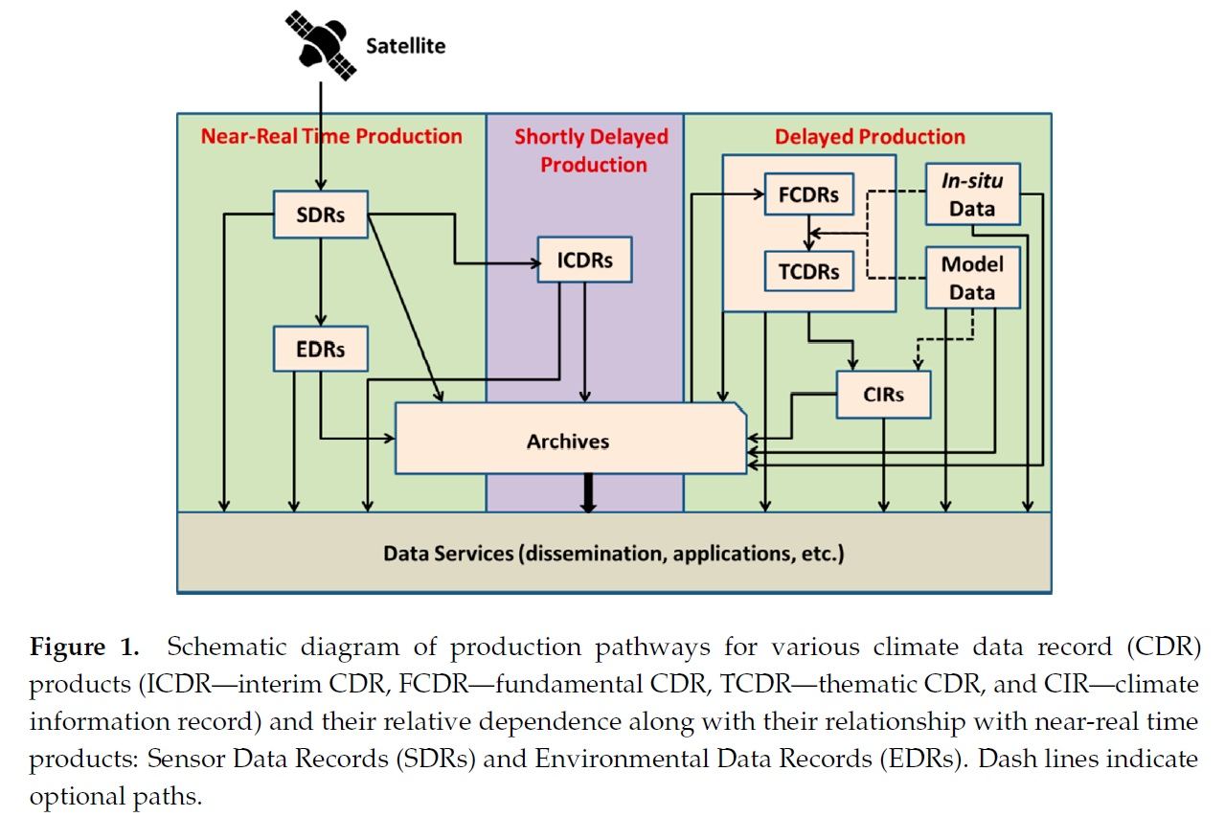
Schematic diagram of production pathway for various climate data record products

Slide 32
List of the Satellite-Derived Rainfall Estimation Products for SEMDP by NOAA and JAXA
Product | Provider | Geophysical Parameter
GSMaP | JAXA/EORC | - Satellite(s): GPM-Core, GCOM-W1, NOAA series, MetOp series, TRMM, Aqua, DMSP series, Geo-meteorological satellite - Spatial Coverage: 45ºS-40ºN/90ºE-160ºW - Spatial Resolution: 0.1 X 0.1 degree grid box - Temporal Resolution: 1 hour - Data Archiving Period: 1 March 2000 to the present - Data Latency: 2-3 hours - Data Format: plain binary format, NetCDF
CMORPH | NOAA/NWS/CPC | - Satellite(s): GPM-Core, GCOM-W1, NOAA series, MetOp series, TRMM, Aqua, DMSP series, Geo-meteorological satellites - Spatial Coverage: 45ºS-40ºN/90ºE-160ºW - Spatial Resolution: 0.1 X 0.1 degree grid box - Temporal Resolution: 30 minutes - Data Archiving Period: 1 January 1998 to the present - Data Latency: 1-2 hours - Data Format: plain binary format, NetCDF
NDVI (Normalized Difference Vegetation Index), VHI (Vegetation Health Index), and SMOPS (Soil Moisture Products) are provided by NOAA/NESDIS

Slide 33
A Cross-cutting Scheme for Implementing Operational Space-based Weather and Climate Extremes Monitoring (SWCEM)
Meteorological Satellite Operators
R&D Space Agencies
CGMS to support SWCEM
Provision of Satellite derived Products
Evaluation/Validation of Products
Ground Station Measurements
Regional Climate Centres (RCCs)
Weather & Climate Extremes Data Base
Detection of Weather & Climate Extremes
sharing of experiences in the application of satellite products for monitoring weather & climate extremes initiation
Issuance of Guidance for Weather & Climate Extremes Monitoring
pre-disaster risk assessment to post-disaster emergency response mapping.
NMHSs
NMHSs
NMHSs
Utilization/Evaluation
of Guidance
Capacity Building

Slide 34
SEMDP Training and Capacity Building Workshop, back-to-back with the Eleventh ASEAN Climate Outlook Forum (ASEANCOF-11), 29-30 November 2018 in Kuala Lumpur, Malaysia

Slide 35
Outcomes from the First Workshop
on WMO SEMDP Training and Capacity Building
29-30 November 2018 in Kuala Lumpur, Malaysia
For the workshop, the satellite operator, JAXA and NOAA shared information on the latest development in the microwave-based satellite observation systems, and the capabilities for monitoring rainfall with other related variables (e.g. vegetation health and soil moisture).

Slide 36
JAXA and NOAA also reported three case studies on the validation of the satellite derived rainfall estimations and comparisons with in-situ rain gauge data demonstrating capabilities to monitor rainfall extremes.
Persistent heavy rainfall event in Nov. - Dec. 2014 that affected Peninsular Malaysia, Southern Thailand, and occurred close to Singapore.
Persistent heavy rainfall in Aug. 2016 which affected the Lao PDR, especially in the North.
Extended dry period in January to March 2014 which affected Singapore, Malaysia and Indonesia.

Slide 37
The case studies demonstrated that the satellite estimates are generally able to represent rainfall well when compared to ground stations, especially spatial and temporal patterns.
However, intensities can be biased especially over orography, where few ground measurements are available to be able to establish ‘ground-truth’ properly.
Intensity-wise, the satellites are able to represent weekly and month averages better than daily averages in general.
Rainfall-derived indices, such as number of rain days or dry days were also represented well in the relevant case studies and showed promising applications.

Slide 38
Overall the Workshop participants felt that the satellite products produced by JAXA and NOAA prepared for the Workshop can reasonably be used experimentally for monitoring the extreme events associated with the rainfall in a demonstration phase.
Furthermore, it was recommended that the workshop participants will be developing their own set of products to be semi-operationalised at the regional (RCCs) and national (NMHSs) levels in 2019.

Slide 39
WMO SWCEM from “Demonstration” to “Operation”

Slide 40
SWCEM Implementation Plan was reviewed in the 18th World Meteorological Congress (Cg-18), June 2019
Cg-18 Having considered;
The significant development and progress of the Space-based Weather and Climate Extremes Monitoring (SWCEM) Demonstration Project (SEMDP), from its concept to the first SEMDP regional subproject implemented in East Asia and Western Pacific in 2018,
focusing on “persistent heavy rainfall” and “drought”, and
involving two Global Satellite-derived Product Providers (JAXA, NOAA), three WMO Regional Climate Centres (RCC Beijing, SEA RCC-Network, Pacific RCC-Network), and three NMHSs (Malaysia, Thailand, Vietnam).
The participating RCCs and NMHSs recognized and appreciated the support from the Global Satellite-derived Product Providers,

Slide 41
Cg-18 Adopted (Resolution 54);
The implementation of SWCEM East Asia and Western Pacific regional operational subproject from 1 January 2020.

Slide 42
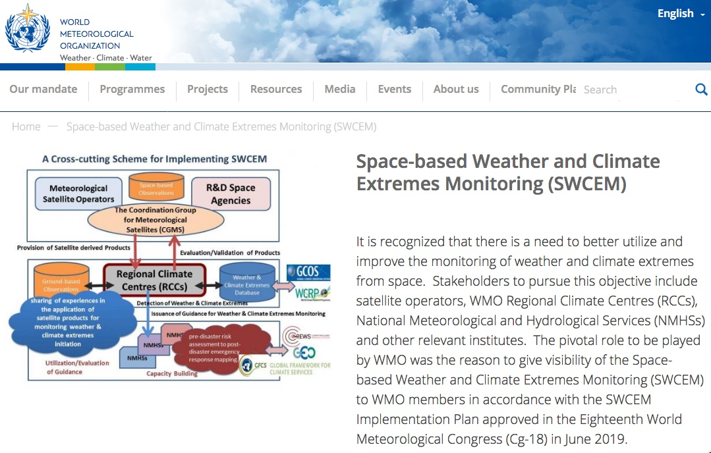
WMO SWCEM Portal https://public.wmo.int/en/space-based-weather-and-climate-extremes-monitoring-swcem
Structure of SWCEM-EAWP
Focal Points
Satellite-derived Products
Case Study
NewsLetter

Slide 43
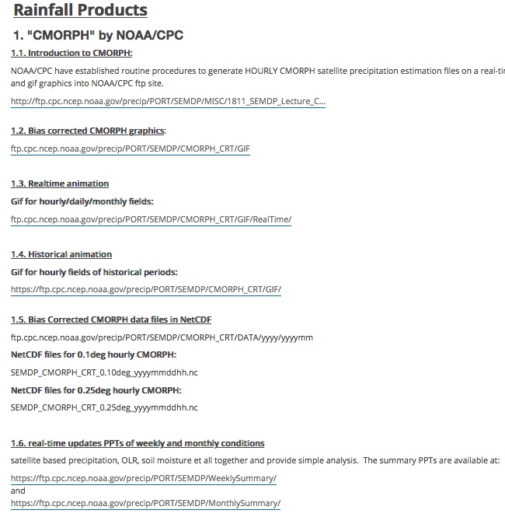
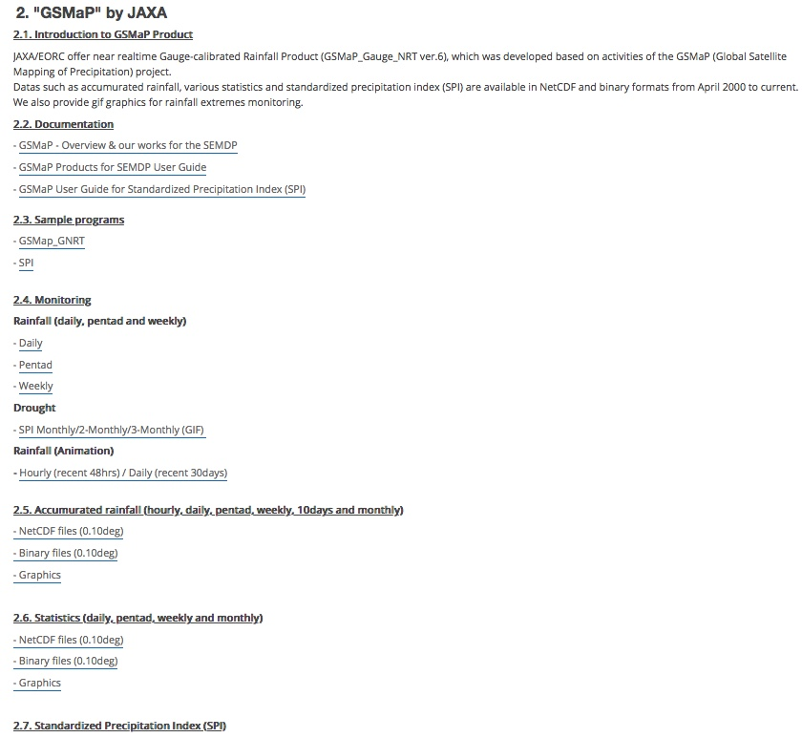
Satellite-derived Products
Access to the Satellite-derived Products for SWCEM
produced by NOAA/CPC and JAXA/EORC

Slide 44
More Information available from SWCEM Portal
Related Documents
SWCEM Implementation Plan
(English - French - Russian - Spanish - Arabic- Chinese)
SWCEM Help-desk
For user feedback, contact: swcem-help-desk@wmo.int

Slide 45
Socrative Question 3
How would you like to obtain additional information about the WMO SWCEM after the conclusion of AOMSUC-10?
Yes, I would like to get more information from the WMO SWCEM Portal
Yes, I would like to get satellite-derived products as trial from the FTP site operated by NOAA/CPC and/or JAXA/EORC with instruction in the WMO SWCEM Portal
No, I am not interested in the WMO SEMDP and I do not think it is relevant to me and my workplace.

Slide 46
Thank you

Slide 47
Cg-18 Having considered also;
The importance of accurate and timely weather and climate extremes monitoring for Members and that, if successful, the concept of the SEMDP in East Asia and Western Pacific should be implemented throughout RA II and RA V and expanded to other WMO Regions, especially in developing countries,
Cg-18 Having considered further;
The project was contributing significantly and in a very concrete way to capacity-building in the NMHSs through a better understanding and use of satellite-derived products together with ground-based observations,
Cg-18 Further noting;
The project provided opportunities to improve interaction with Disaster Management and Civil Protection Authorities, thereby supporting the goal of increasing the visibility of NMHSs,
Cg-18 Acknowledging with appreciation;
The development of the Space-based Weather and Climate Extremes Monitoring (SWCEM) East Asia and Western Pacific regional operational subproject Implementation Plan,
Cg-18 Endorses;
The implementation of SWCEM East Asia and Western Pacific regional operational subproject from 1 January 2020

