Slide 1
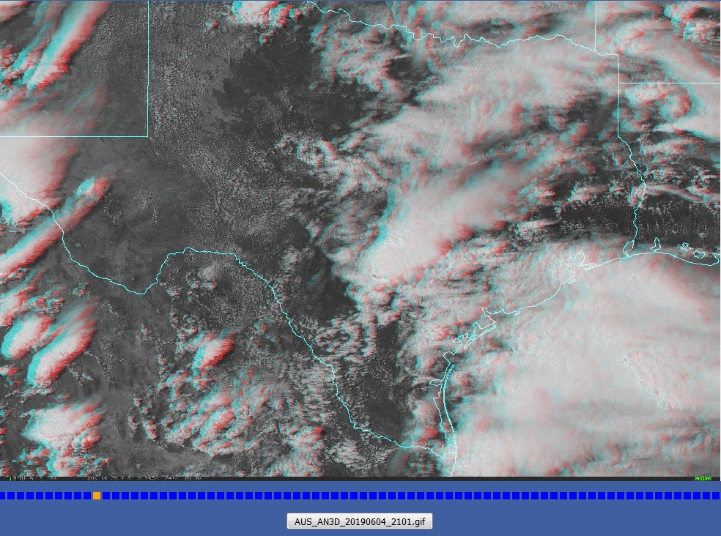
Animation: Texas Convection anaglyph imagery 2101UTC 4th June to 0301UTC 5th June 2019 (5frames per second)
image from Wikipedia
Texas
animations from CONUS imagery presented by Embry-Riddle Aeronautical University

