Slide 1
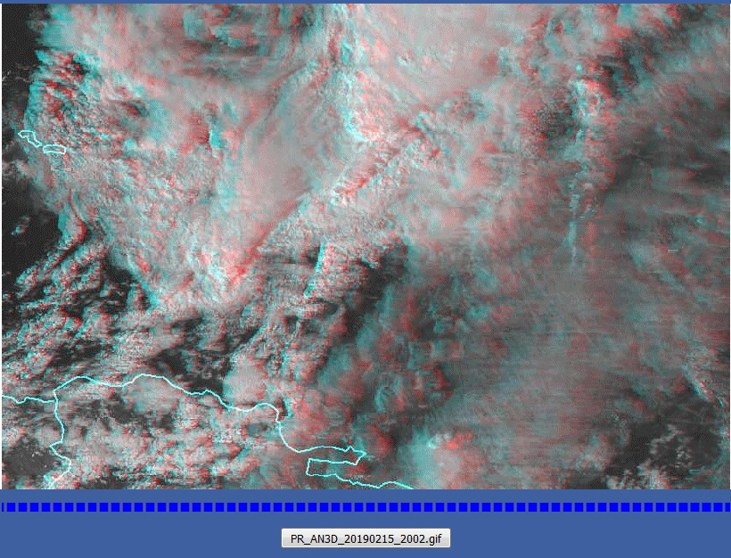
Animation: Thunderstorms north of Puerto Rico
2002UTC 15th February to 0047UTC 16th February 2019
(5FPS rocking animation, visible to enhanced infrared transition)
image from Wikipedia
Dominican Republic
image from CONUS imagery presented by Embry-Riddle Aeronautical University

