Slide 1


“Designing and presenting teaching resources for the effective forecaster use of 3-dimensional stereo satellite imagery”
Presenter: Bodo Zeschke. Bureau of Meteorology Training Centre, Australian VLab Centre of Excellence Point of Contact

Slide 2


Content
Creating stereo imagery using Geo-KOMPSAT-2A and Himawari-8 data.
Pioneering work conducted by BOM/BMTC and KMA. Pioneering work conducted in the USA.
Four ways of presenting 3D stereo satellite imagery
Feedback from BOM/BMTC and KMA staff
Additional resources that you may want to examine.

Slide 3
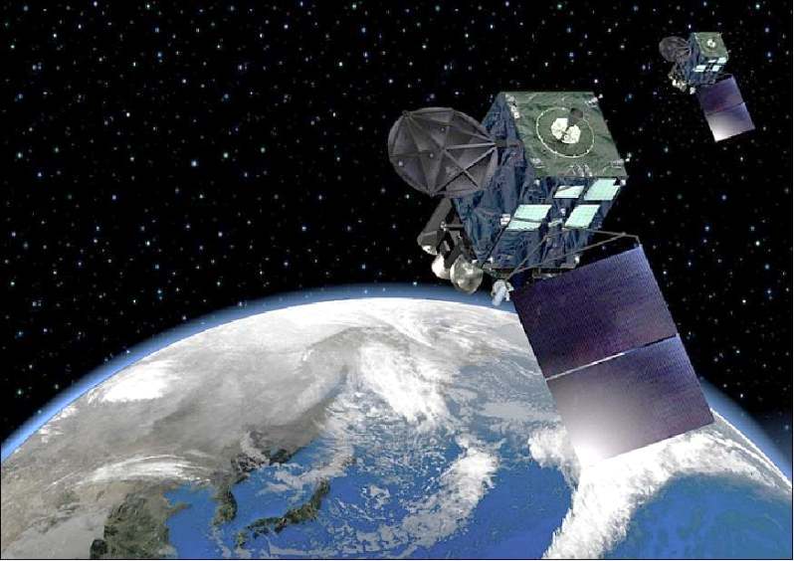
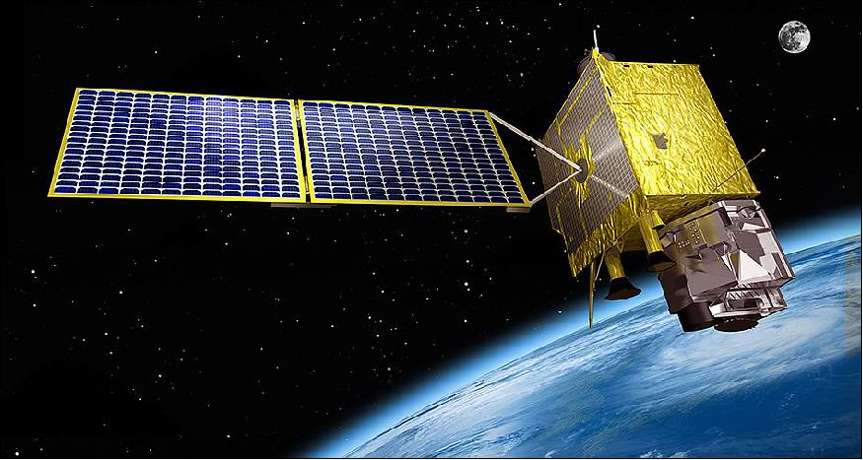
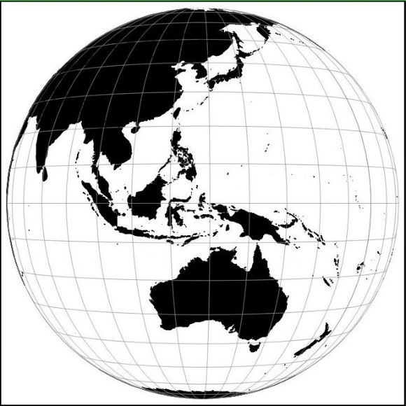
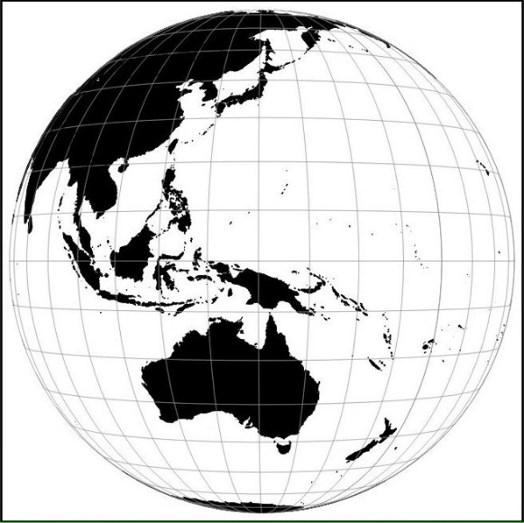
Motivation: utilisation of Himawari-8 and GEO-KOMPSAT-2A data in combination
image from JMA
image from KARI
GEO-KOMPSAT-2A located at 128.2E
Himawari-8 located at 140.7E,
Separation of 12. 5 degrees

Slide 4
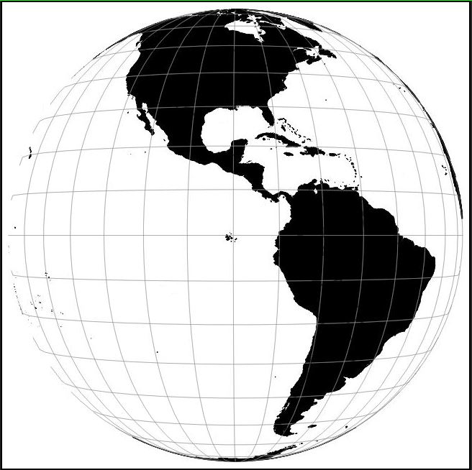
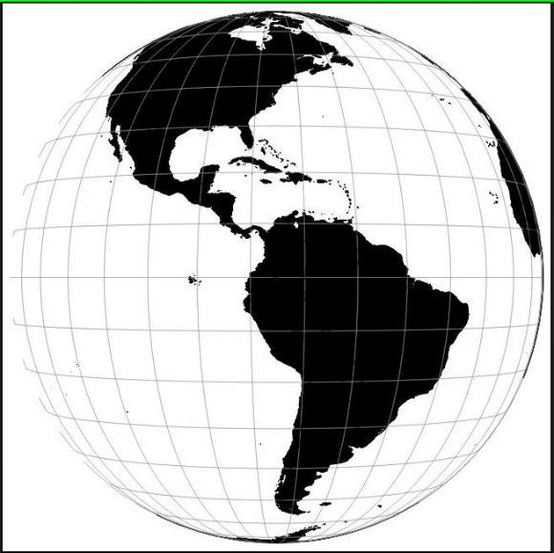
The Pioneers: GOES-16 / GOES-17 (in check out phase) compared to GEO-KOMPSAT-2A and Himawari-8 separation
Separation of 14. 3 degrees
GOES-17
GOES-16
GOES-17 in test position at 89.5º W during 2018, GOES-16 at 75.2º W
GEO-KOMPSAT
2A
Separation of 12. 5 degrees
HIMAWARI-8
Himawari-8 is located at 140.7E, GEO-KOMPSAT-2A is located at 128.2E

Slide 5
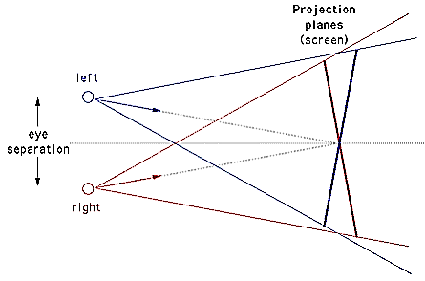
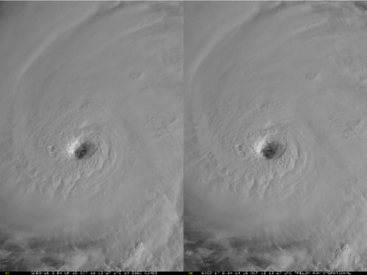
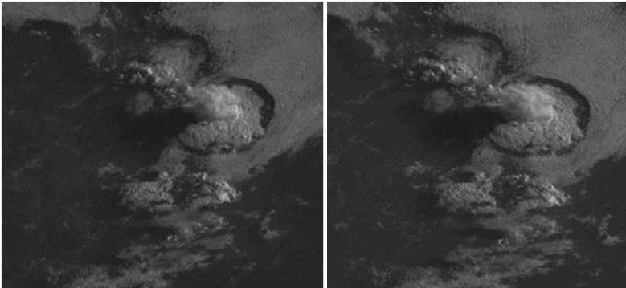
Stereo vision presentation of satellite images – GOES-16 and 17
image from Wikipedia
GOES-16
images from CIMSS Satellite Blog, case studies produced by Scott Lindstrom SSEC
GOES-17
https://cimss.ssec.wisc.edu/goes/blog/?s=stereo
Notes:
https://en.wikipedia.org/wiki/3D_stereo_view

Slide 6
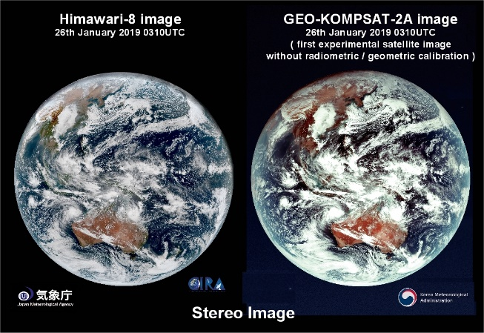
Stereo vision presentation of satellite images Creating the worlds first GEOKOMPSAT-2A / Himawari-8 stereo image
image from Wikipedia
GEOKOMPSAT-2A
Himawari-8
images from CIMSS Satellite Blog, image produced by B.Zeschke in collaboration with JMA and KMA
Notes:
https://en.wikipedia.org/wiki/3D_stereo_view

Slide 7
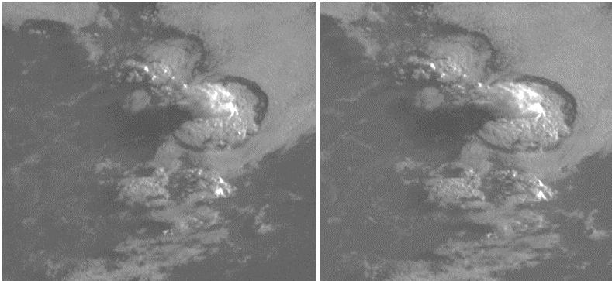
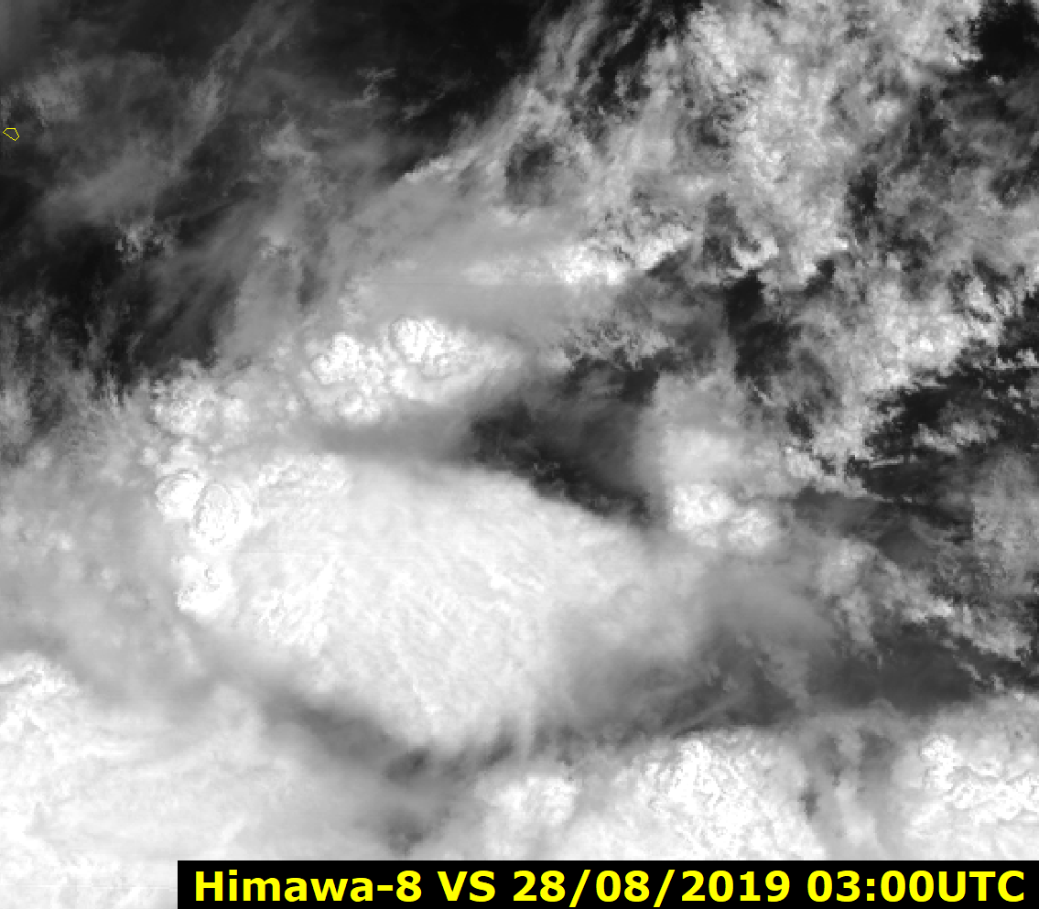
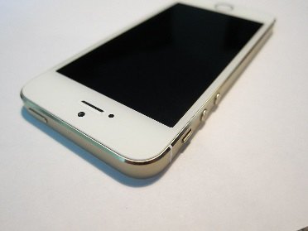
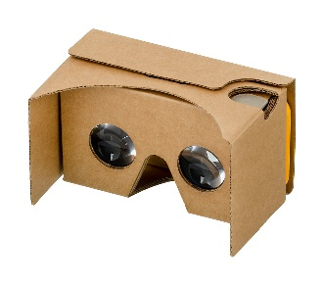
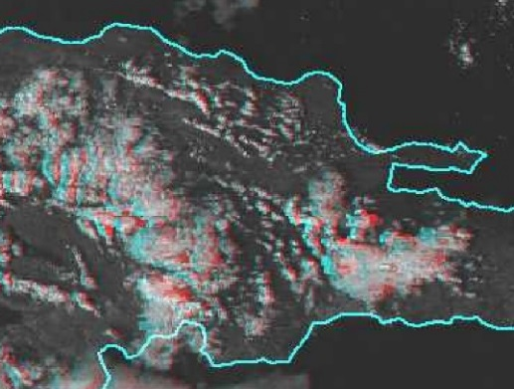
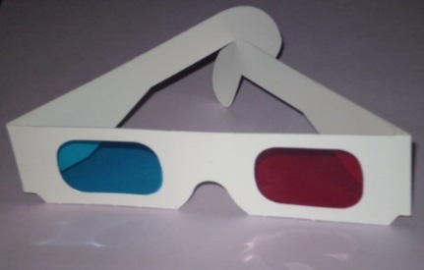
Various ways of presenting 3D stereo satellite imagery
1: "3D Wiggle" animation
2: Stereo pair images
(cross eyed viewing method)
Anaglyph glasses
4: 2 panel image animation played on Smartphone and rendered in a viewer (eg. Google Cardboard).
3: "Anaglyph"animation
(requiring viewing glasses)
Notes:
https://en.wikipedia.org/wiki/Stereoscopy
https://en.wikipedia.org/wiki/Iphone
https://en.wikipedia.org/wiki/Google_Cardboard#/media/File:Google-Cardboard.jpg
http://wx.erau.edu/erau_sat/get_loop.php?cnt=73&skipint=26&winmode=viewport&dir=sat_erau%2FAN3D%2FPR

Slide 8
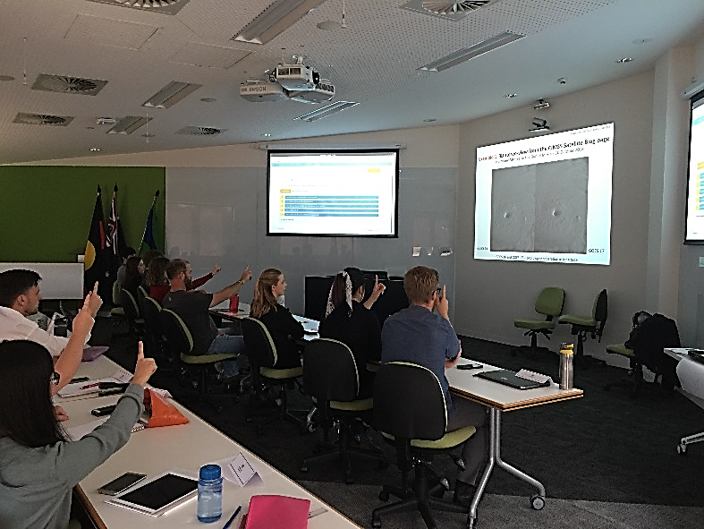
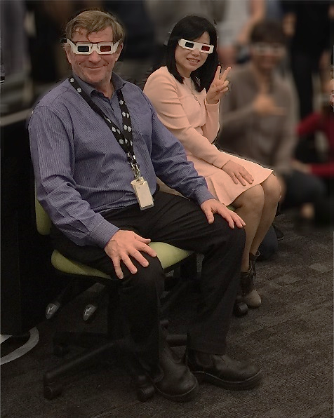
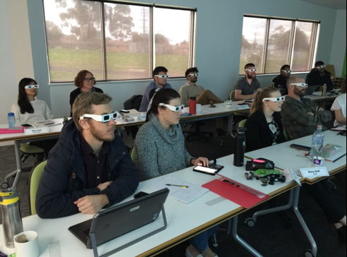
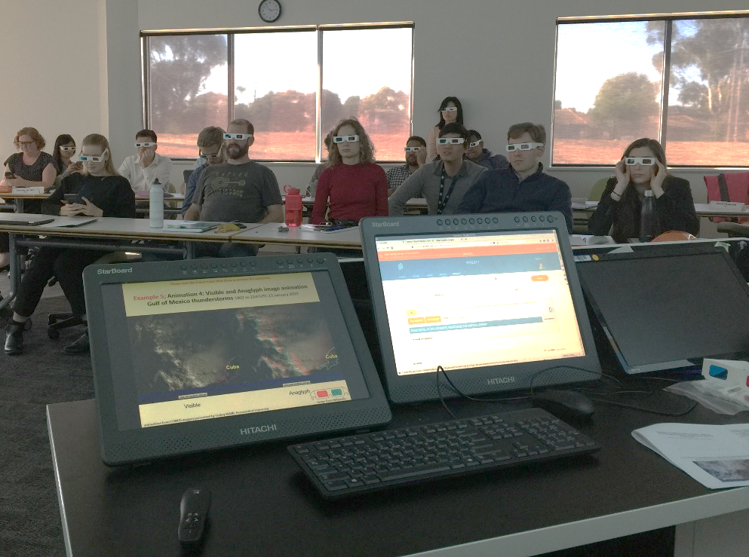
Testing 3D stereo satellite imagery in the classroom with Dr Hyesook Park (2019)

Slide 9
Various ways of presenting 3D stereo satellite imagery
1: "3D Wiggle" animation
2: Stereo pair images
(cross eyed viewing method)
Anaglyph glasses
4: 2 panel image animation played on Smartphone and rendered in a viewer (eg. Google Cardboard).
3: "Anaglyph"animation
(requiring viewing glasses)
Notes:
https://en.wikipedia.org/wiki/Stereoscopy
https://en.wikipedia.org/wiki/Iphone
https://en.wikipedia.org/wiki/Google_Cardboard#/media/File:Google-Cardboard.jpg
http://wx.erau.edu/erau_sat/get_loop.php?cnt=73&skipint=26&winmode=viewport&dir=sat_erau%2FAN3D%2FPR

Slide 10
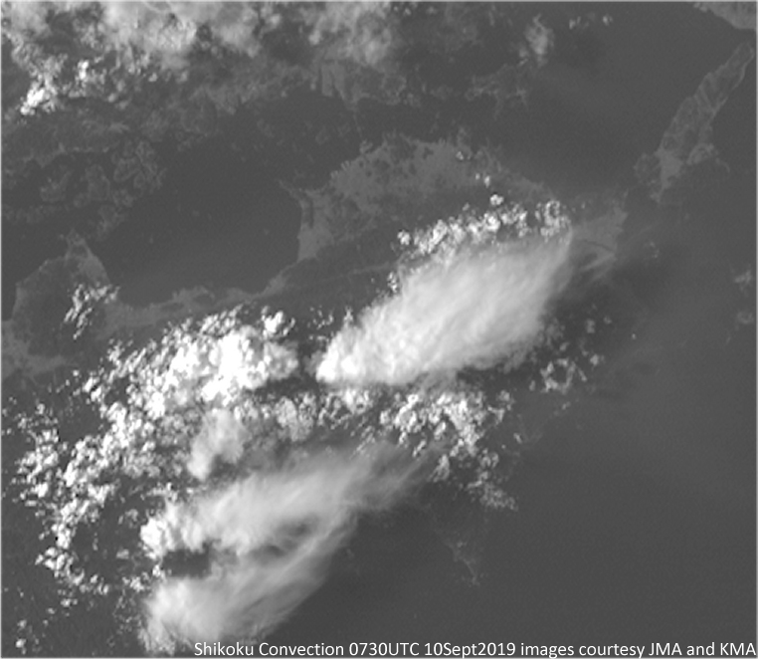
Animation: Demonstrating the stereo effect in GK-2A / H-8 data. Shikoku thunderstorms, 0730UTC 10th September 2019 (2 frames per second Wiggle 3D animation)
animation courtesy Korea Meteorological Administration / Japan Meteorological Agency
Please view this animation carefully and desist if it feels uncomfortable
Shikoku
Please start the Power Point Slide Show to activate the animation

Slide 11
Various ways of presenting 3D stereo satellite imagery
1: "3D Wiggle" animation
2: Stereo pair images
(cross eyed viewing method)
Anaglyph glasses
4: 2 panel image animation played on Smartphone and rendered in a viewer (eg. Google Cardboard).
3: "Anaglyph"animation
(requiring viewing glasses)
Notes:
https://en.wikipedia.org/wiki/Stereoscopy
https://en.wikipedia.org/wiki/Iphone
https://en.wikipedia.org/wiki/Google_Cardboard#/media/File:Google-Cardboard.jpg
http://wx.erau.edu/erau_sat/get_loop.php?cnt=73&skipint=26&winmode=viewport&dir=sat_erau%2FAN3D%2FPR

Slide 12

The worlds first GEO-KOMPSAT-2A / Himawari-8 stereo image! joint effort between Dr Hyesook Park (KMA), Bodo Zeschke (BMTC) and Akihiro Shimizu (JMA)
image pair courtesy Bodo Zeschke, Australian Bureau of Meteorology ; Himawari image courtesy JMA ; GK2A image courtesy KMA and Dr. Hyesook Park. GEOKOMPSAT-2A is also known as Chollian-2a
Notes:
https://cimss.ssec.wisc.edu/goes/blog/?s=stereo
http://wx.erau.edu/erau_sat/index_conus.php?channel=AN3D

Slide 13
Various ways of presenting 3D stereo satellite imagery
1: "3D Wiggle" animation
2: Stereo pair images
(cross eyed viewing method)
Anaglyph glasses
4: 2 panel image animation played on Smartphone and rendered in a viewer (eg. Google Cardboard).
3: "Anaglyph"animation
(requiring viewing glasses)
Notes:
https://en.wikipedia.org/wiki/Stereoscopy
https://en.wikipedia.org/wiki/Iphone
https://en.wikipedia.org/wiki/Google_Cardboard#/media/File:Google-Cardboard.jpg
http://wx.erau.edu/erau_sat/get_loop.php?cnt=73&skipint=26&winmode=viewport&dir=sat_erau%2FAN3D%2FPR

Slide 14
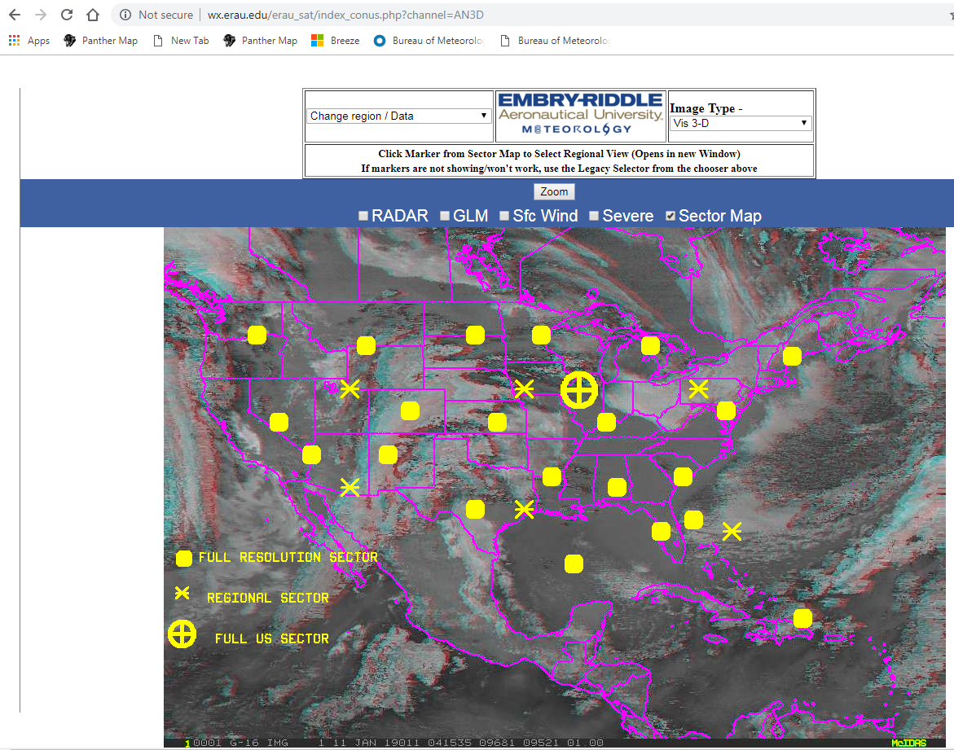
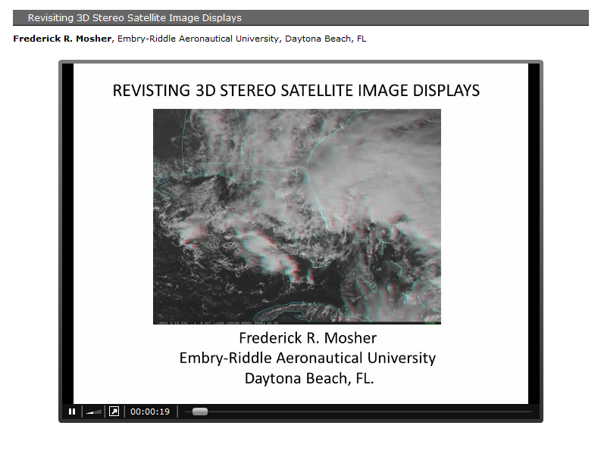
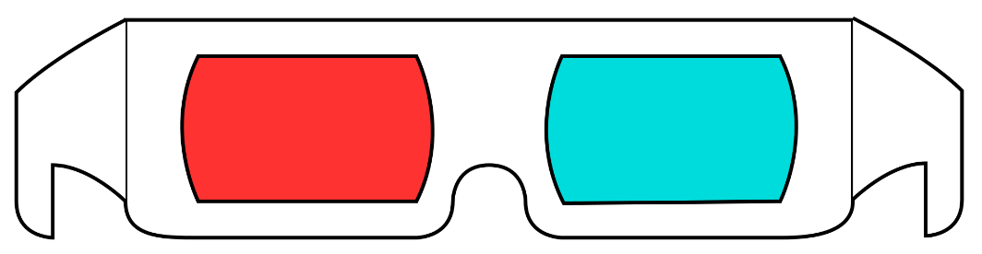
An online source of 3D "anaglyph" images over the CONUS domain, from Embry-Riddle Aeronautical University website
The red/cyan anaglyph images have been posted to the web at http://wx.erau.edu/erau_sat and are publically available.
Notes:
http://wx.erau.edu/erau_sat/index_conus.php?channel=AN3D
https://ams.confex.com/ams/92Annual/flvgateway.cgi/id/19935?recordingid=19935

Slide 15
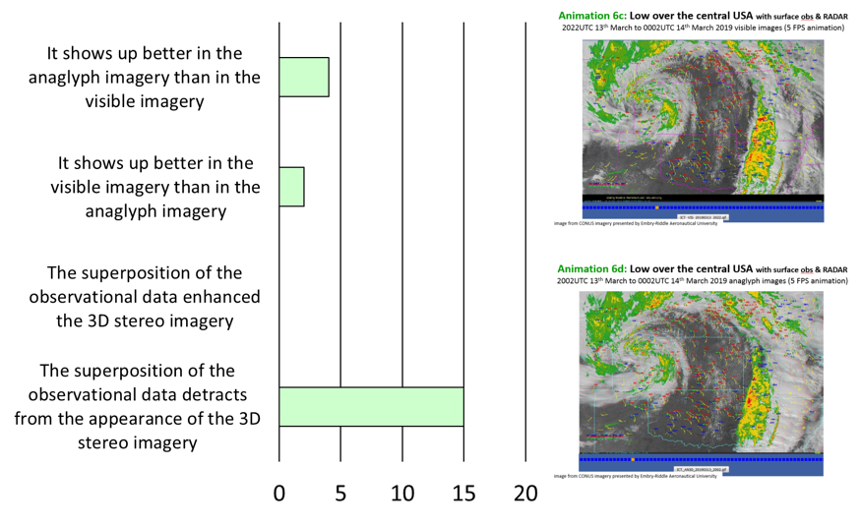
Participant response to the question "How well does the observational data i.e. surface observations and RADAR show up on the anaglyph data for the low pressure system over the central USA". Data 13-14th March 2019.
Visible
Superposition of observational data detracts from the 3D effect of the satellite images
Anaglyph
images from CONUS imagery presented by Embry-Riddle Aeronautical University

Slide 16
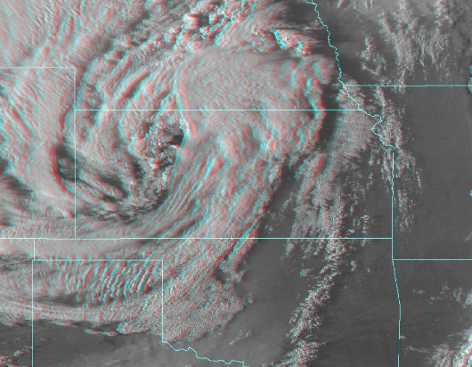
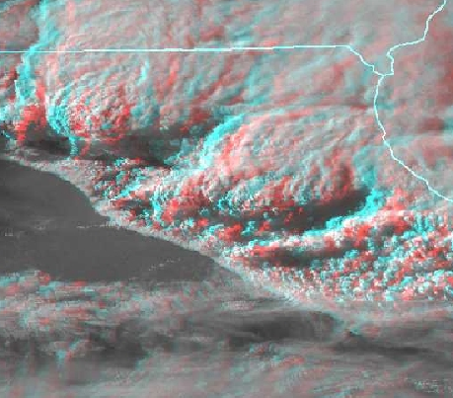
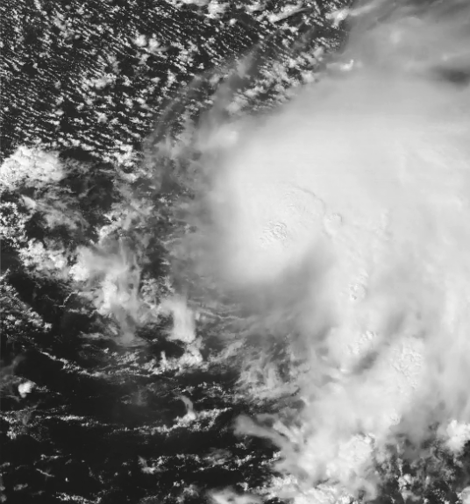
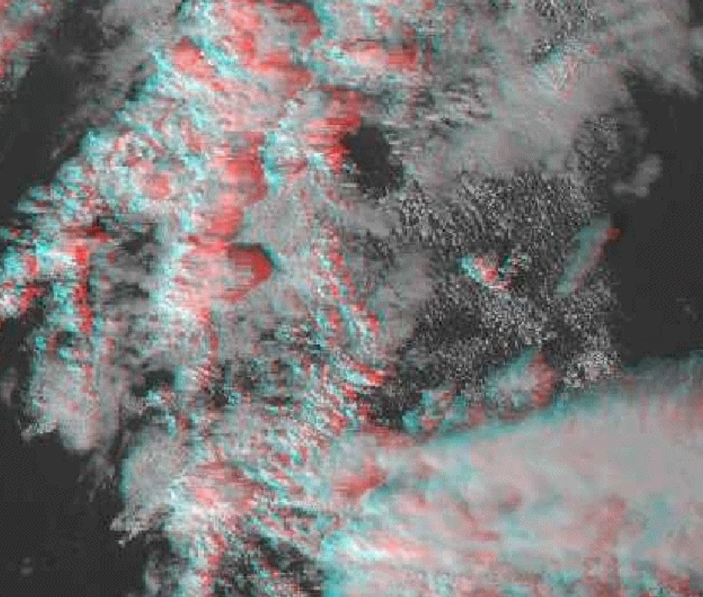
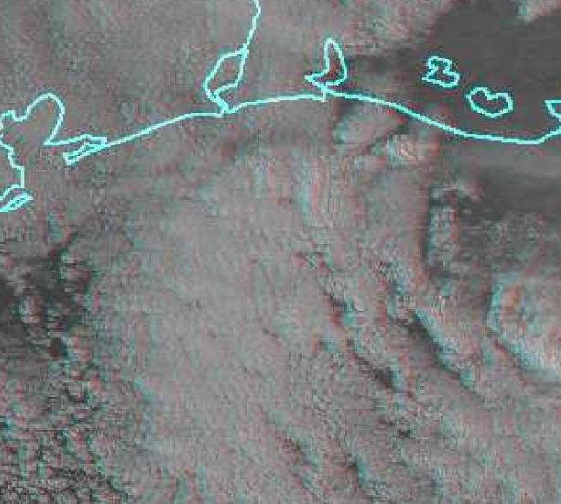
Advantages in using 3D stereo satellite imagery
anaglyph images from CONUS imagery presented by Embry-Riddle Aeronautical University
Analysing multilayer cloud, superior AMV's
Analysing the interaction between low and upper levels of the atmosphere
Analysing vertical motion of developing thunderstorms
Analysing atmospheric shear and trends in these
Better monitor low cloud below broken higher cloud
Detection of minor variations in height for oceanic cellular convection
Non-anaglyph images from CIMSS Satellite Blog, case studies produced by Scott Lindstrom SSEC

Slide 17
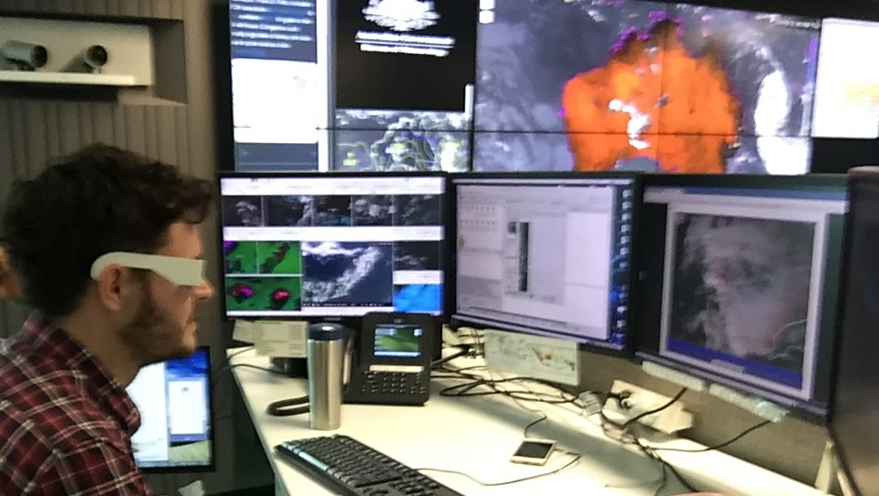
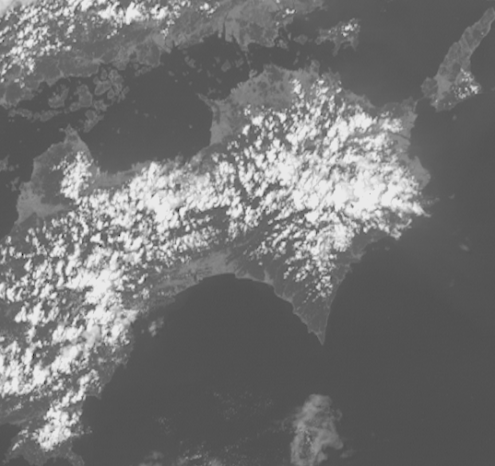
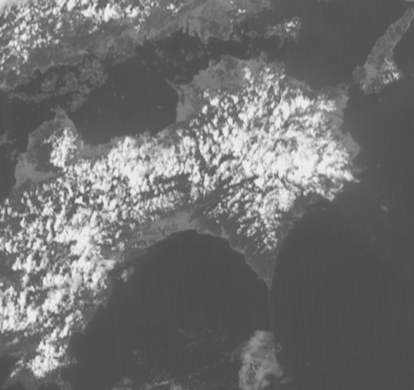
Suggested use of 3D stereo satellite imagery within a meteorological forecasting / training centre
Selective use by severe weather forecasters to gain greater insight into a difficult situation
Enhanced teaching of meteorological principles to Trainee Meteorologists
Normal animation and Wiggle 3D animation in two panel display

Slide 18
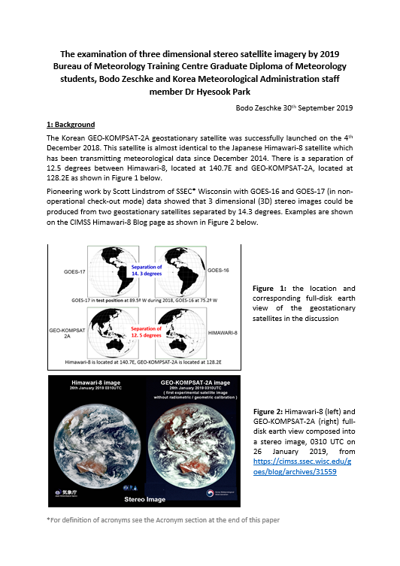

The summary report (passed on to the BMTC 2019 Graduate Diploma of Meteorology students and to Dr Hyesook Park)
The "dandelion" principle of driving cutting edge research

Slide 19
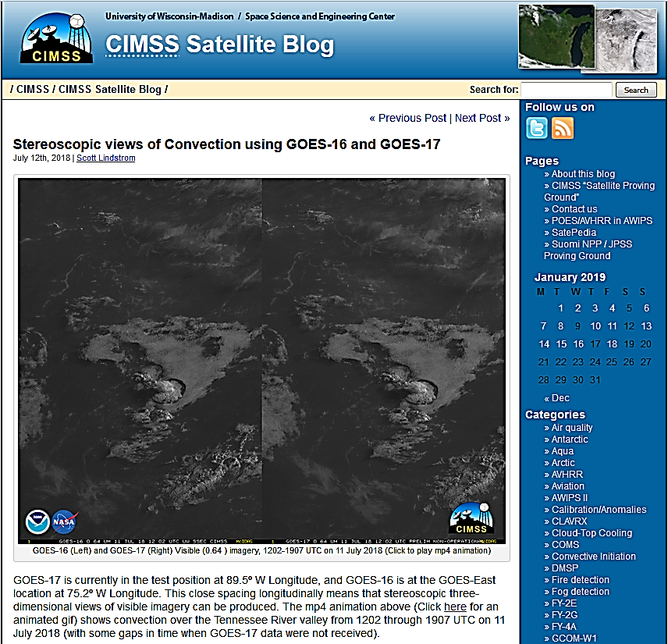
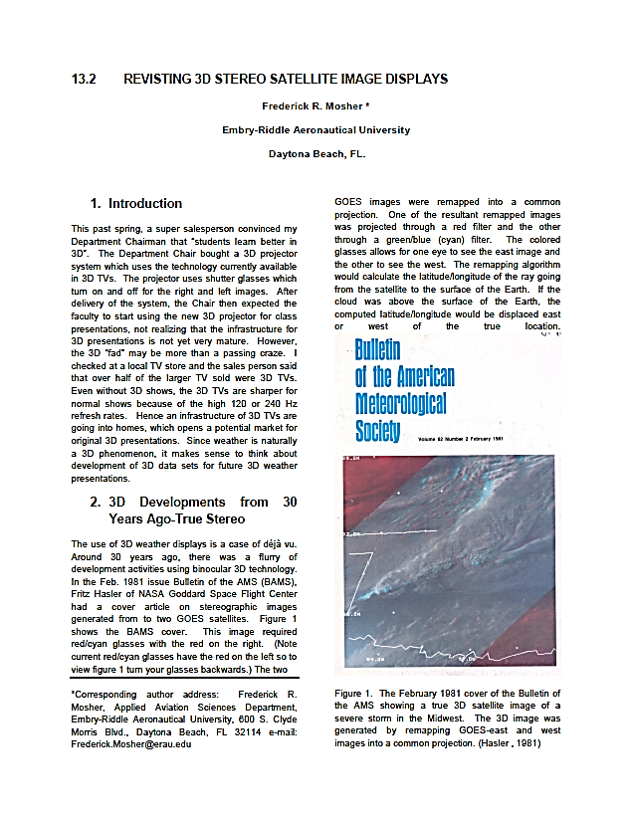
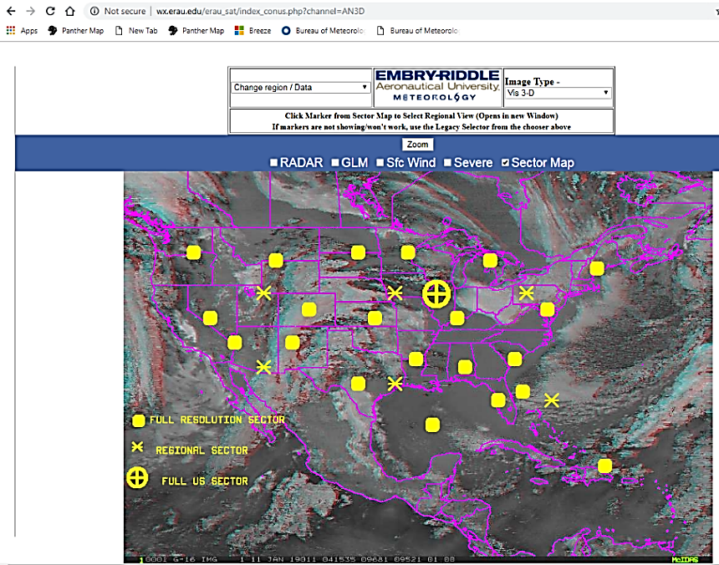
Resources referenced in this presentation
CIMSS Satellite Blog
(case studies presented by Scott Lindstrom SSEC)
Revisiting 3D Stereo Satellite Image Displays
(Frederik R. Mosher, Embry-Riddle Aeronautical University)
EMBRY-RIDDLE
Aeronautical University
Meteorology
(real time imagery over CONUS)
Notes:
https://cimss.ssec.wisc.edu/goes/blog/?s=stereo
http://wx.erau.edu/erau_sat/index_conus.php?channel=AN3D

Slide 20
Summary
Creating stereo imagery using Geo-KOMPSAT-2A and Himawari-8 data.
Pioneering work conducted by BOM/BMTC and KMA and the USA.
Four ways of displaying 3D stereo satellite imagery
Wiggle 3D images and animations
3D stereo (crossed eye method) images and animations
Anaglyph 3D images and animations (briefly only)
3D satellite imagery and other observations superimposed
Feedback from BOM/BMTC and KMA staff
Advantages in using 3D stereo satellite imagery
Suggested use of 3D stereo satellite imagery within a meteorological forecasting / training centre
Additional resources that you may want to examine.

