Slide 1

Investigating the potential of 3D stereo satellite imagery utilising GEO-KOMPSAT-2A and Himawari-8 data. Collaborative work between BOM and KMA.
Presentation for the Fifth Korea Meteorological Administration International Meteorological Satellite Conference (KIMSC-5)
Bodo Zeschke
Bureau of Meteorology Training Centre
Australian VLab Centre of Excellence

Slide 2


Content
Creating stereo imagery using Geo-KOMPSAT-2A and Himawari-8 data.
Pioneering work conducted by BOM/BMTC and KMA. Pioneering work conducted in the USA.
Four ways of presenting 3D stereo satellite imagery
Feedback from BOM/BMTC and KMA staff
Additional resources that you may want to examine.

Slide 3
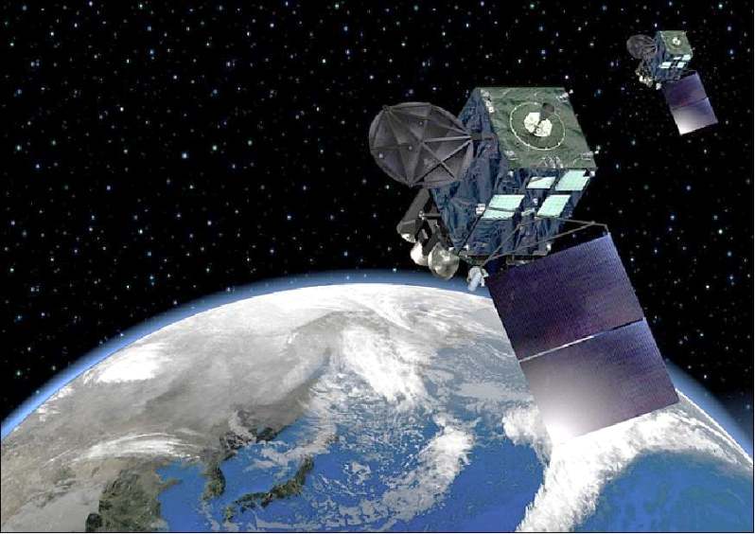
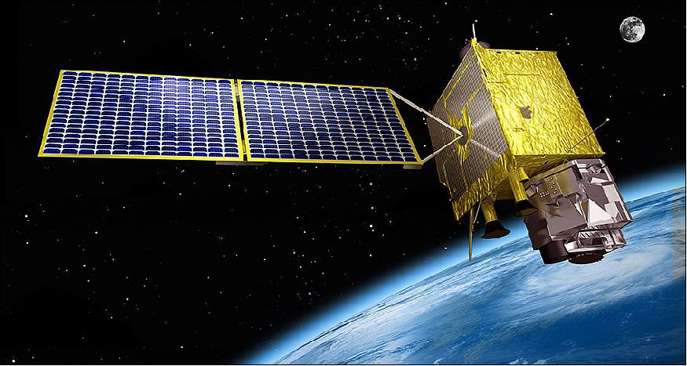
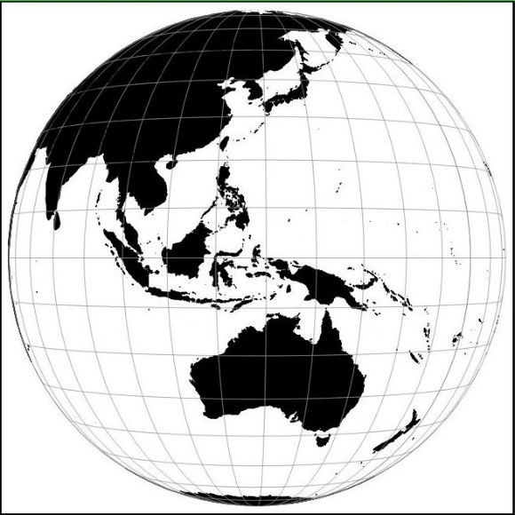
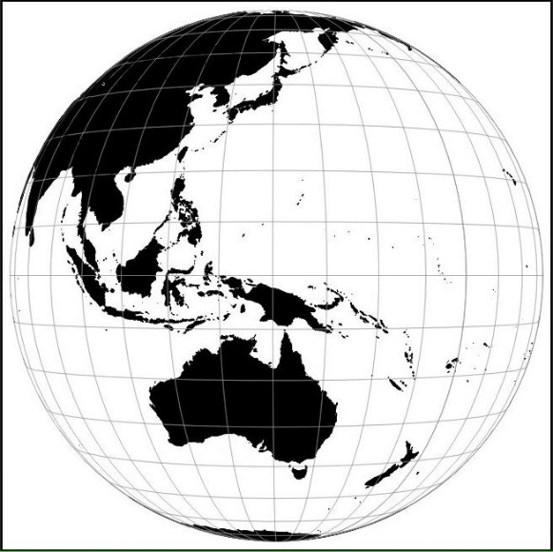
Motivation: utilisation of Himawari-8 and GEO-KOMPSAT-2A data in combination
image from JMA
image from KARI
GEO-KOMPSAT-2A located at 128.2E
Himawari-8 located at 140.7E,
Separation of 12. 5 degrees

Slide 4
Notes
Geo-KOMPSAT-2A and Himawari-8 are almost identical satellites, orbiting the earth in geostationary orbit in different locations of longitude.
This results in images that render the full disk earth from different perspectives, with a separation of 12.5 degrees.
The important question pertaining to the theme of this presentation is whether this separation is sufficient for the generation of 3D stereo satellite imagery?
REFERENCE

Slide 5
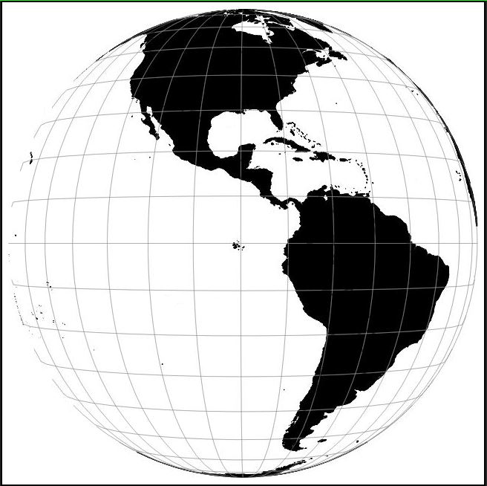
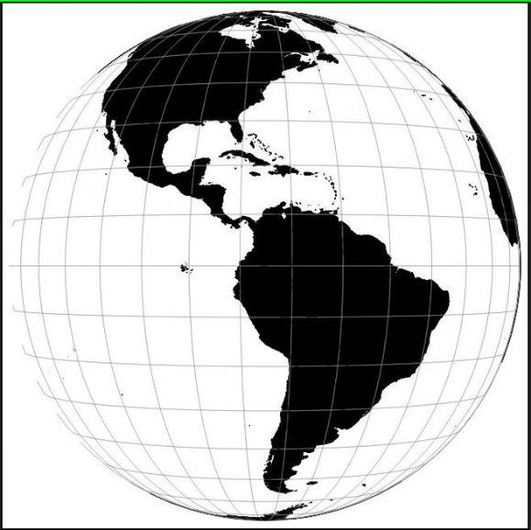
The Pioneers: GOES-16 / GOES-17 (in check out phase) compared to GEO-KOMPSAT-2A and Himawari-8 separation
Separation of 14. 3 degrees
GOES-17
GOES-16
GOES-17 in test position at 89.5º W during 2018, GOES-16 at 75.2º W
GEO-KOMPSAT
2A
Separation of 12. 5 degrees
HIMAWARI-8
Himawari-8 is located at 140.7E, GEO-KOMPSAT-2A is located at 128.2E

Slide 6
Notes
Previous work in the USA, principally be Scott Lindstrom of the Cooperative Institute for Meteorological Satellite Studies at the University of Wisconsin-Madison has shown that stereo imagery could be produced from GOES-16 and GOES-17 data.
In particular during 2018 GOES-17 was located in the check out phase location at 89.5W.
REFERENCE

Slide 7
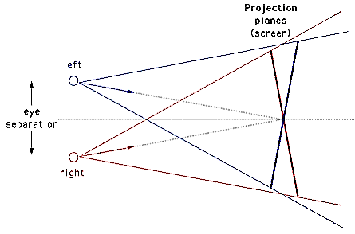
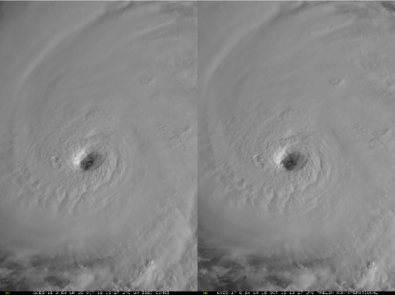
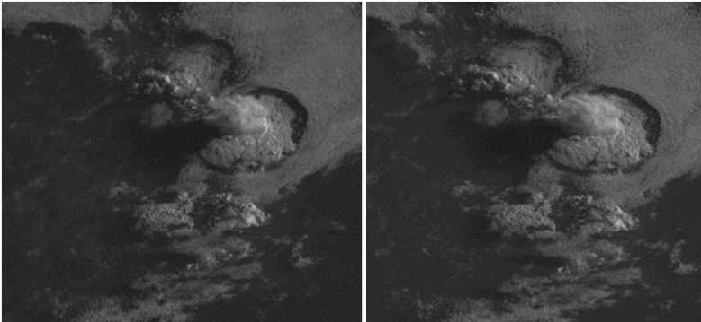
Stereo vision presentation of satellite images – GOES-16 and 17
image from Wikipedia
GOES-16
images from CIMSS Satellite Blog, case studies produced by Scott Lindstrom SSEC
GOES-17
https://cimss.ssec.wisc.edu/goes/blog/?s=stereo
Notes:
https://en.wikipedia.org/wiki/3D_stereo_view

Slide 8
Notes
Stereo imagery was created from this GOES-16 GOES-17 data, with a separation of 14.3 degrees longitude.
Below are examples of a Hurricane and a thunderstorm in 2 panel stereo display over the American region.
We have found that these stereo images and animations clearly render in three dimensions when they are viewed in the prescribed manner.
These and many other examples have been posted on the CIMSS Satellite Blog pages by Scott Lindstrom. I will show some examples and the references for these later on during this presentation.
REFERENCE

Slide 9
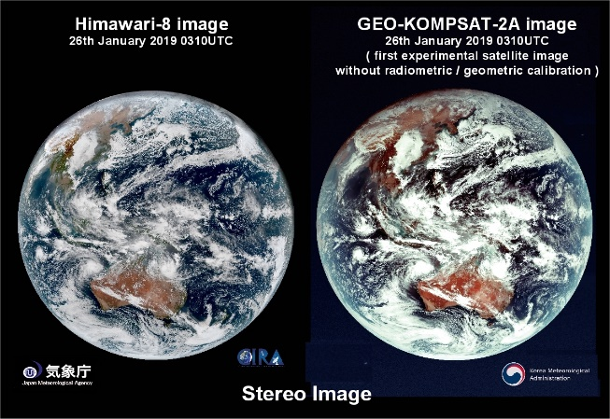
Stereo vision presentation of satellite images Creating the worlds first GEOKOMPSAT-2A / Himawari-8 stereo image
image from Wikipedia
GEOKOMPSAT-2A
Himawari-8
images from CIMSS Satellite Blog, image produced by B.Zeschke in collaboration with JMA and KMA
Notes:
https://en.wikipedia.org/wiki/3D_stereo_view

Slide 10
Notes
This gives us confidence that Geo-KOMPSAT-2A and Himawari-8 satellite data can render 3D stereo images and animations when used in combination.
The first opportunity or this came with the generation and release of the first Geo-KOMPSAT-2A full disk image on the 26th January 2019.
With the helpful assistance of Dr Hyesook Park of the Korea Meteorological Administration and Akihiro Shimizu of the Japan Meteorological Agency we were able to produce the worlds first Himawari-8 GK2A 3D stereo image as shown below.
I will show this in more detail later in the presentation.
REFERENCE

Slide 11
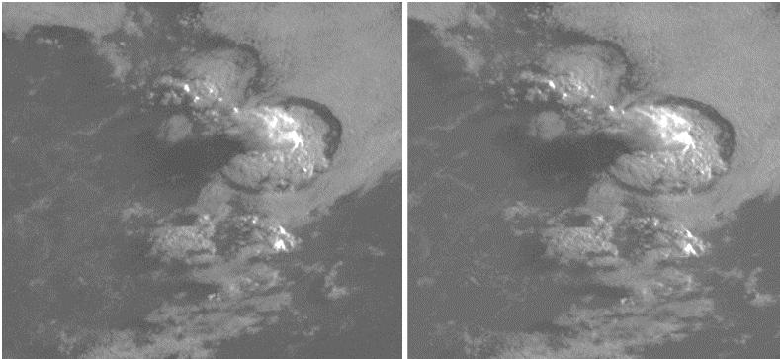
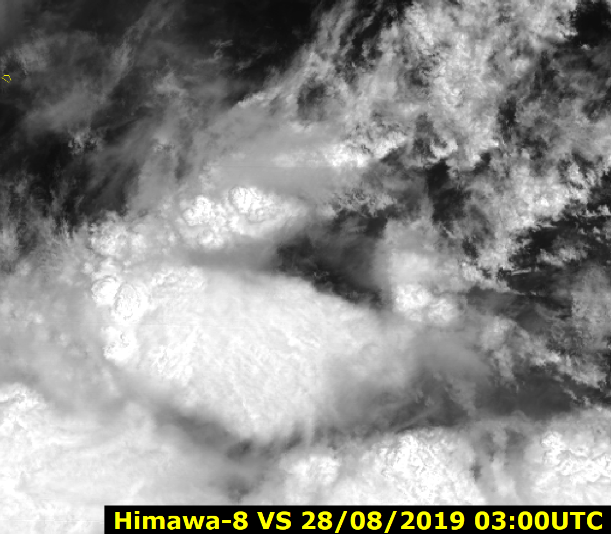
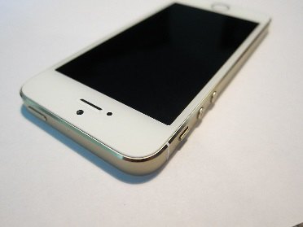
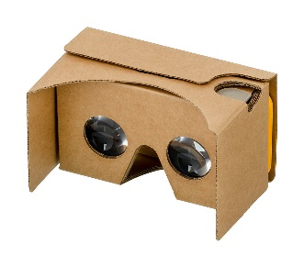
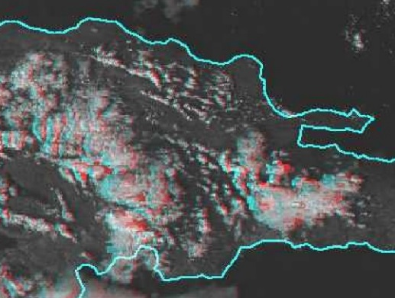
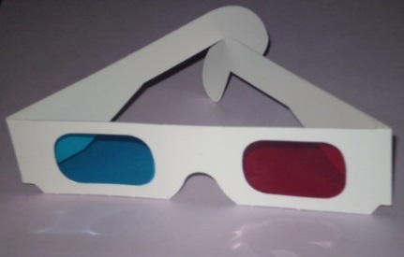
Various ways of presenting 3D stereo satellite imagery
Socrative questions 1 and 2
1: "3D Wiggle" animation
2: Stereo pair images
(cross eyed viewing method)
Anaglyph glasses
4: 2 panel image animation played on Smartphone and rendered in a viewer (eg. Google Cardboard).
3: "Anaglyph"animation
(requiring viewing glasses)
Notes:
https://en.wikipedia.org/wiki/Stereoscopy
https://en.wikipedia.org/wiki/Iphone
https://en.wikipedia.org/wiki/Google_Cardboard#/media/File:Google-Cardboard.jpg
http://wx.erau.edu/erau_sat/get_loop.php?cnt=73&skipint=26&winmode=viewport&dir=sat_erau%2FAN3D%2FPR

Slide 12
Notes
Lets examine four ways of presenting 3D stereo imagery.
The first is 3D Wiggle animation and this involves animating the view of a scene from two different perspectives in succession. Features located closer to the viewer will be displaced more than features further away from the viewer and this will give a 3D effect.
The "stereo pair image" method displays each view side by side and the viewer employs the "cross eyed viewing method" to render this in 3D. We will practice this viewing method later on in the presentation.
The "anaglyph 3D" method renders the imagery in anaglyph format. This requires the use of red-blue anaglyph glasses in order to view the image in three dimensions.
REFERENCE

Slide 13
Notes
The fourth method involves stereo pair images and animations played on a smartphone and viewed on a viewer such as Google Cardboard.
The BMTC/BOM/KMA pioneering work has been conducted using methods 1, 2 and 3.
In this presentation we will look at Wiggle 3D and Stereo Pair images and animations.
We will also briefly summarise our results when using anaglyph image animations.
Please answer Socrative Question 1
Please answer Socrative Question 2
REFERENCE

Slide 14
Socrative question 1: Which 3D stereo rendering methods for satellite imagery are you familiar with?
3D Wiggle animation
Stereo pair images (cross eyed viewing method)
Anaglyph animation (requiring Anaglyph viewing glasses)
2 panel image animation played on a smartphone and rendered in a viewer
None of the above. I have not used 3D stereo satellite imagery.
I am not sure. Tell me more…
REFERENCE

Slide 15
Socrative question 2: If you have viewed the 3D imagery what has been your reaction?
I can easily view the imagery and it is fantastic
I can view the imagery and it is ok
I can sometimes view the imagery and sometimes not.
I have trouble viewing the imagery and it is uncomfortable
I have not viewed the 3D imagery.
REFERENCE

Slide 16
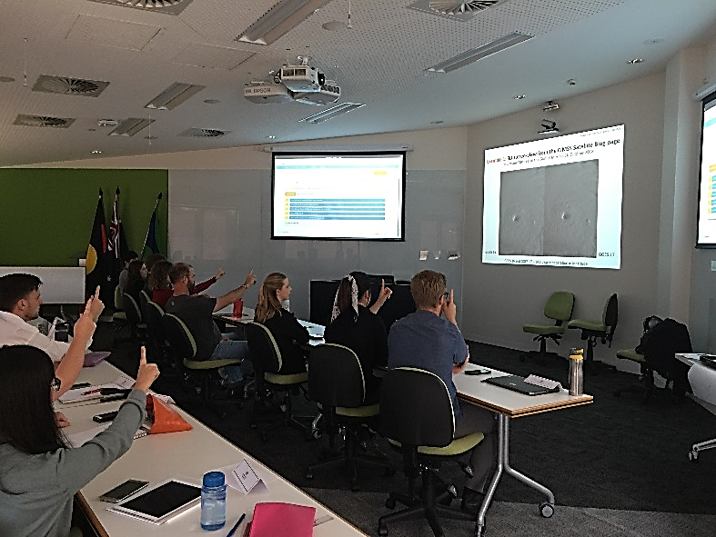
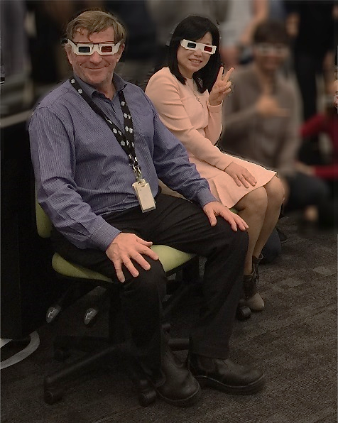
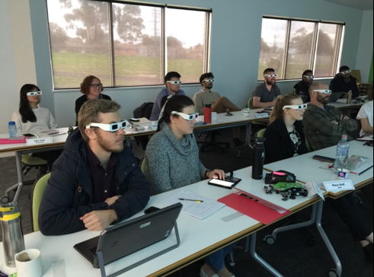
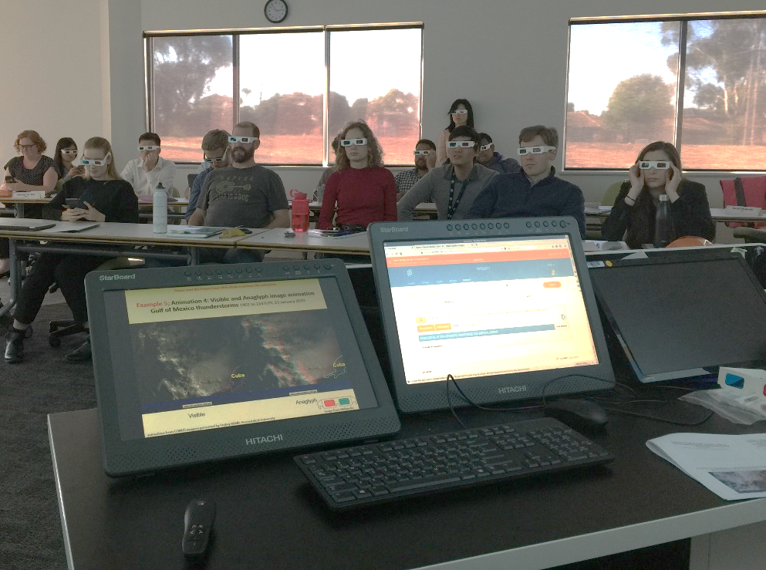
Testing 3D stereo satellite imagery in the classroom with Dr Hyesook Park (2019)

Slide 17
Notes
This picture collage shows BMTC Graduate Diploma of Meteorology students and Dr Park and myself examining and evaluating 3D stereo satellite imagery during April and July 2019.
The top left hand side panel shows students examining the stereo pair image animation using the cross eyed viewing method.
The bottom two panels shows students assessing the anaglyph 3D images and animations using the anaglyph glasses.
Note that during these sessions the students response to viewing the 3D images and animations was captured using the Socrative cloud based learner response system.
The anonymous feedback is shown on the computer screens in the top left and bottom right hand panels in the picture collage.
REFERENCE

Slide 18
Various ways of presenting 3D stereo satellite imagery
1: "3D Wiggle" animation
2: Stereo pair images
(cross eyed viewing method)
Anaglyph glasses
4: 2 panel image animation played on Smartphone and rendered in a viewer (eg. Google Cardboard).
3: "Anaglyph"animation
(requiring viewing glasses)
Notes:
https://en.wikipedia.org/wiki/Stereoscopy
https://en.wikipedia.org/wiki/Iphone
https://en.wikipedia.org/wiki/Google_Cardboard#/media/File:Google-Cardboard.jpg
http://wx.erau.edu/erau_sat/get_loop.php?cnt=73&skipint=26&winmode=viewport&dir=sat_erau%2FAN3D%2FPR

Slide 19
Notes
Lets look at some wiggle 3D animation imagery.
A word of caution though. Some people find this image animation disturbing, especially if this is presented at 5 or 10 frames per second.
This is due to the phenomenon called "flicker vertigo". This is "an imbalance in brain-cell activity caused by exposure to low-frequency flickering (or flashing) of a relatively bright light." It is a disorientation-, vertigo-, and nausea-inducing effect.
In response to this issue the animations on the next two slides are at the slower two frames per second.
This is a relatively safe animation speed for this type of imagery.
However, should you find these animations disturbing, please look away.
REFERENCE

Slide 20
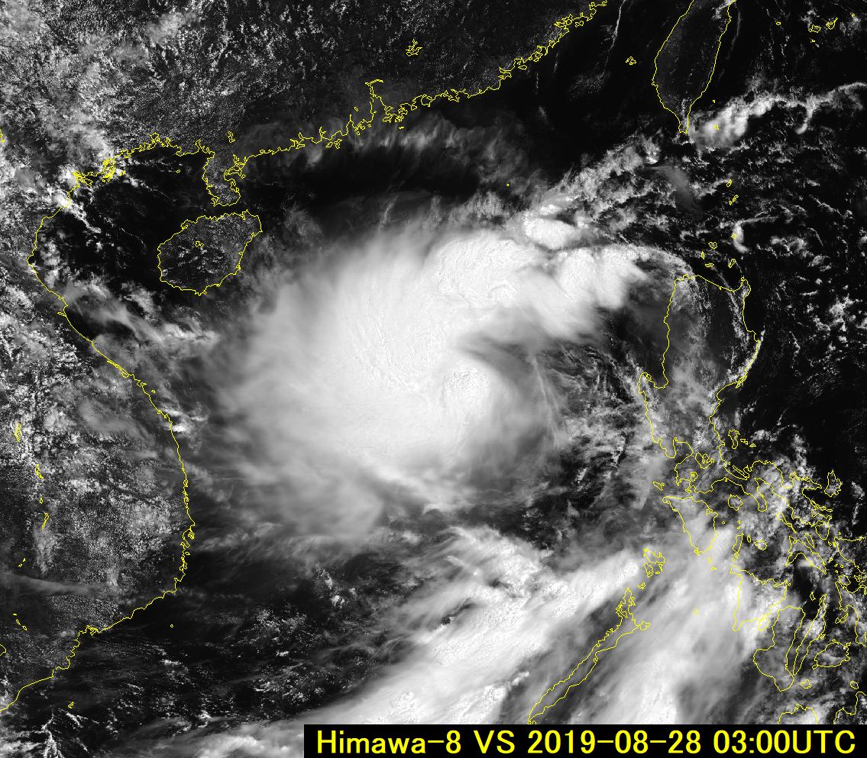
Himawari-8 / GEO-KOMPSAT-2A Wiggle 3D animation
0.64 micron visible imagery 03UTC 28th August 2019. Tropical Storm 13W Podul
animation kindly provided by Akihiro Shimizu JMA
China
Please view this animation carefully and desist if it feels uncomfortable
2 frames per second
Philippines
Vietnam
rendered within SATAID
Please start the Power Point Slide Show to activate the animation

Slide 21
Notes
This is the two frames per second Wiggle 3D animation utilising GK2A and Himawari-8 data over Tropical Storm Podul, 28th August 2019.
As you can see, the image offset between the two data are evident, though in comparison to the dimensions of the large domain this is rather small.
REFERENCE

Slide 22
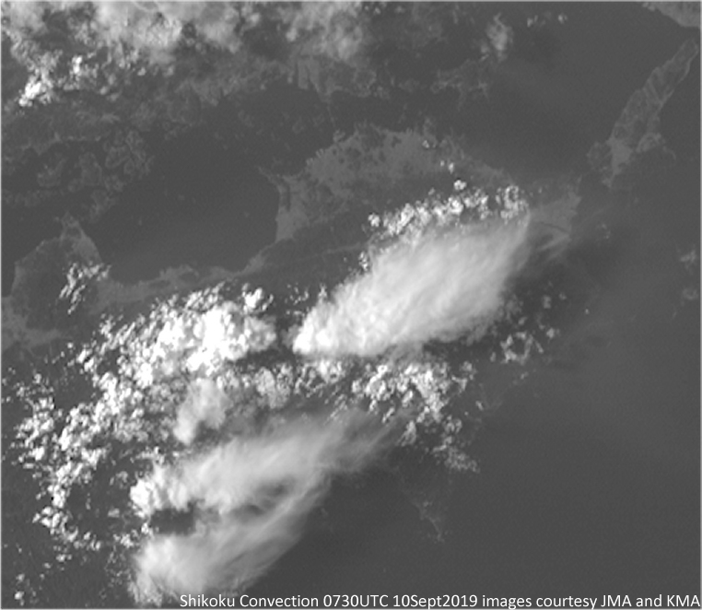
Animation: Demonstrating the stereo effect in GK-2A / H-8 data.
Shikoku thunderstorms, 0730UTC 10th September 2019 (2 frames per second Wiggle 3D animation)
animation courtesy Korea Meteorological Administration / Japan Meteorological Agency
Socrative question 3
Please view this animation carefully and desist if it feels uncomfortable
Shikoku
Please start the Power Point Slide Show to activate the animation

Slide 23
Notes
The image offset and the consequent 3D effect becomes much more apparent over the scale of a thunderstorm complex, such as these storms over Shikoku, Japan, 10 September 2019.
You can clearly see the greater displacement of the thunderstorm anvils, compared to the smaller displacement of the cumulus and cumulus congestus cloud.
Please answer Socrative Question 3
REFERENCE

Slide 24
Socrative question 3: How do you like the Wiggle 3D animation?
I like it. It shows the 3D stereo effect well
I like it. But I cannot see the 3D stereo effect very well.
It is so-so (ok).
I don't like it.
I don't like it. It is uncomfortable to look at.
REFERENCE

Slide 25
Various ways of presenting 3D stereo satellite imagery
1: "3D Wiggle" animation
2: Stereo pair images
(cross eyed viewing method)
Anaglyph glasses
4: 2 panel image animation played on Smartphone and rendered in a viewer (eg. Google Cardboard).
3: "Anaglyph"animation
(requiring viewing glasses)
Notes:
https://en.wikipedia.org/wiki/Stereoscopy
https://en.wikipedia.org/wiki/Iphone
https://en.wikipedia.org/wiki/Google_Cardboard#/media/File:Google-Cardboard.jpg
http://wx.erau.edu/erau_sat/get_loop.php?cnt=73&skipint=26&winmode=viewport&dir=sat_erau%2FAN3D%2FPR

Slide 26
Notes
The second way of presenting 3D stereo satellite imagery is in the viewing of stereo pair images using the cross eyed viewing method.
REFERENCE

Slide 27
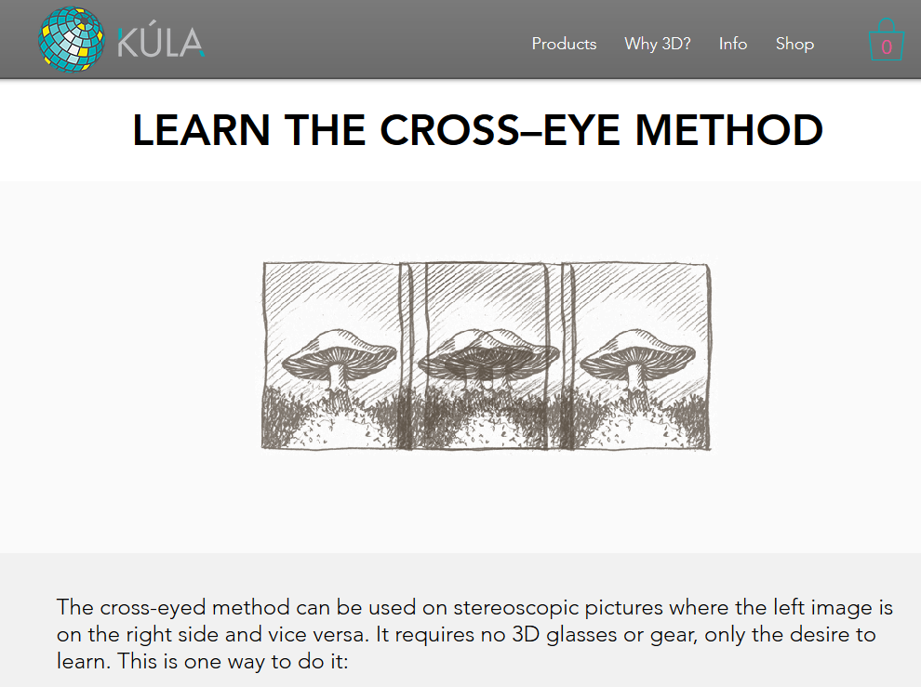
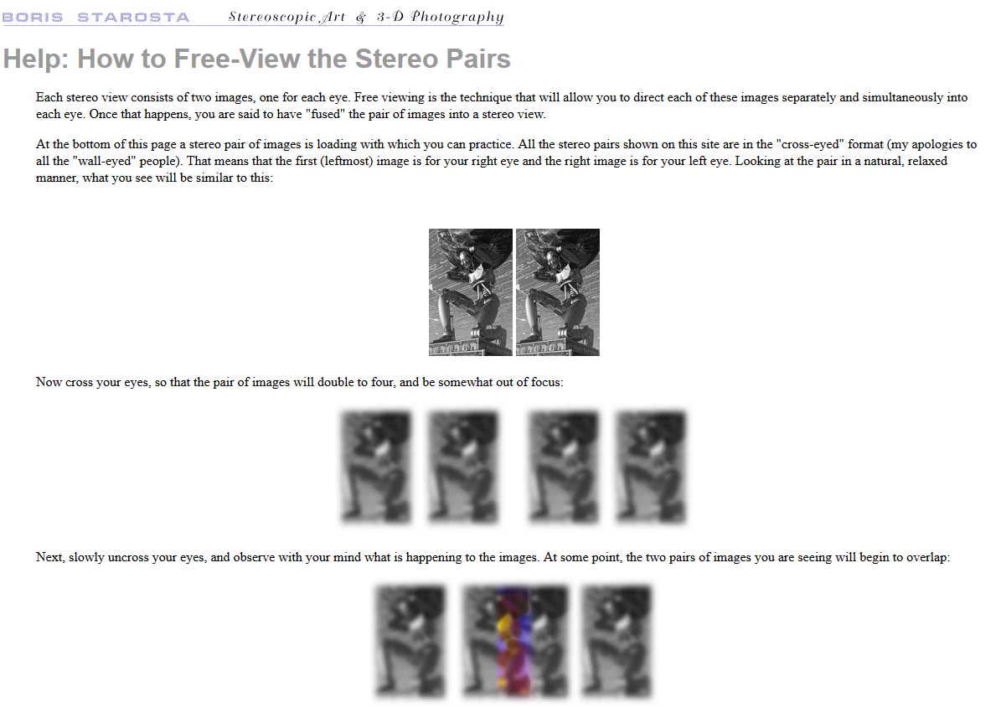
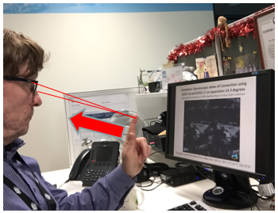
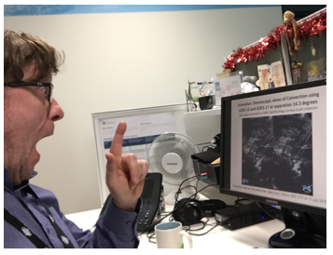
How to view stereo-pairs references
https://www.kula3d.com/how-to-use-the-cross-eyed-method
http://www.starosta.com/3dshowcase/ihelp.html
Amazing!!!
Wow!!!
3D

Slide 28

The worlds first GEO-KOMPSAT-2A / Himawari-8 stereo image! joint effort between Dr Hyesook Park (KMA), Bodo Zeschke (BMTC) and Akihiro Shimizu (JMA)
Socrative question 4
image pair courtesy Bodo Zeschke, Australian Bureau of Meteorology ; Himawari image courtesy JMA ; GK2A image courtesy KMA and Dr. Hyesook Park. GEOKOMPSAT-2A is also known as Chollian-2a
Notes:
https://cimss.ssec.wisc.edu/goes/blog/?s=stereo
http://wx.erau.edu/erau_sat/index_conus.php?channel=AN3D

Slide 29
Notes
Lets try this exercise on the worlds first Geo-KOMPSAT-2A / Himawari-8 Stereo Image" introduced earlier.
Using the cross-eye technique described previously you should be able to visualise a third 3D image appearing between the two images shown in the slide.
This will reveal the 3D sphere of our beautiful earth.
Please answer Socrative Question 4
REFERENCE

Slide 30
Socrative question 4: Can you see the "round" earth using the cross-eyed method?
Yes I can. It shows the 3D stereo effect well
Yes I can. But I cannot see the 3D stereo effect very well.
It is so-so (ok).
No I cannot.
No I cannot. It is uncomfortable to look at.
REFERENCE

Slide 31
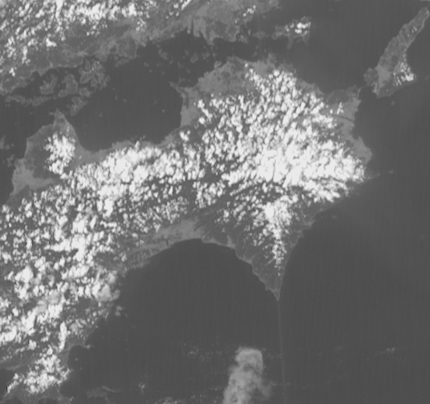
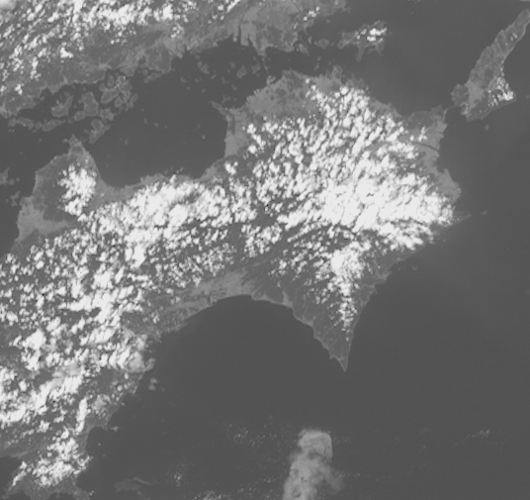
Animation: Himawari-8 / GEO-KOMPSAT-2A stereo animation.
Shikoku convection, 0400 to 0830UTC 10th September 2019, 5 frames per second rocking animation
images forwarded by Vincent Villani BOM
Shikoku
Shikoku
Himawari-8 data
(courtesy Japan Meteorological Agency)
GEOKOMPSAT-2A
(data courtesy Korea Meteorological Administration)
Please start the Power Point Slide Show to activate the animation

Slide 32
Notes
Here is another example that you can view using the cross eye method. This animation shows the development of the Shikoku thunderstorms shown earlier.
For added clarity I have rendered this as a "rocking" animation as favoured by USA colleagues.
Try viewing this using the instructions given previously.
I hope you can experience the "wow" effect when the 3D imagery is revealed.
It is as if you are an astronaut looking down on the earth from space.
REFERENCE

Slide 33
Various ways of presenting 3D stereo satellite imagery
1: "3D Wiggle" animation
2: Stereo pair images
(cross eyed viewing method)
Anaglyph glasses
4: 2 panel image animation played on Smartphone and rendered in a viewer (eg. Google Cardboard).
3: "Anaglyph"animation
(requiring viewing glasses)
Notes:
https://en.wikipedia.org/wiki/Stereoscopy
https://en.wikipedia.org/wiki/Iphone
https://en.wikipedia.org/wiki/Google_Cardboard#/media/File:Google-Cardboard.jpg
http://wx.erau.edu/erau_sat/get_loop.php?cnt=73&skipint=26&winmode=viewport&dir=sat_erau%2FAN3D%2FPR

Slide 34
Notes
The third way of presenting 3D stereo satellite imagery and image animations is in the viewing of anaglyph 3D imagery.
However, this requires you to have anaglyph glasses.
For the sake of this discussion we will simply review this method, show resources and show the results given by BMTC students who have analysed a number of case studies.
Later I will show you some analgyph case studies that you can view.
REFERENCE

Slide 35
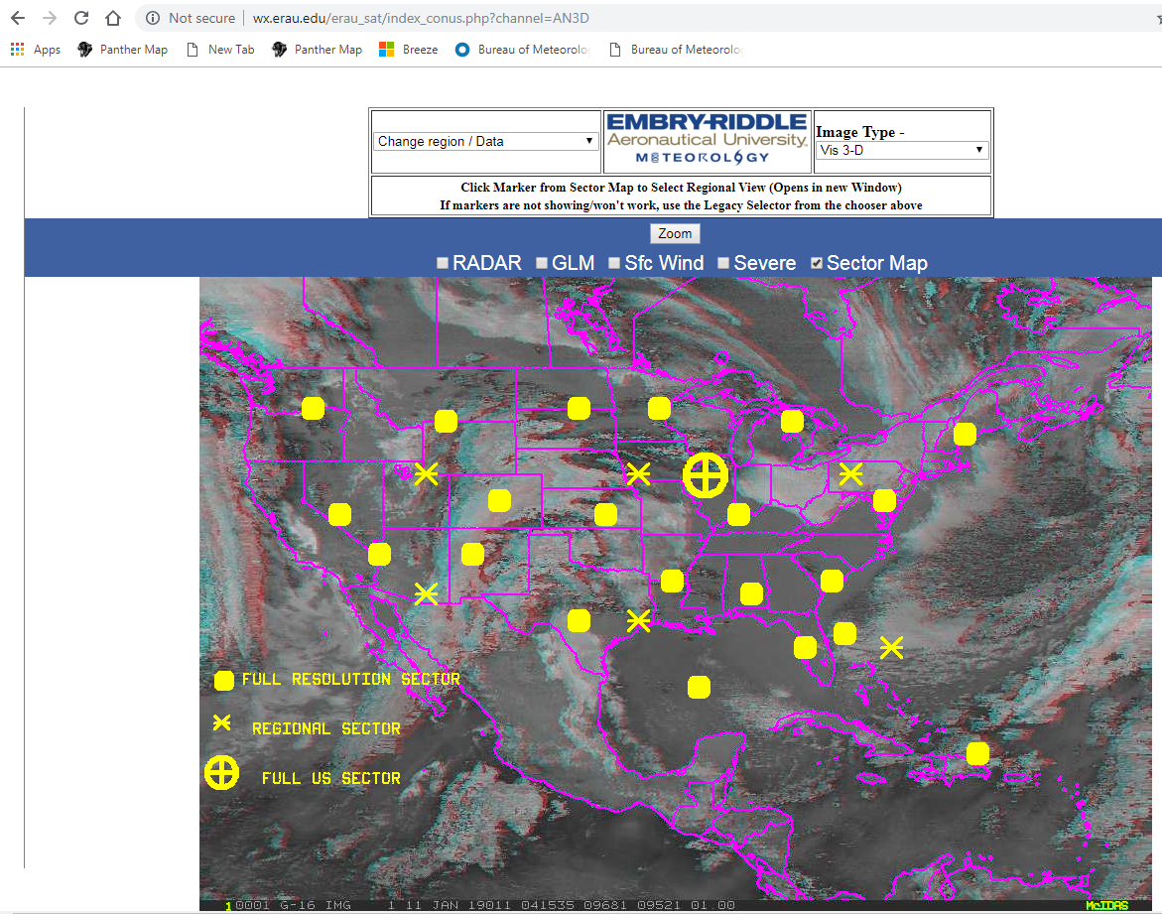
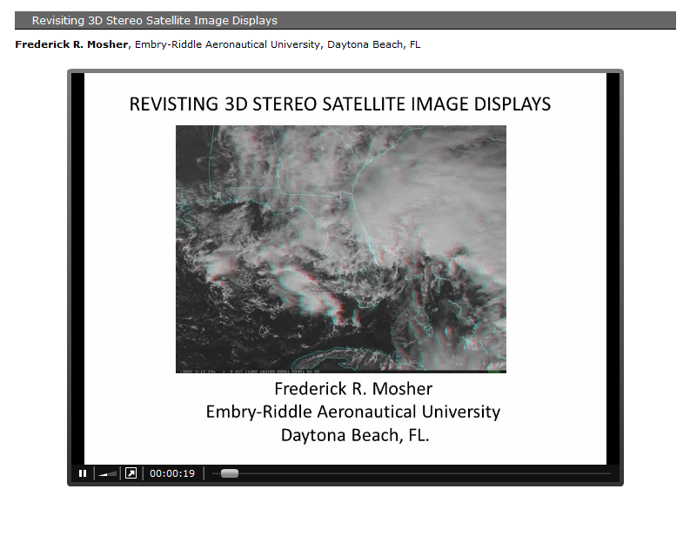
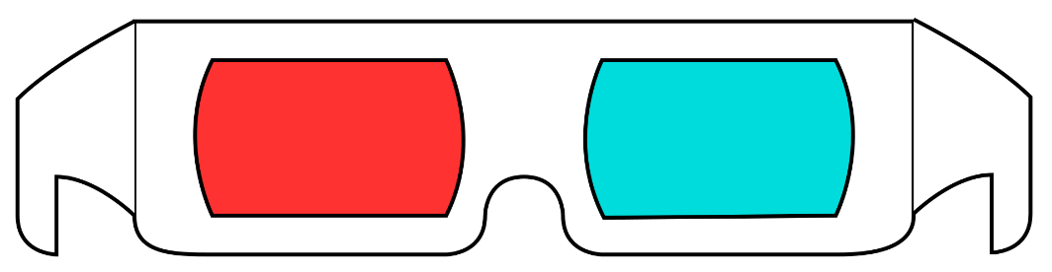
An online source of 3D "anaglyph" images over the CONUS domain, from Embry-Riddle Aeronautical University website
The red/cyan anaglyph images have been posted to the web at http://wx.erau.edu/erau_sat and are publically available.
Notes:
http://wx.erau.edu/erau_sat/index_conus.php?channel=AN3D
https://ams.confex.com/ams/92Annual/flvgateway.cgi/id/19935?recordingid=19935

Slide 36
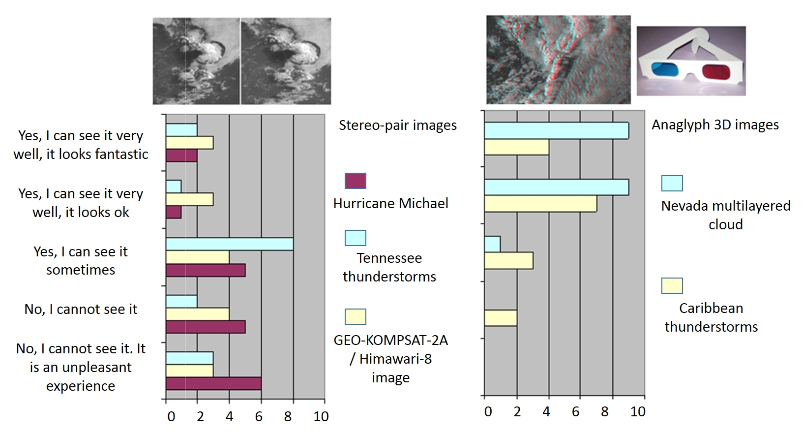
Comparing the ease of viewing of stereo pair images (cross eyed viewing method) and the viewing of anaglyph 3D images in animation
Can see it very well
Cannot see it
stereo pair image animation
(cross eyed viewing method)
Anaglyph 3d image animation
(cross eyed viewing method)

Slide 37
Notes
Here are the results provided by the BMTC students regarding the ease of viewing of the stereo pair images (cross eyed viewing method) on the left hand side and the viewing of anaglyph 3D images on the right hand side in animation.
These results were obtained anonymously using the Socrative cloud based learner response system.
As can be seen, the students voted that the anaglyph 3D images and animations are much easier to view.
A number of students could not view either type 3D image rendering. One of the students had issues with eyes not properly aligning.
REFERENCE

Slide 38
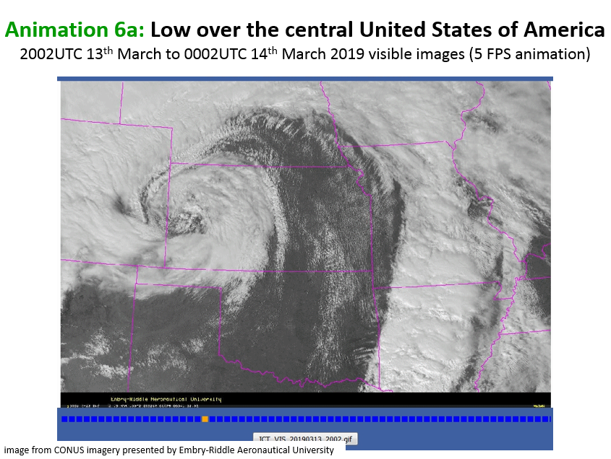
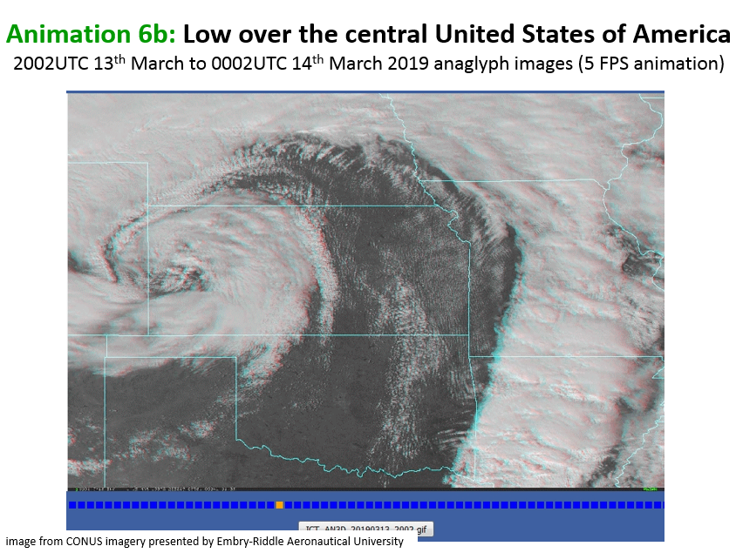
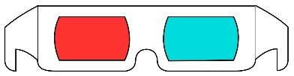
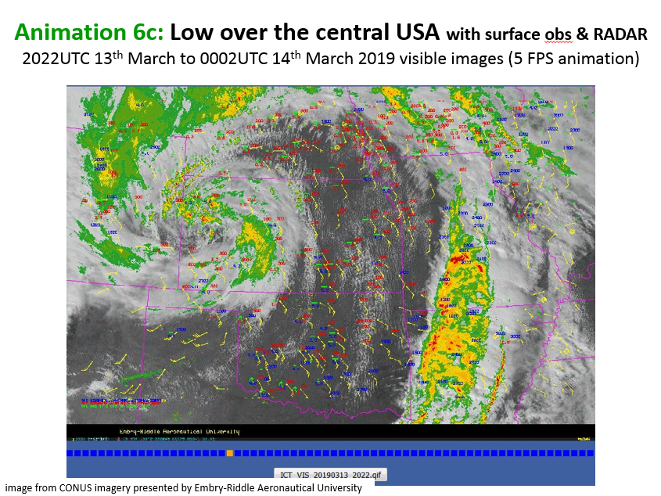
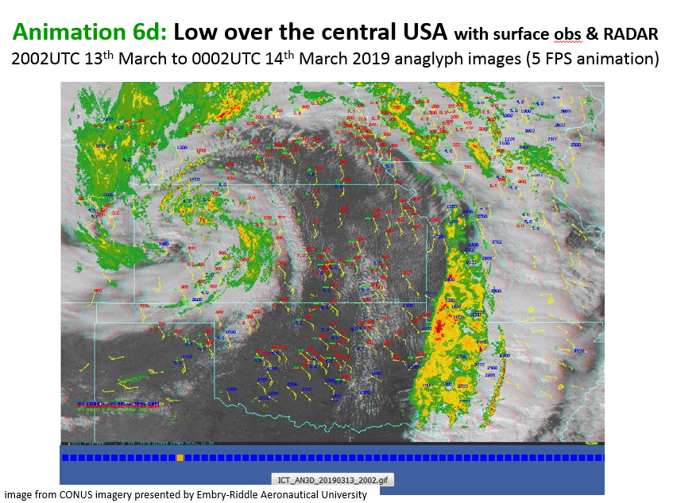
Anaglyph and visible image animation and observation (RADAR and surface observations) overlay low pressure system over central USA, 13-14 March 2019
images from CONUS imagery presented by Embry-Riddle Aeronautical University
Visible
(5FPS animation)
Anaglyph
(5FPS animation)
Visible
& Observations
(5FPS animation)
Anaglyph
& Observations
(5FPS animation)

Slide 39
Notes
As satellite imagery should never be used in isolation, therefore we also conducted some work in viewing anaglyph 3D imagery with surface observations and RADAR reflectivity superimposed.
This data can be obtained from the Embry-Riddle Aeronautical University website mentioned earlier.
REFERENCE

Slide 40
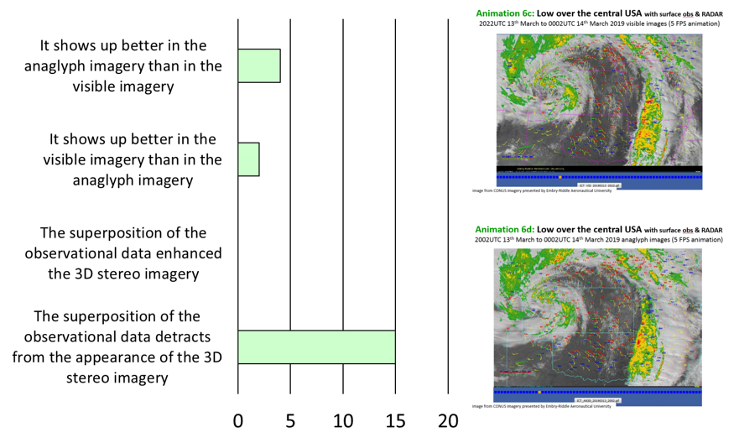
Participant response to the question "How well does the observational data i.e. surface observations and RADAR show up on the anaglyph data for the low pressure system over the central USA". Data 13-14th March 2019.
Superposition of observational data detracts from the 3D effect of the satellite images
images from CONUS imagery presented by Embry-Riddle Aeronautical University

Slide 41
Notes
Interestingly, most students found that the superposition of these 2D rendered surface and RADAR observations detracts from the appearance of the 3D satellite stereo imagery.
This indicates that data fields also need to be rendered in 3D in order to make them compatible with the 3D stereo satellite images.
REFERENCE

Slide 42
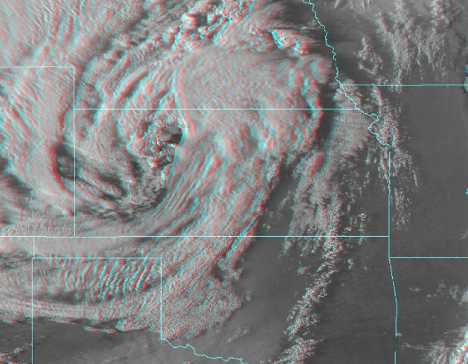
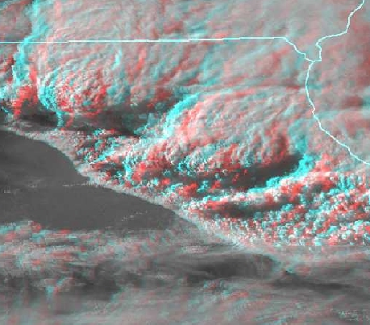
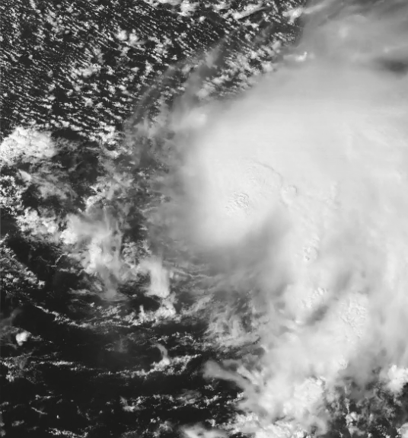
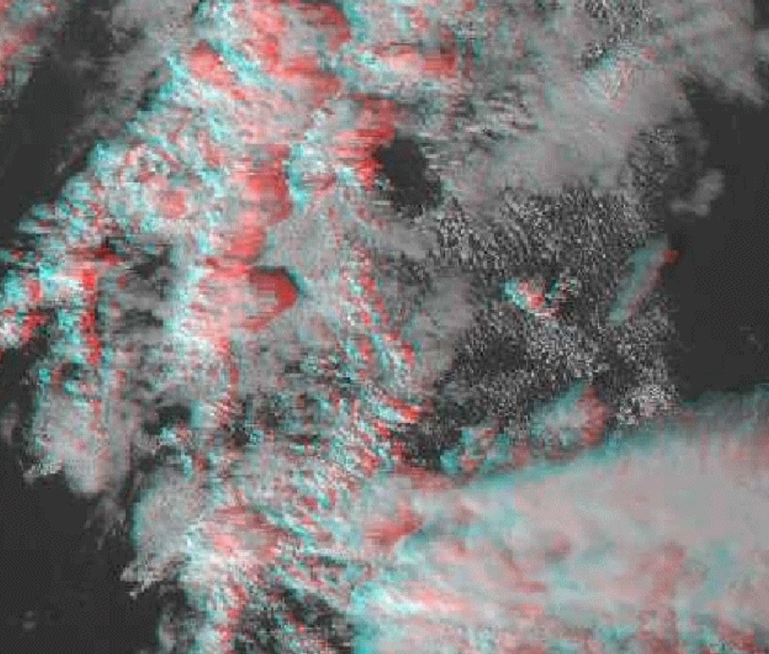
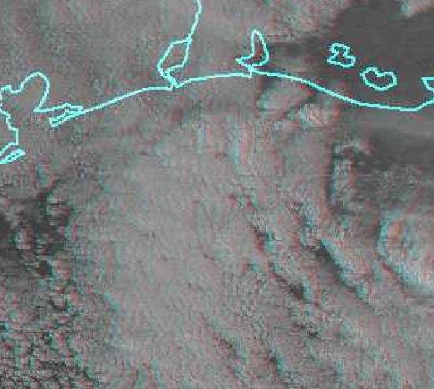
Advantages in using 3D stereo satellite imagery
anaglyph images from CONUS imagery presented by Embry-Riddle Aeronautical University
Analysing multilayer cloud, superior AMV's
Analysing the interaction between low and upper levels of the atmosphere
Analysing vertical motion of developing thunderstorms
Analysing atmospheric shear and trends in these
Better monitor low cloud below broken higher cloud
Detection of minor variations in height for oceanic cellular convection
Non-anaglyph images from CIMSS Satellite Blog, case studies produced by Scott Lindstrom SSEC

Slide 43
Advantages in using 3D stereo satellite imagery
Analysing multilayer cloud (e.g. illustrating isentropic flow, monitoring low level circulation in Tropical Storms, relationship of different flow patterns at different levels)
Analysing the interaction between low and upper levels of the atmosphere (advantage in using Airmass RGB in 3D stereo satellite imagery)
Analysing vertical motion of developing thunderstorms (e.g. the vigorousness of development, i.e. "thunderstorms popping out of the screen").
Analysing atmospheric shear and trends in these (e.g. developing or dissipating Tropical Storms)
Stereo viewing permits the forecaster to better monitor low cloud below broken higher cloud due to the two angles of view.
Detection of minor variations in height for oceanic cellular convection, which could help identify areas of precipitation and reduced low level visibility.
Potential for improved cloud height determination for cloud-drift winds. Resolution of the satellite image is an issue, but synthetically produced imagery could overcome this
REFERENCE

Slide 44
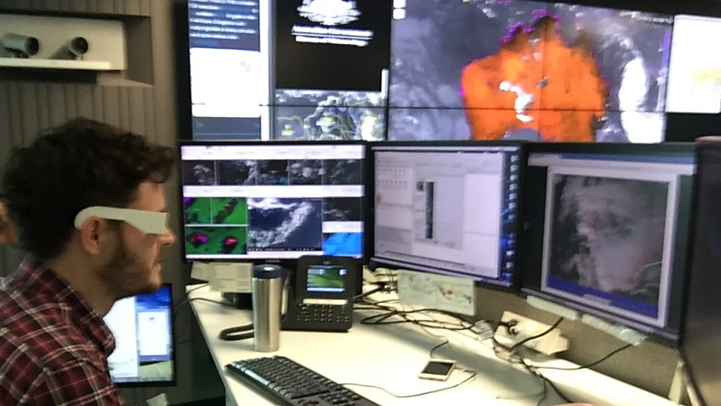
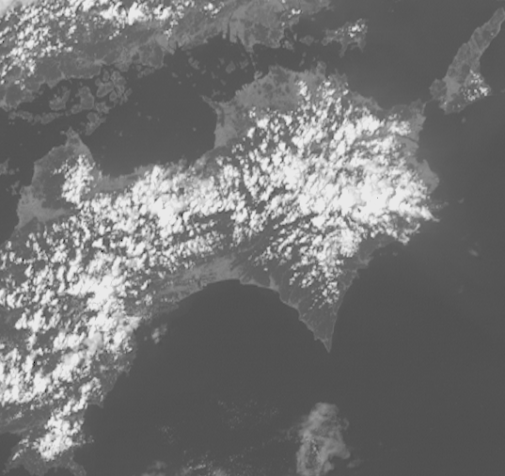
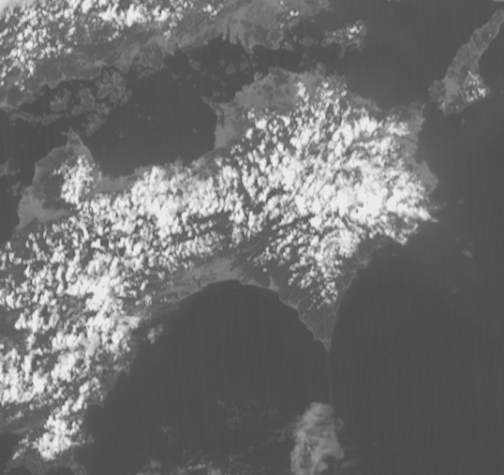
Suggested use of 3D stereo satellite imagery within a meteorological forecasting / training centre
Selective use by severe weather forecasters to gain greater insight into a difficult situation
Enhanced teaching of meteorological principles to Trainee Meteorologists
Normal animation and Wiggle 3D animation in two panel display

Slide 45
Notes
Students were asked about the potential use of the 3 dimensional stereo imagery during an operational forecasting shift. I also obtained freedback from some of our operational forecasters. Responses are as follows:
That 2D imagery be used for routine weather watching and monitoring, with the 3D imagery as a supplementary monitoring tool to be used under special circumstances (thunderstorm development, volcanic eruption etc.)
One student recommended that it may be useful to use the Wiggle 3D animation side by side with 2D image animations in multipanel display during routine forecasting. This combines the familiar high resolution 2D data with insights into the 3rd dimension.
That forecasters need training in the use of this data.
That some forecasters may not be able to use all of the 3D image resources, due to colour vision impairment etc.
That special equipment needs to be made available to facilitate the viewing of some of this data.
REFERENCE

Slide 46
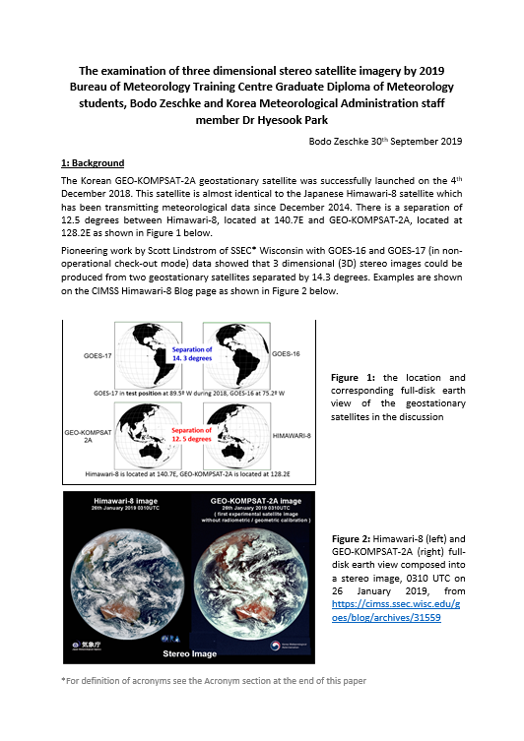

The summary report
(passed on to the BMTC 2019 Graduate Diploma of Meteorology students and to Dr Hyesook Park)
The "dandelion" principle of driving cutting edge research

Slide 47
Notes
I have forwarded the report summarising our work pertaining to 3D satellite stereo imagery to the BMTC Graduate Diploma of Meteorology students and to Dr Hyesook Park of KMA.
The results of relevant Socrative Quiz sessions were also provided.
I encouraged interested students and Dr Park to use this material in order to develop this research.
I named this the "dandelion in the breeze" principle of inspired teaching.
This is how it works:
The teacher introduces the idea and the students may or may not develop this.
The analogy are the little dandelion seeds under their parachutes and drifting in the breeze. Each little dandelion seed holds great potential.
Of course I asked the recipients that if they do develop this material, they should also reference this report.
REFERENCE

Slide 48
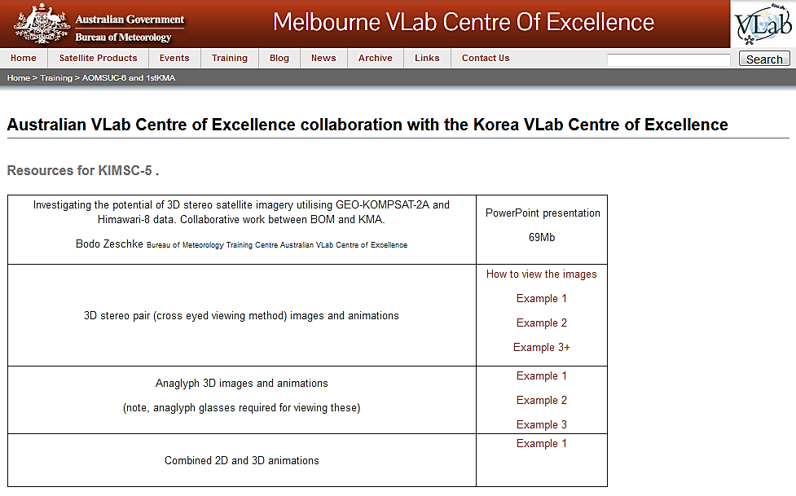
Resources that you may want to practise on
Data 13-14th March 2019. http://www.virtuallab.bom.gov.au/training/aomsuc-6-and-1stkma/

Slide 49
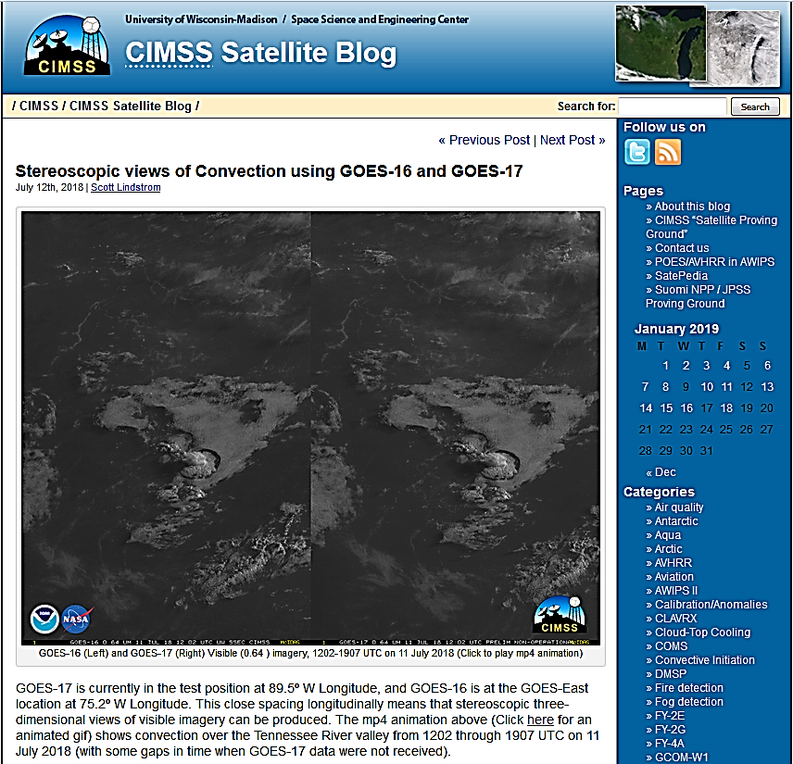
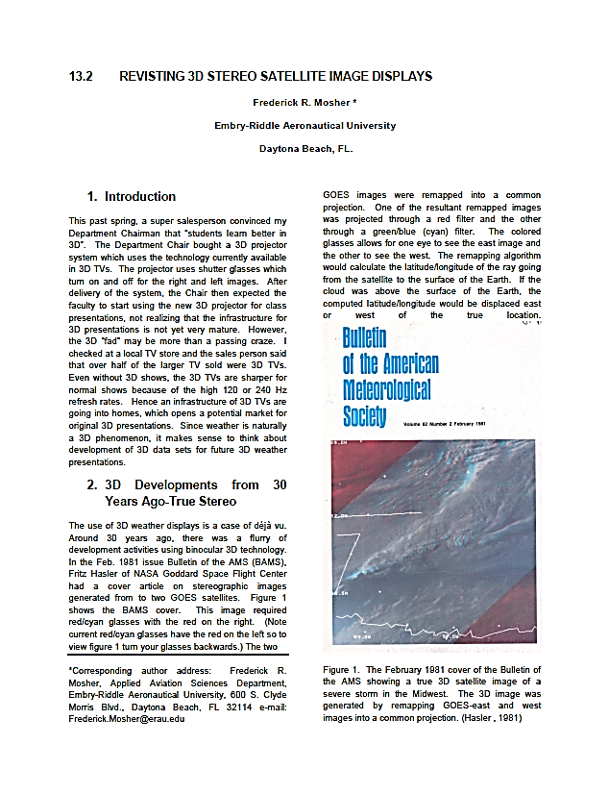

Resources referenced in this presentation
CIMSS Satellite Blog
(case studies presented by Scott Lindstrom SSEC)
Revisiting 3D Stereo Satellite Image Displays
(Frederik R. Mosher, Embry-Riddle Aeronautical University)
EMBRY-RIDDLE
Aeronautical University
Meteorology
(real time imagery over CONUS)
Notes:
https://cimss.ssec.wisc.edu/goes/blog/?s=stereo
http://wx.erau.edu/erau_sat/index_conus.php?channel=AN3D

Slide 50
Summary
Creating stereo imagery using Geo-KOMPSAT-2A and Himawari-8 data.
Pioneering work conducted by BOM/BMTC and KMA and the USA.
We presented four ways of displaying 3D stereo satellite imagery
Wiggle 3D images and animations
3D stereo (crossed eye method) images and animations
Anaglyph 3D images and animations (briefly only)
3D satellite imagery and other observations superimposed
Feedback from BOM/BMTC and KMA staff
Advantages in using 3D stereo satellite imagery
Suggested use of 3D stereo satellite imagery within a meteorological forecasting / training centre
Additional resources that you may want to examine.

