Slide 1
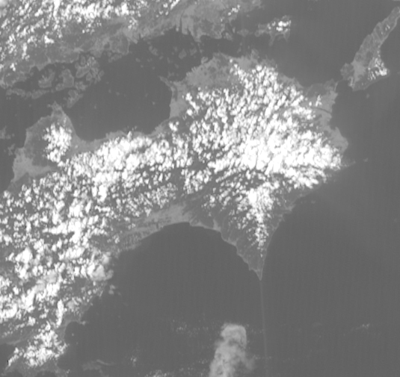
Himawari-8 / GEO-KOMPSAT-2A stereo animation. Shikoku convection, 0400 to 0910UTC 10th September 2019, 5 frames per second rocking animation
images forwarded by Vincent Villani BOM
Shikoku
Himawari-8 data
(courtesy Japan Meteorological Agency)
GEOKOMPSAT-2A
(data courtesy Korea Meteorological Administration)
Please start the Power Point Slide Show to activate the animation

