Slide 1
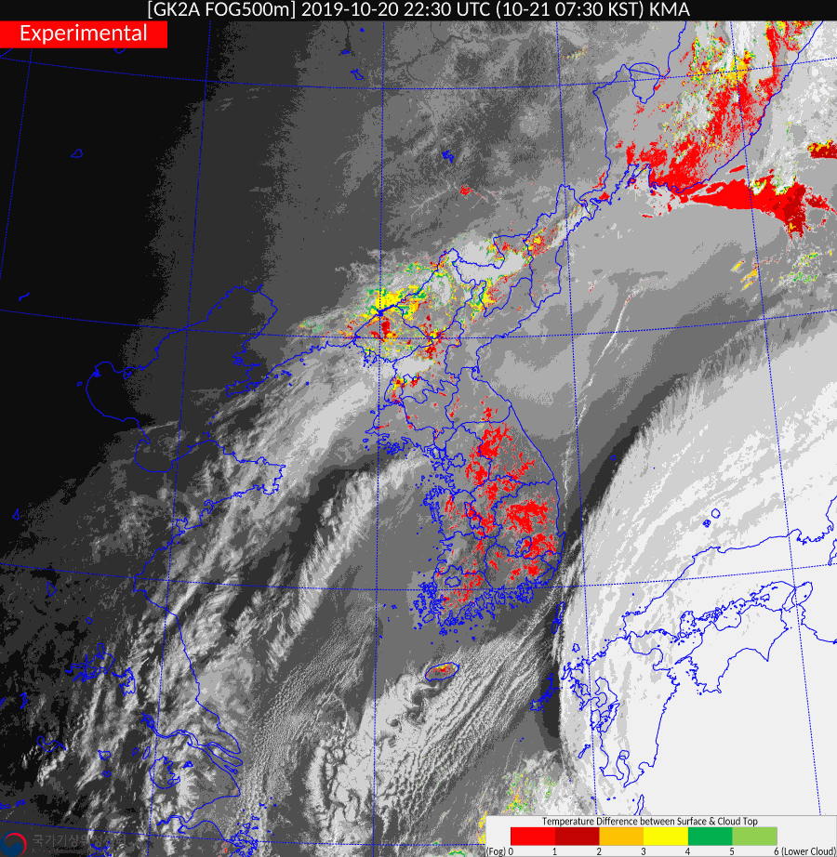
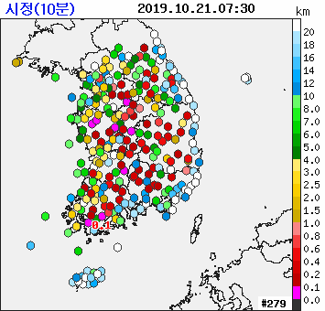
Some applications of weather monitoring using GEO-KOMPSAT-2A meteorological products(facilitator Dr Sung-Rae Chung, Korea Meteorological Administration) Animation 1
animations courtesy KMA

